Slide 1

Book Recommendation System
The system will recommend to the user 5 books that he might like
based on a book he has already read and loved
Tal hadad-313194623
github.com/talhd/Book-Recommendation-System

Slide 2
main steps
Research question
Identify the necessary
data,and
data crawling
Exploring data
Modeling data
Conclusions

Slide 3
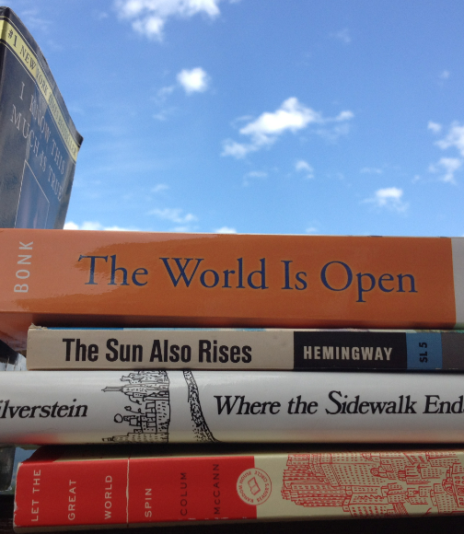
The research question
Is it possible to compare books and quantify the similarity between them?
How can we achieved the most accurate results?
תמונה זו מאת מחבר לא ידוע ניתנת ברשיון במסגרת CC BY-SA-NC.

Slide 4

Data crawling
All the data is taken from goodreads.com the necessary information is:
book title,summary,book rating,categories,date of publication
In the project I used Python packages Beautiful Soup,request
Regular expression-re,and pandas for data crawling

Slide 5
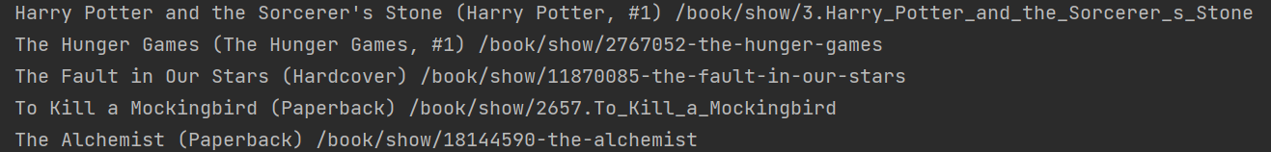
The process has 2 main stages:
1.Build a list that contain the title of the book and the uri to the book on goodreads.com
2.Gather all the relevant information about the book,for each book on the list

Slide 6
Data cleansing
In the next step we need to perform data cleansing.
remove data we do not need,like the volume number in the series or comments about the cover
remove duplication and lines with missing data
remove books that have not yet been published
Remov books that are too old (before 1564)
Although there is also importance to old books ,we do not want in the system old books to the point of being irrelevant
Before data cleansing we had 27,909 books,and then we were left with 22,371

Slide 7
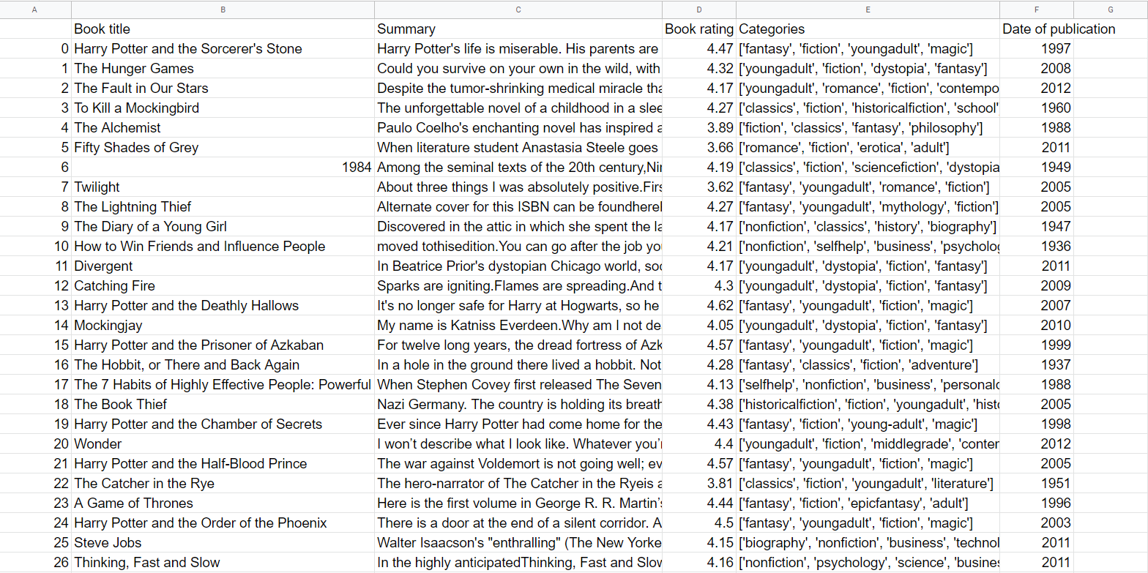

Slide 8
The problems that were discovered when we exploring the data
1) What is the weight given to each feature?
2)Will we use all the information to achieve a high level of accuracy?
3)Is there a range of relevant feature at all to arrive to a good match?

Slide 9
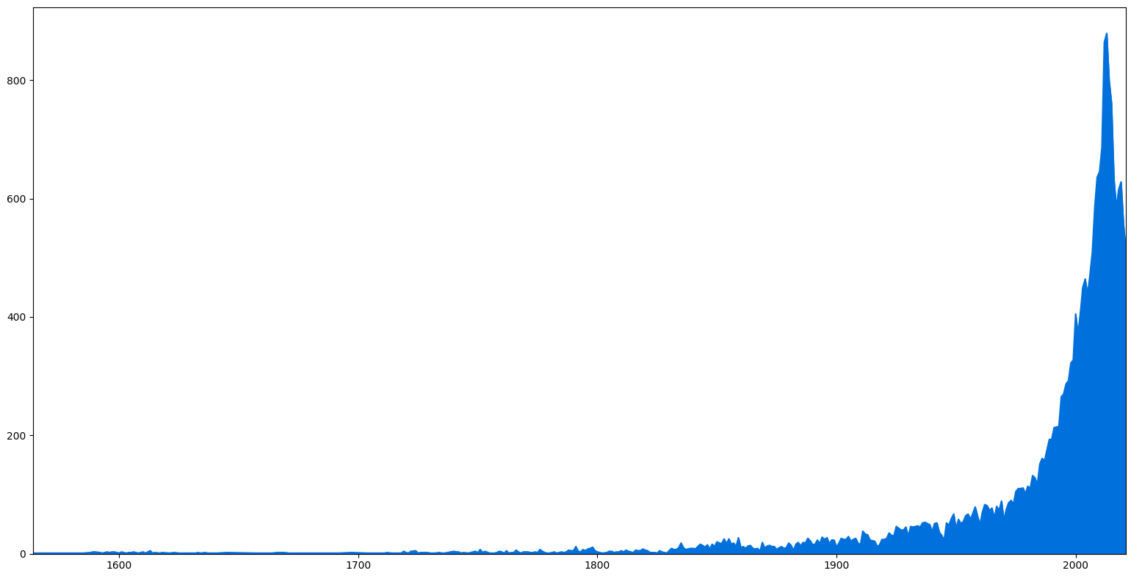

Slide 10
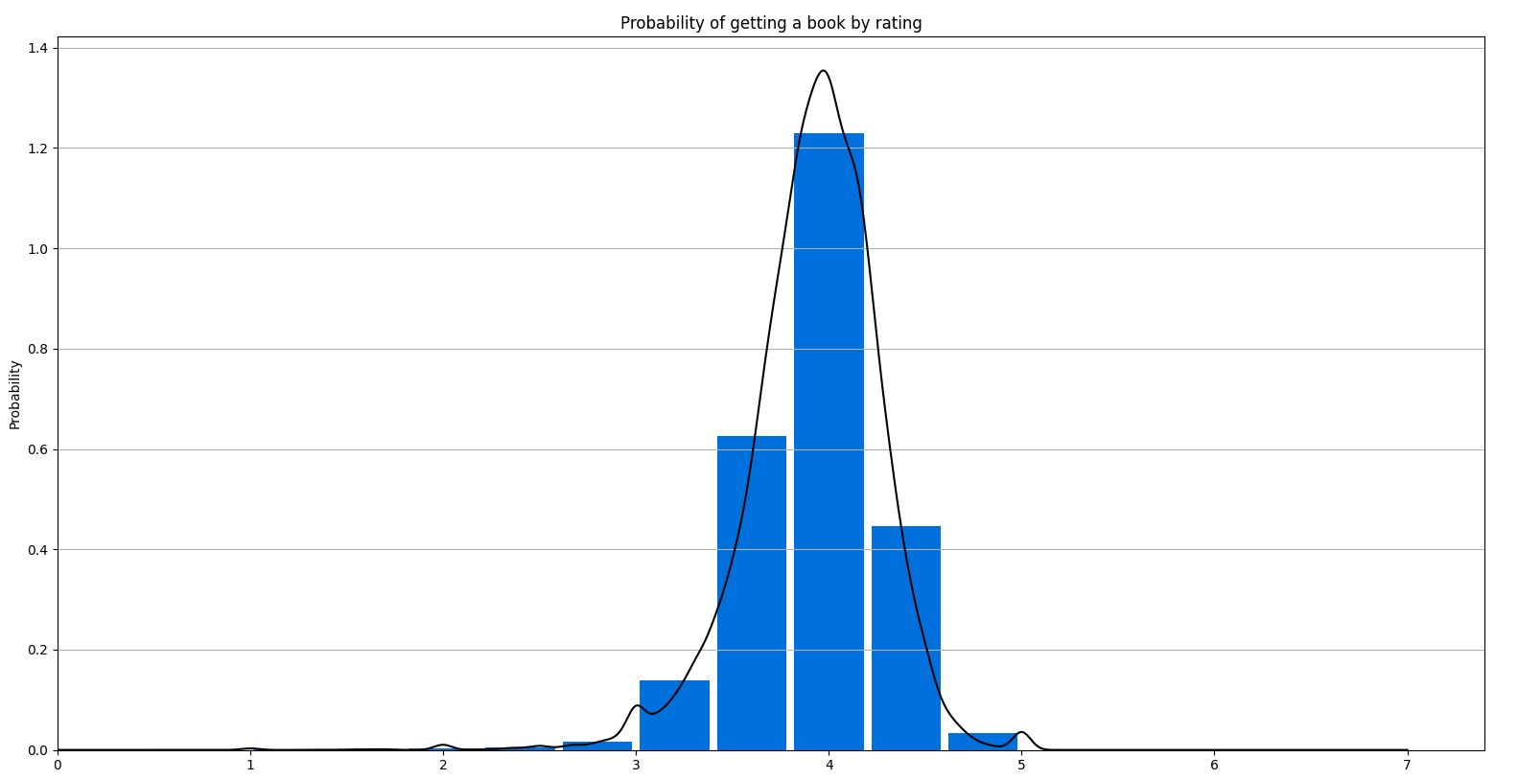

Slide 11
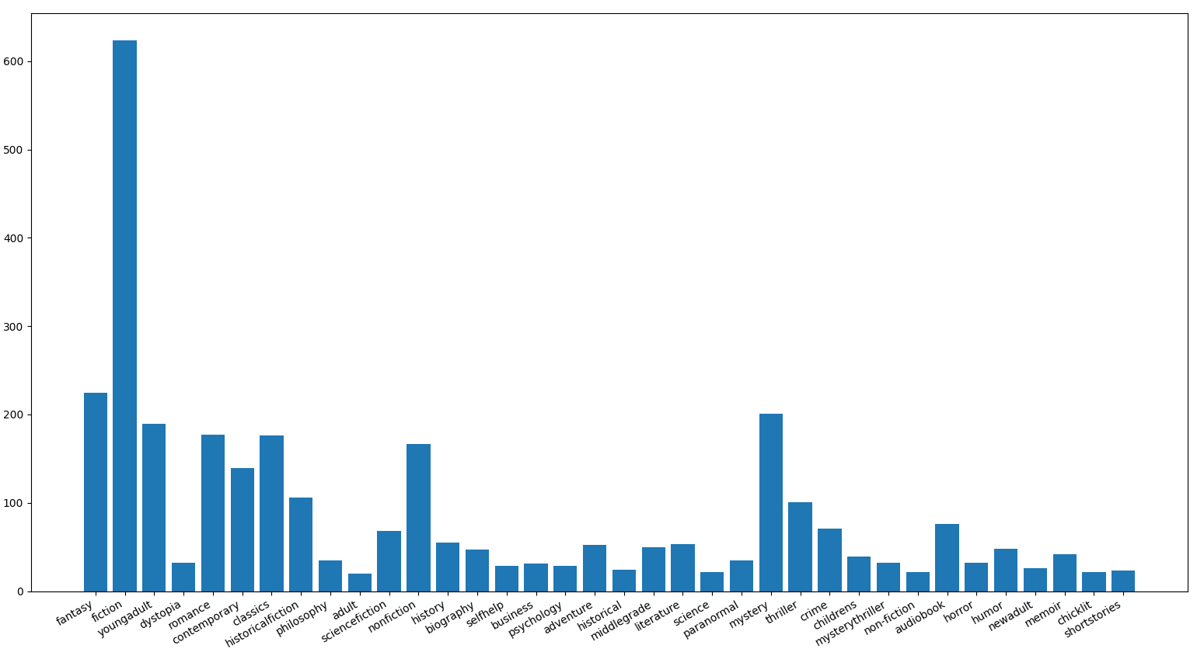

Slide 12

An alternative solution based on the book summary
we understand that in order to reach a good fit we need to rely on the summary of the book
When we use the book summary we give weight to the words and not to the technical details,In this way we can quantify and compare books well
The content of the book is the most important feature in our case

Slide 13
tf–idf and cosine similarity
in general: we will create the word vectors and calculate the angle between the vectors to find the 5 books closest to the original book
An example of a vector words for a book Harry Potter and the Sorcerer's Stone
(Due to technical limitations words that appear in the dictionary but not in the summary will not appear)

Slide 14
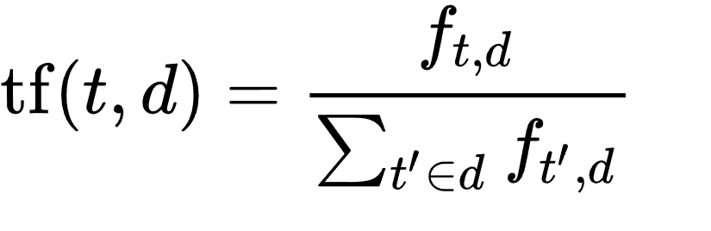
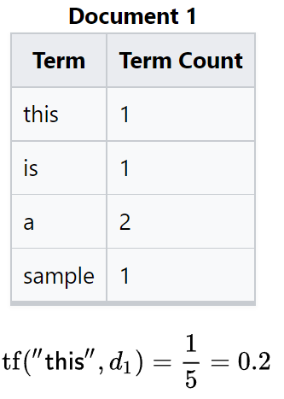
How tf-idf and cosine similarity
work
Term Frequency(tf)-the frequency of the word in each text,the ratio of number of times the word appears in a text compared to the total number of words in that text
for example

Slide 15
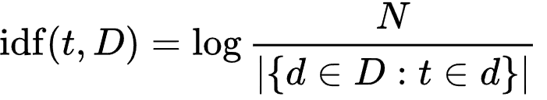


Inverse Data Frequency (idf)-
used to calculate the weight of rare words in txts
Rare words get a higher score
Some of the formulas were taken from
https://en.wikipedia.org/wiki/Tf-idf

Slide 16
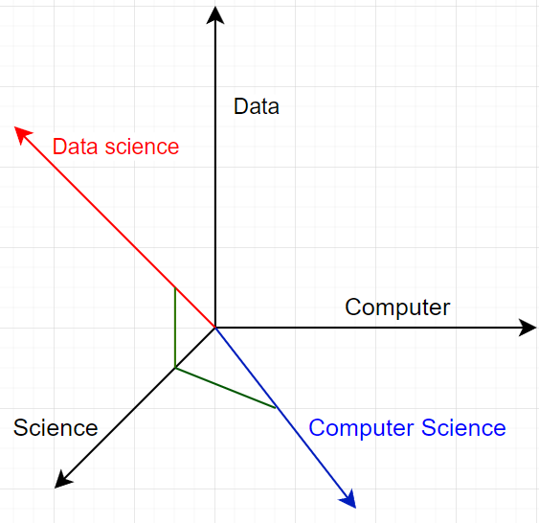
cosine similarity
Cosine similarity used to calculate the angle between the word vectors,and by doing so we can find the closest vectors to the original vector

Slide 17
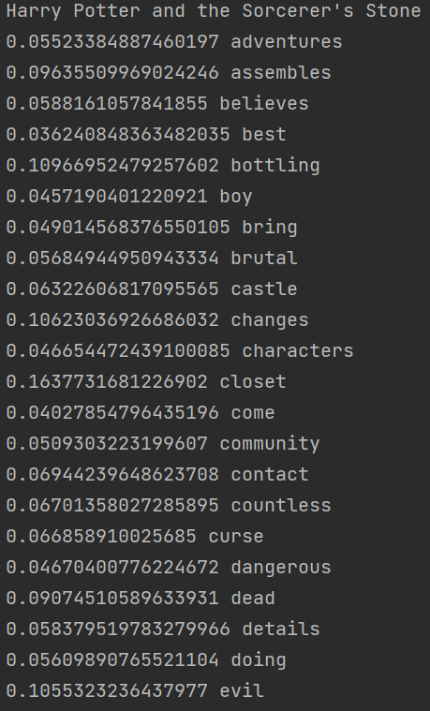

Slide 18
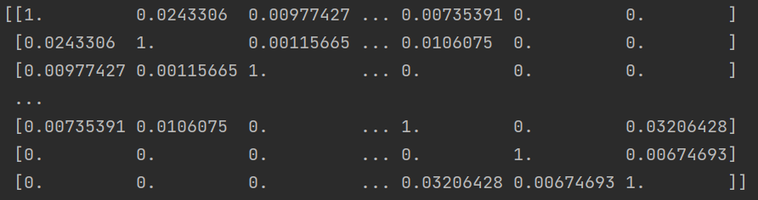

Slide 19
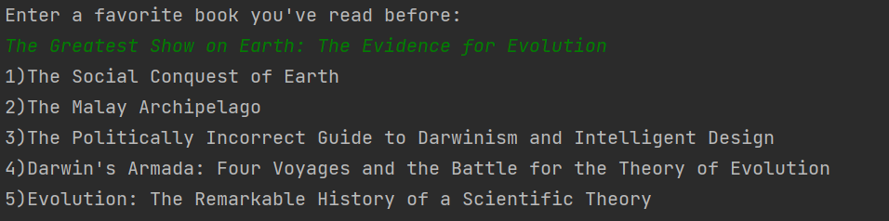
Example of using the system

Slide 20
conclusions
You can see that with tf–idf and cosine similarity we solve a lot of problems which appeared when we examined the possibility of using different features to compare books.
In addition to this,in the current form we give weight to the really important data,and ignore data that may influence and lead to wrong result.

