Slide 1

Face Detection
Sung & Poggio and Viola & Jones
Luca Settimo – 872778 and Tommaso Talamo – 875496
26/08/2023

Slide 2


Datasets
Wider_face
Face detection benchmark dataset from Hugging Face
32.203 images with 393.703 labeled faces
Each row has different attributes but we consider only bbox
https://huggingface.co/datasets/wider_face
Natural images
An image dataset of 6899 images from 8 classes from Kaggle
Airplane, Car, Cat, Dog, Flower, Fruit, Motorbike, Person
We have kept only the images without humans for non-faces images
https://www.kaggle.com/datasets/prasunroy/natural-images

Slide 3
Training set and Test set
Face images extracted by using bbox coordinates on image of wider_face
Non-face images are extracted randomly from Natural Image with sliding windows
Sung and Poggio
Training set
4000 face image and about 43.000 non-face images
Test set
500 face image and about 15.500 non-face images
Viola and Jones
Training set
5000 or 1000 rows taken from 3500 face images and about 30.000 non-face images
Test set
500 face image and about 8000 non-face images

Slide 4
Sung and Poggio
Steps folllowed for the implementation of the models: [1]
Pre-processing of the images
implemented by using the cv2 module
Resizing to 19x19, Masking, Illumination gradient correction, Histogram equalization
Clustering of the training data with K-Means
Computation of the distances to the testing data
Creation of a Neural Network
Application of the training phase
Obtaining the model’s predictions

Slide 5
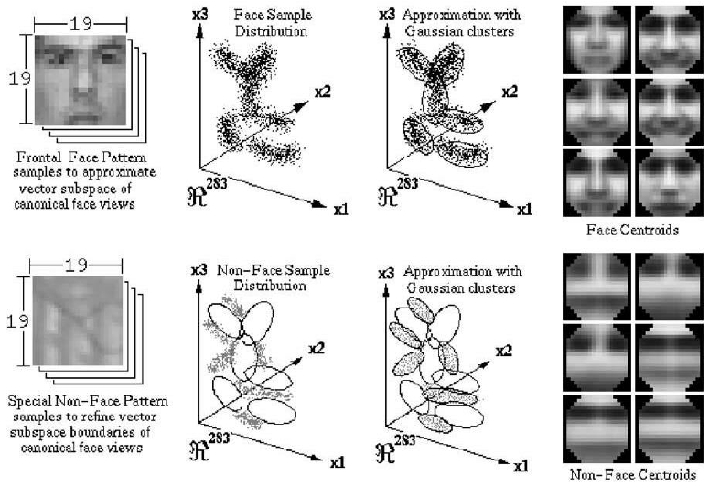
Sung and Poggio
Clustering with K-Means [1]
Separating the face patterns to the non-faces patterns of training set and grouping them
Applying K-Means to both the ensmbles with k=6
Modeling the clusters as a multi-dimensional gaussian with a centroid and a covariance matrix
Approximating each covariance matrices with a subspace by using the largest eigenvectors

Slide 6
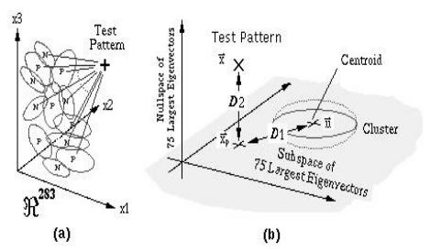
Sung and Poggio
Computation of the distances
Two distance metrics for each the test image: [1]
D1: Mahalanobis distance of the projected sample to cluster centers
D2: distance of the sample to the subspace
These 24 measurements for each test image represents its feature vector
The feature vectors and the labels will represent the new training set and the new test set

Slide 7
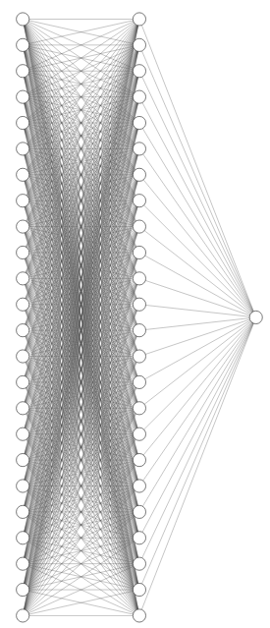
Sung and Poggio
Neural Network of the model
The network is trained for a binary classification problem (face or non-face) [1] [4]
The neural network is composed with: [4]
24 input units
24 hidden units
1 output unit
The forward step of our network applies: [4]
Linear transformation of the data: y = x * A^T + b
Rectified Linear Units (ReLU) activation function
Linear transformation of the data: y = x * A^T + b
Sigmoid activation function
Back-propagation steps with 250 epochs
Learning rate and weight decay equal to 1e-5
Draw of the neural network [2]

Slide 8
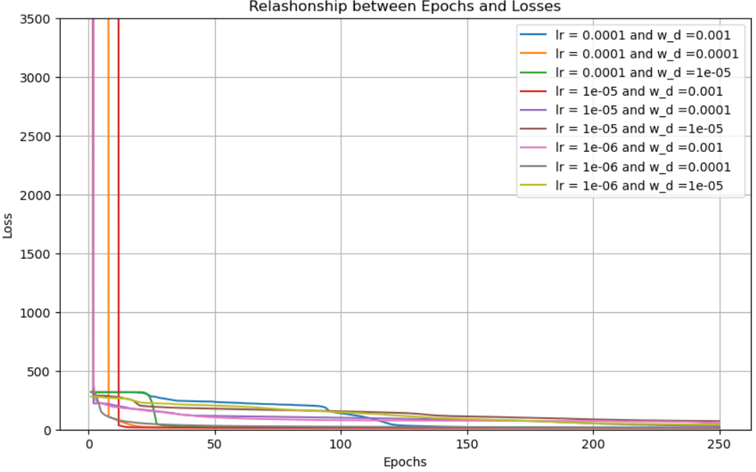
Sung and Poggio
Results – Changing learning rate and weight decay [4]
Training the model on a training set of 47.000 rows
Checking the loss value by changing the learning rate and the weight decay

Slide 9
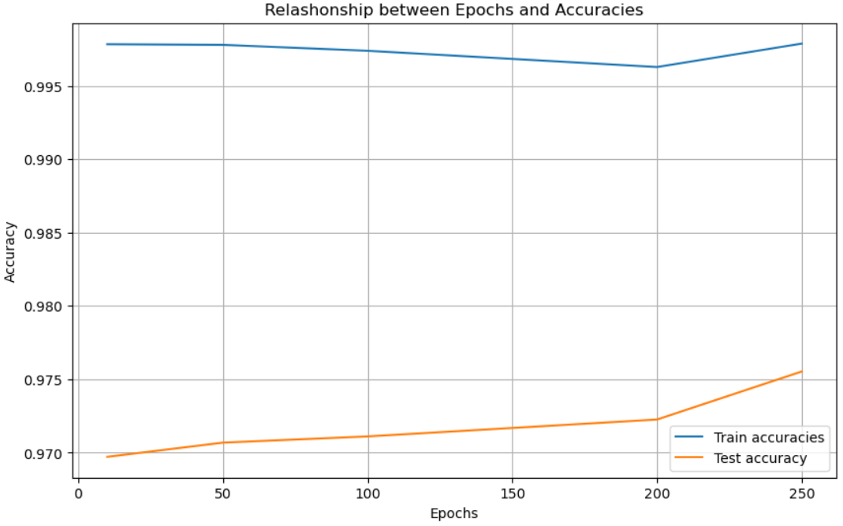
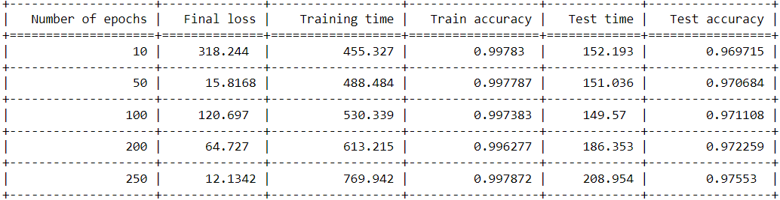
Sung and Poggio
Results – Relationship between epochs and accuracies [4]
Results with:
Epochs = [10, 50, 100, 200, 250]
Training set composed by 47.000 rows
Test set composed by 16.000 rows
For the implementation of the plots and the table we have maintained the same training set and test set

Slide 10
Viola and Jones
Steps folllowed for the implementation of the models: [3]
Pre-processing of the images
implemented by using the cv2 module
Resizing to 24x24, Masking, Illumination gradient correction, Histogram equalization
Calculation of the integral images
Application of boosting for evaluating the features and finding a strong classifier
Attentional Cascade for rejecting the non-faces in a faster way
Non-Maxima Suppression (NMS) for estimating the overlapping bounding boxes

Slide 11
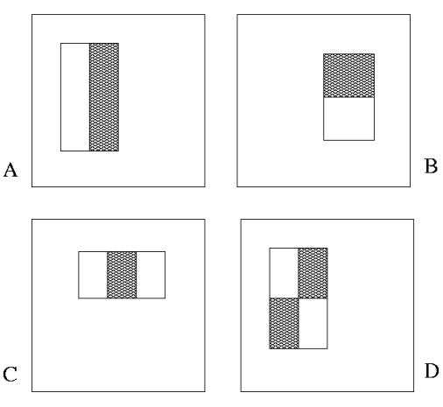
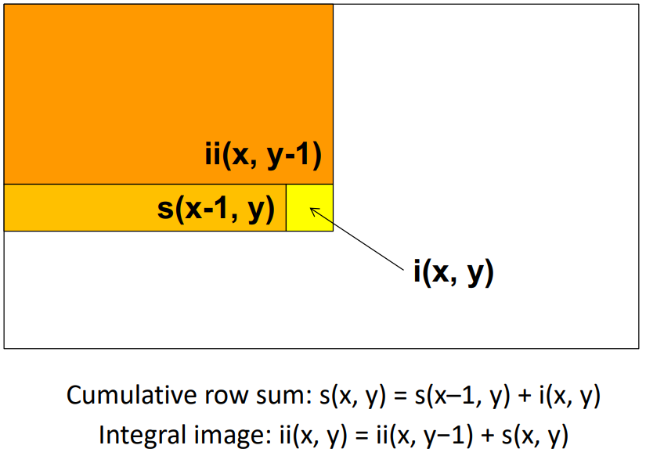
Viola and Jones
Haar features and Integral Images
Haar Features: [3]
For each image we find every possible combination of rectangle regions
Each rectangle is represented as a dictionary with paremeters:
x, y, width, height
∑ (pixels in white area) – ∑ (pixels in black area)
Integral image: [3]
The value at each pixel (x,y) is the sum of the pixel values above and to the left of (x,y)
With A, B, C, D values of the integral images’ corner
Sum = A – B – C + D

Slide 12

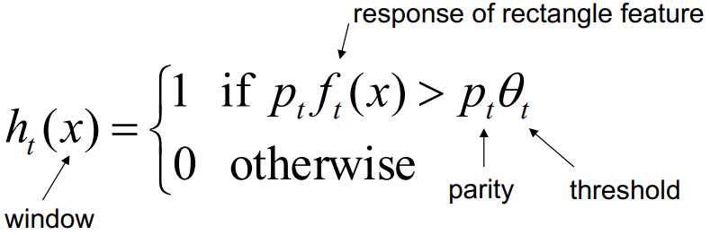
Viola and Jones
Boosting [3]
We have rejected the usage of ADABoost
For each strong classifier: values of alpha and the weak classifier objects
Each weak classifier is represented as a dictionary object with parameters:
Lists of positive and negative regions, Threshold and Polarity
The polarity (parity) can be 1 or -1
In case of -1 the inequality sign is reversed

Slide 13
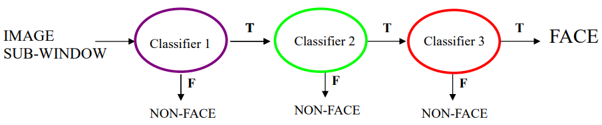
Viola and Jones
Attentional Cascade
We have built a classification in which we have a series of strong classifiers which rejects immediately the non-faces and corrects the false positives
We give to the model an input list of t values and the training phase will run the whole training set on the first value and then the others t values on the false positives
Application of the Non-Maxima Suppression (NMS) for the overlapping bounding boxes predicted by the model on a big image

Slide 14
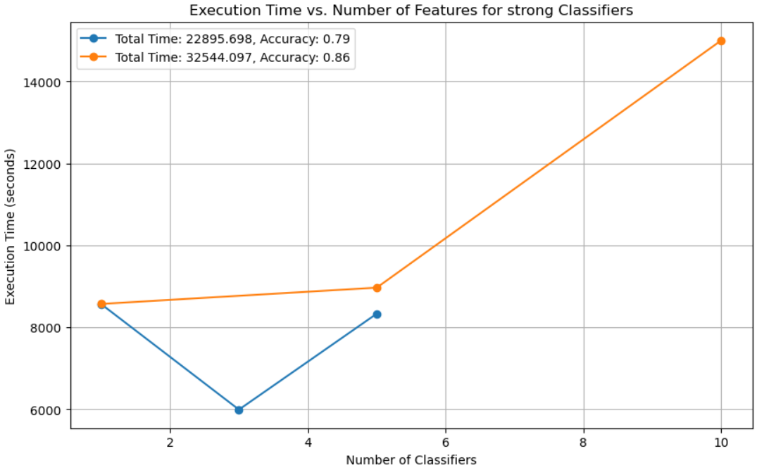
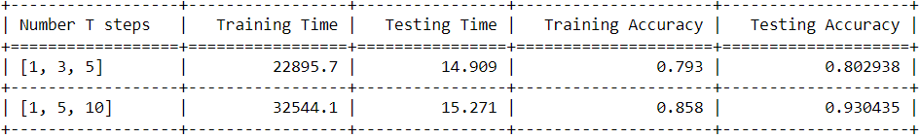
Viola and Jones
Results [4]
Results with:
Steps = [1, 3, 5] and steps = [1, 5, 10]
Training set composed by 1000 rows
Test set composed by 8500 rows
We also show the running time during the various step
With 5000 rows of training set and steps equal to [1, 5, 10]:
Train accuracy: 0.81
Test accuracy: 0.7032

Slide 15
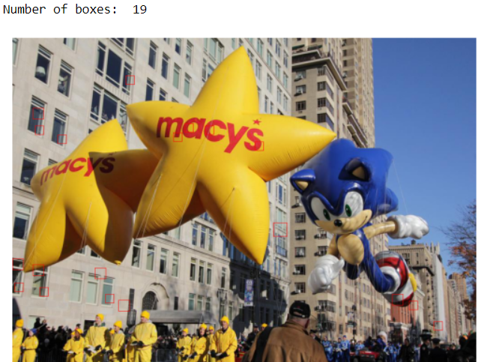
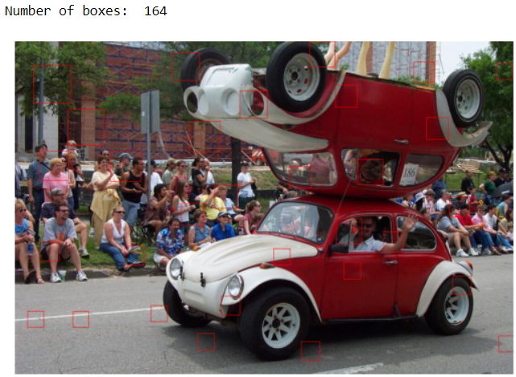
Comparation of the two models [4]
On training phase, with less rows in the training set, we have a longer execution time on Viola and Jones
On the test phase Viola and Jones model is way faster than Sung and Poggio
The lines in the training set of viola and jones are much less and therefore the accuracy suffers
Both models have too few non-face images in the training set:
Small number of windows that are labeled as non-faces on training set
Normal image with sliding windows and NMS:
Too many bounding boxes, especially on Viola & Jones

Slide 16
References
[1] Sung, Kah-kay & Poggio, Tomaso. (1996). Learning A Distribution-Based Face Model For Human Face Detection. 10.1109/NNSP.1995.514914.
[2] NN-SVG - https://alexlenail.me/NN-SVG/
[3] Viola, Paul & Jones, Michael. (2001). Rapid Object Detection using a Boosted Cascade of Simple Features. IEEE Conf Comput Vis Pattern Recognit. 1. I-511. 10.1109/CVPR.2001.990517.
[4] Luca Settimo (872778), Tommaso Talamo (875496), Face Detection project

