Slide 1
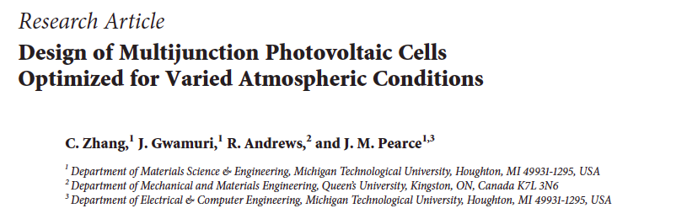
Talia Martz-Oberlander
Literature Review
20-01-17

Slide 2
The Study:
How do different climates affect optimal bandgaps?
Simulate bandgap needs, to reduce loss of incident solar radiation
Eventually use this to best tune solar cells, such as In_{x}Ga_{1-x}N
Notes:
Using computer modeling, in Matlab to calculate the ideal bandgaps for environmental characteristics

Slide 3
How does the model work?
Evaluates different spectra from varying climate (eg. cloudiness or presence of aerosols and pollutants)
Matches available bandgaps to reduce solar energy loss
Modeling (multi)junction PV cells to fit these climates
Notes:
Took air condition data to calculate absorption at certain spectra
Atmospheric Radiative Transfer of Sunshine (SMARTS model from NREL for clear skies)
SBDART for cloudy
AM1.5G spectra: water vapour, ground level, tilt towards sun/equator, ozone

Slide 4
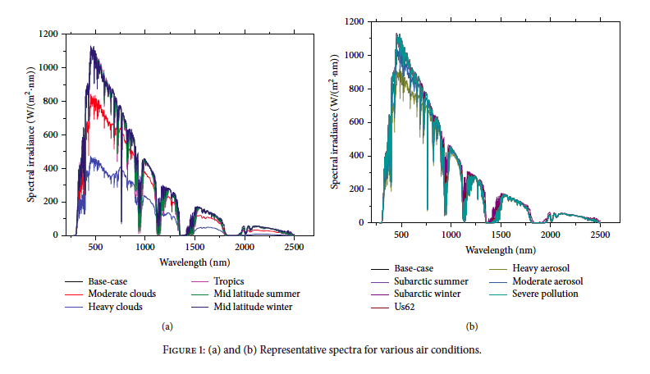
Solar spectra in different climates

Slide 5



Calculating energy losses due to mismatched bandgaps
Notes:
Lost energy: sum of energy from photos > bandgap plus photos < bandgap

Slide 6
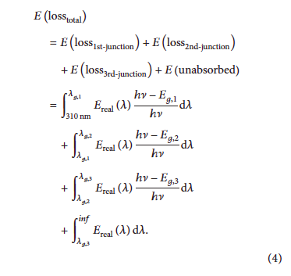
Calculating energy losses due to mismatched bandgaps

Slide 7
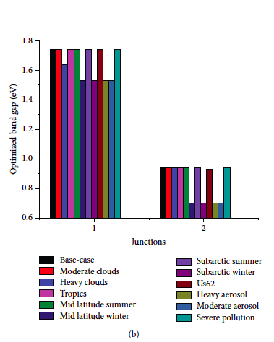
Different optimal bandgaps depending on climate

Slide 8
Overall findings:
Seasonal changes
Climates with different length winter affected
Wider tilts multi-junct. Insignificant affect from albedo, single-junct. Significant
Location and climate most important
- (13.7% change in ideal bandgap)
Notes:
Soil deposition patterns also important
from base to subarctic, changed optimal bandgap for top tandem cell by 13.7% saving 2.4W/m2 power (compared with

Slide 9
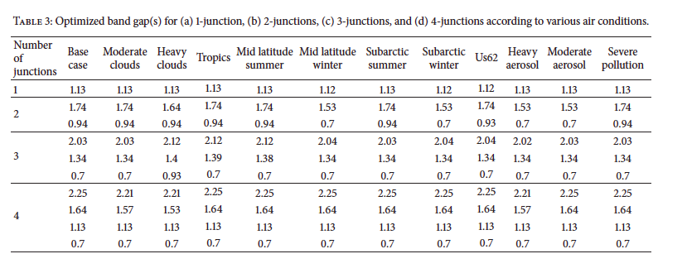

Slide 10


Future: use this computational study to develop (affordable) materials with these bandgaps

