Slide 1
The quiz game
Become a Millionaire

Slide 2
Content
Introduction
Output screenshot
Motivation
Objective
Feature
Outcome
Conclusion

Slide 3
Project Introduction
I have divided this mini project into many functions, and listed below are some of those which may help you understand the project better.
edit_score() – adds the current cash prize won to the previous one upon giving the right answer to a question.
help() – help menu with game summary and rules.
reset_score() – to reset the highest score/cash prize to default.
show_record() – shows the highest cash prize won by a particular user.
show_score() – to view the highest score.
In this quiz game mini project, you can store the user name, view the highest score secured by a user, and even reset the score. Additionally, to make the game look a little more interesting, it is divided into two rounds; user must pass the first round to reach the second one.
Of the 2 rounds I mentioned above, the first is called the Warm-up Round; the second is the Challenge round. In the warm-up round, the user is asked a total of three simple questions and they must be able to answer at least two of them correctly to enter the next round. If the user is not capable of doing that, he is not permitted to proceed further.
In the second and more interesting round of this quiz game in C, the user will be asked questions continuously, and for each right answer given, they will earn $100,000!
The game ends when the user’s cash prize piles up to $1 million. For each question asked, there are 4 options, namely A, B, C and D. There are no negative markings, so the user’s accumulated cash money won’t be deducted for wrong answers to the questions.

Slide 4
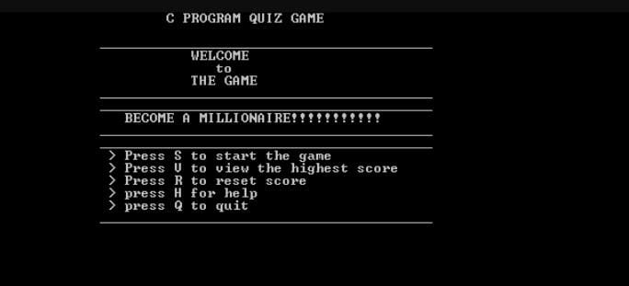
Output screenshots welcome screen

Slide 5
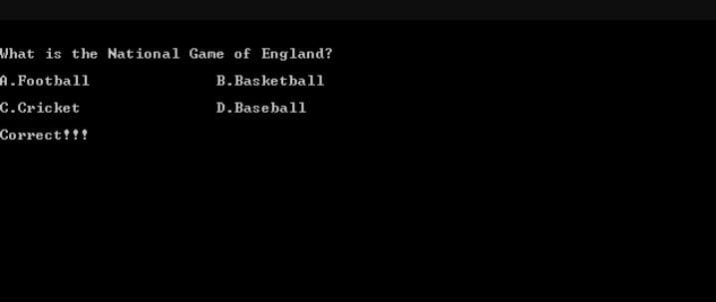
Correct answer

Slide 6
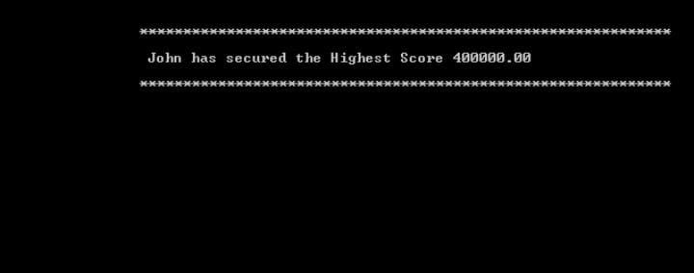
Highest score

Slide 7
Motivations
This game motives user to create a new questions
Motive user to learn something.
Through this game it about fun. But this game help to increase any students current affairs knowledge. Because quiz questions is about general knowledge

Slide 8
Objectives
Testing identifies gaps in knowledge .
Testing produces better organization of knowledge by helping the brain organize material in clusters to allow better retrieval.

Slide 9
Features
These are two rounds in the game.
In 1st round there has 3 questions.
2nd round has 10 Random questions.
In every question in 2nd round user get $1,00000.
Anyone can play the game.

Slide 10
Outcome (expected)
Main menu (start, score, help, exit).
User name.
First round & Second round.
Score board.
Exit option.
Game will finished when user get $1000,000.

Slide 11
Conclusion
Every thing has two sides (negative/positive).
After all one thing we create, this game for fun.
We request every one to take the game positively.

Slide 12
Thank you

