Slide 1
TestApi
A library of testing types,
data-structures and algorithms
Ivo Manolov, Microsoft

Slide 2
Sharing of {Test} Code is GOOD
Reduced duplication of effort
Higher code quality - through evolution
Lower maintenance costs
Deeper, more mature coverage
Etc, etc, etc (see your favorite book on code reuse)

Slide 3
Sharing of Tests is TRICKY
Need to “adapt” tests to environment
Test environment dictates policy…
Discovery
Deployment / Distribution
Execution
Logging
Reporting
Result aggregation and reporting
Notes:
Sharing of test code is tricky.
If you attempt to share tests, you have to adapt the tests you share to the target test run environment, which is not tricky

Slide 4
Sharing of Tools is TRICKY
Big tools / infrastructure
High adoption cost
“Proprietary” stack – extension may be tricky
“Hosting” costs
Deployment on dev machines is frowned upon
Combining tool parts may not be supported
Small tools (e.g. PICT.EXE, RADAR):
Deployment
Cleanup
Adaptation (of input / output)
Upgrades
SLAs

Slide 5
Well, what CAN we share?
Automated tests ARE programs
A Program =
reusable blocks +
domain-specific logic +
config
We can share the blocks!

Slide 6
Enter TestApi…

Slide 7
TestApi is…
An API library
Provides data-structures and algorithms common to testing
Documented
Layered
Easy to deploy (xcopy)
Policy-free
It’s just a set of DLLs you link to
We have xUnit, NUnit, MSTEST samples
Licensed under Ms-PL (shared source)

Slide 8
TestApi is not going to…
tell you what a test is
tell you how to test
make a test pass/fail decision for you
tell you how to log
make implicit assumptions
integrate with your tools (VS, Eclipse, etc.)
retain execution state

Slide 9

A Lap Around TestApi

Slide 10
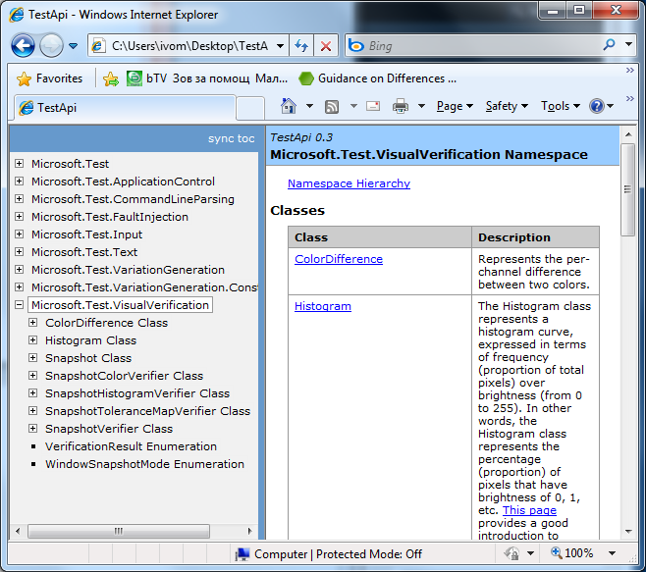
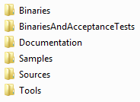
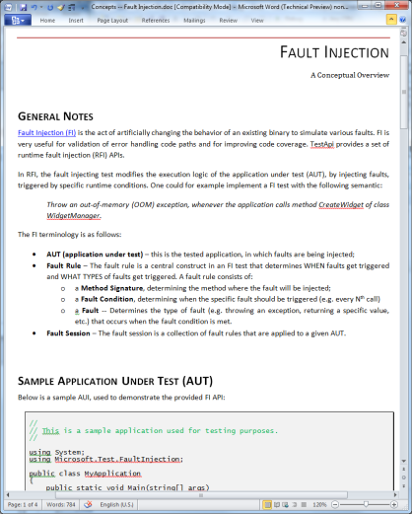
Package
http://codeplex.com/testapi
The ZIP contains…
Binaries
Sources
Documentation
Samples

Slide 11
Input Simulation API
Mouse.MoveTo(new Point(10, 10));
Mouse.Click(MouseButton.Left);
Keyboard.Type("Hello world!");
Keyboard.Press(Key.LeftShift);
Keyboard.Type("hello, capitalized world!");
Keyboard.Release(Key.LeftShift);
Mouse and Keyboard are wrappers of the SendInput Win32 API.
They are GUI-toolkit-agnostic (Mouse works in screen coordinates, etc.)
Notes:
The input simulation API provides a simple way to simulate input.
The input API wrap the SendInput Win32 API under the covers.

Slide 12
Visual Verification API
// Take a snapshot of a window. Load a snapshot from disk. Compare.
Snapshot actual = Snapshot.FromWindow(hwnd, WindowSnapshotMode.ExcludeWindowBorder);
Snapshot expected = Snapshot.FromFile("Expected.png");
Snapshot difference = actual.CompareTo(expected);
// Initialize a SnapshotVerifier and use it to verify the difference image
Snapshot toleranceMap = Snapshot.FromFile("ExpectedImageToleranceMap.png");
SnapshotVerifier verifier = new SnapshotToleranceMapVerifier(toleranceMap);
if (verifier.Verify(difference) == VerificationResult.Fail)
{
actual.ToFile("Actual.png", ImageFormat.Png);
difference.ToFile("Difference.png", ImageFormat.Png);
Console.WriteLine("Image mismatch!");
}
The API provides different visual verification strategies via different SnapshotVerifiers
Notes:
The fundamental premise of visual verification is comparing an expected image (either a master image loaded from file or a generated image) to an actual image and making a pass/fail decision based on the result from the comparison.
The Snapshot class allows you to take snapshots of the screen, load snapshots from disk and compare the current Snapshot instance to another instance (generating a diff).
The API also provides a family of verifiers (they all inherit from SnapshotVerifier), which use different strategies to perform verification of (most commonly a diff) Snapshot instance.

Slide 13
Variation Generation API
Define a set of named parameters and constraints.
var destination = new Parameter<string>("Destination") { "Whistler", "Las Vegas" };
var hotelQuality = new Parameter<int>("Hotel Quality") { 5, 4, 3, 2, 1 };
var activity = new Parameter<string>("Activity") { "gambling", "swimming", "skiing" };
var parameters = new List<ParameterBase> { destination, hotelQuality, activity};
var constraints = new List<Constraint<Variation>>
{
Constraint<Variation>
.If(v => destination.GetValue(v) == "Las Vegas")
.Then(v => activity.GetValue(v) != "skiing"),
...
};
Model model = new Model(parameters, constraints);
foreach (var v in model.GenerateVariations(2, 1234))
{
Console.WriteLine("{0} {1} {2}",
v["Destination"], v["Hotel Quality"], v["Activity"]);
}
Create a model from them. Then query the model for variations.
Notes:
Note that the API also supports weighted parameters as well as “tagged parameter values” for negative testing, etc.

Slide 14
Variation Generation API - 2
// Need to go to Cleveland more often...
object tag = (object)-1;
double weight = 5.0;
var destination =
new Parameter<string>("Destination")
{
"Whistler",
"Hawaii",
"Las Vegas",
new ParameterValue<string>("Cleveland", tag, weight)
};
...
foreach (var v in model.GenerateVariations(2, 1234))
{
switch (v.Tag as int) {...}
}
Parameter value weights are also supported.
Parameter value tags provide a generic support for “negative” variations, etc.

Slide 15
Variation Generation API - 3
Models can also be constructed declaratively.
class OsConfiguration
{
[Parameter(512, 1024, 2048)]
public int Memory { get; set; }
[Parameter("WinXP")]
[Parameter("Vista", "Win7", Weight = 3.0F)]
public string OS { get; set; }
}
static void CreateModel()
{
var model = new Model<OsConfiguration>();
foreach (OsConfiguration c in model.GenerateVariations(2))
{
Console.WriteLine(
"{0} {1}",
c.Memory,
c.OS);
}
The declarative syntax supports equivalence classes and weights too.
Notes:
Of course, we support

Slide 16
Fault Injection API
string caller = "MyApp.Main(string[])"
string method = "MyApp.PrintToConsole(string)";
Exception exception = new ApplicationException("Injected!"));
// Create a set of fault rules
ICondition condition = BuiltInConditions.TriggerIfCalledBy(caller);
IFault fault = BuiltInFaults.ThrowExceptionFault(exception);
FaultRule rule = new FaultRule(method, condition, fault);
// Establish a session, injecting faults defined by the rules
FaultSession session = new FaultSession(rule);
// Launch the target process. Observe faults.
ProcessStartInfo psi = session.GetProcessStartInfo(@"\MyApp.exe");
Process p = Process.Start(psi);
...
Under the cover, TestApi uses the CLR profiling API to modify the prologue of the intercepted method at runtime…
Notes:
Fault injection is a code coverage technique that allows you to change the behavior of a program.
TestApi provides a simple mechanism for injecting of faults in managed code at run-time.

Slide 17
Memory Leak Detection API
// Start your process...
// Perform various operations. Take memory snapshots
MemorySnapshot s1 = MemorySnapshot.FromProcess(pid);
...
MemorySnapshot s2 = MemorySnapshot.FromProcess(pid);
// Compare snapshots. Identify possible leaks.
MemorySnapshot diff = s2.CompareTo(s1);
if (diff.GdiObjectCount != 0)
{
s1.ToFile(@"\s1.xml");
s2.ToFile(@"\s2.xml");
Console.WriteLine("Possible GDI handle leak.");
}
Notes:
The MemorySnapshot class provides an easy way to take memory snapshots of a running process (or load saved snapshots from disk).The generated memory snapshots track all main memory metrics of a process:
GdiObjectCount
HandleCount
PageFileBytes
PageFilePeakBytes
PoolNonpagedBytes
PoolPagedBytes
ThreadCount
Timestamp
UserObjectCount
VirtualMemoryBytes
VirtualMemoryPrivateBytes
WorkingSetBytes
WorkingSetPeakBytes
WorkingSetPrivateBytes

Slide 18
Text Generation API
StringProperties sp = new StringProperties();
sp.UnicodeRanges.Add(new UnicodeRange(0x0400, 0x04FF));
sp.MinNumberOfCodePoints = sp.MaxNumberOfCodePoints = 10;
string s = StringFactory.GenerateRandomString(sp, 1234);
The result would be a string of 10 characters in the Cyrillic Unicode character code range, e.g. …
“хѝЗКтТшщчЯ”

Slide 19
Object Comparison API
// o1 and o2 are arbitrarily complex objects...
ObjectGraphFactory f = new PublicPropertyObjectGraphFactory();
ObjectGraphComparer c = new ObjectGraphComparer(f);
GraphNode l = f.CreateObjectGraph(o1);
GraphNode r = f.CreateObjectGraph(o2);
bool match = c.Compare(l, r);
if (!match)
{
Console.WriteLine("The two objects do not match.");
}
// you can also get a collection of mismatches...
bool match = c.Compare(l, r, out mismatches);
...
For custom comparison strategies, create your own ObjectGraphFactory.
ObjectComparisonMismatch instances.
Notes:
ObjectGraphComparer is a sealed class (cannot be extended)
ObjectGraphFactory is an abstract class, with a single virtual method CreateObjectGraph, which returns a GraphNode instance representing the root node of the created graph.
ObjectComparisonMismatch instances have LeftObjectNode, RightObjectNode and MismatchType members.
ObjectGraphCodec is an abstract class with Encode and Decode methods which correspondingly serialize object graphs to and deserialize them from arbitrary streams.
ObjectGraphComparisonStrategy is an abstract class with a single method Compare, which compares two graph nodes and/or their children. It allows to override the default comparison algorithm.

Slide 20
Application Control API
var a = new OutOfProcessApplication(
new OutOfProcessApplicationSettings
{
ProcessStartInfo = new ProcessStartInfo(path),
ApplicationImplementationFactory =
new UIAutomationOutOfProcessApplicationFactory()
});
a.Start();
a.WaitForMainWindow(TimeSpan.FromMilliseconds(5000));
// Perform various tests...
a.Close();
The API provides both in-proc and out-of-proc application control capabilities for arbitrary applications (you may need to write your own factories)

Slide 21
Command-Line Parsing API
// Example 1:
// Parse "test.exe /verbose /runId=10"
CommandLineDictionary d =
CommandLineDictionary.FromArguments(args)
bool verbose = d.ContainsKey("verbose");
int testId = Int32.Parse(d["testId"]);
// Example 2:
// Parse the same into a structure
public class MyArguments
{
public bool? Verbose { get; set; }
public int? RunId { get; set; }
}
MyArguments a = new MyArguments();
CommandLineParser.ParseArguments(a, args);
There is also a 3rd layer, which provides capability to parse into type-safe commands to support usages such as
“Test.exe run /runId=10 /verbose”
Notes:
For more, see http://blogs.msdn.com/ivo_manolov/archive/2008/12/17/9230331.aspx

Slide 22
In Closing…
TestApi enables code reuse at the building block level. Think of it as a testing BCL.
Democratic use of facilities – no strings attached
Layered, decoupled
Public
Get Engaged!
http://codeplex.com/testapi
testapi@microsoft.com

Slide 23
Q & A
?

