Slide 1
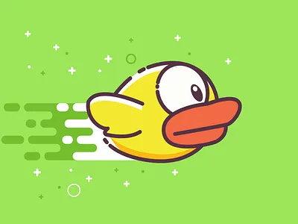
Flappy Bird Game (using Python and pygame) Presented by:
Sana Arshad(2025-CYS-140)
Taliha Tahir(2025-CYS-122)
Warda Qamar(2025-CYS-139)

Slide 2
Introduction
Flappy Bird is a simple yet popular 2D arcade game.
It helps understand core programming concepts. Flappy Bird is a popular side-scrolling mobile game.
Gameplay is simple yet addictive.
Player controls a bird to navigate through green pipes with gaps.
Bird moves by tapping the screen or pressing a key.

Slide 3
Project Objective
Implement Flappy Bird game on PiTFT screen.
Create user-friendly interfaces for easy understanding of game.
Allow users to choose playing modes and background settings.
Control the bird using touchscreen or keyboard buttons.
Include a scoreboard to track previous scores/history.

Slide 4
Programming Concepts Used
Variable
Loops
Conditions
Functions
Classes & Objects
Event Handling
Collision detection & Logic

Slide 5
Variable used
Screen Width
Screen Height
Ground Height
Gravity
Bird Position
Pip Position
Score

Slide 6
Design
Created all static interfaces and buttons first.
Developed single-player mode:
Pipe and background movement
Bird falling/jumping
Score and life tracking
Sound effects
Created backend JSON file to read/write new records.
Developed dual-player mode based on single-player mode.

Slide 7
Testing
Tested overall game structure by navigating each interface.
Verified that bird movements are smooth and responsive.
Checked score and life updates correctly during gameplay.
Ensured collision detection works properly (bird vs pipes/ground).
Ensured all sounds play correctly at right events.

Slide 8
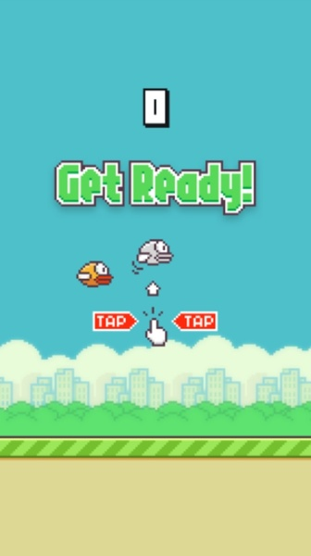
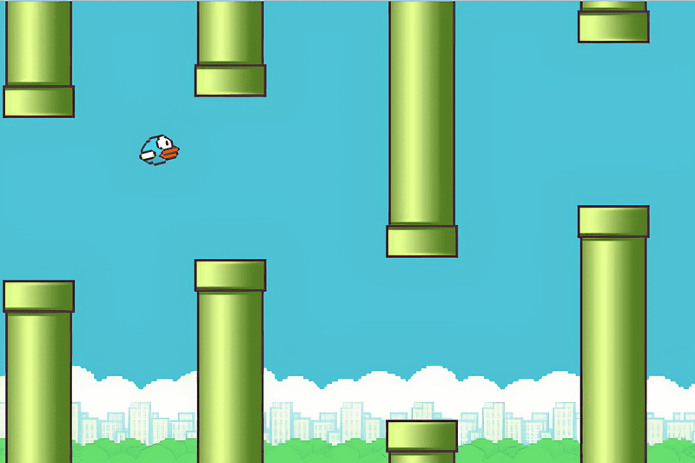
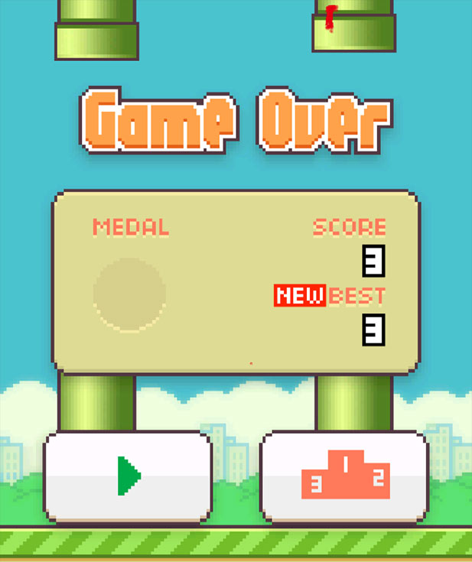
Drawings
Start Screen Game Play Game Over

Slide 9
Gameplay in Action

Slide 10
Thank You

