Slide 1
TrackMe
903822-Buse Gunay
917104-Ezgi Tasti
915609-Talip Turkmen

Slide 2
GOALS
Data4Help – Individual
Retrieving user’s data
Sharing individual data with third parties
Tracking user’s own data and share history
Data4Help - Third Party
Access to specific individual’s data
Access to anonymized data of group of individuals.

Slide 3
GOALS
Automated SOS
Sending a notification to the nearest hospital in case of emergency
Keeping individual’s SOS history
Track4Run
Specifying paths
Registering for run
Spectating runners on the map

Slide 4
BOUNDARIES
WORLD PHENOMENA | SHARED PHENOMENA | MACHINE PHENOMENA
Having a smart device | Receiving health and location data from smart device | Storing data in database
Having a unique SSN | Requesting personal or anonymized data | Controlling anonymization
Making the monitoring data to receive | Defining pre-confirmed list | Checking pre-confirmed list
Measuring health data and location by smart device | Notifying individuals about data sharing request | Preparing requested data
Dispatching ambulance | Approve or reject data sharing request | Storing data request
Defining threshold values | Showing requested data to third party | Comparing measured values and threshold values
Organizing a run | Tracking runners | Storing SOS information

Slide 5
DOMAIN ASSUMPTIONS
Data retrieval
Smart devices used by individual users provides an interface to retrieve health and location data
The health and location data provided by smart devices is accurate and real-time
AutomatedSOS
Third parties have a system which receives notification from AutomatedSOS and can dispatch the ambulance to requested location
Track4Run
Location services of runners are available and accurate during the run

Slide 6
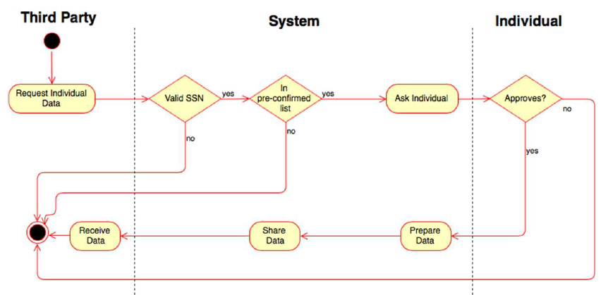
REQUIREMENTS
Data Retrieval
System should retrieve health and location data by exploiting the APIs that are provided by smart devices application.
Individual Data Request
When system receives an individual data request it should respond according to Approval Procedure
Notes:
1-satisfies Goal 1: retrieving user’s data

Slide 7
REQUIREMENTS
Anonymized Data Request
The system must evaluate anonym data requests from third parties
AutomatedSOS
The system should send a notification to the nearest active third party if the health values of the individual fall below a certain value
Track4Run
The system should provide a map to spectators and organizers for displaying the path and the location of all runners during the run
Notes:
1: As a result of the
evaluation, if the number of people whose data is desired is higher than
1000, the system should share the data with the third party. Otherwise,
the request must be rejected.

Slide 8
USE CASES

Slide 9
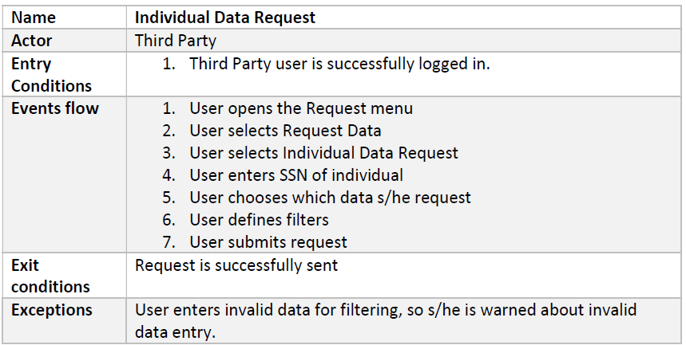
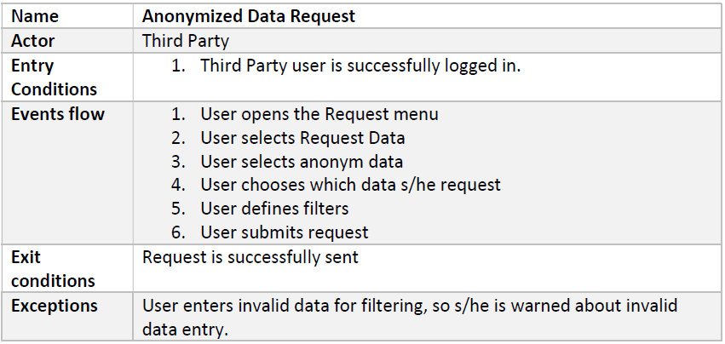
USE CASES

Slide 10
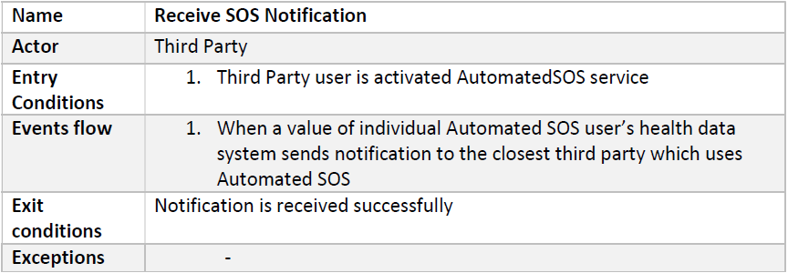
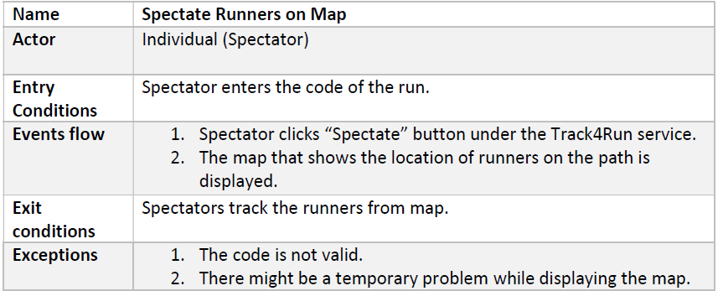
USE CASES

Slide 11
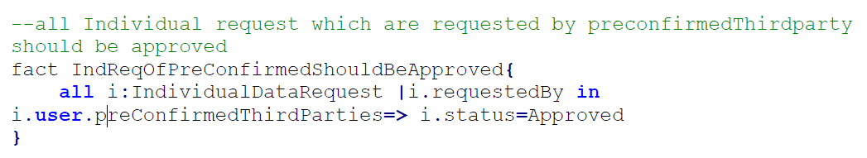
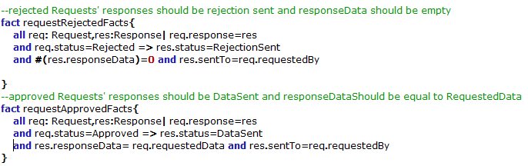
ALLOY
Data4Help
When a request is sent by a pre-confirmed third party, it should be approved, and requested data should be sent to the third party
If the request is approved or rejected there should be one response for this request. Status of the response depends on the status of the request.

Slide 12
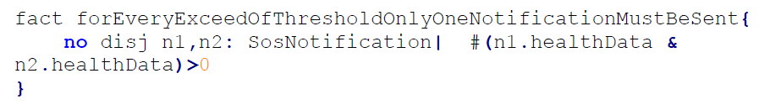
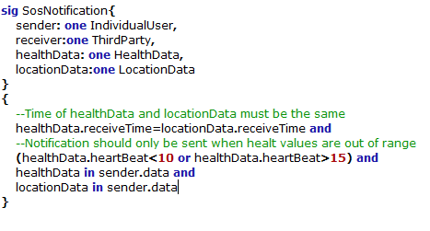
ALLOY
AutomatedSOS
When the health values are out of range a notification should be sent to a third party which serves AutomatedSOS service.

Slide 13
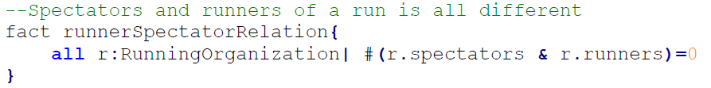
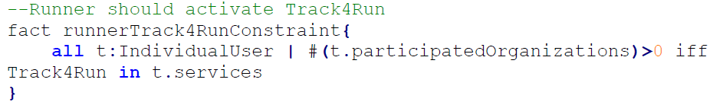
ALLOY
Track4Run
A user can’t attend an organization as both runner and spectator.
In order to attend, the runner individual must activate Track4Run. Also, the third party must activate Track4Run service to organize a run

Slide 14
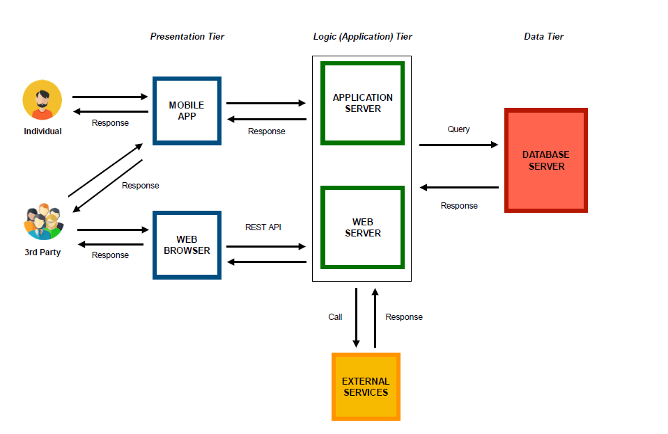
ARCHITECTURAL DESIGN
Notes:
3 tiered architecture

Slide 15
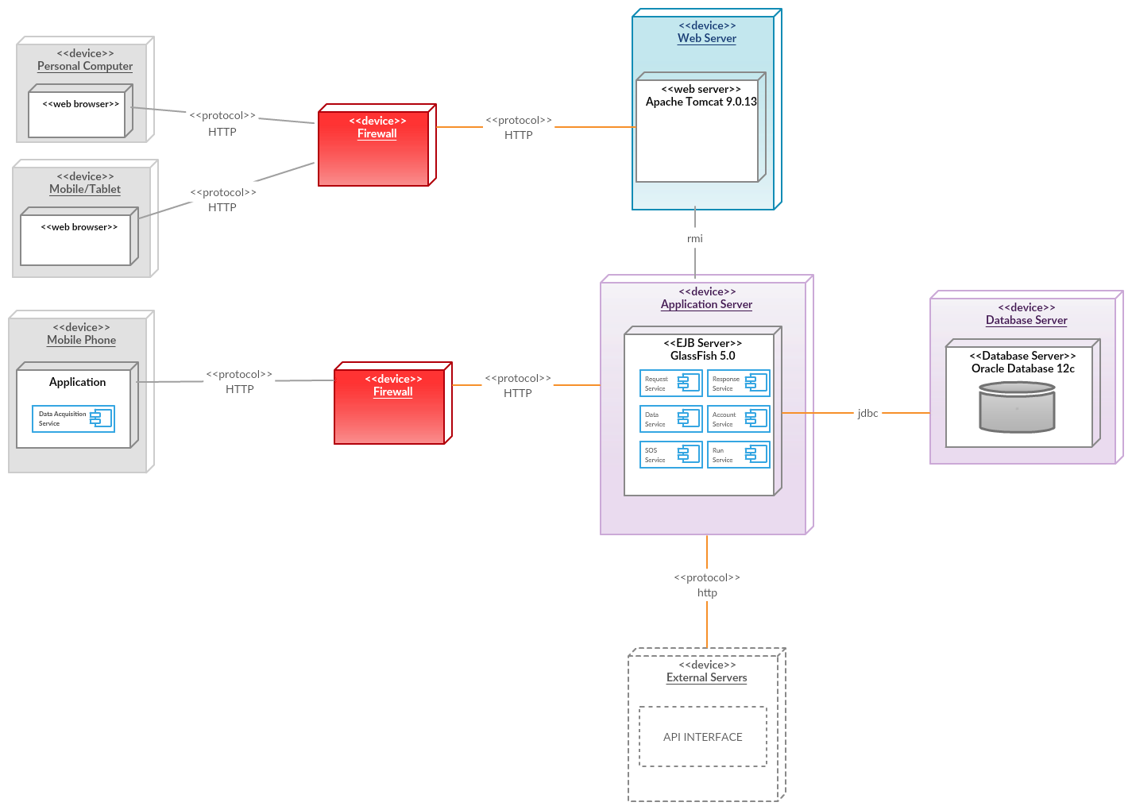
DEPLOYMENT VIEW
Notes:
3 tiered architecture

Slide 16
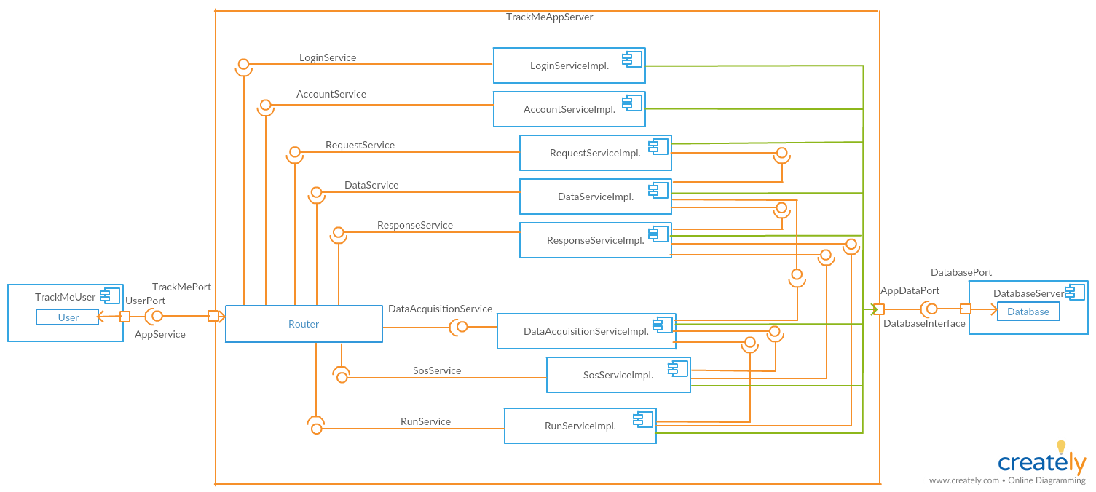
COMPONENTS DIAGRAM

Slide 17
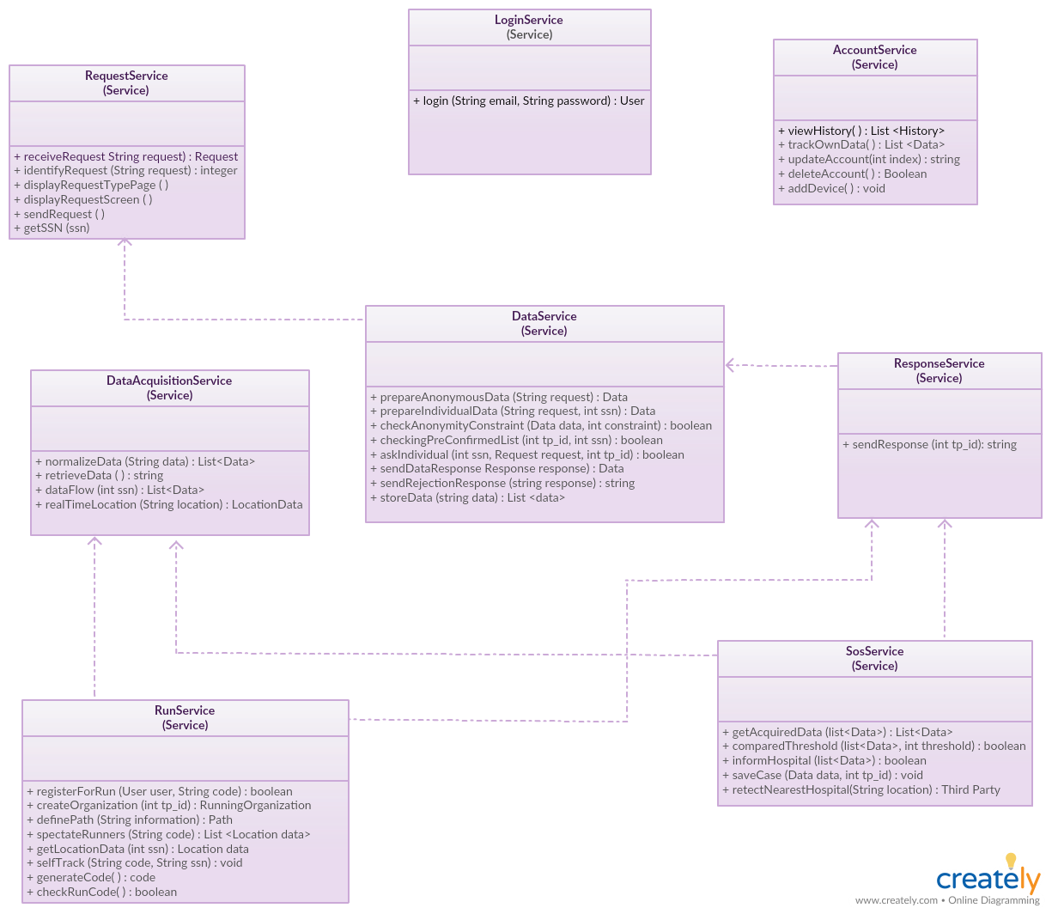
COMPONENT INTERFACES

Slide 18
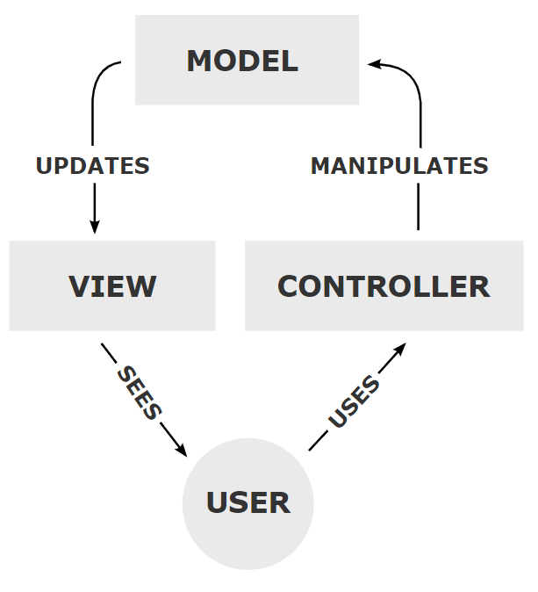
ARCHTECTURAL STYLES
MVC
Factory Pattern DB Factory
Builder Pattern Creating request by third party
Observer Pattern Checking threshold
Facade Pattern Routing request from web server to application server

Slide 19
IMPLEMENTATION
Implementation Order
1. Model
2. DataService and DataAcquisitionService
3. RequestService and ResponseService
4. SOSService
5. RunService
6. LoginService and AccountService
7. Router

Slide 20
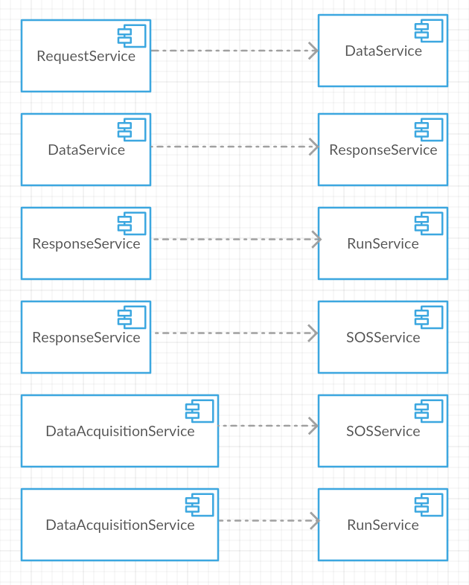
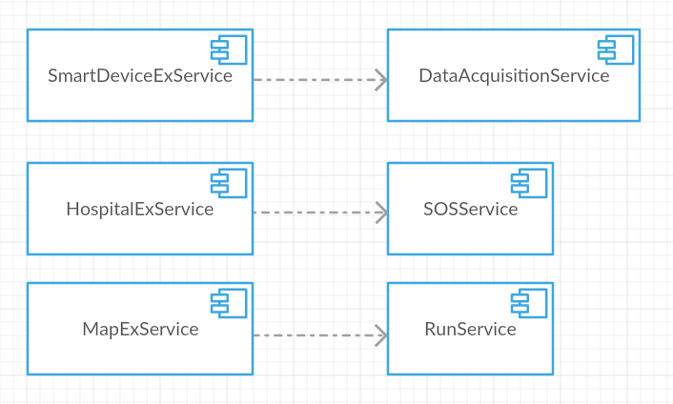
INTEGRATION
Integration between the external services and application components
Integration between the application server components
Notes:
DBMS integraiton

Slide 21
TESTING
Testing order

Slide 22
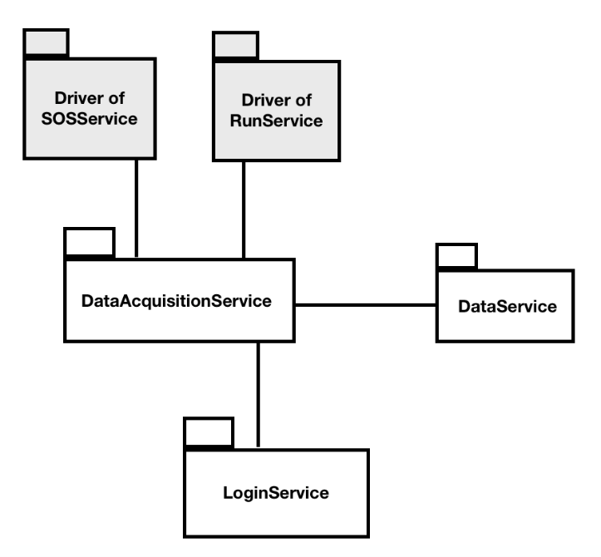
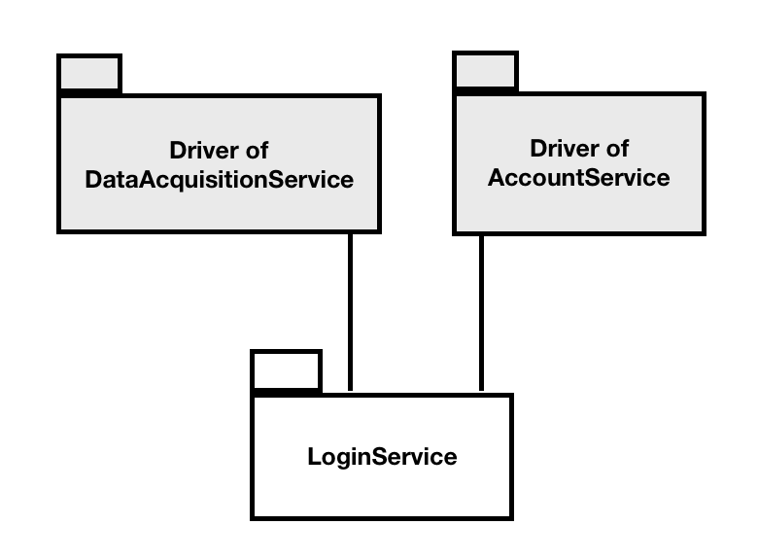
TESTING
Bottom Up Approach
Integration testing of LoginService
Integration testing of DataAcquisitionService

Slide 23
THANKS…

