Slide 1
Astrological-Compatibility
File created on: 4/14/2023 1:46:37 AM

Slide 2
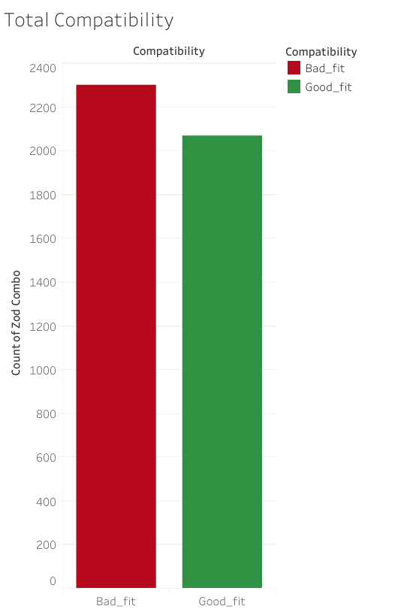

Slide 3
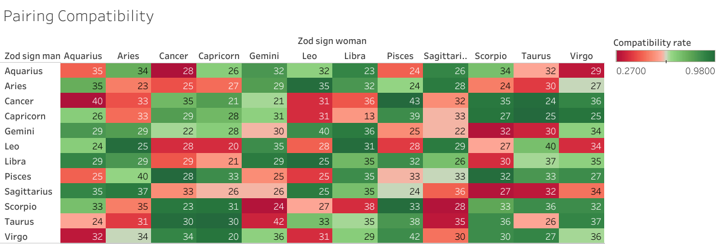

Slide 4
