Slide 1

MILESTONE 3
Talitha Salsabila

Slide 2
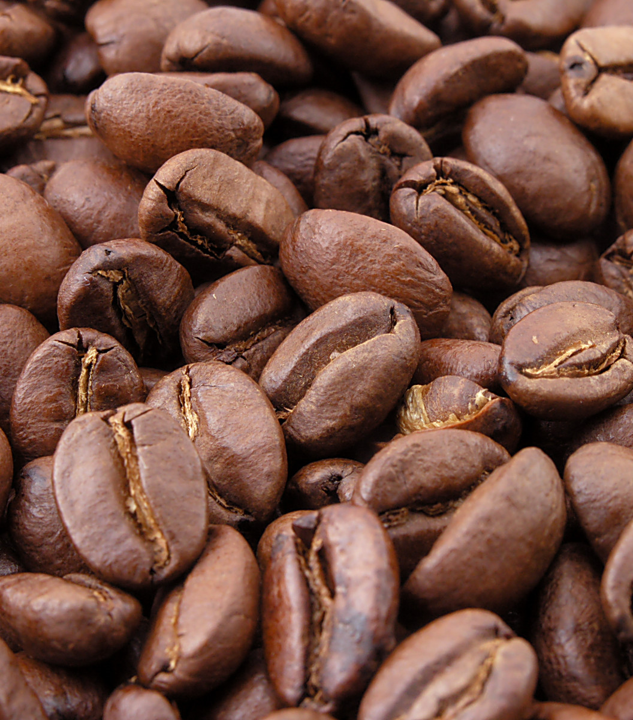
Background
Warung Berkah is a store that sell coffee & tea specialty products in the United States
Its branch are spread across 4 regions: East, West, North, and South. And specifically, occupy 20 states.
Warung Berkah plan to open a new store in one of the existing state.
Thus, they ask a data scientist to help them to decide the new store location
The data used is from 2010-2011. Inflation factor is not calculated in this case

Slide 3
Analysis Questions
Which region has the highest profit?
What is the marketing cost and total expenses of each region?
How is the sales performance in region of interest?
How profitable the store in region of interest?
What is the most sold products?
What is the most profitable product in the state of interest?
What is the predicted profit of the new store in 2 years?

Slide 4
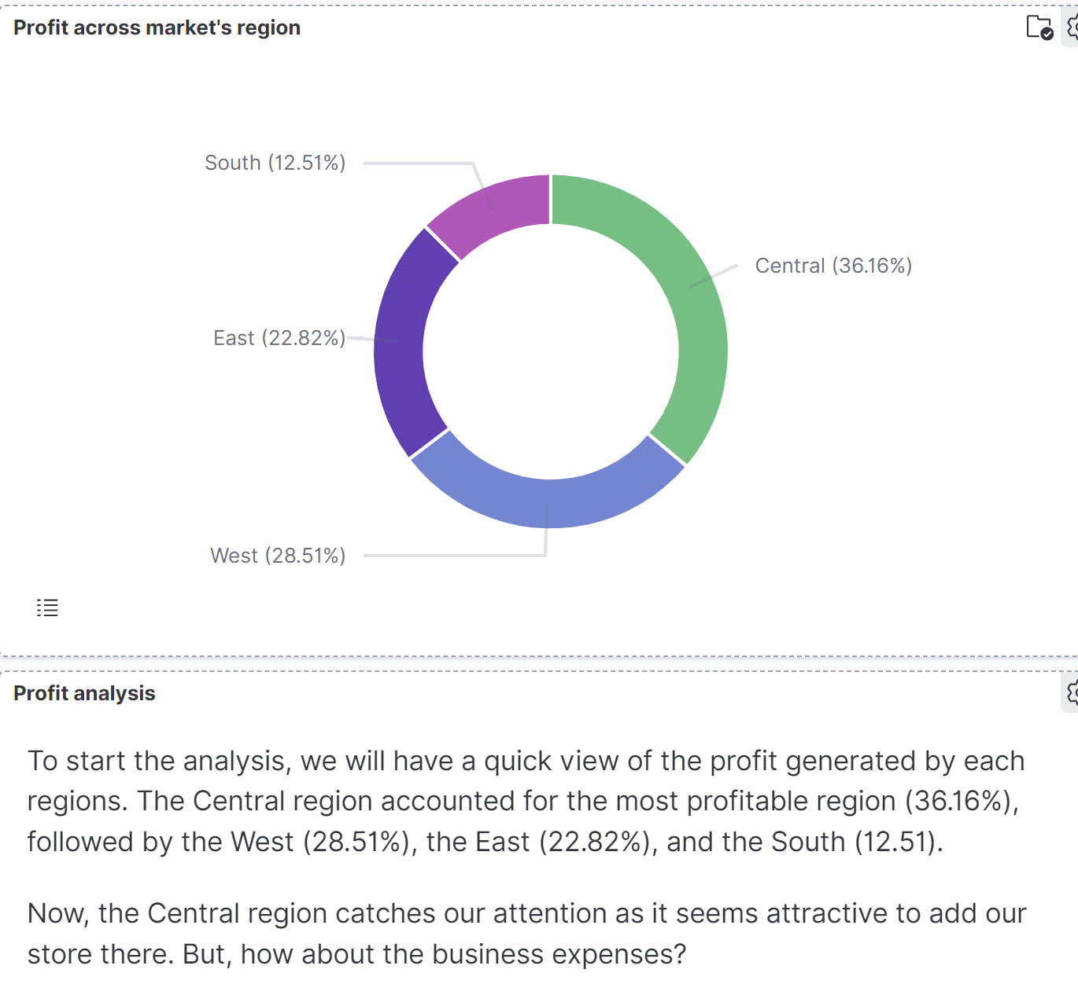
Store Profit Across Region

Slide 5
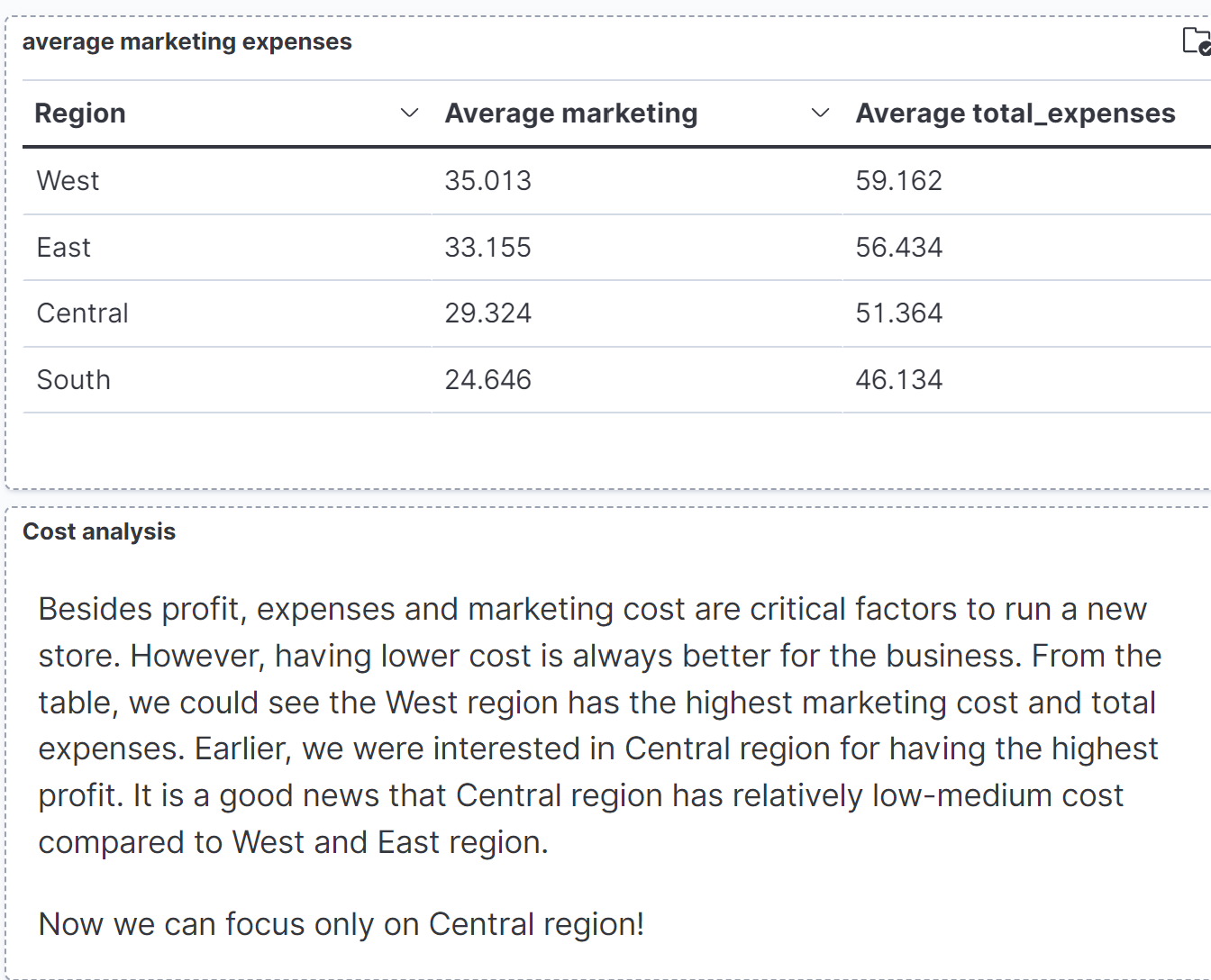
Marketing and Total Expenses

Slide 6
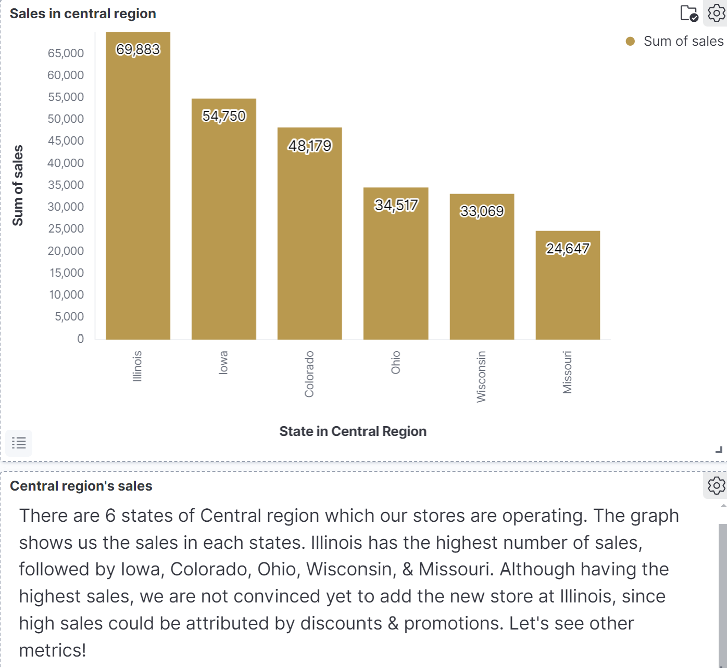
Sales in Central Region

Slide 7
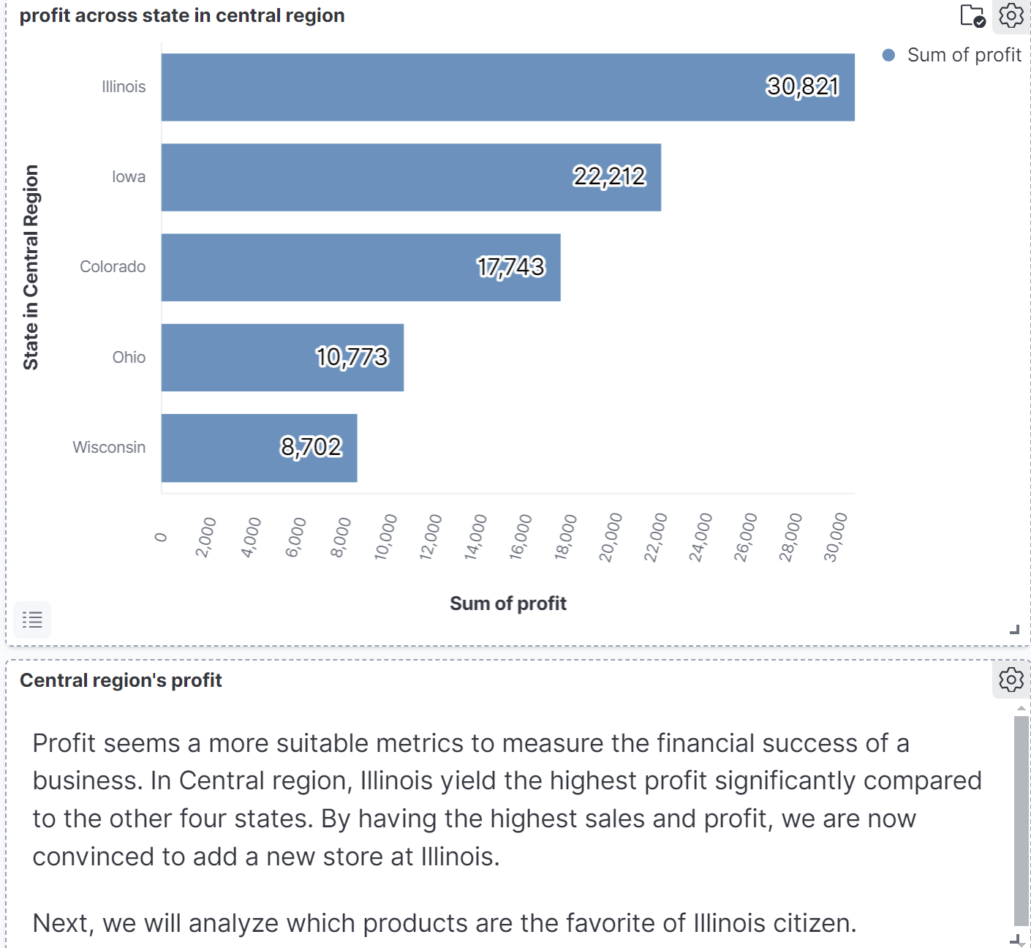
Profit in Central Region

Slide 8
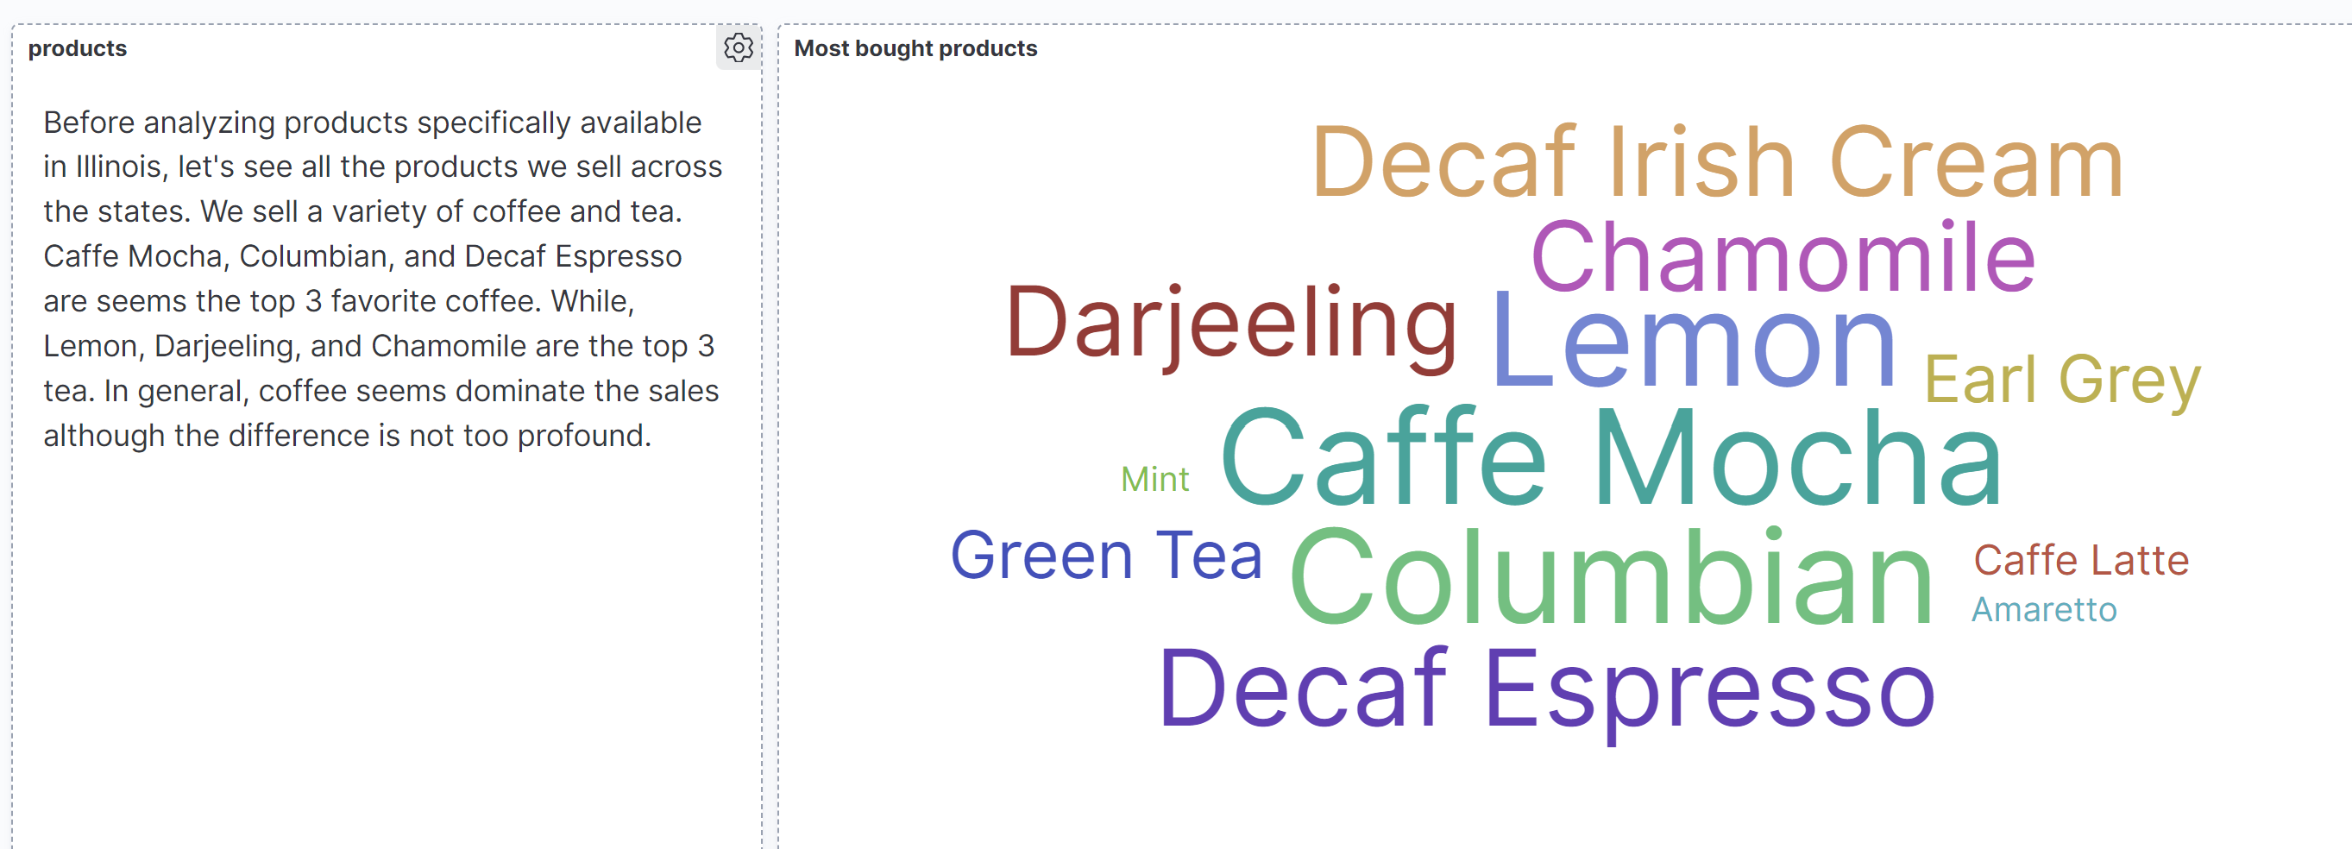
Most Bought Product

Slide 9
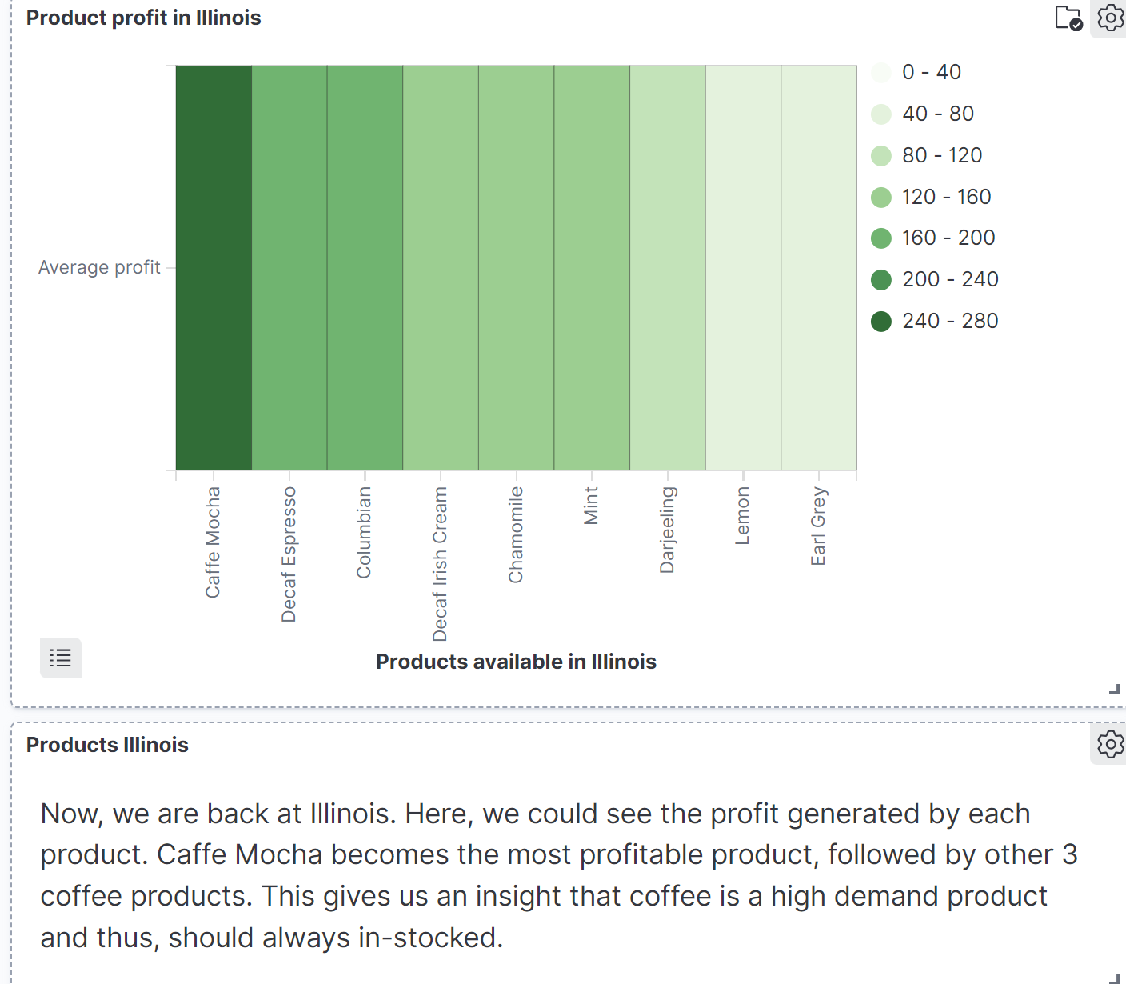
Products in Illinois

Slide 10
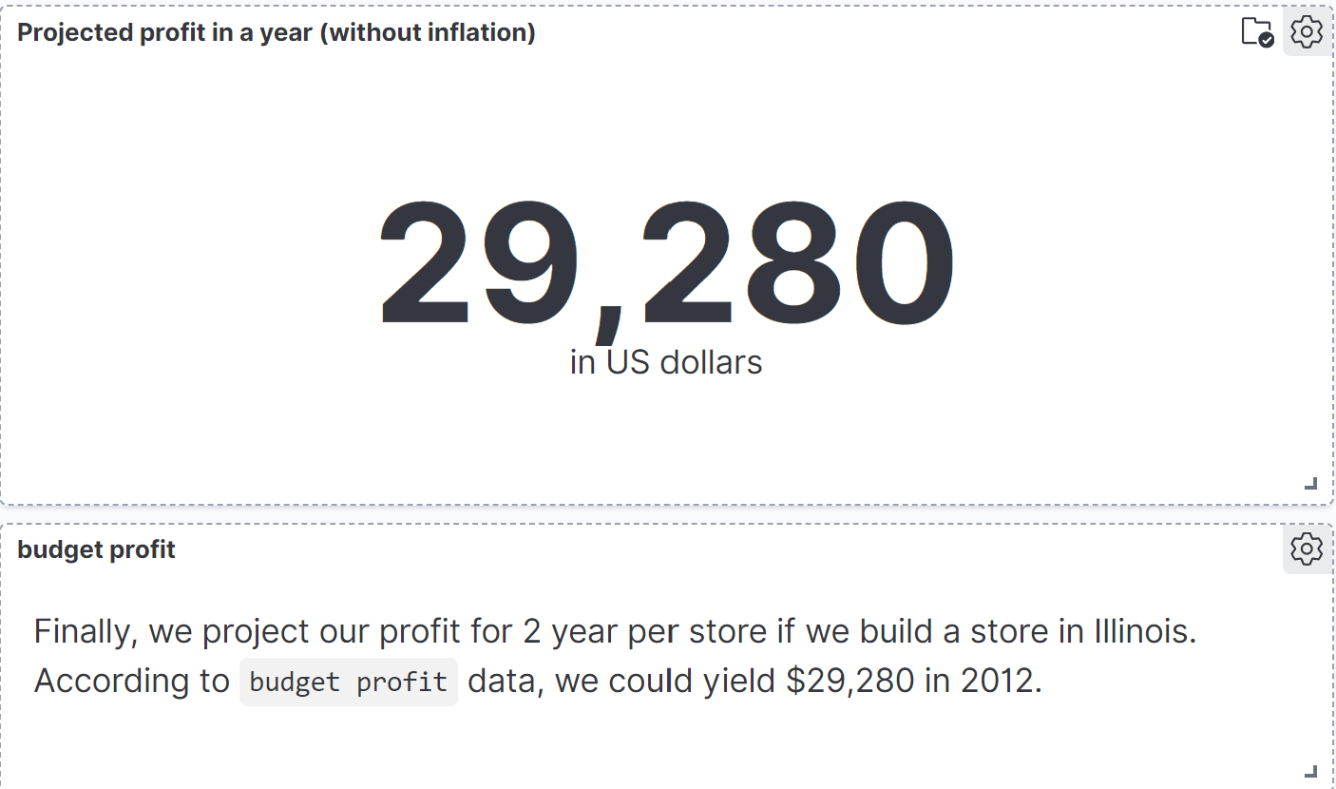
Projected Profit for 2 Year

Slide 11





Conclusions
Objectives
To decide which location is optimum to build a new store
Area of analysis
Profit
Number of sales
Total expenses
Marketing cost
Product variations
Profit prediction
Location of new store
Out of 20 states, we choose Illinois as our new store location. Based on the sales record, Illinois generated high profit with relatively low marketing cost and total expenses
Predicted profit
profit of a new store would be $29,280 per 2 years
Recommendation
Conduct a competitive analysis
Establish key performance indicators (KPIs) to evaluate and monitor business evaluation

Slide 12




Thank you

