Slide 1
Chat-GPT Based Entities Classification - ESWA 2023
Submitters
Taliya Shitreet - 314855099
Renana Rimon - 207616830
Eran Levy - 311382360
Daniel Tzafrir - 206920860

Slide 2
Introduction Urban Planning in Bogota's Savannah - Shaping a Sustainable Future
Problem:
Urban Planning in collaboration with residents.
Challenges:
Data Collection - Collecting residents' opinions
Data labeling
Data analysis – Classify sentence to category

Slide 3
Introduction
Solutions
Collection - Chatbot
labeling – ChatGPT
Analysis (classification) –
Supervised model
TF-IDF
Sentence-BERT
Unsupervised model
language-agnostic BERT

Slide 4
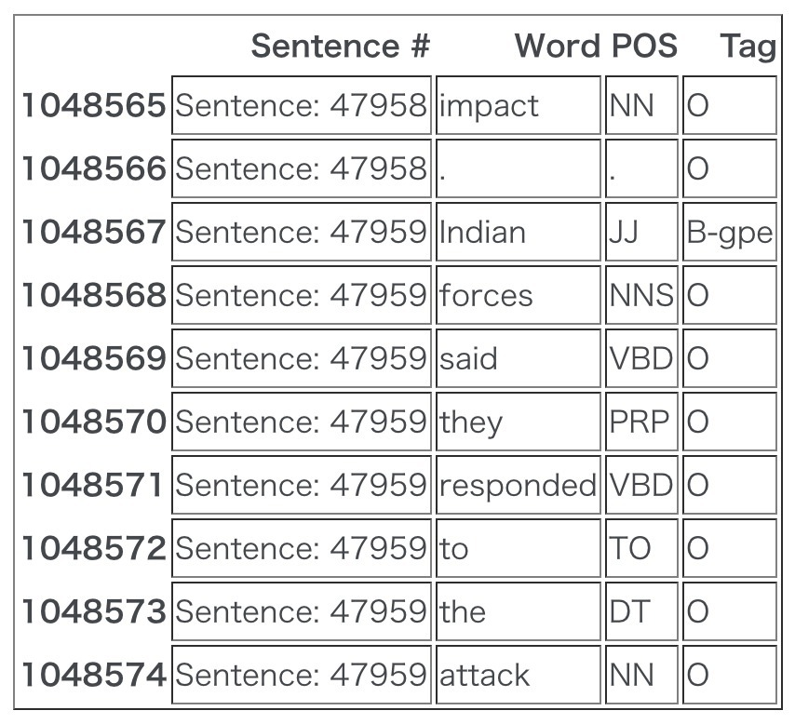
Dataset
Label | Sentence
['Land use'] | "Are there any alternative materials?"
['Mobility (transport)', 'Land use'] | "Such as bridges"
['other'] | "Do you use every idea?"
['Local identity'] | "minimalistic architecture"

Slide 5
Dataset
Total # of labels | Total # of sentences
405 | 360 | All Data
325 | 288 | Train (80%)
80 | 72 | Test (20%)
Mobility (transport) | Land use | Environment and climate resilience | Future of work | Local identity | Other
12 | 108 | 76 | 48 | 73 | 88 | All Data
10 | 86 | 61 | 39 | 59 | 70 | Train (80%)
2 | 22 | 15 | 9 | 14 | 18 | Test (20%)

Slide 6
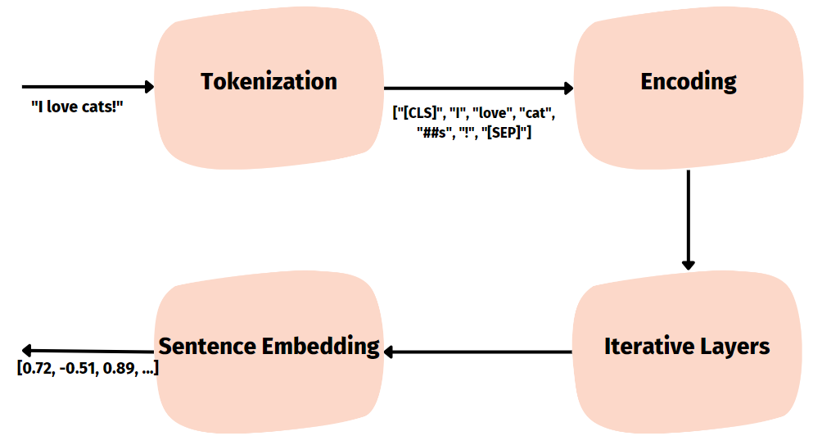
Bert Embedding
BERT embedding is a representation of words or sentences as numerical vectors, capturing their meaning and contextual information, enabling advanced natural language processing tasks.
Notes:
In BERT, words are represented as numbers to help computers understand their meaning. This representation is like a special code for each word. The process starts by breaking down a sentence into smaller parts called tokens. Each token is assigned a unique number. These numbers are like labels for the words.
To make these numbers meaningful, BERT uses a technique called word embeddings. It assigns a set of numerical values to each number (word) based on the meaning of the word and how it relates to other words. These numerical values are like a fingerprint that captures the important information about each word.
When a sentence is input to BERT, it converts each word into its corresponding number (token) and then looks up the associated set of numerical values (embedding) for that number. These embeddings contain information about the word's meaning and its relationship with other words in the sentence.
BERT then uses these numerical values to analyze the sentence and understand its context. It uses fancy math operations to process and refine these numbers, capturing important patterns and connections between words. This helps BERT make sense of the sentence and extract useful information from it.
So, in simple terms, BERT represents words as special numbers called embeddings. These embeddings contain meaningful information about the words and their relationships. BERT uses these numbers to understand the sentence and extract useful insights from it.

Slide 7
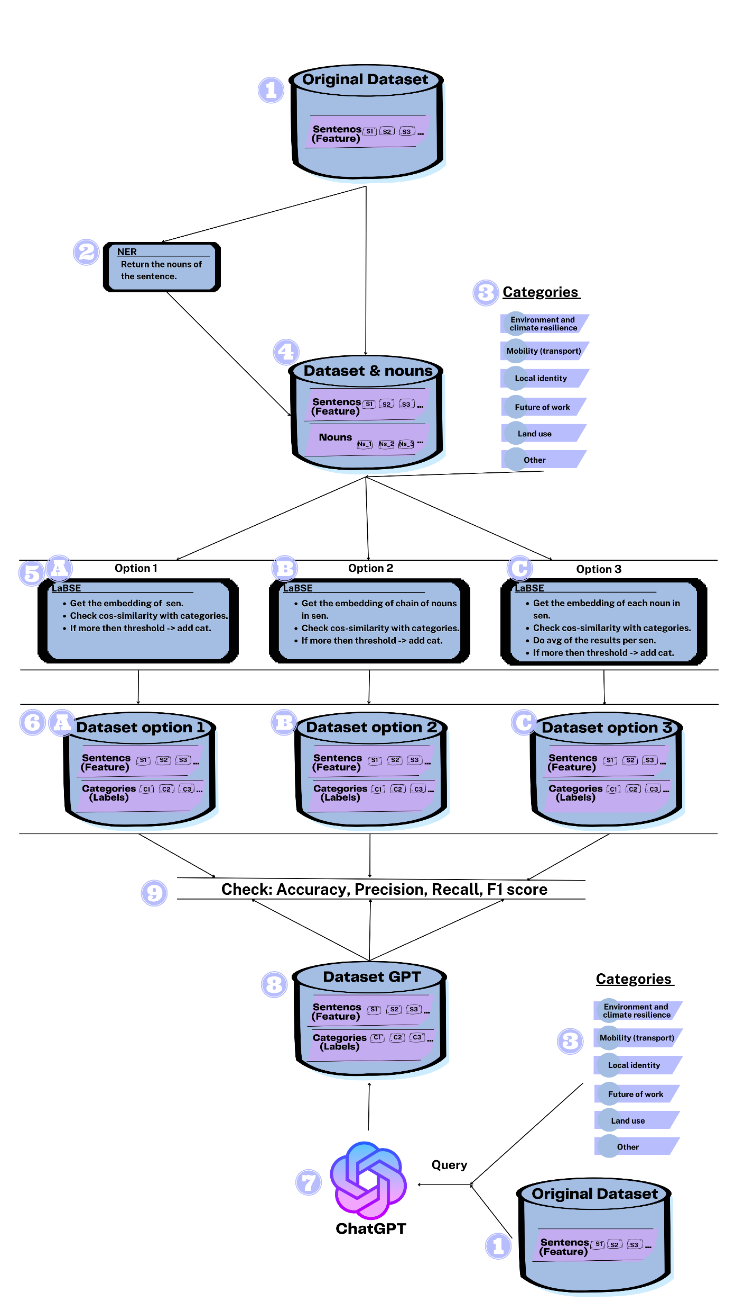
Unsupervised Learning
Unsupervised learning is a machine learning technique that does not require labeled data
Notes:
Unsupervised learning is a machine learning technique that does not require labeled data. Unsupervised learning can be used to find patterns in unlabeled data. These patterns can be used to extract knowledge from text. In this article, both of the techniques will be used.
In the unsupervised method, a smaller variant of the LaBSE (Language-agnostic BERT Sentence Embedding) model was employed to generate sentence embeddings. To prepare the input for the model, we used an NER (Named Entity Recognition) model to extract entities from the sentence. For each sentence, the input to the LaBSE model consisted of three versions: 1. The original sentence. 2. The list of Nouns extracted by NER. 3. Each noun is send as a sentence and after getting the vector – avg for each category. These embeddings capture the semantic meaning of the sentences in a numerical representation. By calculating the cosine similarity between the sentence embeddings and predefined categories, the method determines the relevance or similarity of the sentences to each category.
We sent the dataset to chatGPT to create a labeled dataset as ‘truth ground’ to check the results from each option.

Slide 8
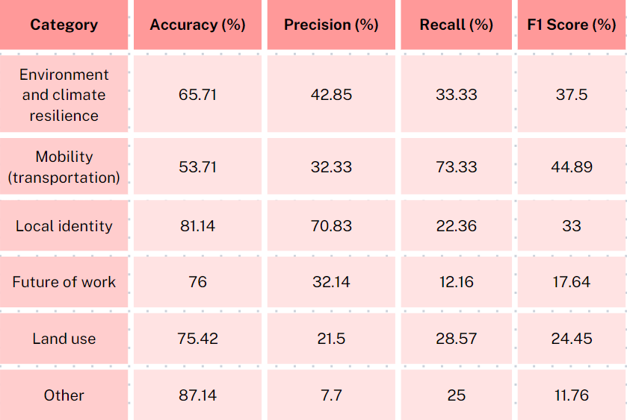
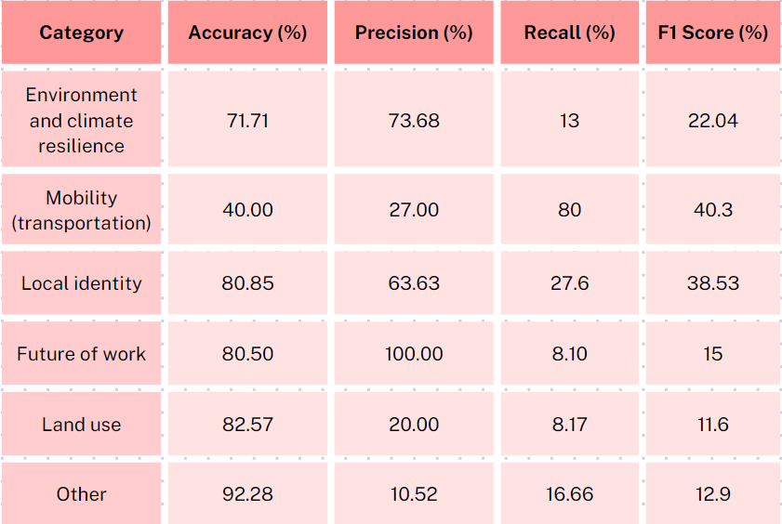
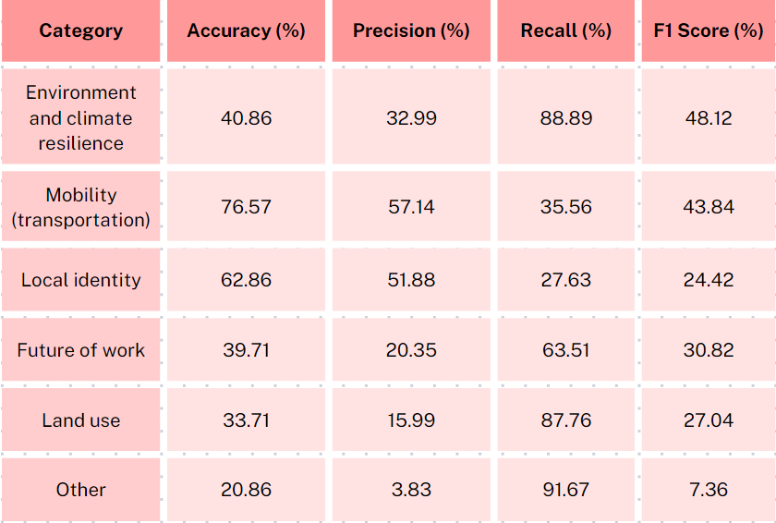
Results Unsupervised
Option 2 - concatenated string
Option 1 - all sentence
Option 3- avg all nouns

Slide 9
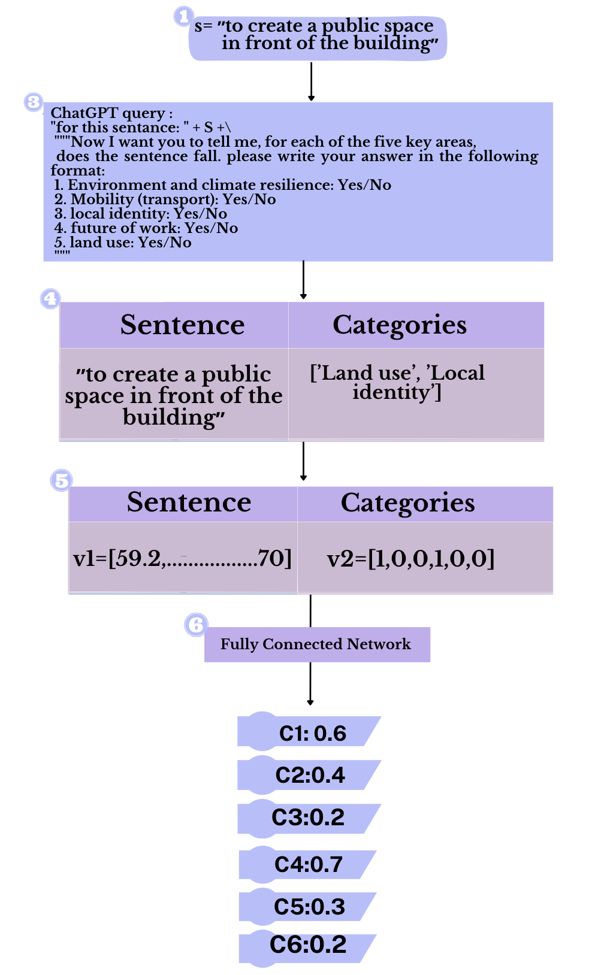
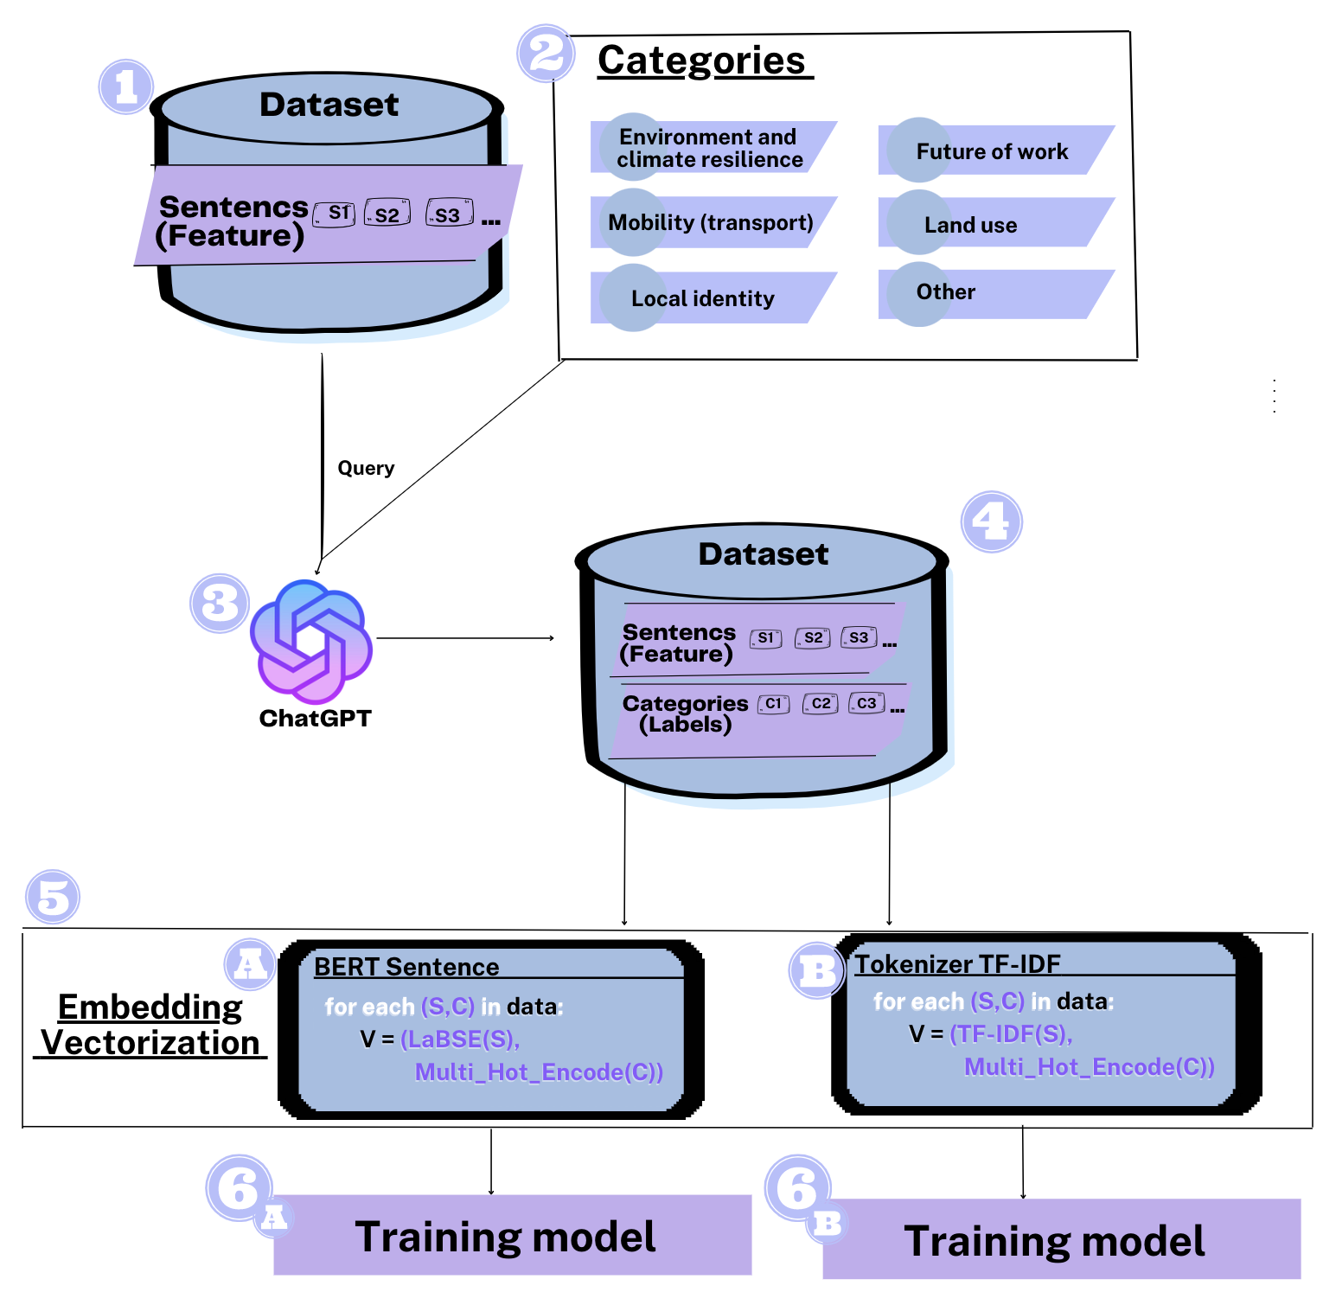
Supervised process

Slide 10
Supervised – the model
MLP Model (hidden layers: 512,256,128,64)
last layer with 6 neurons and sigmoid activation function.
Loss function = ‘binary_crossentropy’: - (y * log(y_pred) + (1 - y) * log(1 - y_pred))
ADAM optimizer
Threshold: equal/above 0.5, if there isn’t, take the Max.

Slide 11
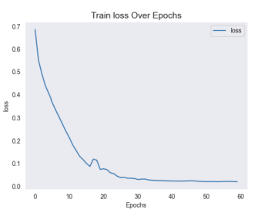
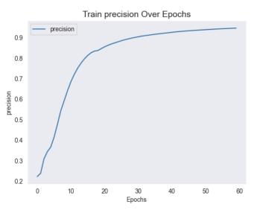
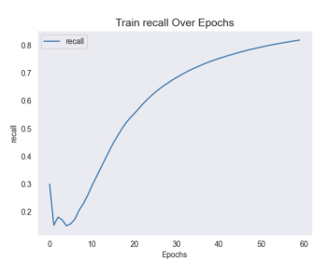
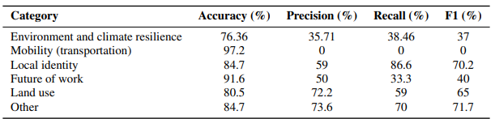
Results TF-IDF
Train
Test

Slide 12
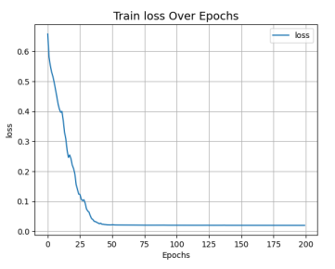
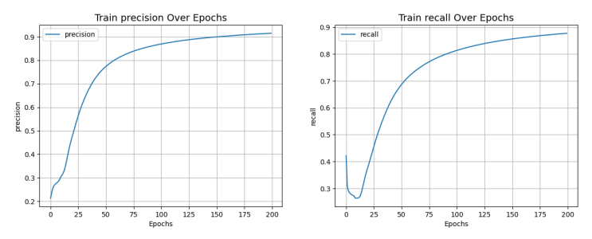
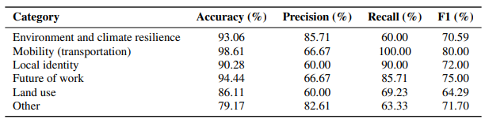
Results Sentence-BERT
Train
Test

Slide 13
Code Questions
Specify what part was written by who

Slide 14
Discussion Open Questions & Future Work
Generalization - LaBSE didn’t worked in the supervised model, so the supervised model is not multilingual.
Data - The model will improve as it has more data to learn from.

