Slide 1

Natural Language Processing with Disaster Tweets

Slide 2

Project Summary
Data Preprocessing
Implemented Data Mining Pipeline/System
Implemented Results
  5-fold CV, OOF probability & threshold planning
  Ensemble and hold-out evaluation
  Confusion matrix
Potential Issues
Future Plans
Contents

Slide 3
Goal: Classify tweets as disaster vs. non-disaster for real-time emergency detection.
Data Insights:
  Metadata useful but incomplete (missing keywords/locations).
  Imbalance: ~57% non-disaster vs. 43% disaster tweets.
  Disaster tweets often contain URLs & specific terms (e.g., fire, evacuate).
Advanced Pipeline:
  Combined word+character TF-IDF
  Meta-data features.
  One-hot keywords
  Explored Models
Results and Challenges:
  Delivered enhanced performance (F1 = 0.7763) on a 15% holdout set using a blended ensemble of the LR and SVC models.
Future Plans:
  Integrate Transformer Models
  Advanced Ensembling (Stacking).
Project Summary

Slide 4
Data Preprocessing
Text normalization:
  Lowercasing, removing/replacing URLs, mentions, hashtags.
  Collapsing elongated characters (e.g., “soooo” → “soo”).
Added binary signals:
  n_words (Tweet word count)
  n_chars (Tweet character length)
  Keyword_norm (Normalized keyword for OHE)

Slide 5
Implemented Data Mining Pipeline/System
Data Preprocessing
Feature Engineering
Evaluation
Modeling
Deduplicate train (110); stratified 5-fold CV, fixed seed
Normalize text: lowercase, URL/@/# → tokens, trim punctuation/whitespace (preserve negations)
Metadata: lowercase keyword + simple mapping; add URL/@/# flags; drop location for MVP
TF-IDF (word + char n-grams)
Simple features: length stats, keyword one-hot, URL/@/# flags
Models Compared: Logistic Regression, Calibrated Linear SVM, Complement Naïve Bayes
Ensemble: DistilBERT fine-tune; optional ensemble (LR/SVM + transformer)
Metric: F1 score (Tune decision threshold on CV to maximize F1)
Confusion matrix + error buckets (sarcasm/figurative “exploded”)
Reproducible runs (seed, exact versions) + CV ↔ Kaggle LB check
Data readiness: model-ready after light normalization; no extra data collection needed

Slide 6
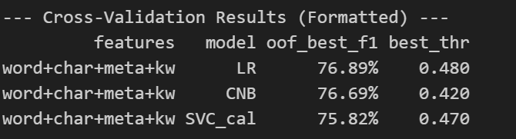
5-fold CV, OOF Probabilities & Threshold tuning

Slide 7
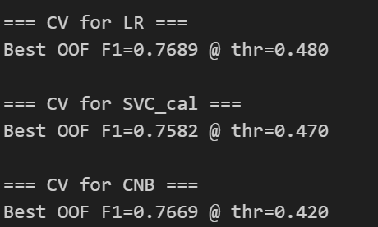
5-fold CV, OOF Probabilities & Threshold tuning

Slide 8
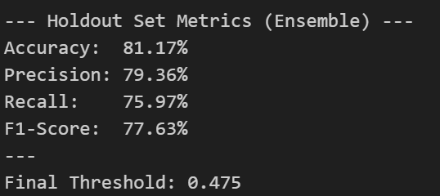
Ensemble & Hold-Out Evaluation

Slide 9
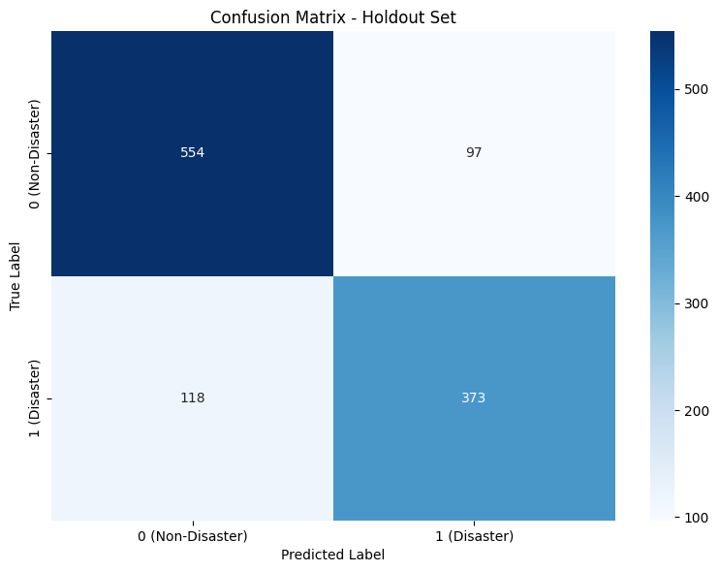
Confusion Matrix

Slide 10
Lack of Hyperparameter Tuning
Simple Ensemble Method
Semantic Gaps
Potential Issues

Slide 11
Push F1 ≥ 0.78–0.784 and accuracy ≥ 0.82
Full Pipeline Hyperparameter Tuning
Implement Advanced Ensembling (Stacking)
Fine-Tune a Transformer Model (LSTM/BERT)
Future Plans

Slide 12

Thank You

