Slide 1
WISE Folder Hider - Reverse Engineering Project
Tina Philip & Samyuktha Sridharan
Graduate Student, Computer Science
Dec. 08, 2014

Slide 2
Agenda
Goal
Features
Patch
Demo
Fixes

Slide 3
Goal
Understand Assembly level functions and reverse engineer ‘WISE folder Hider’
Find Security Flaws
By Pass Registration

Slide 4
Features
Hides folders/ files/ USB drives
Set password for each hidden folders
Uninstalled and then installed again- still uses same old password
Charged a fee of $10 each time a user forgot their password.

Slide 5
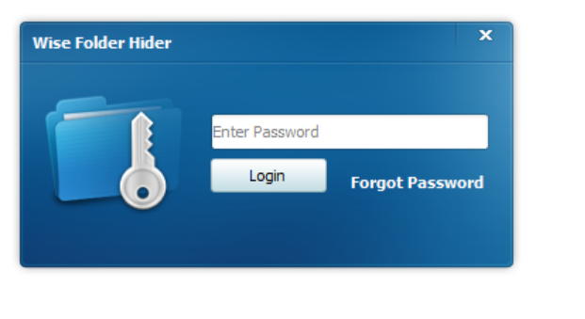
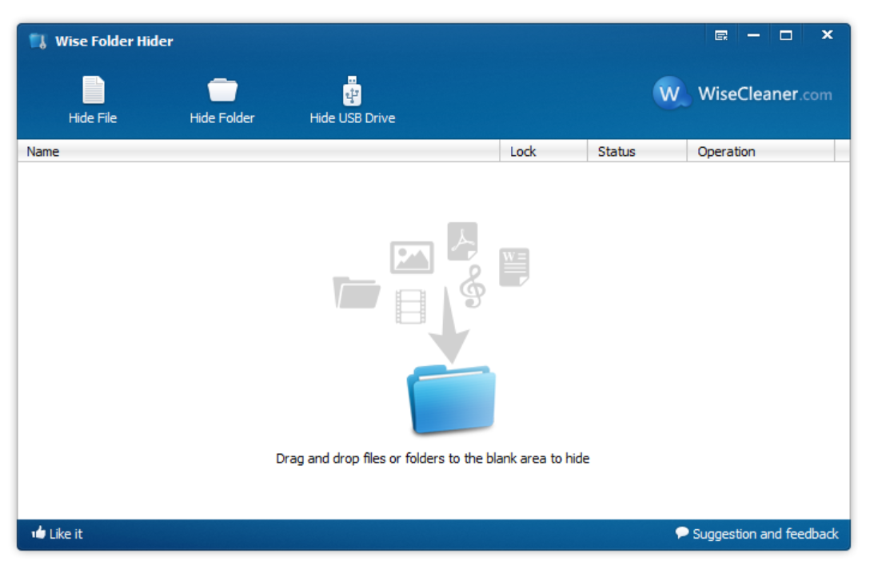
Screenshots
Login
Home page

Slide 6
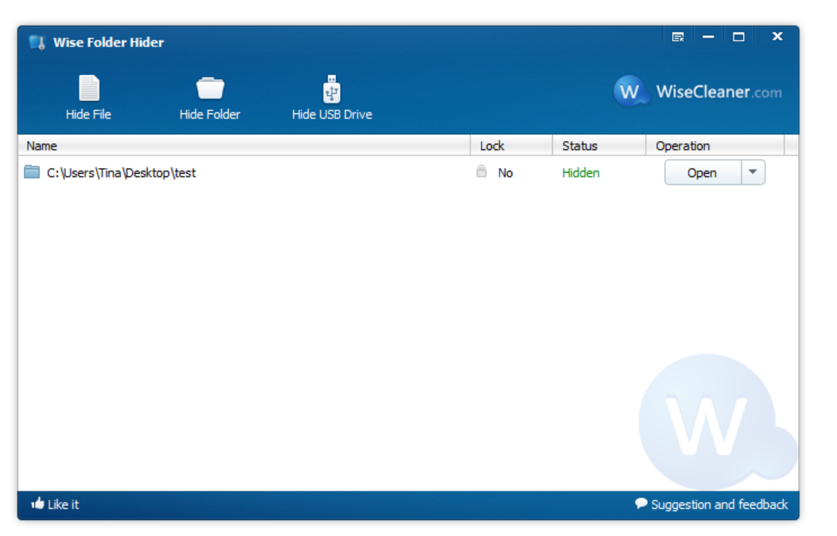
Folder Hidden

Slide 7
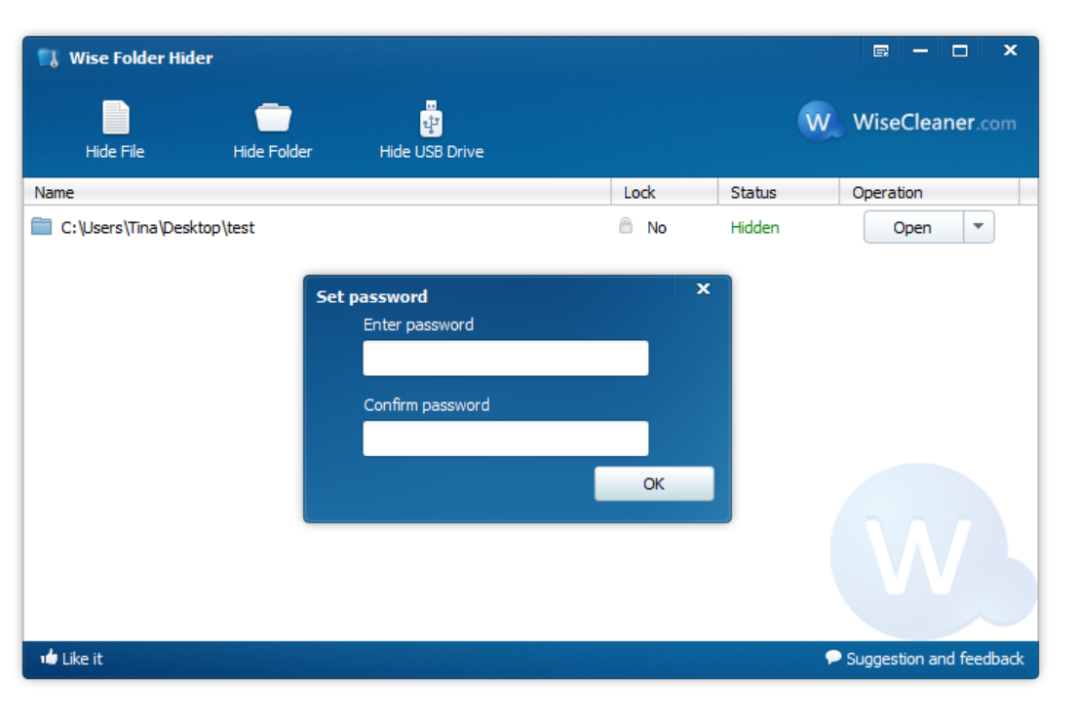
Set Folder Password

Slide 8
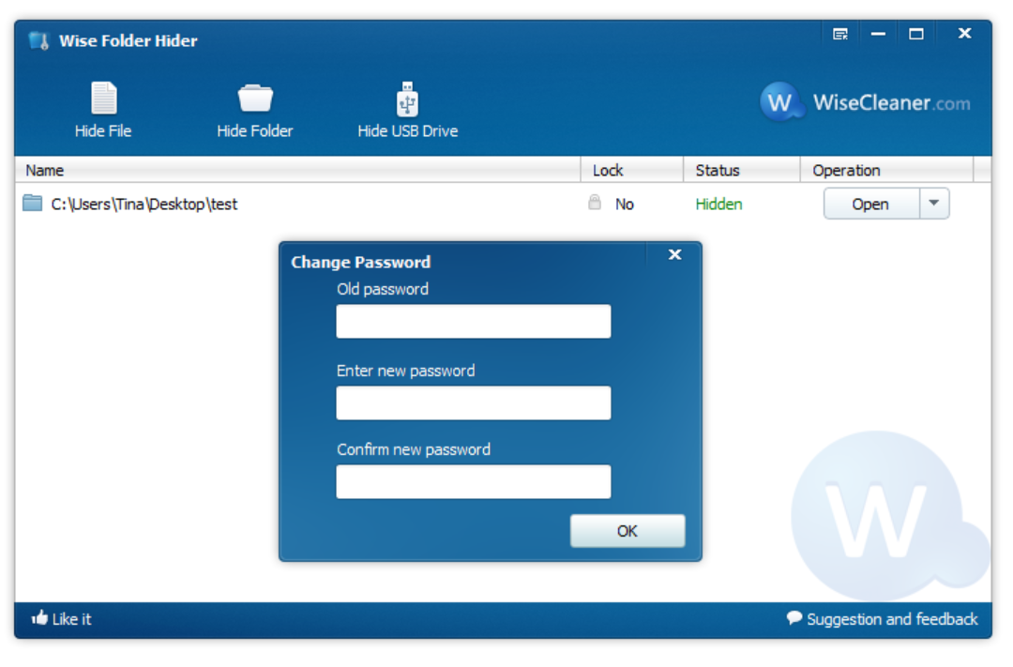
Change Password

Slide 9
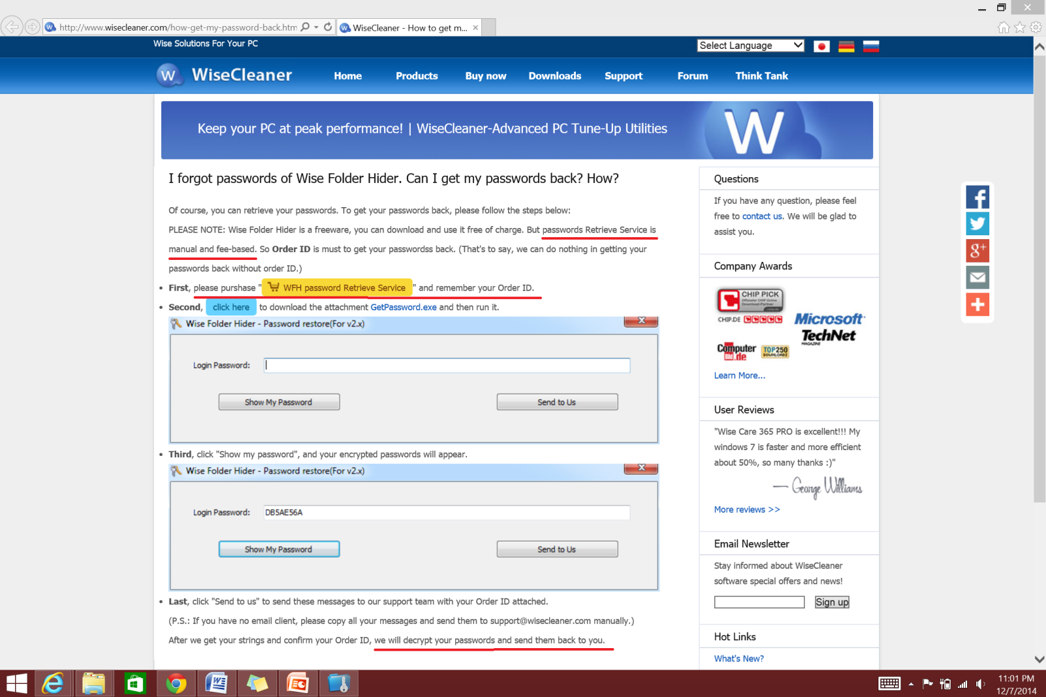
Forgot Password
“Password Retrieval Service is manual and fee based.”
“We will decrypt your passwords and send them back to you.”

Slide 10
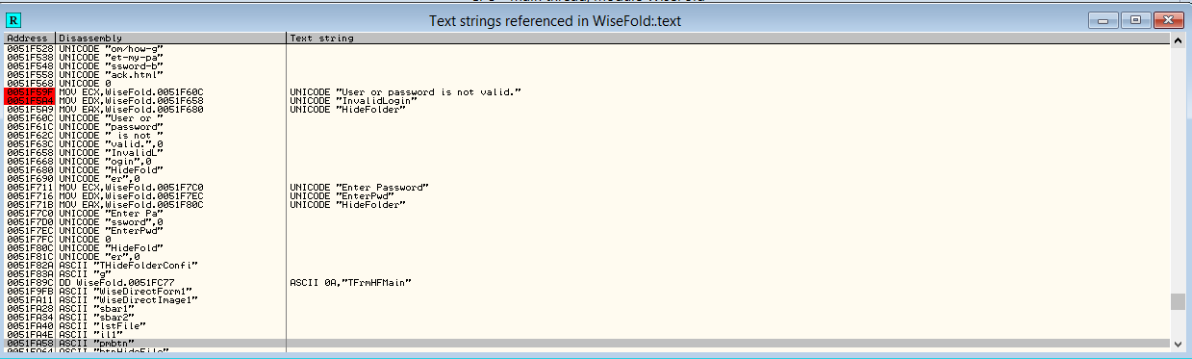
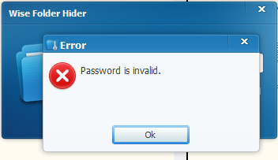
Patch
Locate String corresponding to Message Box.

Slide 11
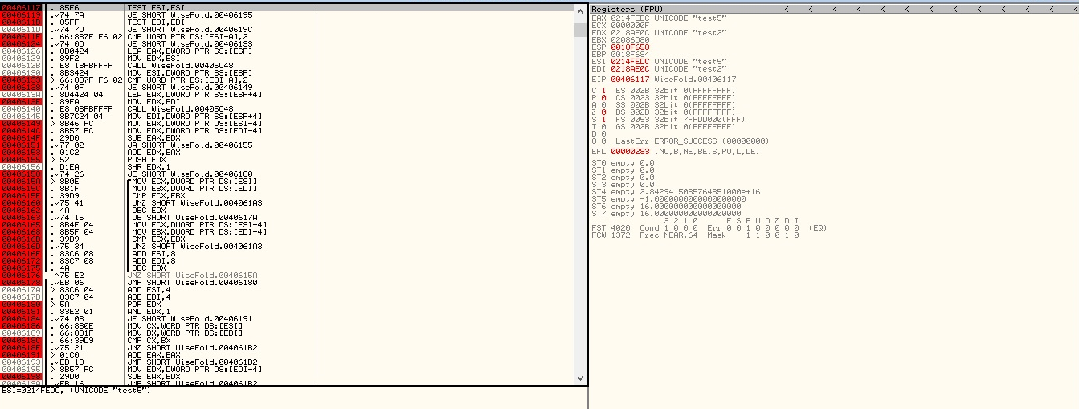
Patch
Inserted Breakpoints at specific locations and traced the stack
Found the Register values populated with the string input

Slide 12
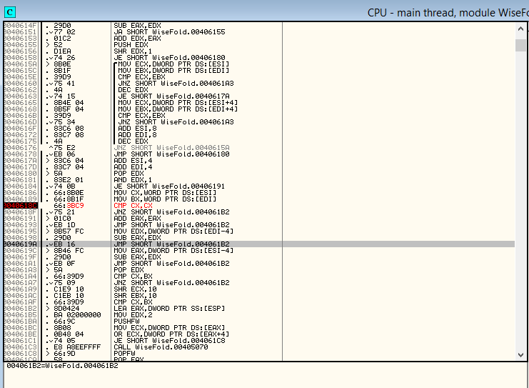
Patch
Checked where the comparison happens - not in EDI or ESI registers
Code Patch in CMP CX, BX

Slide 13
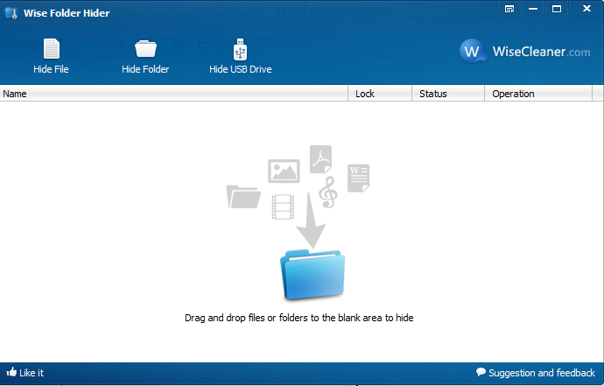
Patch
After bypass – logged in with incorrect password

Slide 14
Security Fixes
Encrypted Password
Cost Factor – The shareware charges $9.99 to retrieve password
Bypassing allows access to the software without the cost
Same patch works for bypassing password protected hidden folder

Slide 15
Questions?

