Slide 1

Pattern Recognition and Machine Learning
Chapter 1: Introduction

Slide 2
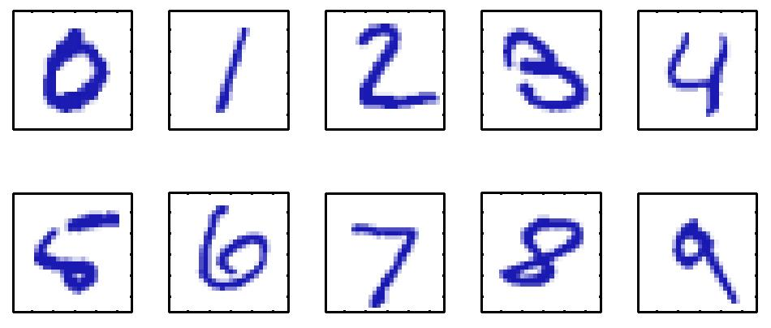
Example
Handwritten Digit Recognition

Slide 3
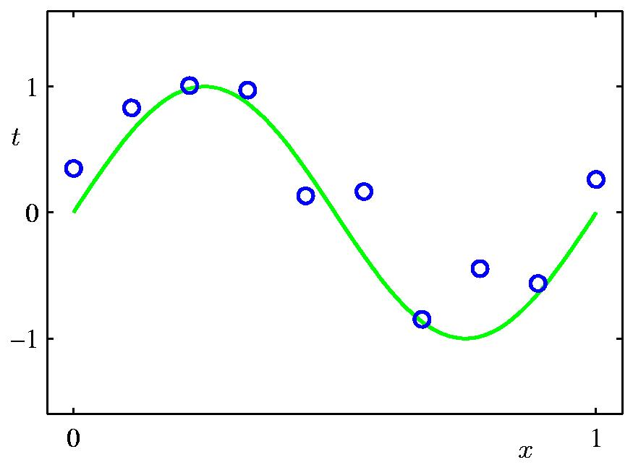
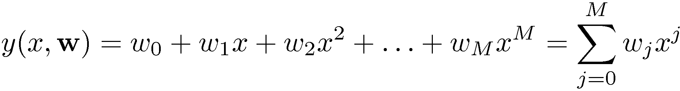
Polynomial Curve Fitting

Slide 4
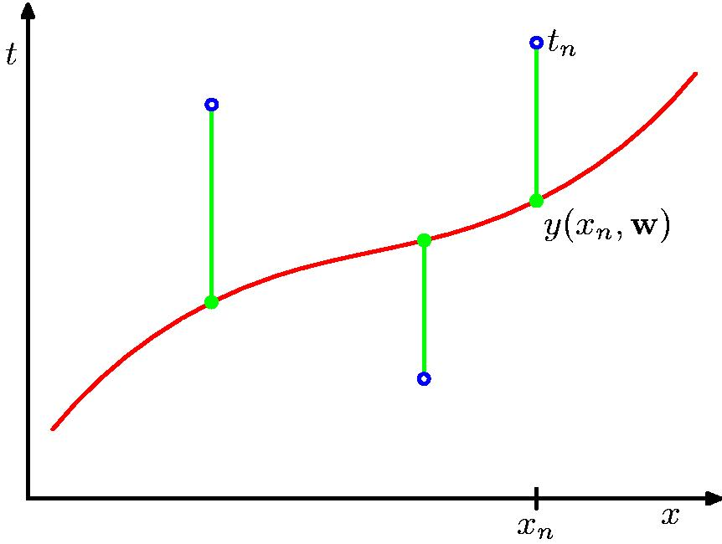
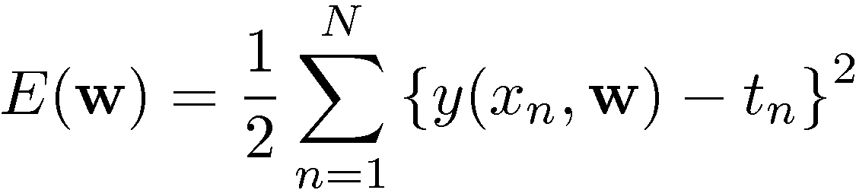
Sum-of-Squares Error Function

Slide 5
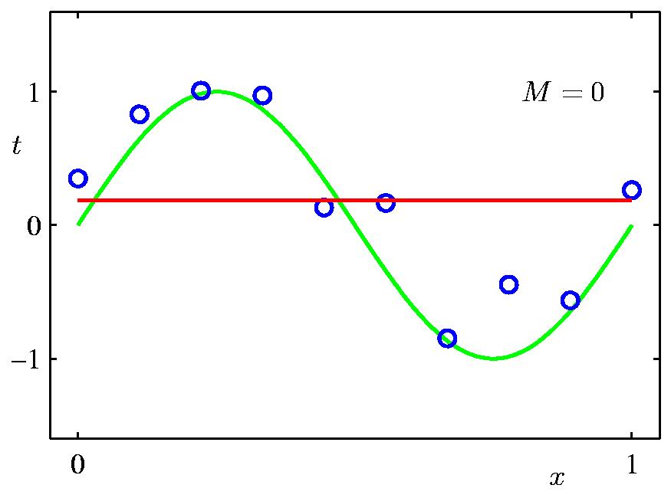
0th Order Polynomial

Slide 6
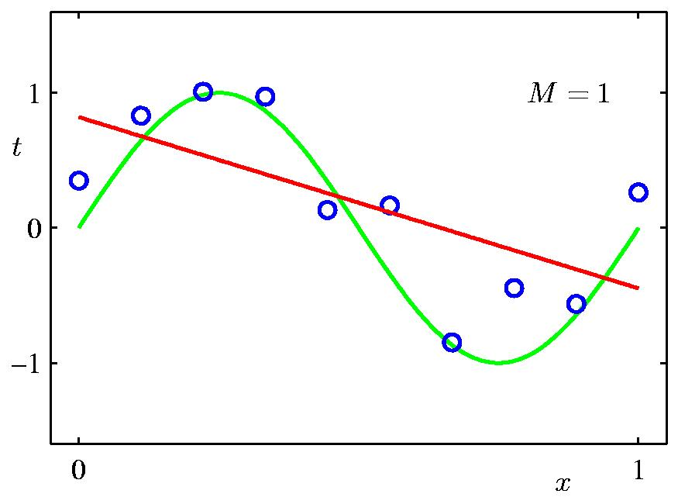
1st Order Polynomial

Slide 7
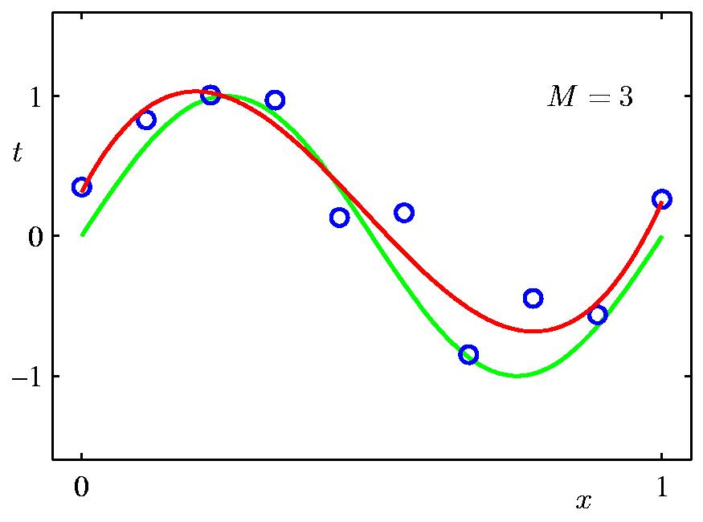
3rd Order Polynomial

Slide 8
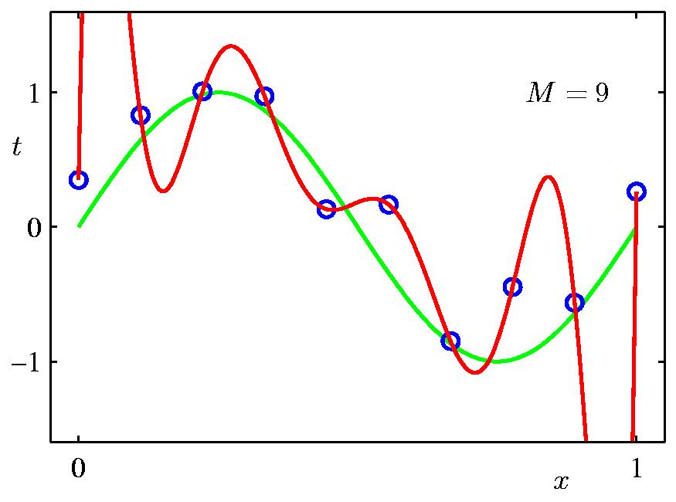
9th Order Polynomial

Slide 9
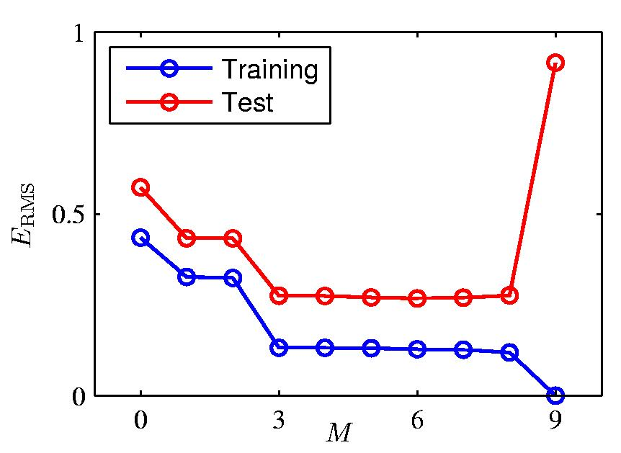
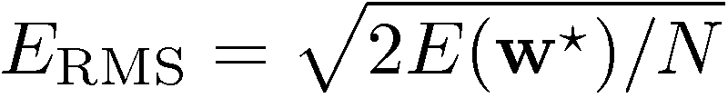
Over-fitting
Root-Mean-Square (RMS) Error:

Slide 10
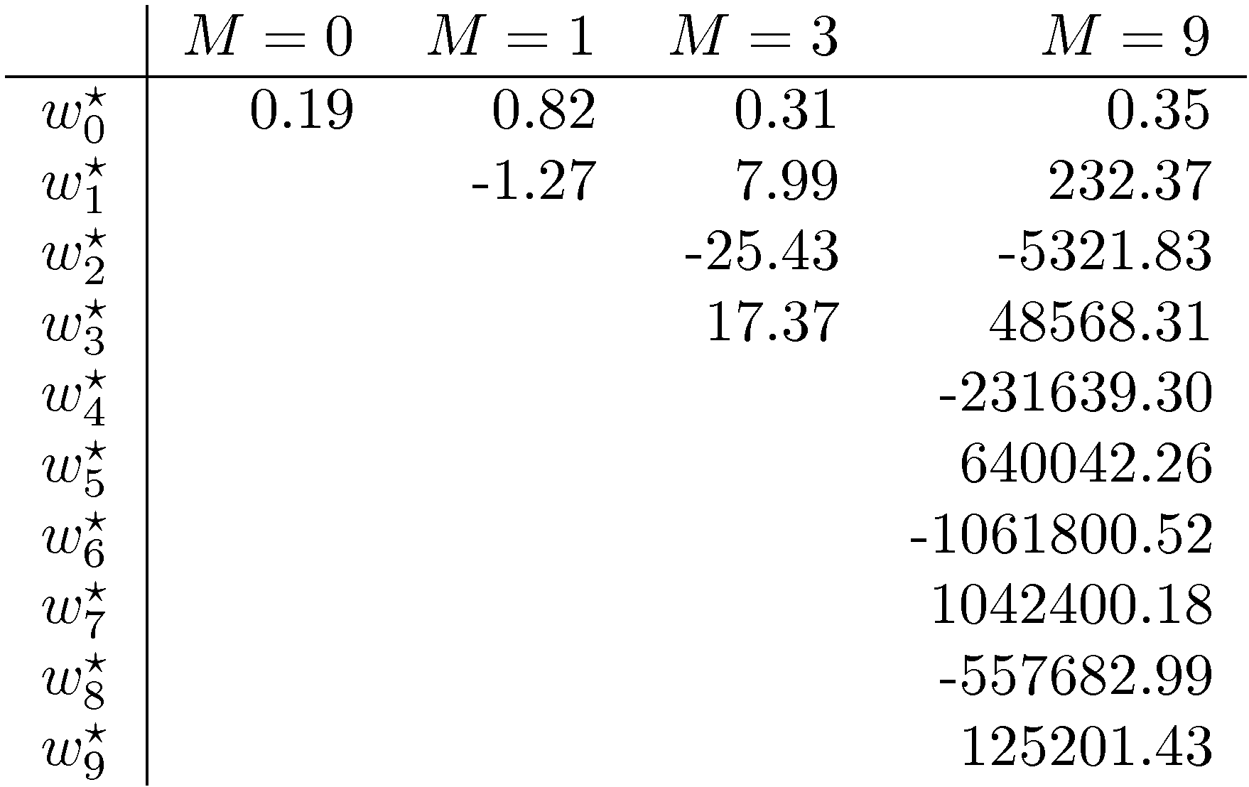
Polynomial Coefficients

Slide 11

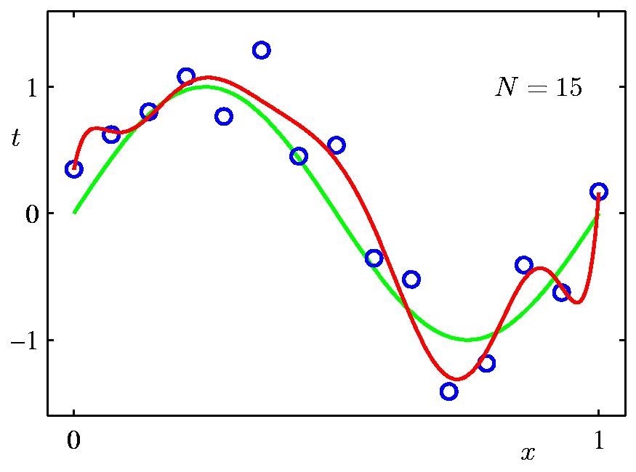
Data Set Size:
9th Order Polynomial

Slide 12

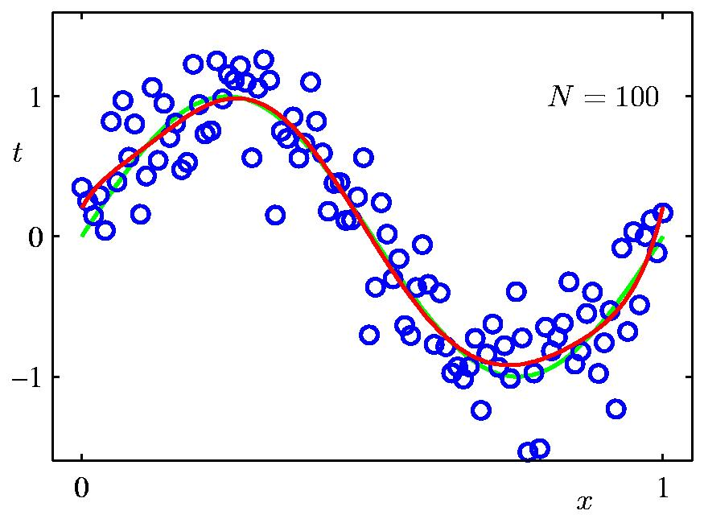
Data Set Size:
9th Order Polynomial

Slide 13
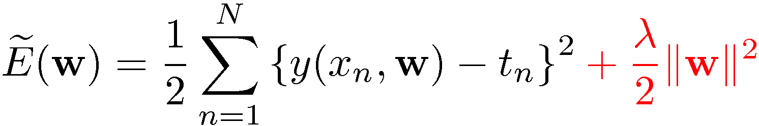
Regularization
Penalize large coefficient values

Slide 14

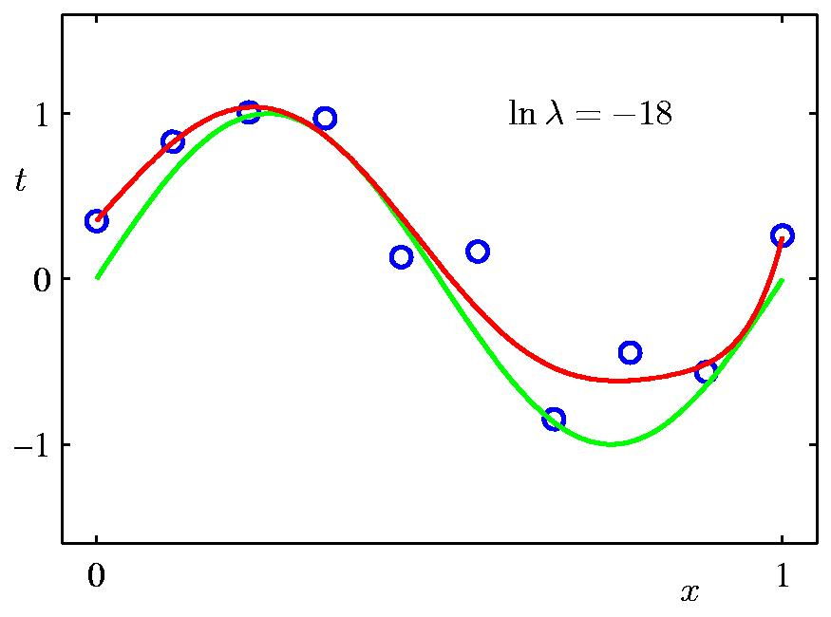
Regularization:

Slide 15

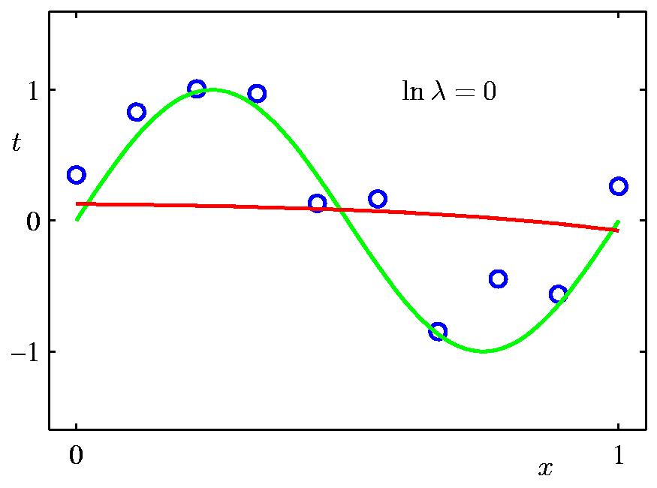
Regularization:

Slide 16


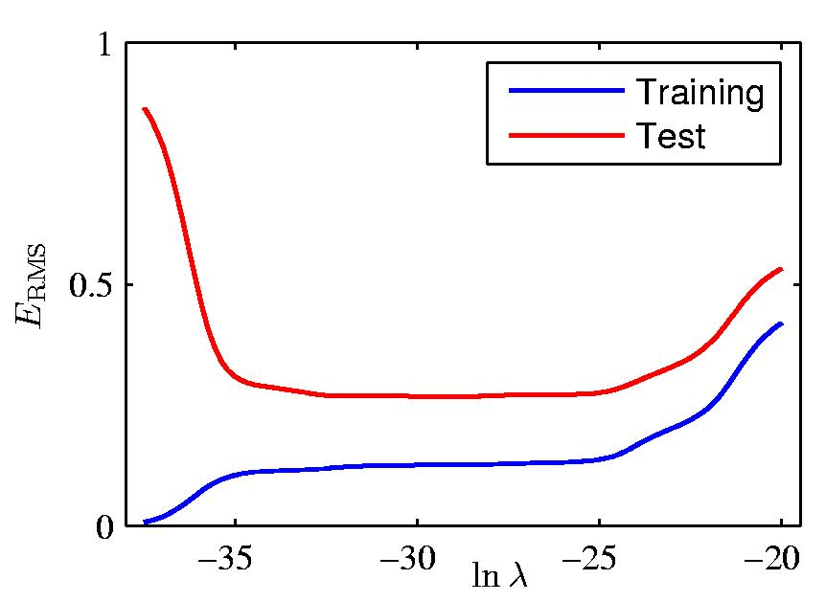
Regularization: vs.

Slide 17
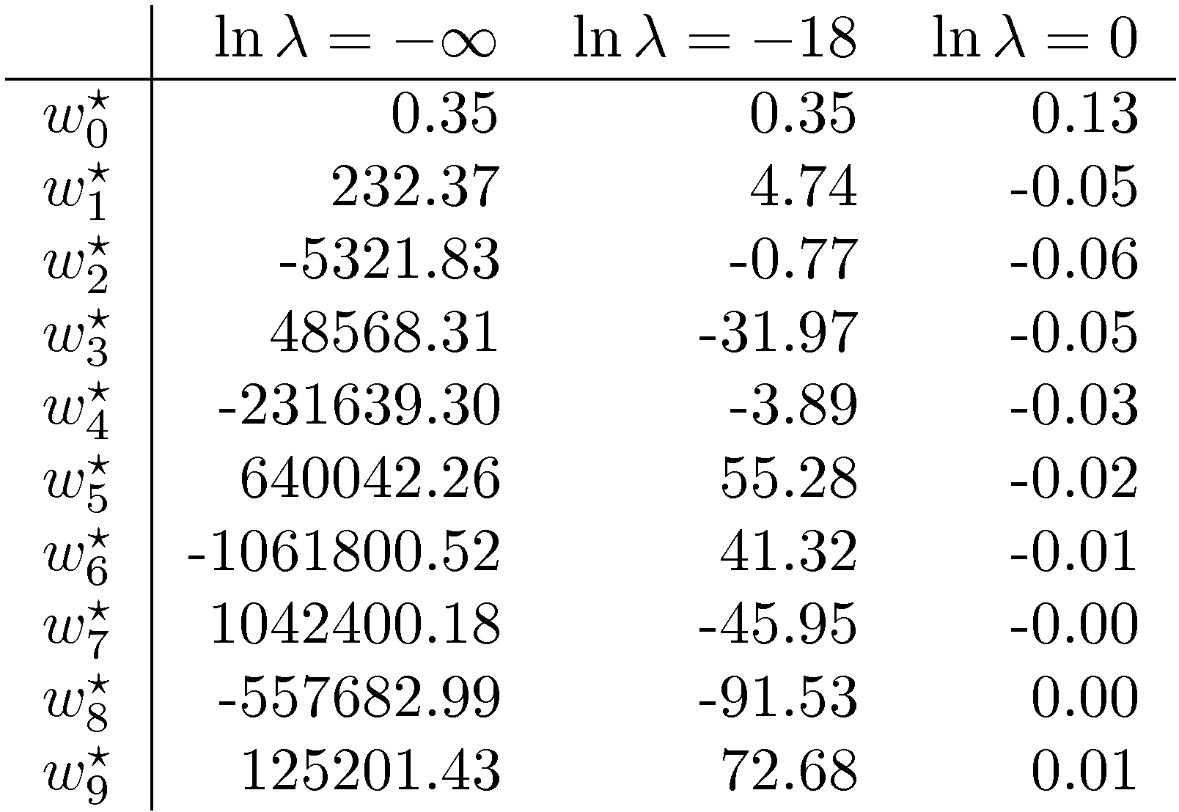
Polynomial Coefficients

Slide 18
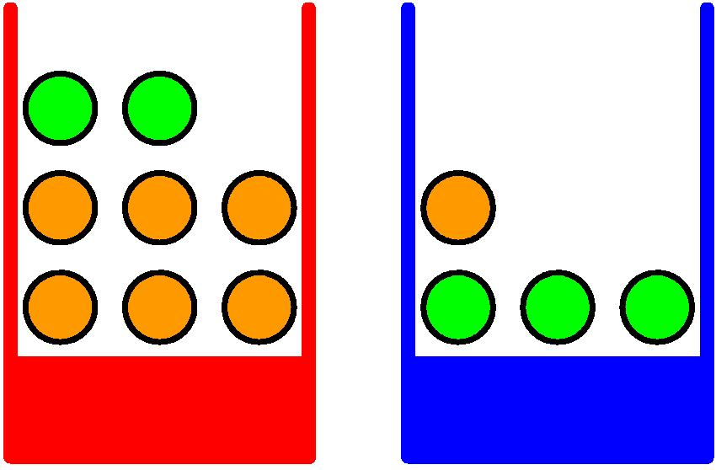
Probability Theory
Apples and Oranges

Slide 19
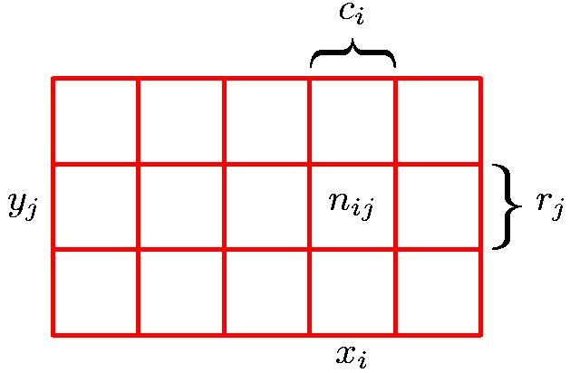
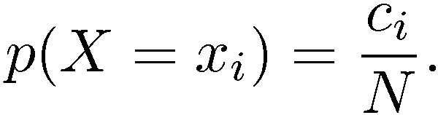
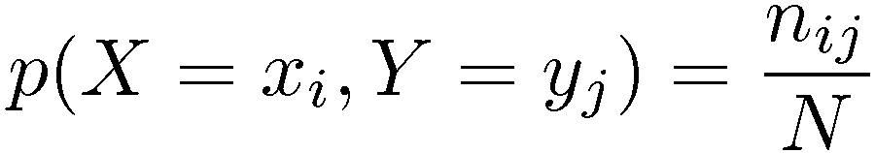
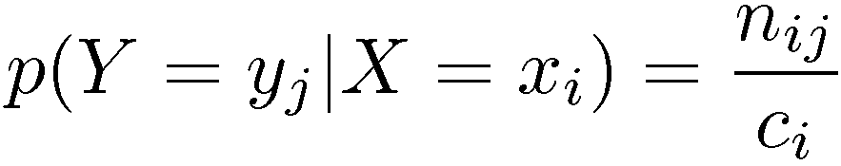
Probability Theory
Marginal Probability
Conditional Probability
Joint Probability

Slide 20
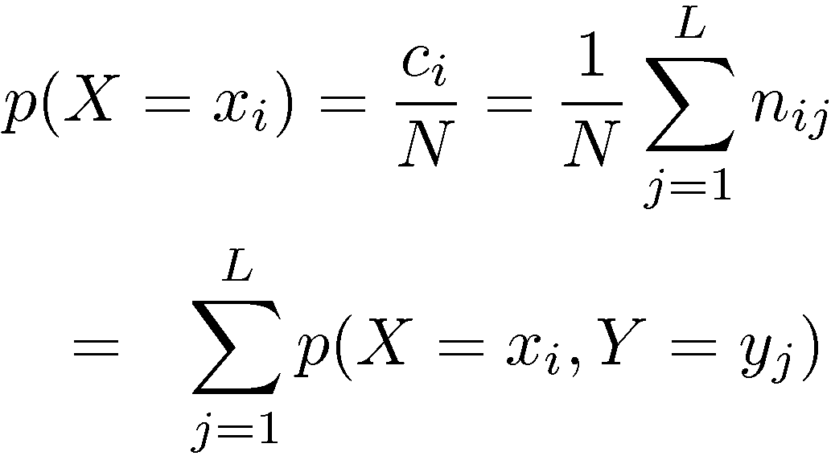
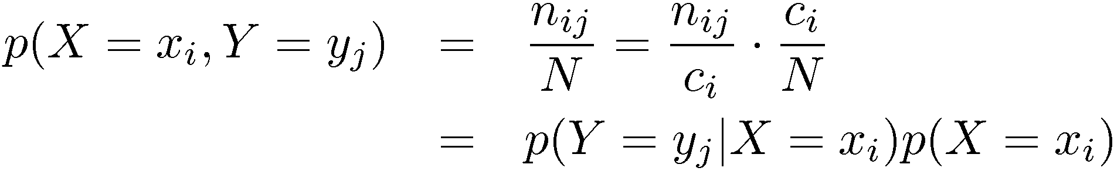
Probability Theory
Sum Rule
Product Rule

Slide 21
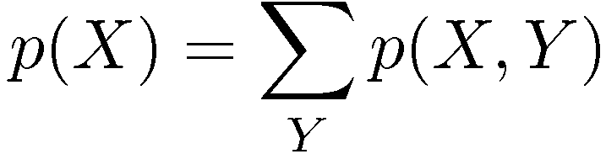

The Rules of Probability
Sum Rule
Product Rule

Slide 22
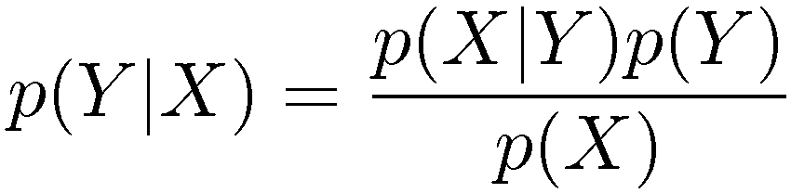
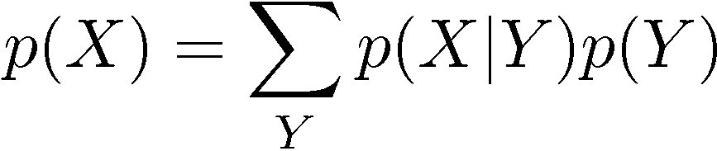
Bayes’ Theorem
posterior ∝ likelihood × prior

Slide 23
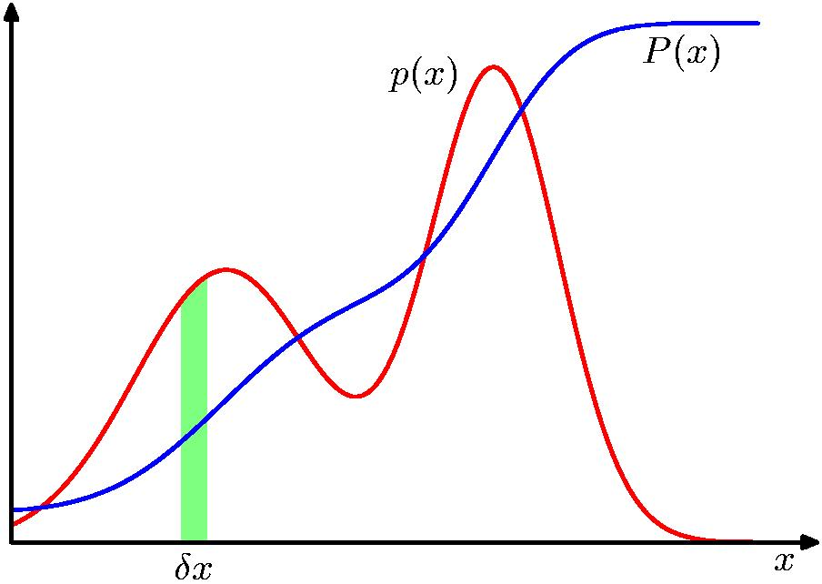
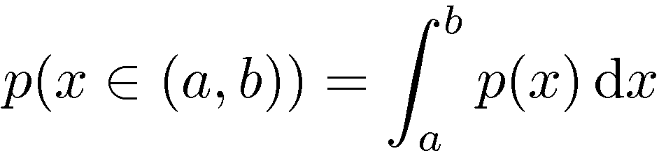
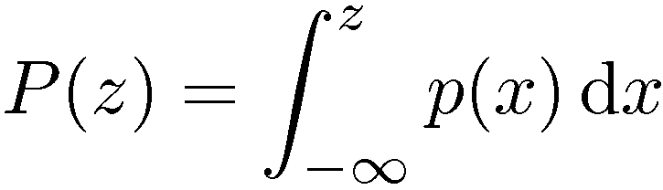
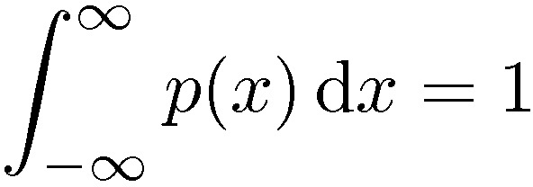

Probability Densities

Slide 24
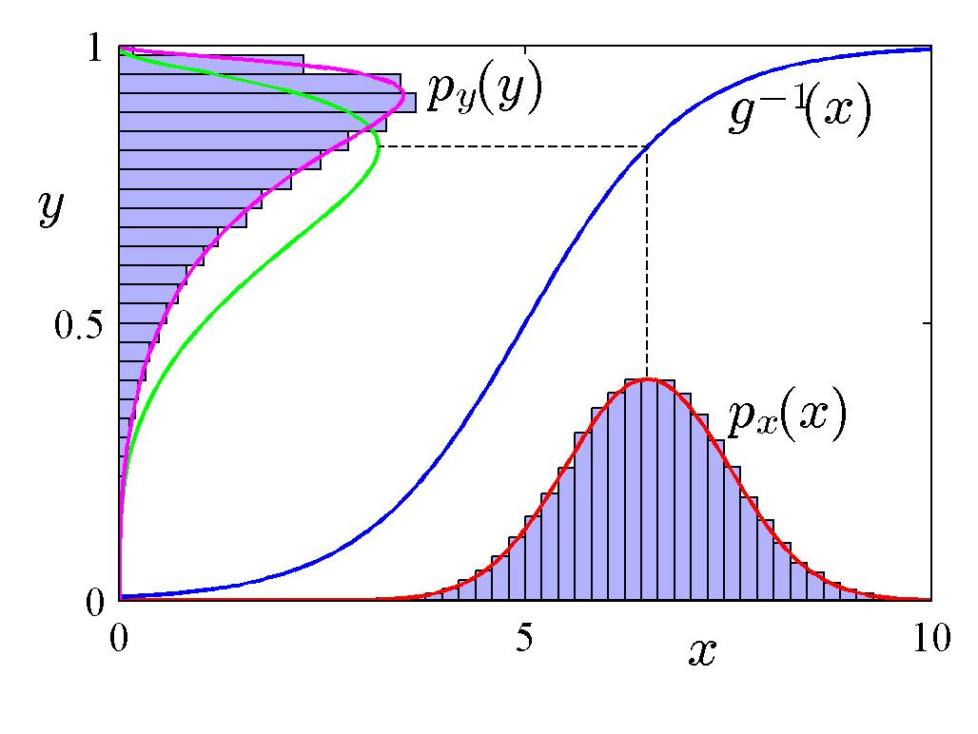
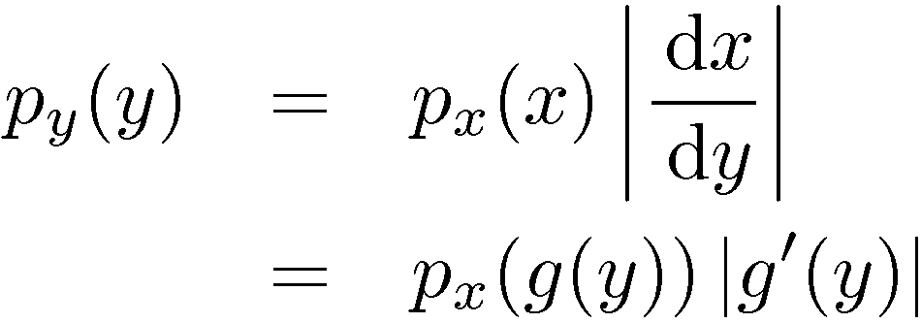
Transformed Densities

Slide 25
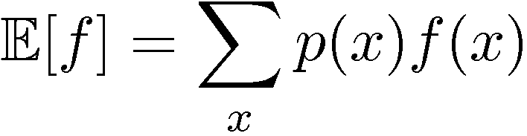
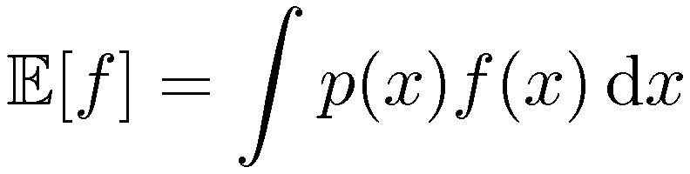
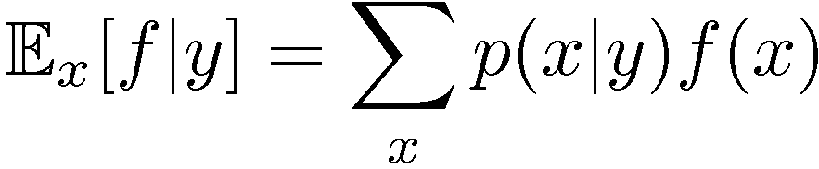
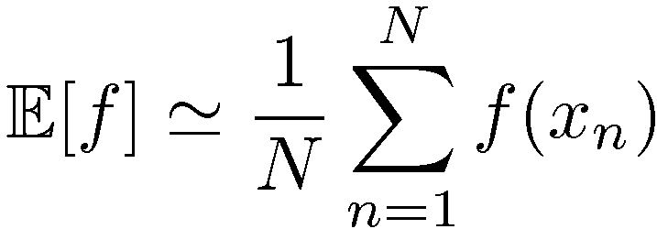
Expectations
Conditional Expectation
(discrete)
Approximate Expectation
(discrete and continuous)

Slide 26
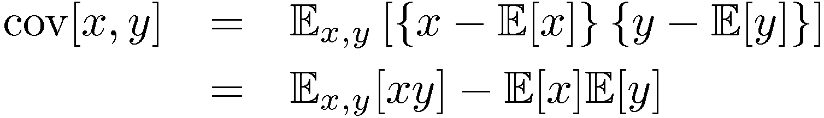
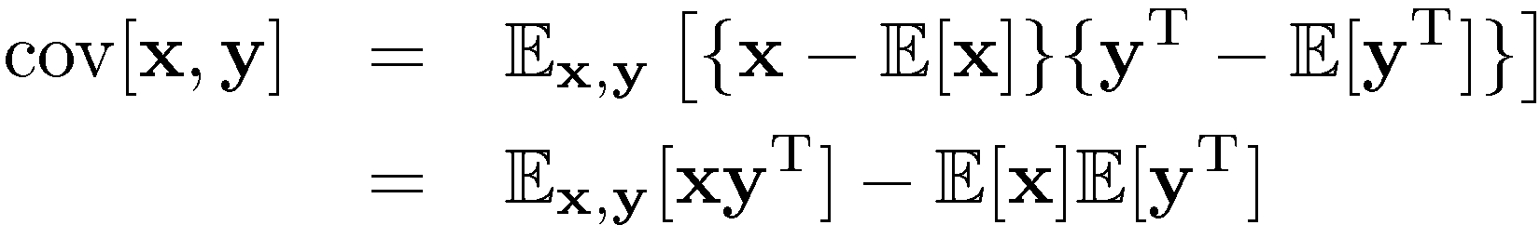
Variances and Covariances

Slide 27
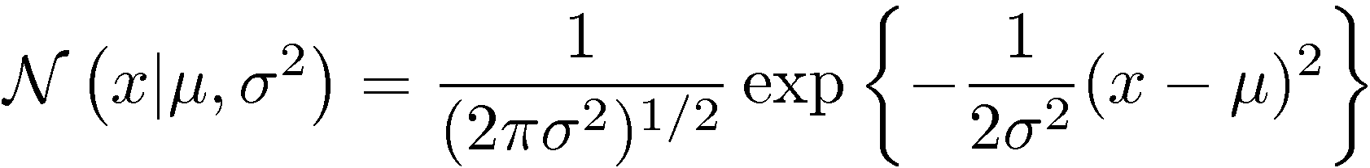
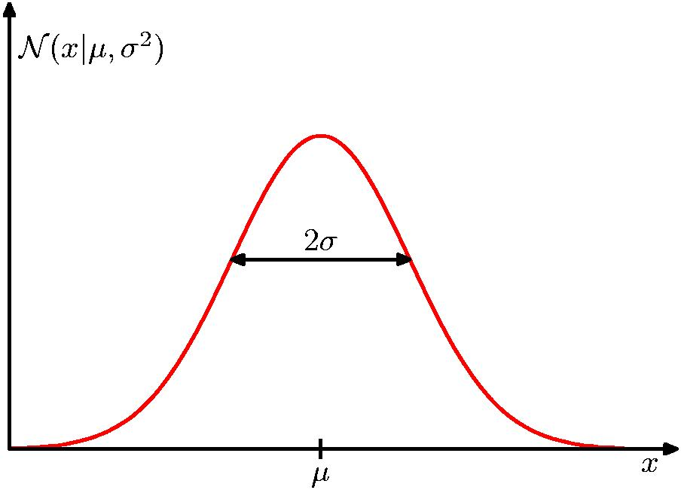
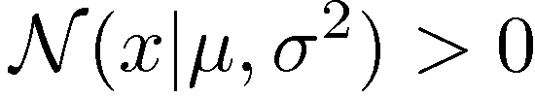
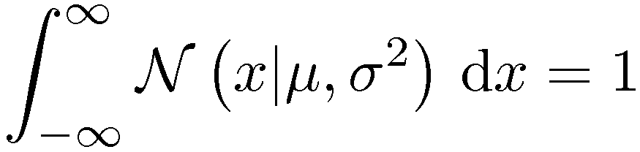
The Gaussian Distribution

Slide 28
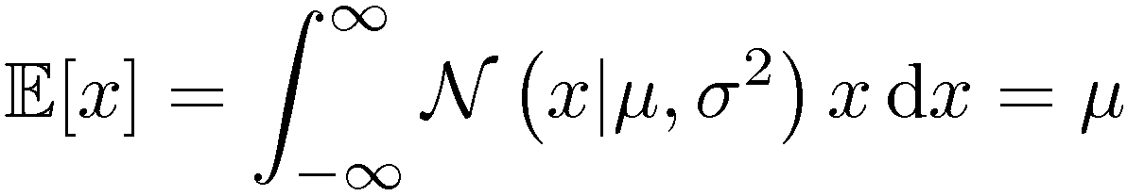
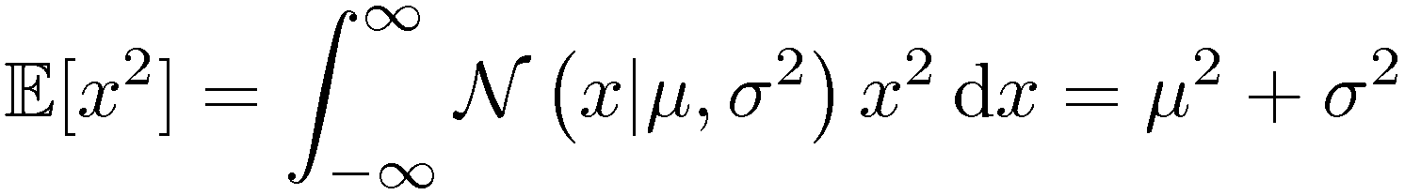
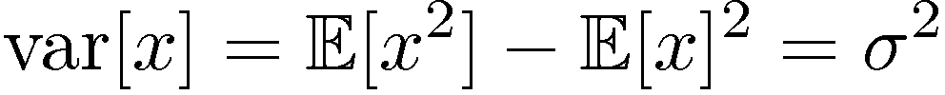
Gaussian Mean and Variance

Slide 29
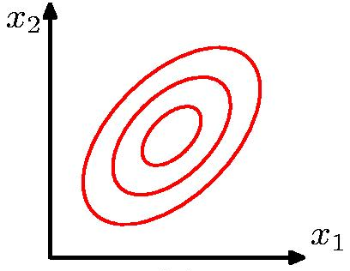
The Multivariate Gaussian

Slide 30
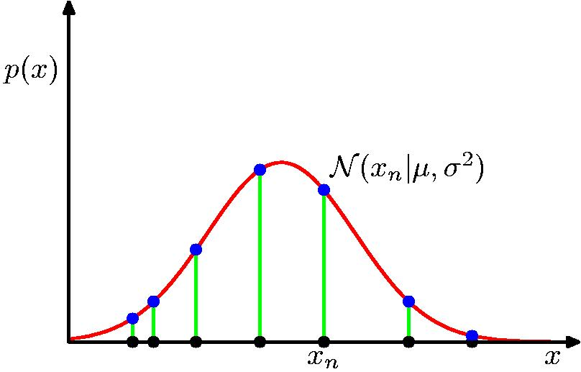

Gaussian Parameter Estimation
Likelihood function

Slide 31



Maximum (Log) Likelihood

Slide 32






Properties of and

Slide 33


Curve Fitting Re-visited

Slide 34





Maximum Likelihood
Determine by minimizing sum-of-squares error, .

Slide 35

Predictive Distribution

Slide 36



MAP: A Step towards Bayes
Determine by minimizing regularized sum-of-squares error, .

Slide 37




Bayesian Curve Fitting

Slide 38

Bayesian Predictive Distribution

Slide 39

Model Selection
Cross-Validation

Slide 40



Curse of Dimensionality

Slide 41


Curse of Dimensionality
Polynomial curve fitting, M = 3
Gaussian Densities in higher dimensions

Slide 42


Decision Theory
Inference step
Determine either or .
Decision step
For given x, determine optimal t.

Slide 43


Minimum Misclassification Rate

Slide 44

Minimum Expected Loss
Example: classify medical images as ‘cancer’ or ‘normal’
Decision
Truth

Slide 45



Minimum Expected Loss
Regions are chosen to minimize

Slide 46

Reject Option

Slide 47
Why Separate Inference and Decision?
Minimizing risk (loss matrix may change over time)
Reject option
Unbalanced class priors
Combining models

Slide 48

Decision Theory for Regression
Inference step
Determine .
Decision step
For given x, make optimal prediction, y(x), for t.
Loss function:

Slide 49



The Squared Loss Function

Slide 50


Generative vs Discriminative
Generative approach:
Model
Use Bayes’ theorem
Discriminative approach:
Model directly

Slide 51

Entropy
Important quantity in
coding theory
statistical physics
machine learning

Slide 52

Entropy
Coding theory: x discrete with 8 possible states; how many bits to transmit the state of x?
All states equally likely

Slide 53



Entropy

Slide 54



Entropy
In how many ways can N identical objects be allocated M bins?
Entropy maximized when

Slide 55


Entropy

Slide 56




Differential Entropy
Put bins of width ¢ along the real line
Differential entropy maximized (for fixed ) when
in which case

Slide 57


Conditional Entropy

Slide 58




The Kullback-Leibler Divergence

Slide 59

Mutual Information

