Slide 1


Dependency Injection Using Autofac
Amit Dhir
Notes:
Good morning everyone, Let me start this session with one question, How many of you have already used dependency injection? Set Expectation - Level 100. DI intro -> Pros and cons -> DI Types -> Autofac -> container -> register dependency -> build container -> resolve those dependency -> lifetime scope.
My name is Amit, i am working for Technossus from past 8 years, Love design patterns.

Slide 2
DI Types
Constructor Injection.
Property Injection.
Method Injection.

Slide 3
Lifetime scope
Instance per dependency.
Instance per lifetime scope.
Single instance.
Instance per request.

Slide 4
DI Frameworks
Autofac
Ninject
Unity
Castle Windsor

Slide 5
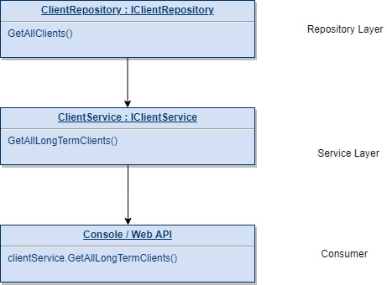

Slide 6
DEMO

Slide 7
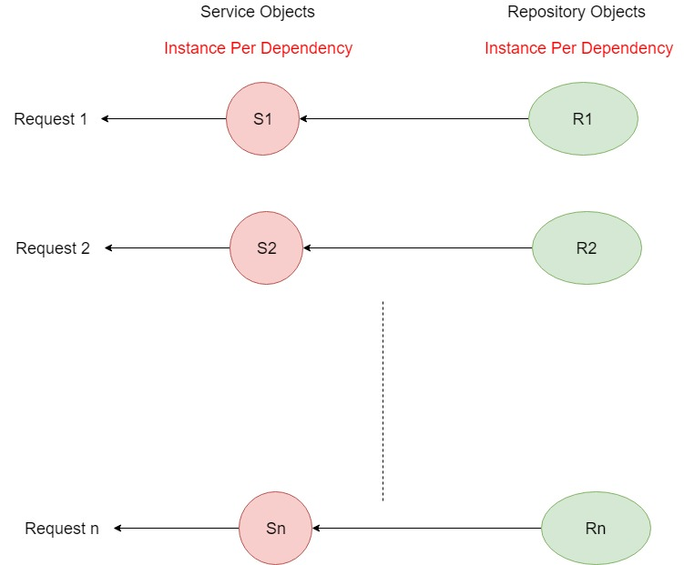

Slide 8
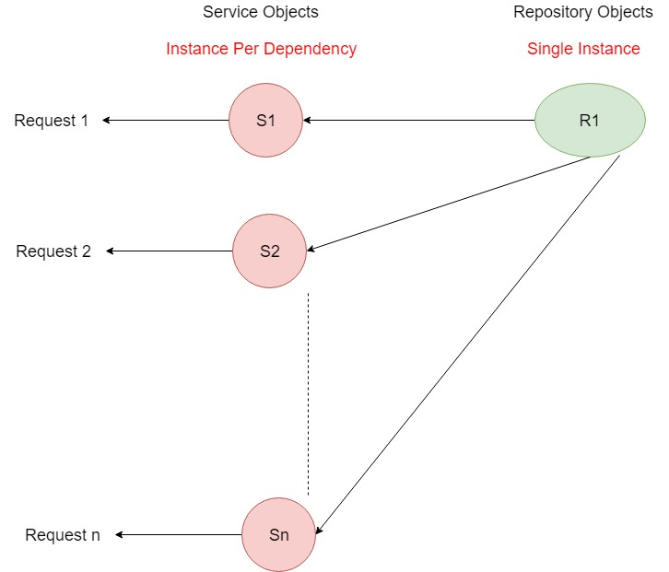

Slide 9
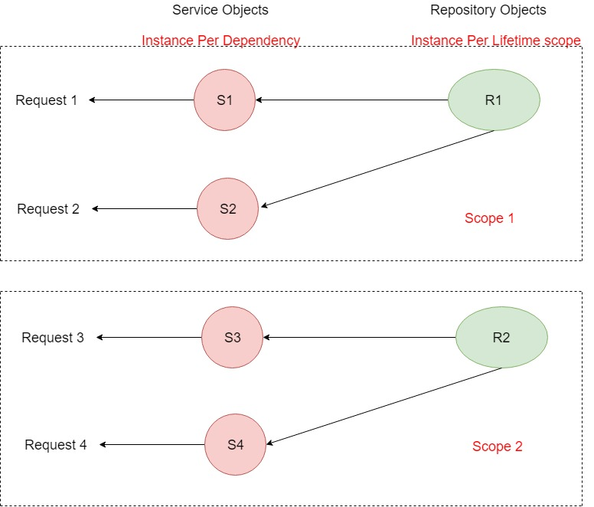

Slide 10
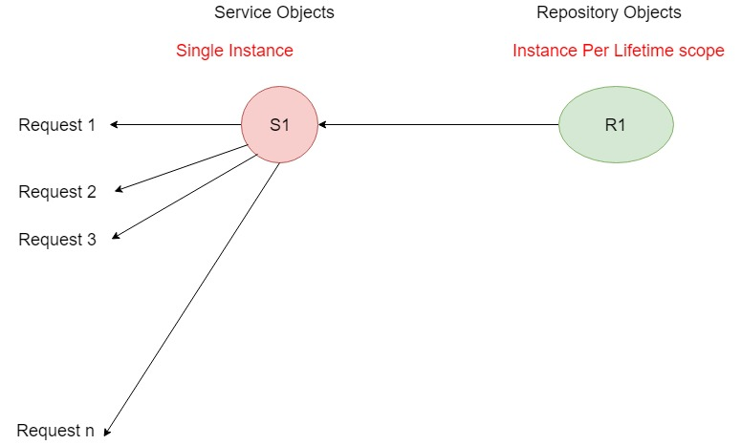

Slide 11
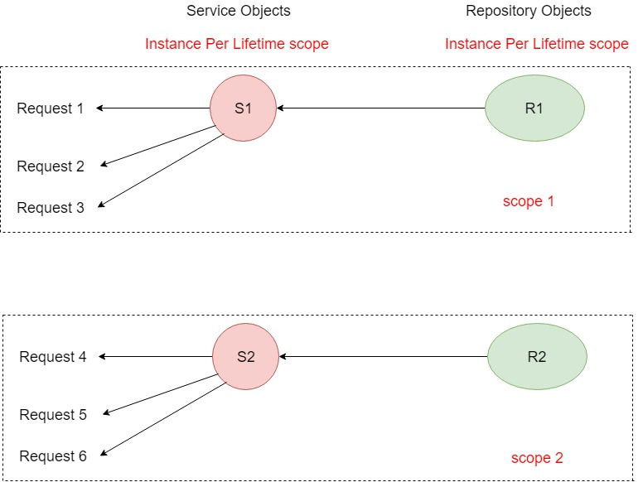

Slide 12
References
https://autofaccn.readthedocs.io/en/latest/lifetime/instance-scope.html
https://autofaccn.readthedocs.io/en/latest/faq/per-request-scope.html
https://autofaccn.readthedocs.io/en/latest/integration/index.html

Slide 13
git clone https://github.com/talktoamitdhir/DependencyInjection.git
QUESTIONS???

