Slide 1


Understanding Kubernetes
Amit Dhir
Principal Consultant

Slide 2
Agenda
What is Kubernetes?
Automatic deployment, Scaling , Management of containerized application.
Terminology
Why we need Kubernetes and its components.
Walkthrough of a demo app and setting up of local environment.
Docker file and accessing docker image from the docker hub.
Running a docker container on local machine also via Kubernetes.
Hands on.
Demonstration of Pod, Services, Replica set, Deployments, probes and Config maps and secrets.
References, Summary and QA.

Slide 3
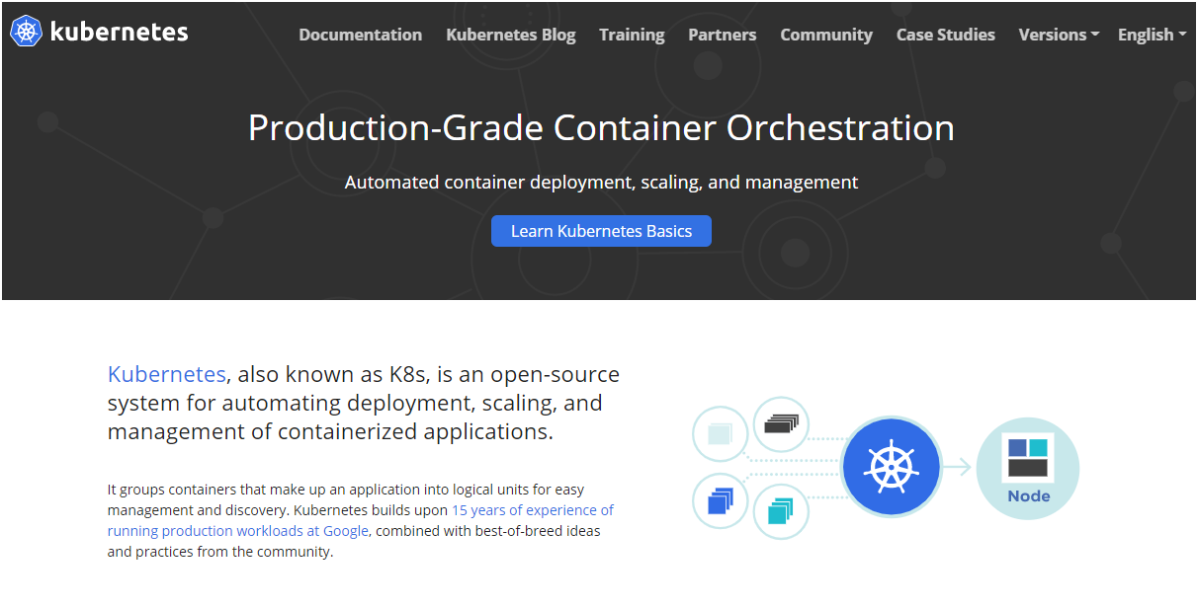

Slide 4
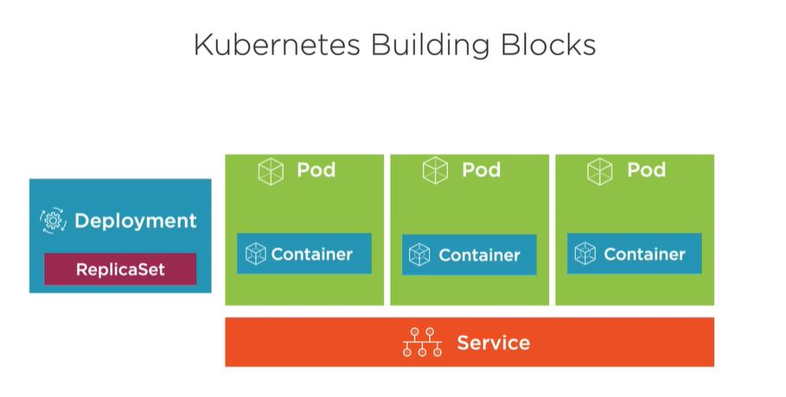
Terminology ( K8s objects )
Pod
Container
Node
Services and Load balancing
Deployments and Replica set.
Auto scaling and self healing.
Config Map and secrets

Slide 5
Why we need Kubernetes
Service discovery and load balancing
Storage orchestration
Automated rollouts and rollbacks
Automatic bin packing
Self-healing
Secret and configuration management

Slide 6
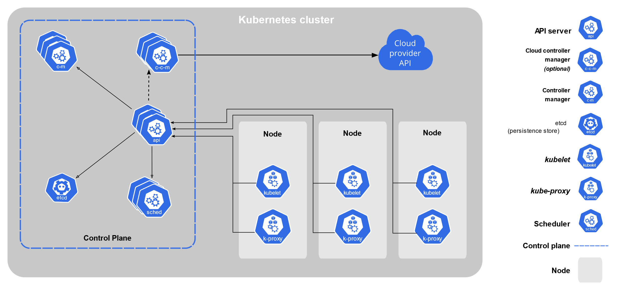

Slide 7
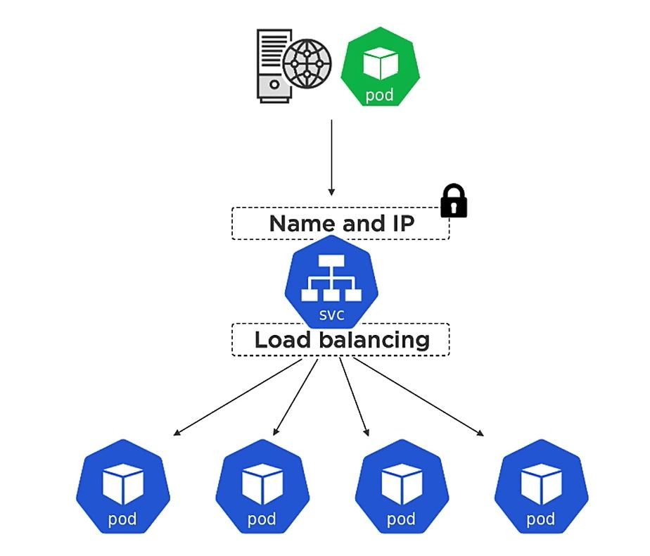
Pods and Service

Slide 8
DEMO APP

Slide 9
References
Kubernetes https://kubernetes.io/docs/concepts/overview/what-is-kubernetes/ https://kubernetes.io/docs/concepts/overview/ Docker Hub
https://hub.docker.com/ Plural Sight course
https://app.pluralsight.com/library/courses/kubernetes-getting-started/table-of-contents
https://app.pluralsight.com/library/courses/docker-kubernetes-big-picture/table-of-contents

Slide 10
SUMMARY
https://github.com/talktoamitdhir/kube
QUESTIONS?

