Slide 1


Understanding Kubernetes
Amit Dhir
Principal Consultant

Slide 2
Agenda
What is Kubernetes?
Automatic deployment, Scaling , Management of containerized application.
Walkthrough of a demo app and setting up of local environment.
Docker file and accessing docker image from the docker hub.
Running a docker container on local machine also via Kubernetes.
Kubernetes
Theory
Container, Pod, Services, Replica set, Deployments and Config maps.
Demonstration of same using demo application using Declarative manner ( using manifest file ) .
Summary and QA

Slide 3
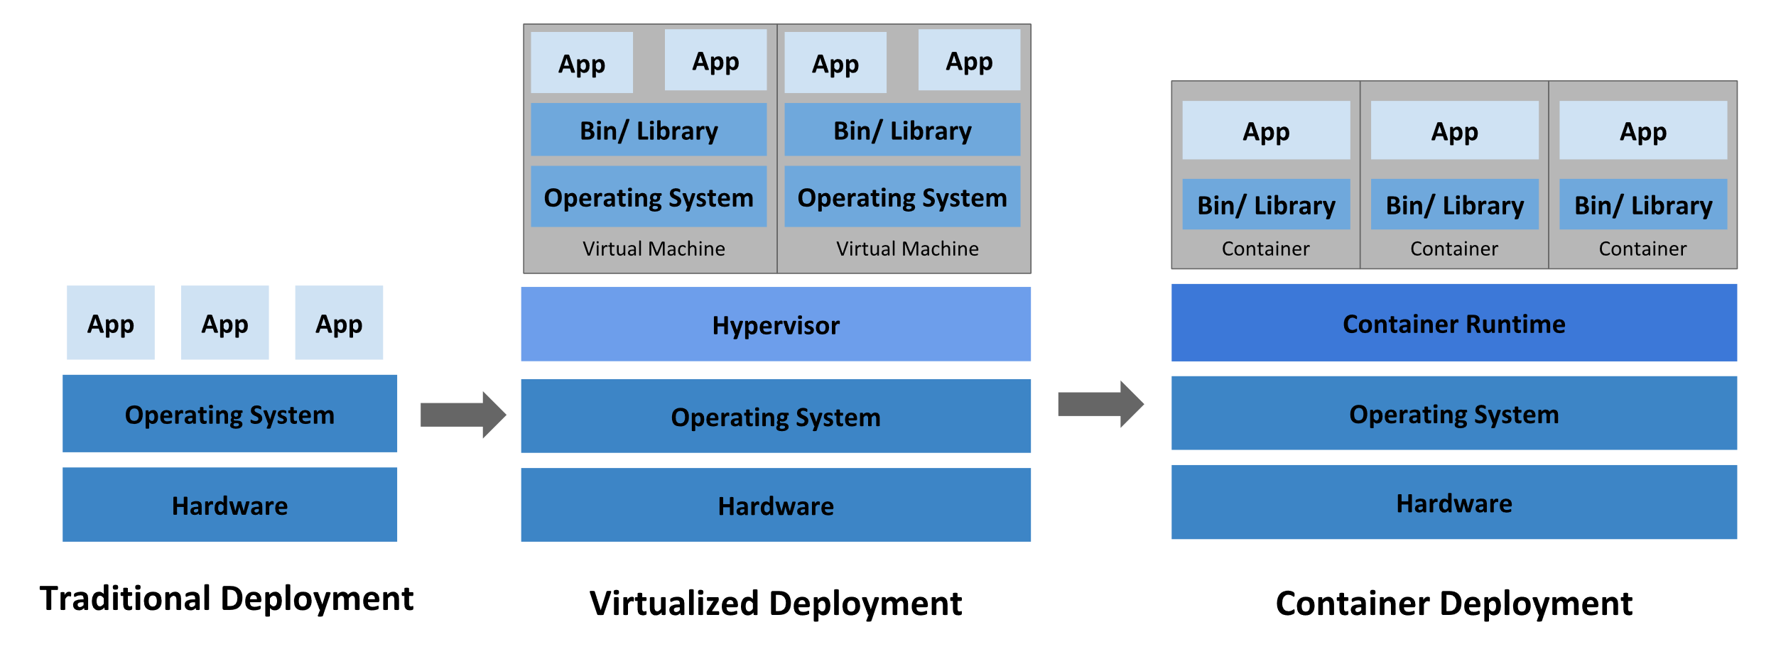
Going back in time

Slide 4
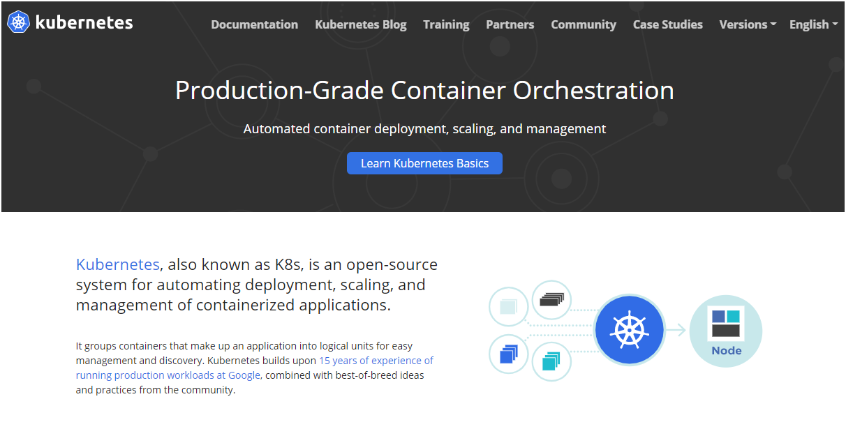

Slide 5
DEMO APP

Slide 6
Pods
Deployments and Replica set
Services
Liveliness and readiness probe
Load balancing
Config Map and secrets
Auto scaling and self healing

Slide 7
References
Kubernetes https://kubernetes.io/docs/concepts/overview/what-is-kubernetes/ https://kubernetes.io/docs/concepts/overview/ Docker Hub
https://hub.docker.com/ Plural Sight course
https://app.pluralsight.com/library/courses/kubernetes-getting-started/table-of-contents
https://app.pluralsight.com/library/courses/docker-kubernetes-big-picture/table-of-contents

Slide 8
SUMMARY
https://github.com/talktoamitdhir/kube
QUESTIONS?

