Slide 1
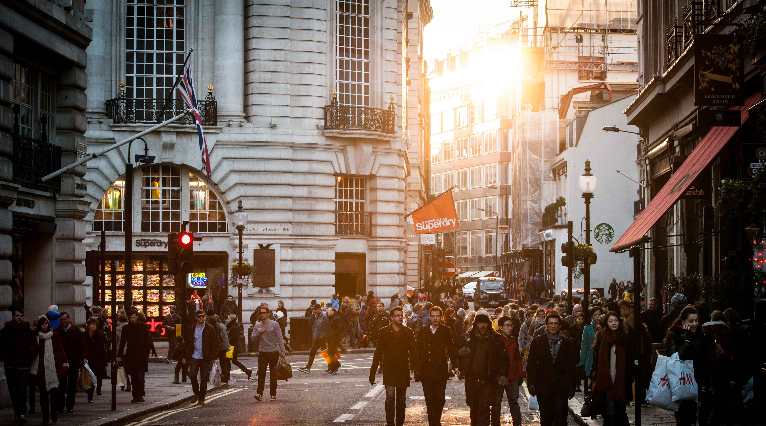


Slide 2
Agenda
What is Kubernetes?
Automatic deployment.
Scaling.
Management of containerized application.
Explanation of demo.
Using socker image and accessing same via web browser.
Running a docker container on local machine.
How can we run same image via Kubernetes.

Slide 3
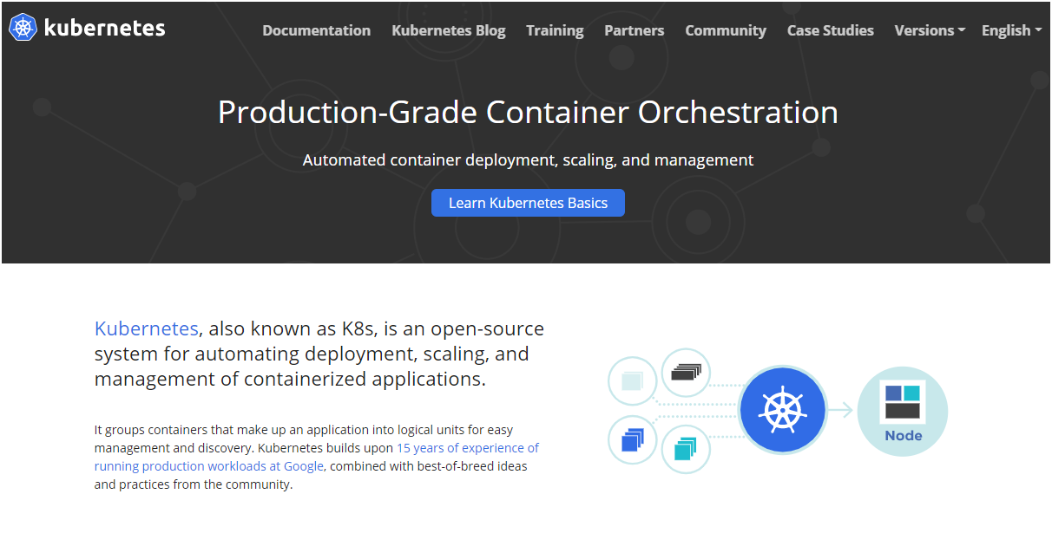

Slide 4
DEMO

Slide 5
QUESTIONS???

