Slide 1
eCommerce CMS
Critical Design Review
2013 March 19

Slide 2
eCommerce CMS – Project Goals
The eCommerce CMS will utilize several technologies including:
RESTful web service with HTTP and URI contracts
Database-driven (SQL or NoSQL, not sure which) inventory management
JavaScript front end and Java back end architecture
eCommerce CMS represents many of the technologies that we have learned at LMU and offers a specific community a real benefit that can be immediately realized.

Slide 3
eCommerce CMS – Description
Content Management System web application that can be launched from any major browser
Graphical User Interfaces
Shopping cart and checkout options with payment acceptance assistance
Easy Sales and Promotions management
Sales and business report generation
Target Audience: Small Business Owners looking to start their own eCommerce web site, but not looking to spend money on more expensive, monthly-paid solutions.

Slide 4
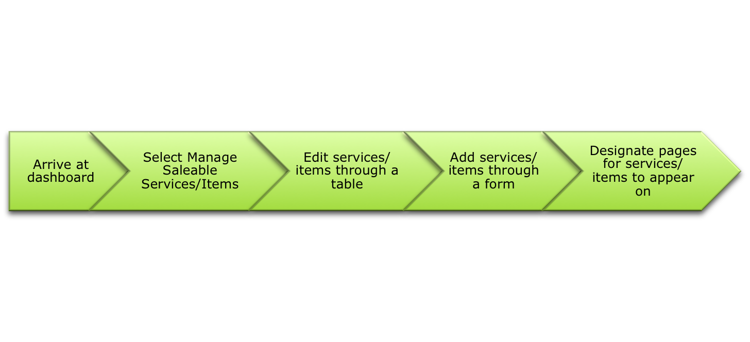
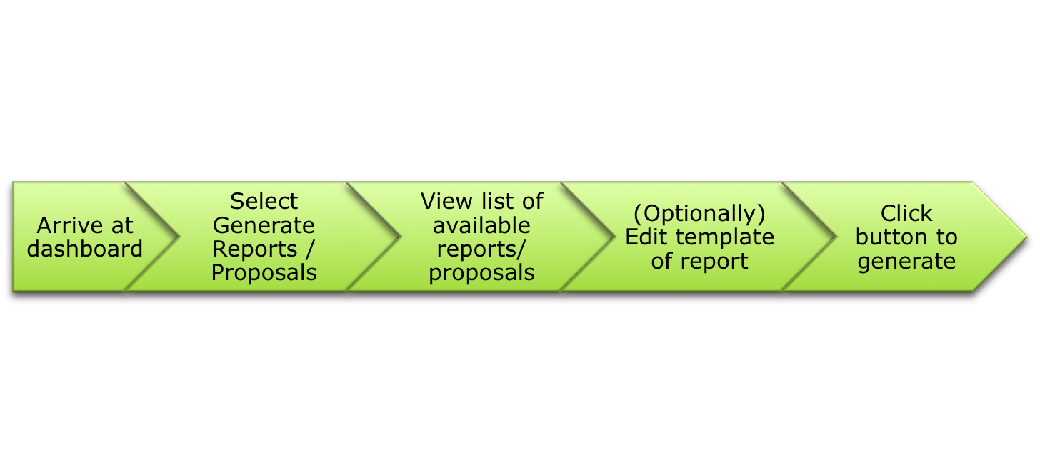
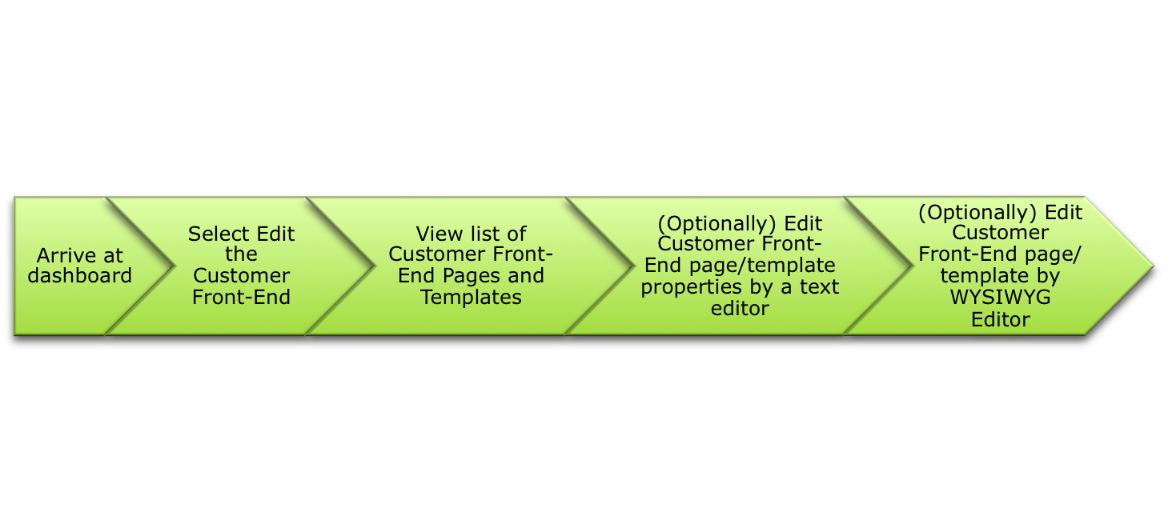
eCommerce CMS – Operations
User – Managing Saleable Services/Items
User – Generating Reports/Proposals
User – Edit the Customer Front-End

Slide 5
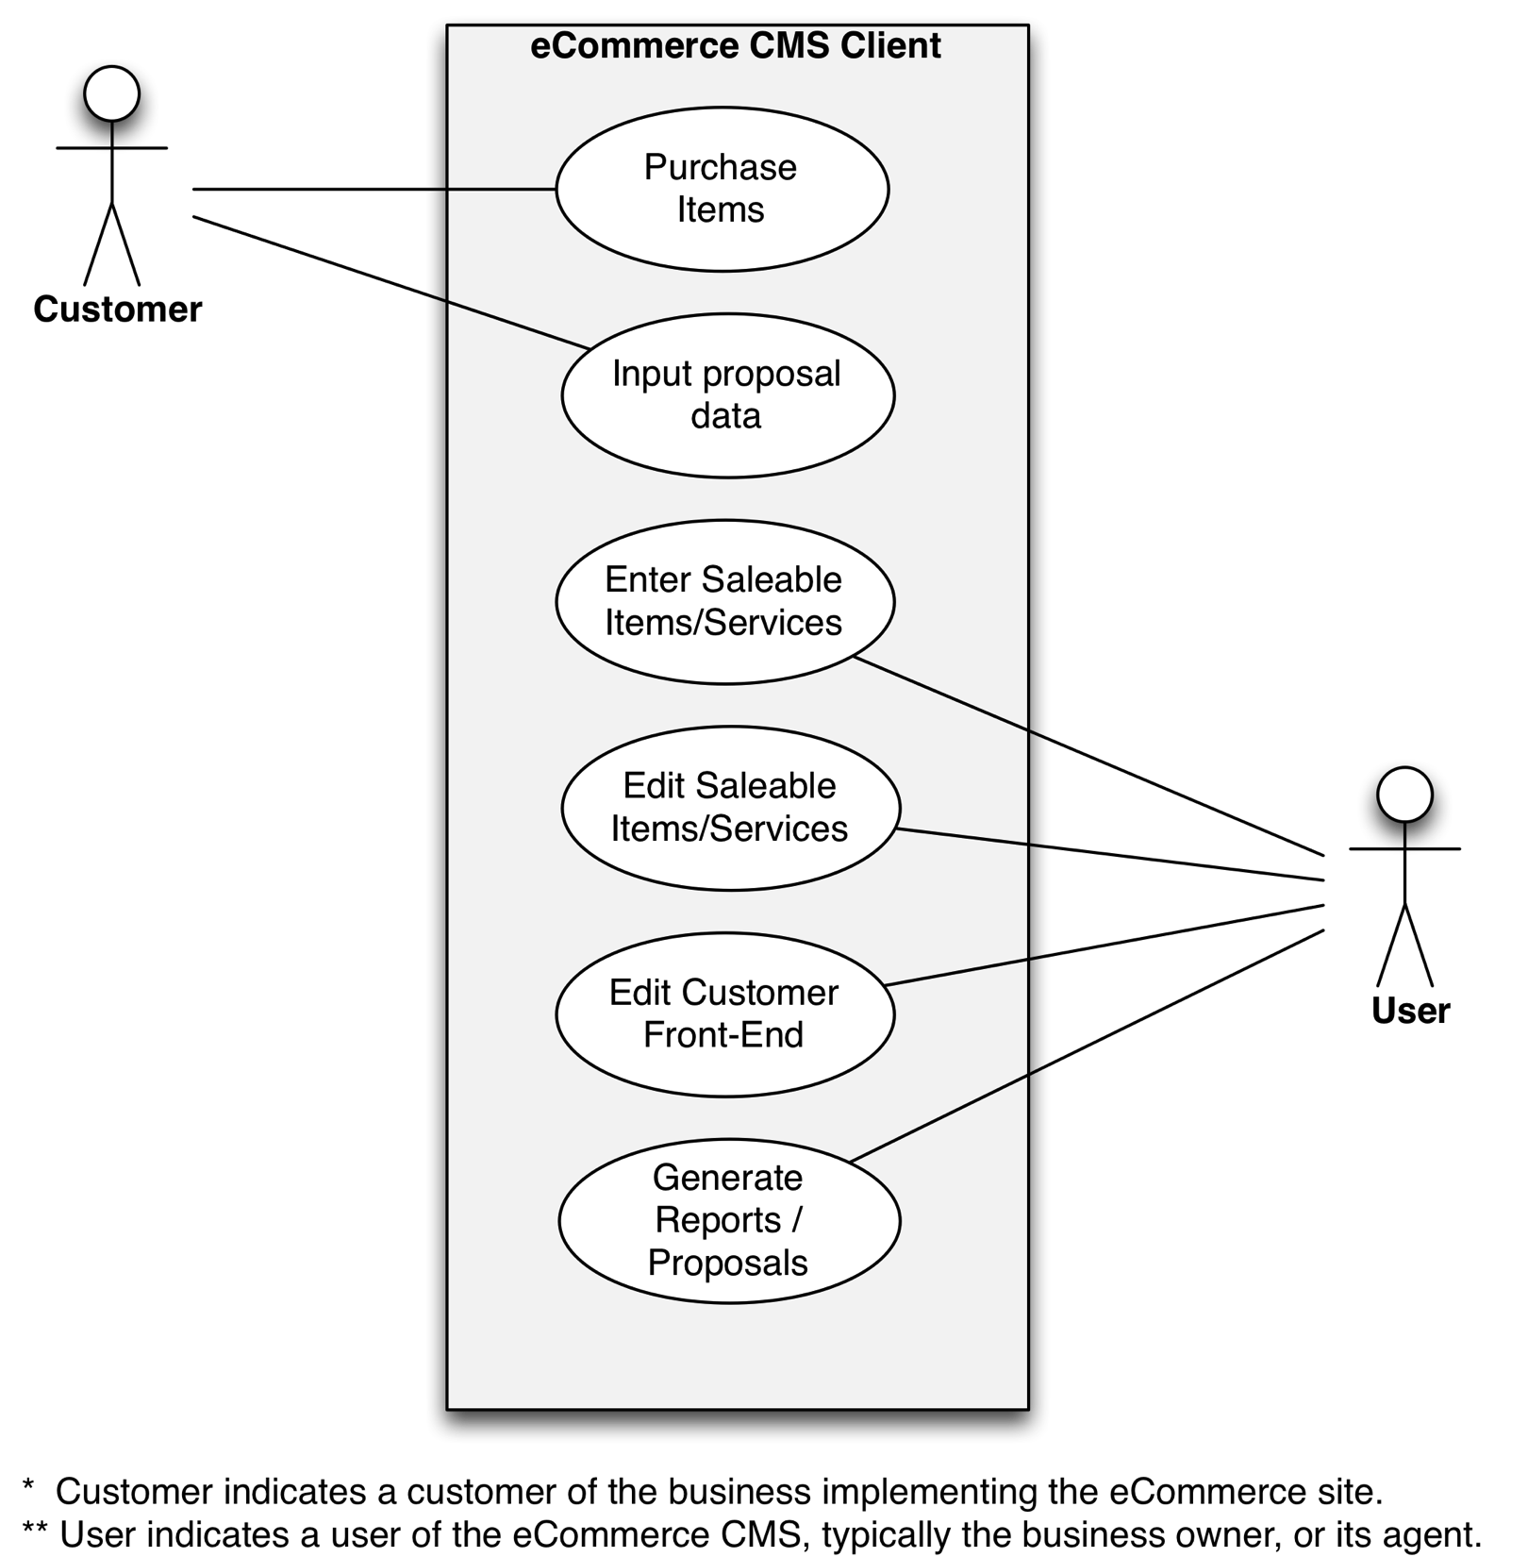
eCommerce CMS – Use Cases

Slide 6
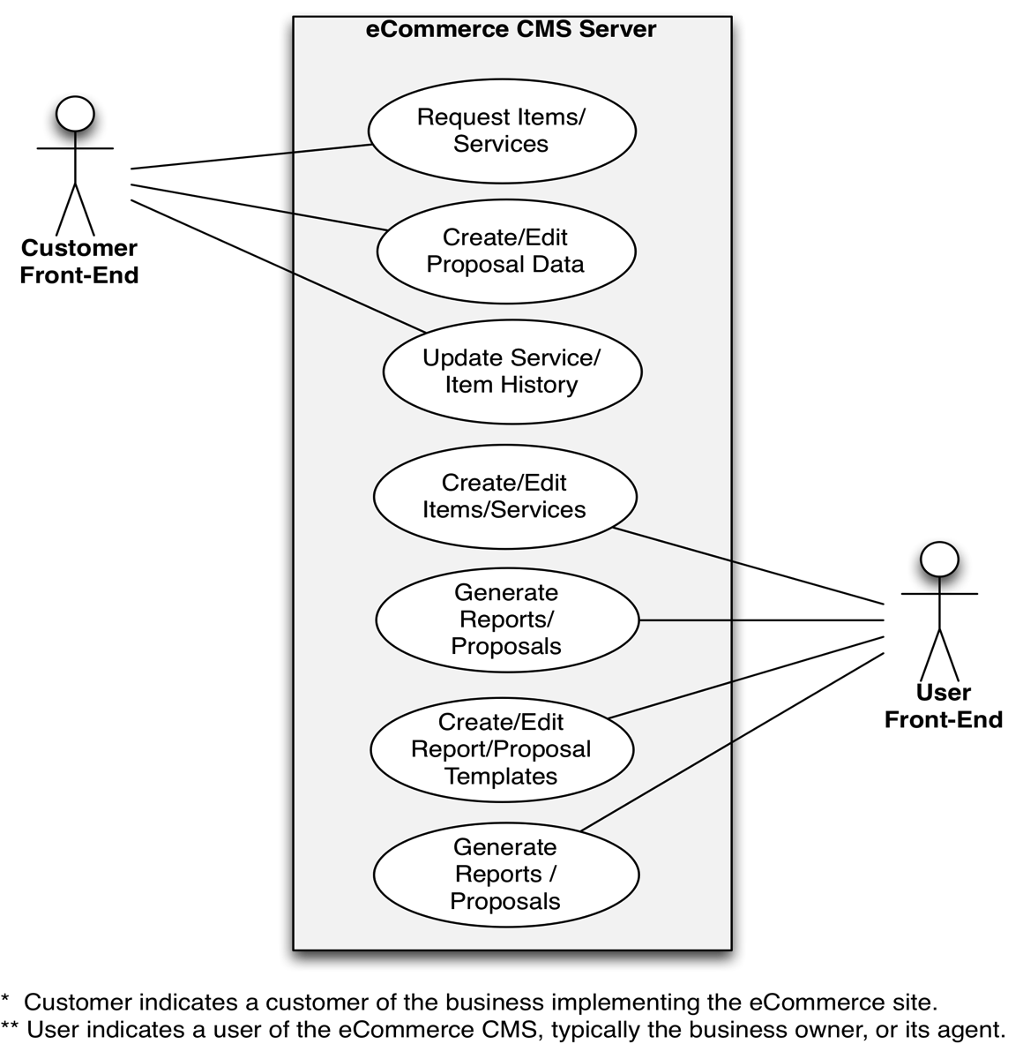
eCommerce CMS – Use Cases

Slide 7
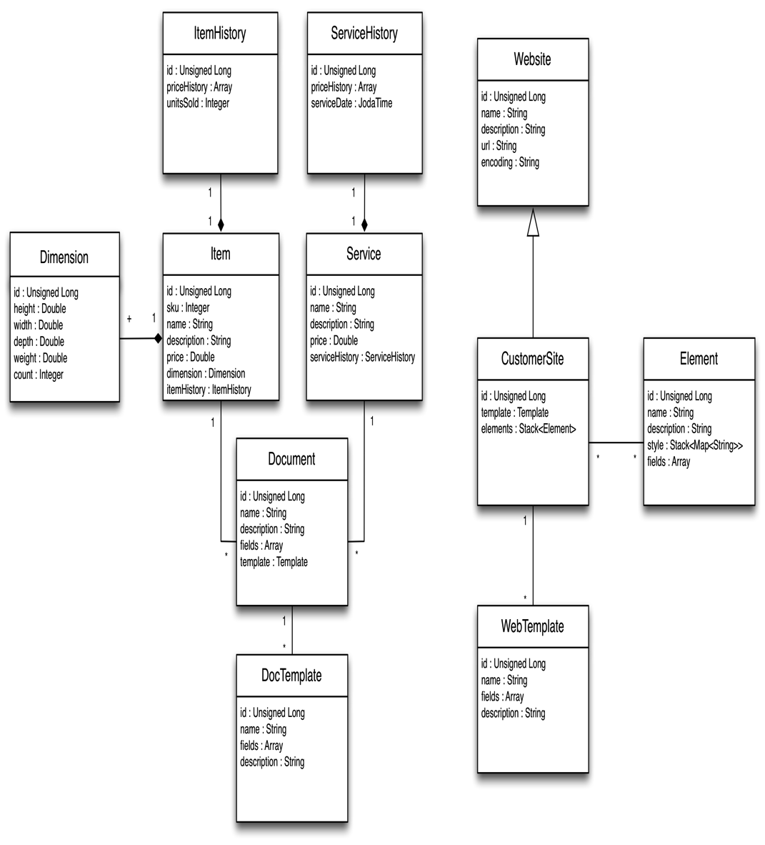
eCommerce CMS – Class Diagrams
* Client is in JavaScript and does not have classes.

Slide 8
eCommerce CMS – User Interface
To be determined…

Slide 9
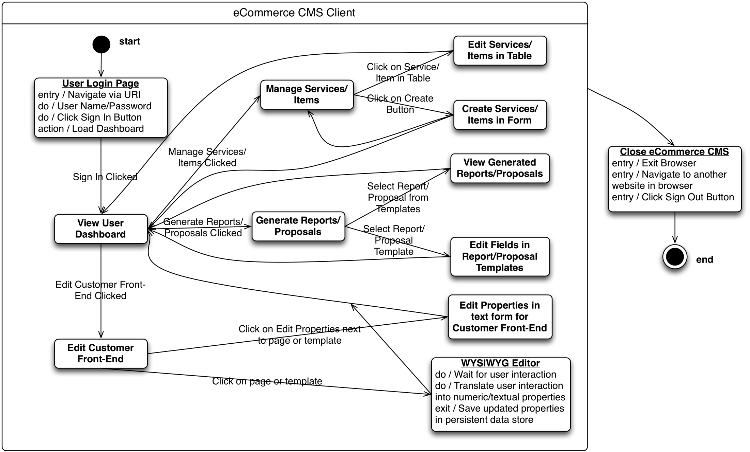
eCommerce CMS – State Diagram

Slide 10
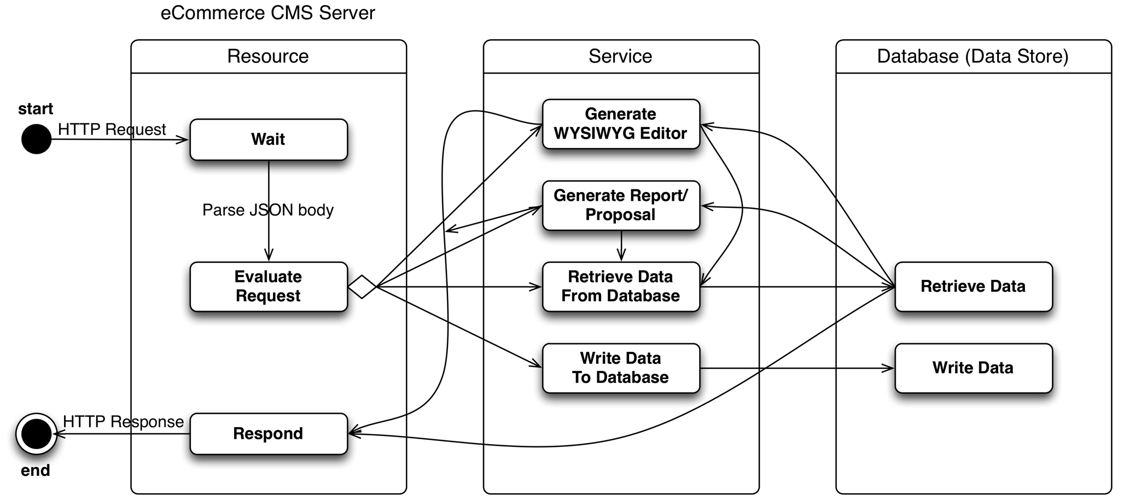
eCommerce CMS – State Diagram

Slide 11
eCommerce CMS - Challenges
Lack of time

Slide 12
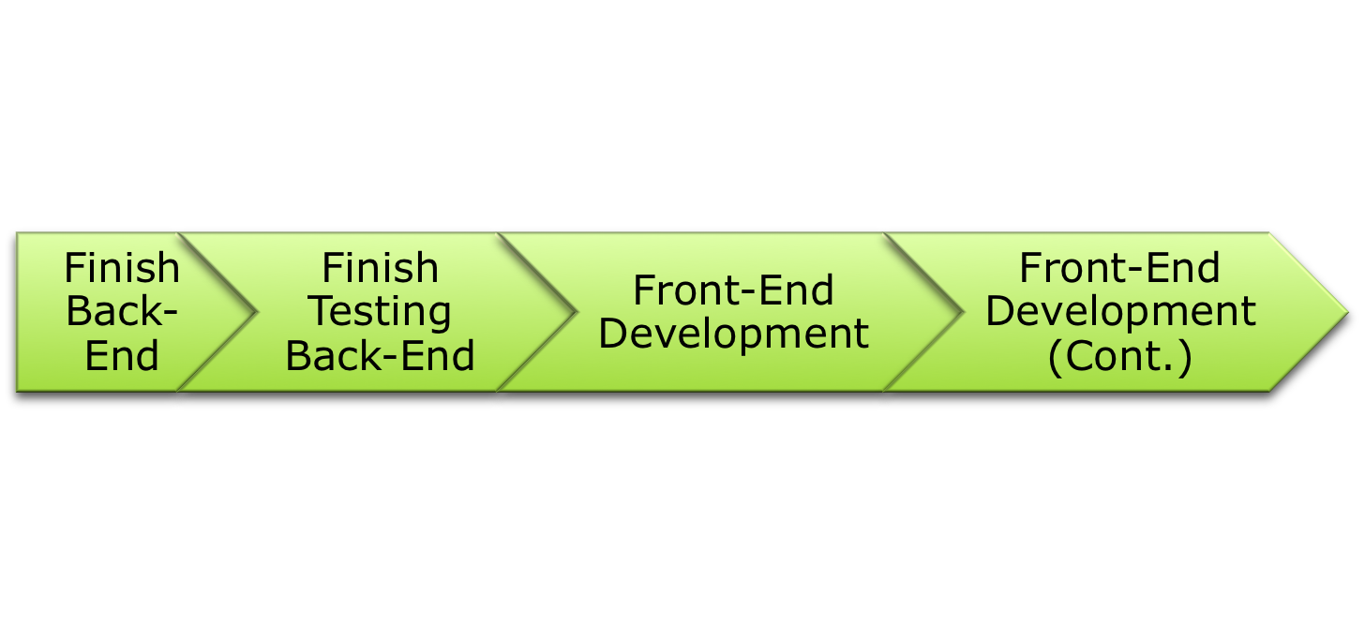
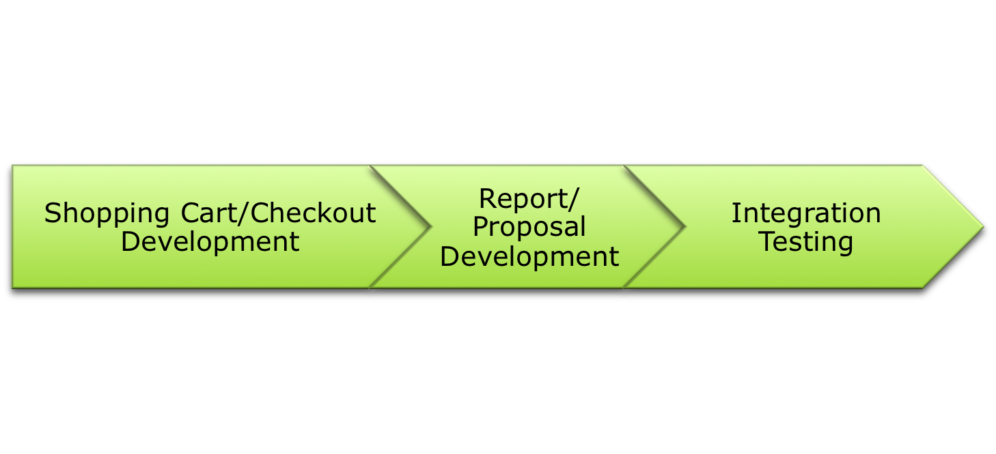
eCommerce CMS – Status Update
Week -7
Week -6
Week -5
Week -4
Week -3
Week -2
Week -1

Slide 13
eCommerce CMS - Questions
Any Questions?

