Slide 1

Alpha-Beta Presentation
2013 April 16

Slide 2
eCommerce CMS – Project Goals
The eCommerce CMS utilizes several technologies including:
RESTful web service with HTTP and URI contracts
Database-driven (SQL) inventory management
JavaScript front end and Java back end architecture
eCommerce CMS represents many of the technologies that we have learned at LMU and offers a specific community a real benefit that can be immediately realized.

Slide 3
eCommerce CMS – Description
Content Management System web application that can be launched from any major browser
Graphical User Interfaces
Shopping cart and checkout options with payment acceptance assistance
Easy Sales and Promotions management
Sales and business report generation
Target Audience: Small Business Owners looking to start their own eCommerce web site, but not looking to spend money on more expensive, monthly-paid solutions.

Slide 4
eCommerce CMS – User Scenarios
Arrive at dashboard
Edit services/items through a table
Add services/items through a form
Select Manage Saleable Services/Items
Designate pages for services/items to appear on
User – Managing Saleable Services/Items
Arrive at dashboard
View list of available reports/proposals
Click button to generate
Select Generate Reports / Proposals
(Optionally) Edit template of report
User – Generating Reports/Proposals
Arrive at dashboard
View list of Customer Front-End Pages and Templates
(Optionally) Edit Customer Front-End page/template by WYSIWYG Editor
Select Edit the Customer Front-End
(Optionally) Edit Customer Front-End page/template properties by a text editor
User – Edit the Customer Front-End

Slide 5
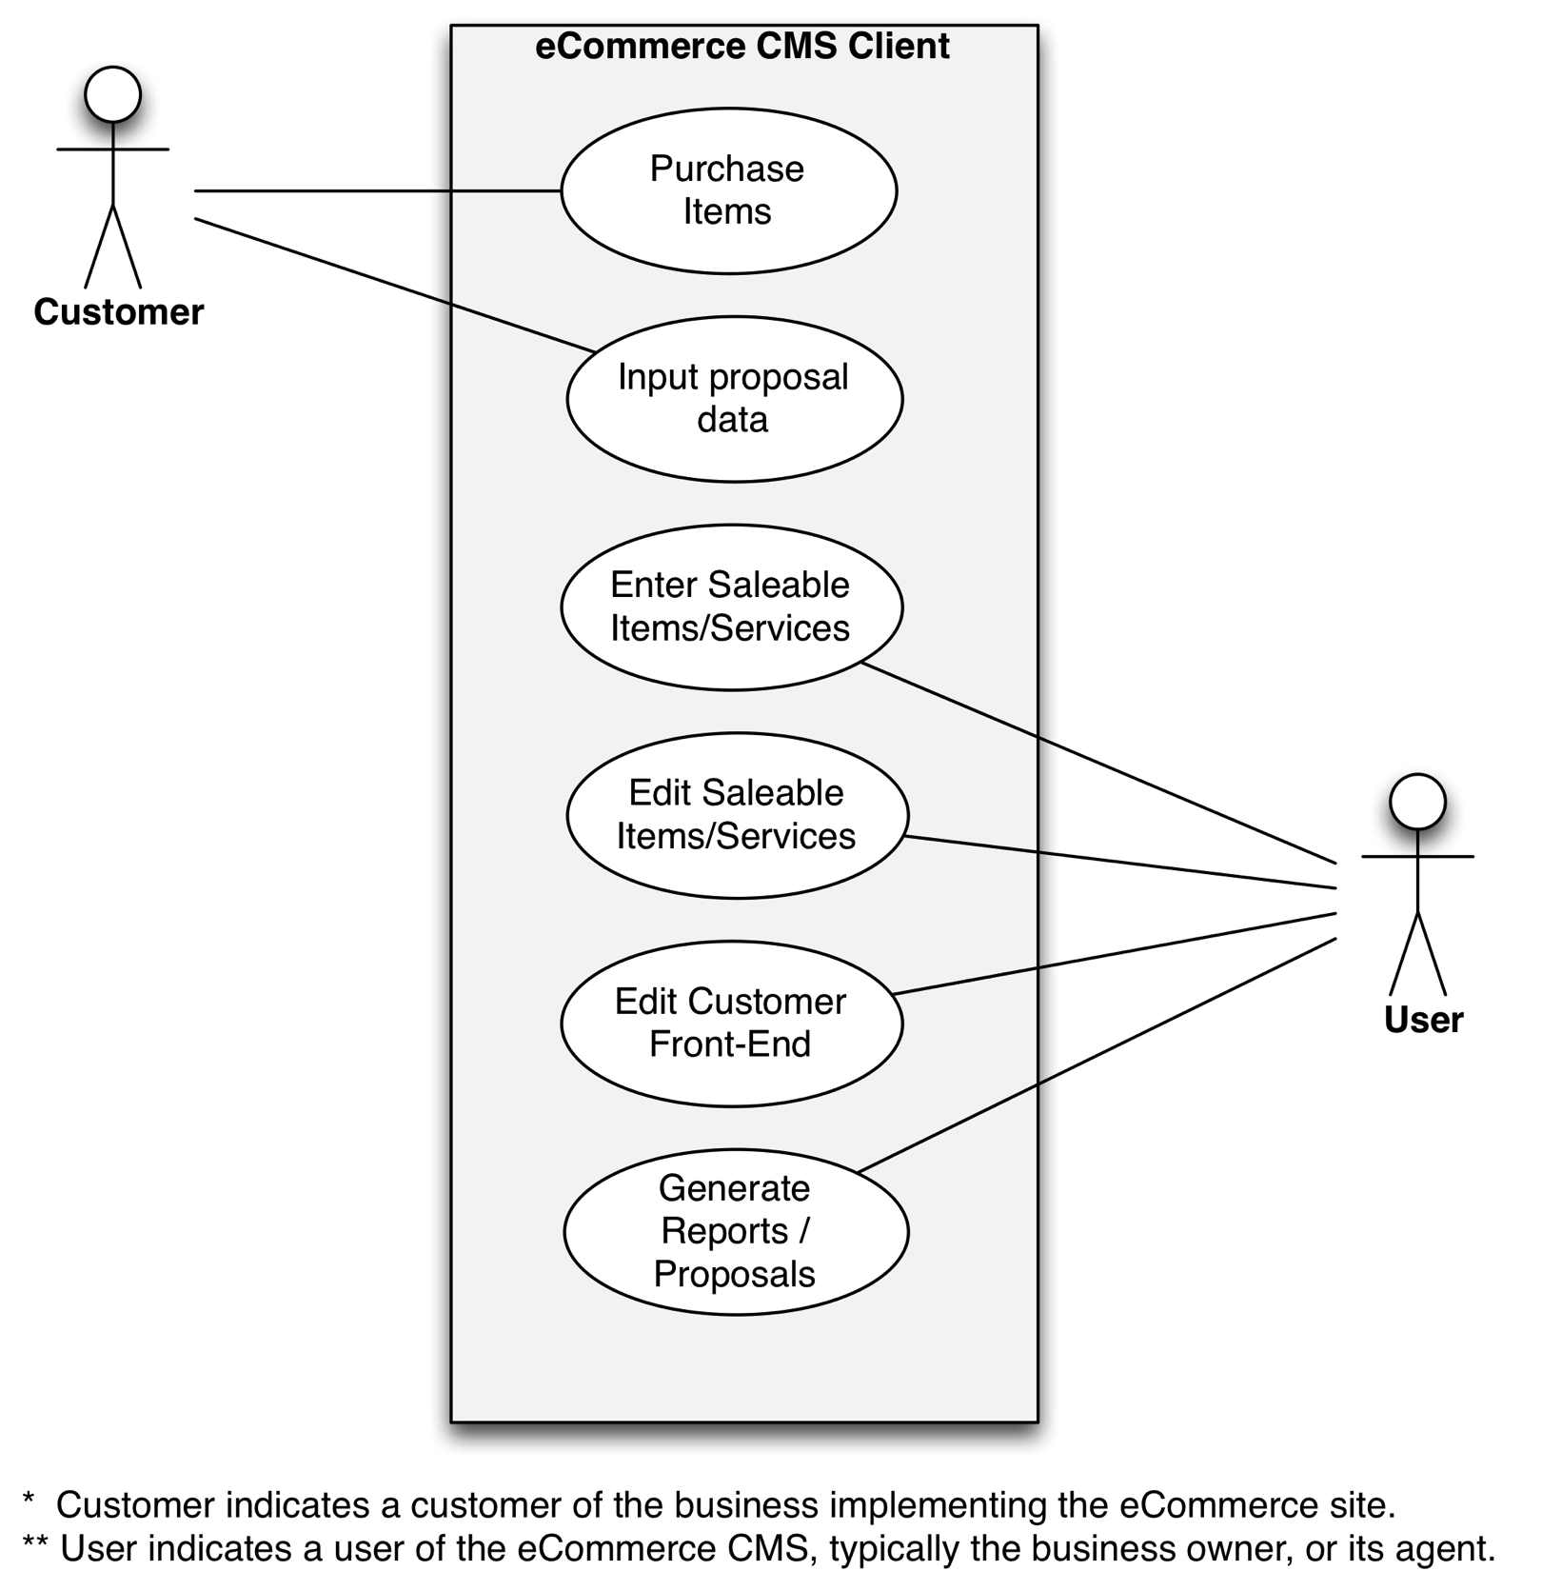
eCommerce CMS – Client Use Cases

Slide 6
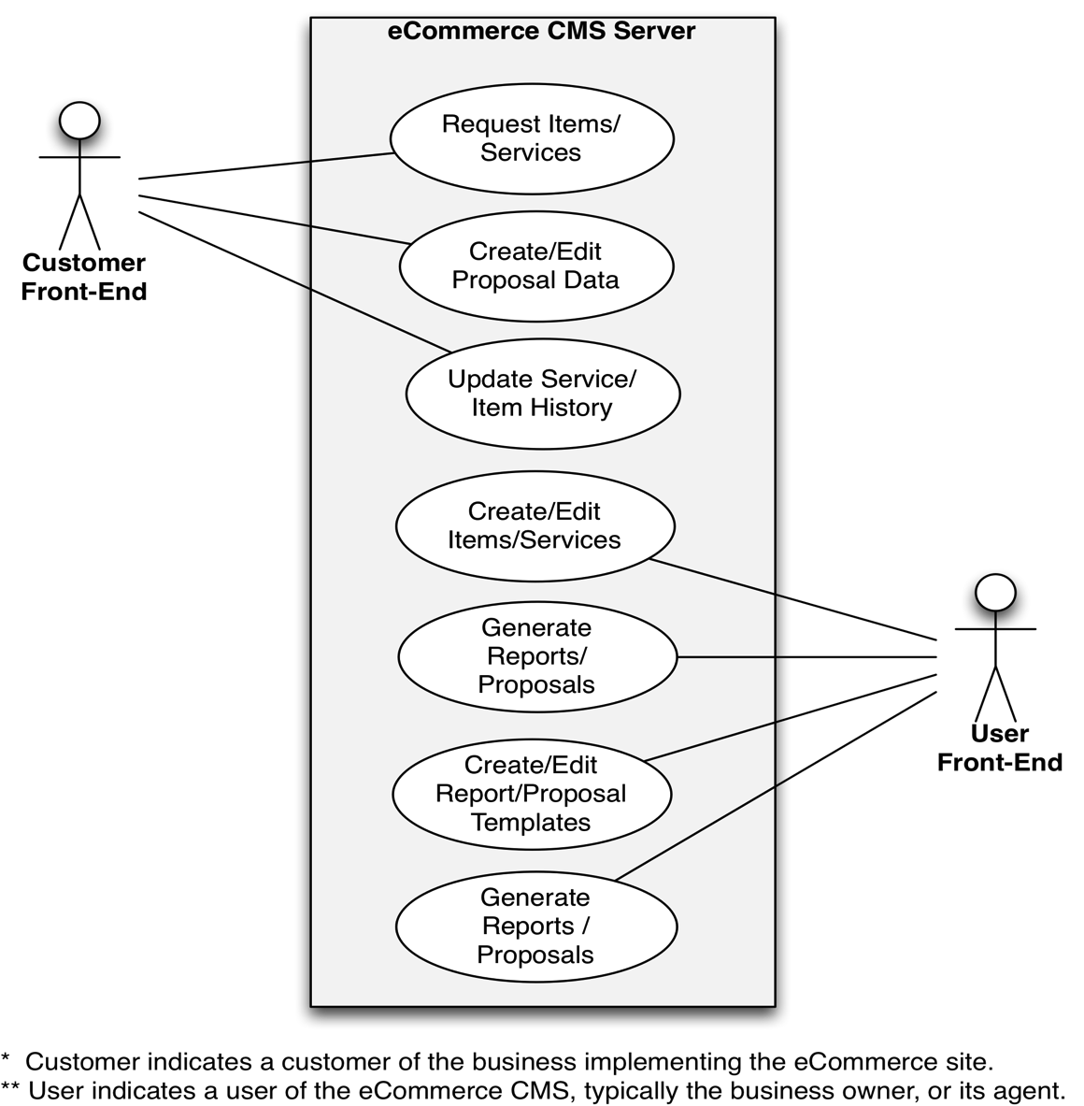
eCommerce CMS – Server Use Cases

Slide 7
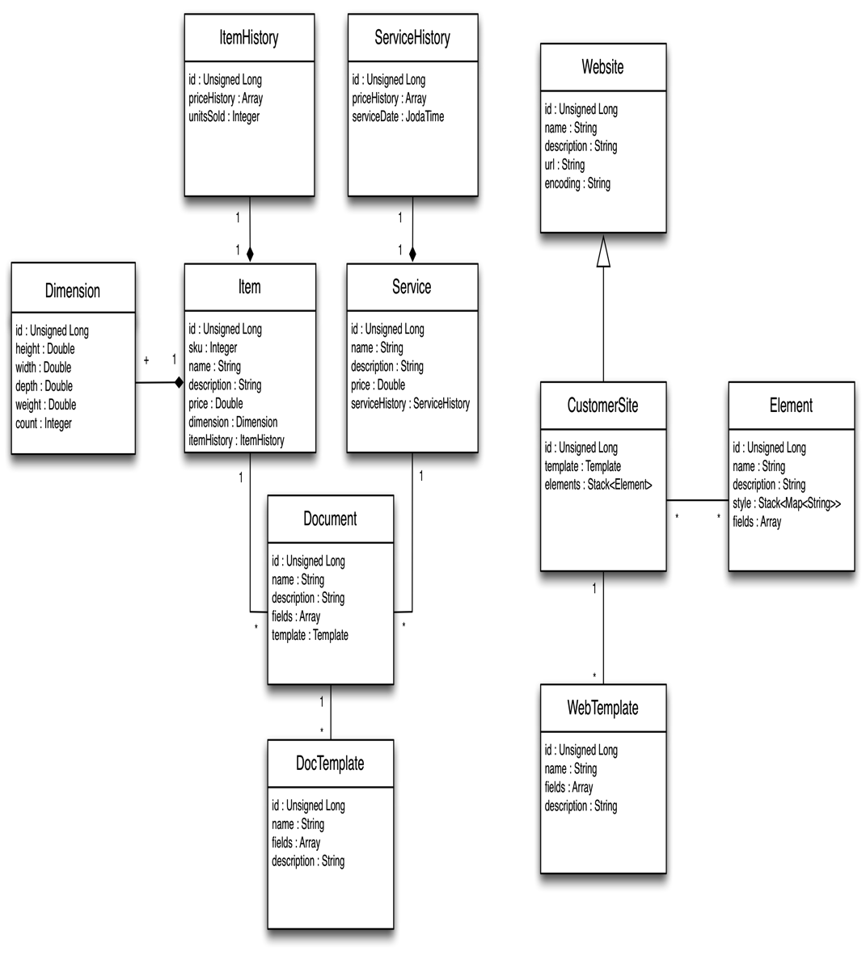
eCommerce CMS – Class Diagrams
* Client is in JavaScript and does not have classes.

Slide 8
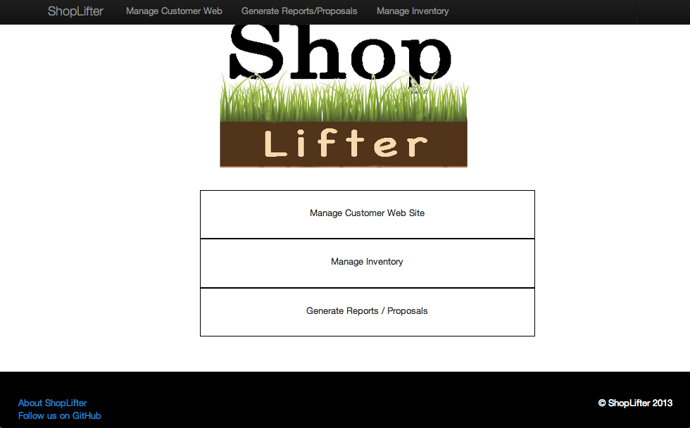
eCommerce CMS – User Interface

Slide 9
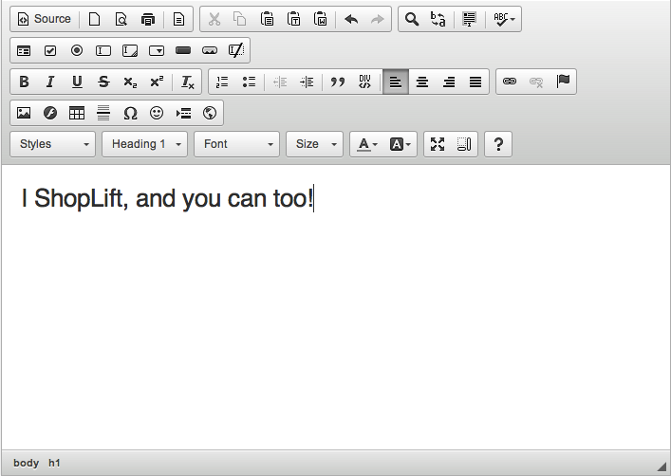
eCommerce CMS – User Interface
HTML Editing provided by CKEditor

Slide 10
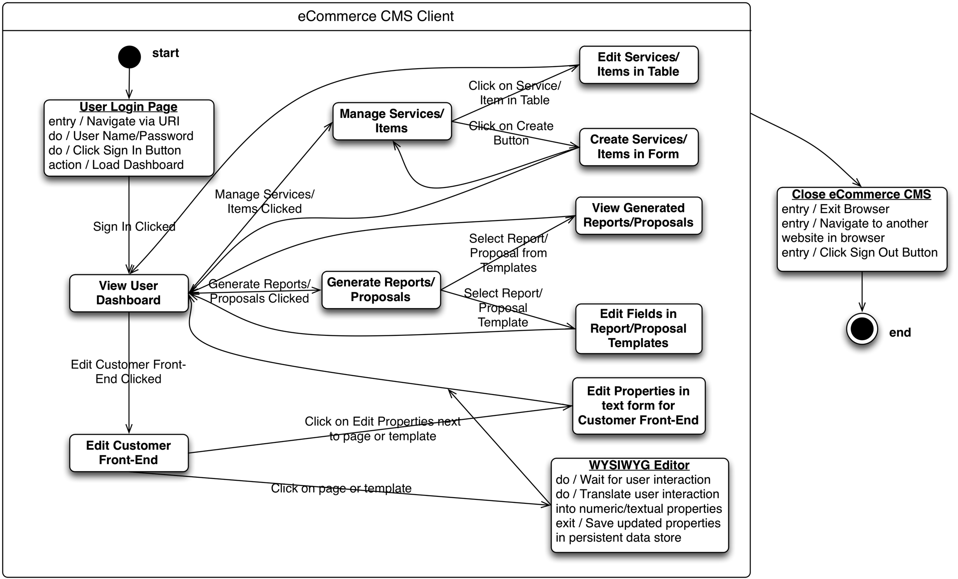
eCommerce CMS – State Diagram

Slide 11
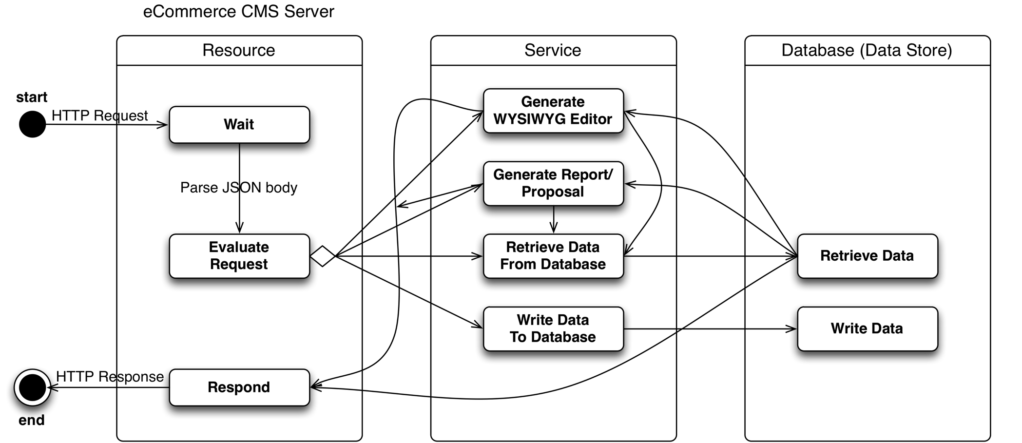
eCommerce CMS – State Diagram
Spring
JAX-RS
JAXB
Jackson
POJO
Hibernate
POJO
PostgreSQL

Slide 12
eCommerce CMS - Challenges
Lack of time

Slide 13
eCommerce CMS – Status Update
Front-End Development
Front-End Development
Integration Testing
Week -3
Week -2
Week -1

Slide 14
eCommerce CMS - Questions
Any Questions?

