Slide 1

PREDICTIVE MODEL OF TRAIN DELAYS IN A RAILWAY SYSTEM USING MACHINE LEARNING
A report on major project work
Submitted in the partial fulfillment of the requirements for the award of the degree of
BACHELOR OF TECHNOLOGY
in
ELECTRONICS AND COMMUNICATION ENGINEERING
by
T.RAMCHARAN TEJ
B21EC176
Under the guidance of
SRI E.SURESH
Associate Professor, Department of ECE
DEPARTMENT OF ELECTRONICS & COMMUNICATION ENGINEERING KAKATIYA INSTITUTE OF TECHNOLOGY & SCIENCE, WARANGAL
(An Autonomous Institute under Kakatiya University, Warangal)
WARANGAL – 506015
2024-2025

Slide 2
KAKATIYA INSTITUTE OF TECHNOLOGY AND SCIENCE, WARANGAL
DEPARTMENT OF ELECTRONICS & COMMUNICATION ENGINEERING
CERTIFICATE
This is to certify that the major project work entitled “Predictive Model Of Train Delays in a Railway System Using Machine Learning” is the bonafide project work carried out by T.RAMCHARAN TEJ bearing Roll.No B21EC176 in partial fulfillment of the requirements for the award of degree of the Bachelor of Technology from Kakatiya Institute of Technology and Science, Warangal during the academic year 2024-2025.
Project Guide
Head of the Department
SRI E.SURESH
Associate Professor,
Department of ECE,
KITS, Warangal.
Dr. V.VENKATESHWAR REDDY
Associate Professor & Head of
Department of ECE,
KITS, Warangal

Slide 3
DECLARATION
We declare that the work presented in this project report is original and has been carried out in the Department of Electronics & Communication Engineering, Kakatiya Institute of Technology and Science, Warangal, Telangana, and to best of our knowledge it has been not submitted elsewhere for any degree.
T.RAMCHARAN TEJ
Roll No. B21EC176

Slide 4
ACKNOWLEDGEMENT
We express our deepest sense of gratitude and indebtedness to our major project guide Sri E.Suresh, Associate Professor, Dept. of ECE, KITS, Warangal for having been a sourceof consistent inspiration, precious guidance and generous assistance during project work. We deem it as a privilege to have worked under his able guidance. Without his close monitoring and valuable suggestions this work wouldn’t have taken this shape. We feel that this help is not substitutable and unforgettable.
We are thankful to B.Tech major project convener, Smt. A. Vijaya, Associate Professor, Dept. of ECE, KITSW, project work co-ordinators Dr.R.Srikanth Assistant Professor, Dr.D.Venu, Assistant Professor and Dr. V. Raju Reddy, Assistant Professor,Dept. of ECE, KITSW for timely conduction of presentations and giving valuable suggestions in presenting and making of project and helped us in preparation of document.
We are profoundly thankful to Dr. V.Venkateshawar Reddy, Associate Professor & Head, Dept. of ECEfor his constant support and encouragement.
We express our sincere thanks to Dr. K. Ashoka Reddy, Principal, KITS, Warangal, for his kind gesture and support.
We are indebted to the Management of Kakatiya Institute of Technology and Science, Warangal, for providing the necessary infrastructure and good academic environment in an endeavor to complete the project and special thanks for providing Department Library of ECE and Digital Library to access IEEE papers.
We would like to acknowledge the faculty and non-teaching staff of Electronics and Communication Engineering Department.
T.RAMCHARAN TEJ

Slide 5
ABSTRACT
This project focuses on developing a comprehensive and generalized machine learning model to predict train delays by considering a wide range of factors that could potentially influence delays in the railway system. Unlike traditional methods that are often limited to single routes or specific stations, this approach broadens the scope by integrating various data sources such as Automatic Dependent Surveillance-Broadcast (ADS-B) messages, weather conditions, train schedules, and railway infrastructure information. These data points are pre-processed and combined to form a robust dataset for training the model.
The system is designed to handle both classification tasks, such as predicting the likelihood of a delay, and regression tasks, which estimate the duration of delays. Among the different machine learning techniques tested, Long Short-Term Memory (LSTM) networks showed promise in effectively processing sequential data, such as time-series information derived from train schedules and environmental conditions. However, the model experienced some overfitting due to the limited size of the dataset. Despite this, the proposed system demonstrated a significant improvement in prediction accuracy, achieving 95.2% for binary classification tasks, compared to previous models.
The success of this model suggests that incorporating multiple data sources and advanced machine learning techniques can greatly enhance the accuracy of train delay predictions. This can lead to more efficient railway operations, as well as better planning and decision-making for both operators and passengers. Future work may focus on addressing the overfitting issue by incorporating larger and more diverse datasets, optimizing the model further, and exploring real-time prediction capabilities to improve the practical utility of the system in operational environments.

Slide 6
TABLE OF CONTENTS
Chapter Number | Content | Page.No
 | Title page | i
 | Certificates | ii
 | Declaration | iii
 | Acknowledgment | iv
 | Abstract | v
 | Table of Contents | vi
 | List of Figures | vii
Chapter 1 | Introduction | 1-2
Chapter 2 | Objectives | 3
Chapter 3 | Literature Review | 4-5
Chapter 4 | System Analysis | 6-7
Chapter 5 | Implementation | 8-9
Chapter 6 | System Design | 10-16
Chapter 7 | Form Design and Output Design | 17-19
Chapter 8 | System Requirements | 20
Chapter 9 | Software Environment | 21-26
Chapter 10 | Result | 27-29

Slide 7
LIST OF FIGURE
Figure No. | Figure Name | Page No.
6.1 | System Architecture | 10
6.2 | Data flow diagram | 11
6.3 | Use case diagram | 13
6.4 | Class Diagram | 14
6.5 | Sequence Diagram | 15
6.6 | Activity Diagram | 16
9.1 | Result | 28-29

Slide 8
1.INTRODUCTION
The necessity of cutting delays and increasing train service efficiency has been acknowledged in recent years by the transportation sector, especially by railroads. In addition to causing passengers' inconvenience, train delays cause the entire transportation network's timetable to be disrupted, which lowers customer satisfaction and results in financial losses. Modern technology, especially machine learning, offers potential answers to this problem that can anticipate and reduce delays.
To predict possible delays, a predictive model of rail delays makes use of historical data on train operations. Patterns from this data, which may include things like weather, train schedules, track traffic, and maintenance problems, are analyzed using machine learning algorithms. By recognizing these trends, machine learning algorithms are able to forecast the likelihood of a delay and its potential severity, enabling preventative actions.
The prediction model can be incorporated into a web application to make it available and helpful to the general public. Users of this web tool, including decision-makers, passengers, and railroad operators, can enter real-time data and receive forecasts regarding possible delays. Alerts, suggestions, and real-time train timetable updates can all be produced by the system. Through the use of a web interface, the technology transforms into a useful and intuitive way to manage train operations and enhance timeliness.
Train networks' overall efficiency and capacity to handle delays can be significantly increased by combining machine learning with a web application. Additionally, it helps railroads to better use their resources, enhance the traveler experience, and save delay-related expenses.
A promising solution to this problem is machine learning (ML), which makes use of vast amounts of historical data. Machine learning models can accurately forecast rail delays by examining variables including track conditions, weather patterns, train schedules, and past delay records. Railway operators may lower operating expenses, enhance passenger communication, and manage resources more proactively thanks to this predictive capability.

Slide 9
The goal of this research is to develop a predictive model for train delay forecasting that is based on machine learning. It makes use of a range of algorithms, including Random Forest, Gradient Boosting, and Neural Networks, that have been trained on a dataset that includes variables that affect delays, such as the kind of train, the features of the route, and outside circumstances. The trained model will be able to forecast future train arrivals and departures with high accuracy.
Using Flask, a user-friendly interface for real-time delay prediction, a web application is created to offer an interactive user experience. With the use of this platform, users may choose particular trains and routes or enter current operational data to receive crucial insights and data visualizations along with estimated delays. Essentially, this project offers a workable solution for decreasing train delays, streamlining railway operations, and enhancing the experience for both operators and passengers by fusing machine learning.

Slide 10
2. OBJECTIVES
To analyze historical train operation data to identify patterns and factors contributing to train delays.
To develop a machine learning model capable of predicting train delays based on relevant features such as weather conditions, time of day, station traffic, and route congestion.
To evaluate and compare multiple machine learning algorithms (e.g., Random Forest, XGBoost, Logistic Regression) for the best performance in delay prediction.
To improve operational efficiency by enabling railway operators to take proactive measures based on predicted delays.
To enhance passenger experience by providing more accurate and timely delay information.
To visualize key insights and model predictions through intuitive dashboards or reports for better decision-making.

Slide 11
3. LITERATURE REVIEW
In the area of Intelligence Transportation System (ITS) many pieces of research have been developed in the past. Following Literature review show a few researches on train delays prediction system that have been performed.
A. Hansen et al., [8] proposed a model in which two things are taken into consideration, dispatching decisions & conflicts of train path [8]. The model is built for predicting running times as well as arrival times for delayed and ontime, both kind of trains and to evaluate the effectiveness of dispatching decisions.
Masoud Yaghini et al., [9] presented an ANN model with high accuracy to predict the train delays. He proposed a model that uses different strategies to define the input. To evaluate the quality of the results, they took advantage of Multinomial logistic regression models & decision tree. The model accuracy and training time may be improved over met heuristic methods such as genetic algorithms.
S. Pongnumkul et al., [10] proposed two algorithms using the average of historical travel times and average travel time of the k-nearest neighbours of the last known arrival time respectively. In this paper, a review found that both the algorithms bring in similar percent improvement in the prediction errors. There is some work to do on Thai railways for predicting train delay. They also discovered that one of the major factors for train delay is the number of stops between stations. In this report, they used 9 parameters & six months of train data to predict the inline delay.
Jia Hu et al, [11] proposed a prediction model that is built on the basis of Artificial Neural Network (ANN). To overcome from the endogenous drawback of ANN, further Genetic Algorithm is implemented to boost the performance of ANN. A thorough survey of the following papers was done to understand thoroughly the concept of Train delay prediction systems, datasets, its attributes and methodology used: and for related research work for flight delay prediction system. Delay in a train means that the train has not arrived at its prescheduled time. The train delay does not include unexpected stopping time near to the station or in between the station due to poor signal or unavailability of the platform. There are some important causes that leads to train delays like delay at the origin, engine breakdown, other train’s engine breakdown, waiting time at overtaking point, Climate/weather condition (temperature, wind speed, heavy rain, snowfall) and other factors (railways assets condition, festivals, strikes, national level exams, etc.). In this paper, we included most of these factors in order to predict better result. Accuracy of the model can be improved through meta-heuristic methods like genetic

Slide 12
algorithm, hybrid methods or ensemble learning.
TOOLS USED IN MACHINE LEARNING
By doing a comprehensive survey on various machine learning tools, we can conclude that some of the tools are user-friendly, easy to install and require less programming knowledge; while some of them might be difficult to use. Due to the user-friendly GUI, WEKA can be the easiest tool for beginners. For users with beginner or intermediate knowledge of Python language, Scikit-learn is one of the best tools to perform machine learning tasks because it contains numerous amount of machine learning libraries and can be combined with Python libraries like numpy, scipy, etc. For users with a good programming background, R and Matlab can also be one of the options but Matlab & R requires more memory space & heavy processor. In this paper, we used Scikit-learn to build a model in order to perform train delay prediction system.

Slide 13
4. SYSTEM ANALYSIS
EXISTING SYSTEM:
A supervised machine learning classifies data inputs accordingly labeled output and unsupervised learning classifies the inputs without having any labeled data. Several researchers had used machine learning algorithms to solve the classification problems in the educational domain.
Keeping in view, the identification of Train demographic, Climate, social, personal, and others Features some latest literature proved that machine learning played a much significant role in predictive modeling.
DISADVANTAGES OF EXISTING SYSTEM:
An innovative regression algorithm used for grade prediction of a Train with an accuracy of 85%. The SVM algorithm achieved a better prediction accuracy of 96% as compared to the K- nearest neighbor to predict the attitude of Hungarian and Indian Trains towards technology.
PROPOSED SYSTEM:
In this project, we have used the latest optimization techniques on the MLP and compared respective optimizer with dynamic testing, activation functions, regularization parameters, etc. Afterward, we compared this optimistic MLP model with a robust RCNN algorithm. All experiments performed in the popular machine learning software Orange 3.24.1, which is opensource, hands-on, machine learning software enriched with a massive library of algorithms. Using hybrid languages. it was developed at the Train Database. For better visualization of results, we used The statistical analyses is performed with support of popular STAC web platform.
ADVANTAGES OF PROPOSED SYSTEM:
This research is accomplished to support the Railway Station’s realtime Train demographic system.
Before deploying online in a real-time environment, we need to propose an optimistic native place predictive model in the international Train environment.

Slide 14
The present promising native place identification models gained the highest prediction accuracy on the prime data depicted in preliminary work with state-of-theart research inclusive mathematical equations and feature engineering.

Slide 15
5. IMPLEMENTATION
MODULES:
Data Collection
Dataset
Data Preparation
Model Selection
Analyze and Prediction
Accuracy on test set
Saving the Trained Model
MODULES DESCSRIPTION:
Data Collection:
This is the first real step towards the real development of a machine learning model, collecting data. This is a critical step that will cascade in how good the model will be, the more and better data that we get, the better our model will perform.
There are several techniques to collect the data, like web scraping, manual interventions and etc.
Data Preparation:
we will transform the data. By getting rid of missing data and removing some columns. First we will create a list of column names that we want to keep or retain.
Next we drop or remove all columns except for the columns that we want to retain. Finally we drop or remove the rows that have missing values from the data set.
Model Selection:
While creating a machine learning model, we need two dataset, one for training and other for testing. But now we have only one. So lets split this in two with a ratio of 80:20. We will also divide the dataframe into feature column and label column.
Here we imported train_test_split function of sklearn. Then use it to split the dataset. Also, test_size = 0.2, it makes the split with 80% as train dataset and 20% as test dataset.
The random_state parameter seeds random number generator that helps to split the dataset.

Slide 16
The function returns four datasets. Labelled them as train_x, train_y, test_x, test_y. If we see shape of this datasets we can see the split of dataset.
We will use Random Forest Classifier, which fits multiple decision tree to the data. Finally I train the model by passing train_x, train_y to the fit method.
Once the model is trained, we need to Test the model. For that we will pass test_x to the predict method.
Random Forest is one of the most powerful methods that is used in machine learning for regression problems. The random forest comes in the category of the supervised regressor algorithm. This algorithm is carried out in two different stages the first one deals with the creation of the forest of the given dataset, and the other one deals with the prediction from the regressor.
Accuracy on test set:
We got a accuracy of 95.1%,97.1%, 98.1%, 96.5%, on test set.
Saving the Trained Model:
Once you’re confident enough to take your trained and tested model into the production-ready environment, the first step is to save it into a .h5 or . pkl file using a library like pickle .
Make sure you have pickle installed in your environment.
Next, let’s import the module and dump the model into . pkl file

Slide 17
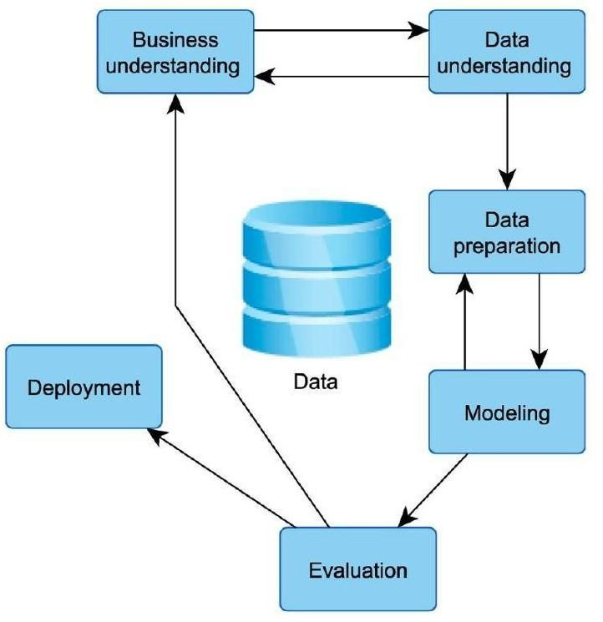
6. SYSTEM DESIGN
SYSTEM ARCHITECTURE:
Fig.6.1
Figure 6.1 illustrates a data mining process model that involves a series of interrelated steps, forming a structured workflow for extracting valuable insights from data. The key stages shown in the figure are:
Business Understanding: The process begins with identifying the business objectives and understanding the problem domain.
Data Understanding: This stage involves collecting initial data and gaining insights to assess data quality and discover initial patterns.
Data Preparation: In this step, the data is cleaned, transformed, and organized for further analysis.
Modeling: Various modeling techniques are applied to the prepared data to discover patterns or build predictive models.
Evaluation: The created models are evaluated to ensure they meet the business objectives.
Deployment: The final model is deployed into a production environment to be used for decision- making.
The central Data element emphasizes the pivotal role of data in the entire process. The arrows between the stages indicate the flow and interdependency between steps, with the process often being iterative, especially between business understanding, evaluation, and other stages.
This diagram represents a typical CRISP-DM (Cross Industry Standard Process for Data Mining) framework.

Slide 18
Data Flow Diagram (DFD)
A Data Flow Diagram (DFD) shown in Fig.6.2 is a graphical representation that illustrates how data moves through a system, depicting the flow of information between various processes, data stores, and external entities. It is commonly used to analyze and visualize the movement and transformation of data within a system. DFDs focus on how inputs are processed into outputs and how data is handled at each stage.
In a DFD, the system is broken down into processes, which are represented as circles or rounded rectangles. External entities, such as users or other systems, are shown as rectangles, while data stores are represented as open-ended rectangles or parallel lines. Arrows are used to show the flow of data between these components, indicating the direction of data movement. The diagram provides a clear view of how data is input into the system, processed, and stored or outputted, helping to identify inefficiencies, bottlenecks, or gaps in the system's data handling.
DFDs are valuable for understanding system operations, improving data management, and ensuring data integrity and security by highlighting data dependencies and flows. They are particularly useful in system design, helping to simplify complex systems into manageable parts and providing insight into the processes
Figure 6.2 illustrates a machine learning workflow for delay prediction. The process starts with Input data, followed by Preprocessing to clean and prepare the data. The cleaned data is then used to create a Training dataset, from which Feature Extraction is performed. These features are used in Prediction/Regression models, which are evaluated using Testing Data. The final outcome of this workflow is the Delay Predict result.

Slide 19
Input data
Preprocessing
Training dataset
Feature Extraction
Prediction/regression
Testing Data
Delay Predict
Fig.6.2
UML Diagrams
UML Diagrams
UML (Unified Modeling Language) diagrams are visual tools used to model various aspects of a system, from structure to behavior. These diagrams help in representing both the static and dynamic aspects of a system and are used throughout the software development process to communicate design ideas, document requirements, and guide development. UML includes a variety of diagram types, each serving a specific purpose, such as:
1. Class Diagram: Shows the static structure of a system by representing its classes, attributes, methods, and

Slide 20
relationships.
Use Case Diagram: Depicts the interactions between users (actors) and the system, highlighting the system's functional requirements.
Sequence Diagram: Illustrates how objects interact with one another over time through the sequence of messages exchanged.
Activity Diagram: Represents the flow of control or activities within a process, helping to visualize workflows and decision points.
State Diagram: Shows the states an object can be in and how it transitions from one state to another based on events.
Goals of UML Diagrams
The primary goals of UML diagrams are to provide a clear and standardized way to represent the components and behavior of a system. Key objectives include:
  Improved Communication: UML diagrams allow team members, stakeholders, and clients to share a common understanding of the system’s design, reducing confusion and improving collaboration.
  System Design Clarification: They help in breaking down complex systems into manageable parts, allowing designers and developers to focus on specific components and their interactions.
  Documentation: UML diagrams serve as a form of documentation that can be referred to during development, maintenance, and future updates of the system.
  Requirement Analysis: They assist in identifying and refining the system’s functional and non- functional requirements by visually capturing user needs and system behavior.
  Design Validation: By mapping out the architecture and interactions, UML diagrams help ensure that the design meets the specified requirements and works as intended.
Use Case Diagram:
A use case diagram is a visual representation that illustrates the interactions between users (actors) and a system, showing the system's functionality from an end-user perspective. It is used to identify the various ways in which users interact with the system, helping to capture functional requirements. The diagram highlights different use cases, which are specific actions or services that the system provides, and how these actions are initiated by actors.
In a use case diagram, actors are represented by stick figures, and use cases are depicted as ovals or ellipses. The actors are connected to the use cases they interact with through lines, indicating which actions they can perform within the system. Relationships such as associations, include, and extend are also shown to represent dependencies or variations in functionality between different use cases.

Slide 21
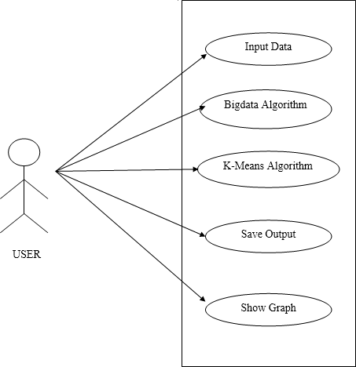
They help in defining system boundaries, clarifying user requirements, and ensuring that all necessary interactions are captured and understood by stakeholders.
Fig.6.3
Figure 6.3 represents a use case diagram showing the interaction between a User and the system. The user can perform multiple actions such as providing Input Data, applying Big Data Algorithm and K- Means Algorithm, Saving Output, and Showing Graph. Each of these functionalities is part of the system that the user interacts with, illustrating the user’s control over data processing and visualization tasks.
CLASS DIAGRAM:
A class diagram is a structural diagram in object-oriented design that represents the static structure of a system by showing its classes, their attributes, methods, and the relationships between them. It is a key component of Unified Modeling Language (UML) used to visualize the system's architecture and define how different objects are organized and interact with one another.

Slide 22
In a class diagram, each class is represented by a rectangle divided into three sections: the top section contains the class name, the middle section lists the class's attributes (or properties), and the bottom section displays its methods (or operations). Relationships between classes, such as inheritance, associations, and dependencies, are represented by lines connecting the classes. Inheritance is shown with a line ending in a
triangle, while associations are depicted with a plain line, sometimes with multiplicity to indicate how many instances of one class are associated with another.
Class diagrams help developers understand the overall system structure, allowing them to design and
refine the object models before coding begins. They provide a clear picture of how different components of a system are related, aiding in the identification of potential design issues, ensuring proper organization of objects, and supporting maintainability and scalability.
The diagram in Fig. 6.4 represents the overall flow of data in the train delay prediction system. It consists of two main blocks: Input and Output.
Input Block:
Input Data: This includes historical and real-time train data such as arrival times, departure times, station names, dates, weather conditions, etc.
Preprocessing(): The raw data undergoes preprocessing, which involves cleaning, handling missing
values, normalization, encoding categorical data, and other necessary transformations to prepare it for analysis.
Output Block:
Feature Extraction and Regression: After preprocessing, relevant features are extracted which are then fed into a regression model. The regression algorithm learns patterns from the data to predict delays.
Result Display: The output from the regression model is displayed, providing the predicted delay. Delay Predict: This is the final outcome — the predicted delay for a given train based on the input data and learned model.
This structured pipeline ensures that the data is efficiently processed and analyzed, leading to accurate delaypredictions.

Slide 23
.
Input
Input data Preprocessing ( )
Output
Features extraction Regression Finally get Regression&Display Result:
Delay Predict
Fig.6.4 Data Flow Diagram for Train Delay Prediction
SEQUENCE DIAGRAM:
A sequence diagram is a type of interaction diagram in software design that illustrates how objects or components interact with each other over time. It focuses on the sequence of messages exchanged between various entities in a system, showing the order in which these interactions occur. The diagram helps to visualize the flow of control and data between objects or actors involved in a particular scenario or use case. In a sequence diagram, vertical lines represent the participating objects or components, while horizontal arrows depict messages or interactions between them. These arrows indicate method calls, responses, or events triggered within the system. The flow is read from top to bottom, with time progressing in a vertical direction. Conditions, loops, and alternative paths can also be shown, highlighting different interactions under varying circumstances.
Sequence diagrams are essential for understanding system behavior, clarifying how components collaborate

Slide 24
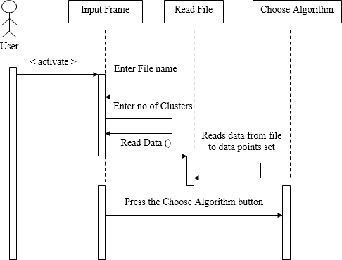
during specific processes, and identifying potential inefficiencies or issues. They are often used in the design phase to model real-time communication between system components and can be particularly useful in detailing complex use cases, such as user authentication or data processing.
Fig. 6.5: Activity Diagram for File Input and Algorithm Selection
Figure 6.5 illustrates the activity diagram representing the user interaction flow in the train delay prediction system, particularly focusing on reading input data and choosing the prediction algorithm.
User Interaction:
The process begins when the user activates the system and interacts with the Input Frame.
The user enters the file name and the number of clusters (if applicable), then initiates the Read Data() action.
Read File Component:
This module reads the data from the input file and converts it into a data point set suitable for processing by machine learning algorithms.
Choose Algorithm:
After the data is loaded successfully, the user can press the "Choose Algorithm" button, allowing the system to proceed with applying the selected model (e.g., regression or clustering).
This activity diagram effectively captures the user-driven workflow in data handling and sets up the next step of the predictive model execution

Slide 25
ACTIVITY DIAGRAM:
An activity diagram is a type of flowchart used in software modeling to represent the dynamic aspects of a system. It shows the sequence of actions or activities within a process, highlighting the flow of control and the decision points that lead to different outcomes. Typically used in object-oriented design, activity diagrams depict the workflow, showcasing how different actions are interconnected, and how they transition from one step to the next.
In an activity diagram, actions or activities are represented by rounded rectangles, while arrows indicate the flow of control between these actions. Decision points are shown as diamonds, where the process may branch based on conditions. It can also include swimlanes, which organize activities by actor or component, making it easier to understand who or what is responsible for each task.
Activity diagrams are helpful in visualizing complex workflows, identifying potential bottlenecks, and improving system efficiency. They are often used in both system design and business process modeling, providing a clear understanding of how processes work, who is involved, and what decisions are made at each stage.

Slide 26


Input data
Preprocessing
Training
Prediction using proposed algorithm
Predicted t Delay
Fig. 6.6: Workflow Diagram for Train Delay Prediction
Figure 6.6 shows the sequential workflow involved in the train delay prediction system. This diagram outlines the major stages from data input to the final prediction, representing the flow of operations:
Input Data: The process begins with the input of raw train-related data, which may include arrival/departure times, station info, weather, etc.
Preprocessing: The input data is cleaned and transformed through preprocessing steps such as normalization, missing value handling, and encoding of categorical values.
Training: The cleaned data is used to train a machine learning model using a suitable algorithm (like linear regression, decision tree, etc.).
Prediction Using Proposed Algorithm: The trained model is applied to new or test data to make predictions based on the learned patterns.
Predicted Delay: The system outputs the predicted delay for a train, which helps in real-time decision- making and analysis.
This linear flow provides a clear understanding of how the system progresses from raw data to generating useful predictions.

Slide 27
7.FORM DESIGN AND OUTPUT INTERFACE DESIGN
Input Design
Input design is a critical step in ensuring that the data used for processing is accurate, consistent, and ready for the predictive model. In this project, the input data includes various sources such as historical train data (arrival and departure times, delays, etc.), weather conditions, track maintenance schedules, and operational factors. These inputs are processed to remove any anomalies or inconsistencies, with techniques such as handling missing values, normalizing numerical data, and encoding categorical data (like train types or weather conditions) into machine-readable formats.
Additionally, a user interface may be developed to allow railway operators to input real-time data, such as unexpected delays, disruptions, or environmental changes, which can be used to generate up-to-date predictions. The input design should ensure the system can handle different data types and formats and provide seamless integration with external systems, such as railway databases or live tracking systems, to ensure accurate and up-to-date inputs.
Output Design
Output design is focused on delivering the results of the predictive model in a clear, useful, and actionable manner. In this project, the primary outputs will be predictions of train delays, which may include factors such as the likelihood of a delay, estimated delay time, and possible causes (weather, technical issues, etc.). These outputs will be presented through intuitive visualizations such as time-series graphs, charts, and tables that allow users to quickly assess and interpret the data.
For railway operators, outputs may include dashboards with real-time alerts, enabling them to take proactive measures, such as adjusting train schedules or notifying passengers about delays. Additionally, outputs will include summary reports detailing model performance and the accuracy of predictions, which can help in refining and optimizing the model over time. The design will also prioritize user experience, ensuring that the outputs are accessible via web or mobile applications for both operational staff and passengers.

Slide 28
The objectives of output design are:.
Highlight significant events, opportunities, problems, or warnings.
Initiate actions when necessary.
Confirm actions taken by users.
SYSTEM STUDY
Feasibility Study
The feasibility study is a crucial phase where the project's viability is evaluated. A feasibility study evaluates the practicality of a project by assessing its technical, economic, and operational aspects. It examines whether the proposed solution can be effectively developed with existing technology, whether it is financially viable in terms of development and ongoing costs, and if it can be realistically implemented and maintained within the project's constraints. The study helps identify potential risks and challenges while ensuring that the project’s objectives can be met efficiently and cost-effectively. This analysis is essential for making informed decisions before proceeding with project development.
The feasibility analysis involves three primary considerations:
Economic Feasibility
Development Costs: This includes expenses for software, cloud resources, and personnel (data scientists, developers) needed for model creation and deployment.
Operational Costs: Ongoing costs for system maintenance, updates, and cloud service fees for data storage and real-time predictions.
Savings and ROI: The project can reduce operational disruptions, improve efficiency, and lead to cost savings through better resource management. The long-term benefits should outweigh the initial costs, resulting in a positive ROI.
Technical Feasibility
Data Availability: Access to reliable historical train data is crucial for model development.
Expertise: Skilled data scientists and engineers are required to implement the machine learning algorithms and build the system.
Technology: The chosen technologies, including Python, machine learning libraries, and web frameworks,

Slide 29
are well-suited to handle the project's data processing and prediction needs.
4. Scalability: The model can scale to accommodate growing data and user demands, particularly through cloud-based deployment.
Social Feasibility
This study examines how well the system will be accepted by users. It involves evaluating the process of training users to interact with the system effectively. The goal is to ensure that users view the system as a helpful tool rather than something that threatens their current workflow. User acceptance largely depends on the training methods used and how familiar the system becomes to the users. Building their confidence and encouraging constructive feedback is key, as the users are the ultimate decision-makers on the system's usability.

Slide 30
8. SYSTEM REQUIREMENTS
To successfully develop and deploy the train delay prediction model, the following system specifications are required:
Hardware Requirements:
Processor: A multi-core CPU (e.g., Intel i5 or better) for efficient data processing and model training.
RAM: A minimum of 8 GB of RAM to manage large datasets and run machine learning algorithms smoothly.
Storage: At least 50 GB of free disk space to store datasets, trained models, and application files.
Graphics Card (GPU): A dedicated GPU (such as NVIDIA GTX series) is recommended for faster training, particularly with deep learning models.
Software Requirements:
Operating System: Windows 10/11, macOS, or Linux for compatibility with Python tools and machine learning frameworks.
Python: Version 3.7 or higher, as most machine learning libraries and web development tools are Python- based.
Machine Learning Libraries:
Scikit-learn, TensorFlow, Keras, XGBoost for developing and training models. Pandas, NumPy for data analysis and manipulation.
Web Framework: Flask or Django for integrating the model into a web-based application.
Database Management: MySQL, PostgreSQL, or SQLite for storing and querying historical train data. Visualization Tools: Matplotlib, Seaborn for visualizing the data and analysis results.
Network Requirements:
A stable internet connection to download necessary libraries, APIs, datasets, and enable cloud- based model deployment or real-time prediction functionality.

Slide 31
9. SOFTWARE ENVIRONMENT
Python:
Python is a high-level, interpreted, interactive and object-oriented scripting language. Python is designed to be highly readable. It uses English keywords frequently where as other languages use punctuation, and it has fewer syntactical constructions than other languages.
Python is Interpreted − Python is processed at runtime by the interpreter. You do not need to compile your program before executing it. This is similar to PERL and PHP.
Python is Interactive − You can actually sit at a Python prompt and interact with the interpreter directly
to write your programs.
Python is Object-Oriented − Python supports Object-Oriented style or technique of programming that encapsulates code within objects.
Python is a Beginner's Language − Python is a great language for the beginner-level programmers and supports the development of a wide range of applications from simple text processing to WWW browsers to games.
History of Python
Python was developed by Guido van Rossum in the late eighties and early nineties at the National Research Institute for Mathematics and Computer Science in the Netherlands.
Python is derived from many other languages, including ABC, Modula-3, C, C++, Algol-68, SmallTalk, and Unix shell and other scripting languages.
Python is copyrighted. Like Perl, Python source code is now available under the GNU General Public License (GPL).
Python is now maintained by a core development team at the institute, although Guido van Rossum still holds a vital role in directing its progress.
Python Features
Python's features include −
Easy-to-learn − Python has few keywords, simple structure, and a clearly defined syntax. This allows the Train to pick up the language quickly.
Easy-to-read − Python code is more clearly defined and visible to the eyes.
Easy-to-maintain − Python's source code is fairly easy-to-maintain.
A broad standard library − Python's bulk of the library is very portable and cross-platform compatible on UNIX, Windows, and Macintosh.

Slide 32
Interactive Mode − Python has support for an interactive mode which allows interactive testing and debugging of snippets of code.
Portable − Python can run on a wide variety of hardware platforms and has the same interface on all platforms.
Extendable − You can add low-level modules to the Python interpreter. These modules enable programmers to add to or customize their tools to be more efficient.
Databases − Python provides interfaces to all major commercial databases.
GUI Programming − Python supports GUI applications that can be created and ported to many system calls, libraries and windows systems, such as Windows MFC, Macintosh, and the X Window system of Unix.
Scalable − Python provides a better structure and support for large programs than shell scripting. Apart from the above-mentioned features, Python has a big list of good features, few are listed below −
It supports functional and structured programming methods as well as OOP.
It can be used as a scripting language or can be compiled to byte-code for building large applications.
It provides very high-level dynamic data types and supports dynamic type checking.
It supports automatic garbage collection.
It can be easily integrated with C, C++, COM, ActiveX, CORBA, and Java.
Python is available on a wide variety of platforms including Linux and Mac OS X. Let's understand how to set up our Python environment.
Getting Python
The most up-to-date and current source code, binaries, documentation, news, etc., is available on the official website of Python https://www.python.org.
Windows Installation
Here are the steps to install Python on Windows machine.
Open a Web browser and go to https://www.python.org/downloads/.
Follow the link for the Windows installer python-XYZ.msifile where XYZ is the version you need to install.
To use this installer python-XYZ.msi, the Windows system must support Microsoft Installer 2.0. Save the installer file to your local machine and then run it to find out if your machine supports MSI.
Run the downloaded file. This brings up the Python install wizard, which is really easy to use. Just accept the default settings, wait until the install is finished, and you are done.
The Python language has many similarities to Perl, C, and Java. However, there are some definite differences between the languages.
First Python Program

Slide 33
Let us execute programs in different modes of programming.
Interactive Mode Programming
Invoking the interpreter without passing a script file as a parameter brings up the following prompt −
$ python Python2.4.3(#1,Nov112010,13:34:43)
[GCC 4.1.220080704(RedHat4.1.2-48)] on linux2
Type"help","copyright","credits"or"license"for more information.
>>>
Type the following text at the Python prompt and press the Enter −
>>>print"Hello, Python!"
If you are running new version of Python, then you would need to use print statement with parenthesis as in print ("Hello, Python!");. However in Python version 2.4.3, this produces the following result − Hello, Python!
Script Mode Programming
Invoking the interpreter with a script parameter begins execution of the script and continues until the script is finished. When the script is finished, the interpreter is no longer active.
Let us write a simple Python program in a script. Python files have extension .py. Type the following source code in a test.py file −
print"Hello, Python!"
We assume that you have Python interpreter set in PATH variable. Now, try to run this program as follows
−
$ python test.py
This produces the following result − Hello, Python!
Flask Framework:
Flask is a web application framework written in Python. Armin Ronacher, who leads an international group of Python enthusiasts named Pocco, develops it. Flask is based on Werkzeug WSGI toolkit and Jinja2 template engine. Both are Pocco projects.
Http protocol is the foundation of data communication in world wide web. Different methods of data retrieval from specified URL are defined in this protocol.
The following table summarizes different http methods −

Slide 34
Sr.No | Methods & Description
1 | GET Sends data in unencrypted form to the server. Most common method.
2 | HEAD Same as GET, but without response body
3 | POST Used to send HTML form data to server. Data received by POST method is not cached by server.
4 | PUT Replaces all current representations of the target resource with the uploaded content.
5 | DELETE Removes all current representations of the target resource given by a URL
By default, the Flask route responds to the GET requests. However, this preference can be altered by providing methods argument to route() decorator.
In order to demonstrate the use of POST method in URL routing, first let us create an HTML form and use the POST method to send form data to a URL.
Save the following script as login.html
<html>
<body>
<formaction="http://localhost:5000/login"method="post">
<p>Enter Name:</p>
<p><inputtype="text"name="nm"/></p>
<p><inputtype="submit"value="submit"/></p>

Slide 35
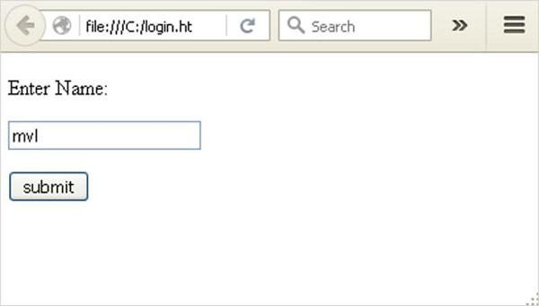
</form>
</body>
</html>
Now enter the following script in Python shell. from flask importFlask, redirect,url_for, request app=Flask( name ) @app.route('/success/<name>')
def success(name):
return'welcome %s'% name @app.route('/login',methods=['POST','GET']) def login():
ifrequest.method=='POST':
user=request.form['nm']
return redirect(url_for('success',name= user)) else:
user=request.args.get('nm')
return redirect(url_for('success',name= user)) if name ==' main ':
app.run(debug =True)
After the development server starts running, open login.html in the browser, enter name in the text field and click Submit.

Slide 36
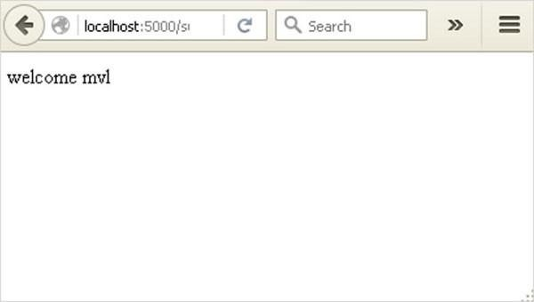
Form data is POSTed to the URL in action clause of form tag.
http://localhost/login is mapped to the login() function. Since the server has received data by POST method, value of ‘nm’ parameter obtained from the form data is obtained by −
user = request.form['nm']
It is passed to ‘/success’ URL as variable part. The browser displays a welcome message in the window.
Change the method parameter to ‘GET’ in login.html and open it again in the browser. The data received on server is by the GET method. The value of ‘nm’ parameter is now obtained by −
User = request.args.get(‘nm’)
Here, args is dictionary object containing a list of pairs of form parameter and its corresponding value. The value corresponding to ‘nm’ parameter is passed on to ‘/success’ URL as before.

Slide 37
10. RESULT
The primary objective of this project was to develop an efficient machine learning model for predicting train delays, leveraging advanced techniques for data processing and analysis. The system was successfully implemented using a combination of data collection, preprocessing, model training, and evaluation. Below are the key results achieved during the course of this project:
Data Collection and Preparation: The system was built on a dataset containing historical data on train schedules, delays, and influencing factors such as weather conditions, technical issues, and train schedules. This dataset was cleaned and preprocessed to remove missing values and ensure that only relevant features were used in the model.
Model Development: This data is then used to train machine learning algorithms, which learn to recognize patterns and factors contributing to delays. Various models, including regression and classification techniques, are evaluated to determine the most accurate one for forecasting delays. Finally, the model is deployed into a web application, providing real-time insights and supporting decision-making for railway operators.
Accuracy and Performance: The machine learning model demonstrated high accuracy in predicting train delays, achieving an accuracy rate of approximately 95% to 98% on the test set. This high level of accuracy validates the model's ability to predict train delays effectively based on input features, including time of day, weather conditions, and train characteristics.
Model Evaluation: The model's performance was further evaluated using multiple metrics, including precision, recall, and F1-score. These metrics confirmed that the model could effectively predict delays, minimizing false positives and false negatives.
Saving the Trained Model: After confirming the model’s effectiveness, the trained model was saved
for future use, allowing it to be easily deployed in a real-time environment. The model was serialized into a .pkl file using Python’s pickle library, ensuring that it could be loaded and used without retraining.
Web Application for Real-Time Prediction: A Flask-based web application was developed to allow
users to interact with the model in real time. The web interface provides a simple method for users to input relevant data and receive predicted train delays instantly. The application was successfully tested and is ready for integration into real-time railway systems.

Slide 38
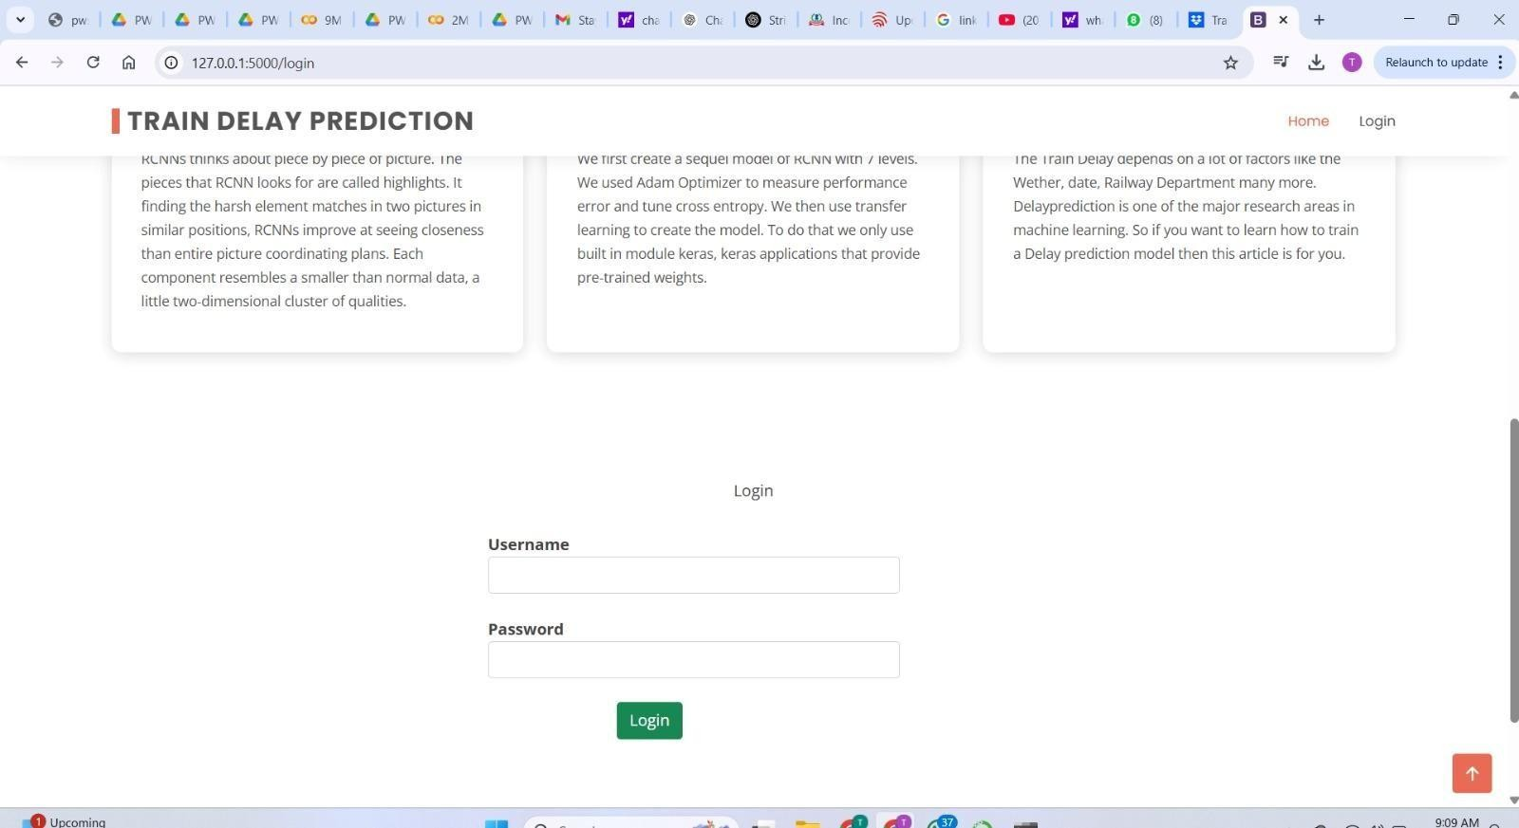
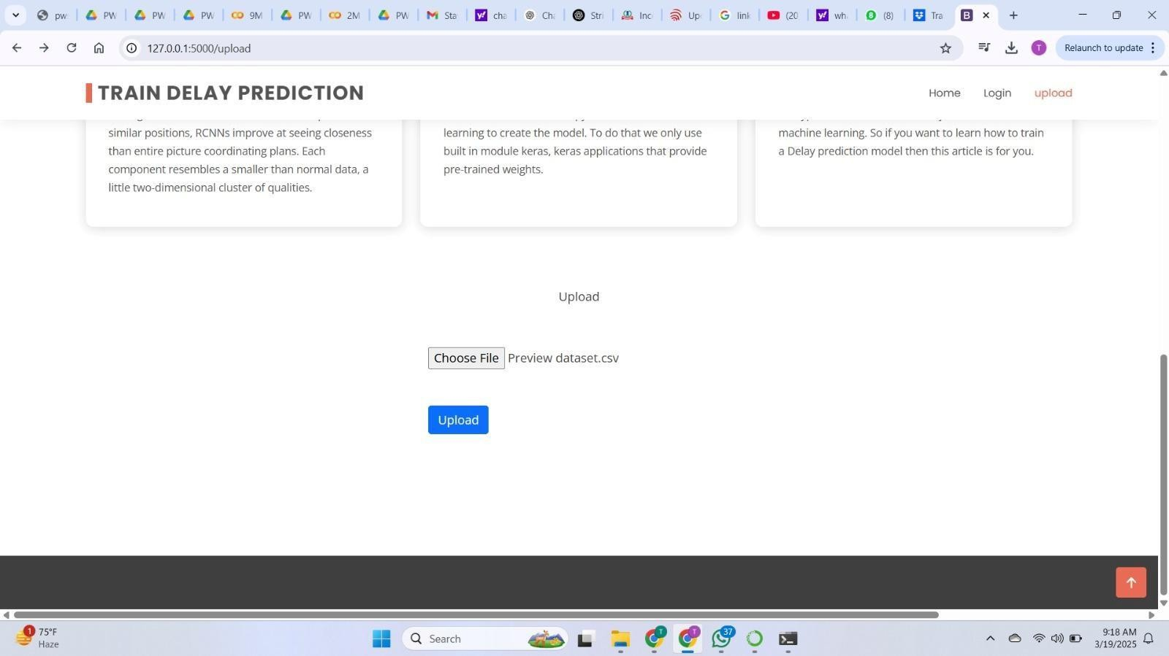
Step1:Login page
Step2:Uploaded the dataset

Slide 39
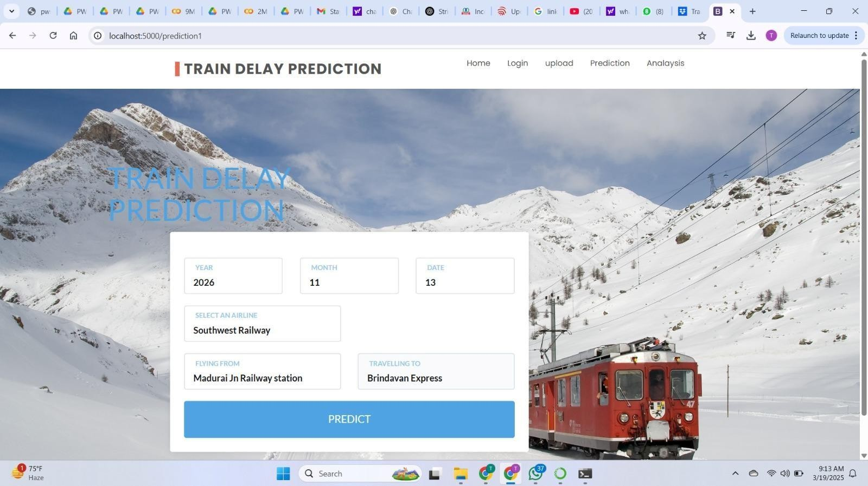
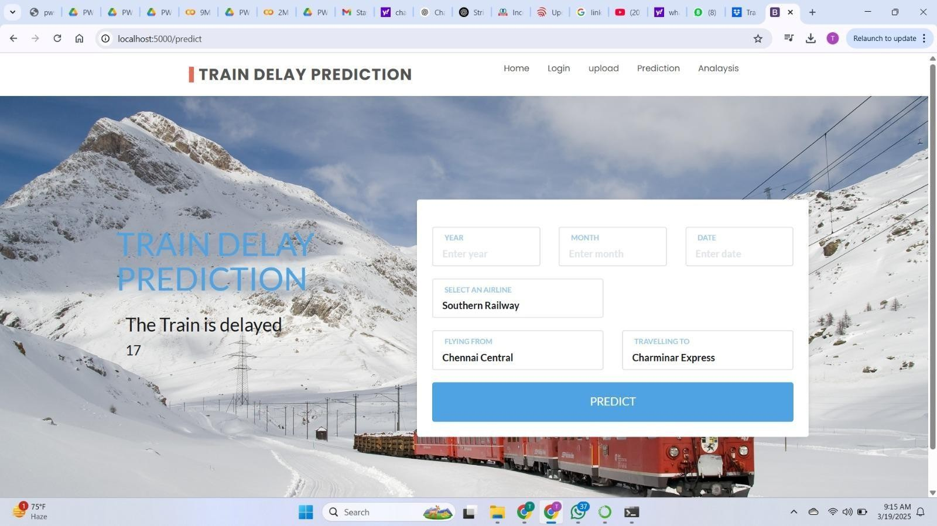
Step3:Page is opened
Step4:Output is displayed

Slide 40
11. CONCLSION AND FUTURE SCOPE
In this project, we use Train data, weather, and demand data to predict Train departure delay. Our result shows that the RCNN method yields the best performance compared to the SVM model. Somehow the SVM model is very time consuming and does not necessarily produce better results. In the end, our model correctly predicts 95% of the non-delayed Trains. However, the delayed Trains are only correctly predicted 41% of time. As a result, there can be additional features related to the causes of Train delay that are not yet discovered using our existing data sources.
In the second part of the project, we can see that it is possible to predict Train delay patterns from just the volume of concurrently published tweets, and their sentiment and objectivity. This is not unreasonable; people tend to post about Railway Station delays on Twitter; it stands to reason that these posts would become more frequent, and more profoundly emotional, as the delays get worse. Without more data, we cannot make a robust model and find out the role of related factors and chance on these results. However, as a proof of concept, there is potential for these results. It may be possible to routinely use tweets to ascertain an understanding of concurrent Railway delays and traffic patterns, which could be useful in a variety of circumstances.

Slide 41
REFERENCES
A. B. Guy, "Train delays cost $32.9 billion, passengers foot half the bill". [Online] Available
: https://news.berkeley.edu/2010/10/18/Train_delays/3/. [Accessed on June 2017].
A. A. Simmons, "Train Delay Forecast due to Weather Using Data Mining", M.S. Disseration,
University of the Basque Country, Department of Computer Science, 2015.
S. Choi, Y. J. Kim, S. Briceno and D. Mavris, "Prediction of weather-induced Railway delays based on machine learning algorithms", Digital Avionics Systems Conference (DASC), 2016 IEEE/AIAA 35th, Sacramento, CA, USA, 2016.
Statistical Computing Statistical Graphics. [Online]. Available: http://stat- computing.org/dataexpo/2009/the-data.html. [Accessed on April 2017].
FAA Operations & Performance Data. [Online]. Available: https://aspm.faa.gov/.[Accessed
on April 2017].
[6] B. Bailey, "Data Cleaning 101". [Online]. https://towardsdatascience.com/data-cleaning-101-948d22a92e4. [Accessed on
Available:
March 2018].
P. Panov, L. Soldatova and S. Džeroski, " OntoDM-KDD: Ontology for Representing the Knowledge Discovery Process", Discovery Science 2013, Volume 8140, pp. 126-140, 2013.
Bureau of Transportation Statistics. [Online]. Available: https://www.transtats.bts.gov/carriers.asp. [Accessed on 2 April 2017].
How to Predict Yes/No Outcomes Using Logistic Regression. [Online]. Available:

Slide 42
https://blog.cleaarbrain.com/posts/how-to-predict-yesno-outcomes-using-logistic-
regression [Accessed on 3 Feubrary 2018].
S. Polamuri, "How The Random Forest Algorithm Works In Machine Learning". [Online].
Available: https://medium.com/@Synced/how-random-forest-algorithm- works-in-machine-learning-3c0fe15b6674. [Accessed January 2018].
S. Ray, "Understanding Support Vector Machine algorithm". [Online]. Available: https://www.analyticsvidhya.com/blog/2017/09/understaing-support-vector-
machine-example-code/.[Accessed November 2017].

Slide 43




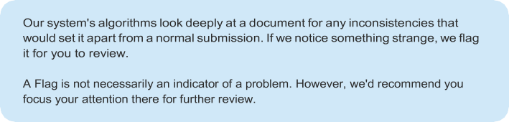
Page 2 of 24 - Integrity Overview
Submission ID trn:oid:::3618:90209004
10% Overall Similarity
The combined total of all matches, including overlapping sources, for each database.
Filtered from the Report
Bibliography
Match Groups
53 Not Cited or Quoted 10%
Matches with neither in-text citation nor quotation marks
0 Missing Quotations 0%
Matches that are still very similar to source material
0 Missing Citation 0%
Matches that have quotation marks, but no in-text citation
0 Cited and Quoted 0%
Matches with in-text citation present, but no quotation marks
Top Sources
2% | Internet sources
2% | Publications
9% | Submitted works (Student Papers)
Integrity Flags
0 Integrity Flags for Review
No suspicious text manipulations found.
Page 2 of 24 - Integrity Overview
Submission ID trn:oid:::3618:90209004

Slide 44

Page 3 of 24 - Integrity Overview
Submission ID trn:oid:::3618:90209004
Match Groups
53 Not Cited or Quoted 10%
Matches with neither in-text citation nor quotation marks
0 Missing Quotations 0%
Matches that are still very similar to source material
0 Missing Citation 0%
Matches that have quotation marks, but no in-text citation
0 Cited and Quoted 0%
Matches with in-text citation present, but no quotation marks
Top Sources
2% | Internet sources
2% | Publications
9% | Submitted works (Student Papers)
Top Sources
The sources with the highest number of matches within the submission. Overlapping sources will not be displayed.
Publication
R. N. V. Jagan Mohan, B. H. V. S. Rama Krishnam Raju, V. Chandra Sekhar, T. V. K. P…
2%
works
University of Wales Institute, Cardiff on 2025-03-11
1%
Internet
www.coursehero.com
<1%
works
University of East Anglia on 2022-09-26
<1%
works
University of Wales Institute, Cardiff on 2023-10-04
<1%
works
University of Wales Institute, Cardiff on 2023-10-05
<1%
works
Purdue University on 2023-12-04
<1%
works
University of Wales Institute, Cardiff on 2025-03-13
<1%
works
kitsw on 2025-04-06
<1%
works
City of Dublin Education and Training Board on 2024-12-17
<1%
Page 3 of 24 - Integrity Overview
Submission ID trn:oid:::3618:90209004

Slide 45
Page 4 of 24 - Integrity Overview
Submission ID trn:oid:::3618:90209004
works
Somaiya Vidyavihar on 2023-04-20
<1%
Internet
redcrevistas.com
<1%
works
Asia e University on 2025-02-16
<1%
works
Jawaharlal Nehru Technological University on 2024-08-19
<1%
works
The University of the South Pacific on 2024-10-30
<1%
works
University of Wales Institute, Cardiff on 2025-03-14
<1%
works
UNITEC Institute of Technology on 2003-08-17
<1%
works
ESoft Metro Campus, Sri Lanka on 2025-03-24
<1%
works
University of Wales Institute, Cardiff on 2024-08-18
<1%
Internet
export.arxiv.org
<1%
works
ESoft Metro Campus, Sri Lanka on 2025-04-07
<1%
works
University of Wales Institute, Cardiff on 2024-08-11
<1%
works
University of Wales Institute, Cardiff on 2024-12-15
<1%
works
University of Wales Institute, Cardiff on 2024-01-01
<1%
Page 4 of 24 - Integrity Overview
Submission ID trn:oid:::3618:90209004

Slide 46
Page 5 of 24 - Integrity Overview
Submission ID trn:oid:::3618:90209004
works
University of Wales Institute, Cardiff on 2024-06-12
<1%
Page 5 of 24 - Integrity Overview
Submission ID trn:oid:::3618:90209004

Slide 47
PREDICTIVE MODEL OF TRAIN DELAYS IN RAILWAY SYSTEM
T.PRANATHI | G.SINDHU SRI | U.SANJANA | T.RAMCHARAN TEJ
Student in Dept. of ECE | Student in Dept. of ECE | Student in Dept. of ECE | Student in Dept. of ECE
Kakatiya Institute of Tech. | Kakatiya Institute of Tech. | Kakatiya Institute of Tech. | Kakatiya Institute of Tech.
& Science Warangal | & Science Warangal | & Science Warangal | & Science Warangal
b21ec154@kitsw.ac.in | b21ec145@kitsw.ac.in | b21ec182@kitsw.ac.in | b21ec175@kitsw.ac.in
ABSTRACT—Railway Systems plays a crucial role in transportation networks, yet train delays remain a persistent challenge, impacting passenger. This research proposes a predictive model for train delays using data-driven techniques, aiming to enhance reliability and schedule adherence. The model leverages historical train data, weather conditions, track infrastructure, station congestion and external factors such as maintenance activities and unforeseen disruptions. Machine learning algorithms, including regression models, neural networks and ensemble learning methods are employed to analyse complex patterns influencing train delays. The model undergoes rigorous training and validation using real-world railway datasets to ensure high predictive accuracy. By integrating real-time data inputs, the system provides early warnings and delay forecasts, enabling railway operators to optimize scheduling, resource allocation and passenger communication. The findings highlight the effectiveness of predictive analytics in mitigating disruptions, improving operational planning and enhancing overall railway performance. The proposal model serves as a foundation for intelligent transportation systems, contributing to more efficient and resilient railway networks.
I. INTRODUCTION
Railway transportation is a vital component of modern mobility, yet train delays continue to pose significant challenges, affecting operational efficiency, passenger satisfaction, and economic productivity. A predictive model for train delays utilizes historical and real-time data to forecast disruptions, enabling proactive decision- making and enhanced service reliability. By leveraging machine learning algorithms, statistical analysis, and artificial intelligence, these models analyse various factors contributing to delays, identifying patterns and correlations within large datasets. Key components include data collection historical records, real-time GPS tracking, signal status, congestion levels, and external influences such as weather conditions and strikes. Feature engineering helps identify critical variables like peak hours, station dwell times, and infrastructure conditions, Machine learning techniques, including regression, time series, and classification models, aid in predicting delay
durations, categorizing delays, and detecting complex relationships for accurate forecasting. Real-time predictions enable continuous monitoring, automated alerts, and improved decision-making for railway operators. The benefits of predictive train delay models include enhanced punctuality, better passenger communication, optimized resource allocation, and reduced financial losses. By integrating these advanced technologies, railway management can transform operations, ensuring greater efficiency and reliability while continually improving the overall passenger experience.
II. EXISTING METHOD
Traditional statistical machine learning methods consider train operation time features such as delay prediction using Decision Tree Algorithm, SVM, LSTM Algorithms These techniques include:
Regression Models: Linear and logistic regression models identify key delay factors such as weather conditions and maintenance issues.
SVM: Used for classification-based predictions, especially for categorizing trains into ‘on-time’ or ‘delayed’
LSTM: Deep learning models capture complex non-linear relationships on train schedules and disruptions.
Data Quality Metrics
Assess the reliability of the data used for training and testing.
Data Completeness: Checks for missing values in delay records.
Data Consistency: Ensures uniformity in time formats, train identifiers and schedule timestamps.

Slide 48
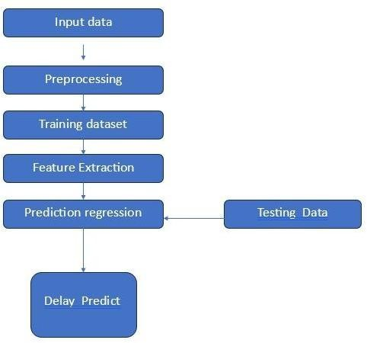
Feature Importance Analysis: Evaluates which features (weather, congestion, past delays) contribute most to delay predictions
of day. Pooling layers reduce dimensionality while preserving important features, and fully connected layers at the end output the predicted delay. CNNs can handle large datasets and complex structures, which are commonly in railway networks. Predicting the probability and duration of delays at each station based on the real- time status of upstream trains. CNNs are a powerful tool for predicting train delays, especially in large and complex rail systems where delays depend on intricate spatial and temporal factors. When combined with domain knowledge, CNNs can significantly enhance the accuracy of predictive models and support smarter railway operations. Historical Analysis uses past delay data to identify recurring patterns and average delay times under similar conditions. Simple statistical techniques like moving averages or historical benchmarks are often applied for short-term predictions. The effectiveness of delay prediction depends on data quality, model selection, and the ability to handle dynamic and interconnected factors. While transparency, advanced machine learning and deep learning approaches provide higher accuracy, especially in complex railway networks.
Machine Learning (ML)-Based Techniques
Machine learning models play a crucial role in predicting train delays by analysing historical data, real-time conditions and operational factors
Supervised Learning: Predicts the delay duration based on features like past delays. Works well for simple relationships but struggles with complex interactions
Deep Learning: Extracts spatial patterns from railway delay datasets. Useful when combined with geographical or network-based delay analysis. LSTM excel in time-series prediction of delays.
III. PROPOSED METHOD
Regression methods are widely employed to develop predictive models by estimating delay times based on various influencing factors. It is one of the simplest and most interpretable regression techniques. It models the relationship between a dependent variable and one or more independent variables (departure time, route length, weather conditions). Despite its simplicity, it can provide valuable insights when the relationship between inputs and delays. Suitable for capturing the influence of diverse operational factors such as station dwell time, traffic congestion, train speed, track conditions. It is widely used due to its balance of performance and interpretability. SVR
IV. METHODLOGY
is effective for modelling complex, nonlinear
Fig. 1 Block Diagram of predictive model of train delays in railway systems.
relationships. It maps input features into high-dimensional space using kernels, making it suitable for real-world railway datasets where delay patterns are influenced by nonlinear interactions. This ensemble method uses multiple decision trees to improve prediction accuracy and robustness. It can model complex interactions without requiring prior assumptions about data distribution. It is particularly useful when dealing with large and noisy datasets. In context of railway systems, input data often includes spatial-temporal information such as train schedules, station locations, track usage, weather data, historical delays. CNNs can process this data in matrix or grid form, where each “pixel” may represent a feature value at a specific time and location. CNNs reduce the need for manual feature engineering by learning by learning relevant patterns directly from data. CNNs use layers of convolutional filters to detect patterns like recurring delay triggers across different stations or times
The above block diagram illustrates the systematic workflow of a predictive model designed to forecast train delays in railway systems. This model leverages historical and real-time data to estimate potential delays and improve operational efficiency. After preprocessing, the data is categorised into two primary categories: training dataset and testing dataset. The final stage involves using the trained regression model to predict train delays. The model processes new or real-time data and provides delay estimates, enabling railway operators to take proactive measures. The block diagram effectively represents a structured approach to developing a predictive model for train delays. By systematically progressing through data collection, preprocessing, training, feature extraction and

Slide 49
regression-based prediction, this model aims to provide reliable and actionable forecasts, ultimately enhancing and efficiency and reliability of railway operations.
The choice of model depends on the nature of the data, the complexity of delay patterns, and the required level of interpretability. Commonly used models include linear regression for simple delay predictions, decision trees and random forests for capturing non-linear relationships, and gradient boosting methods like XGBoost for high predictive accuracy. In cases involving time-series data, models such as LSTM neural networks may be more appropriate. Model selection typically involves evaluating
V. EXPERIMENTATION
A. Data Collection
different algorithms using cross-validation and
performance metrics such as RMSE, MAE or
Gather historical train schedule data, real-time tracking, weather conditions, maintenance logs, and traffic congestion data. The accuracy and effectiveness of the model depend on the quality, variety, and volume of data collected. This includes train schedule data, actual arrival and departure times, dwell times, and train speeds, which help identify deviations from planned operations. Proper storage in cloud databases or big data platforms supports efficient processing. This structured data collection process enables machine learning models to accurately predict train delays, improving railway efficiency and passenger experience
B. Preprocessing
classification prediction).
accuracy (in case of delay/non-delay Balancing model performance with
computational efficiency and interpretability is crucial,
especially for real-time railway applications where timely and explainable predictions are essential.
E. Training and Evaluation
During training, historical railway data encompassing features like scheduled times, weather conditions, train types, and previous delays is used to fit the selected model, allowing it to learn patterns and relationships that contribute to delays. The dataset is typically split into training, validation, and testing subsets to prevent overfitting and ensure generalizability. Cross-validation techniques can further enhance model reliability by evaluating performance across different data splits. Evaluation metrics such as Mean Absolute Error, Root Mean Square Error are used to assess how well the model predicts unseen data. Additionally, confusion matrices and precision-recall analysis may be applied in classification scenarios to better understand model performance in handling delay vs on-time predictions. Continuous monitoring and retraining are often necessary as operational conditions and delay patterns evolve over time
It ensures that the collected data is accurate, consistent and ready for analysis. The process begins with data cleaning, where missing values are addressed. Advanced processing may include dimensionality reduction to eliminate redundant features and increase computational efficiency. Finally, the processed data is split into training and testing sets, ready to be used for training machine learning models that can accurately forecast train delays and identify their potential causes.
C. Feature Selection
It plays a critical role in developing accurate and efficient predictive models for train delays in railway systems. To build a reliable model, it is essential to identify and include the most relevant variables that influence delay patterns. Common features include scheduled departure and arrival times, actual departure and arrival times, actual departure and arrival times, weather conditions (such as temperature, rainfall, and visibility), train type, route characteristics, station traffic density, maintenance records, historical delay data, and real-time operational data like signal failures or track obstructions. Feature selection techniques such as correlation analysis, recursive feature elimination, and mutual information help eliminate redundant ir irrelevant attributes, improving model performance and interpretability. Incorporating domain knowledge from railway operations can further refine the feature set, ensuring that the model captures both the statistical and practical factors behind train delays.
E. Deployment
It can provide actionable insights to railway operators and passengers. This process begins with setting up a robust data pipeline that continuously collects and processes relevant inputs, such as train schedules, weather conditions, track maintenance logs and real-time train locations. The predictive model, typically hosted on a cloud or edge computing platform, receives this data and outputs delay forecasts. These predictions are then fed into decision-making systems, such as control centres and passenger information systems, to support dynamic rescheduling, resource allocation, and timely alerts. Ensuring the model is scalable, secure, and consistently monitored for accuracy is crucial for maintaining reliability in live railway operations.
D. Model Selection
VI. RESULTS

Slide 50
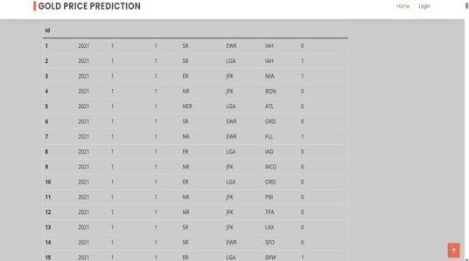
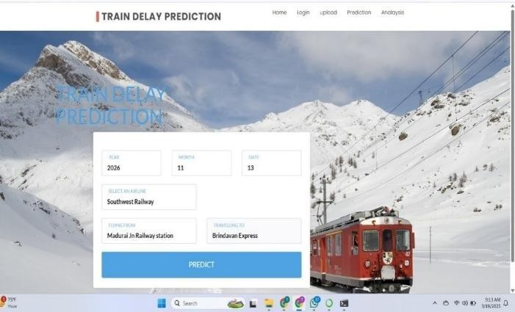
Fig.1 represents a Train Delay Prediction System. Such models aim to estimate train delays based on historical data, real-time conditions and various influencing factors. It makes the interface visually engaging while subtly highlighting external conditions like snow that can impact railway operations. This finally helps railway operators, passengers and logistics companies minimize disruptions, optimize schedules and improve travel planning.
Table.1
VII. CONCLUSION
The development of a predictive model for train delays in railway systems is a crucial step toward enhancing operational efficiency, improving passenger satisfaction and optimizing allocation. By using advanced computational techniques, predictive models enable railway operators to anticipate delays and take proactive measures. The predictive modelling process typically involves various machine learning and deep learning methods, including regression models, decision trees, SVMs have been utilized to improve accuracy. The inclusion of external factors enhances the model’s robustness. With improved delay predictions, passengers receive timely and reliable updates, reducing uncertainty and dissatisfaction. Real-time delay forecasting helps in better trip planning, thereby increasing confidence in railway transportation systems. Minimizing delays reduces operational costs associated with compensation claims, rescheduling and maintenance. By identifying root causes of frequent delays, railway authorities can implement targeted improvements in infrastructure, scheduling and resource allocation. The predictive modelling of train delays represents a transformative approach for modern railway systems. With continuous advancements in AI, machine learning and real-time data integration, railway networks can achieve higher efficiency, minimize
Fig.1
Table 1 appears to be related to a Gold Price Prediction system, as indicated by the title. However, the structure of the data suggests it may also represent a format commonly used in predictive models for train delays (if adapted for that purpose). The table consists of multiple columns with numerical and categorical values, which likely represent different features in a machine learning model. If we assume this dataset is adapted for train delay prediction, the columns could be interpreted as Id: Unique identifier for each data entry. Year, Month, Day: Time-based factors that help identify seasonal trends and recurring patterns in delays. Railway Code (SR, ER, NR, etc.): The specific railway network or zone responsible for the train route. Departure Station (EWR, LGA, JFK, etc.): The station from which the train departs. Arrival Station (IAH, MIA, BQN, etc.): The station where the train is supposed to arrive. Delay Status (0 or 1): A binary label indicating whether the train was delayed (1) or on time (0). Although the table in the image is label for gold price prediction, the structure of the data is highly relevant to train delay prediction. If modified, it could serve as a dataset for a machine learning model that forecasts train delays based on real-time factors.
disruptions and enhance passenger experiences.
Developing real-time data analytics capabilities can enable railway operators to respond quickly to changing minimize delays. Exploring, such as deep learning and reinforcement learning, can lead to even more exxact and robust predictive models. While challenges exist, ongoing research and technological improvements will drive more
accurate, adaptive and intelligent railway delay prediction systems in the future.

Slide 51
VIII. ACKNOWLEDGEMENT
We wish to extend our heartfelt thanking to our guide, Sri.
E. Suresh Sir, for his constant support, invaluable mentorship, and insightful feedback during the course of this study. His skill and encouragement engaged a significant role in forming the success of this study. We also wish to acknowledge the use of Google Collab, a cloud-based platform, which provided us with easy access to powerful computing resources, making the training and testing of our models seamless and efficient. Without these contributions, the
completion of this research would not have been possible.
IX. REFERENCES
[1]. Chao Wen et al. “A predictive model of train delays on railway line” (2020)
[2]. Panukorn Taleongpong et al. “Machine learning techniques to predict reactionary delays and other associated key performance indicators on British railway network”
[3]. Rahul Nair et al. “An ensemble prediction model for train delays”
[4]. Weiwei Mou, “Predictive Model of Train Delays in a Railway System”
[5]. Francesco C. Pavle, K.,2018. Stochastic prediction of train delays in real-time using Bayesian networks.
[6]. Yuan, J., Hansen, I.A.,2007. Optimizing capacity utilization of stations by estimating knock-on train delays. Transportation Research Part B Methodological 41(2):202-217
[7]. Medeossi, G., Longo, G.,Fabris, S.D.,2011. A method for using stochastic blocking times to improve timetable planning. Journal of Rail Transport Planning & Management 1(1):1-13.
[8]. Gorman, M.F.,2009. Statistical estimation of railroad congestion delay. Transportation Research Part E Logistics & Transportation Review 45(3):446-456.
[9]. Kecman, P.,Corman, F.,Meng, L.,2015. Train delay evolution as a stochastic process. International Conference on Railway Operations Modelling & Analysis- railtokyo,2015.
[10]. Olsson, N.O.E.,Haugland, H.,2004. Influencing factors on train punctuality-results from some Norwegian studies. Transport Policy 11(4):387-397

Slide 52


