Slide 1
BATCH 4
Credit Card Fraud Detection Using Logistic Regression and Isolation-Forest Anomaly
Section 8
TEAM
UNDER THE GUIDANCE OF
Bandi Pranavi
Roll No: 2520030026
T.S.S.S. Ananya
Roll No: 2520030039
Shaik Asif
Assistant Professor, CSE
1

Slide 2
Problem Statement
Binary
2 Techniques
5 Metrics
Classification task: Fraud (1) vs Genuine (0)
Logistic Regression + Isolation Forest (hybrid)
Accuracy · Precision · Recall · F1 · ROC-AUC
Target variable
Input features
Transaction outcome — fraudulent (1) or genuine (0) — from the Class column.
28 PCA-anonymized features (V1–V28), transaction Time, and transaction Amount.
Why it matters
Project goal
Fraud is rare (~0.17% of transactions) and constantly evolving; rule-based systems miss new patterns that ML can catch.
Combine an interpretable supervised model (Logistic Regression) with an unsupervised anomaly detector (Isolation Forest) to catch both known and novel fraud.
2

Slide 3
Dataset Identification
Credit Card Fraud Detection Dataset
Source: Kaggle — anonymized European cardholder transactions collected over two days in September 2013.
284,807 × 31
492
2 Days
creditcard.csv — rows × columns
Fraudulent transactions (0.17%)
Span of transactions captured
Column | Description
Time | Seconds elapsed between this transaction and the first transaction in the dataset.
V1–V28 | 28 PCA-transformed features; original attributes withheld for confidentiality.
Amount | Transaction amount — usable for cost-sensitive evaluation.
Class | Target label: 1 = fraud, 0 = genuine.
Why this dataset: real anonymized transactions with a genuine, extreme class imbalance — exactly the scenario a hybrid supervised + anomaly-detection approach is designed for.
3

Slide 4
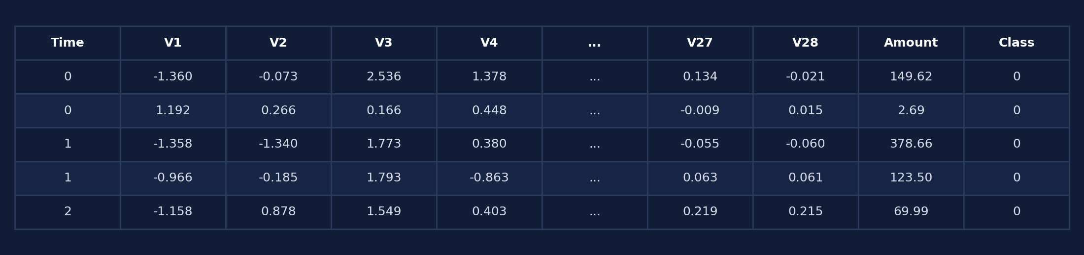
Dataset Snapshot
creditcard.csv — df.shape / df.head()
284,807 rows × 31 columns — all numeric (float64 × 30, int64 × 1)
No missing values in any column (confirmed via df.isnull().sum())
V1–V28 are PCA components already centered around 0
4

Slide 5
Data Cleaning & Preparation
Missing values — df.isnull().sum()
Key preprocessing steps
Time
0
No imputation needed
V1
0
Dataset ships fully clean — confirmed zero nulls across every column, so no row/column drops or fills are required.
V2
0
V3
0
Feature scaling (Time & Amount)
...
0
V1–V28 are already PCA-scaled; Time and Amount are standardized (StandardScaler / RobustScaler) so they don’t dominate distance- and gradient-based steps.
V26
0
V27
0
Class imbalance handling
V28
0
With fraud at just 0.17% of rows, techniques such as SMOTE, class-weighting, or undersampling are applied before/during model training.
Amount
0
Class
0
Train/test split
Total missing values across all 284,807 rows: 0
Stratified split preserves the fraud ratio in both sets so evaluation reflects real-world class distribution.
5

Slide 6
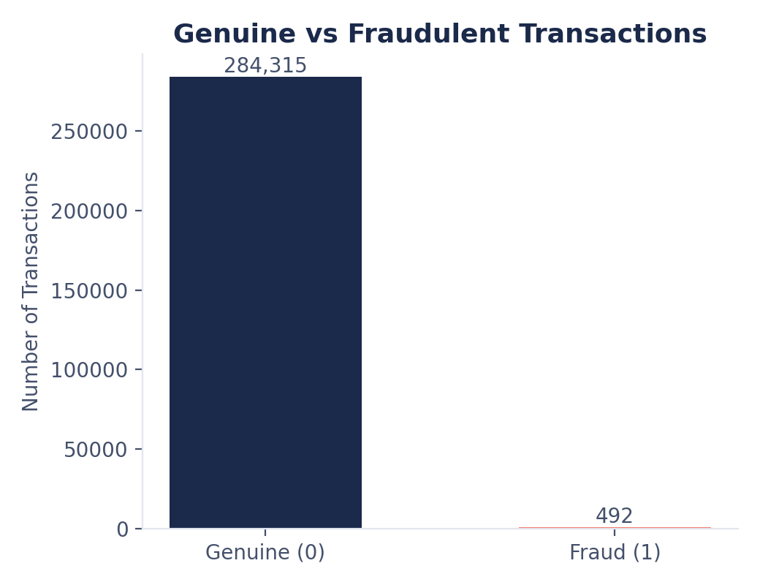
EXPLORATORY ANALYSIS
EDA — Class Distribution
99.83%
Genuine transactions (284,315)
0.17%
Fraudulent transactions (492)
Takeaway: Genuine transactions make up 99.83% of the data versus just 0.17% fraud (492 of 284,807) — a severe class imbalance that plain accuracy cannot capture, motivating the Isolation Forest component and imbalance-aware evaluation (precision, recall, F1, ROC-AUC).
6

Slide 7
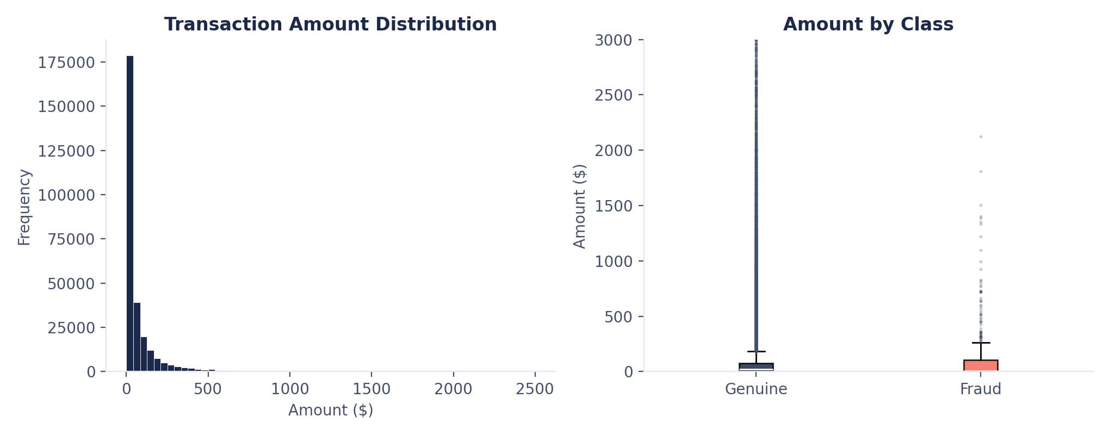
EDA — Transaction Amount Analysis
Takeaway: Amounts are heavily right-skewed — median ≈ $22, most transactions under $100, with a long tail of large purchases. Fraudulent transactions cluster at lower amounts, suggesting fraudsters test with small charges; Amount will need scaling before modeling.
7

Slide 8
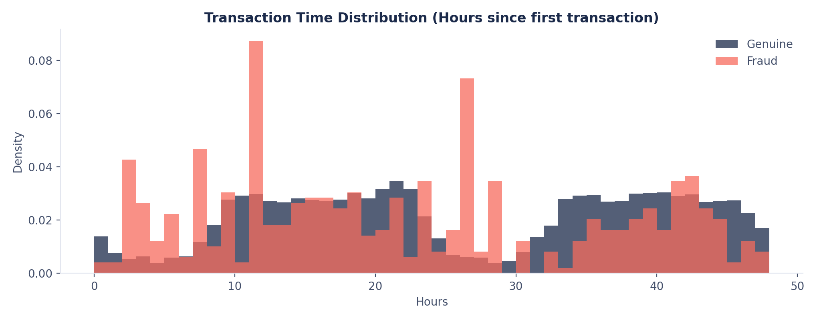
EDA — Transaction Time Analysis
Takeaway: Transaction volume follows a clear day/night cycle across the two captured days, dipping overnight and peaking mid-day. Fraud shows a flatter, less cyclical pattern — fraudulent activity is not tied to normal daytime spending habits, making Time a useful engineered signal.
8

Slide 9
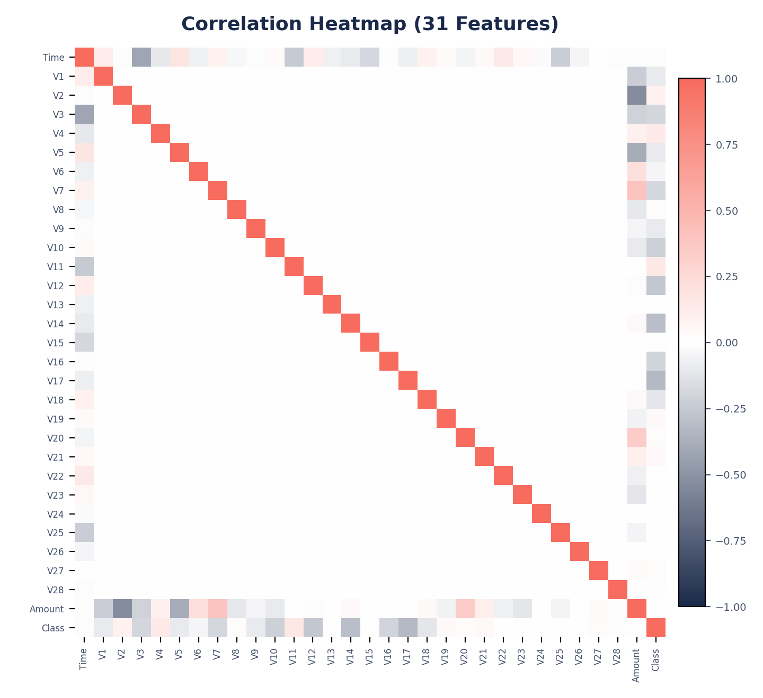
EDA — Correlation Heatmap
What it shows
Most V1–V28 features are weakly correlated with each other — expected, since PCA components are designed to be near-orthogonal.
V17, V14, V12 and V10 show the strongest (negative) correlation with Class — the most informative features for separating fraud from genuine transactions.
No single raw feature is strongly predictive alone, reinforcing the case for a model that combines multiple weak signals.
Implication:
Predictive power will come mainly from the strongest correlated features plus the anomaly signal from Isolation Forest — not from any one raw column alone.
9

Slide 10
Methodology (Planned)
1
2
3
4
5
Preprocessing
Imbalance Handling
Train/Test Split
Model Training
Evaluation
Scale Time & Amount, confirm no nulls, encode target
SMOTE / class-weighting for the 0.17% fraud rate
Stratified split to preserve the fraud ratio
Logistic Regression (supervised) + Isolation Forest (unsupervised)
Accuracy, precision, recall, F1-score, ROC-AUC
→
→
→
→
Why combine two models: Logistic Regression offers interpretability and learns known fraud patterns from labeled data. Isolation Forest needs no labels and can flag new, previously unseen fraud types by isolating anomalies. Combining both maximizes rare-fraud detection while keeping false positives low.
10

Slide 11
THANK YOU
Credit Card Fraud Detection — Section 8, Batch 4
11

