Slide 1

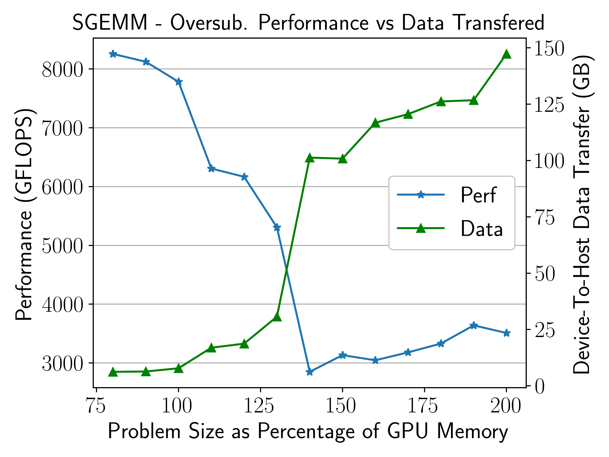
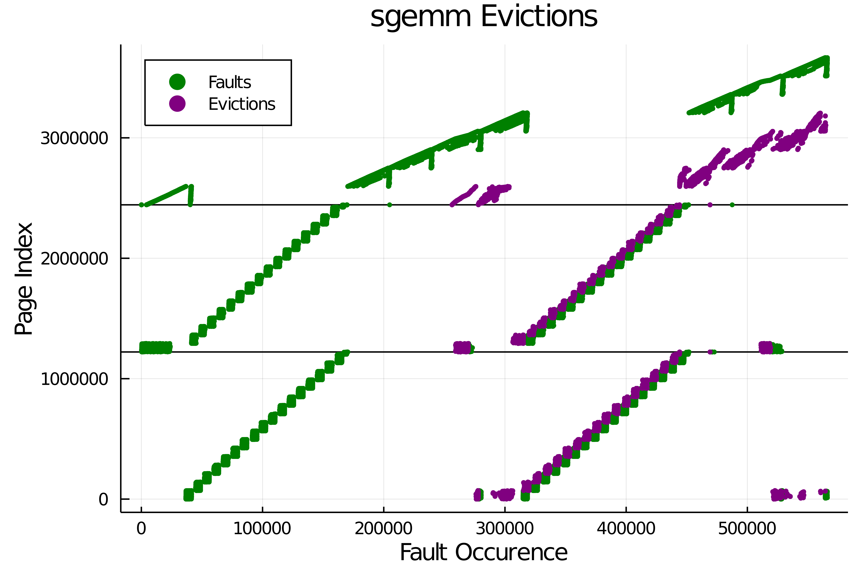
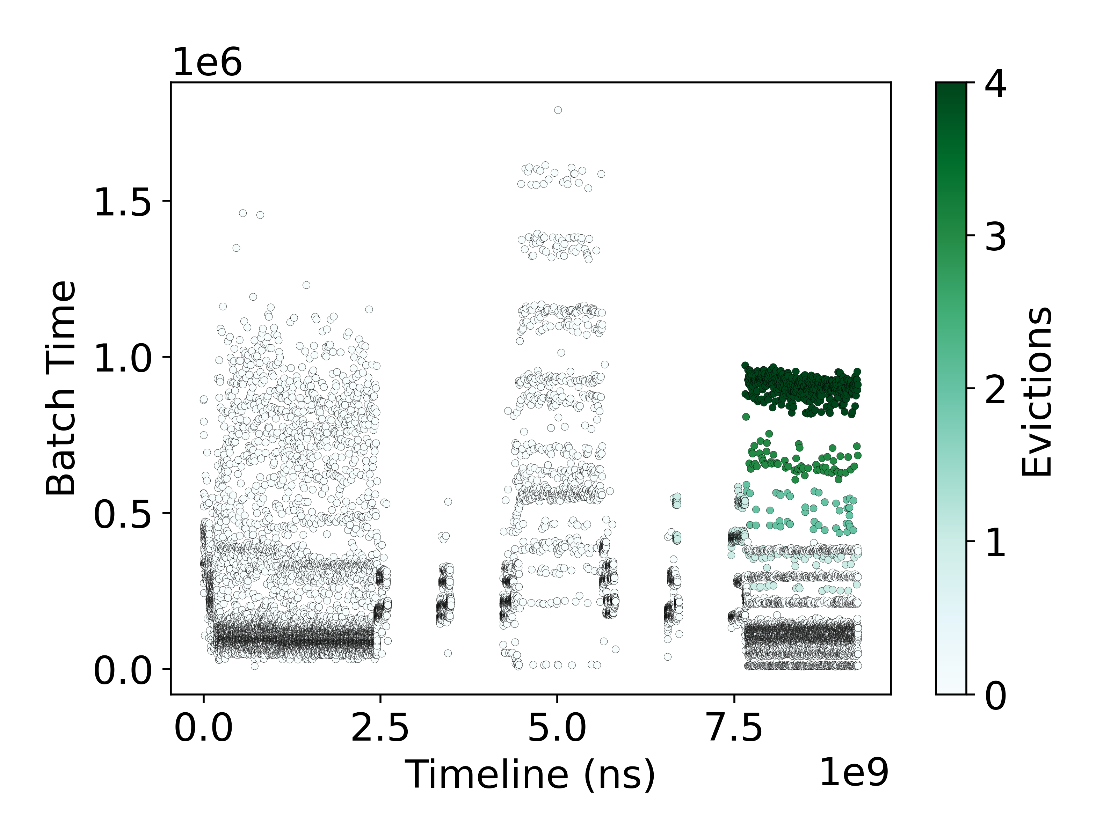
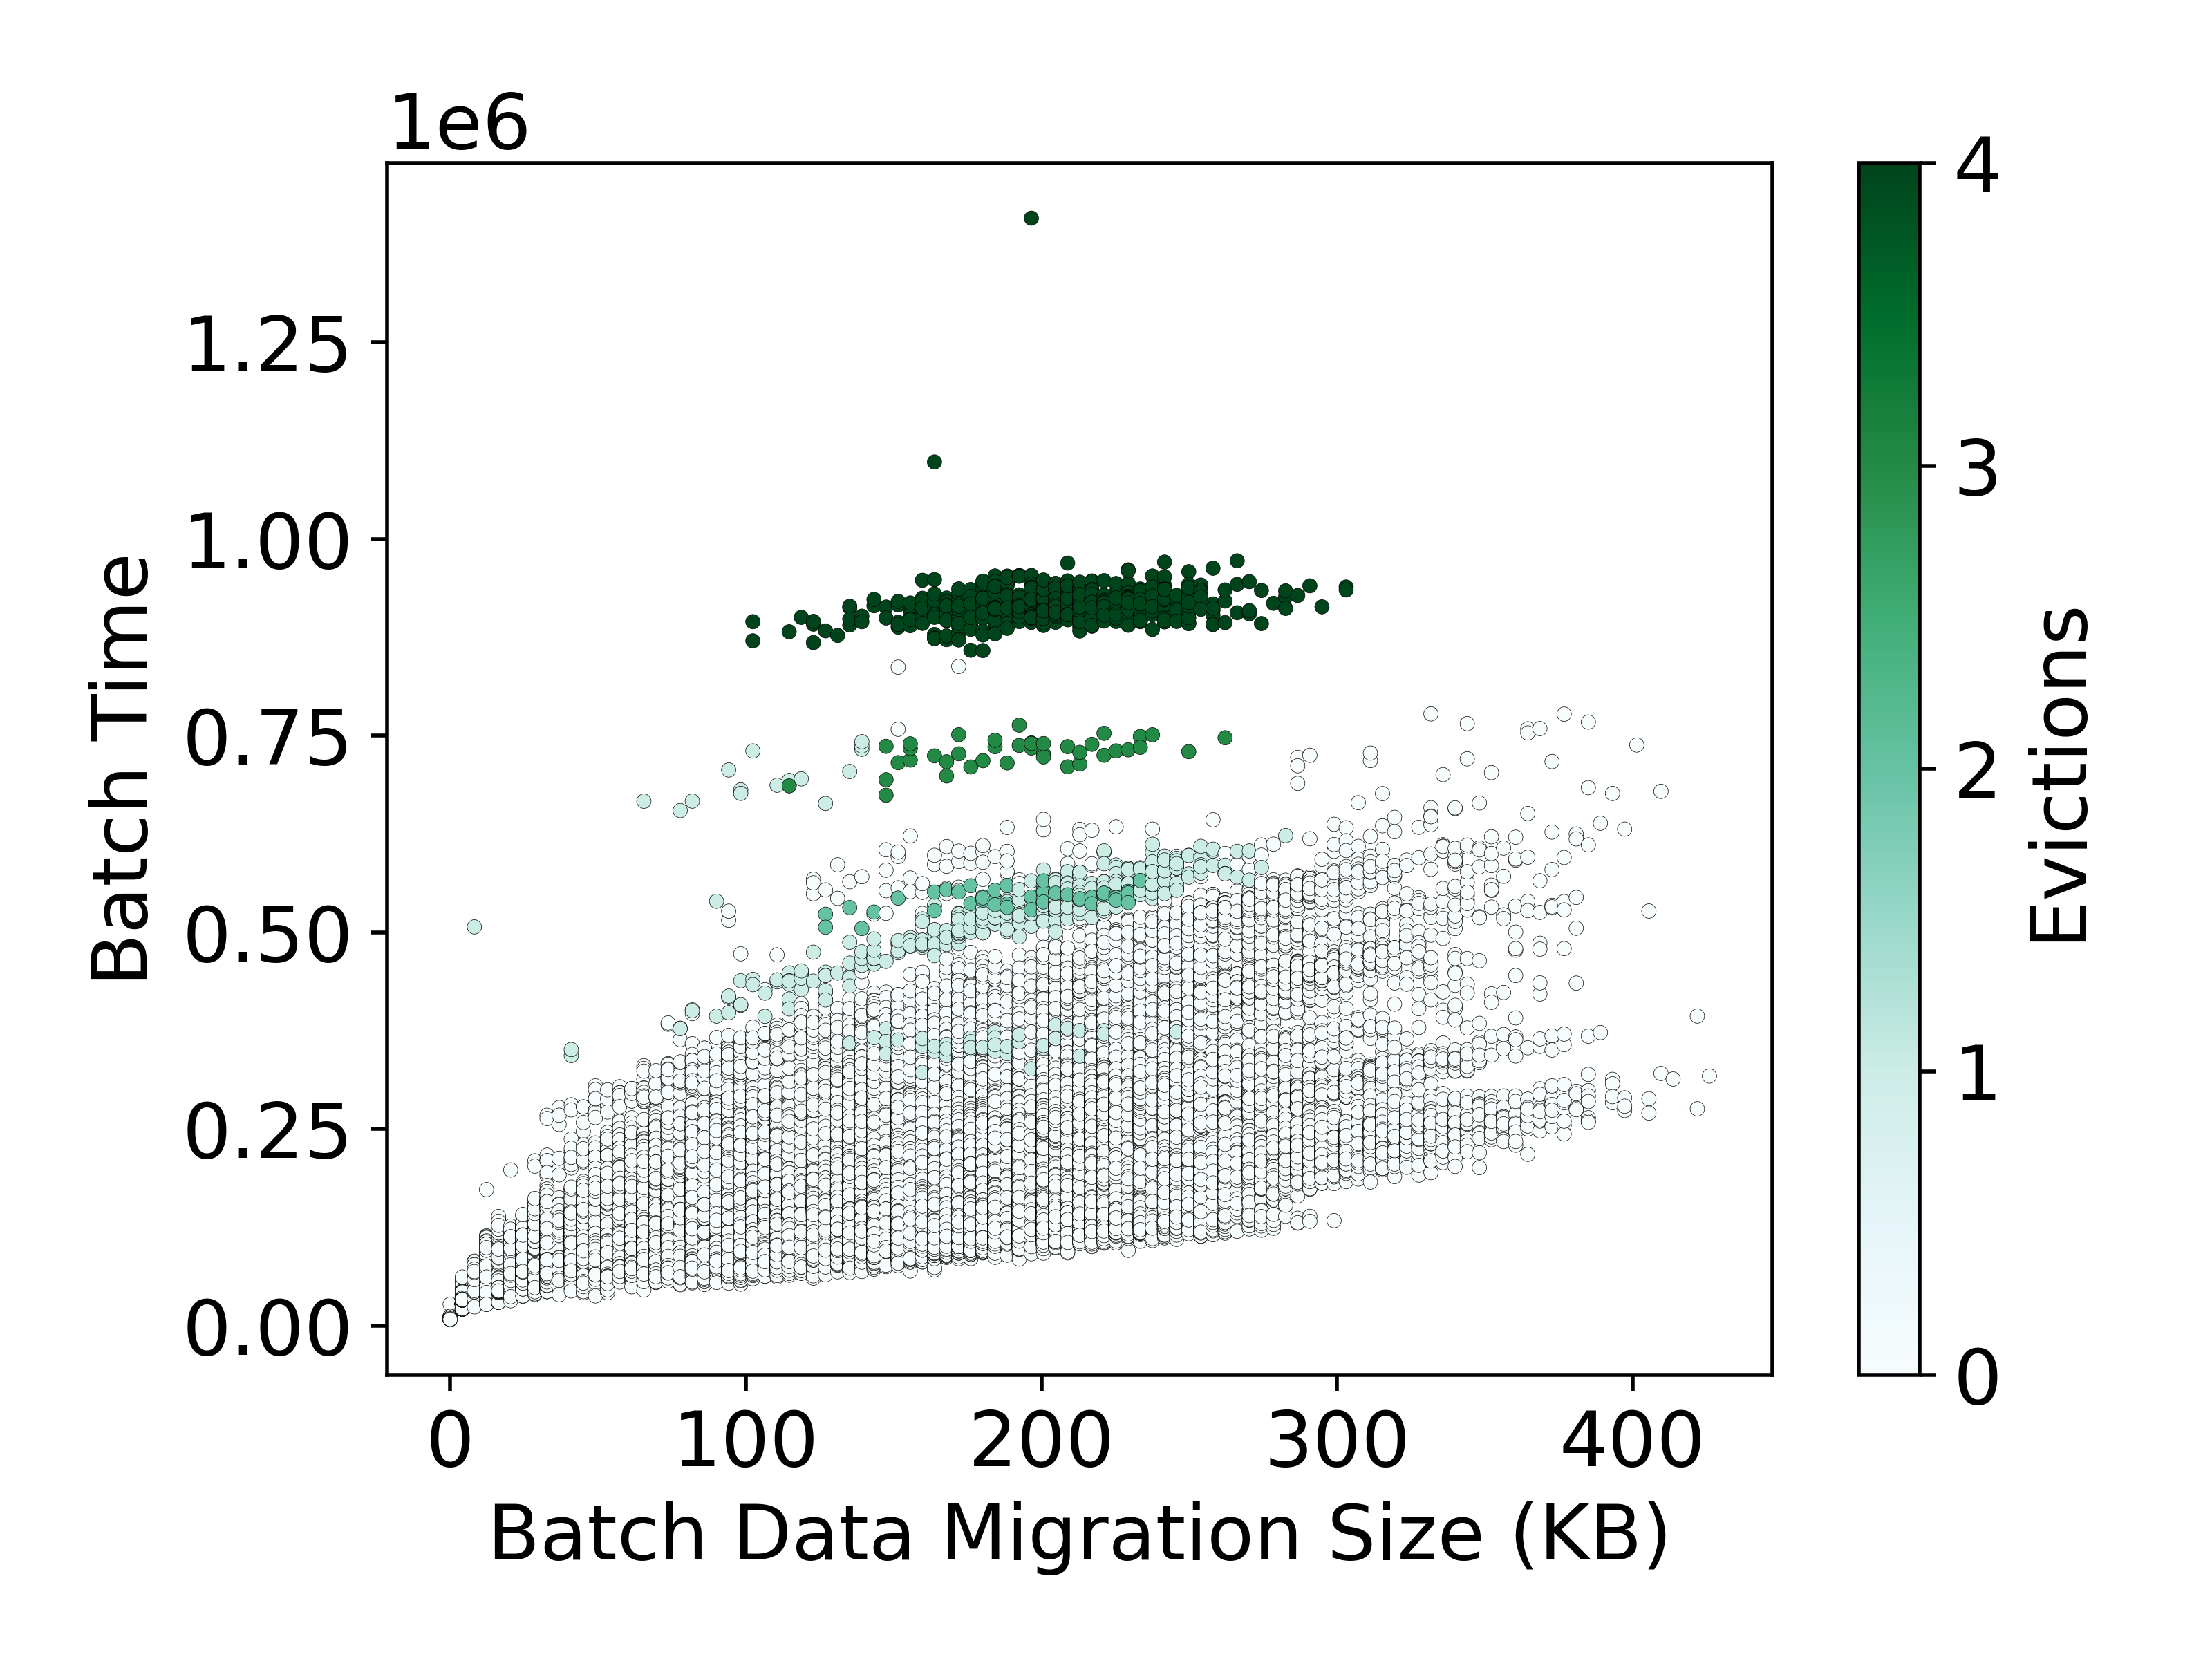
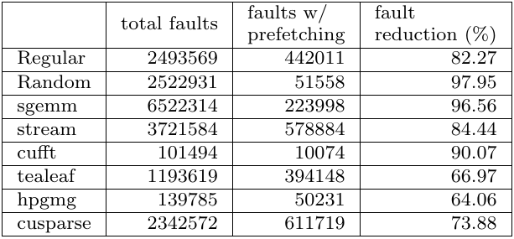
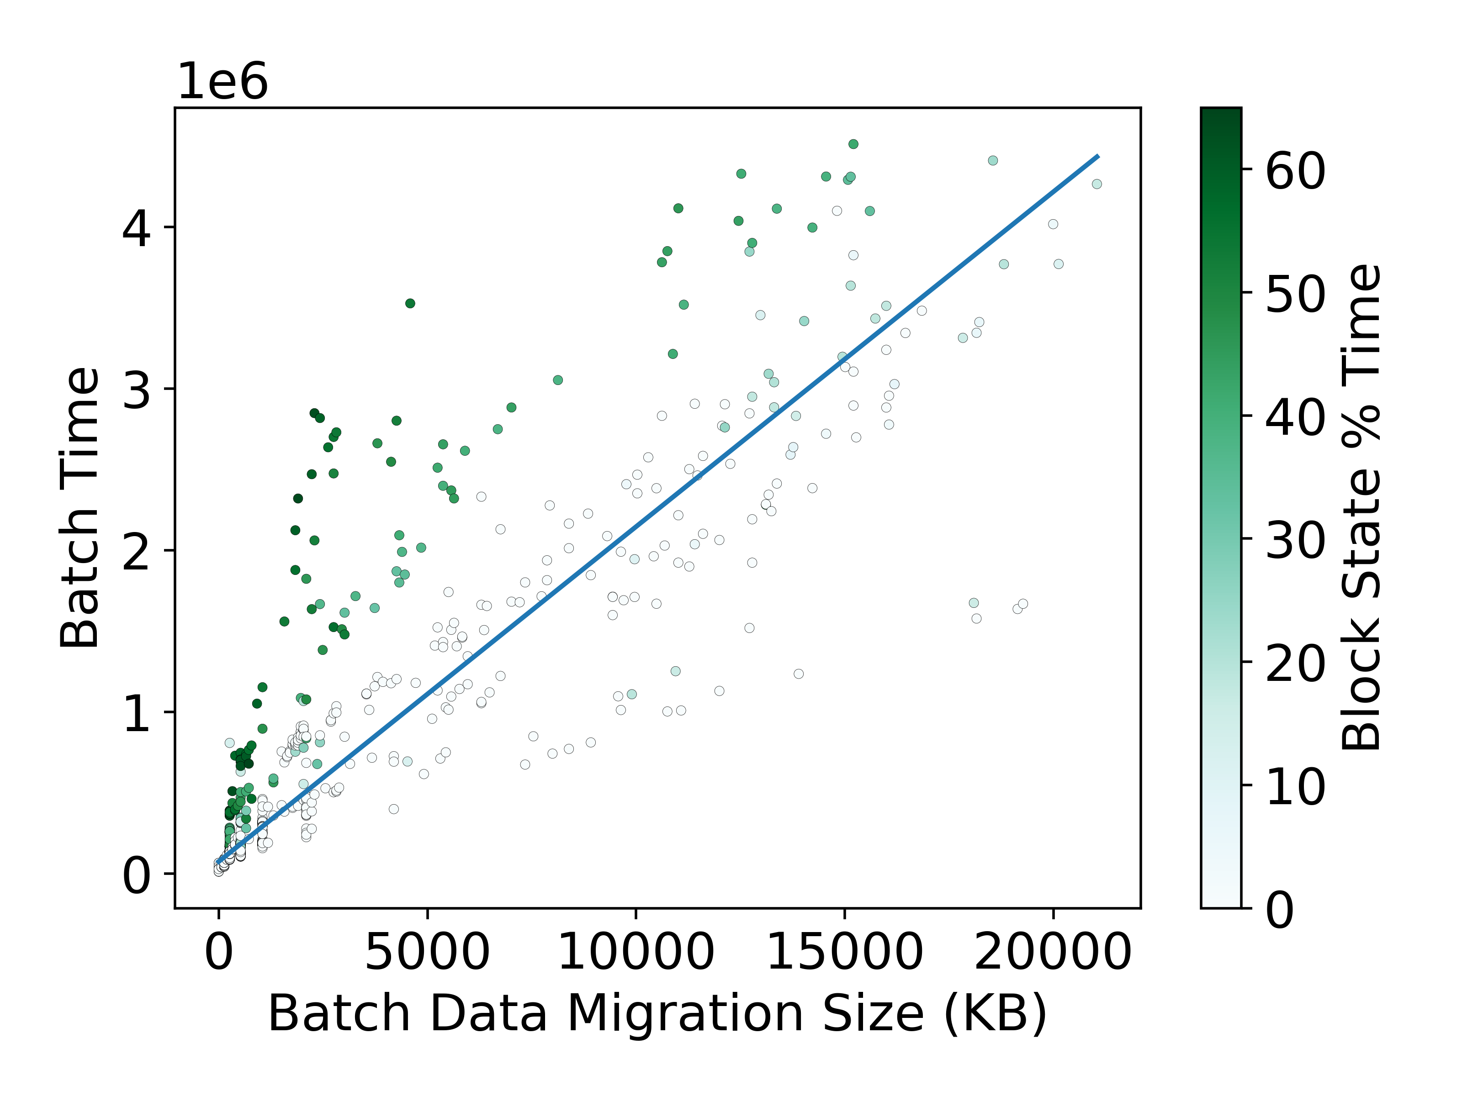
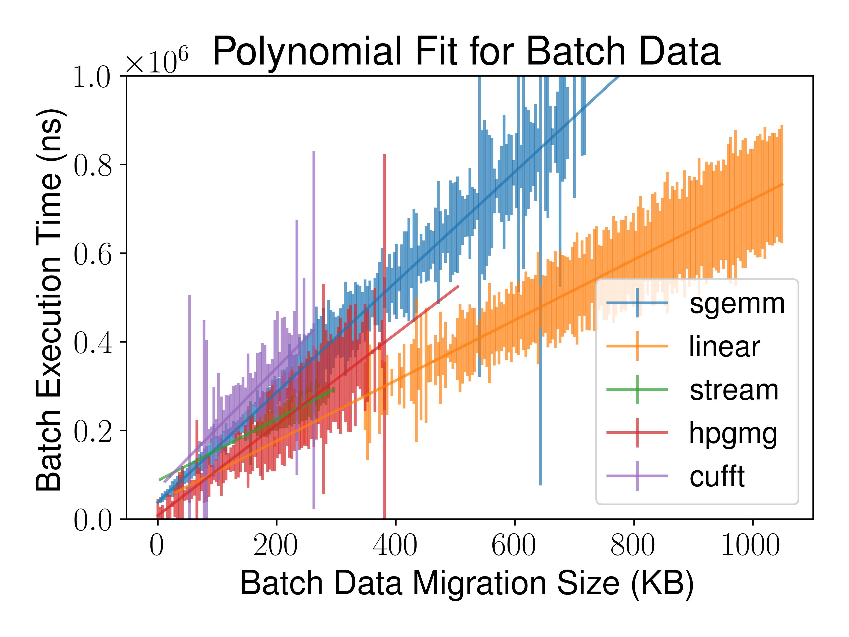
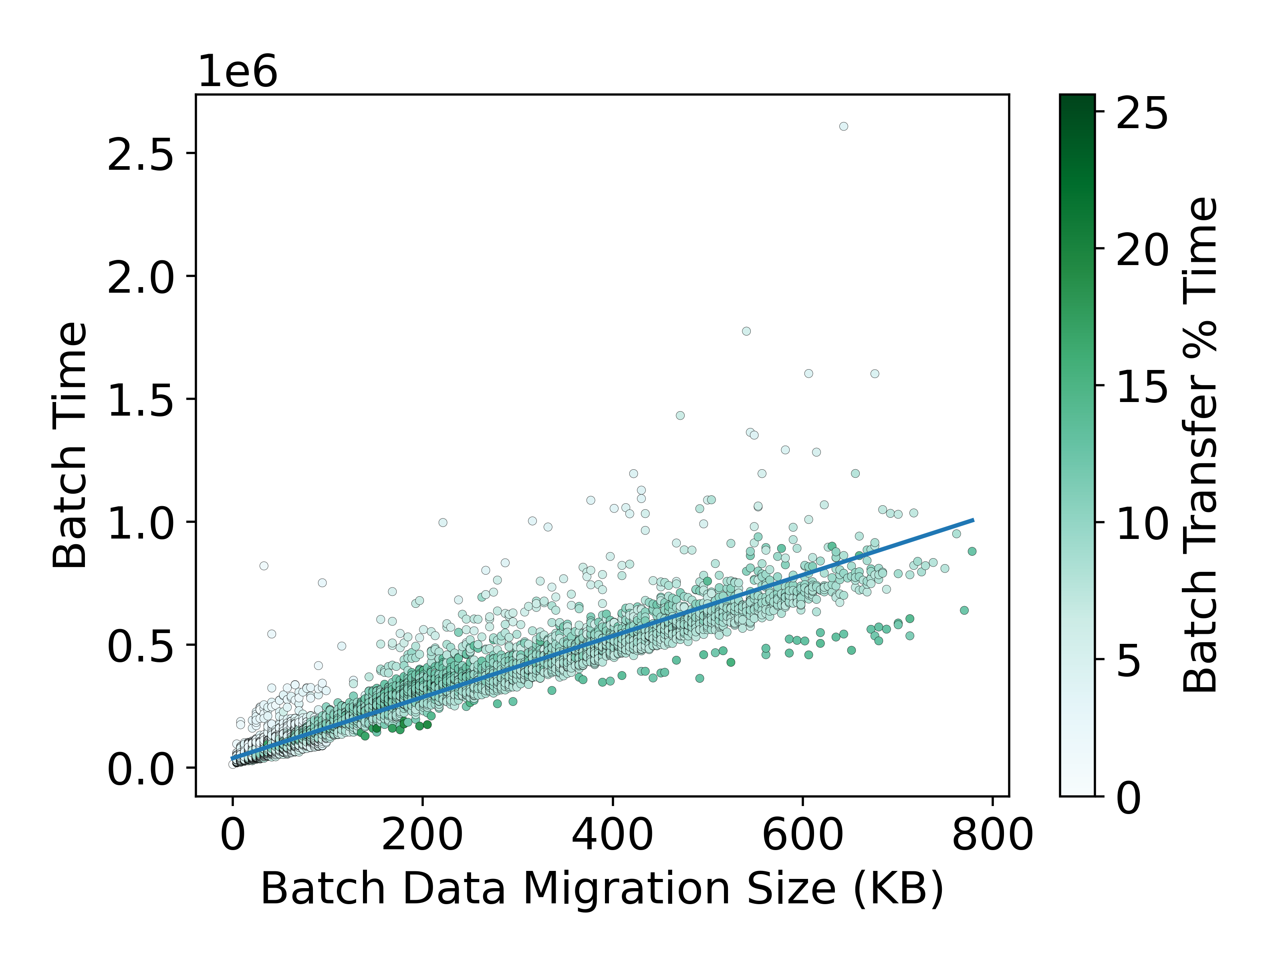
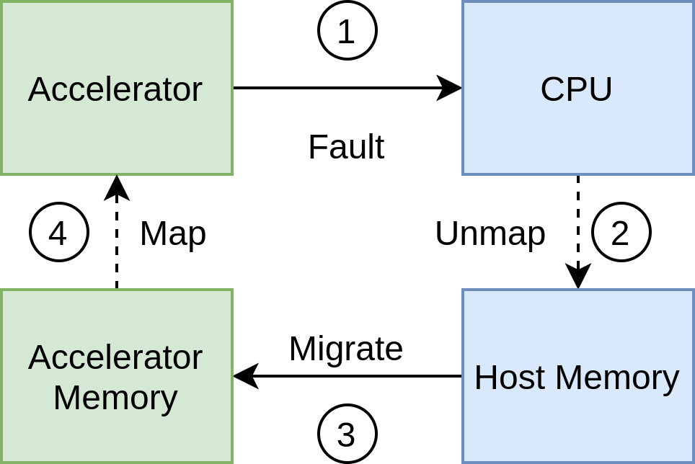
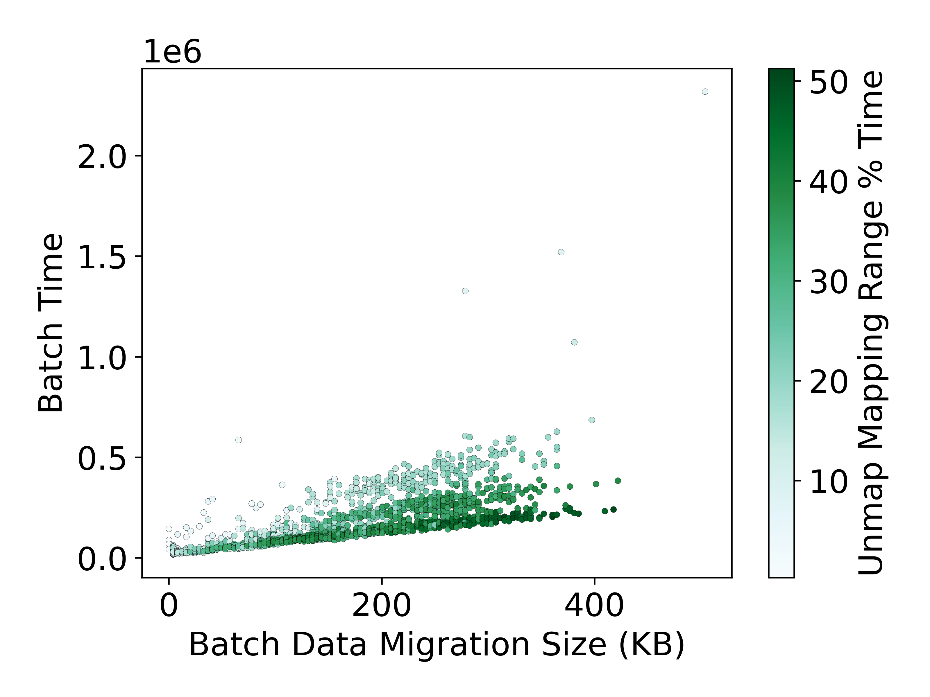
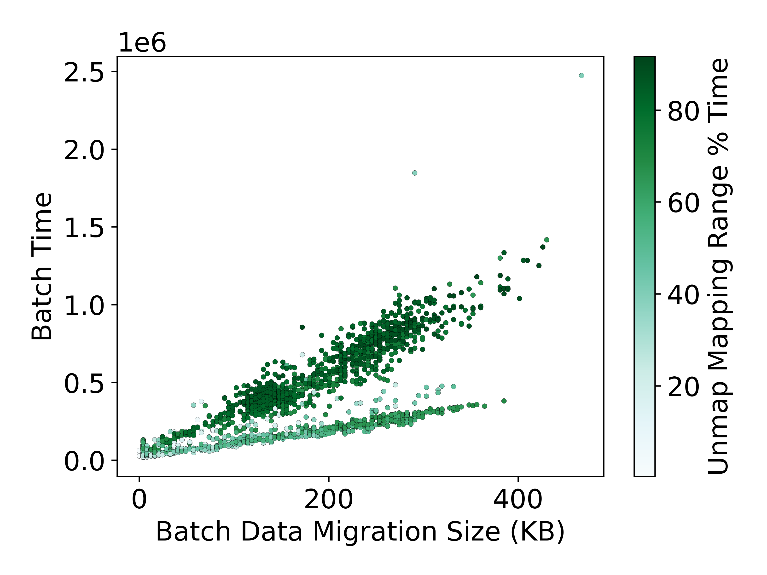


Holistic Performance Analysis and Optimization of Unified Virtual Memory
Tyler Allen, Rong Ge (Adviser)
Motivation
Technologies such as Unified Virtual Memory (UVM) and Heterogeneous Memory Management (HMM) handle physical memory placement for programmers in systems software on heterogeneous systems.
This makes heterogeneous systems easier to program and makes code more portable.
UVM increasingly adopted by applications, frameworks, such as Kokkos, Raja, and Trilinos.
Problem: Trade-off is potentially significant lost of overall application performance.
UVM performance loss not well understood at systems software level, but improvement would benefit all implementing applications.
In our work, we examine systemic performance and workload characteristics of UVM to gain insights into how these technologies can be improved, and then work to optimize them.
High-Level Performance
For UVM, we identify that the majority of cost at scale falls into the “service faults” category.
The breakdown of service faults is primarily attributed to the unmap → migrate → map process, with negligible overhead at scale for operations such as memory allocation
Prefetching
UVM implements a density prefetching mechanism to reduce faults and improve overall performance. We show the page-level access pattern of several applications to show the workload of this prefetcher.
Oversubscription
Eviction uses LRU from host driver perspective; page fault updates virtual address block (2MB) position in LRU list.
Highly-used regions can be evicted early; once all data has been paged to device, it can no longer move up in LRU list.
Evicted pages must be paged back (left).
Evicted data is highly correlated with performance (right).
Eviction occurs once memory is fully allocated. (left)
Eviction has a flat cost based on # of evictions. (right)
In practice, the prefetcher is able to reduce total number of page faults by up to 96%.
Notably, prefetching is very effective but cannot remove all overhead; costs like page unmapping and DMA setup (shown below) cannot be avoided and are a larger percentage of overhead with prefetching.
Prefetching notably decreases the number of batches seen, reducing the baseline overhead despite bulk costs.
The trade-offs for prefetching occur when oversubscription is enabled, potentially increasing the amount of evicted data.
Data Size and Migration
UVM batches faults as an optimization to reduce overall overhead.
In practice, the amount of data migrated is correlated with the time required to process, but shows wide variance within each application and different trends between applications
Performance analysis shows that time spent actually transferring data is not the majority of cost, contrary to intuition, indicating that variance is related to other system operations
Key Findings/Discussion
Data transfer is not the primary cost of UVM; higher bandwidth can improve performance but is not the main issue.
System costs like building DMA connections and TLB shootdowns are a primary source of overhead.
Prefetching is effective but cannot eliminate these overheads.
Oversubscription/eviction has flat cost and does not antagonize system costs, but is subject to them.
Optimizing these costs can improve all application performance in addition to application-specific optimizations.
Background
UVM and HMM are two examples of technologies implementing heterogeneous shared memory.
Heterogeneous shared memory systems fundamentally use on-demand page migration as the backing technology for physical memory placement.
Physical pages are migrated when page faults occur on OS virtual memory pages on any device.
Although there are many implementations and optimizations, fundamentally this process is 4 steps: fault → unmap → migrate → map
Optimization
Optimization focusing on page unmapping and system-level improvements is in-progress and to be added in September.
Page Unmapping
A primary source of overhead is CPU page unmapping.
This overhead can account for up to 50% of batch execution time (left), and over 80% in certain scenarios with CPU parallelization (right).
Tracing indicates that this overhead is likely attributed to TLB shootdowns.
Publications
Tyler Allen, Rong Ge, “In-Depth Analyses of Unified Virtual Memory System for GPU Accelerated Computing”, Supercomputing 2021
Tyler Allen, Rong Ge, “Demystifying GPU UVM Cost with Deep Runtime and Workload Analysis,” 2021 IEEE International Parallel and Distributed Processing Symposium (IPDPS), 2021, pp. 141-150, 10.1109/IPDPS49936.2021.00023
Student Author
Poster
Reproducibility

