Slide 1
EA999
Curso de Projeto para circuitos lógicos e aplicação em áudio
VHDL em poucas palavras (curso intensivo para design RTL)
Projeto: Audio Synthesizer (funções básicas e extras)
Organização: calendário e regras do jogo

Slide 2
VHDL_01: Basics & RTL Block Design
VHDL Block Description
Entity / Architecture
Ports / Signals
Syntax: Data Types, Operators, Comments, …
Statements: concurrents vs. Sequential
Processes for FF or Reg- and Comb-Logic
RTL Diagram
Counters

Slide 3
VHDL_01: Basics & RTL Block Design
Examples
MUX2TO1.VHD
GRAY_DECODER.VHD
HEX2SEVSEG.VHD
SIMPLE_DFF_CIRC.VHD
EDGE_DETECTOR.VHD
MODULO_DIVIDER_SIMPLE.VHD
MODULO_DIVIDER.VHD

Slide 4
VHDL_01: Basics & RTL Block Design
Laboratório
Counter from schematics to VHDL

Slide 5
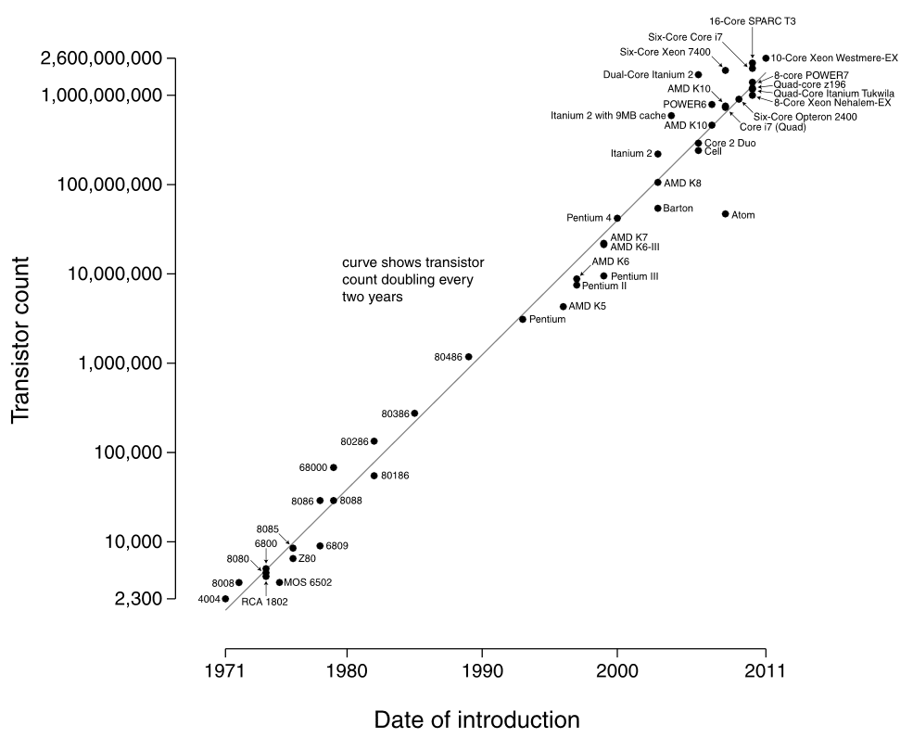

Why do we need a HW-Description-Language? Growth of number of transistor pro IC
Notes:
Gordon E. Moore cofounder of Intel postulated in 1965 the so called Moores Law. According to his law, the number of components which can be put on an IC in an economical manner doubles every two years.

Slide 6
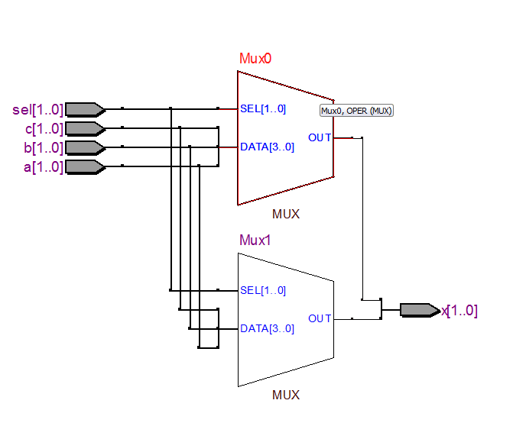
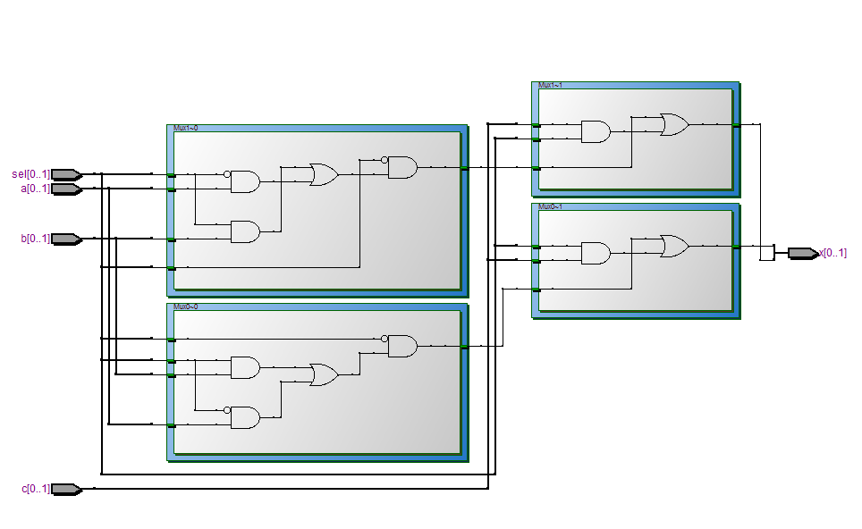
VHDL Synthesis vs. Simulation
ARCHITECTURE comb OF mux_beispiel IS BEGIN muxer: PROCESS(sel,a,b,c,d) BEGIN CASE sel IS WHEN "00" => x <= a; WHEN "01" => x <= b; WHEN “10" => x <= c; WHEN OTHERS => x <= d; END CASE; END PROCESS muxer; END comb;
VHDL Description
RTL View
Technologie MAP View
Notes:
VHDL code can be used for synthsis (transformation into logic gates) or simulation
The compiler first transforms vhdl instructions into a generic schematic, which often consists of multiplexers, adders or logic gates if obvious
The generic schematic is then transformed into the logic blocks, which are based on the libraries of the target technologie

Slide 7
Common Hardware Description Languages
Language | VHDL | Verilog
Introduction | 1987 from the US Department of Defense also adopted/further developed as IEEE Standard | 1984 from the semiconductor industry
The abreviations stand for:
VHDL: VHSIC Hardware Description Language VHSIC: Very High Speed Integrated Circuit
Notes:
While the capabilites of Verilog and VHDL are very similar, the syntax however is completely different.
Verilog, initiated by the electronics industrie, came to the market a bit earlier then VHDL, which was initiate by the defense industrie.
While in the US, many designers are more aquainted with Verilog, European designers are more used to VHDL.

Slide 8
Structure of a VHDL Description

Slide 9
Basic Elements of a VHDL Description
Notes:
VHDL is based on the 4 Elements: Package, Entity, Architecture and Configuration.
All 4 Elements could be contained in one file or each element can be in a different file.
Usually Entity and Architecture are contained in one file.
Package and Configuration are often contained in a separate files

Slide 10
VHDL Template
LIBRARY ieee; USE ieee.std_logic_1164.all;
ENTITY entity_name IS
PORT(signal1 :mode type;
signal2 :mode type);
END ENTITY entity_name;
ARCHITECTURE name OF entity_name IS
-- internal signal and constant -- declarations
BEGIN
Concurrent statement 1;
Concurrent statement 2;
Concurrent statement 3;
Concurrent statement 4;
END ARCHITECTURE name;

Slide 11
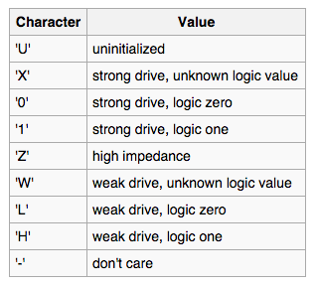
Library
LIBRARY ieee; USE ieee.std_logic_1164.all;
IEEE: Institute of Electrical and Electronic Engineers
VHDL Standardisierungs Gremium (IEEE 1076)
Notes:
The different data types are defined by Libraries, not by the VHDL programming language.
The libraries must be linked to VHDL code before using data types or functions of the libraries
The ieee is the comitee which standrdises the VHDL language and provides free VHDL libraries (www.ieee.org)
The std_logic_1164 contains amongst others the std_logic signal types
The numeric_std contains amongst others also the aritmetic and conversion functions

Slide 12
Entity
ENTITY <Entityname> IS PORT ( <port>,… : IN¦OUT¦… <Input-Output Type>; <port>,… : IN¦OUT¦… <Input-Output Type> ); END <Entityname> ;
entity name
ENTITY mux_beispiel IS PORT ( a,b : IN std_logic; sel : IN std_logic; x : OUT std_logic ); END mux_beispiel;
port names
port mode (direction)
Notes:
A VHDL Entity is the description of the shell of a block, it describes all inputs and outputs of a block. It is comparable of the .bsf file of Quartus Schematic design
The Name of the Entity «mux_beispiel» must be the same at the END of the Entity
Port is the Listing of all inputs and outputs of the Entity
Std_logic_vector is a data type, a representation of the characteristics of the input or outputs of the Entity

Slide 13
Syntax: Definition von Signalen und Vektoren
std_logic ; -- single bit signal or port std_logic_vector (3 DOWNTO 0) ; -- vector with 4 bits
MSB of the Vector
LSB of the Vector
Notes:
Std_logic_vector is a data type, a representation of the characteristics of the input or outputs of the Entity
A bus is called a vector the vector with and direction is defined as n downto 0

Slide 14
Architecture
ARCHITECTURE <architecture name> OF <entity name> IS [<architecture declarations>;]
BEGIN {VHDL instructions;}
END <architecture name> ;
ARCHITECTURE comb OF mux_beispiel IS BEGIN x <= a WHEN (sel = '1') ELSE b;
END comb;
a
sel = 1
b
sel = 0
x
sel
Notes:
Architecture and Entity belong together and are a pair.
The Architecture describes the content of a design
The architecture has a name different to the entity in this case «comb» and referes to an entity «OF»
At the END of the architecture, the name of the architecture has to appear again

Slide 15
VHDL Example – Concurrent Statements
-- Code Fragment A
Architecture test of example is
begin
y1 <= a and b;
y2 <= c and d;
y <= y1 or y2;
end architecture test;
-- Code Fragment B
Architecture test of example is
begin
y1 <= a and b;
y <= y1 or y2;
y2 <= c and d;
end architecture test;
-- Code Fragment C
Architecture test of example is
begin
y <= y1 or y2;
y1 <= a and b;
y2 <= c and d;
end architecture test;
The same HW results from these 3 descriptions!
Notes:
The sequence of the statements among concurrent statements is irrelevant!
Because all HW components will be synthesized as gates.

Slide 16
Comments in a VHDL Code
-- This is a comment line -- also a 2nd line must start with „--"
ENTITY nand4 IS ( -- Comment from here till end of line
-- VHDL is case insensitive -- Nevertheless define your naming style within your lab group -- Plus Quartus pinning name is case sensitive!

Slide 17
Constants and Signals
Syntax:
CONSTANT name: type := value;
SIGNAL name: type;
Beispiel:
CONSTANT s0: std_logic_vector(1 downto 0):= "01";
SIGNAL gray_code: std_logic_vector(2 downto 0);
Notes:
Use a set of single apostrophes to enclose a single bit (e.g. '1').
Use a set of quotations to enclose multiple bits (e.g. “01”).

Slide 18
Example: Signals and Constants
ARCHITECTURE rtl OF decoder IS SIGNAL gray_code : std_logic_vector(2 downto 0); SIGNAL my_code : std_logic_vector(2 downto 0);
CONSTANT gray0 : std_logic_vector(2 downto 0) := "000"; CONSTANT gray1 : std_logic_vector(2 downto 0) := "001"; CONSTANT gray2 : std_logic_vector(2 downto 0) := "010"; BEGIN –-Begin of the Architecture …
Notes:
In order to connect design blocks within an entity, signals are used.
Constants are, like in any other programming language, used to define a constant value, they need to have a values assigned to it.
Variables are treated like variables in any other programming language, but can be used in processes only and are not accesible outside the process (More about varibles later)
Signals are like port definitions, but do not have a direction attached (IN, OUT) to it.
Connecting two or more logic blocks inside an entity together is accomplished with signals
Connecting a logic block to the outside of an entity is accomplished with a port
Signals and Variables may have a value attached to it, but one should consider, that after power up of a system, signals and variables are undefined until they are assigned in the Architecture or Process. Therefore a simulation with assigned initial values is not realistic.

Slide 19
Pre-Defined Datatypes for Signals and Variables
Datatype | Possible values
integer | 0, 1, 2, 345, 4, -1, -2, -3
boolean | True oder false
bit | '1' oder '0'
bit_vector | „0010110"
std_logic | U uninitialized X forcing unknown 0 forcing zero 1 Forcing one Z High Impedance W weak unknown L weak zero H weak one - don't care
std_logic_vector | "0010110" oder "HHHHLLH"
unsigned | „0010110"
signed | „0010110"
To be avoided
Notes:
Integers can be positve and negative values
Boolean can defines a true or false result of an operation
Bit can be 1 or 0
Bit vector is equivalent to bit, but describes a parallel bus
Std_logic includes also the metastates of a signal, like undefined, not driving any current (high impedance), or pulled up or down by a resistor
Std_logic_vector is equivalent tu std_logic, but signifies a bundle of signals
Unsigned defines a bus, but does not assume the MSB a the sign bit
Signed defines a bus

Slide 20
Operators

Slide 21
Syntax: Assignment of Ports or Signals
<= | Assignment operator for signals and ports | S <= ( a AND b)
<signal> <= '1'; -- Zuweisen eines Signales auf '1' <signal> <= '0'; -- Zuweisen eines Signales auf '0' <signal_1> <= <signal_2>; -- Variable Sig. Zuw. <vektor> <= "100110"; -- Zuweisung auf festen Vector <vektor>(n) <= '<1¦0>'; -- Zuweisung einzelnes Bit v. Vect.
<vektor> <= x"nm"; -- Zuweisung e. hexadezimalen Wertes
Notes:
A signal is an internal connection in a design and equivalent to a wire
A port is an external connection in and out of the Entity
Signals and ports are defined and treated the same
A port does not need to be assigned to a signal again, but sometimes is
A signal can be assignet «1», «0» «z» …
A signal can be assigned with the value of another signal

Slide 22
Example of Logical Operators
logical operator
a <= (b and c) or d ;
c
&
b
>1
a
d
Notes:
In VHDL the expression of conventional logic functions is possible
The type of a, b, c and d in this example is from type boolean (true or false)

Slide 23
Example of Relational Operators
= | gleich
< | kleiner
> | grösser
/= | ungleich
<= | Kleiner gleich
>= | Grösser gleich
SIGNAL a : unsigned (7 DOWNTO 0) ; SIGNAL b : unsigned (7 DOWNTO 0) ; SIGNAL c : std_logic ;
c <= '1' WHEN (a <= b) ELSE '0';
assignment
relational operator
Notes:
The VHDL compiler distinguishes between an assignment and relational operator according to the context

Slide 24
Example of Arithmetical Operators
+ | addition
- | subtraktion
& | Verknüpfungs-operator
* | multiplikation
/ | division
SIGNAL a : unsigned (7 DOWNTO 0) ; SIGNAL b : unsigned (7 DOWNTO 0) ; SIGNAL c : unsigned (7 DOWNTO 0) ; SIGNAL d : unsigned (15 DOWNTO 0);
c <= a + b; -- Addition, but will loose overflow
d <= a & b; -- Concatenation
"0001100110001111" <= "00011001" & "10001111"
Notes:
When synthesizing code using arithmetic operators, the synthesizer uses adders or multipliers if contained in the technologie library of the component
If there are no adders or comparators, the synthesizer builts the functions based on logic gates or cells, which may consume many resources and slow down the maximal clock speed of the resulting circuit considerably

Slide 25
Processes
plus
Concurrent vs. Sequential Statements

Slide 26
Process VHDL 1993
[<process name>:] PROCESS[(<Inputs>,<Inputs>,…)][<process declarations>] BEGIN {<sequential statements>}; END PROCESS [<process name>] ;
ARCHITECTURE comb OF mux_beispiel IS BEGIN muxer: PROCESS(w,a,b) BEGIN IF w = '1' THEN x <= a; ELSE x <= b; END IF; END PROCESS muxer; END comb;
Sensitivity List
list enumerating all process input signals
Sequential Statements
Notes:
A Process is a structure within an Architecture description.
A Process can be considered a design block within an architecture
Within an Architecture there can be many Processes
A Process needs a listing of all ist «Input» signals, these are signals which are «abgefragt» inside the process. This Listing is called sensitivity list.
If a signal gets forgotten on the sensitivity list, the simulation returns wrong results
The details of Process are described later

Slide 27
Syntax: Process
[<process name>:] PROCESS[(<Inputs>,<Inputs>,…)]
[<process declarations>] BEGIN {<sequential statements>}; END PROCESS [<process name>] ;

Slide 28
Each Process Is a Concurrent Statements
ARCHITECTURE comb OF decoder IS BEGIN
END comb;
P1:Process(xxx) Begin … End process p1;
Concurrent Statements
P2: Process(xxx) Begin … End process p2;

Slide 29
Process VHDL 2008
[<process name>:] PROCESS[(<Inputs>,<Inputs>,…)][<process declarations>] BEGIN {<sequential statements>}; END PROCESS [<process name>] ;
Simplified Sensitivity List no need to list all input signals
Attention: need to set Simulator und Compiler for VHDL 2008 syntax
ARCHITECTURE comb OF mux_beispiel IS BEGIN muxer: PROCESS(ALL) BEGIN IF w = '1' THEN x <= a; ELSE x <= b; END IF; END PROCESS muxer; END comb;
Sequential Statements
Notes:
A Process is a structure within an Architecture description.
A Process can be considered a design block within an architecture
Within an Architecture there can be many Processes
A Process needs a listing of all ist «Input» signals, these are signals which are «abgefragt» inside the process. This Listing is called sensitivity list.
If a signal gets forgotten on the sensitivity list, the simulation returns wrong results
The details of Process are described later

Slide 30
Processes Pitfalls
Concurrent Statements (outside processes) | Sequential Statements (inside processes)
overflow <= '0' ; . . overflow <= '1' ; not possible – error message | overflow <= '0' ; . . overflow <= '1' ; possible – code is interpreted line by line. But attention to understand when signals will be updated!

Slide 31
IF-THEN-ELSE Statement
possible inside processes

Slide 32
Example: 2 x 1 Multiplexer mit IF-THEN-ELSE
IF <condition_1> THEN {<sequential statement>;} [ELSIF <condition_2 > THEN {<sequential statement>;} ELSIF … ] [ELSE {<sequential statement>;}] END IF;
Multiplexer21: PROCESS(a,b,sel) BEGIN IF sel = '1' THEN x <= b; ELSE x <= a; END IF; END PROCESS Multiplexer21;
4
sel = 0
a
4
4
b
sel = 1
x
sel
Notes:
A second methhod to generate combinatorial Logic with VHDL is using IF-THEN-ELSE Statements.
If the else statemnets are more flexible then CASE statements

Slide 33
Case Statements
possible inside processes

Slide 34
Example: 4 x 1 Multiplexer mit CASE
2
a
2
"00"
b
"01"
x
c
"10"
d
2
"11"
sel
CASE has no priority
ARCHITECTURE comb OF mux_beispiel IS BEGIN muxer: PROCESS(sel,a,b,c,d) BEGIN CASE sel IS WHEN "00" => x <= a; WHEN "01" => x <= b; WHEN "10" => x <= c; WHEN OTHERS => x <= d; END CASE; END PROCESS muxer; END comb;
Notes:
A CASE is one method in VHDL to describe combinatorial logic
Case is very similar to a truth table sel is the vector description of the Input of the truth table
Each entry of a line that begins with «WHEN» describes the output behavoiour of that trutj table
If a truth table can not be listed complete (in most cases it is impossible, since a signal is not just 1 or 0 but als o Z, x …) WHEN OTHERS covers all thos unlisted combinations. The compiler checks if all combinations are listed

Slide 35
Case Statement in Process
CASE <control input> IS WHEN <test> => {<sequential statements>}; [WHEN <test> => {<sequential statements>};] … [WHEN OTHERS => {<sequential statements>};]
END CASE;

Slide 36
D-Flip-Flop
basic building block with memory
synchronous update (clock controlled flip-flop)
edge triggered storage element

Slide 37
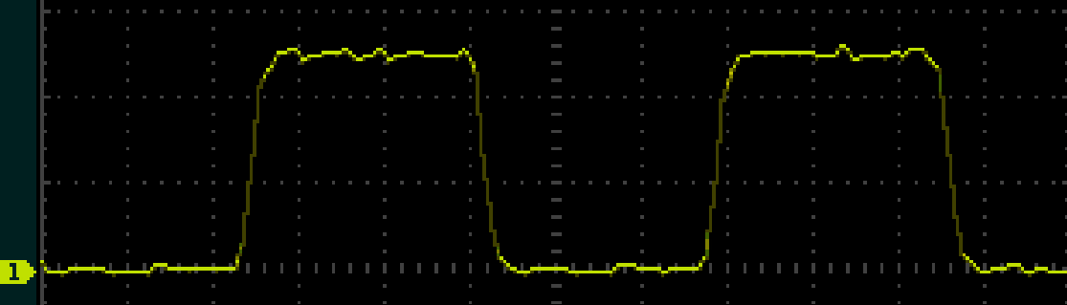
Clock Signal
Measured timing
Abstract timing representation
amplitude [V]
rising edge
Falling edge
T1
T0
with rise and fall times
time [s]
amplitude [V]
T1
without rise and fall times
T0
time [s]
T
period T = T0 + T1 [s] frequency f = 1/T [Hz] duty cycle = T1/T [-]

Slide 38
Clock Signal
Period T
measured in seconds (s)
Frequency f
measured in Hertz (1/s)
i.e. number of cycles per second
T | f
1 s | 1 Hz
1 ms = 10⁻³ s | 1 kHz = 10³ Hz
1 us = 10⁻⁶ s | 1 MHz = 10⁶ Hz
1 ns = 10⁻⁹ s | 1 GHz = 10⁹ Hz

Slide 39
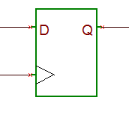
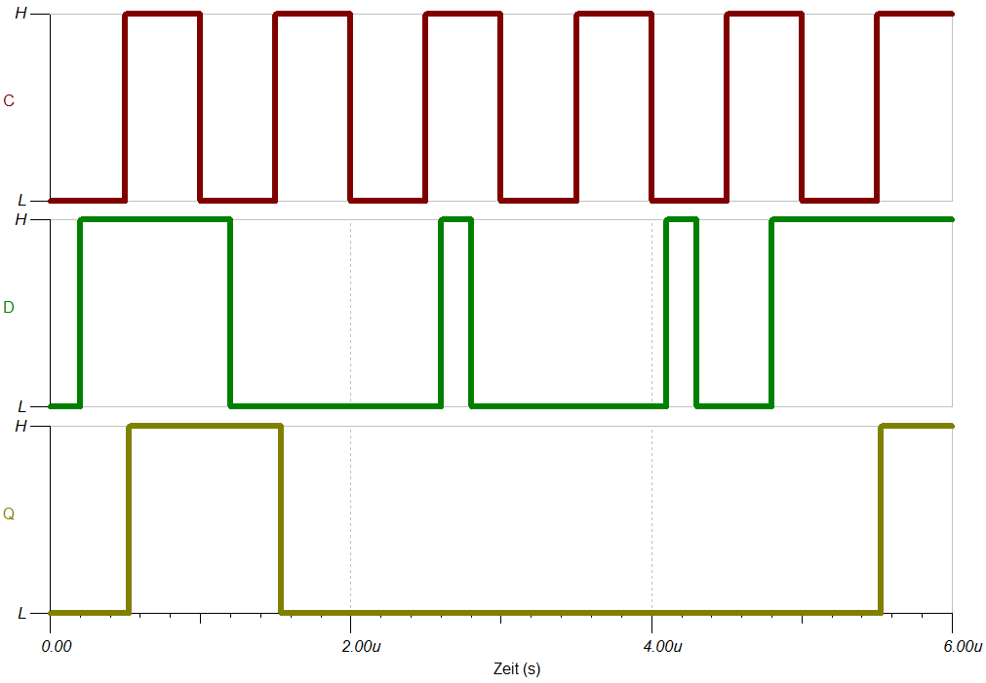
D-Flip-Flop
Edge triggered storage element
rising edge of clk → current value at input D is stored (Q = D)
other times → no change of Q
Basic block of all our sequential circuits
clk
clk
D
value at input D is stored and transferred to output Q, if clk changes from 0 to 1 (0 → 1)
Q
Notes:
Erklären der Funktionen des Flip Flops
Einführen des Zeitverlaufsdiagramms kommt später!
-> Weiteres Bsp. an Tafel erarbeiten

Slide 40
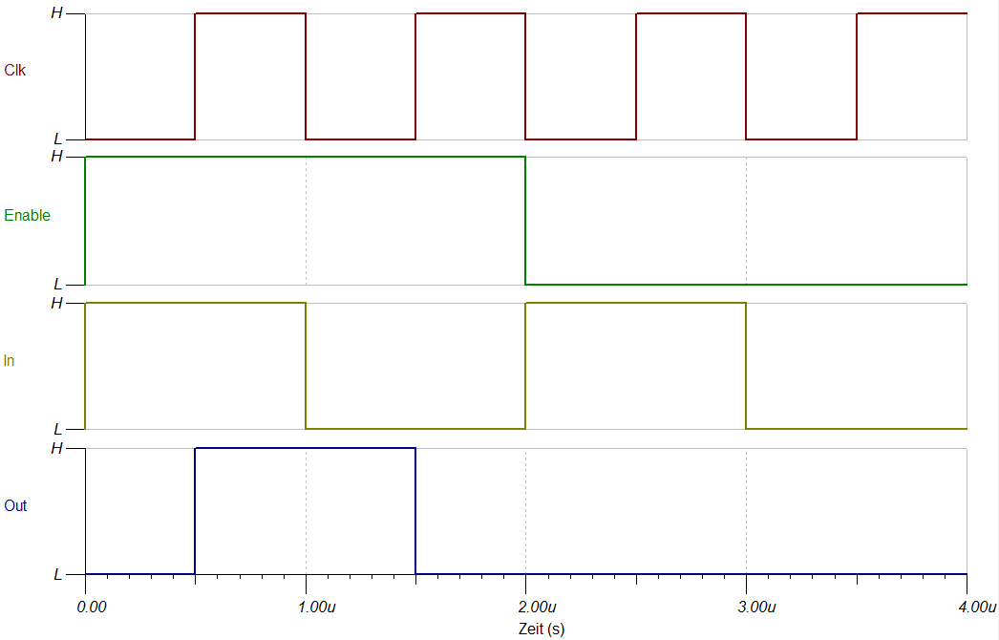
Timing Diagram
Example: flip-flop with multiplexer
0
D-FF
D
D
Q
Q
1
Enable
!Q
clk
clk
Enable
D
Q
Notes:
Timingdiagramm zeigt den Zeitverlauf der digitalen Signale an.
Verlauf von Clk, In und Enable ist gegeben.
Den Verlauf von Out kann ich dann bestimmen.
Anfangszustand des FFs wird als 0 angenommen.

Slide 41
Timing Diagram of the D-Flip-Flop
D
Q
IEC Symbol des D-Flip-Flop
CLK
!Q
Wahrheitstabelle des D-Flip-Flop
CLK
D
D | Q_{n+1}
1 | 1
0 | 0
Q(ideal)
Q (real)
Notes:
The Q output is idealy changing immediately after the rising edge clock
Due to delays through the latches and the internal clk line, Q changes a bit after the rising edge of clock
(Delays are in the range of ns)

Slide 42
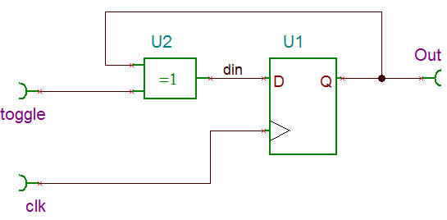
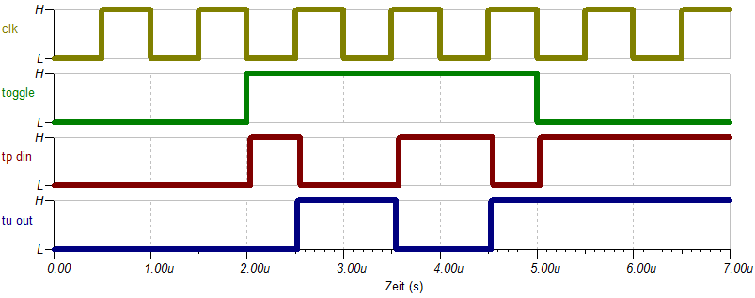
Timing Diagram
Exercise
Complete the timing diagram

Slide 43
Timing Diagram
solution
Exercise → solution
Complete the timing diagram
Notes:
Homework + preparation lab: draw timing diagrams!

Slide 44
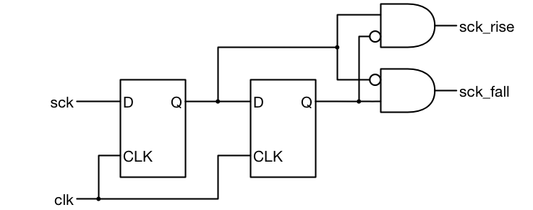
Edge Detector
rise
q1
data_in
fall
q2
clk
data_in
q1
q2
rise
fall

Slide 45
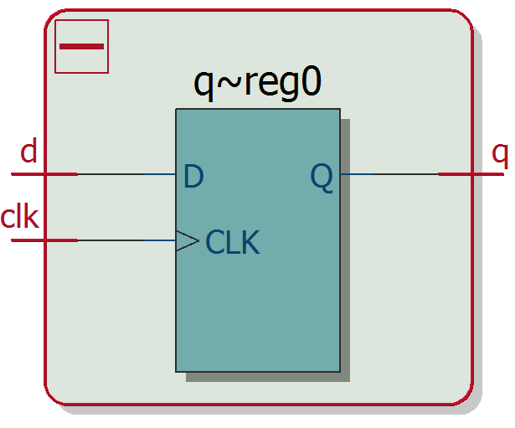
VHDL Description of a D-FF
LIBRARY ieee; USE ieee.std_logic_1164.all; ENTITY dff_logic IS
PORT(clk : IN std_logic; d : IN std_logic; q : OUT std_logic);
END dff_logic;
ARCHITECTURE rtl OF dff_logic IS BEGIN dff : PROCESS(clk) BEGIN IF rising_edge(clk) THEN q <= d;
END IF; END PROCESS dff; END rtl;
Process is only activated when clk changes
Only true when clk rises
This syntax below
IF rising_edge(clk) THEN
is equivalent to (old style)
IF clk'event AND clk = '1' THEN

Slide 46
What is different here?
LIBRARY ieee; USE ieee.std_logic_1164.all; ENTITY dff_logic IS
PORT(clk : IN std_logic; d : IN std_logic_vector(7 downto 0); q : OUT std_logic_vector(7 downto 0);
END dff_logic;
ARCHITECTURE rtl OF dff_logic IS BEGIN dff : PROCESS(clk) BEGIN IF rising_edge(clk) THEN q <= d; END IF; END PROCESS dff; END rtl;

Slide 47
Register with 8 bits
D(7)
D
Q
Q(7)
D(0)
D
Q
Q(0)
CLK

Slide 48
Flip Flops with Asynchronous Set and Reset
SET
D
Q
!Q
RST
Addionally to the data input, the D-FF can have asynchronous
set and reset inputs
Notes:
D-Flip-Flops often reset and set inputs
Since the set and reset immediately changes the output, without waiting for the clock, it is called asynchronous

Slide 49
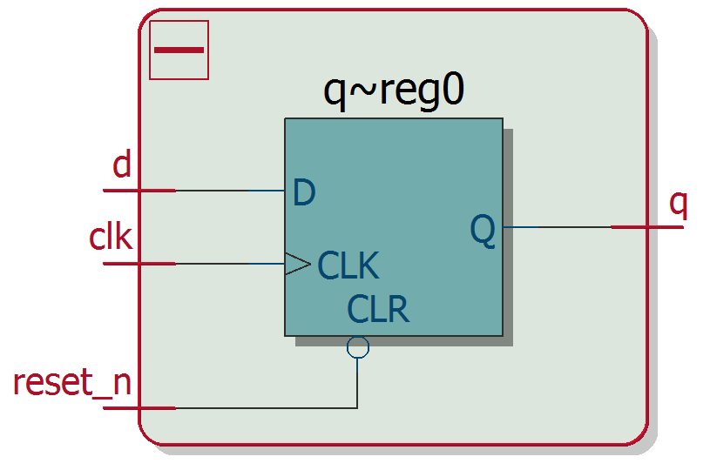
Asynchronous Reset
LIBRARY ieee;
USE ieee.std_logic_1164.all;
ENTITY dff_arst IS
PORT(
clk, d, reset_n : IN std_logic; q : OUT std_logic
);
END dff_arst;
ARCHITECTURE rtl OF dff_arst IS
BEGIN
dff : PROCESS(clk, reset)
BEGIN
IF reset_n = '0' THEN
q <= '0';
ELSIF rising_edge(clk) THEN
q <= d;
END IF;
END PROCESS dff;
END rtl;
Asynchronous Reset !
Reset first in if statement which means highest priority

Slide 50
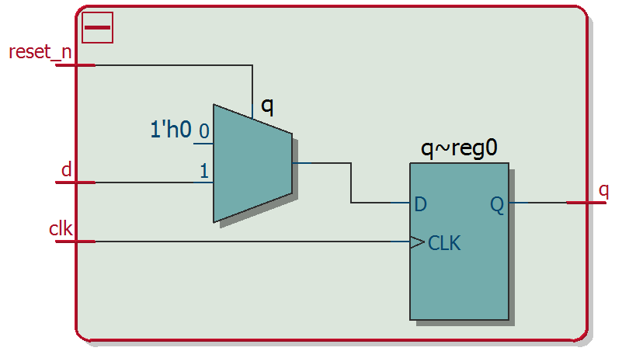
Synchronous Reset
LIBRARY ieee;
USE ieee.std_logic_1164.all;
ENTITY dff_arst IS
PORT(
clk, d, reset : IN std_logic; q : OUT std_logic
);
END dff_arst;
ARCHITECTURE rtl OF dff_arst IS
BEGIN
dff : PROCESS(clk, reset)
BEGIN
IF rising_edge(clk) THEN
IF reset_n = '0' THEN
q <= '0';
ELSE
q <= d;
END IF;
END IF;
END PROCESS dff;
END rtl;
Synchronous Reset

Slide 51
Synthesis Behaviour of “rising_edge”
init_n
&
pattern_out
data_in
s
s
s
D
D
Q
D
Q
Q
D
D
Q
q(0)
Q
q(1)
q(2)
clk
IF rising_edge(clk) THEN q(0) <= data_in; q(1) <= q(0); q(2) <= q(1); END IF;
Rule of Thumb:
every signal assigned after a
rising_edge (clk) statement is synthesized as flip-flop

Slide 52
Notation and Definitions for Timing Diagrams and RTL Diagrams
4
Group of signals (bus) with 4 bits
Group of 4 Flip-Flops
Combinational Logic (without memory/FFs) (represented as a cloud)
Notes:
Mehrere Signale können zu Signalgruppen (Bus) zusammengefasst werden
FF können als Bündel dargestellt werden
Kombintorische Logik, kann ohne die Details zu erklären, zu einer Wolke zusammengefasst werden. Die Details der komb. Logik könnten konzeptuell als Wahrheitstabelle dargestellt werden.

Slide 53
Timing Diagrams: Notation
Signal changing from logical „0" to „1"
Zeit t
Signal changing from logical „1" to „0"
Group of signals (= bus or vector) changing value in hexa
0x3
0x4
0x7
0x9
Vector changing from unknown to a defined value
0x4
Vector changing from defined to unknown value
0x3
Notes:
Analog to Signalgroups can the values be displayed in hex or decimal format
After Power on, before reset or a signal assignment Signals groups can be undefined

Slide 54
Counters
Basic RTL block

Slide 55
RTL Diagram of a Counter
n
input
comb-logic
D Q
output
comb-logic
S
D Q
count_next
n
R
count
clock
reset_n
cnt_out

Slide 56
Timing Diagram of a Counter (with delays)
clock
t_{pdclkq}
count (current status)
n + 1
n + 2
n
t_{pdLogik}
next_count (= Anregungs-Funktion)
n + 1
n + 2
count
input comb-logic
next_count
count (current status)
t_{pdLogik}
t_{pdclkq}
clock
Notes:
The time from the rising edge to the change of the FF Output or current statusis the propagation delay from clock to Q (tpfclkq)
To calculate the Folgezustand requires a flow through the «Anregungsfunktion» which is the Propagation delay through the logic (tpdlogik)
The flow through FF and Logic must be completed within one clock period for the counter to work
If the delay through FF and logic is faster then the hold time requirement of the FF, the FFis are unable to propaget the proper current status

Slide 57
Modulo Counter
+
Q
n
n
n
= number of FFs
+1
clock
Overflow when counting up:
Underflow when counting down:
0xf | 1111
+0x1 | 0001
 | 10000
0x0 | 0000
-0x1 | 1111
 | 1111
Carry bit (ignored / hardware limitation!)
57

Slide 58
Counter Description in VHDL Structure and Datatype
RTL-Structure : Recommendation
At least 2 processes: one for the FFs + one for the comb-logic (evtl for better overview split output comb-logic in a 3rd process)
Datatype: Selection
Usually unsigned, signed oder integer
(unsigned and signed allow easier conversion into std_logic_vector)
Example Analyse example in next 2 slides: simple_counter.vhd

Slide 59
Simple Counter Example in VHDL (1/2)
LIBRARY ieee;
USE ieee.std_logic_1164.all; USE ieee.numeric_std.all;
ENTITY simple_counter IS PORT( clk,reset : IN std_logic; cnt_out : OUT std_logic_vector(3 downto 0) ); END simple_counter;
Package with std_logic, std_logic_vector
Package with arithmetic functions
and numerical datatypes

Slide 60
Simple Counter Example in VHDL (2/2)
ARCHITECTURE rtl OF simple_counter IS
SIGNAL count: UNSIGNED(3 downto 0); SIGNAL next_count: UNSIGNED(3 downto 0);
BEGIN comb_logic : PROCESS(count) BEGIN next_count <= count + 1 ; END PROCESS comb_logic;
flip_flops : PROCESS(clk, reset)
BEGIN IF reset = '1' THEN count <= (OTHERS => '0'); ELSIF rising_edge(clk) THEN count <= next_count; END IF; END PROCESS flip_flops;
cnt_out <= std_logic_vector(count); END ARCHITECTURE rtl;
Process for input comb-logic
Process for FFs (registers)
Type cast for output signal unsigned -> std_logic

Slide 61
Datatype Conversion Functions in IEEE numeric_std package

Slide 62
Datatype Conversion between: integer <-> std_logic_vector (needs 2 steps!!)
conversion std_logic_vector -> unsigned
cnt_out <= to_integer(unsigned(data));
conversion unsigned -> signed integer
output: integer
input: std_logic_vector
conversion signed integer -> unsigned
cnt_out <= std_logic_vector(to_unsigned(cnt, 4));
conversion unsigned -> std_logic_vector
output: std_logic_vector
input: integer
Notes:
Once a signal or port is assigned to a logic type, for that particular signal only that particular logic type may be used.
If a signal or port must be assigned from a different logic type, a conversion must be done first

