Slide 1
VHDL_03: Hierarchical VHDL and Simulation
Structure of a Hierarchical Design
Component Declaration and Instantiations
Testbench
Device-Under-Test, Stimuli, Clock-Generator, Checks
Simulation
Tools, Libraries und Script
Mini-Exercise
Analysis of Code and Testbench for simple_dff_circ.vhd (analyse code and draw RTL + timing diagrams)

Slide 2
Hierarchical VHDL Design

Slide 3
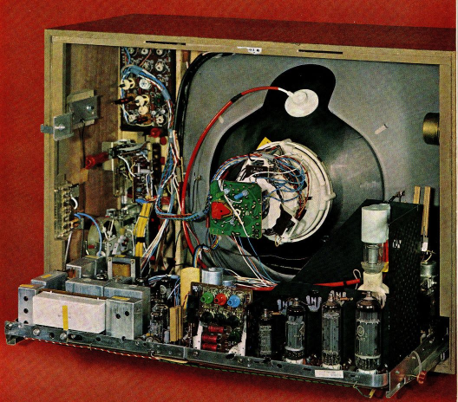
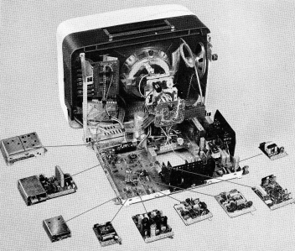
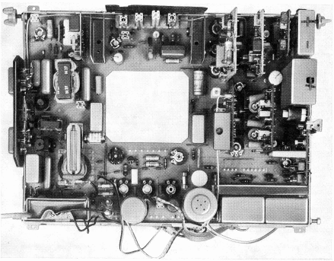
Hierarchical Design
3

Slide 4

Matroschka Doll

Slide 5
Hierarchical VHDL Design or Structural Modeling
Top_Level
Top_Level
Peripherals
Prozessor
ROM
uC Core
Peripherals
Prozessor
Audio Block
RAM
Audio Block
Video Block
uC Core
ROM
RAM
UART
Video Block
Parallel Port
UART

Slide 6
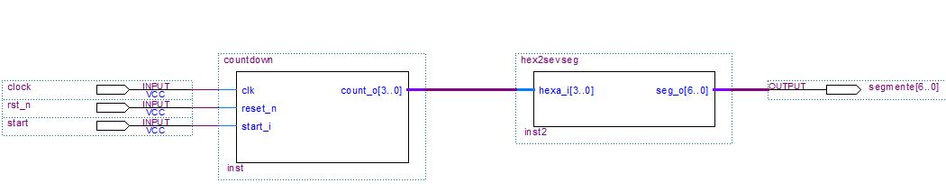
Example of a hierarchical Design
countdown.vhd
hex2sevseg.vhd
Objective: replace this top level schematics by a VHDL description.

Slide 7
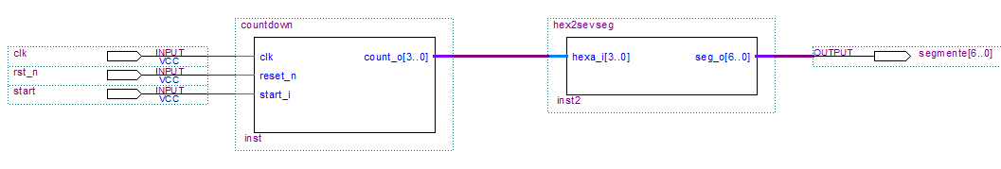
STEP-1: The top-level has an Entity
countdown.vhd
hex2sevseg.vhd
ENTITY top_level IS
PORT(
clock : IN std_logic;
rst_n : IN std_logic;
start : IN std_logic;
segmente : OUT std_logic_vector(6 downto 0)
);
END top_level ;

Slide 8
STEP-2: The Top Level has an Architecture with Component Declarations
Connection signal:
count2hexa
ARCHITECTURE struct OF top_level IS
-- components and signals declaration
COMPONENT hex2sevseg
PORT( hexa_i : IN std_logic_vector(3 downto 0);
seg_o : OUT std_logic_vector(6 downto 0)
);
END COMPONENT;
COMPONENT countdown
PORT( clk,
reset_n : IN std_logic;
start_i : IN std_logic;
count_o : OUT std_logic_vector(3 downto 0)
);
END COMPONENT;
SIGNAL count2hexa : std_logic_vector(3 downto 0);
BEGIN

Slide 9
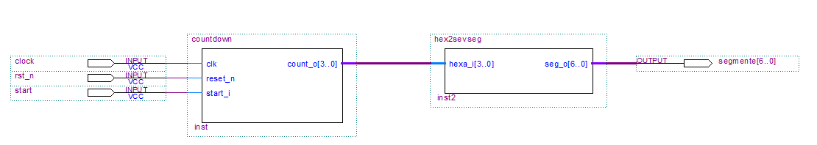
STEP-3: The components are instantiated on the top level architecture description
Instance = unique realisation of component
count2hexa
Signal Names in the top architecture
containing the instance
Entity Name
BEGIN
inst_countdown_1: countdown
PORT MAP (
clk => clock,
reset_n => rst_n,
start_i => start,
count_o => count2hexa
);
inst_hex2sevenseg_1: hex2sevseg
PORT MAP (
hexa_i => count2hexa,
seg_o => segmente
);
END struct;
Instance Name (freely selectable)
Ports of the Component Entity (see Component Declaration)

Slide 10
Overview: Example of a Top Level Architecture
ARCHITECTURE struct OF top_level IS
COMPONENT hex2sevseg PORT(
hexa_i : IN std_logic_vector(3 downto 0);
seg_o : OUT std_logic_vector(6 downto 0));
END COMPONENT;
COMPONENT countdown
PORT( clk,reset_n : IN std_logic;
start_i : IN std_logic;
count_o : OUT std_logic_vector(3 downto 0));
END COMPONENT;
SIGNAL count2hexa : std_logic_vector(3 downto 0);
BEGIN
inst_countdown_1: countdown
PORT MAP (clk => clock,
reset_n => rst_n,
start_i => start,
count_o => count2hexa
);
inst_hex2sevenseg_1: hex2sevseg
PORT MAP (hexa_i => count2hexa,
seg_o => segmente
);
END struct;

Slide 11
Exercise-1: Draw the schematics described below
LIBRARY IEEE;
USE IEEE.std_logic_1164.ALL;
ENTITY dekoder_einfach IS PORT (
A: IN std_logic;
B: IN std_logic;
C: IN std_logic;
D: IN std_logic;
Z: OUT std_logic );
END dekoder_einfach ;
ARCHITECTURE structural OF dekoder_einfach IS
SIGNAL int1: std_logic;
COMPONENT nand2
PORT ( in1,in2 : IN std_logic;
outp : OUT std_logic );
END COMPONENT;
COMPONENT and3
PORT ( in1,in2,in3 : IN std_logic;
outp : OUT std_logic );
END COMPONENT;
BEGIN
inst1: nand2 PORT MAP (
in1 => A,
in2 => B,
outp => int1 );
inst2: and3 PORT MAP (
in1 => int1,
in2 => C,
in3 => D,
outp => Z );
END ARCHITECTURE structural;

Slide 12
VHDL Simulation

Slide 13
Simulation Tool = Modelsim
Entity «Testbench»
DUT (device under test)
Clock
Generator
Checks
Stimuli Generator
Stimuli & Check Process

Slide 14
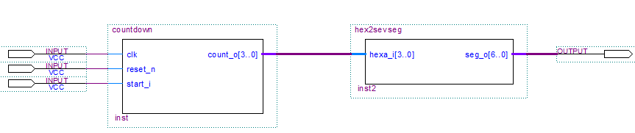
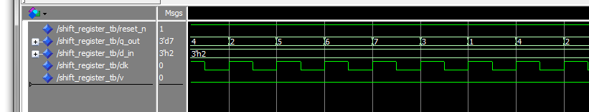
Testbench is a hierarchy level above Top Level
top_level_testbench
top_level
Stimuli:
Visual
Check
Simulationsausgabe:
ENTITY testbench_counter IS
END testbench_counter;

Slide 15
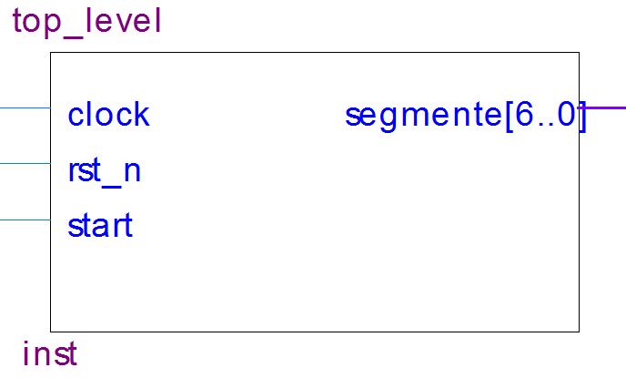
Definition of Component to be tested and connection signals
top_level_testbench
tb_clock
tb_segmente
tb_rst_n
tb_start
ARCHITECTURE struct OF testbench_counter IS
COMPONENT top_level
PORT( clock : IN std_logic;
rst_n : IN std_logic;
start : IN std_logic;
segmente : OUT std_logic_vector(6 downto 0));
END COMPONENT;
SIGNAL tb_clock : std_logic;
SIGNAL tb_rst_n : std_logic;
SIGNAL tb_start : std_logic;
SIGNAL tb_segmente : std_logic_vector(6 downto 0);
CONSTANT clk_halfp : time := 20 ns;
BEGIN

Slide 16
Instantiation of top_level as Device Under Test (DUT)
top_level_testbench
tb_clock
tb_segmente
tb_rst_n
tb_start
BEGIN
DUT: top_level
PORT MAP ( clock => tb_clock,
rst_n => tb_rst_n,
start => tb_start,
segmente => tb_segmente
);

Slide 17
Clock Generation for Simulation
…
SIGNAL clk_halfp : time := 20ns;
…
clkgen : PROCESS
BEGIN
clk <= '0';
WAIT FOR 1*clk_halfp;
clk <= '1';
WAIT FOR 1*clk_halfp;
END PROCESS clkgen;
…
END struct;
(Ohne Sensitivity Liste)

Slide 18
Stimuli Process: simple example
stimuli: PROCESS
BEGIN
tb_rst_n <= '0';
tb_start <= '0';
WAIT FOR 12 * clk_halfp;
tb_rst_n <= '1';
WAIT FOR 2 * clk_halfp;
tb_start <= '1';
WAIT FOR 2 * clk_halfp;
tb_start <= '0';
WAIT FOR 20 * clk_halfp;
tb_start <= '1';
WAIT FOR 2 * clk_halfp;
tb_start <= '0';
WAIT;
END PROCESS stimuli;
END struct;

Slide 19
Wait Statements
WAIT UNTIL condition;
Wait until certain condition is fulfilled
wait on signal_list;
Wait until change of specified signal(s)
WAIT FOR time;
Wait for given time period
wait;
Undefined wait
Beispiele:
Wait until CLK= ‘1‘;
Wait for 10 nS;
Wait on A,B;

Slide 20
WAIT Statements
WAIT Statements are sequential and can only appear within processes
By execution of WAIT Statements the process is stopped and all related signal assignments are updated
After the execution of the WAIT statement, the process is resumed (from the same point where stopped)
WAIT is not synthesisable

Slide 21
Assert Statement
ASSERT condition REPORT string SEVERITY SEVERITY_level ;
Possible levels are: note warning ERROR failure (stops simulation)
Case „Condition“ not fulfilled, a report is generated
Beispiele:
ASSERT (A = B) REPORT “A ungleich B“ SEVERITY ERROR ;
ASSERT false REPORT “Test programm beendet“ SEVERITY note ;
„ASSERT“ allows to build a test during the simulation, generating a report, and select gravity in case of mismatch with expected result.
Assert is ignored by the Synthesis.

Slide 22
Example: Testbench for bcd-gray Decoder
«errors» are counted but
do not stop the simulation.
Failure stops the simulation (break up execution)
STIMULUS: process
begin
bcd <= "000" ;
WAIT FOR 10 ns;
ASSERT (gray = "000") REPORT "expected "000" " SEVERITY ERROR;
WAIT FOR 100 ns;
bcd <= "111";
WAIT FOR 10 ns;
ASSERT (gray = "100") REPORT "expected „100“ " SEVERITY ERROR;
WAIT FOR 100 ns;
ASSERT false REPORT " --- ALL TESTS PASS ---" SEVERITY FAILURE;
end process;
stops the simulation

Slide 23
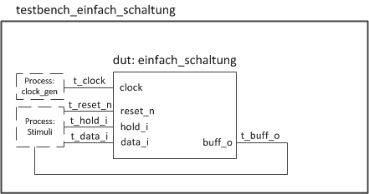
Testbench for Lab3 – Exercise 1.1)
Ausgangssignal wird verglichen

Slide 24
Einfach_Schaltung
BEGIN
-------------------------------------------
-- Process for combinatorial logic
-------------------------------------------
comb_logic: PROCESS(ALL)
BEGIN
-- hold or update
IF hold_i='1' THEN
next_buff <= buff;
ELSE
next_buff <= data_i;
END IF;
END PROCESS comb_logic;
-------------------------------------------
-- Process for registers (flip-flops)
-------------------------------------------
flip_flops : PROCESS(clock, reset_n)
BEGIN
IF reset_n = '0' THEN
buff <= '0';
ELSIF RISING_EDGE(clock) THEN
buff <= next_buff ;
END IF;
END PROCESS flip_flops;
-------------------------------------------
-- Concurrent Assignements
-- e.g. Assign outputs from intermediatesignals
-------------------------------------------
buff_o <= buff;
-- Library & Use Statements
LIBRARY ieee;
USE ieee.std_logic_1164.all;
-- Entity Declaration
ENTITY einfach_schaltung IS
PORT (
clock : in std_logic;
reset_n : in std_logic;
data_i : in std_logic;
hold_i : in std_logic;
buff_o : out std_logic
);
END einfach_schaltung;
-- Architecture Declaration
ARCHITECTURE rtl OF einfach_schaltung IS
-- Signals & Constants Declaration
SIGNAL buff, next_buff : std_logic ;

Slide 25
Testbench for Lab3 – Exercise 1.1) [Page 1/2]
-- Testbench-Code: testbench_rsff.vhd
-- History: ...
-- Library & Use Statements
LIBRARY ieee;
USE ieee.std_logic_1164.all;
-- Entity Declaration
ENTITY testbench_einfach_schaltung IS
END testbench_einfach_schaltung;
-- Architecture Declaration
ARCHITECTURE struct OF testbench_einfach_schaltung IS
-- Component Declaration
COMPONENT einfach_schaltung
PORT ( clock : in std_logic;
reset_n : in std_logic;
data_i : in std_logic;
hold_i : in std_logic;
buff_o : out std_logic );
END COMPONENT einfach_schaltung;
-- Signals & Constants Declaration
SIGNAL t_clock : std_logic;
SIGNAL t_reset_n : std_logic;
SIGNAL t_data_i : std_logic;
SIGNAL t_hold_i : std_logic;
SIGNAL t_buff_o : std_logic;
CONSTANT clk_halfp : time := 0.5 us;
-- Begin Architecture
BEGIN
-- Instantiation DUT (Device under Test)
dut: einfach_schaltung
PORT MAP( clock => t_clock,
reset_n => t_reset_n,
data_i => t_data_i,
hold_i => t_hold_i,
buff_o => t_buff_o );
-- Clock Generation Process (with wait)
clock_gen: PROCESS
BEGIN
t_clock <= '0';
WAIT FOR clk_halfp;
t_clock <= '1';
WAIT FOR clk_halfp;
END PROCESS clock_gen;

Slide 26
Testbench for Lab3 – Exercise 1.1) [Page 2/2]
-- Stimuli and Check Process (wait & ASSERT) stimuli: PROCESS
BEGIN
-- initialize all inputs and activate reset_n to initialize the DUT
t_reset_n <= ‘0'; t_data_i <= '1'; t_hold_i <= '0';
WAIT FOR 10*clk_halfp;
-- release reset_n and wait 2 clock-periods
WAIT UNTIL t_clock = '0';
t_reset_n <= '1';
WAIT FOR 2*clk_halfp;
-- since hold was not active, after clock rising edge check that buff_o = data_i
WAIT UNTIL t_clock = '0';
ASSERT (t_buff_o = t_data_i) REPORT "TEST_1: buff_o not equal data_i" SEVERITY ERROR ;
WAIT FOR 2*clk_halfp; ...
-- change data_i and check that buff_o follows
WAIT UNTIL t_clock = '0';
t_data_i <= '0';
WAIT FOR 2*clk_halfp;
Assert (t_buff_o = t_data_i) REPORT "TEST_2: buff_o not equal data_i" SEVERITY ERROR ;
-- now set hold and check that buff_o do not -- follow data_i changes
WAIT UNTIL t_clock = '0';
t_hold_i <= '1'; t_data_i <= '1';
WAIT FOR 2*clk_halfp;
ASSERT (t_buff_o /= t_data_i) REPORT "TEST_3: buff_o equal data_i" SEVERITY ERROR ;
-- stop simulation
WAIT FOR 10*clk_halfp;
ASSERT (FALSE) REPORT "Test programm beendet" SEVERITY FAILURE;
END PROCESS stimuli;
-- End Architecture
END struct;

Slide 27
VHDL Simulator
Architecture: A
Architecture: B
Package: A
ieee Library
Primitive Libraries
Entity: A
Entity: B
VHDL Simulator
Working Library
.
.
.
.

Slide 28
edaverzeichnis
Projekt
simulation
source
synthese
.vhdl
modelsim
scripts
work
.do

Slide 29
Compile Script (compile.do) for VHDL Simulation
# create work library
vlib work
# compile project files
vcom -2008 -explicit -work work ../../source/testbench_einfach.vhd
vcom -2008 -explicit -work work ../../source/einfach.vhd
# run the simulation
vsim -novopt -t 1ns -lib work work. testbench_einfach
do ../scripts/wave.do
run 1800.0 ns
create work directory „work“ to store ModeSim compiled data
compiles VHDL source files and store compiled data in „work“ dir
starts simulator
open Waveform Window with saved preferences
run simulation for 1800 ns

Slide 30
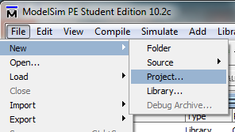
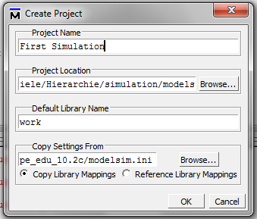
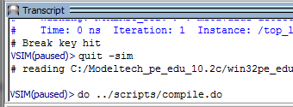
Simulator ModelSim: Getting Started
Creating a new Project
Select project directory
where «work» compiled director will
Be generated
Start simulation with script in the command line

Slide 31
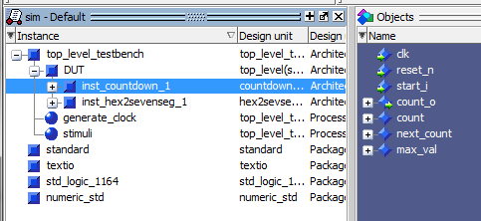
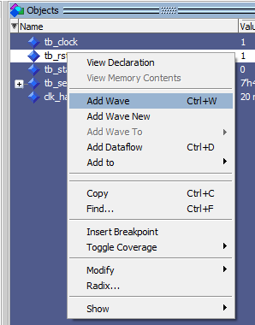
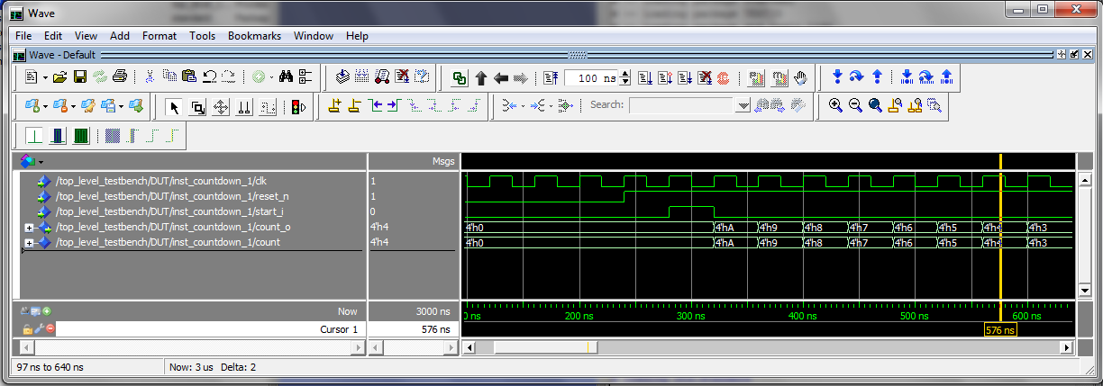
Waveform Window
Structure Window (Design Hierarchy Browser)
Objects Window (to select Signals for visualisation)
Add Wave

Slide 32
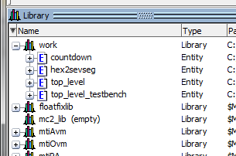
Library Window

Slide 33
VHDL Templates
Block Design (RTL)
Block Design (Hierarchical)
Testbench (Hierarchical & Behavioural)

Slide 34
Template _ Block Design (RTL)
-- Library & Use Statements
-- Entity Declaration
-- Architecture Declaration -- Signals & Constants Declaration
-- Begin Architecture
-------------------------------------------
-- Process for combinatorial logic
------------------------------------------- -- Process for registers (flip-flops)
-------------------------------------------
-- Concurrent Assignements
-- e.g. Assign outputs from intermediate signals -------------------------------------------
-- End Architecture

Slide 35
Template _ Block Design (Hierarchical)
-- Library & Use Statements
-- Entity Declaration
-- Architecture Declaration -- Components Declaration
-- Signals & Constants Declaration
-- Begin Architecture
-------------------------------------------
-- Instantiation Block - 1
------------------------------------------- -- Instantiation Block – 2 ...
-------------------------------------------
-- Concurrent Assignments
-- e.g. Assign outputs from intermediate signals -------------------------------------------
-- End Architecture

Slide 36
Template _ Testbench (Hierarchical & Behavioural)
-- Library & Use Statements
-- Entity Declaration
-- Architecture Declaration -- Component Declaration
-- Signals & Constants Declaration
-- Begin Architecture
-------------------------------------------
-- Instantiation DUT (Device under Test)
------------------------------------------- -- Clock Generation Process (with wait)
-------------------------------------------
-- Stimuli and Check Process (with wait & ASSERT) -------------------------------------------
-- End Architecture
non
synthetisisable
commands

