Slide 1

SYSTEM PRESENTATION
B-SMART
Barangay System for Monitoring, Access, and Record of Treatment
4
User Roles
MySQL
Database
B-SMART Barangay Health Monitoring System
01

Slide 2
INTRODUCTION
INTRODUCTION
B-SMART is a barangay health monitoring system developed to improve the management of resident health records, appointments, reports, and inventory. The system was designed using C# Windows Forms and MySQL database technology.
The project helps barangay personnel organize information digitally instead of relying on manual paper-based records. Through this system, users can easily store, update, retrieve, and monitor health-related data.
The system also improves communication between residents and barangay health workers by allowing appointment scheduling and notifications.
B-SMART Barangay Health Monitoring System
02

Slide 3
PROBLEM
STATEMENT OF THE PROBLEM
Many barangays still use manual recording systems for health information. Because of this, several problems may occur:
Resident records are difficult to organize.
Some files become duplicated or lost.
Health reports take a long time to prepare.
Monitoring medicines and vaccines becomes difficult.
Appointment processing is slow and inefficient.
Important notifications may be missed.
These problems affect the efficiency of barangay health services and delay important health operations.
B-SMART Barangay Health Monitoring System
03

Slide 4
OBJECTIVES & LIMITATIONS
The system improves visibility while staying within a desktop barangay workflow.
Desktop-based Windows Forms application
Depends on local MySQL database availability
Manual data input still required for health and resident records
Access is role-scoped
Limitations
Centralize records
Generate reports
Store resident accounts and health records in one MySQL-backed system.
Show barangay health report metrics by week, month, or year.
Manage appointments
Control inventory
Let residents book services and notify staff when approval is needed.
Track medicines and vaccines, including near-expiry archive behavior.
B-SMART Barangay Health Monitoring System
04

Slide 5
USER TYPES
Each account sees the same health picture through a different permission scope.
Mayor
LGU Staff
OVERALL
BARANGAY
Views overall resident records, reports, barangay health summaries, inventory by barangay, and notifications.
Manages barangay health records, resident appointments, inventory, reports, archive, and approvals.
Barangay Captain
Resident
BARANGAY
SELF
Views barangay-scoped residents, accounts, frozen accounts, records, reports, archive, and notifications.
Books appointments, views own health records, receives approval notifications, downloads medical-certificate-style record.
B-SMART Barangay Health Monitoring System
05

Slide 6
DEVELOPMENT TOOLS
B-SMART is built as a desktop health system with a relational data core.
C#
.NET WinForms
MySQL
Primary programming language
Desktop UI framework
Relational database storage
Visual Studio
PDF Reports
MySql.Data
IDE and form designer
Downloaded records and reports
Database connectivity
B-SMART Barangay Health Monitoring System
06

Slide 7
DATABASE
Core tables organize people, places, health events, and service requests.
users
barangays
Resident, staff, captain, and mayor accounts; also stores resident profile fields and account status.
Reference table that scopes users, inventory, health records, reports, and notifications.
health_records
appointments
Resident health entries with diagnosis, treatment, assigned doctor/nurse, dates, and resident codes.
Resident bookings for available health services with approval status and notifications.
B-SMART Barangay Health Monitoring System
07

Slide 8
DATA OPERATIONS
Supporting tables keep supplies, notifications, and history connected to daily work.
medicines / vaccines
Inventory quantity, expiry dates, barangay ownership, and archive behavior.
health_services
Service catalog for resident appointment booking.
notifications
Role-scoped alerts for approvals, new records, registrations, and resident updates.
archive logs
Recovered or inactive data remains traceable after archiving.
B-SMART Barangay Health Monitoring System
08

Slide 9
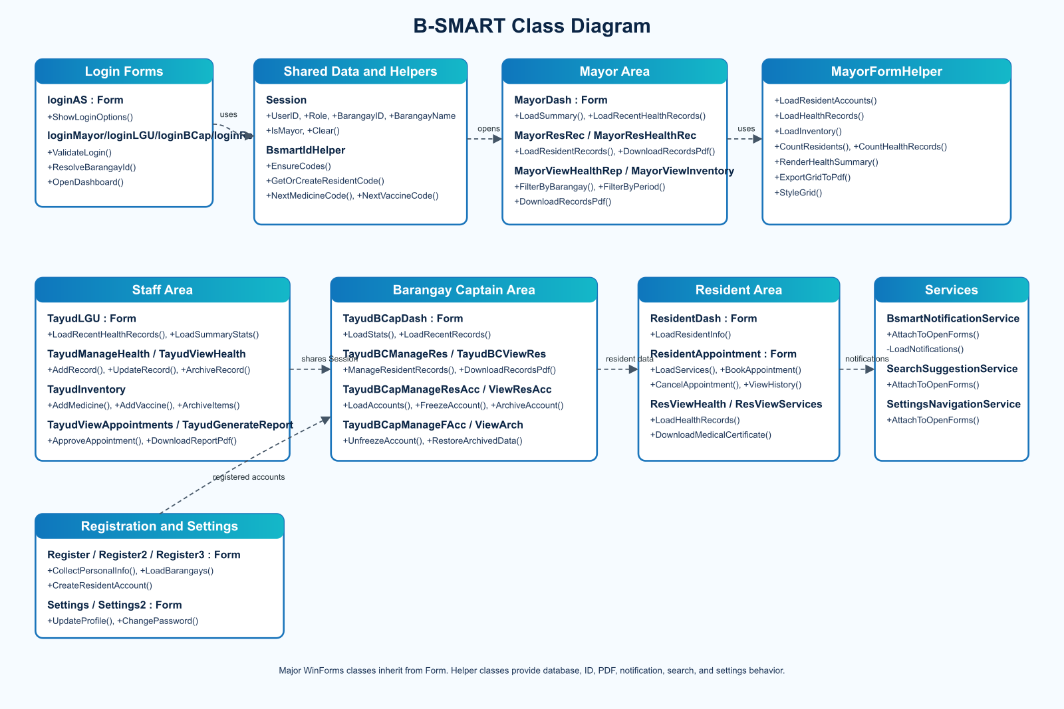
CLASS DIAGRAM
Forms, helpers, and services separate UI behavior from shared system logic.
The diagram below uses the provided BSMART_Class_Diagram asset.
The form classes represent user-facing screens, while shared helpers handle IDs, notifications, navigation, settings, and report/export logic. This supports repeated workflows across mayor, staff, captain, and resident accounts.
B-SMART Barangay Health Monitoring System
09

Slide 10
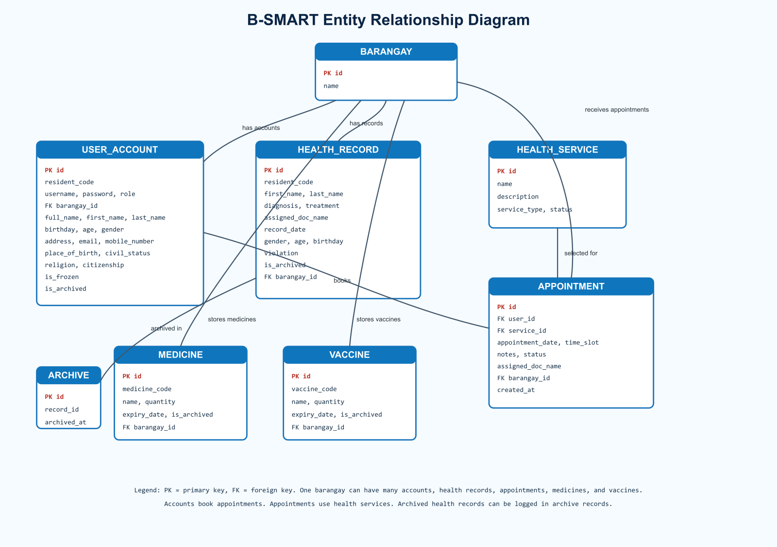
ENTITY RELATIONSHIP DIAGRAM
Barangay scope is the anchor for accounts, health data, appointments, and inventory.
The diagram below uses the provided BSMART_Entity_Diagram asset.
One barangay can have many users, health records, appointments, medicines, and vaccines. Resident-facing workflows link back to accounts and services.
Resident identity fields and generated resident codes help prevent repeated residents from being counted incorrectly.
B-SMART Barangay Health Monitoring System
10

Slide 11
KEY WORKFLOWS
B-SMART connects records, reports, notifications, and PDF outputs into one loop.
1
2
3
4
Register
Record
Notify
Report
Resident account created or existing record checked
Staff/captain adds or updates health details
Role-scoped alerts appear on dashboard bell
Tables and health summaries can be viewed or downloaded
Outputs
Resident medical-certificate-style downloads, table-style PDFs for officials, and filtered health reports
B-SMART Barangay Health Monitoring System
11

Slide 12
CONCLUSION
B-SMART makes barangay health data easier to record, review, and act on.
Centralizes resident and health records in MySQL
Shows dashboard metrics and filtered health reports
Supports resident appointments and approval notifications
Tracks medicines and vaccines with expiry awareness
Uses class and entity structures that match the implementation
B-SMART Barangay Health Monitoring System
12

