Slide 1
Deep representation learning for multimodal brain networks
W. Zhang, L. Zhan, P. Thompson, Y. Wang
2020
Presented by Avery Peiffer (Project 2)

Slide 2
Introduction

Slide 3
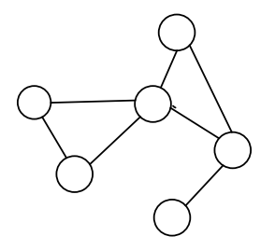
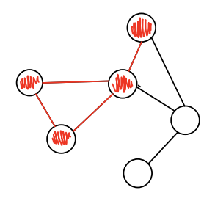
Modeling multimodal brain networks
Brain imaging techniques can show two types of networks (modalities)
Structural Network: physical network structure (white matter pathways)
Functional Network: what regions are activated together during an activity¹ (fMRI signals)

Slide 4
understanding network organization
Connection breakdown between relevant brain regions has strong association with progression of neurodegenerative diseases²
Repovs et al. showed changes to connectivity in individuals with schizophrenia
However, changes to the brain are reflected differently in each modality
It is difficult to determine the resulting multimodal change to the brain network

Slide 5
Existing work
Represent brain as graph to perform convolutions
Use deep graph convolutional networks (GCNs) to extract features from imaging data
However, existing framework³ only works for structural networks, which limits accuracy
Difficult to draw brain saliency maps

Slide 6
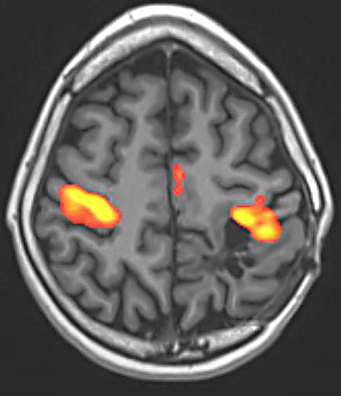
Structural and functional networks are related
Structural network is the skeleton that constrains brain functional activities
Functional activities reshape the structural network in the long term
Want to learn mappings from structural to functional networks
Create a better saliency map of brain
⁴

Slide 7
methods

Slide 8
Multimodal brain network data
For each subject, there are two graphs that map connections of brain regions
G^{f} represents functional brain network
G^{d} represents structural brain network
Use identical definition of brain regions, but differ in network topology and edge weights

Slide 9
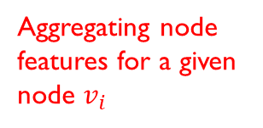


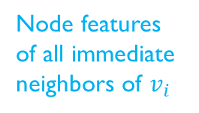
Multi-stage graph convolution kernel (MGCK)
Learnable parameters
Nodes should be affected by their nearest neighbors
Want to aggregate features in local neighborhoods
$AGG\left(h_{v_{i}}\right)= \sum_{v_{j}εΝ(v_{i}) }{h_{v_{j}} ∗(x_{i,j}x_{i,j}^{ATT}+ βx_{i,j}+ αx_{i,j}^{ATT}+ αβδ)}$
Thresholding function for edge
Aggregating node features for a given node $v_{i}$
Node features of all immediate neighbors of $v_{i}$
Edge weight between $v_{i}$ and $v_{j}$
Edge weight using a graph attention network⁵ (more dynamic)

Slide 10

MGCK (continued)
${\hat{h}}_{v_{i}}= σ\left({AGG}^{k}\left(h_{v_{i}}\right)∗w\right)$
Nonlinear activation function
Aggregation from previous slide
Learnable weight matrix

Slide 11
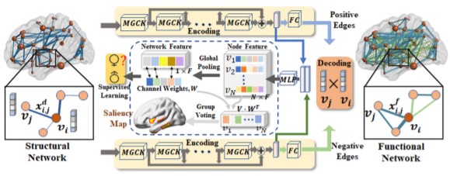
Deep multimodal brain network (DMBN)
Generates multimodal graph node representation for different learning tasks

Slide 12
DMBN Part I – encoding-decoding network
Encoding-decoding network constructs functional network from structural connection
Two encoding networks used – one for positive edges and one for negative edges
MGCK layers aggregate the node features

Slide 13
Dmbn part ii – supervised learning
Concatenate node features from positive and negative encoding networks
Feed into multilayer perceptron (MLP) network to make prediction and create saliency map

Slide 14
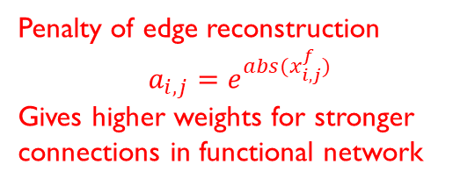
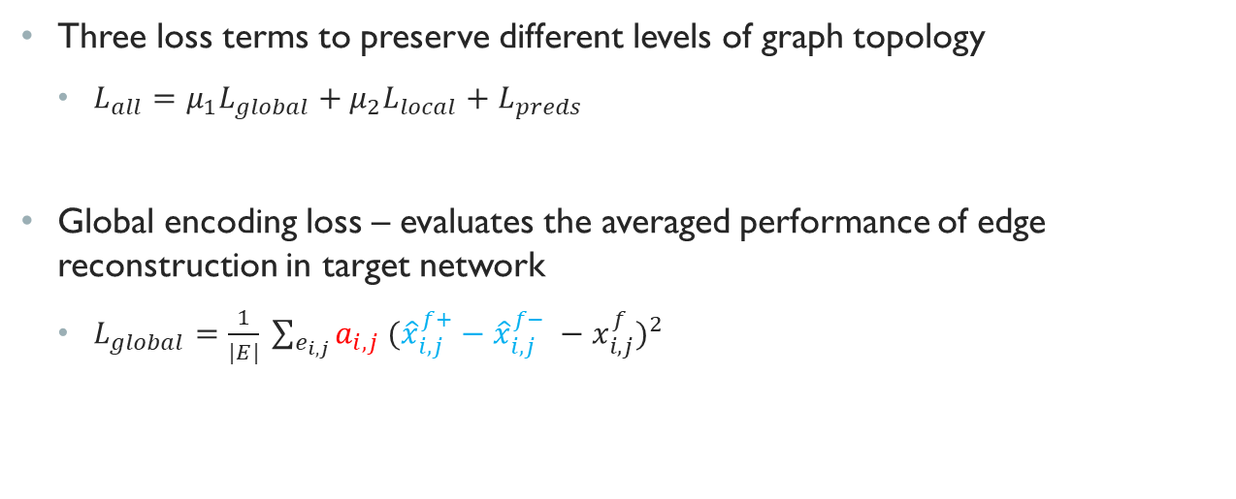
Dmbn loss terms
Three loss terms to preserve different levels of graph topology
$L_{all}=μ_{1}L_{global}+μ_{2}L_{local}+L_{preds}$
Global encoding loss – evaluates the averaged performance of edge reconstruction in target network
$L_{global}=\frac{1}{|E|} \sum_{e_{i, j}}{a_{i,j} {({\hat{x}}_{i,j}^{f+}−{\hat{x}}_{i,j}^{f−} −x_{i,j}^{f})}^{2} }$
Penalty of edge reconstruction
$$a_{i,j}=e^{abs(x_{i,j}^{f})}$$
Gives higher weights for stronger connections in functional network
Decoded functional network connections from positive and negative encoder/decoder

Slide 15
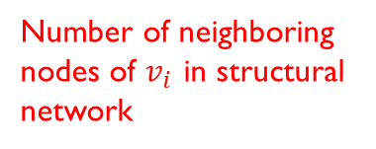

Dmbn loss terms
Local decoding loss – captures local structure
$L_{local}= \sum_{i=1}^{n}{\frac{1}{|N_{i}^{d}|}} \sum_{j ε N_{i}^{d}}{e^{δ(x_{i,j}^{d})}{\left\|h_{v_{i}}^{f} −h_{v_{j}}^{f}\right\|}_{2}^{2}}$
Number of neighboring nodes of $v_{i}$ in structural network
Threshold function which favors strong generalization
Features of nodes in functional network

Slide 16

Dmbn loss terms
Supervised loss – loss function for prediction, similar to cross-entropy
$L_{pred}=−\frac{1}{K} \sum_{i=1}^{K}{y_{i} ∗log⁡(f_{pred}(h_{v_{i}}))}$
Number of subjects
Function learned by MLP network

Slide 17
Experimental results

Slide 18
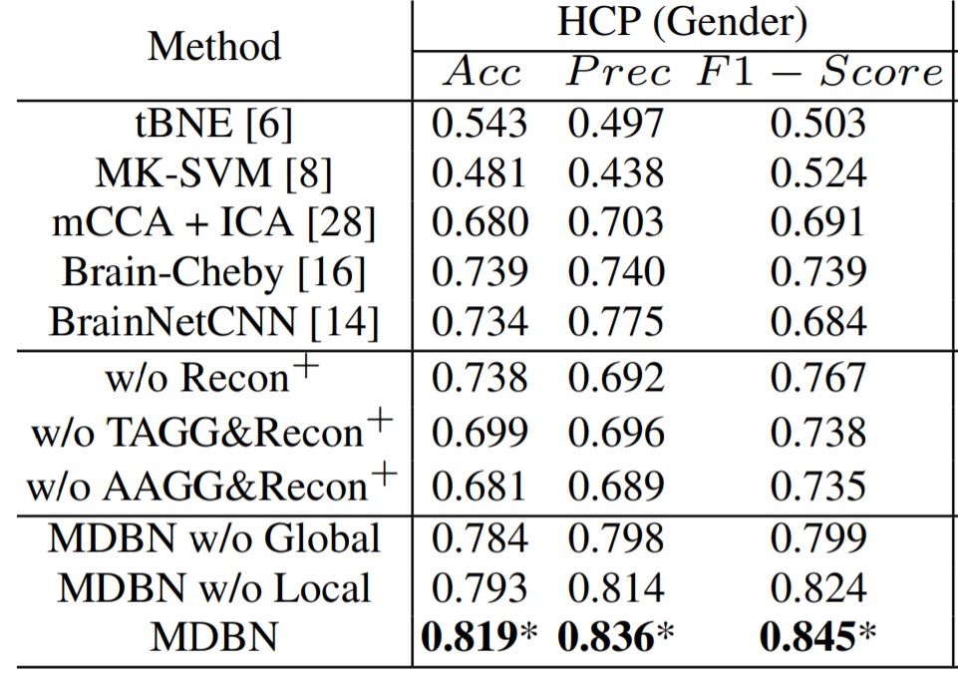
Gender prediction
Strong relationship between gender and brain connectivity patterns⁶
Try to predict gender based on multimodal network topology
Achieved higher accuracy (81.9%) compared to five state-of-the-art baseline models
Accuracies when removing elements of model, i.e., removing decoding network, removing aggregating mechanisms

Slide 19
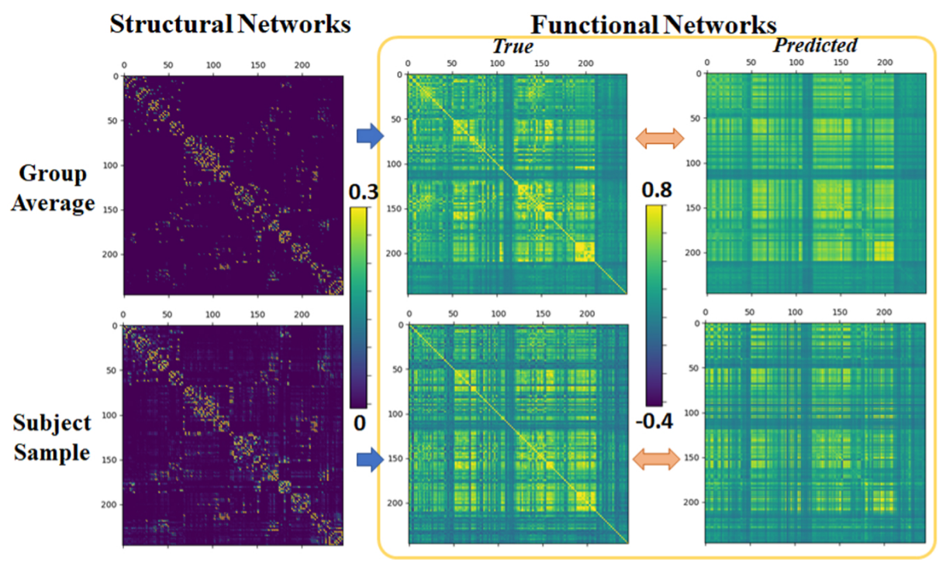
Gender prediction (cont.)
High correlation in predicting functional network (0.83)

Slide 20
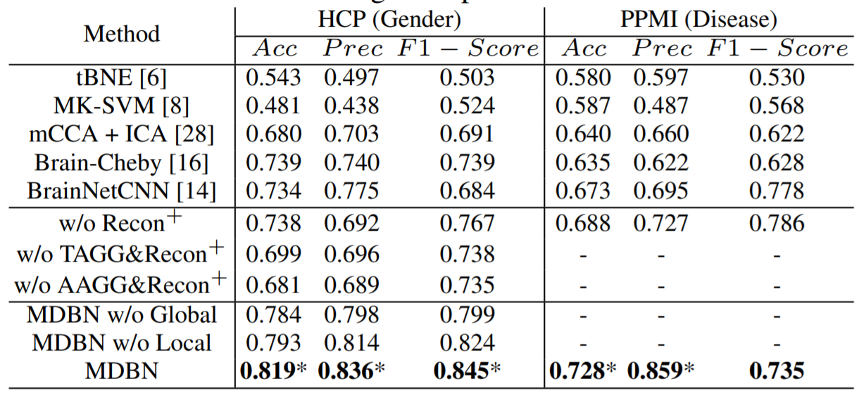
Parkinson’s disease classification
Same baseline models used for comparison as in gender prediction
MDBN achieves best prediction performance

Slide 21
Discussion

Slide 22
conclusion
MDBN cross-modality network learns node features
Helps create a brain saliency map for detecting disease biomarkers
In future: extend model to brain cortical parcellation (dividing brain into macroscopic regions) and cognitive activity prediction

Slide 23
Additional references
[1]: Park, H.-J., & Friston, K. (2013). Structural and functional brain networks: From connections to cognition. Science, 342(6158). https://doi.org/10.1126/science.1238411
[2]: Repovs, G., Csernansky, J. G., & Barch, D. M. (2011). Brain Network connectivity in individuals with schizophrenia and their siblings. Biological Psychiatry, 69(10), 967–973. https://doi.org/10.1016/j.biopsych.2010.11.009
[3]: Kawahara, J., Brown, C. J., Miller, S. P., Booth, B. G., Chau, V., Grunau, R. E., Zwicker, J. G., & Hamarneh, G. (2017). BrainNetCNN: Convolutional Neural Networks for brain networks; towards predicting neurodevelopment. NeuroImage, 146, 1038–1049. https://doi.org/10.1016/j.neuroimage.2016.09.046
[4]: Dell Children's Medical Center of Central Texas. (n.d.). Functional magnetic resonance imaging (fmri). Dell Children's Medical Center of Central Texas. Retrieved November 12, 2021, from https://www.dellchildrens.net/services-and-programs/imaging-services/functional-magnetic-resonance-imaging/
[5]: Veličković, P., Cucurull, G., Casanova, A., Romero, A., Liò, P., & Bengio, Y. (2018, February 4). Graph attention networks. arXiv.org. Retrieved November 13, 2021, from https://arxiv.org/abs/1710.10903v3
[6] Ruigrok, A. N. V., Salimi-Khorshidi, G., Lai, M.-C., Baron-Cohen, S., Lombardo, M. V., Tait, R. J., & Suckling, J. (2014). A meta-analysis of sex differences in human brain structure. Neuroscience & Biobehavioral Reviews, 39, 34–50. https://doi.org/10.1016/j.neubiorev.2013.12.004

