Slide 1
Fully convolutional networks for semantic segmentation
Jonathan Long, Evan Shelhamer, Trevor Darrell
2015 IEEE Conference on Computer Vision and Pattern Recognition
Presented by Avery Peiffer (Project 3)

Slide 2
What is a cnn?
Two steps
Automatic feature extraction (“filters” that extract local patterns from an image)
“Filters” applied using convolution operation
Output prediction (traditional neural network)
Feature extraction phase means that convnets are very good at performing recognition/detection tasks on images
Translation invariance – components operate on local input regions, so features can be detected at any position in image

Slide 3
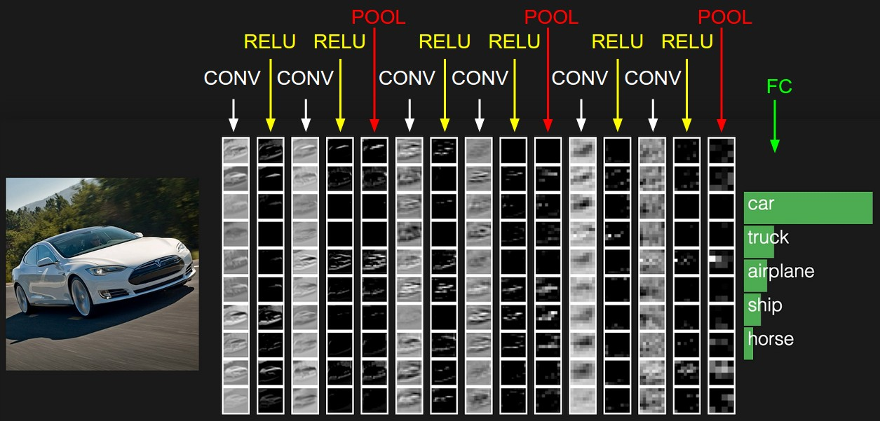
What is a cnn?
Image source

Slide 4
Using convnets for segmentation
Want to perform semantic segmentation – associate every pixel with a class label
Multiple objects of the same class are the same entity (as opposed to instance segmentation)
Prior approaches perform semantic segmentation by labeling pixels with the class of the region that encloses it
Instead, perform semantic segmentation at the pixel level

Slide 5
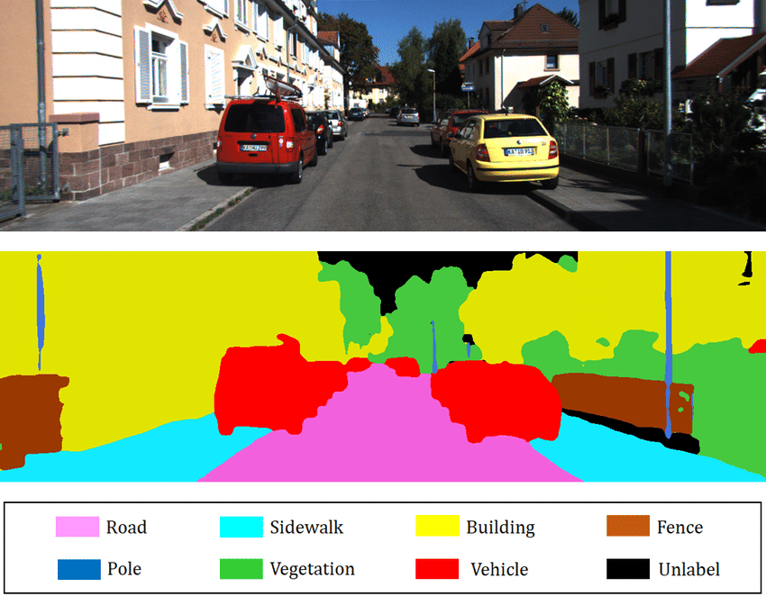
Semantic segmentation example
Image source

Slide 6
Combining coarse and fine features
Two aspects of semantic segmentation
Global information resolves what the object is
Local information resolves where the object is
Want to combine deep, coarse, semantic information and shallow, fine, appearance information

Slide 7
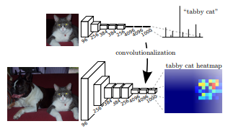
Classification → segmentation
Would be infeasible to train segmentation architecture from ground-up
Can instead adapt existing classification architectures for use in segmentation
Transforming fully connected layers to convolution layers enables these classification architectures to produce a heatmap → Fully Convolutional Net

Slide 8
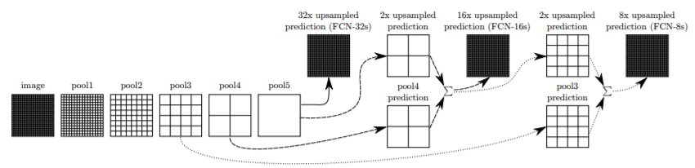
Combining coarse and fine information
Convolutionalized classifiers can perform well, but their output is very coarse
Define a new fully convolutional net that refines the output precision

Slide 9
Segmentation Architecture
FCN-32s: coarse prediction from pretrained classifier (solid line)
FCN-16s: combine predictions from FCN-32s and pool4 prediction (dashed line)
FCN-8s: combine predictions from FCN-32s and pool3 prediction (dotted line)

Slide 10
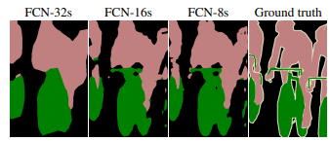
Architecture
“Skip” architecture combines coarse and fine information
Model makes local predictions that respect global structure

Slide 11
experimentation
Test FCN architecture on several datasets for segmentation
PASCAL VOC, NYUDv2, SIFT Flow
Start with pre-trained classifiers that can be adapted for segmentation
FCN-AlexNet, FCN-VGG16, FCN-GoogLeNet

Slide 12

Experimental metrics
Let $n_{ij}$ be number of pixels of class $i$ predicted to belong to class $j$
$n_{cl}$ different classes
Let $t_{i}= \sum_{j}{n_{ij}}$ be total number of pixels in class $i$

Slide 13
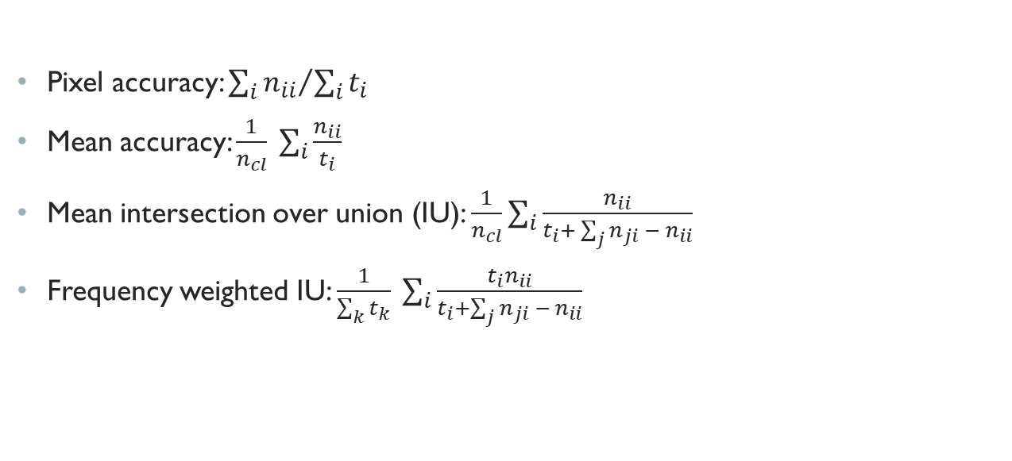
Experimental metrics
Pixel accuracy: ${\sum_{i}{n_{ii}}}/{\sum_{i}{t_{i}}}$
Mean accuracy: $\frac{1}{n_{cl}} \sum_{i}{\frac{n_{ii}}{t_{i}}}$
Mean intersection over union (IU): $\frac{1}{n_{cl}}\sum_{i}{\frac{n_{ii}}{t_{i}+ \sum_{j}{n_{ji} − n_{ii}}}}$
Frequency weighted IU: $\frac{1}{\sum_{k}{t_{k}}} \sum_{i}{\frac{t_{i}n_{ii}}{t_{i}+\sum_{j}{n_{ji} − n_{ii}}}}$

Slide 14
Experimental results
Using PASCAL VOC 2011 and 2012 test sets
20% improvement over state-of-the-art while reducing inference time
 | Mean IU (VOC2011) | Mean IU (VOC2012) | Inference time
R-CNN¹ | 47.9 | - | -
SDS² | 52.6 | 51.6 | ~ 50 s
FCN-8s | 62.7 | 62.2 | ~ 175 ms

Slide 15
Experimental results
Using NYUDv2³, a dataset collected using the Microsoft Kinect
 | Pixel accuracy | Mean accuracy | Mean IU | F.W. IU
Gupta et al.⁴ | 60.3 | - | 28.6 | 47.0
FCN-32s RGB | 60.0 | 42.2 | 29.2 | 43.9
FCN-32s RGBD | 61.5 | 42.4 | 30.5 | 45.5
FCN-32s HHA | 57.1 | 35.2 | 24.2 | 40.4
FCN-32s RGB-HHA | 64.3 | 44.9 | 32.8 | 48.0
FCN-16s RGB-HHA | 65.4 | 46.1 | 34.0 | 49.5
RGBD: fusion of RGB and depth channels
HHA: horizontal disparity, height above ground, angle of surface
RGB-HHA: sum of RGB and HHA predictions

Slide 16
Experimental results
Using SIFT Flow, another segmentation dataset
 | Pixel acc. | Mean acc. | Mean IU | F.W. IU | Geom. acc.
Liu et al.⁵ | 76.7 | - | - | - | -
Tighe et al.⁶ | - | - | - | - | 90.8
Tighe et al.⁷, 1 | 75.6 | 41.1 | - | - | -
Tighe et al.⁷, 2 | 78.6 | 39.2 | - | - | -
Farabet et al.⁸, 1 | 72.3 | 50.8 | - | - | -
Farabet et al.⁸, 2 | 78.5 | 29.6 | - | - | -
Pinheiro et al.⁹ | 77.7 | 29.8 | - | - | -
FCN-16s | 85.2 | 51.7 | 39.5 | 76.1 | 94.3

Slide 17
Conclusion
Existing classification networks can easily be extended to perform segmentation tasks
After extending, these classification architectures can be drastically improved by introducing the multi-resolution layer combinations
Allows for both coarse and fine information to be represented in final segmentation prediction

Slide 18
Additional references
[1]: R. Girshick, J. Donahue, T. Darrell, and J. Malik. Rich feature hierarchies for accurate object detection and semantic segmentation. In Computer Vision and Pattern Recognition, 2014.
[2]: B. Hariharan, P. Arbelaez, R. Girshick, and J. Malik. Simultaneous detection and segmentation. In European Conference on Computer Vision (ECCV), 2014.
[3]: N. Silberman, D. Hoiem, P. Kohli, and R. Fergus. Indoor segmentation and support inference from rgbd images. In ECCV, 2012.
[4]: S. Gupta, R. Girshick, P. Arbelaez, and J. Malik. Learning rich features from RGB-D images for object detection and segmentation. In ECCV. Springer, 2014.
[5]: C. Liu, J. Yuen, and A. Torralba. Sift flow: Dense correspondence across scenes and its applications. Pattern Analysis and Machine Intelligence, IEEE Transactions on, 33(5):978– 994, 2011.
[6]: J. Tighe and S. Lazebnik. Superparsing: scalable nonparametric image parsing with superpixels. In ECCV, pages 352– 365. Springer, 2010.
[7]: J. Tighe and S. Lazebnik. Finding things: Image parsing with regions and per-exemplar detectors. In CVPR, 2013.
[8]: C. Farabet, C. Couprie, L. Najman, and Y. LeCun. Learning hierarchical features for scene labeling. Pattern Analysis and Machine Intelligence, IEEE Transactions on, 2013.
[9]: P. H. Pinheiro and R. Collobert. Recurrent convolutional neural networks for scene labeling. In ICML, 2014.

