Slide 1
The Potential of Gallium-nitride as an Alternate Semiconductor Material in Transistors
Claibourne Countess, cdc77@pitt.edu
Avery Peiffer, aep65@pitt.edu

Slide 2
Conductivity of Atoms
Determined by number of valence electrons atom possesses
Valence electrons can be easily dislodged from atom and flow through material, conducting electricity as they do so
Conductors (silver, copper) have more free electrons than insulators (rubber, glass)
Semiconductors are insulators at low energy, conductors at high energy

Slide 3
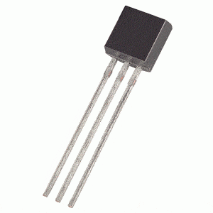
Transistors
“True” and “False” represented by whether or not the semiconductor is conducting electricity
Uses flow of current to perform calculations
Combined onto an integrated circuit to increase computing power
Traditionally made using silicon as semiconductor

Slide 4

Moore’s Law
Prediction by Gordon Moore in 1965
Every two years, number of transistors on an integrated circuit would double by decreasing their size
Number of Transistors:
1958, First integrated circuit: 1
1969, Apollo 11 guidance computer: 10,000
2018, iPhone X: 4,300,000,000

Slide 5
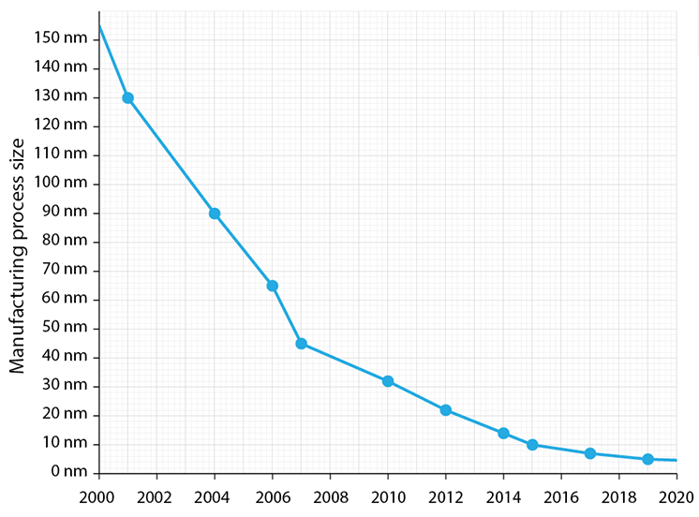
A Plateau
Most recent working transistor only 7 nanometers wide, fourteen times larger than an individual silicon atom
Subject to phenomenon of quantum mechanics called quantum tunneling – transistor loses ability to control current

Slide 6
The Consequences of Big Data
90% of the world’s data has been created over the last two years
Must be matched by either an equal increase in computing power or a greater investment in data centers
Electricity used yearly by 3,000,000 US data centers could power entirety of New York City for two years
Incredibly expensive and unfeasible to only invest in data centers

Slide 7
Moving Away From Silicon
Semiconductor Industry Association announced that “by 2021 it will not be economically efficient to reduce the size of silicon transistors any further”
Must turn to other semiconductor materials to increase computing power
Gallium-nitride (GaN) identified as potential replacement
United States Department of Energy estimated that GaN could reduce power consumption of data centers by 20% over the next ten years

Slide 8
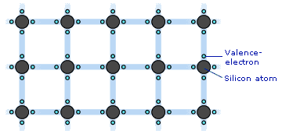
Semiconductor Crystals
Atoms inherently want exactly eight valence electrons
Semiconductor atoms (four valence electrons) will “share” one electron with each of four surrounding atoms
Creates an “infinite crystal”

Slide 9
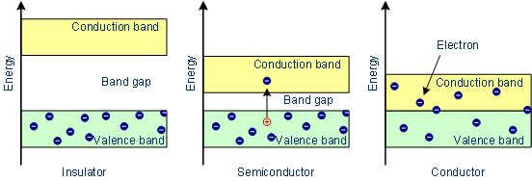
Energy Bands
Energy already possessed by electrons falls within range of energy levels called valence band
To conduct electricity, the energy of an electron must be increased to a certain level – these energy levels are called the conduction band
Difference between valence and conduction band is large in insulators, small in semiconductors, and nonexistent in conductors

Slide 10
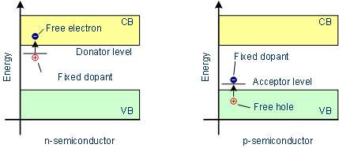
N-type and P-type Doping
Foreign elements are added to semiconductors to add or subtract the amount of electrons present
Doing so decreases the difference between the valence and conduction bands
Semiconductor is able to conduct electricity on demand – basis for transistor

Slide 11
Band Gap Size Comparison
GaN has a band gap three times wider than silicon
GaN molecule is more densely packed, requiring more energy to release an electron

Slide 12
Differences Between Silicon and GaN Transistors
Wider band gap means GaN transistors can tolerate higher temperatures than silicon
GaN transistors have less internal resistance
Can make calculations 10-20 times faster than silicon transistors
Increases efficiency of transistor by ~3%, translates to 10-20% reduction in energy consumption of large-scale device

Slide 13
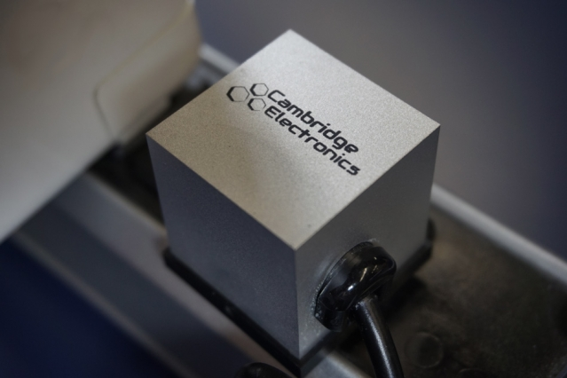
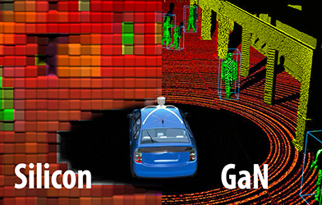
GaN Current Device Applications
Cambridge Electronics, Inc: 1.5 in³ laptop power adapter prototype made using GaN transistors, smallest ever made
Efficient Power Conversion Corporation (EPC): Using GaN transistors to improve LiDAR systems in self-driving cars

Slide 14
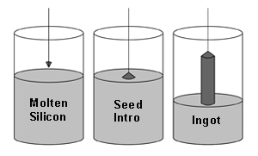
Crystal Growth: The Conventional Method
Small, high-quality silicon crystal (the seed) is rotated inside liquid of same material
Forms a small cylinder of solid silicon that can be sliced into wafers for transistors

Slide 15
Crystal Growth: The Conventional Method
Cannot be used to create GaN crystals
GaN is very difficult to obtain naturally
Seed crystals must be created in a laboratory, requiring extreme temperature and pressure conditions
2500°C and 4.5 gigapascals, 40,000 times the normal atmospheric pressure
Crystals produced are only about the size of a human hair, not suitable for production

Slide 16
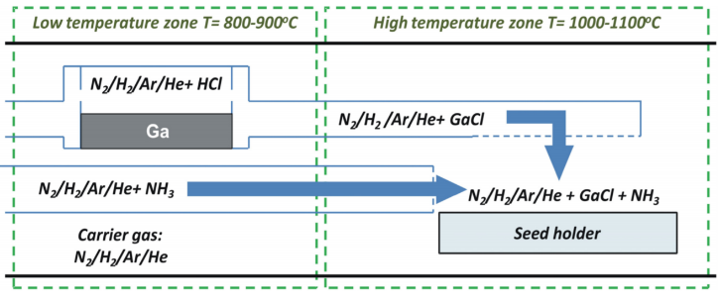
New Growth Methods: HVPE Process
Solid gallium reacted with hydrochloride to form gallium chloride (GaCl) in low temperature zone
GaCl is transported to high temperature zone by gases containing nitrogen
Gallium-nitride then crystallizes onto seed crystal of gallium and sapphire in relatively fast process

Slide 17
HVPE Limitations
Crystallizing gallium on a substrate that is not purely gallium results in up to 15,000 foreign molecules per square centimeter in the crystals
HVPE cannot guarantee high-quality GaN crystals

Slide 18
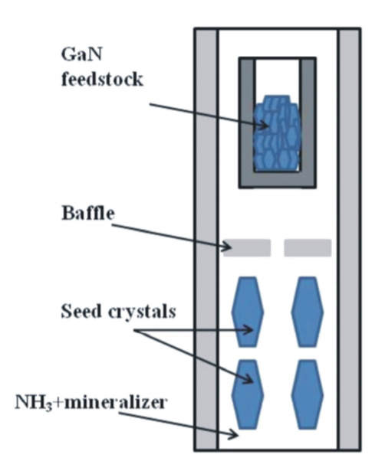
New Growth Methods: Ammonothermal Process
Seed GaN crystals are dissolved in an ammonia solution in a low-temperature region
Solution is then circulated to a high-temperature region, where the GaN recrystallizes
Crystals fabricated are relatively large and of high quality

Slide 19
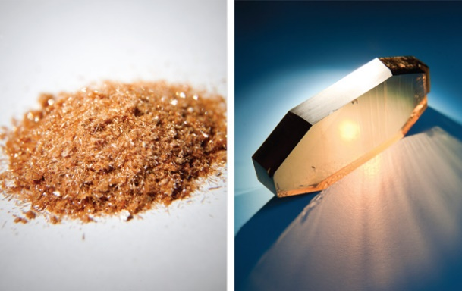
Ammonothermal Growth Limitations
Process can take weeks to fabricate full-size crystals
Crystals are extremely expensive, priced at $5000 compared to $370 for silicon crystals

Slide 20
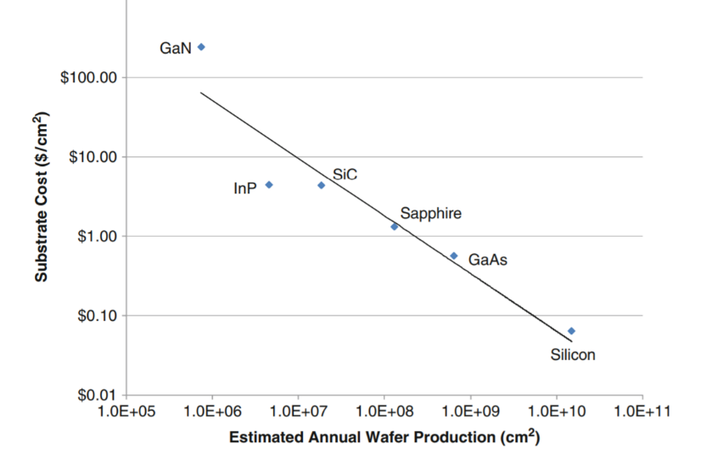
Outlook
The demand for increased computing power will continue
Silicon cannot remain the standard semiconductor in transistors indefinitely if this demand is to be satisfied
GaN is significantly hindered by price, and so not currently a feasible replacement
Amount of research conducted into fabricating GaN suggests GaN transistors could see significant integration into mainstream devices in the coming decades

