Slide 1
Preparing for Finals

Slide 2
Finals Week Information
Last Day of Classes: Friday, December 7
Finals Week: December 10-15 (including Saturday)
Finals occur at a specially scheduled time – check course syllabus for exact time, date, and location
Finals are typically 2 hours long
Some finals are cumulative and others are not – check with your instructors for specific information
Finals Schedule: https://www.registrar.pitt.edu/assets/pdf/2191_EXAMS.pdf

Slide 3
How to Prepare
2 weeks of classes after Thanksgiving Break – start studying the week you get back
Think now about how you’re going to prepare (Practice tests, homework problems, lecture slides, etc.) – your approach should differ based on the class
Have some way of evaluating your strengths and weaknesses in a class before you start studying – Practice tests are the best

Slide 4
How to Prepare
Practicing with the material from the specific course you are in is often better than trying to learn something on the internet
Usually, TAs or professors will offer review sessions that can be very useful, especially for departmental finals
Professors’ office hours will start to have more people show up – you can just sit and listen if you don’t have any specific questions

Slide 5
The Week Before Finals and Finals Week
Try to give yourself two full days of focused studying for each test in the span of these two weeks
Split your time between exams like a shell
Make sure to account for some time to relax between tests

Slide 6
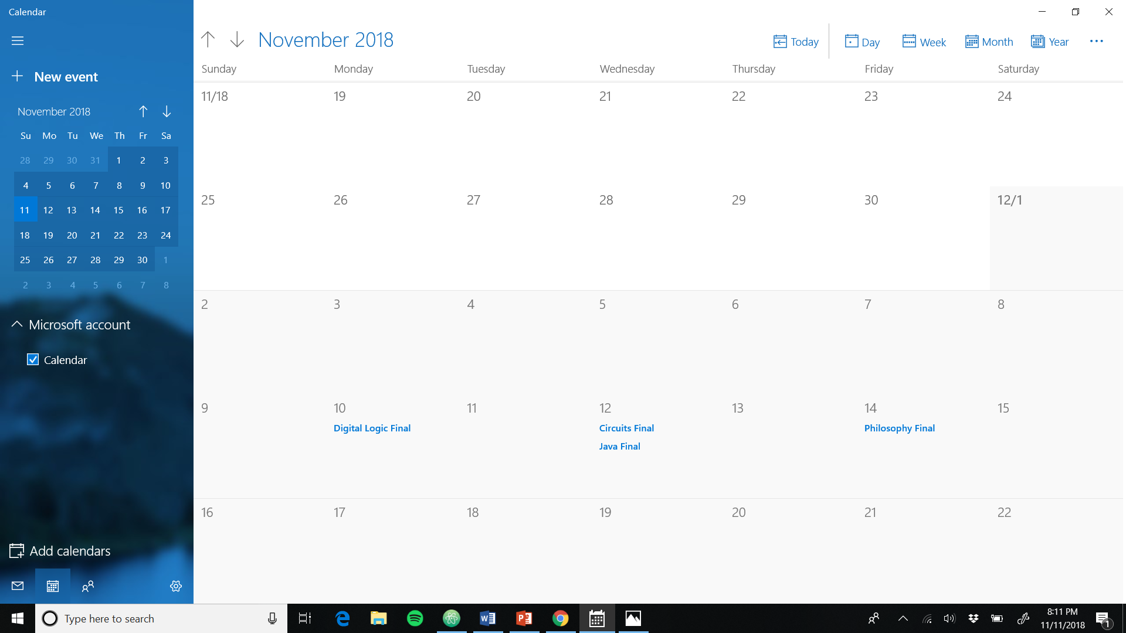

Slide 7
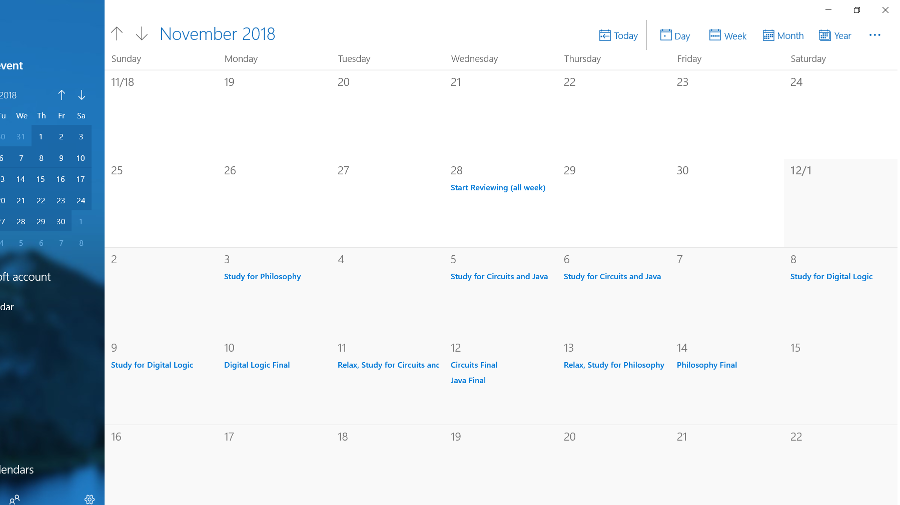

Slide 8
Course-Specific Information
Need C’s in class overall to pass in most situations (Physics II: C-)
Need a >60% average on ENGR 0011/0711 tests to pass the class
Math Department Policy: Can’t get more than one letter grade better than your final exam grade regardless of current grade

Slide 9
Final Exam Prep Evaluation Activity

