Slide 1
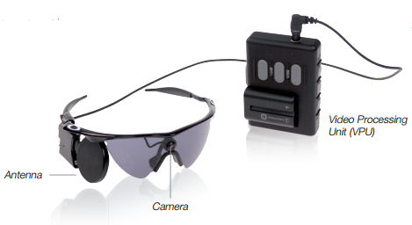

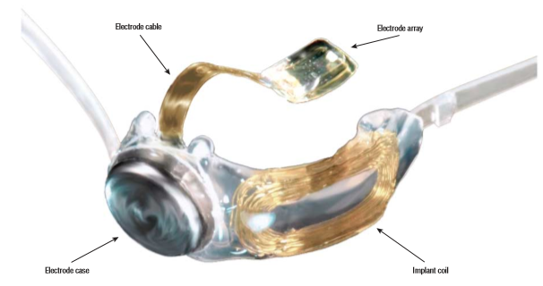
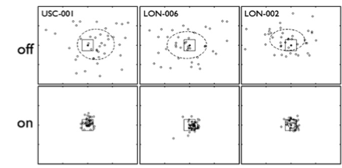
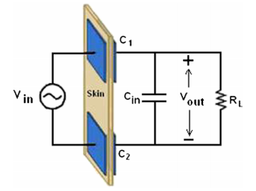
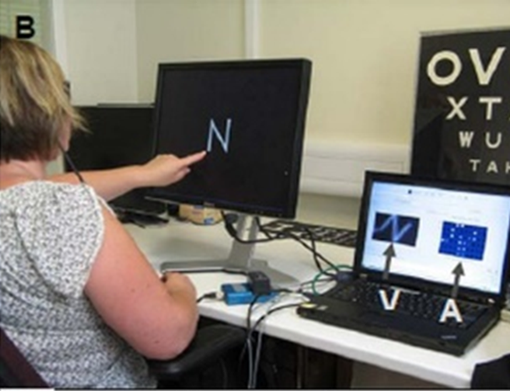
The Argus II Retinal Prosthesis System: A Sustainable Device in the Treatment of Retinitis Pigmentosa
Marade Bergen (mcb97@pitt.edu) , Emily Frederick (ejf44@pitt.edu)
THE NEED FOR A ‘BIONIC EYE’
THE EXTERNAL COMPONENTS
Retinitis Pigmentosa is a hereditary disease that causes degeneration of retinal photoreceptor cells, affecting one in four thousand individuals worldwide. Patients with RP experience a common progression of symptoms, beginning with the loss of night vision in adolescence. Peripheral vision is weakened and eventually lost by early adulthood, followed by complete blindness typically by age sixty.
Argus II glasses contain a miniature camera and transmitting coil used to send electrical signals and power to the implanted device.
Video processing unit (VPU): The VPU is worn on the user’s waist and is responsible for converting video to electrical information. Rechargeable batteries inside the VPU provide power (external power source).
3. A cable connects the two external components (limitation).
*Sustainability: The lack of an implanted battery yields a safer product and prevents chemical side effects, irritation and infection.
STUDIES IN SUPPORT OF THE ARGUS II SYSTEM
The External Components of the Argus II (above)
(2010) British Journal of Ophthalmology
27 nearly blind individuals were tested in locating a high contrast digital square traveling around a monitor.
The tests were run both with the Argus system off and on
Results:
Accuracy improvement rate: 96%
Repeatability rate: 93%
The results from three subjects are shown below.
THE IMPLANTED DEVICE
Healthy Vision Early RP Vision
As RP destroys rod and cone photoreceptor cells, responsible for nighttime vision and daytime vision respectively, patients will experience a decrease in their field of vision until they are completely blind.
The implanted device consists of a 60 electrode array implanted in and around the retina, providing a 20° field of vision.
The implanted device receives data from the VPU and outputs the desired electrical stimuli. The stimuli affects the living bipolar and ganglion cells located within the retina, which creates light patterns that can be learned and interpreted by the user .
A period of rehabilitation is needed after implantation, where settings such as contrast and edge enhancement are customized for individual needs.
*Sustainability: The Argus II is powered by the most efficient method of harvesting energy for implanted devices.
The Implanted Device (above)
Cost Effectiveness | Implant Eligibility Restrictions | Design
Duke Eye Center,: The cost of the system (approximately $200,000) covers the device costs, the surgical costs and about a month of post-surgery training and rehabilitation. | According to the FDA and European CE mark patients are NOT eligible for implantation if they are: Under the age of 25 years old Unable to exhibit some residual light perception | While this device provides sight to blind retinitis pigmentosa patients, the design of the system does limit the mobility of the user, whose quality of life may be affected by the presence of the external components.
A study released by the Biomedical Center of Ophthalmology found that the annual cost of the Argus II was $14,988 per patient. | Unable to respond to retinal stimulation Have and ocular diseases such as optic nerve disease, central retinal artery or vein occlusion, or have a history of retinal detachment and trauma | One future improvement that could be made to sustain and improve the livability of the patient is the remodeling of the system, resulting in a size reduction of the external components.
As of August 15, 2013, the Argus II system was approved by Centers for Medicare and Medicaid Services (CMS) in the United States, and on October 1st, Medicare offered complete coverage of the device. | Have thin conjunctiva or corneal ulcers Have a preexisting implant in the head, such as a cochlear implant Can not undergo general anesthesia or take the necessary antibiotics post implantation | A more discrete design would increase the quality of life of the patient by offering more privacy and freedom to continue with a normal life.
Inductive Coupling: An Efficient Method of Harvesting Energy for Implanted Devices
(2013) British Journal of Ophthalmology gathered data related to word recognition
Subjects were asked to determine the letters and three letter words on the computer screen.
The tests were completed both before and after implantation of the device.
Results:
Subjects consistently identified letters of size 2.3 cm.
Subjects identified more correct letters with the device than without it, 51.7-72.3 % of the time.
The inducting coupling link consists of two RLC circuits (resistor, inductor and capacitor), functioning as the transmitting and receiving coils.
Shown above is a simplified version of the inductive coupling link circuit is shown, where V_{in} is the input voltage, obtained from the VPU and sent to the transmitting coils mounted on the glasses.
The voltage input then enters the RLC circuit, where C_{in} is the equivalent capacitance and V_{out} is the power output to the implanted device.
Maximum power efficiency: 80%
Minimum power efficiency: 73%

