Slide 1
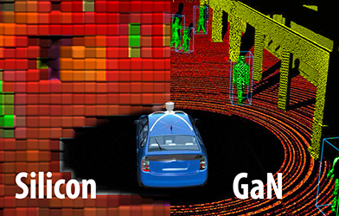
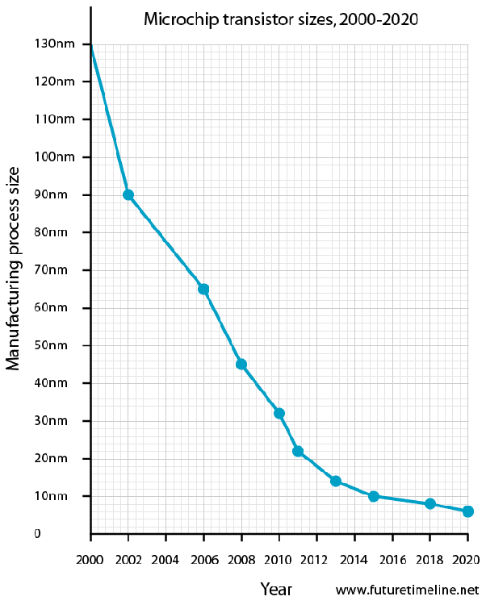
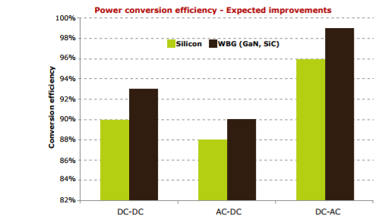
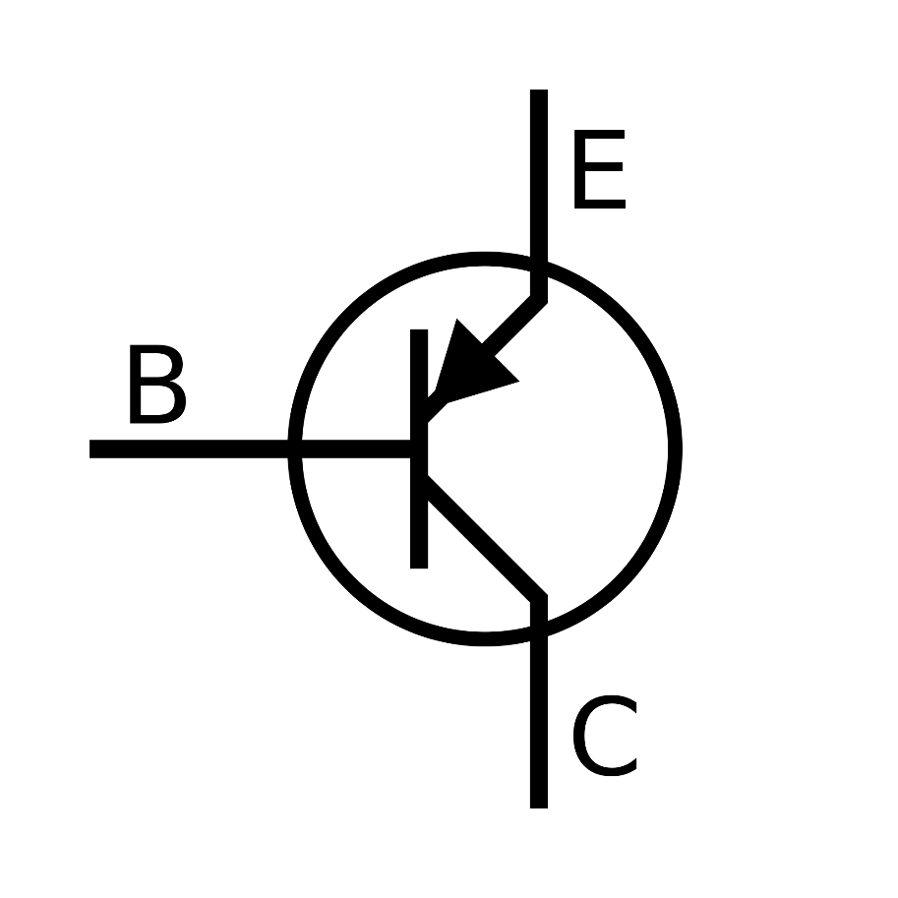
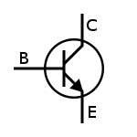

The Potential of Gallium-nitride as an Alternate Semiconductor in Transistors
Claibourne Countess, cdc77@pitt.edu, Avery Peiffer, aep65@pitt.edu
The need for new transistors
Gallium-nitride transistors
Current applications
Silicon transistors have decreased in size since their invention in 1958, from 1-5 centimeters to 5-7 nanometers. Though this represents an increase in computing power to seemingly-infinite levels, silicon transistors can not be decreased in size any further. At sizes of around 14 nanometers, the transistors are subject to the unpredictability of quantum physics, meaning they can no longer be improved upon.
Gallium-nitride (GaN) is a semiconductor that can also be used for transistors. GaN transistors can be made smaller than silicon and can perform computations ten times faster. They have additionally been shown to be more efficient than silicon, with the ability to reduce the energy consumption of a large-scale device by up to 20% if they are fully implemented.
Efficient Power Conversion Corporation (EPC): Using superior speed of GaN transistors to improve laser diodes in LiDAR systems for self-driving cars (right)
Mouser Electronics: Utilizing GaN transistors in infrastructure, defense, and aerospace applications such as radar, electronic warfare, communications, and navigation
Cambridge Electronics, Inc.: Fabricating own GaN transistors and power electronics circuits; developed 1.5 cubic inch laptop power adapter, the smallest ever made (right)
Efficiency comparison of silicon and gallium-nitride transistors (right)
Visualization of EPC’s LiDAR technology with the use of GaN transistors (above)
Laptop power adapter designed by Cambridge Electronics, Inc. (below)
Notable research
The two traditional configurations of transistors (above)
(2015) United States Department of Energy
Used half of a $140,000,000 research institute to research the potential of GaN to reduce energy consumption
(2016) Semiconductor Science and Technology
Showed that combining two most popular crystal growth processes can increase the efficiency of crystal production
Assessed merits and drawbacks of each growth process to provide a realistic outlook for the future of crystal growth
Transistor size over the past two decades (above)
How transistors work
A transistor is a device with three terminals: the base, collector, and emitter (pictured above). Each terminal is made from a semiconductor, an element that has a conductivity between that of a conductor and an insulator. The semiconductor is treated with foreign elements such that if a voltage is supplied between the base and the emitter, current will easily flow from the emitter to the collector, or vice versa. In effect, the transistor controls the flow of electricity in a circuit.
Primary limitations
conclusion
 | Silicon | Gallium-nitride
Availability and Production | Second-most abundant element in Earth’s crust (28%) Refinement processes are extremely efficient, taking only 30 hours | Not a naturally occurring compound Most effective fabrication process takes weeks to create quality crystals
Cost | $370/crystal | $5000/crystal
Gallium-nitride transistors possess great potential to replace silicon in devices ranging from consumer electronics to complex power electronics systems. It is clear that demand for increased computing power will continue to exist. Likewise, it is evident that silicon cannot maintain its status as the standard for transistors indefinitely. However, GaN transistors can not currently satisfy this demand due to the relative difficulty of ensuring a reliable and affordable supply. Ultimately, the significant amount of research concerned with perfecting gallium-nitride transistors suggests they could be integrated into mainstream electronic devices in the coming decades.
How many transistors?
1954 First Transistor Computer: 700
1969 Apollo 11 Guidance Computer: 10,000
1996 IBM Deep Blue Chess Computer: 15,000,000
2014 iPhone 6/6S: 2,000,000,000
2018 iPhone X: 4,300,000,000

