Slide 1

Deep Reinforcement Learning for cybersecurity
Thanh Thi Nguyen and Vijay Janapa Reddi
IEEE Transactions on Neural Networks and Learning Systems

Slide 2
Introduction

Slide 3
Machine Learning for Cybersecurity
Many recent advancements in information and communication technology (ICT)
Cognitive radio network, 5G cellular networks, software-defined networking, etc.
With these developments, there is an increasing vulnerability to cyber attacks
AI/ML has been applied to both attacking and defending in cyberspace
Attacker side: ML used to compromise defense strategies
Security side: Used to resist security threats to prevent and minimize impact/damage
However, traditional unsupervised learning methods are not proactive enough to detect many threats
62% of attacks recognized after they have caused significant damage to cyber systems

Slide 4
Using RL Instead of ML
Reinforcement learning can model an autonomous agent to take sequential actions optimally, even without limited prior knowledge of environment
Useful in real time and adversarial environments
Deep learning can be incorporated into RL methods using function approximation and representation learning
Ways to make the RL process closer to formal ML, so that deep learning can be applied
Deep reinforcement learning used in video games, autonomous vehicles, autonomous surgery, etc.
Paper focuses on use of DRL methods to solve cybersecurity problems

Slide 5
Deep Reinforcement Learning Overview

Slide 6
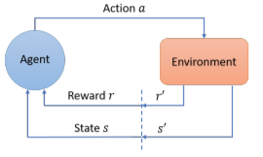
Formalizing Reinforcement Learning
RL described by state, action, and reward
Based on current state and reward, agent takes optimal action, leading to changes in state and reward
Using received rewards, agent learns to take more good actions and gradually filter out bad actions

Slide 7
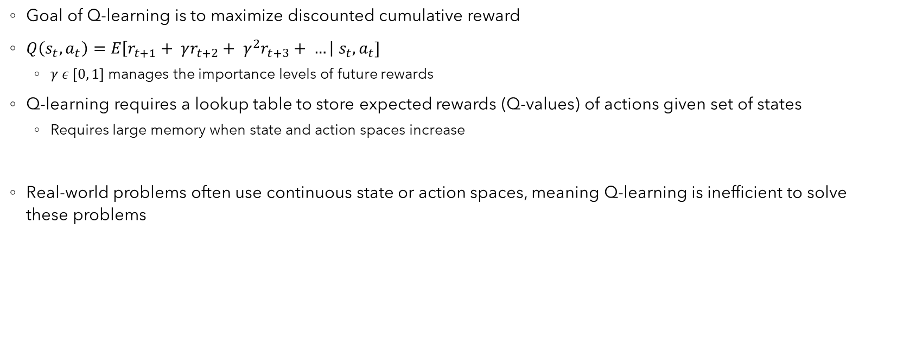
Q-Learning
Goal of Q-learning is to maximize discounted cumulative reward
$Q\left(s_{t}, a_{t}\right)=E\left[r_{t+1}+ γr_{t+2}+ γ^{2}r_{t+3}+ …\right| s_{t}, a_{t}]$
$γ ε [0, 1]$ manages the importance levels of future rewards
Q-learning requires a lookup table to store expected rewards (Q-values) of actions given set of states
Requires large memory when state and action spaces increase
Real-world problems often use continuous state or action spaces, meaning Q-learning is inefficient to solve these problems

Slide 8
Value-based Method: DQN
Deep learning can learn a low-dimensional representation of high-dimensional data effectively through function approximation and representation learning
Deep Q-network pioneered by Google DeepMind; enables Q-learning for high dimensional sensory inputs by using a deep neural network (DNN)
DQN takes long training time and has limitations in solving problems with continuous action spaces
DQN is a value-based method, which evaluates the goodness of an action given a state using the Q-value function
Learn the Q-values of all state-action combinations, and select the action with the highest Q-value for a given state
When the number of states or actions is large or infinite, value-based methods are inefficient/impractical (giant lookup table)

Slide 9

Policy Gradient Methods
Another type of RL; derives actions directly by learning a policy $π(s, a)$ that is a probability distribution over all possible actions
Figure out a high-level “strategy” using probability distribution instead of looking up individual values and comparing
Gradient can fluctuate wildly, making it difficult to estimate

Slide 10
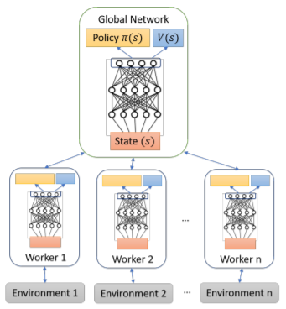
Actor-critic methods
Combination of value-based and policy-gradient methods that mitigate the disadvantages of each
The actor attempts to learn a policy by receiving feedback from the critic
Iterative process that helps the actor improve its strategy and converge to an optimal policy
Often performs better than value-based or policy-gradient methods
Several approaches, such as A3C – has a hierarchy of master learning agent and
individual learners

Slide 11
DRL in cybersecurity

Slide 12
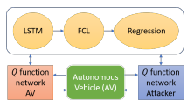
DRL Security Methods for Cyber-physical Systems
Cyber-physical system (CPS): mechanism controlled by algorithms with internet integration
Widely vulnerable to cyber attacks
2015: Phishing attack led to the control system of a German steel mill being hacked; led to partial plant shutdown
CPS defense problem modeled as two-player zero-sum game
Defender is represented by actor-critic DRL algorithm
Feng & Xu [85] showed a method that can learn an optimal strategy to defend CPS
In autonomous vehicles (AVs), attackers can get control of AVs by manipulating sensory data; AV must defend against it [89]
Car following model [90]: A defender car closely follows another car, which tries to mislead the following vehicle (architecture below)

Slide 13
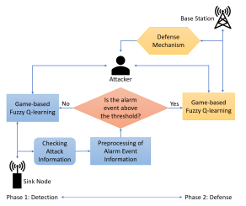
DRL for Intrusion Detection Systems
Intrusion Detection System (IDS): Monitor activity and report any abnormal or malicious activity
Host-based IDS analyzes host computer’s files
Network-based IDS collects transmitting packets in network and examines traffic data (easier to implement, more power)
Two common detection systems
Signature detection: storing patterns of known attacks and comparing possible attacks to those in the database
Anomaly detection: observes system’s normal behaviors and alerts administrator if any activities are found that deviate
[120] introduced IDS system for wireless sensor networks based on a
game theory approach and fuzzy Q-learning algorithm

Slide 14
DRL for Intrusion Detection Systems (cont.)
[124] proposed an adversarial environment using RL in implementing a classifier for network intrusion detection
Random samples are drawn from intrusion dataset and are treated as RL states
Adversarial strategy useful for unbalanced datasets
[125] used DQN, double DQN (DDQN) for network intrusion detection
Results show DDQN is best performing algorithm among employed DRL algorithms

Slide 15
DRL-based Game Theory for Cybersecurity
Traditional cybersecurity methods are passive and lag behind dynamic attacks
Firewall, antivirus software, intrusion detection
Game theory is useful in such situations because it can examine many scenarios and derive the best policy for each agent
Game theoretic models to characterize cybersecurity problems in different attacking scenarios
Jamming
Spoofing
Malware
Attacks in adversarial environments

Slide 16
DRL-based Game Theory for Cybersecurity (cont.)
Jamming attacks: special case of Ddos attacks
[142] studied MEC systems, which allow cloud computing functions to take place at edge nodes of a network
RL methodology used to select defense levels and other relevant parameters
Used DQN to handle high-dimensional data
[143] introduced multiagent RL method to deal with anti-jamming in wideband autonomous cognitive radios (WACRs)
Learns optimal policy for each radio to select appropriate sub-band, which aims to avoid jamming signals and interruptions from other radios
[144] used Q-learning to select new spectrum sub-bands when the current one is interfered by a jammer
Reward structure is amount of time that the jammer or interferer takes to interfere with WACR transmission

Slide 17
DRL-based Game Theory for Cybersecurity (cont.)
Spoofing attacks: attacker claims to be another node using faked identity to gain illegitimate access to network
Can lead to man-in-the-middle or DoS attacks
[156] and [157] modeled interactions between receiver and spoofers as zero-sum authentication game and used Q-learning and Dyna-Q [158] algorithms to address the problem
Utility computed based on Bayesian risk
Improved performance of proposed methods against benchmark method

Slide 18
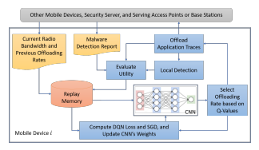
DRL-based Game Theory for Cybersecurity (cont.)
Malware attacks: exploit publicly unknown security vulnerabilities
Mobile devices often offload malware detection tasks to security servers in cloud for processing
However, offloading too many tasks to cloud leads to network congestion that can lead to long detection delay
[161] used Q-learning approach and DQN to find the optimal offloading rate and enhance mobile offloading performance

Slide 19
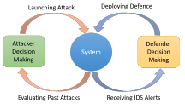
DRL-based Game Theory for Cybersecurity (cont.)
Adversarial environment: defender may not know the private details of the attacker
Type of attack, attacking target, frequency, and location
Defender may allocate substantial resources to protect asset that is not a target of attacker
Needs to dynamically reconfigure defense strategies to increase complexity and cost of intruder
[170] introduced model where defender and attacker can repeatedly change defense and attack strategies
Defender has no prior knowledge about attacker
Used two methods for defenses
Adaptive RL handles attacks that have diminishing exploration rate (non-persistent)
Robust RL deals with intruders that have constant exploration rate (persistent)

Slide 20
Discussions and future research directions

Slide 21
Review of DRL and Future Work
DRL has emerged as one of the most successful methods for creating human/superhuman AI agents
Rely on incorporation of DNNs into framework of traditional RL
Many areas for future work concerns the large-scale and complex nature of cyber-physical systems
DRL for intrusion detection systems is very recent
To this point, most methods have used simulated environments, which can be far from reality
Next step is to use real environments for training, which could be costly
DRL algorithms for cyber defense are model-free methods, which require a large quantity of training data
Difficult to obtain in real cybersecurity practice
Want to learn proxy model of high-dimensional environment
Most current work keeps the action space as discrete, which limits its real world effectiveness

