Slide 1
Robust deep reinforcement learning for security and safety in autonomous vehicle systems
Aidin Ferdowsi, Ursula challita, walid saad, Narayan b. mandayam
2018 IEEE international conference on intelligent transportation systems (Itsc)

Slide 2
Introduction

Slide 3
Autonomous vehicles in intelligent transportation systems
Autonomous Vehicles (AVs) must process a large volume of data collected by sensors and communication links
This reliance on communications and data processing leaves AVs susceptible to cyber-physical attacks
Attacker can reduce reliability of measurements by injecting faulty data, possibly inducing accidents
Many security solutions have been proposed for intra-vehicle security (sensors) and inter-vehicle security (communication)
However, these solutions do not account for the interdependence between the cyber and physical layers of AVs
Also do not properly model an attacker’s actions and goals
Does not help to enhance robustness of AV control to attacks

Slide 4
Paper contributions
Propose a novel adversarial DRL framework to provide robust AV control
Use “car following” model – control an AV that closely follows another AV
Use camera, radar, roadside smart sensors (RSS), and inter-vehicle beaconing data from leading car
Attacker can inject bad data to these sensors
Goal: optimally control speed while being robust to data injection attacks from attacker

Slide 5
System model

Slide 6

Autonomous vehicle cyber-physical system
Each AV $i$ must acquire information about own position, speed $v_{i}$, and distance and speed of nearby objects
For car-following model, look at immediately leading AV $i −1$
Update speed of $i$ as function of speed of $i−1$ using $\dot{v_{i}}\left(t\right)=λ({\hat{v}}_{i−1}\left(t\right)− v_{i}(t))$
${\hat{v}}_{i−1}\left(t\right)$ is estimated speed of AV $i −1$ from AV $i$
$λ$ is reaction parameter
Speed estimates come from:
Camera image $c_{i}$
Radar reading $r_{i}$
Speed report of AV $i −1$ $u_{i −1}$
Closest RSS reported speed $s_{i}$
These are all used to estimate the distance and velocity (complicated Jacobian matrix)

Slide 7

Attack model
From previous slide, derive ${\overline{v}}_{i−1}\left(t\right)= w_{i}^{T}(t)z_{i}(t)$ → weight matrix and sensor vector
${\tilde{z}}_{i}(t)$ is “under attack sensor vector” – a sensor reading that has faulty data injected into it
${\tilde{z}}_{i}\left(t\right)= z_{i}\left(t\right)+ a_{i}(t)$, where $a_{i}(t)$ is injected faulty data and $z_{i}\left(t\right)$ is the sensor vector

Slide 8
Security problem and game formulation

Slide 9

Attacker’s goal
Find an attack vector $a_{i}^{∗}\left(t\right)$ at each time step such that $a_{i}^{∗}\left(t\right)= \max_{a_{i}(t)} R_{i}\left(a_{i}\left(t\right), w_{i}\left(t\right), e_{i}\left(t\right)\right)≜{(d_{i}\left(t\right)− o_{i} \left(v_{i−1}\left(t\right)\right))}^{2}$
“Regret function” – quantifies deviation from optimal safe spacing
Distance between AVs
Optimal safe spacing at time t
Basically, trying to find the maximum deviation from the optimal safe spacing

Slide 10

Defender’s goal
Find a weighting vector $w_{i}^{∗}(t)$ to minimize regret function, defined as follows:
$w_{i}^{∗}\left(t\right)=\min_{w_{i}(t)} R_{i} \left(a_{i}\left(t\right), w_{i}\left(t\right)\right)$, s.t. $\sum_{k=1}^{4}{w_{k}^{i}(t)}=1$
These two optimization problems are dependent on the actions of both the attacker and AV
Need to formulate the problem in a game-theoretic framework

Slide 11
Game theory magic
Lots of theorems and proofs
Ultimately showing that, at each time step, the attacker and defender must choose vectors using past actions
A zero-sum game is defined, which is guaranteed to admit at least one mixed-strategy Nash equilibrium (MSNE) – a stable game state considering all actions of both agents
Though the MSNE exists, it is difficult to derive the equilibrium strategies for each agent → use deep RL algorithm to learn optimal actions

Slide 12
Adversarial deep reinforcement learning for optimal safe av control

Slide 13
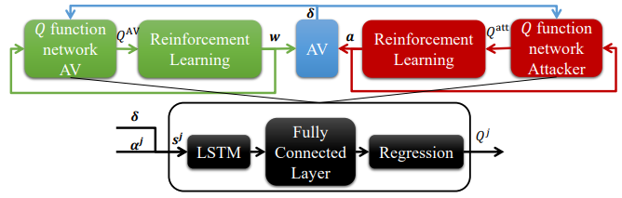
Proposed rl algorithm
Two components:
DNN that summarizes past actions and spacing deviations
RL component, which can be used by each player to decide best action to choose based on summary from DNN
Q-learning algorithm used to select actions
LSTM blocks used to extract features from continuous state space

Slide 14
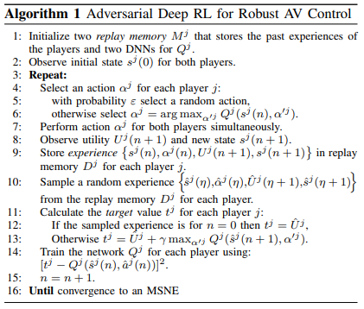
Deep Rl algorithm pseudocode
Used by each player to learn optimal action vectors
Will converge to one of MSNE points of game

Slide 15
Simulation results, analysis, and conclusion

Slide 16
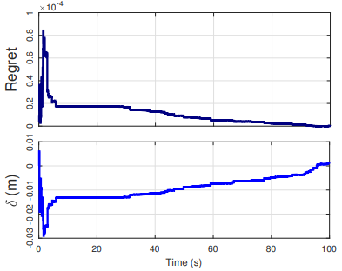
Simulation setup and first simulation
Using theorems, found that each AV only needs information about past 6.6 second to carry out optimal safe action
Simulation 1: Attacker can only attack beacon sensor values
Regret reduces to zero after 100 seconds and attacker cannot force AV to deviate from optimal safe spacing
Deviation

Slide 17
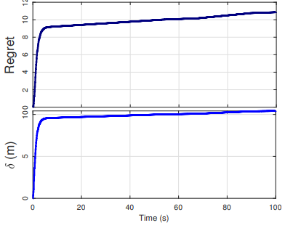
Second simulation
Worst case security scenario: attacker can attack all sensor readings
In first 10 seconds, regret increases abruptly, but stays relatively constant in the remaining time
Since the regret stays approximately constant, defender can feedback the spacing deviation to compensate for deviation from optimal safe spacing

Slide 18
conclusion
Deep RL method used to enable robust dynamics control for AVs in presence of data injection attacks
LSTM blocks used to extract temporal features from infinite state space to make the RL algorithm work
AV can mitigate effect of data injection attacks on sensor data and stay robust to attacks

