Slide 1
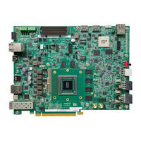
VEK280 Vitis-AI
ML Deployment &
YOLOv7 Evaluation
AMD Versal AI Edge VEK280 (VE2802) · Vitis 2025.2 · Vitis-AI 6.2
Project technical summary

Slide 2
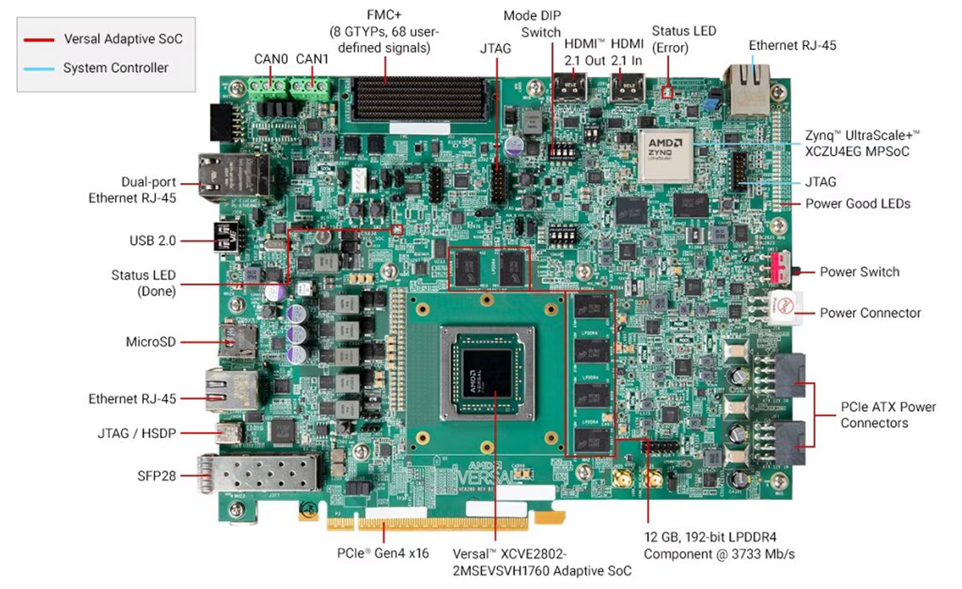
The VEK280 board
Versal AI Edge VE2802 Adaptive SoC for embedded AI inference
VE2802 SoC: processing system, programmable logic and AI Engine-ML array
AIE-ML array: 38 columns × 8 rows (304 tiles)
12 GB LPDDR4 working memory
MicroSD boot, Ethernet, USB/JTAG, HDMI, FMC+, PCIe
Inference runs locally on the board, not the host

Slide 3
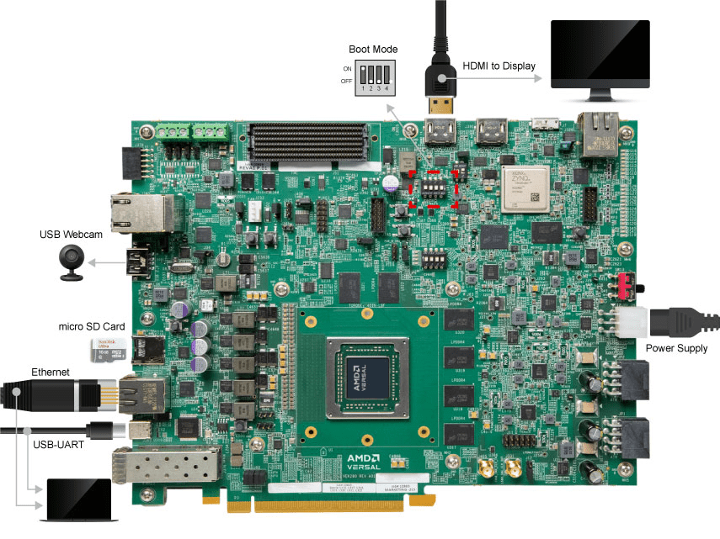
Physical connections
Typical project setup
Power: supplied power input
Boot: MicroSD card
Host PC: Ethernet for SSH and file transfer
Console and debug: USB-UART / JTAG
Optional: USB webcam and HDMI display

Slide 4
YOLOv7 architecture
One-stage, anchor-based detector with a fixed 640×640 input in this project
Input
Backbone
Neck
Head
Post-process
640×640×3 RGB, letterbox resize, normalize
›
Conv-BN-SiLU stem, E-ELAN blocks, MP downsampling → C3, C4, C5 features
›
SPPCSPC, then PAN/FPN top-down and bottom-up feature fusion
›
RepConv per scale, 1×1 conv predicts box, objectness, class (3 anchors)
›
Box decoding and NMS (conf 0.25, IoU 0.45)
Three detection scales
80×80 stride 8 · small objects
40×40 stride 16 · medium objects
20×20 stride 32 · large objects
Runs on the NPU (neural-network layers)
Runs on the Arm CPU (pre- and post-processing)

Slide 5
From trained model to board
A .pt file is not run directly: the model is prepared for the NPU on the host
On the host (x86 Ubuntu)
On the board
1
2
3
4
5
6
7
Export
Quantize
Compile
Snapshot
Deploy
Load
Infer
Trained YOLOv7 to ONNX
INT8 for NPU execution
Map to VE2802_NPU_IP_O00_A304_M3
Deployable model built on x86 host
Copy snapshot and app to MicroSD
VART app loads snapshot, sends tensors
NPU runs network; CPU decodes and NMS
Deployed snapshot: /run/media/mmcblk0p1/snapshot.VE2802_NPU_IP_O00_A304_M3.yolov7.TF
Detector settings: fixed 640×640 input, confidence 0.25, NMS IoU 0.45

Slide 6
Where the model runs on the board
Heavy neural-network math on the NPU; everything around it on the CPU
MicroSD
snapshot + app
AMD Versal AI Edge VE2802
Processing system (Arm CPU)
NPU (PL + AIE-ML)
USB webcam
or image file
Linux + VART runtime
Reads image or camera frame
Resize to 640×640, normalize
Box decoding and NMS
Draws and saves result
INT8 YOLOv7 network layers
AIE-ML array: 38 × 8 = 304 tiles
PL datapath for control and data movement
About 63 ms per frame
input
output
Ethernet / HDMI
SSH, display
12 GB LPDDR4: weights, activations and buffers

Slide 7
YOLOv7 results
100-image baseline, 640×640 model input
63.1 ms
15.8 FPS
0.315 FPS
≈3.3 W
Mean NPU latency
NPU throughput
End-to-end throughput
Monitored rail power (INA226)
NPU latency stayed about the same from 320×240 to 1920×1080 sources, because the model input is fixed at 640×640
Live webcam: about 14.2 NPU FPS but 0.31 end-to-end FPS
The bottleneck is the surrounding pipeline (pre/post-processing, I/O), not the NPU
Energy is about 10.5 J per image; power is a rail measurement, not total board power

