Slide 1
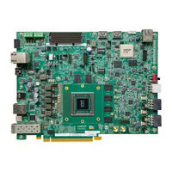
YOLOv7 Deployment and NPU-Only Performance Evaluation on the AMD Versal AI Edge VEK280
Final evaluation: NPU-only mode, CPU subgraphs disabled / skipped
Board | AMD Versal AI Edge VEK280 / VE2802 | Vitis / Vitis-AI | 2025.2 / 6.2
Model | YOLOv7, fixed 640 × 640 | NPU | VE2802 NPU, A304 configuration
Execution | NPU-only, CPU subgraphs skipped | Runner | Native VART/NPU runner

Slide 2
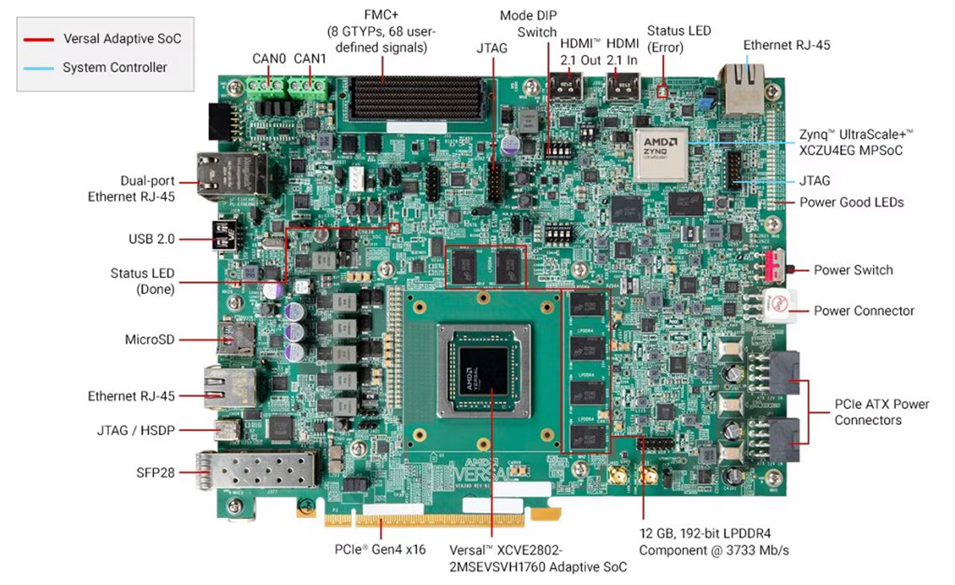
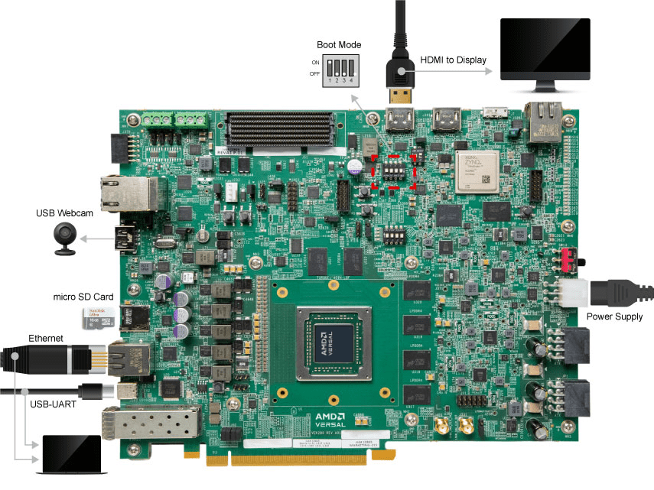
VEK280 hardware and connections
VE2802 SoC: processing system, programmable logic and AIE-ML array (304 tiles, NPU at 500 MHz)
12 GB LPDDR4; MicroSD boot; Ethernet, USB-UART, HDMI and USB webcam
Powered from its supplied input, boots from MicroSD, Ethernet to host for SSH and file transfer, USB-UART for console

Slide 3
NPU architecture and deployment flow
Where each stage executes
Deployment flow
Stage | Executes on
Read/decode, letterbox, input preparation | CPU (processing system)
INT8 neural-network inference | NPU (PL + AIE-ML)
Output decode, NMS, drawing | CPU (processing system)
Model data and buffers | LPDDR4
Host: export model to ONNX
Host: INT8 quantization
Host: compile for VE2802 NPU (A304)
Host: package the snapshot
Board: copy snapshot to MicroSD
Board: VART app loads it and feeds tensors
Board: decode and NMS on NPU output
The VEK280 uses the AI Engine-based NPU, not the DPU of earlier platforms, so the model is compiled specifically for the VE2802 NPU. Compilation is not pruning.
Snapshot: /run/media/mmcblk0p1/snapshot.VE2802_NPU_IP_O00_A304_M3.yolov7.TF

Slide 4
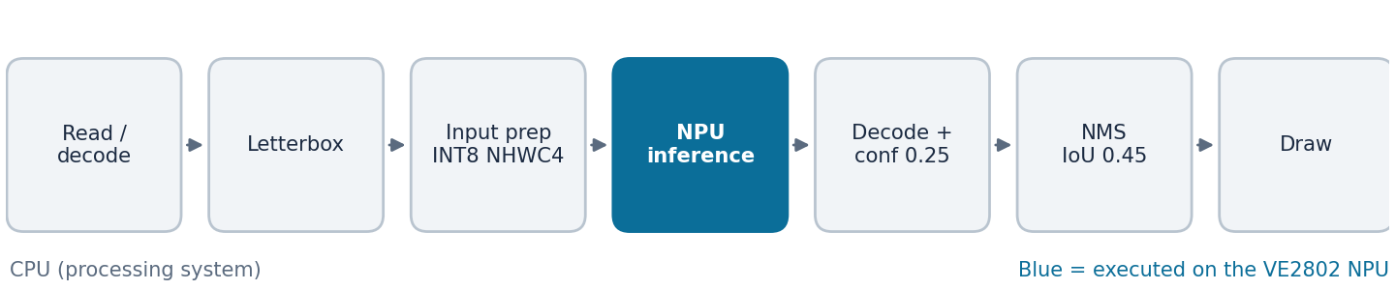
YOLOv7 final configuration: NPU-only
Parameter | Value
Application input | (1, 3, 640, 640) float32 NCHW
Native NPU input | (1, 640, 640, 4) INT8 NHWC4
Output tensor | (1, 25200, 85)
Confidence / NMS IoU | 0.25 / 0.45
CPU subgraph is skipped; the network runs fully on the NPU
Gives a clean accelerator measurement and one consistent configuration
CPU still handles image handling, decode, NMS and display
NPU only mode set. Skipping node wrp_network_embd_export_2_cpu_subgraph_call.

Slide 5
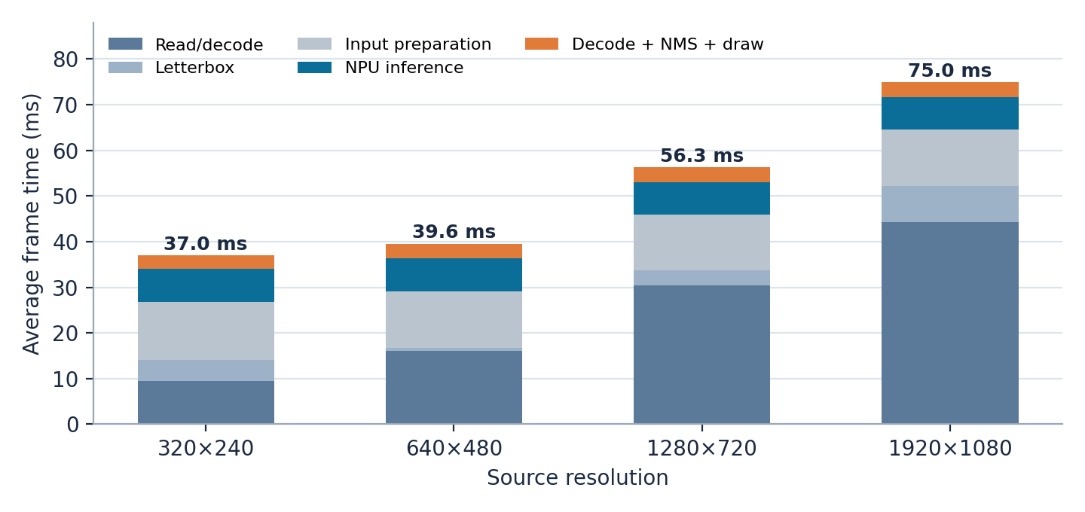
Final NPU-only profiling results
ms per frame | 320×240 | 640×480 | 1280×720 | 1920×1080
Read/decode | 9.52 | 16.07 | 30.50 | 44.31
Letterbox | 4.58 | 0.69 | 3.17 | 7.97
Preparation | 12.78 | 12.41 | 12.25 | 12.22
NPU | 7.18 | 7.14 | 7.12 | 7.12
Decode+NMS+Draw | 2.94 | 3.24 | 3.25 | 3.35
Frame total | 37.02 | 39.57 | 56.32 | 74.99
End-to-end FPS | 27.01 | 25.27 | 17.76 | 13.33
CPU busy | 72% | 72% | 80% | 95%
101 images at each of four source resolutions (404/404 completed). Values are per-frame averages from the stage-level profiler. Model input is fixed at 640×640.

Slide 6
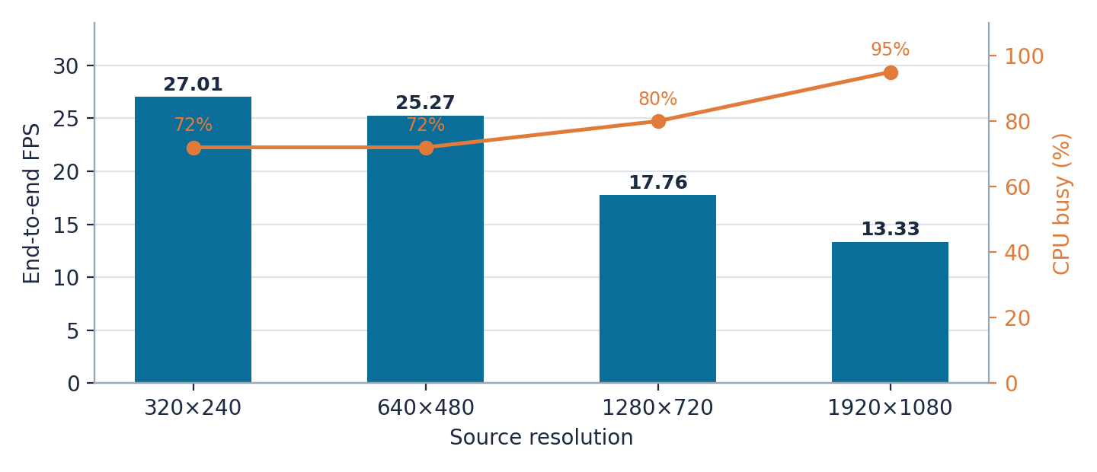
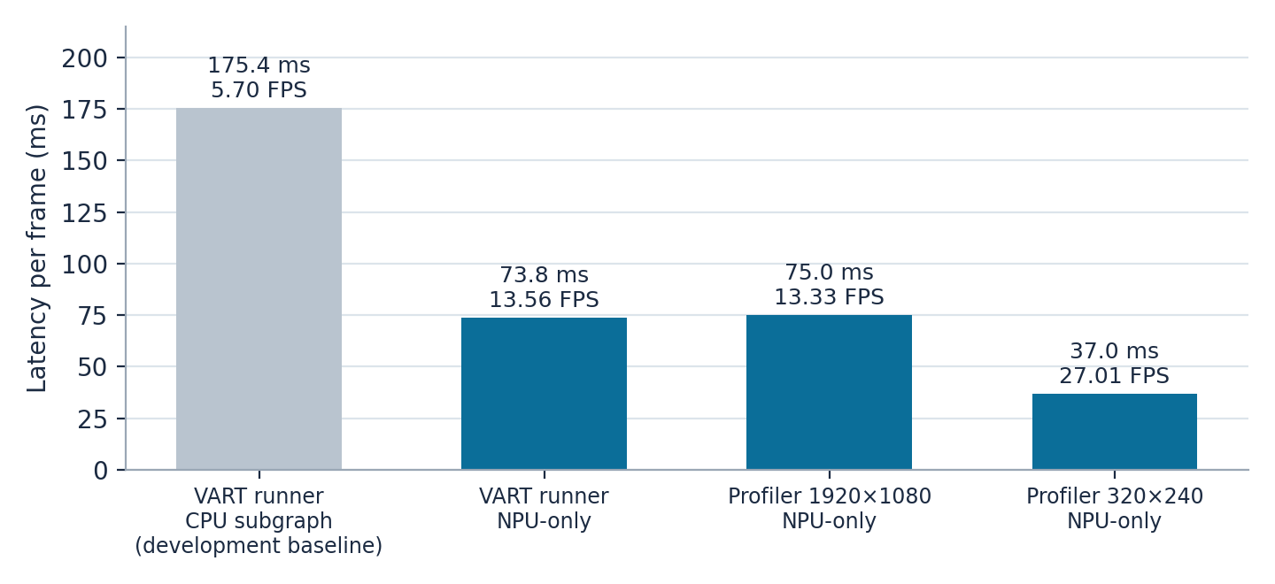
Analysis
NPU latency is stable at 7.12–7.18 ms (ceiling about 140 FPS), about 10× the best end-to-end rate
Read/decode rises 4.7× (9.52 to 44.31 ms) and is about 59% of frame time at 1920×1080; CPU load reaches 95%
Input preparation is a fixed 12.2–12.8 ms cost, larger than the NPU stage; decode, NMS and drawing add only about 3 ms
VART runner: 175.44 ms with CPU subgraph (development baseline) fell to 73.75 ms NPU-only, 2.38× faster
Next: faster decode and resize, overlapped with NPU execution

Slide 7
AIE-ML activity, power and conclusions
Metric | Value
AIE-ML activity, 320×240 to 1280×720 | 51.65–52.07%
AIE-ML activity, 1920×1080 | 61.45% (tiles 59.19–64.40%)
AIE-ML activity, later 1920×1080 run | 52.48% (52.21–52.77%)
Average power (4 resolutions) | 3.546–3.565 W
Peak power | 3.705–3.966 W
Energy per frame | 0.131–0.267 J
Conclusions
YOLOv7 runs on the VE2802 NPU, evaluated in NPU-only mode with CPU subgraphs disabled/skipped
NPU inference is a stable 7.1 ms; the full pipeline reaches 13.33–27.01 FPS
Throughput is limited by CPU-side decode and preparation, not the NPU
ResNet50 and YOLOX-S were also deployed; video and webcam demos use the same NPU-only pipeline
AIE profiling adds large overhead (1920×1080: 74.99 ms rose to about 136 ms), so it is never used for benchmarks. Power is the INA226 monitored rail, not total board power.

