Slide 1
KL UNIVERSITY • BACHUPALLY CAMPUS, HYDERABAD
Department of Computer Science & Engineering
Online Course Recommendation System
A content-based recommender helps learners discover relevant courses from their interests, skills and completed subjects.
PRESENTED BY
UNDER THE GUIDANCE OF
2520030595-S.Sri Sai Pradhyumn
2520030570-T.Akilesh
2520030618-Sri Nityay Varma Manthena
Dr.Raghavendra
Designation Department of CSE
KLH Bachupally Campus
B.Tech II Year | Minor Project - Review 1 | Academic Year 2026-27 | Date: 19-09-2026
Notes:
Model template - Minor Project review presentation for B.Tech II year. Replace every placeholder in angle brackets. Title slide: speak for 30 seconds - greet the panel, state the title, introduce the team and the guide. Do not read the slide word for word.

Slide 2
AGENDA
Contents
1
Introduction & Domain Background
7
Methodology & Modules
2
Problem Statement & Motivation
8
Tools and Technologies
3
Literature Survey
9
Work Completed / Demo
4
Research Gap Identified
10
Timeline & Review Plan
5
Objectives of the Project
11
Expected Outcome & Conclusion
6
Proposed System Architecture
12
References
Dept. of CSE | KL University, Bachupally Campus
2
Notes:
Keep the agenda to one slide. In a 10-12 minute review, spend the most time on literature survey, objectives and work completed.

Slide 3
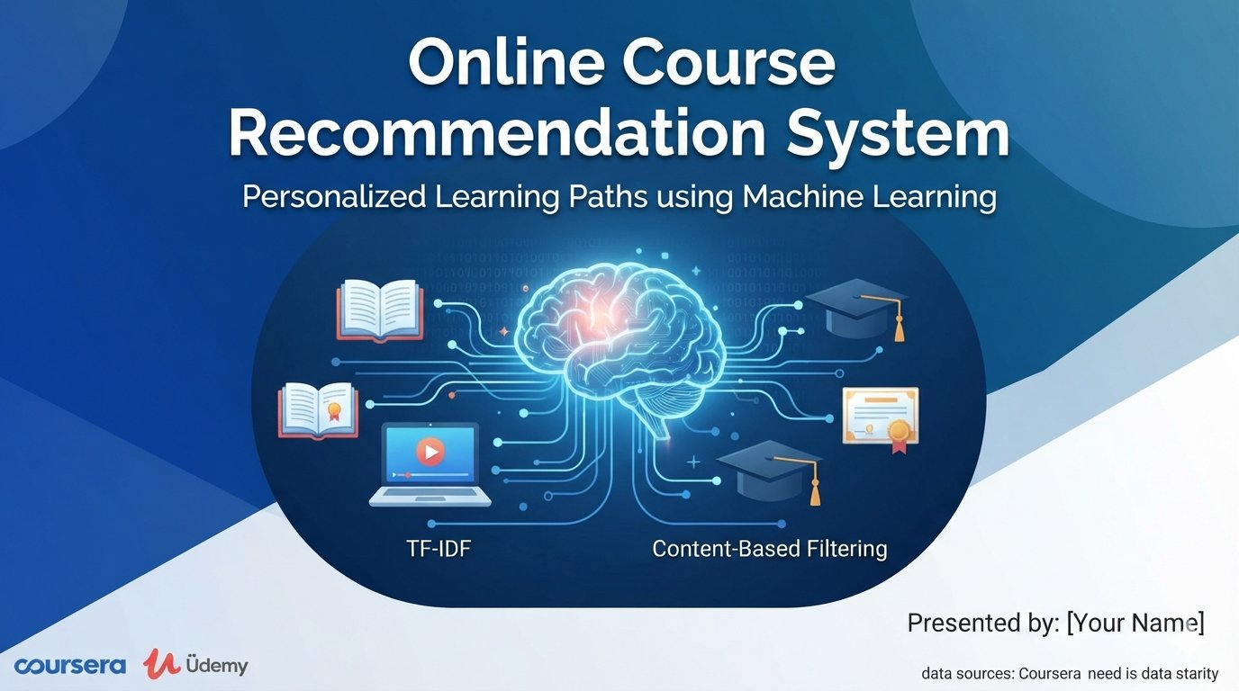
SECTION 1
Introduction & Domain Background
LEARNER PROFILE
Interests • Skills • Completed Subjects
↓
CONTENT MATCHING
TF-IDF + Cosine Similarity
↓
RANKED COURSE SUGGESTIONS
What is the domain?
Domain: Educational Technology & Recommender Systems
A course recommender suggests learning content that fits a learner’s interests, skills and previous learning.
Why is it relevant today?
Online learning platforms offer many courses, making it difficult to choose the most relevant next course.
Where does your project sit?
Our web application ranks courses using TF-IDF text features and cosine similarity, then explains why each course matches the learner profile.
PROJECT SUMMARY
Our project combines a Python Flask backend, a simple web interface and content-based ranking to provide understandable course recommendations.
Dept. of CSE | KL University, Bachupally Campus
3
Notes:
60-90 seconds. Start broad (the domain), end narrow (your specific task). Avoid definitions copied from Wikipedia - the panel will ask for the source.

Slide 4
SECTION 2
Problem Statement & Motivation
PROBLEM STATEMENT
Learners often face information overload when choosing from a large number of online courses, and generic recommendations may not reflect their skills or learning history.
1
2
3
Who is affected?
What is the cost of the problem?
Why solve it now?
Poor course choices can lead to duplicated learning, missing prerequisites and reduced motivation.
Online course libraries continue to grow, so personalized, explainable recommendations can help learners choose a useful next step.
Students and lifelong learners may waste time selecting courses that do not match their goals or current skill level.
Dept. of CSE | KL University, Bachupally Campus
4
Notes:
The problem statement must be ONE sentence. If you need two sentences, the scope is too wide for a minor project. The panel's first question is usually: who exactly benefits?

Slide 5
SECTION 3
Literature Survey
S.No | Author & Year | Title / Technique Used | Dataset / Tools | Key Findings | Limitation / Gap
1 | Pazzani & Billsus (2007) | Content-Based Recommendation Systems | User profile + item descriptions | Content features can recommend items similar to a user profile. | Needs informative item descriptions; may over-specialize.
2 | Salton & Buckley (1988) | Term-Weighting Approaches in Automatic Text Retrieval | Text documents; term weighting / TF-IDF foundations | Weighted terms help represent and retrieve relevant text. | Text overlap alone may miss deeper meaning or context.
Dept. of CSE | KL University, Bachupally Campus
5
Notes:
Do not read the table aloud. Speak about the trend: what most papers did, what results they reached, and what all of them left unsolved. Row 1 is a worked example - delete it and put your own paper there.

Slide 6
SECTION 4
Research Gap Identified
GAP 1
Course suggestions can be generic when learner interests and skills are not represented explicitly.
OUR PROJECT ADDRESSES
GAP 2
The system builds a learner profile from interests, skills and completed course titles, ranks courses with TF-IDF and cosine similarity, and shows matching terms plus prerequisite information.
Recommendation lists often provide limited explanation of why each course was selected.
GAP 3
Learners need a simple workflow that combines course browsing, search, personalized ranking and prerequisite awareness.
Dept. of CSE | KL University, Bachupally Campus
6
Notes:
This is the slide that separates a good review from an average one. State 2-3 gaps only, and make sure each one maps to a paper you listed.

Slide 7
SECTION 5
Objectives of the Project
To prepare course data : Use a structured course catalogue containing titles, descriptions, skills, years and prerequisites.
1
To build recommendations : Represent course text with TF-IDF and compare it with the learner profile using cosine similarity.
2
To explain suggestions : Display a content-match score, matched interest/skill terms and missing prerequisites.
3
To deliver a usable web app : Support year selection, course browsing, searching and personalized course recommendations.
4
Dept. of CSE | KL University, Bachupally Campus
7
Notes:
Avoid vague verbs - study, understand, analyse. Use build, classify, detect, compare, deploy. Four objectives is the right number for a minor project.

Slide 8
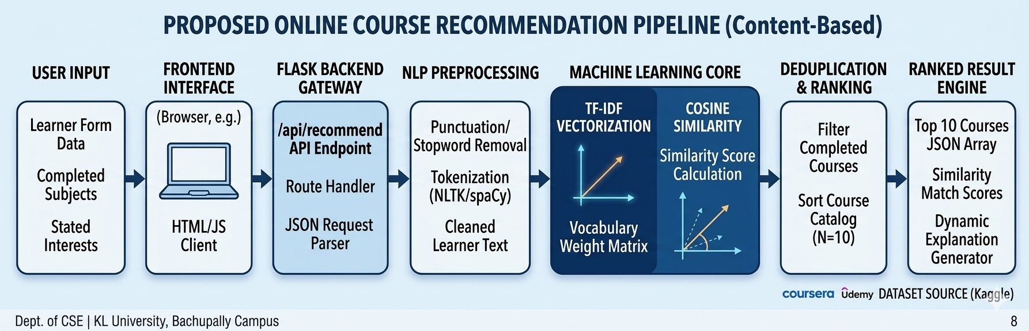
SECTION 6
Proposed System Architecture
LEARNER INPUT
TEXT FEATURES
CORE MODULE
RANKED OUTPUT
• Completed Subjects: List of academic courses the student has already passed.
• Stated Interests: Career goals, domain choices, or desired skills
• Text Cleaning: Lowercasing text and removing punctuation or special characters.
• Stop Word Removal: Stripping out generic words that carry no semantic weight
• TF-IDF Vectorization: Converts the cleaned text tokens into mathematical vectors based on keyword rarity.
• Cosine Similarity: Measures the geometric angle between the User Vector and Kaggle Course Vectors.
• Top-N Selection: Isolates the top 5 to 10 highest-scoring course matches.
• Match Score: Displays a percentage matching value based on similarity proximity.
Flask API flow: Browser form → /api/recommend → learner profile text → TF-IDF vectorization → cosine similarity for each course in selected year → rank top 10 → JSON response → course cards with match score and explanation.
Key implementation detail
The app uses Flask routes for course listing, search, prerequisites and recommendations. Course data is loaded from courses.json; no external database is required for this prototype.
Dept. of CSE | KL University, Bachupally Campus
8
Notes:
Walk the panel through the diagram left to right in under a minute, naming the input and the output first. Be ready to say where your contribution sits.

Slide 9
SECTION 7
Methodology & Modules
1
Module 1 - Course Catalogue
2
Module 2 - Profile & Text Processing
The bundled courses.json stores course ID, title, description, skills, year and prerequisite IDs. The current prototype uses sample course data rather than a live Coursera/Udemy feed.
The learner profile combines stated interests, skills and titles of completed prerequisite courses. TfidfVectorizer removes English stop words and uses one- and two-word phrases.
3
Module 3 - Ranking Logic
4
Module 4 - Web Interface
Cosine similarity compares the learner vector with each course vector. Scores are ranked; a small bonus is added when all listed prerequisites are completed.
Frontend: HTML, CSS and JavaScript
Backend: Python Flask
The UI supports login details, year selection, course search, prerequisite selection and recommendation cards with match explanations.
Dept. of CSE | KL University, Bachupally Campus
9
Notes:
One module per team member works well - it also answers the panel question 'who did what'.

Slide 10
SECTION 8
Tools and Technologies
SOFTWARE
HARDWARE / PLATFORM
Language: Python
Backend framework: Flask 3.1.2
ML / text: scikit-learn (TfidfVectorizer, cosine_similarity)
Data: JSON file (courses.json)
Frontend: HTML, CSS, JavaScript
Browser storage: LocalStorage for learner/university name
IDE: VS Code
Dependencies: requirements.txt
Platform: Windows / Linux / macOS
Runtime: Python 3.10+ recommended
RAM: 4–8 GB recommended
Deployment: Localhost (127.0.0.1:5000)
Network: Not required for local demo after setup
Data source: Bundled sample course catalogue
Future extension: Import a verified Coursera/Udemy course dataset
Dept. of CSE | KL University, Bachupally Campus
10
Notes:
Name versions where you know them. If you have a GitHub repository, show the link here - it is strong evidence of real work.

Slide 11
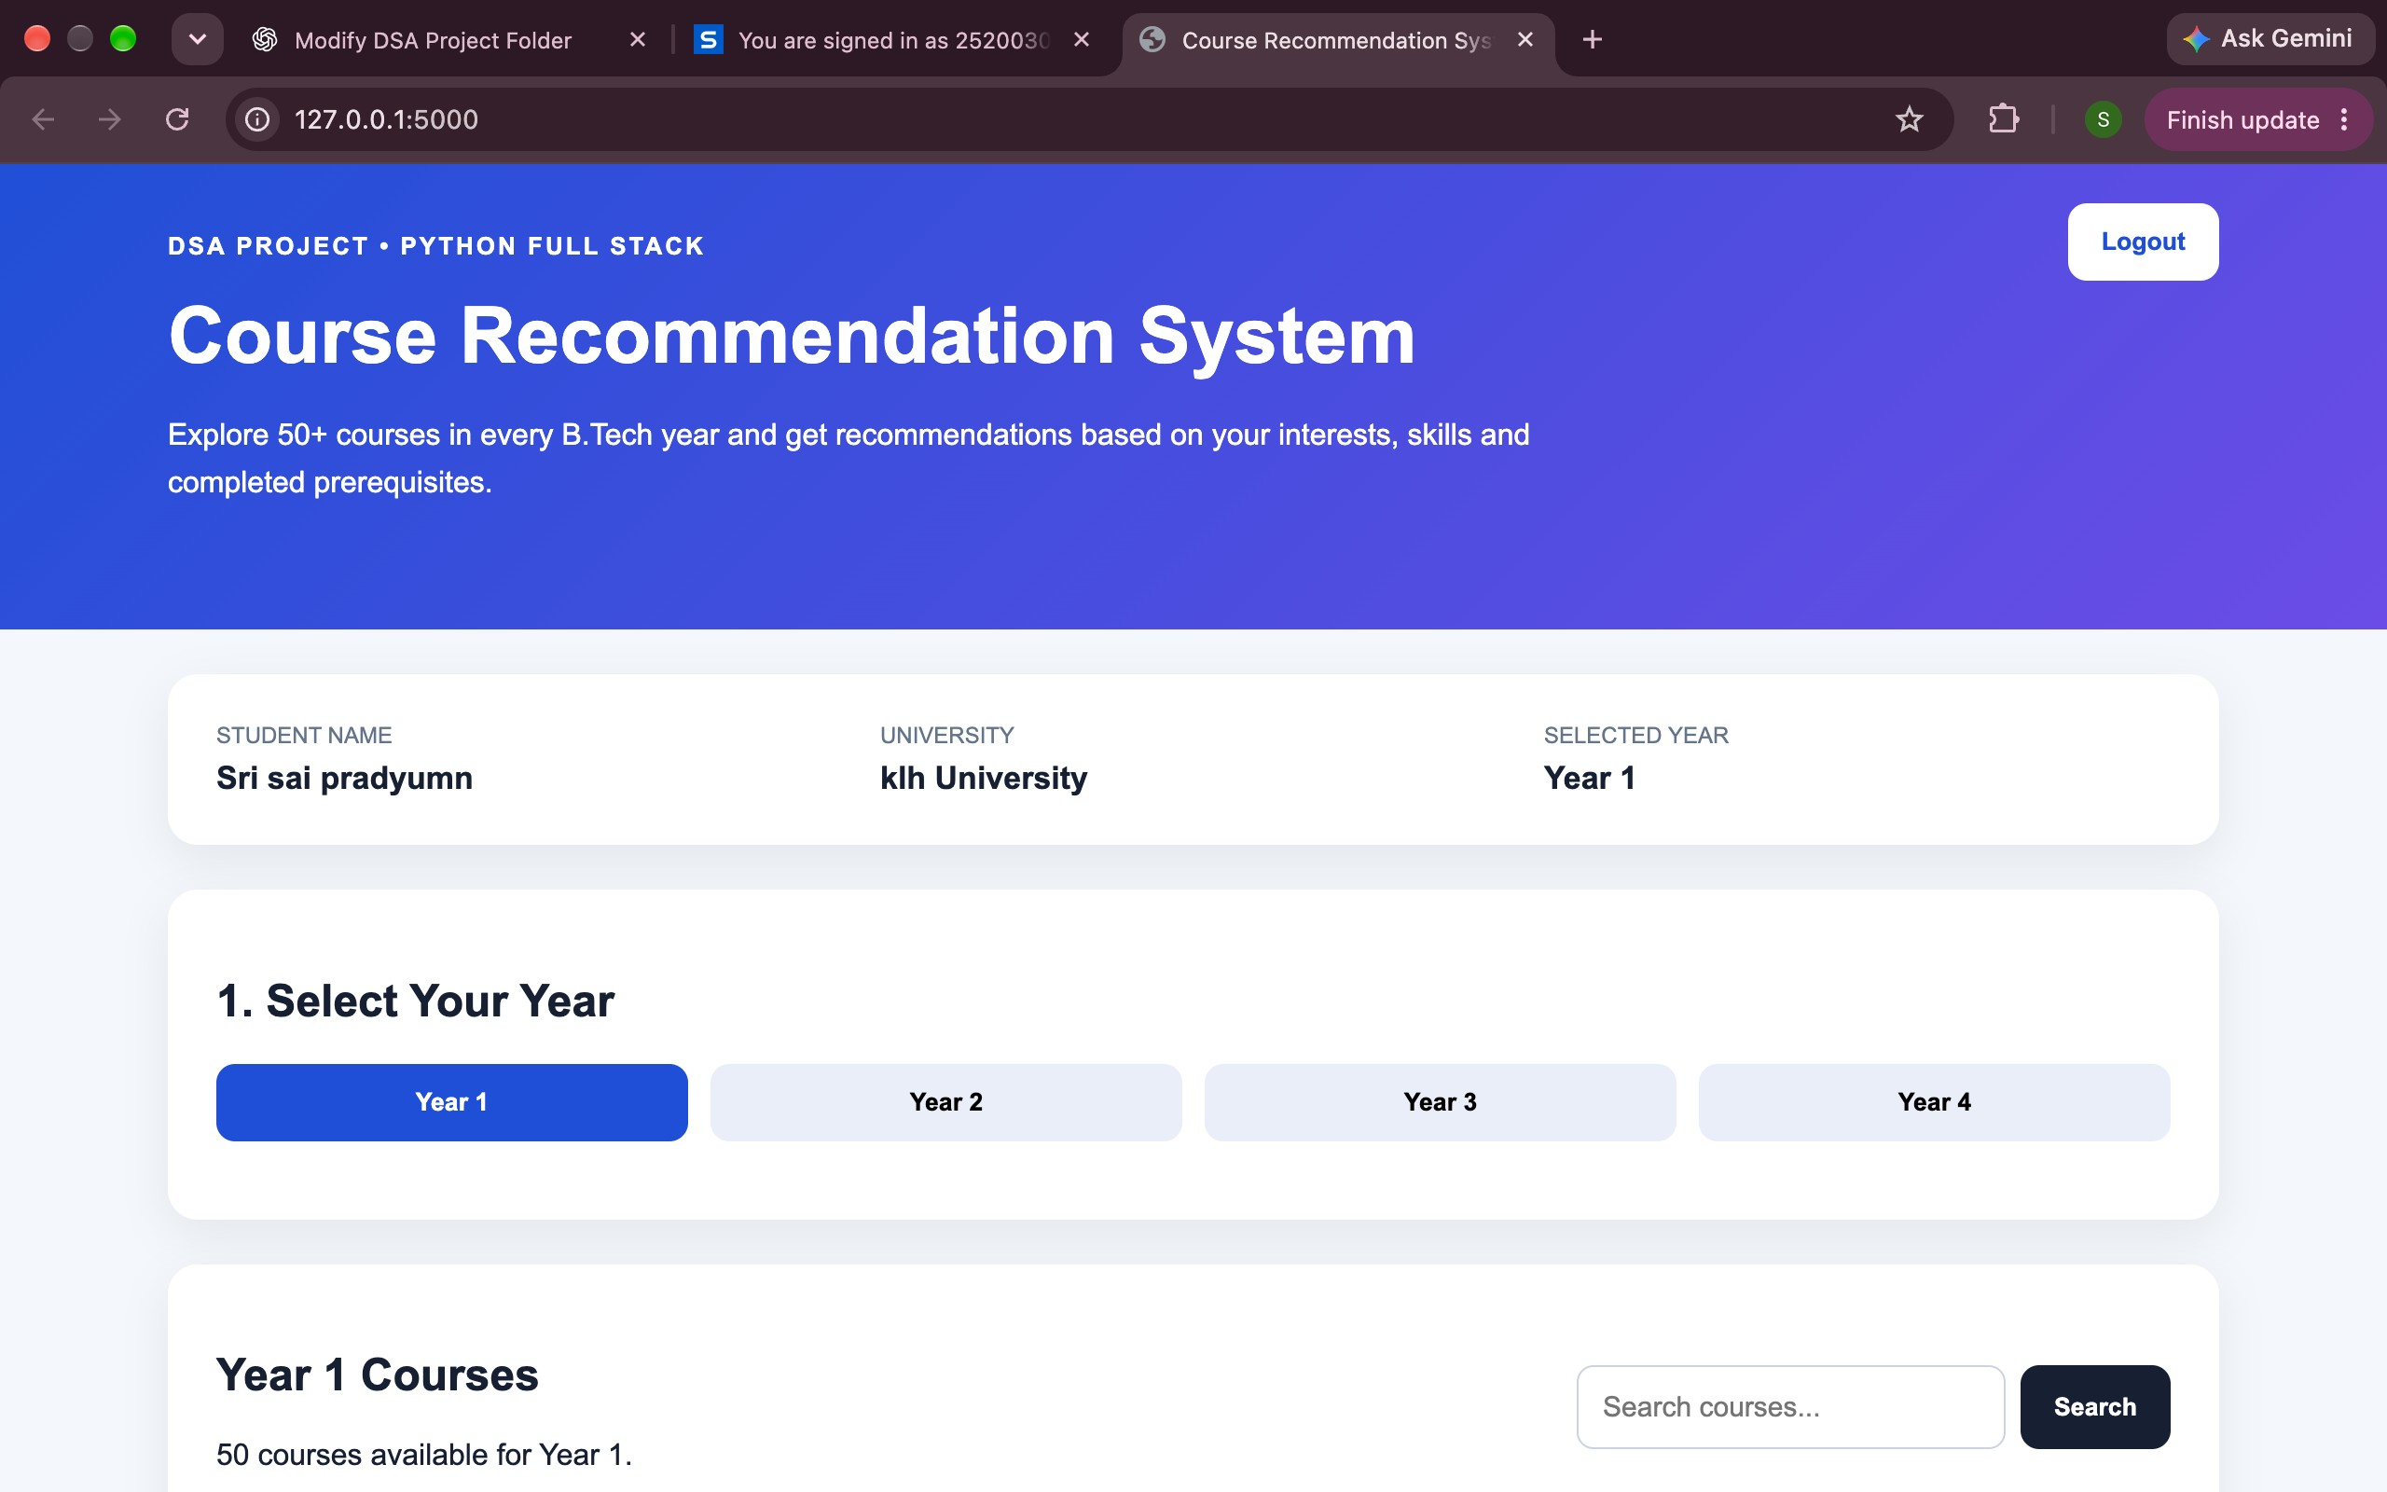
SECTION 9
Work Completed / Demo
Content-based method review
Implemented
DEMO FEATURES
• Browse courses by Year 1–4
• Search course titles / descriptions / skills
• Enter interests and skills
• See top 10 ranked matches
• View match score and “Why this course?”
• Check previous-year prerequisites
Course catalogue (JSON)
Implemented
TF-IDF feature pipeline
Implemented
Similarity ranking engine
Implemented
Flask web UI
To evaluate
Quantitative evaluation
To evaluate
Dept. of CSE | KL University, Bachupally Campus
11
Notes:
Be honest about status. Panels reward accurate self-assessment and penalise claims that fall apart under one question.

Slide 12
SECTION 10
Timeline & Review Plan
Phase 1
Phase 2
Phase 3
Final
Planning
Core Build
Integration
Validation
Prepare course catalogue
Implement TF-IDF and similarity
Create Flask API routes
Connect UI with Flask APIs
Add search and prerequisites
Show scores and explanations
Test common learner profiles
Check ranking and prerequisites
Measure relevance / response time
Prepare final demo and report
Define problem and scope
Identify learner inputs
Design course data schema
Plan UI workflow
Dept. of CSE | KL University, Bachupally Campus
12
Notes:
Adjust week numbers to your academic calendar. Showing a plan for the remaining weeks is what the panel wants to hear at Review 1.

Slide 13
SECTION 11
Expected Outcome & Conclusion
DELIVERABLE
MEASURABLE TARGET
BEYOND THE LAB
A browser-based course recommender with course browsing, search, learner-profile inputs and ranked recommendations with explanations.
Evaluate recommendation relevance with sample learner profiles, top-k relevance checks and response time. No benchmark result is claimed yet.
Can help students plan what to learn next and explore courses aligned with skills, interests and prerequisites.
CONCLUSION
The Online Course Recommendation System helps learners navigate a course catalogue by matching their interests, skills and completed subjects to course content. TF-IDF and cosine similarity provide transparent content-based ranking, while the Flask web interface supports browsing, searching and prerequisite awareness. Future scope: integrate a verified Coursera/Udemy dataset, improve semantic matching and conduct a formal recommendation-quality evaluation.
Dept. of CSE | KL University, Bachupally Campus
13
Notes:
Do not introduce anything new here. The conclusion restates the problem, the gap and the promise - nothing else.

Slide 14
SECTION 12
References
[1] M. J. Pazzani and D. Billsus, “Content-Based Recommendation Systems,” in The Adaptive Web, Springer, 2007, pp. 325–341.
[2] G. Salton and C. Buckley, “Term-weighting approaches in automatic text retrieval,” Information Processing & Management, vol. 24, no. 5, pp. 513–523, 1988.
[3] C. D. Manning, P. Raghavan and H. Schütze, Introduction to Information Retrieval. Cambridge University Press, 2008.
[4] F. Ricci, L. Rokach and B. Shapira, eds., Recommender Systems Handbook, 3rd ed., Springer, 2022.
[5] Project source code: CourseRecommendationDSA/app.py, courses.json, templates/index.html and static/script.js (provided project files).
Dept. of CSE | KL University, Bachupally Campus
14
Notes:
Use Google Scholar's 'Cite' option and pick MLA/IEEE, then fix the formatting by hand. Never cite a blog, a YouTube video or a paper you have not opened.

Slide 15
Thank You
Team: 27 | Guide:Dr.Raghavendra | Dept. of CSE, KLH Bachupally
Notes:
Keep the deck open on the architecture slide during questions - most panel questions point back to it.

