Slide 2
Using Standardization and Analysis of HIV Quality Measures Data to Identify Treatment Gaps and Disparities
Tammie L. Nelson & Samir Parmar
Epidemiology Department
Marion County Public Health Department, Indianapolis, IN

Slide 3
Learning Objectives
Root cause analysis for improving patient care
Best practices for improving clinical care using data standardization and analytic methods with HIV quality measures data
Identification and evaluation of treatment gaps and health disparities in patient populations

Slide 4
Why Evaluate Community Viral Load?
Viral load suppression is the ultimate measure of health for individuals living with HIV ¹
Comparing viral load results over time or between groups requires evaluation of community viral load (CVL) – an average of all viral load results taken from among those in the populations compared
CVL analysis is important in identifying disparities in HIV care outcomes
¹ White House Office of National AIDS Policy. (2015). National HIV/AIDS strategy for the United States: Updated to 2020. https://files.hiv.gov/s3fs-public/nhas-update.pdf

Slide 5
Barriers to Analysis
The Ryan White/HIV Services Program in the Indianapolis transitional grant area (TGA) has historically evaluated viral load among residents, but confidence intervals were too wide for group comparisons
(A confidence interval is a statistical measure of how sure we are about the results)

Slide 6
Root Cause Analysis
Root cause analysis was conducted during the 2016-2017 Part A grant year in order to identify the root causes of wide confidence intervals

Slide 7
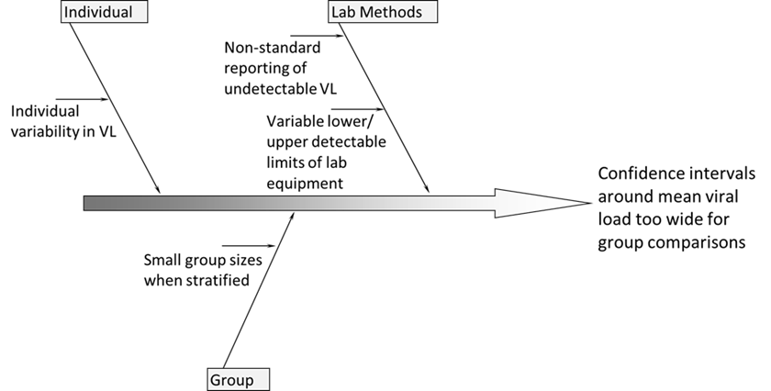
Root Cause Analysis

Slide 8
Root Cause Analysis
Findings:
Labs are not consistent in their instrumentation and reporting
HIV viral load varies widely from person to person and group to group
Resolution:
Viral load results were standardized and evaluated in a manner that helped ensure that statistically significant comparisons could be made

Slide 9
New Analysis Procedures
Standardization (CDC recommended ²):
Lower and upper detectable limits (LDL and UDL) are collected from labs
Results lower than the LDL are standardized to a number equal to half the reported LDL
Exp. Report of 0 from a lab with a LDL = 20 would be standardized to 10 c/mL
Results higher than the UDL are standardized to a number of UDL + 1
Exp. Report of >1,000,000 from a lab with a UDL = 750,000 would be standardized to 750,001 c/mL
Where LDL and/or UDL are missing, results are standardized to the most commonly reported LDL and UDL values for the time period examined
² CDC. (2011). Guidance on community viral load: A family of measures, definitions, and method for calculation. https://stacks.cdc.gov/view/cdc/28147/cdc_28147_DS1.pdf

Slide 10
New Analysis Procedures
Use of Geometric Mean (GM) versus Arithmetic Mean:
GM is a logarithmic transformation calculated by averaging the log transformed values of a set of viral load results
This calculated average is then transformed back to the original (linear) scale as it is a more intuitive value
The base used for the log transformation has no effect on the final GM estimate; however, using log base 10 has an advantage by its relationship to the value on the original scale.
Exp. A value of 2 on the log10 scale = 100 on the original scale; 3 corresponds to 1,000; 4 to 10,000; and so forth.
It is important to note that GM is not a true viral load result and should not be construed as anything but a way to compare the viral load of different populations. Arithmetic mean should be provided to reduce confusion.

Slide 11
Why These New Procedures?
Normalizes data by reducing the influence of outlying values such as the extremely high viral loads seen in those newly infected
Enables evaluation of data covering several orders of magnitude
Tightens confidence intervals allowing statistically significant comparisons to be made

Slide 12
Our Analysis & Findings

Slide 13


SAS Program & R Program
Originally developed using SAS Enterprise Guide 7.1 to compare geometric mean viral loads using Indianapolis TGA viral load data from eHARS
Replicated in R 3.4.1 to provide open source option for partners to freely conduct their own analysis
R program will be made available for use upon request

Slide 14
More Information on SAS and R
SAS is a commercial software developed by SAS Institute with a strong variety of statistical evaluation methods, but can be cost-prohibitive for many organizations
R is the open source alternative to SAS and is free for use with over 15,000 packages available for use in the Comprehensive R Archive Network (CRAN) commonly used with the RStudio integrated development environment (IDE)
R and RStudio are available for download here: https://www.rstudio.com/products/rstudio/download/
The list of all available R packages in CRAN is available here: https://cran.r-project.org/web/packages/available_packages_by_name.html
Packages can be easily installed and loaded with two commands via the R shell. Example:
> install.packages("ggplot2") > library(ggplot2)

Slide 15
Input
Standardized HIV data with year, viral load, and additional variables of interest for comparison such as county, retention status, birth sex, and race
We have utilized eHARS Person and Labs data for Indy TGA

Slide 16
Output
Community arithmetic and geometric mean viral loads with 95% CI for variables known among all PLWH/A in the TGA and by following categories:
Race, Age, Gender, County, Risk, Retention in Care status, Ryan White status, and Facility

Slide 17
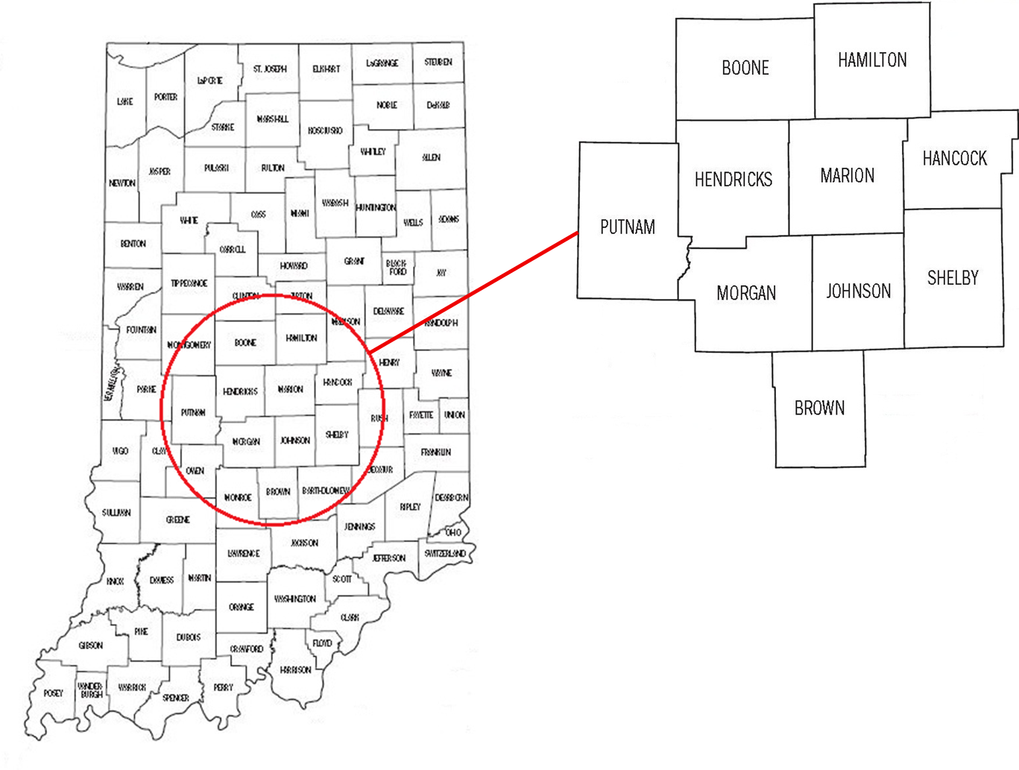
Geographic Area Included
4,513 HIV-positive TGA residents who received HIV-related medical care at least once were included in the analysis

Slide 18
Arithmetic vs. Geometric Mean Results
We can see that viral loads were statistically lower in 2017 than in 2013 using geometric mean (right). This difference would not have been identified using only arithmetic mean

Slide 19
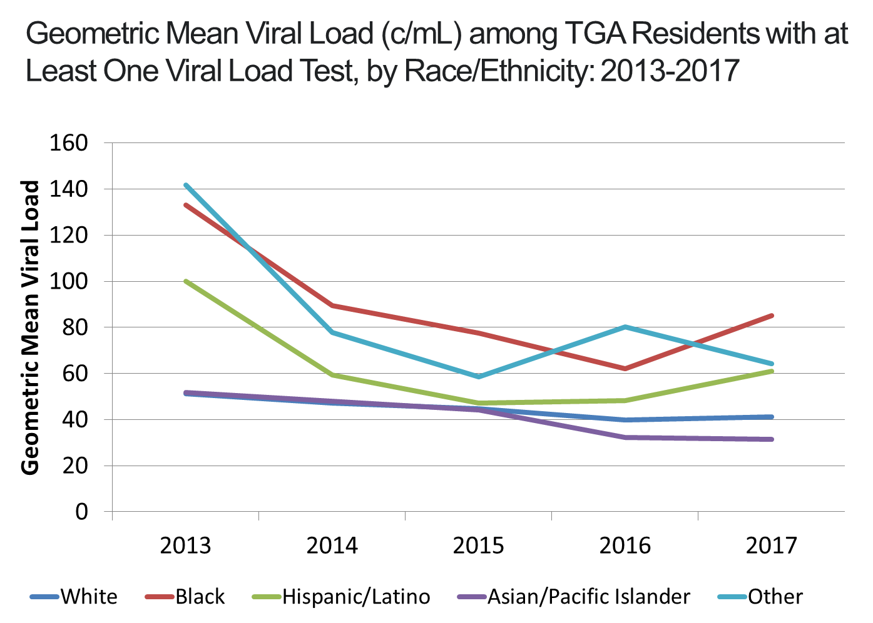
Results
Geometric mean viral load of African Americans was twice that of their white peers
Hispanic/Latino viral load was about 50% higher than that of white PLWH

Slide 20
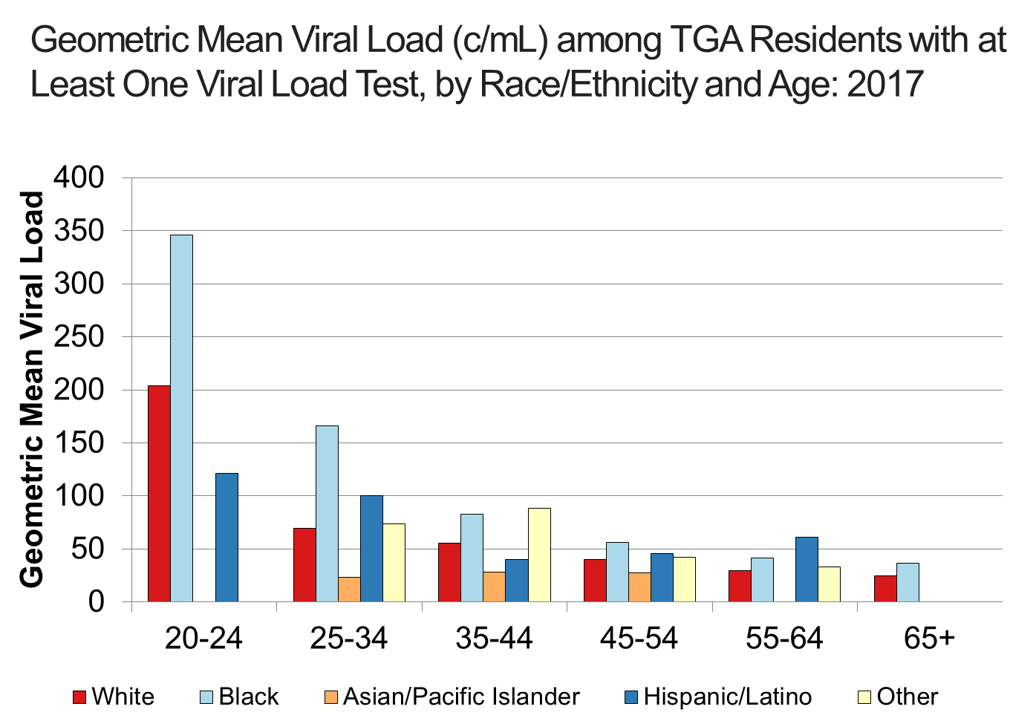
Results
African Americans do not differ significantly from other racial groups in middle to late adulthood
20-34 year old African Americans differs significantly from that of their peers

Slide 21
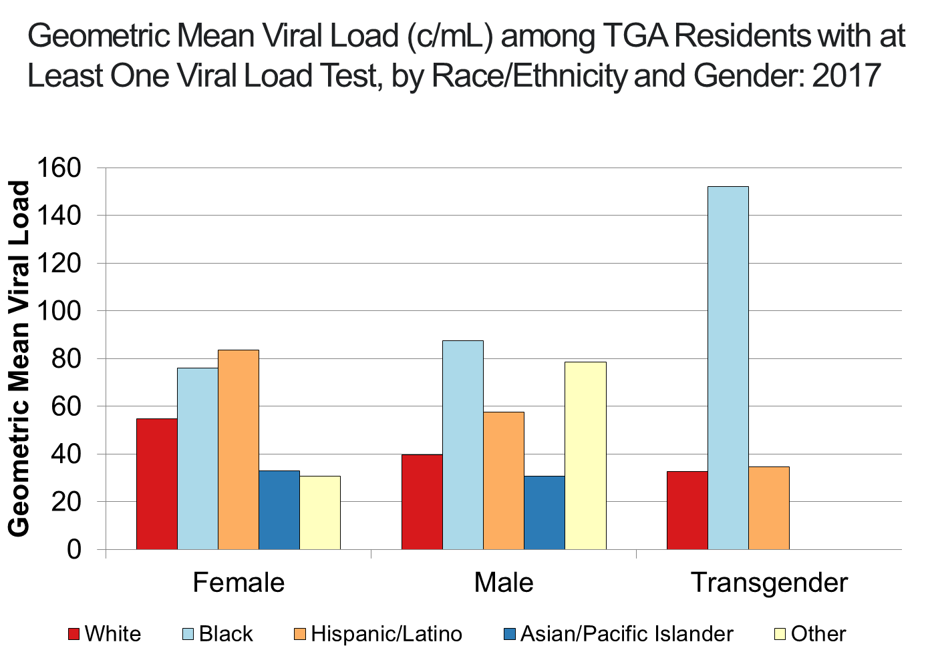
Results
Geometric mean viral load of African American men was more than twice that of white men during 2017
Viral load among females was not significantly different from males

Slide 22
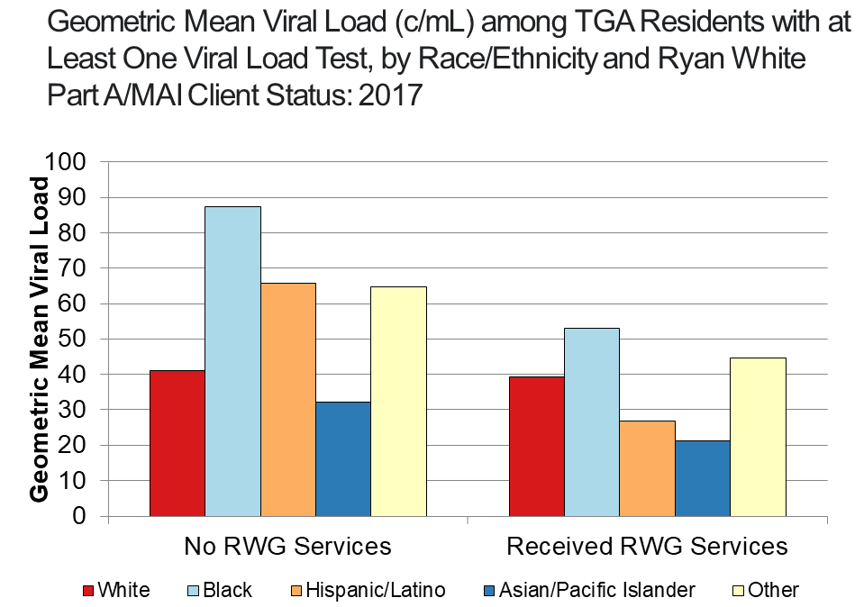
Results
Geometric mean viral load among all racial/ethnic minorities not utilizing Ryan White services in the Indy TGA was higher than among Ryan White clients
This difference was not found among white PLWH in the TGA

Slide 23
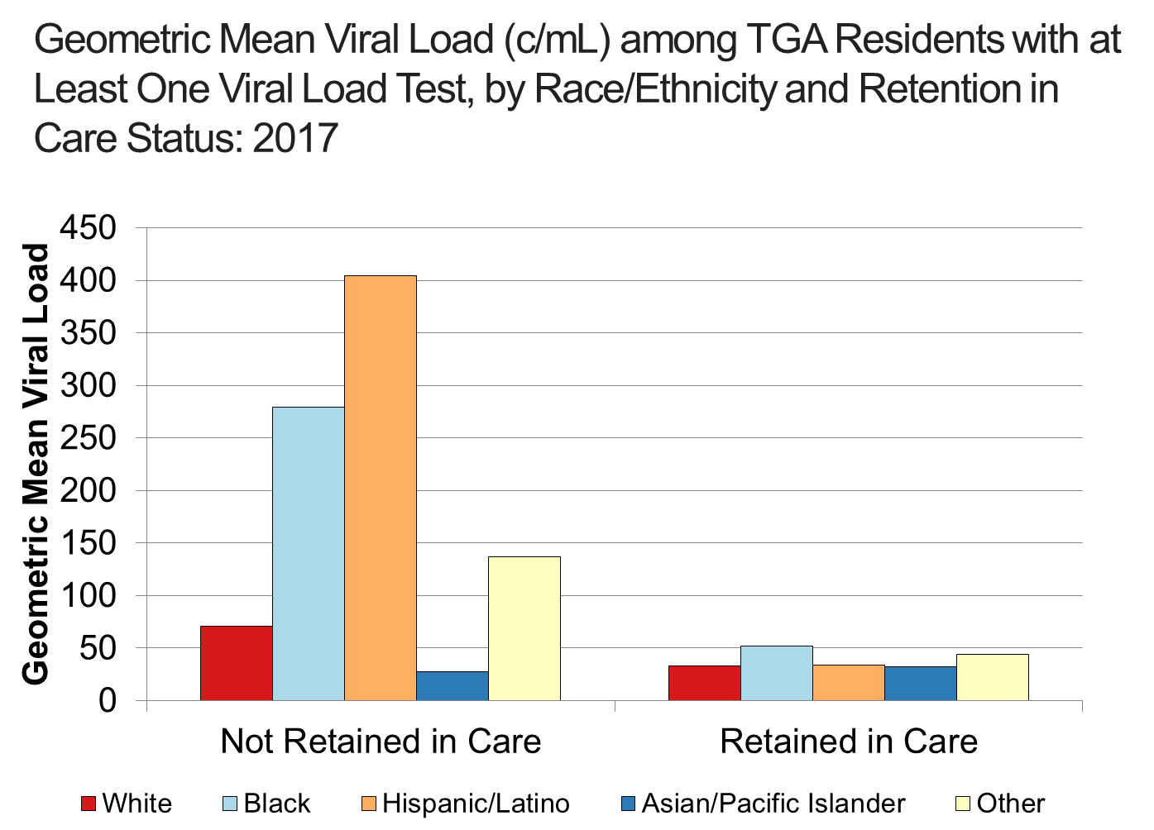
Results
Among individuals not retained in care, Hispanic/Latinos and African Americans experienced the highest viral loads
Even when retained in care, African Americans experienced poorer outcomes, with viral loads 50% higher than their white peers

Slide 24
Conclusions
Using data standardization and geometric mean analysis has allowed us to make better comparisons between groups
Allows for better allocation of resources to target interventions to those most likely to have increased viral loads

Slide 25


Slide 26
Tammie Nelson, MPH, CPH
Epidemiology Manager
epidemiology@marionhealth.org

