Slide 1

Leveraging HIV Surveillance Data to Improve Retention in Care
August 4-7, 2026
Tammie L. McCaskill, MPH, CPH, ELS, Researcher/Scientific Writer, Indiana University School of Medicine
Michael S. Butler, BS, Director, Ryan White HIV Services Program, Marion County Public Health Department
Taylor Gumns, MPH, Epidemiologist, Marion County Public Health Department
Sarah E. Wiehe, MD, MPH, Professor of Pediatrics, Indiana University School of Medicine and Co-Director, Indiana Clinical and Translational Sciences Institute

Slide 2
Project Support
This project and product were supported by Grant R01AI114435 from the National Institute of Allergy and Infectious Diseases, and Grant UM1TR004402 from the National Center for Advancing Translational Sciences, of the U.S. Department of Health and Human Services (HHS).

Slide 3
Project Support
The contents of this presentation are solely the responsibility of the authors and do not necessarily represent the official views of the National Institutes of Health or HHS.

Slide 4
Disclosures - Speakers
Dr. Wiehe is a member of the U.S. Preventive Services Task Force (USPSTF). Materials provided in this presentation do not necessarily represent the views or recommendations of the USPSTF.
No speaker has a financial relationship with ineligible companies or other conflicts of interest to disclose.

Slide 5
Disclosures – Continuing Education
This continuing education activity is provided by AffinityCE, Health Resources and Services Administration (HRSA), and LRG. AffinityCE staff, HRSA, and LRG staff, as well as planners and reviewers, have no relevant financial relationships with ineligible companies associated with the content of this activity to disclose.
AffinityCE adheres to the ACCME’s Standards for Integrity and Independence in Accredited Continuing Education. Any individuals in a position to control the content of a continuing education activity, including faculty, planners, reviewers, or others, are required to disclose all financial relationships with ineligible companies. All relevant financial relationships reported for faculty have been mitigated by the peer review of content by non-conflicted reviewers prior to the commencement of this activity.
Commercial support was not received for this activity.

Slide 6
Research Ethics
This study underwent full board review by Indiana University’s (IU) Institutional Review Board and the Marion County Public Health Department’s (MCPHD) Research Review Committee.
All team members underwent training in human participant research ethics, confidentiality, and requirements of the U.S. Health Insurance Portability and Accountability Act.
One team member is a public health lawyer and bioethics expert.
Our work is guided by community-engaged consultants.

Slide 7
Learning Objectives

Slide 8
Learning Objectives
After this activity, participants will be able to:
Describe how HIV surveillance or treatment data can be utilized to proactively identify people living with HIV who are at risk of falling out of care
Explain the development, testing, and refinement of the
SAS-based predictive alert algorithm, including methods used to reduce unwarranted alerts and tailor outreach based on viral load status
Identify practical strategies for adapting or integrating the SAS code and eHARS-driven workflow into other HIV care systems, such as CareWARE or electronic medical records, to strengthen retention and relinkage efforts

Slide 9
Research Partners

Slide 10

Research Partners – IU School of Medicine
The IU School of Medicine’s FairHealth Collective Team:
Proposed the project and obtained grant funding
Conducted community-engaged research to determine the need for, and methods of, the project
Co-wrote and tested the Early Alert Retention in Care (RIC) Program code
Coordinated project implementation
Devised the project evaluation survey
Will analyze and publish the evaluation
Will disseminate program code and outcomes

Slide 11


Research Partners – IU School of Medicine
Tammie McCaskill, MPH, CPH, ELS is an epidemiologist and scientific writer/editor with extensive experience in public health practice and research. She has been affiliated with the Ryan White Part A Indianapolis Transitional Grant Area’s (TGA) Planning Council since 2012. She oversees the Early Alert RIC Project.
Sarah Wiehe, MD, MPH is a pediatrician and health services researcher. Her expertise is in community engagement, epidemiology, and linking clinical and non-clinical data to inform interventions to improve health among vulnerable populations. She is the Principal Investigator and enjoys engaging with people from communities to inform this work.

Slide 12
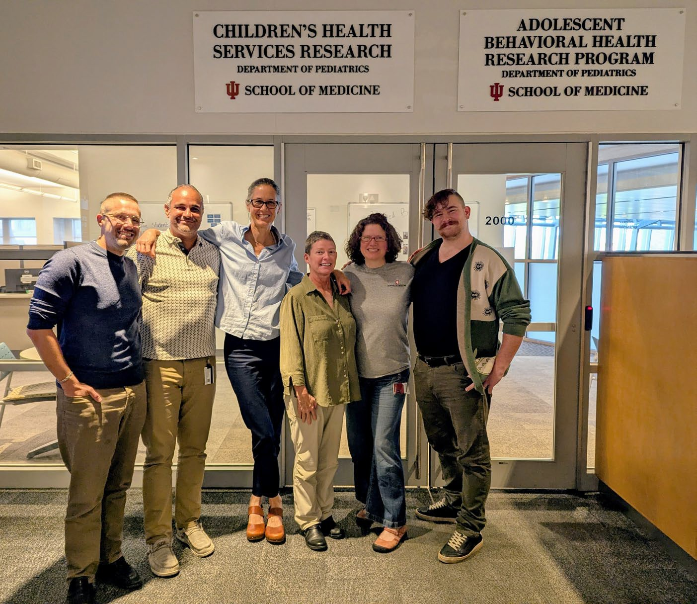
Research Partners – IU School of Medicine
Other team members include:
Matthew Aalsma, PhD
J. Dennis Fortenberry, MD, MS
Ross Silverman, JD, MPH
Marc Rosenman, MD
Sami Gharbi, MS ECE
Unai Miguel Andres, MS, MURP
Ryan Healey, BS
Elaine Cuevas, MPA
The CTSI Research Jam Team

Slide 13

Research Partners – MCPHD
The MCPHD’s Epidemiology Department:
Provided data for program development and testing
Tested the code on their server
Will assist in program evaluation
The MCPHD’s Ryan White HIV Services Program’s Treatment Adherence and Engagement Liaison team:
Will utilize alerts to engage PLWH who are at risk of losing their RIC status
Will collect data for project evaluation

Slide 14

Research Partners - MCPHD
Taylor Gumns, MPH is an epidemiologist supporting both internal and external partners at MCPHD, as well as the Ryan White HIV Services Program and the Indianapolis Part A TGA.
Michael Butler, BS is Director of MCPHD’s Ryan White HIV Services Program, managing the Indianapolis Part A Transitional Grant Area (TGA). He oversees all aspects of the program, including the Treatment Adherence and Engagement Liaison team.

Slide 15
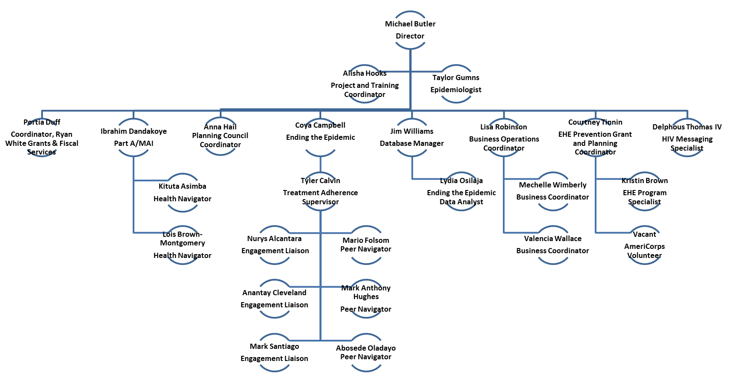
Research Partners - MCPHD
Other MCPHD team members:

Slide 16

Research Partners – IU Biostatistics
IU Richard M. Fairbanks School of Public Health’s Department of Biostatistics and Health Data Science:
Devised, co-wrote, and tested the Early Alert RIC Program
Will assist in program evaluation and dissemination

Slide 17

Research Partners – IU Biostatistics
Constantin Yiannoutsos, PhD is a professor of Biostatistics in the IU Fairbanks School of Public Health. He has spent over 25 years analyzing clinical and observational data obtained from people living with HIV (PLWH) in a variety of settings, both within the US and around the world. His primary research interest is developing methodologies related to loss to follow-up among PLWH, and he specializes in longitudinal data analysis.

Slide 18

Research Partners – State Health Department
The Indiana Department of Health’s (IDOH) Division of HIV, STI, and Viral Hepatitis:
Will train and contract with MCPHD to conduct engagement and linkage to care activities with individuals for whom an alert is generated
Will run the Early Alert RIC Program against the state’s HIV surveillance data
Will conduct preliminary investigations to verify eligibility for case assignment
Will assign eligible cases to MCPHD via the National Electronic Disease Surveillance System Base System (NBS)
Will assist in program evaluation

Slide 19


Research Partners – Research Jam and Community Consultants
Our research was guided, from day one, by a large group of consultants. This consultant panel is made up of PLWH, clinicians who treat PLWH, and non-medical providers of services to PLWH, all in Marion County, Indiana (Indianapolis).¹
Consultant engagement was facilitated by the Indiana Clinical and Translational Sciences Institute’s Research Jam.

Slide 20
Community Engagement

Slide 21
Community Engagement
Our community-engaged consultant panel made our research more relevant, impactful, and sustainable.¹
Our project was guided and informed by those who live with and/or work in HIV every day.
Our community consultants laid the boundaries which should, or should not, be crossed to balance personal autonomy and respect with health outcomes and public health.
Community engagement keeps our research person-centered.
Community engagement empowers individuals living with HIV to collaborate meaningfully with our team.

Slide 22
Community Engagement
We hosted ten Research Jams (engagement workshops) for this project during 2020-2025.¹
Seventy-two (72) individuals participated on our consultant panel.
  These individuals were largely representative of PLWH in Marion County by race/ethnicity.
  The panel was over-represented by females (40% panel vs. <25% PLWH in Marion County).
  Few young (18-24-year-old) people represented (note on self-report)

Slide 23
The Impetus for this Project

Slide 24
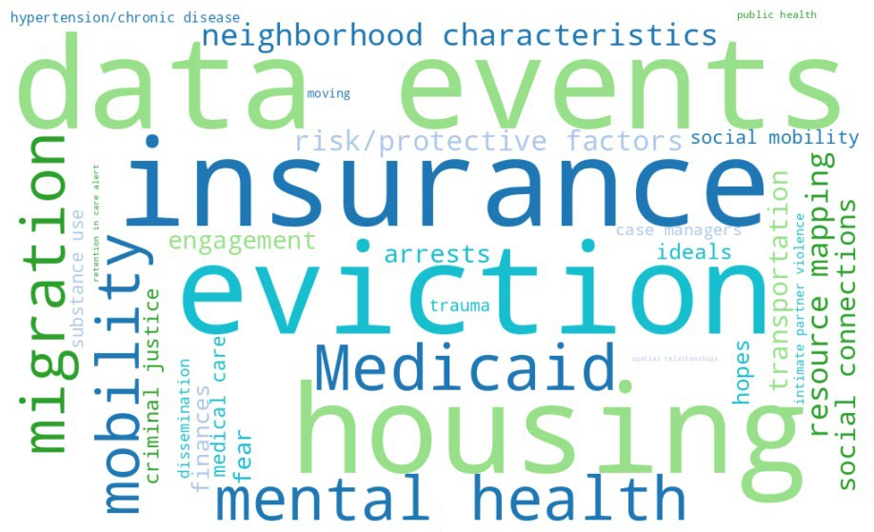
Why Are We Pursuing the Early Alert RIC Project?
During Jams, consultants discussed many topics that may affect the health outcomes of PLWH. We selected several projects recommended by our panel based on these Jam sessions.¹

Slide 25
Why Are We Pursuing the Early Alert RIC Project?
We coordinated several activities to facilitate brainstorming among consultants. Three such activities led directly to the Early Alert RIC Project.¹
The Red Flag Game
The Card Sorting Game
The Reaching Out Decision Tree

Slide 26
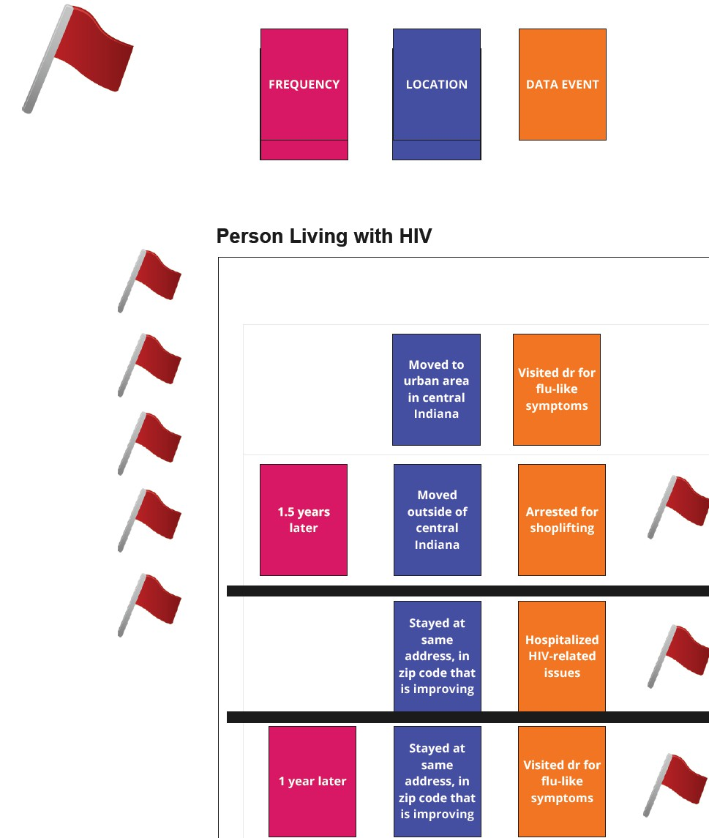
The Red Flag Game
Consultants brainstormed events that might precede HIV-related health getting better or worse. They used red flags to explore when and for what reason(s) they would prioritize for reaching out to a patient/client following these events.

Slide 27
The Card Sorting Game
Results from the Red Flag Game were transferred to cards by frequency, location (e.g., rural area), and event (e.g., arrest). These cards were sorted according to perceived level of concern and under what circumstances public health and/or case managers should check in with a client.

Slide 28
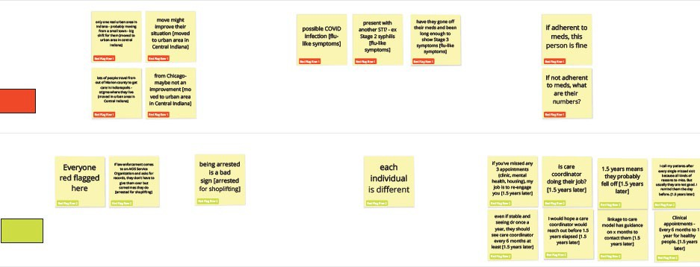
The Card Sorting Game

Slide 29
The Reaching Out Decision Tree
Results of these games were used to facilitate further discussion among our consultants and, eventually, their creation of a Reaching Out Decision Tree for use by our research team.

Slide 30
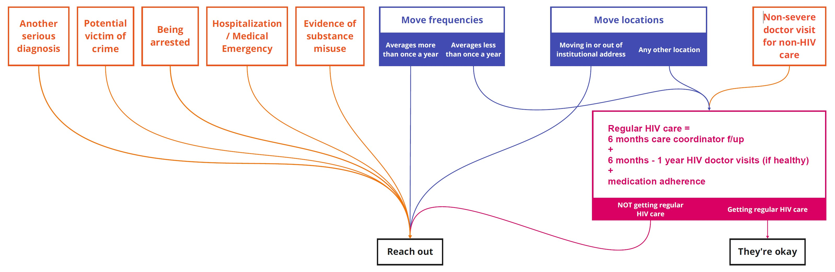
The Reaching Out Decision Tree

Slide 31
The Reaching Out Decision Tree
This product guided further discussion with our consultants, the MCPHD, the IDOH, the Ryan White Part A Planning Council, and Ryan White Part A medical and non-medical providers regarding our implementation of the Early Alert RIC Project.

Slide 32
Early Alert RIC Project Background, Vision, and Objectives

Slide 33
HIV Surveillance Data Description
Enhanced HIV/AIDS Reporting System (eHARS)
A browser-based surveillance tool maintained by HHS’s Centers for Disease Control and Prevention (CDC)²
Contains demographics, HIV/AIDS diagnosis dates, HIV treatment and outcome measures (i.e., CD4 and viral load dates/results), and more for all PLWH in the U.S.
Used by state and large local health departments for reporting, data management, analysis, and transfer of data to the CDC²

Slide 34
Local HIV Surveillance Data Utilization
The MCPHD utilizes eHARS data for the 10-county Ryan White Part A TGA
Person and lab datasets curated by IDOH for MCPHD
eHARS data used to create epidemiological reports
eHARS data are also used to inform Ryan White Part A prioritization, allocation, and progress reports
Early Alert RIC Program code will be run against eHARS to generate alerts that will be assigned to the Ryan White HIV Services Program’s Treatment Adherence and Engagement Liaison team for relinkage services for PLWH at risk of falling out of care

Slide 35
Local Engagement Efforts Based on eHARS
Until now, engagement efforts have been informed by utilization of
retrospective eHARS data for RE-linkage purposes
RIC reports are processed 1-2 times annually to identify PLWH who no longer meet the definition of RIC (received ≥2 quantitative CD4 or VL tests performed ≥90 days apart during a 12-month period)³

Slide 36
Project Vision
An academic-public health partnership to make eHARS data more valuable for the engagement process by using proactive alerts generated before an individual loses RIC status.

Slide 37
Project Objectives
IU, MCPHD, and IDOH will collaborate to:
Create and test a program that generates proactive alerts to identify PLWH prior to them no longer having a RIC status
Conduct early engagement and linkage to care among PLWH to ensure they remain RIC
Evaluate and publish project outcomes
Obtain open-source licensing for the software and make it freely available for use by state and local health departments, and for adaptation for use against Ryan White’s CAREWare and/or providers’ electronic medical record systems

Slide 38
Software Development, Testing, and Revisions

Slide 39
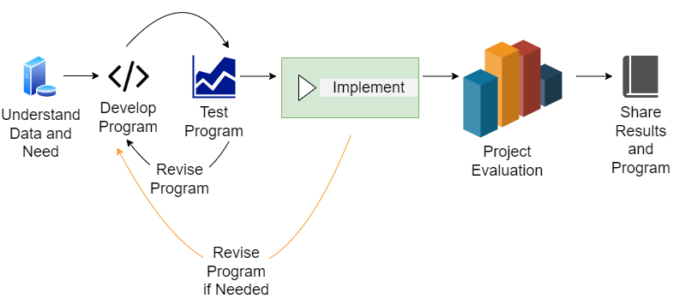
Project Roadmap

Slide 40
Project Roadmap

Slide 41
Early Alert RIC Code v.1
The Early Alert RIC Code v.1 looked backward 12 months to identify each individual’s most recent quantitative CD4 or viral load test (qualifying lab) and then looked forward to confirm that each individual had received at least two qualifying labs ≥3 months apart.

Slide 42
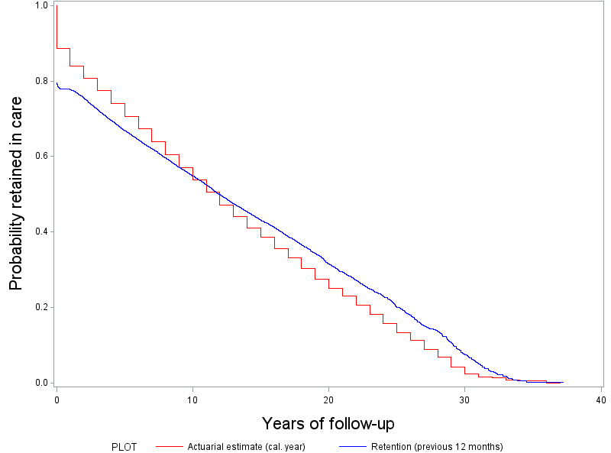
Verifying the Algorithm
Early Alert RIC Code v.1
Used to compare program results to that of the program currently in use
  Predicted outcomes aligned with those of the current method, varying only due to the previous actuarial estimate (calendar year) vs. the monthly method used in our program
Comparison of HIV Care Attrition Using Estimates by Calendar Year vs. the Previous 12 Months in Marion County

Slide 43
Problems with Early Alert RIC Code v.1
Early Alert RIC Code v.1 was computationally difficult and resource intensive
The code would run for many hours, tying up system resources.
This algorithm would not identify individuals who had no qualifying lab test prior to 12 months in the past, omitting individuals already failing to meet the definition of RIC.

Slide 44
Early Alert RIC Code v.2
Early Alert RIC Code v.2 utilized an algorithm that looked back to identify each individual’s most recent qualifying lab and then looked forward from that date to calculate how long it had been since the qualifying lab, generating an alert for each individual 30 days prior to him or her losing RIC status (11 months from the most recent qualifying lab).
This change greatly improved software efficiency with simplified and accelerated execution.
It identified all PLWH who had lost, or were preparing to lose, RIC status.

Slide 45
Problems with Early Alert RIC Code v.2
Early Alert RIC Code v.2 identified everyone who had lost, or were at risk of losing, RIC status; however, it would have resulted in misused time because it created alerts:
For deceased individuals
For individuals no longer living in the TGA
For individuals lost to follow up (out of care for many years) or not wanting to be contacted
Regardless of the results of an individual’s most recent viral load test

Slide 46
Early Alert RIC Code v.3 (Current Version)
Changes in the Early Alert RIC Code v.3 include:
Limits the look-back period to 24 months to shorten the alerts list
  The look-back period can be increased or decreased using a macro within the code.
Excludes individuals with an eHARS date of death
  Can be linked to state death certificates if desired
Excludes individuals known to have moved out of the jurisdiction
  Must have been HIV/AIDS diagnosed and/or died in the jurisdiction and have received a lab in the new jurisdiction for the program to identify the new jurisdiction
Creates alerts based on the most recent viral load result
  Alerts 10 months after a detectable result (≥50 copies/mL) or 11 months after an
undetectable result (<50 copies/mL)

Slide 47
Predicted Outcomes
Alerts generated for individuals at risk of losing RIC status will result in engagement before an individual falls out of care – in many cases, months earlier than using the current algorithm.

Slide 48
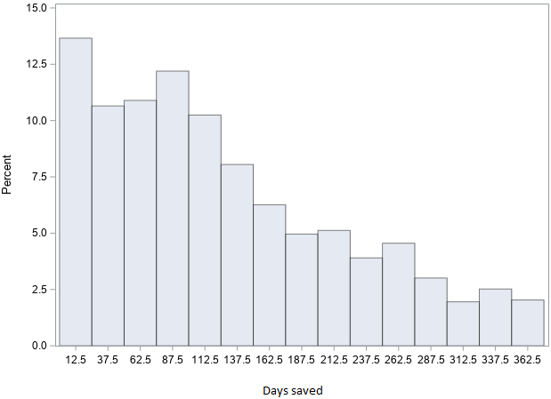
Predicted Outcomes
Based on historic (archived) eHARS data, the RIC Alert program will result in engagement efforts taking place about 3.5 months earlier than the method currently in use (Median = 106 days; IQR 52–190 days).

Slide 49
Program Implementation & Evaluation

Slide 50
Program Evaluation
eHARS data (i.e., post-alert qualifying lab dates) will be used to assess outcomes of engagement efforts among individuals for whom early alerts are generated.

Slide 51
Program Evaluation
MCPHD staff will also complete a survey for each case they work. These surveys are in REDCap and will include:
Number of alerts that were unwarranted (e.g., incorrect, deceased)
Number of alerts for which individuals are contacted
Number of individuals unable to be contacted and/or connected to care
Number of individuals connected to care prior to being non-RIC (from eHARS)
Number of individuals connected to care within 30 days of falling out of care (from eHARS)
Health outcomes following alert-based outreach (i.e., viral load) (from eHARS)
Types of wraparound services referred to clients
Time spent conducting linkage and engagement to those at risk of non-RIC

Slide 52
Program Implementation Steps Taken
IU began the process of obtaining open-source licensing for the Early Alert RIC Program
IU adapted the program for use by MCPHD and handed it over
MCPHD tested the program on current eHARS data
IU developed a project evaluation survey
IU obtained IRB approval for project evaluation
IU presented the project to IDOH and provided them with the program
An agreement was negotiated for IDOH to train MCPHD to conduct engagement and linkage to care activities

Slide 53
Program Implementation Steps to be Taken
IDOH will run the program against the state’s HIV surveillance data bimonthly
IDOH will conduct preliminary investigations against generated alerts to verify eligibility for case assignment (e.g., still alive, still living in Marion County)
IDOH will assign eligible cases to MCPHD via NBS
MCPHD will contact individuals assigned by IDOH to engage them into care and refer individuals to any needed wraparound services
MCPHD will collect data for project evaluation
IU, in collaboration with all participating organizations, will analyze and publish the evaluation
IU will translate the code to R
IU will disseminate program code in SAS and R

Slide 54
Next Steps

Slide 55
Next Steps
Routine medical care is critical to the health of PLWH and to ending the HIV epidemic.
Our academic-public health partnership shifts from retrospective to proactive (early) identification of PLWH at risk of falling out of care.
Our work will improve the health of PLWH nationwide when we share the code and program findings.

Slide 56

Questions?

Slide 57
Contact Us
Tammie L. McCaskill, MPH, CPH, ELS
Department of Pediatrics
Children’s Health Services Research Indiana University School of Medicine 410 West 10th Street | HS 2000 Indianapolis, Indiana 46202
T. 317-278-1045
E. talnelso@iu.edu

Slide 58
References
https://ryanwhite.hrsa.gov/
https://ryanwhite.hrsa.gov/about/recipient-resources
Citations available upon request

Slide 59

Thank you!

Slide 60
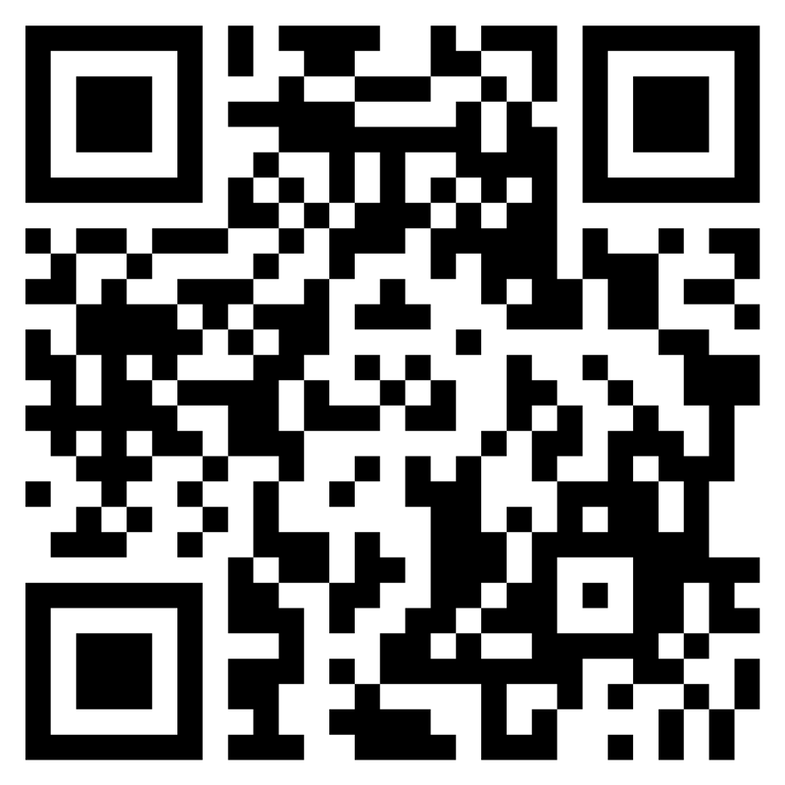
How to Claim Credit
If you would like to receive continuing education credit for this activity, please visit:
https://ryanwhite.cds.affinityced.com You can also scan the QR code below

