Slide 1
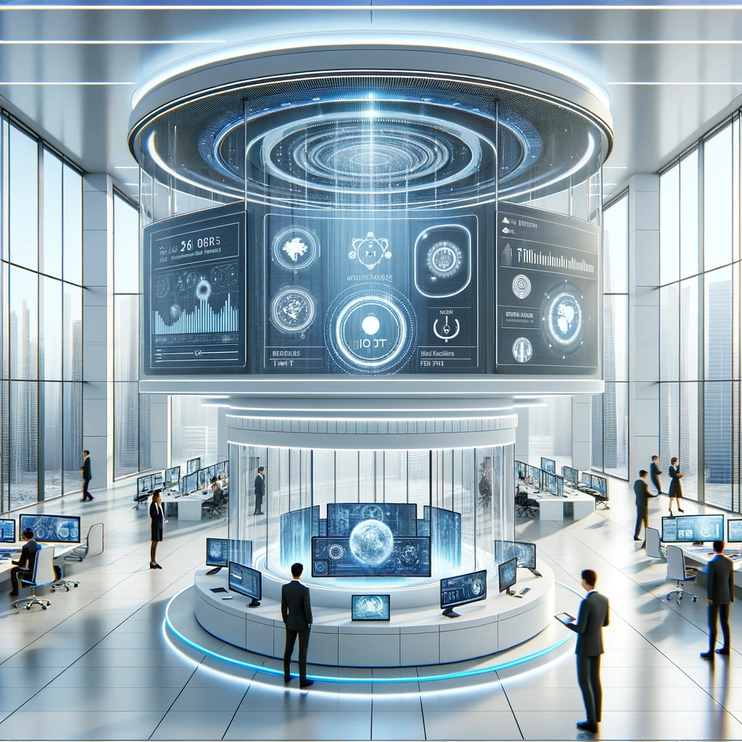
Enhancing Workplace Efficiency and Security with IoT
By Oren Schor & Tal Shvartzberg

Slide 2
Enhancing Workplace Efficiency and Security with IoT
Our project leverages the Internet of Things (IoT) technology to transform the modern workplace. By integrating smart access control, personalized climate settings, and data-driven management tools, we aim to elevate productivity, security, and employee satisfaction.
This comprehensive system connects seamlessly to the cloud, enabling real-time data analysis and decision-making.

Slide 3
Smart Access Control: Facial Recognition and RFID
Our access control system enhances security and convenience through facial recognition technology, backed by RFID as a secondary verification method. Fast Face Recognition: Instantly detects and recognizes employees' faces for quick entry.
Image Logging: Captures and saves entry images to Google Drive for secure record-keeping.
Attendance Tracking: Automatically updates a local CSV file for each entry, logging time and identity for accurate attendance records. In addition, the logs are saved in InfluxDB and synced with Grafana for attendance visualizations.
RFID Backup: If face recognition fails, RFID cards provide a reliable alternative for entry, ensuring seamless access at all times.
https://github.com/talshva/IOT-Final-Project

Slide 4




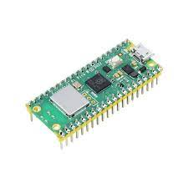
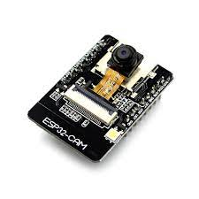


Smart Access Control: Block Diagram
http
https
http
mqtt
http
mqtt
SPI
Gpio (PWM)

Slide 5
Intelligent Climate Management for Enhanced Comfort
Our smart climate control system adapts to personal preferences and environmental conditions, ensuring optimal comfort for all employees. By analyzing individual preferences and room occupancy, the system dynamically adjusts temperature and humidity, promoting a healthier and more productive workplace environment.

Slide 6
Empowering Management with IoT Data Insights
Our system provides managers with actionable insights derived from IoT data. This includes access patterns, environmental preferences, and energy usage. These insights support informed decision-making, enabling optimizations that boost efficiency, reduce costs, and improve employee well-being.

Slide 7
Towards a Connected and Efficient Workplace
As we improve our system, we imagine an office where IoT technologies make everything work together smoothly. Our project starts the path for new improvements in managing workplaces. We hope for a future where technology and a focus on people combine to make work more productive and enjoyable.

