Slide 1

Notes:
SLIDE 1 — TITLE
LOGO: Duble//Slash wordmark · 200x48 · swap in _bmad/assets/logos/duble-slash-wordmark-white.svg

Slide 2
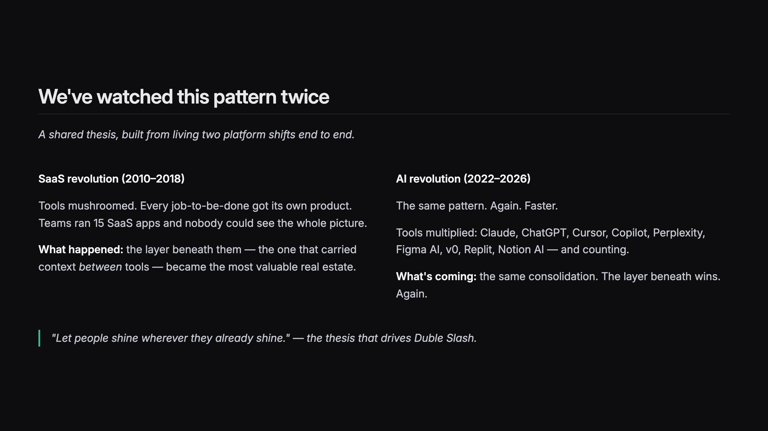
Notes:
SLIDE 2 — THE PATTERN

Slide 3
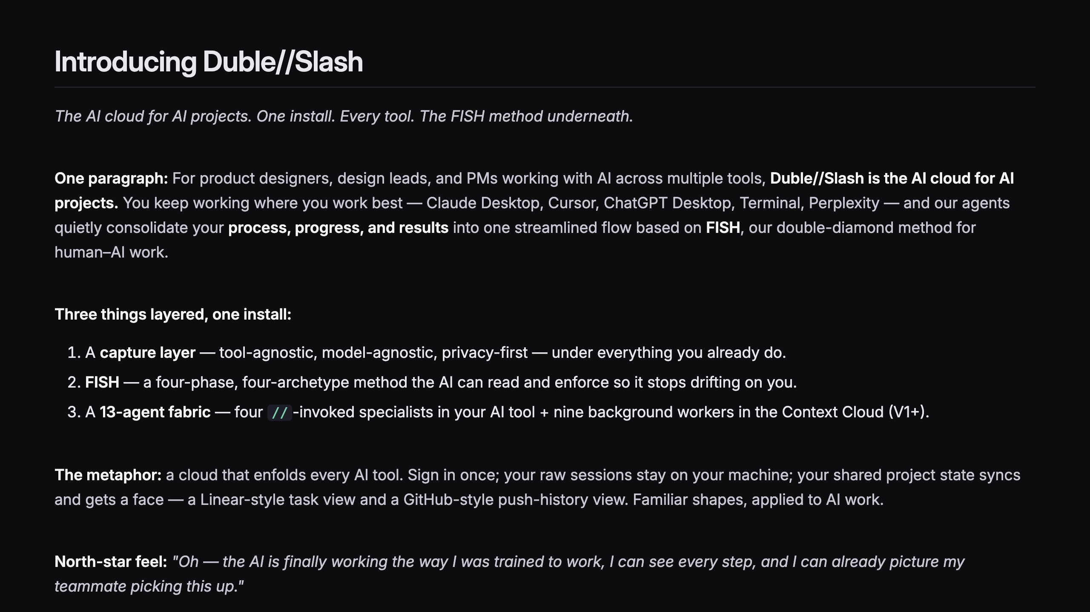
Notes:
SLIDE 3 — INTRODUCING DUBLE SLASH
LOGO: Duble//Slash wordmark · 160x36 · swap in _bmad/assets/logos/duble-slash-wordmark-white.svg

Slide 4
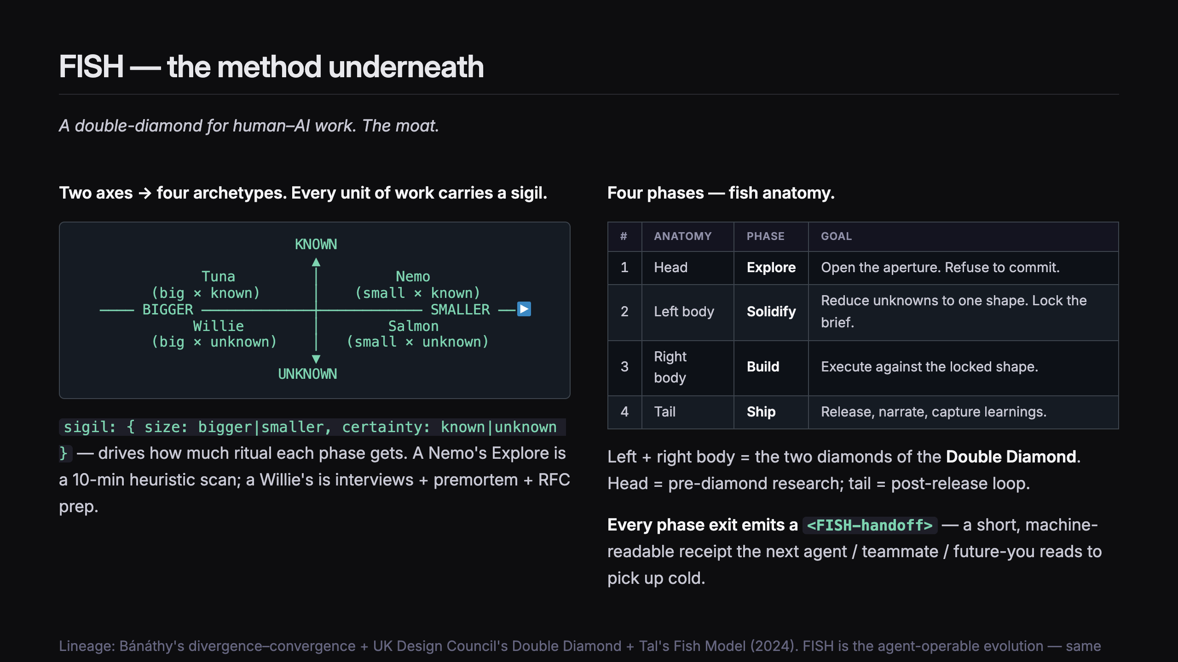
Notes:
SLIDE 3.5 — FISH: THE METHOD

Slide 5
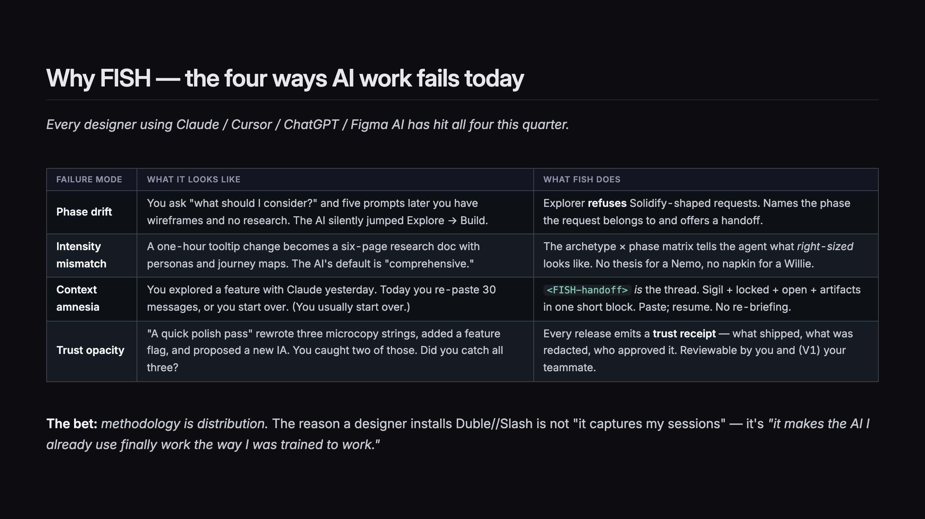
Notes:
SLIDE 3.6 — WHY FISH (FAILURE MODES)

Slide 6
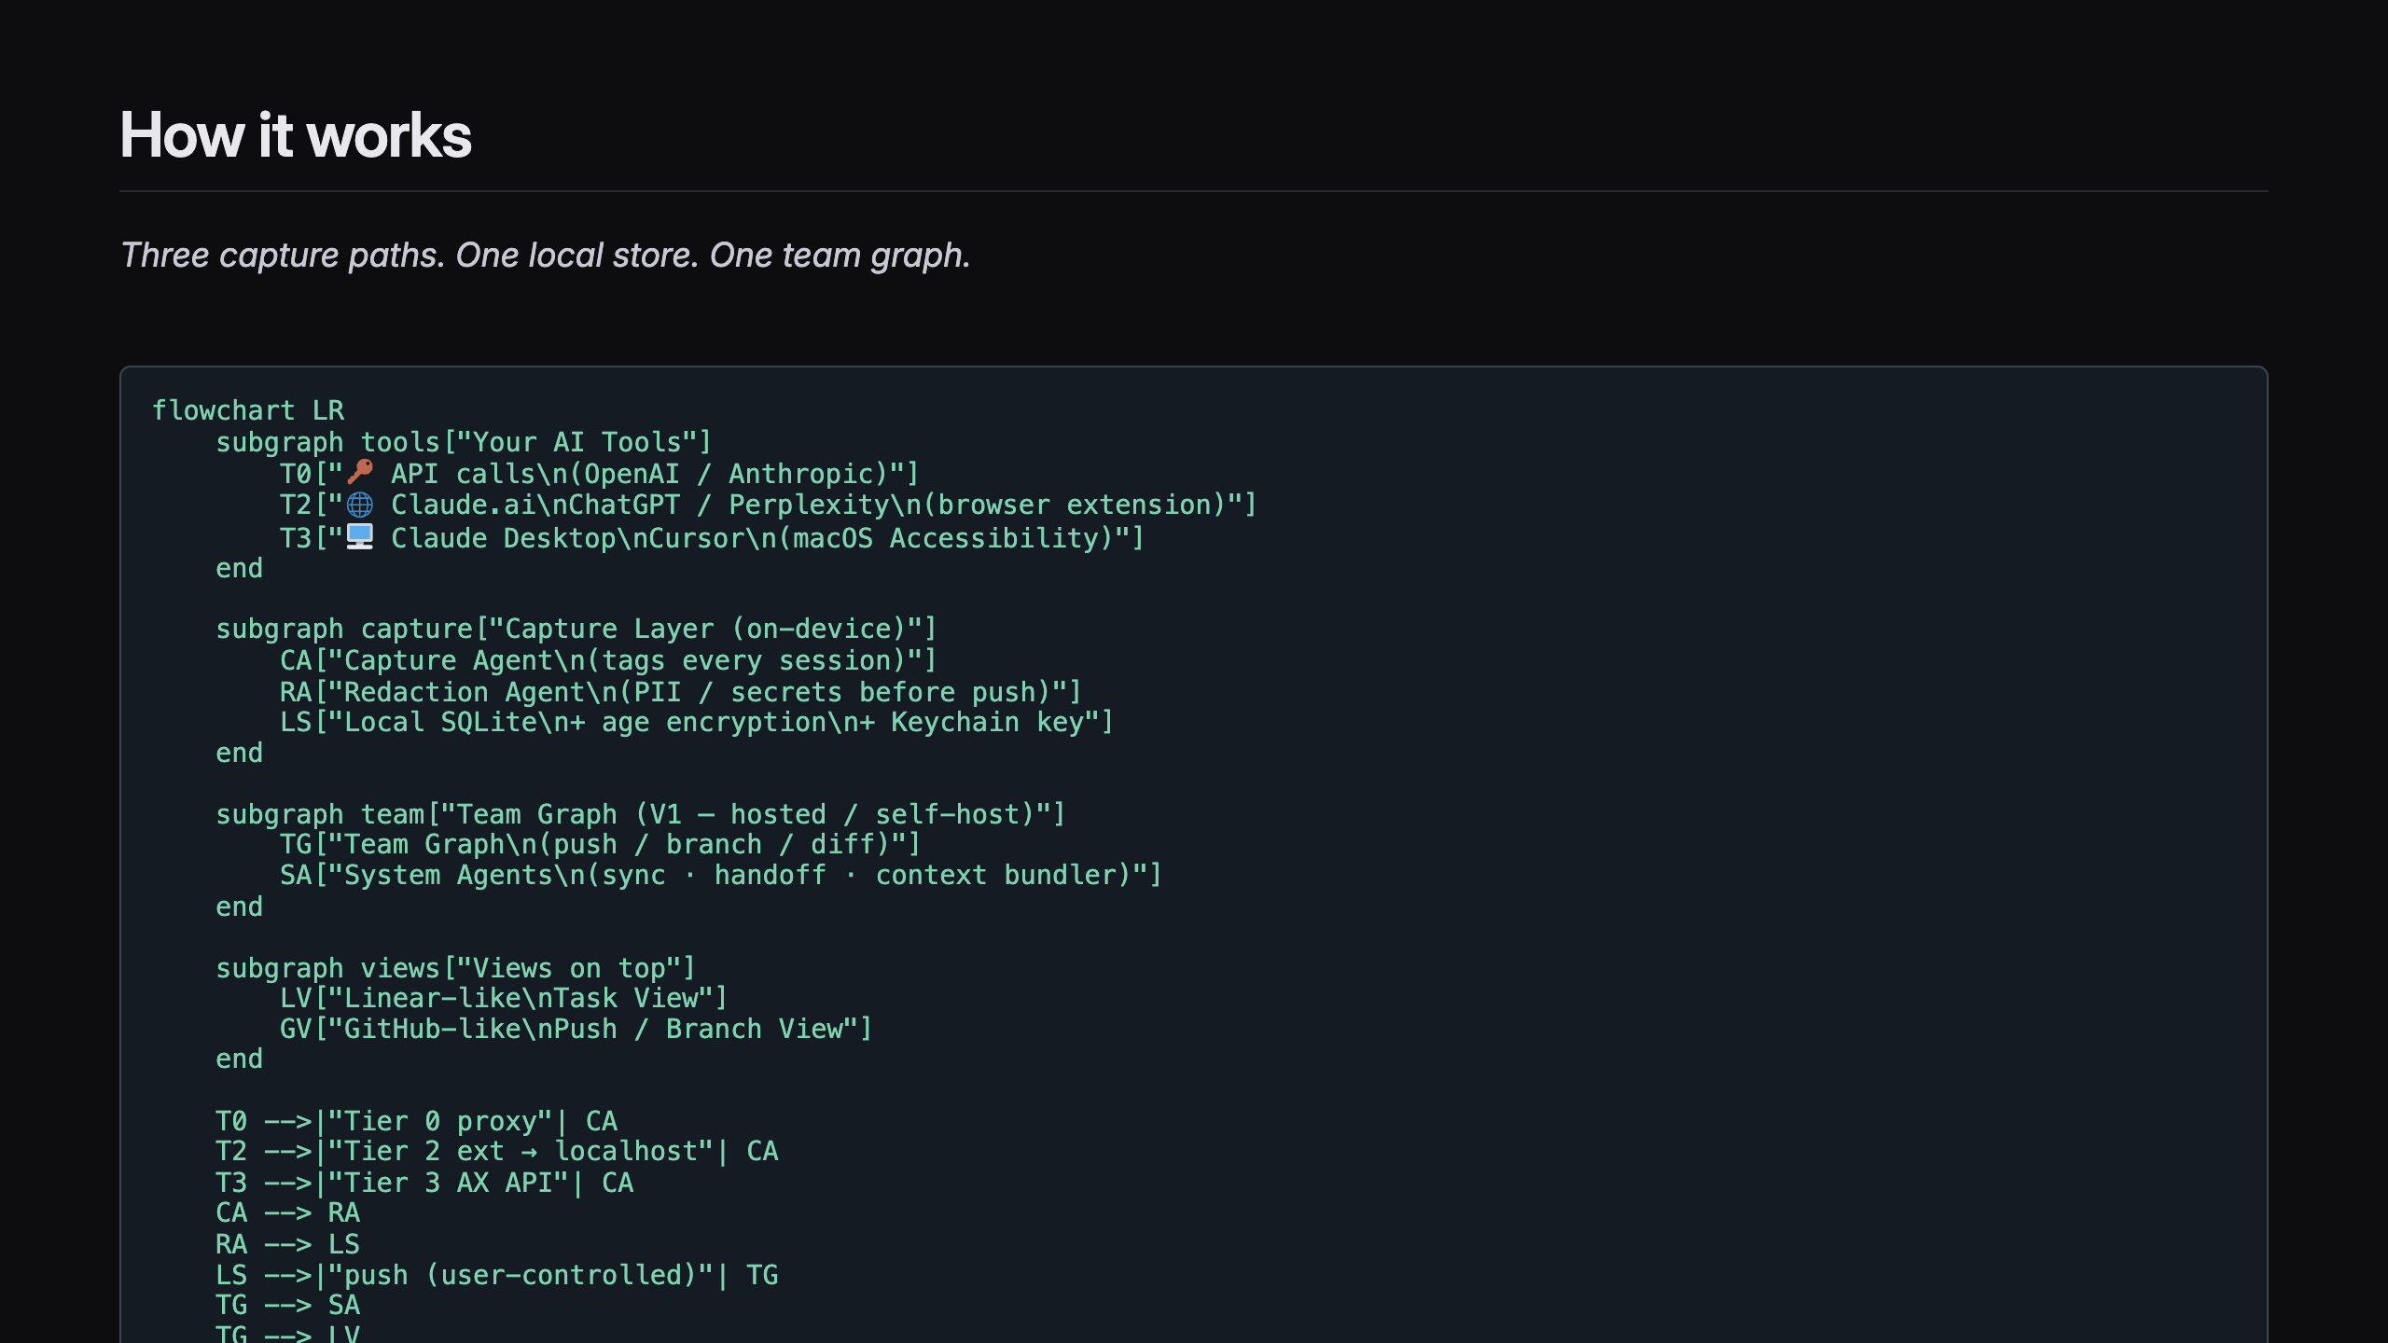
Notes:
SLIDE 4 — HOW IT WORKS — DIAGRAM

Slide 7
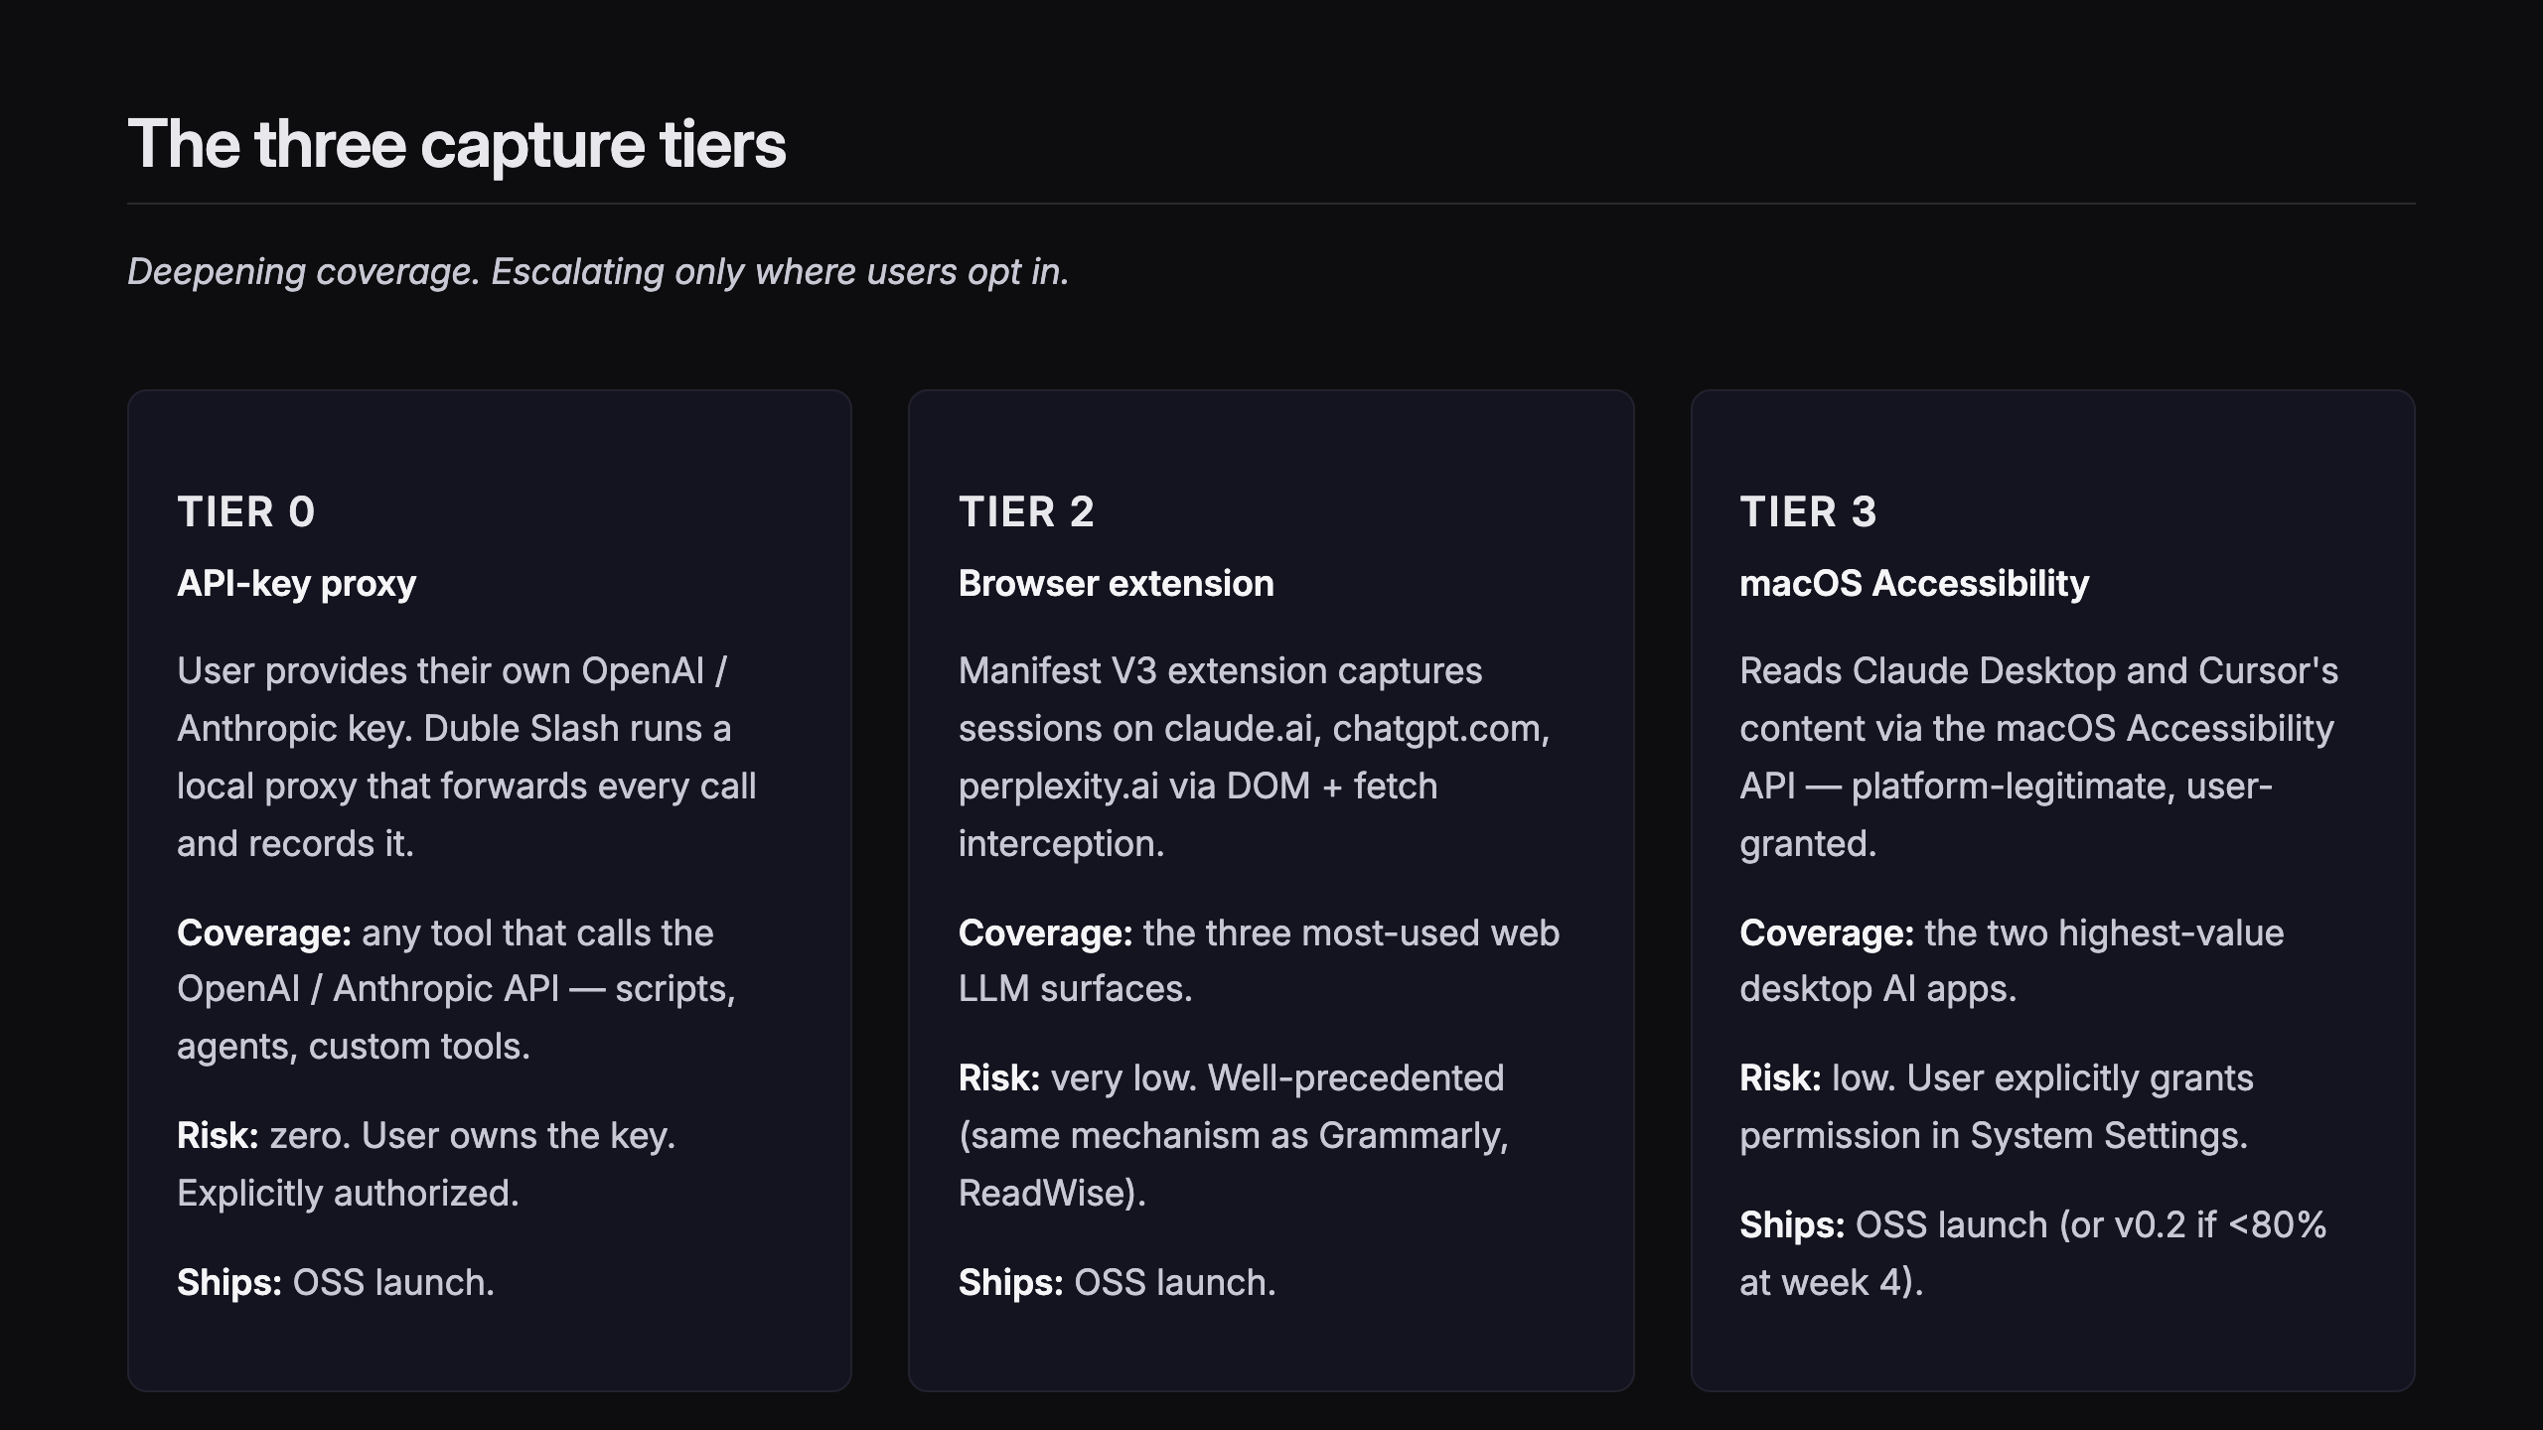
Notes:
SLIDE 5 — THE THREE CAPTURE TIERS

Slide 8
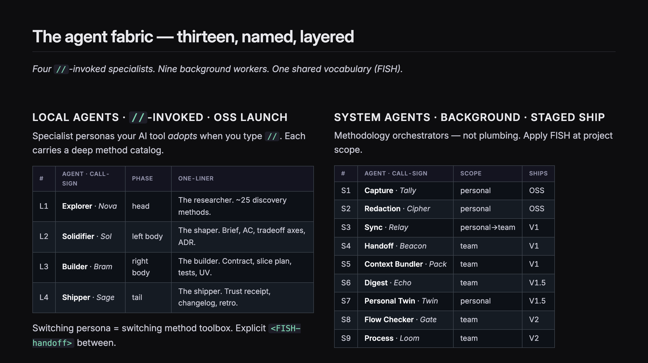
Notes:
SLIDE 6 — THE 13 AGENTS

Slide 9
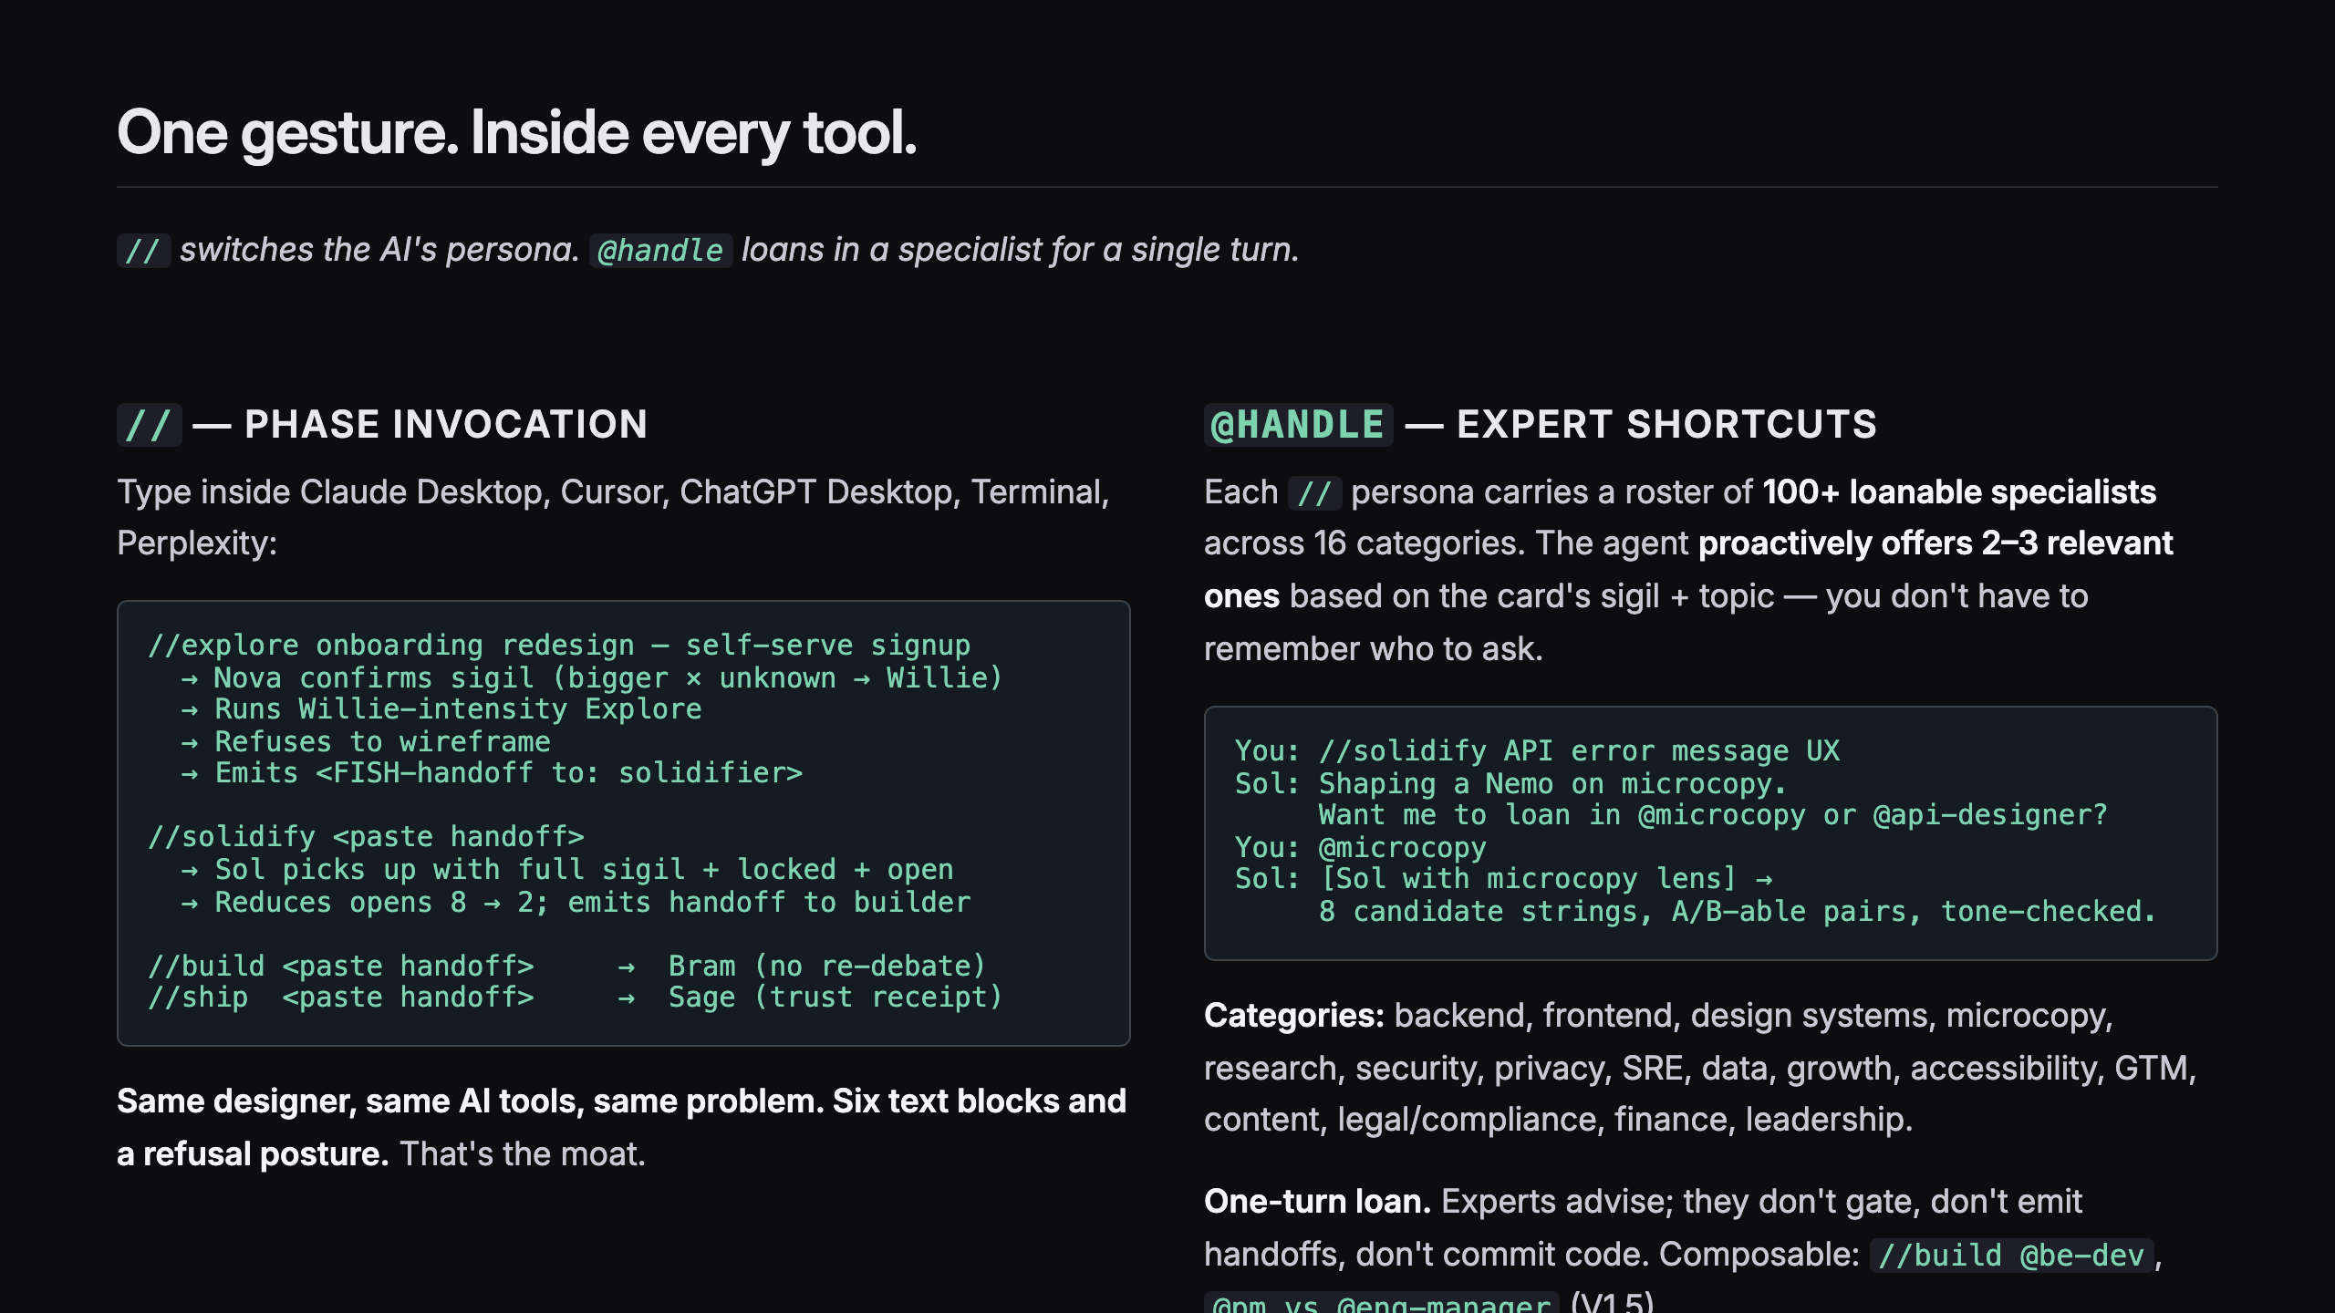
Notes:
SLIDE 6.5 — THE // GESTURE + @EXPERTS

Slide 10
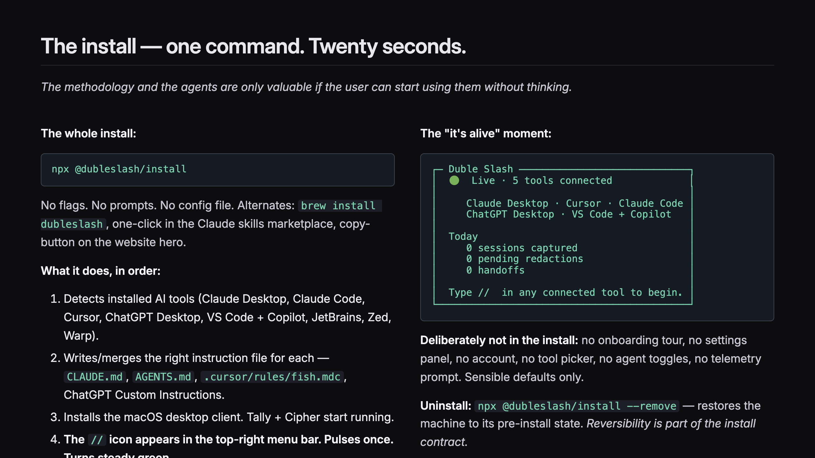
Notes:
SLIDE 6.7 — INSTALL EXPERIENCE

Slide 11
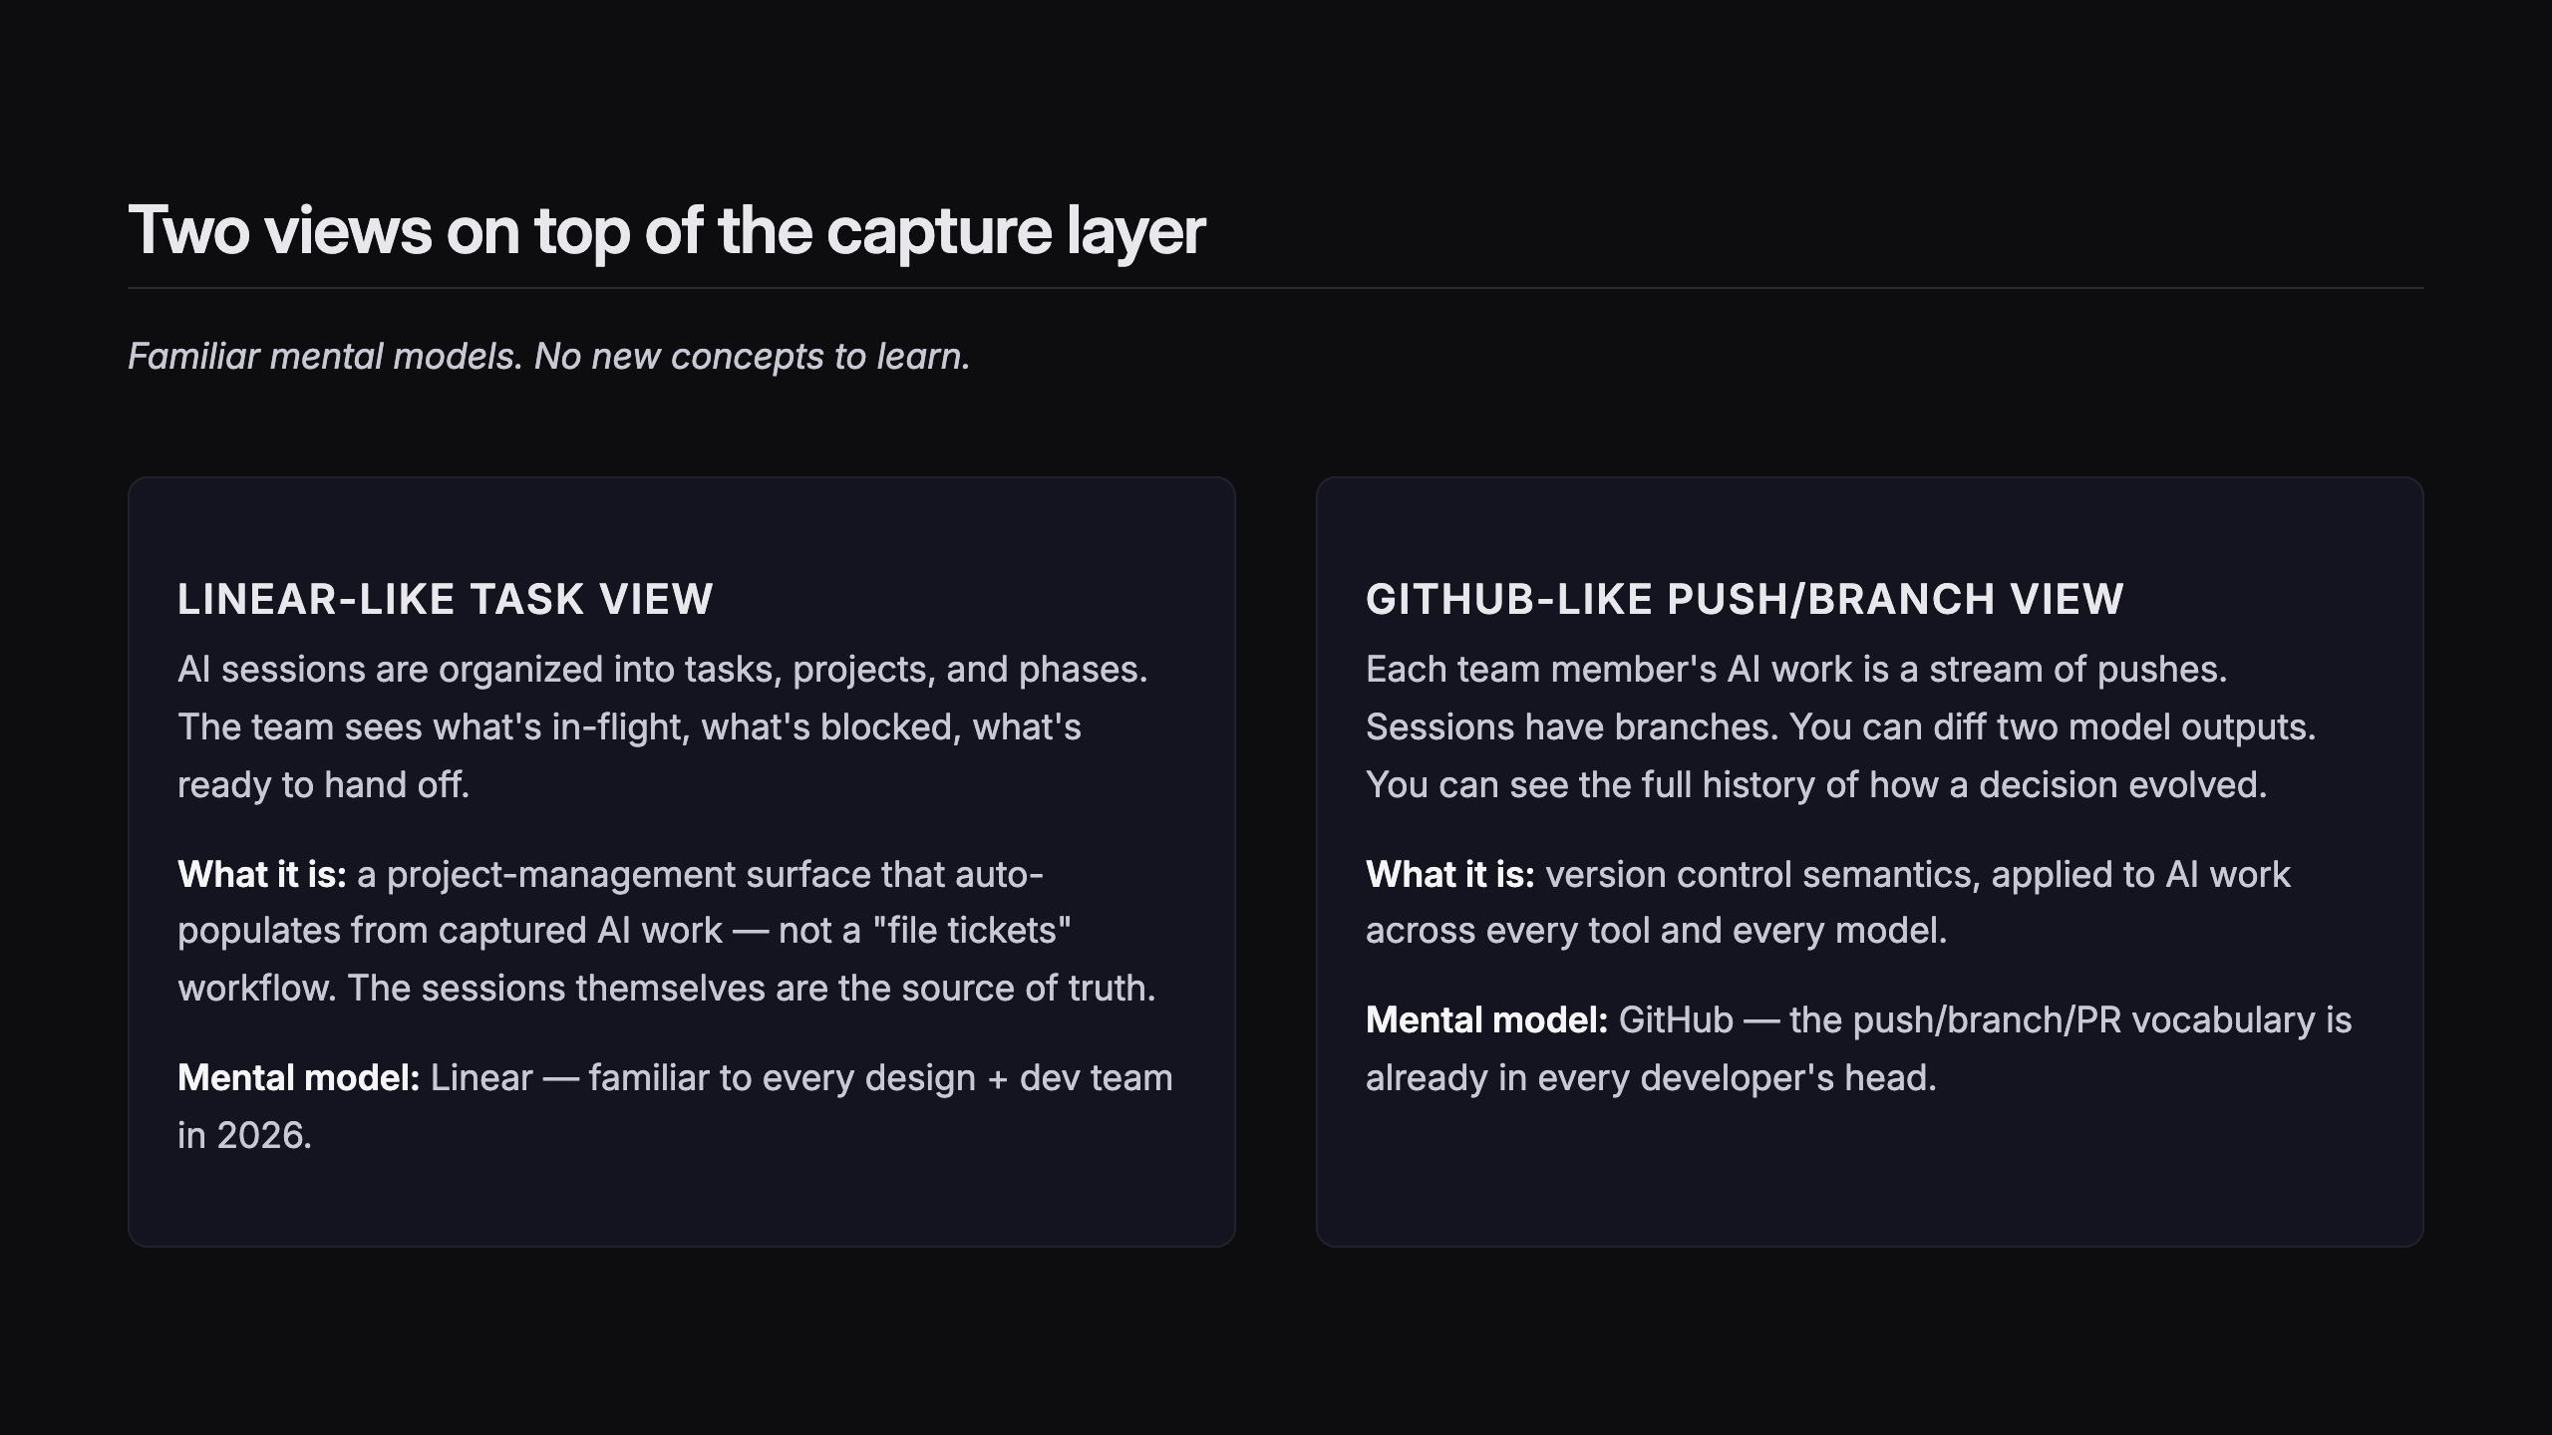
Notes:
SLIDE 7 — TWO VIEWS ON TOP
SCREENSHOT: Linear-like task view · see ux-design doc — V1 surface, placeholder
SCREENSHOT: GitHub-like push/branch view · see ux-design doc — V1 surface, placeholder

Slide 12
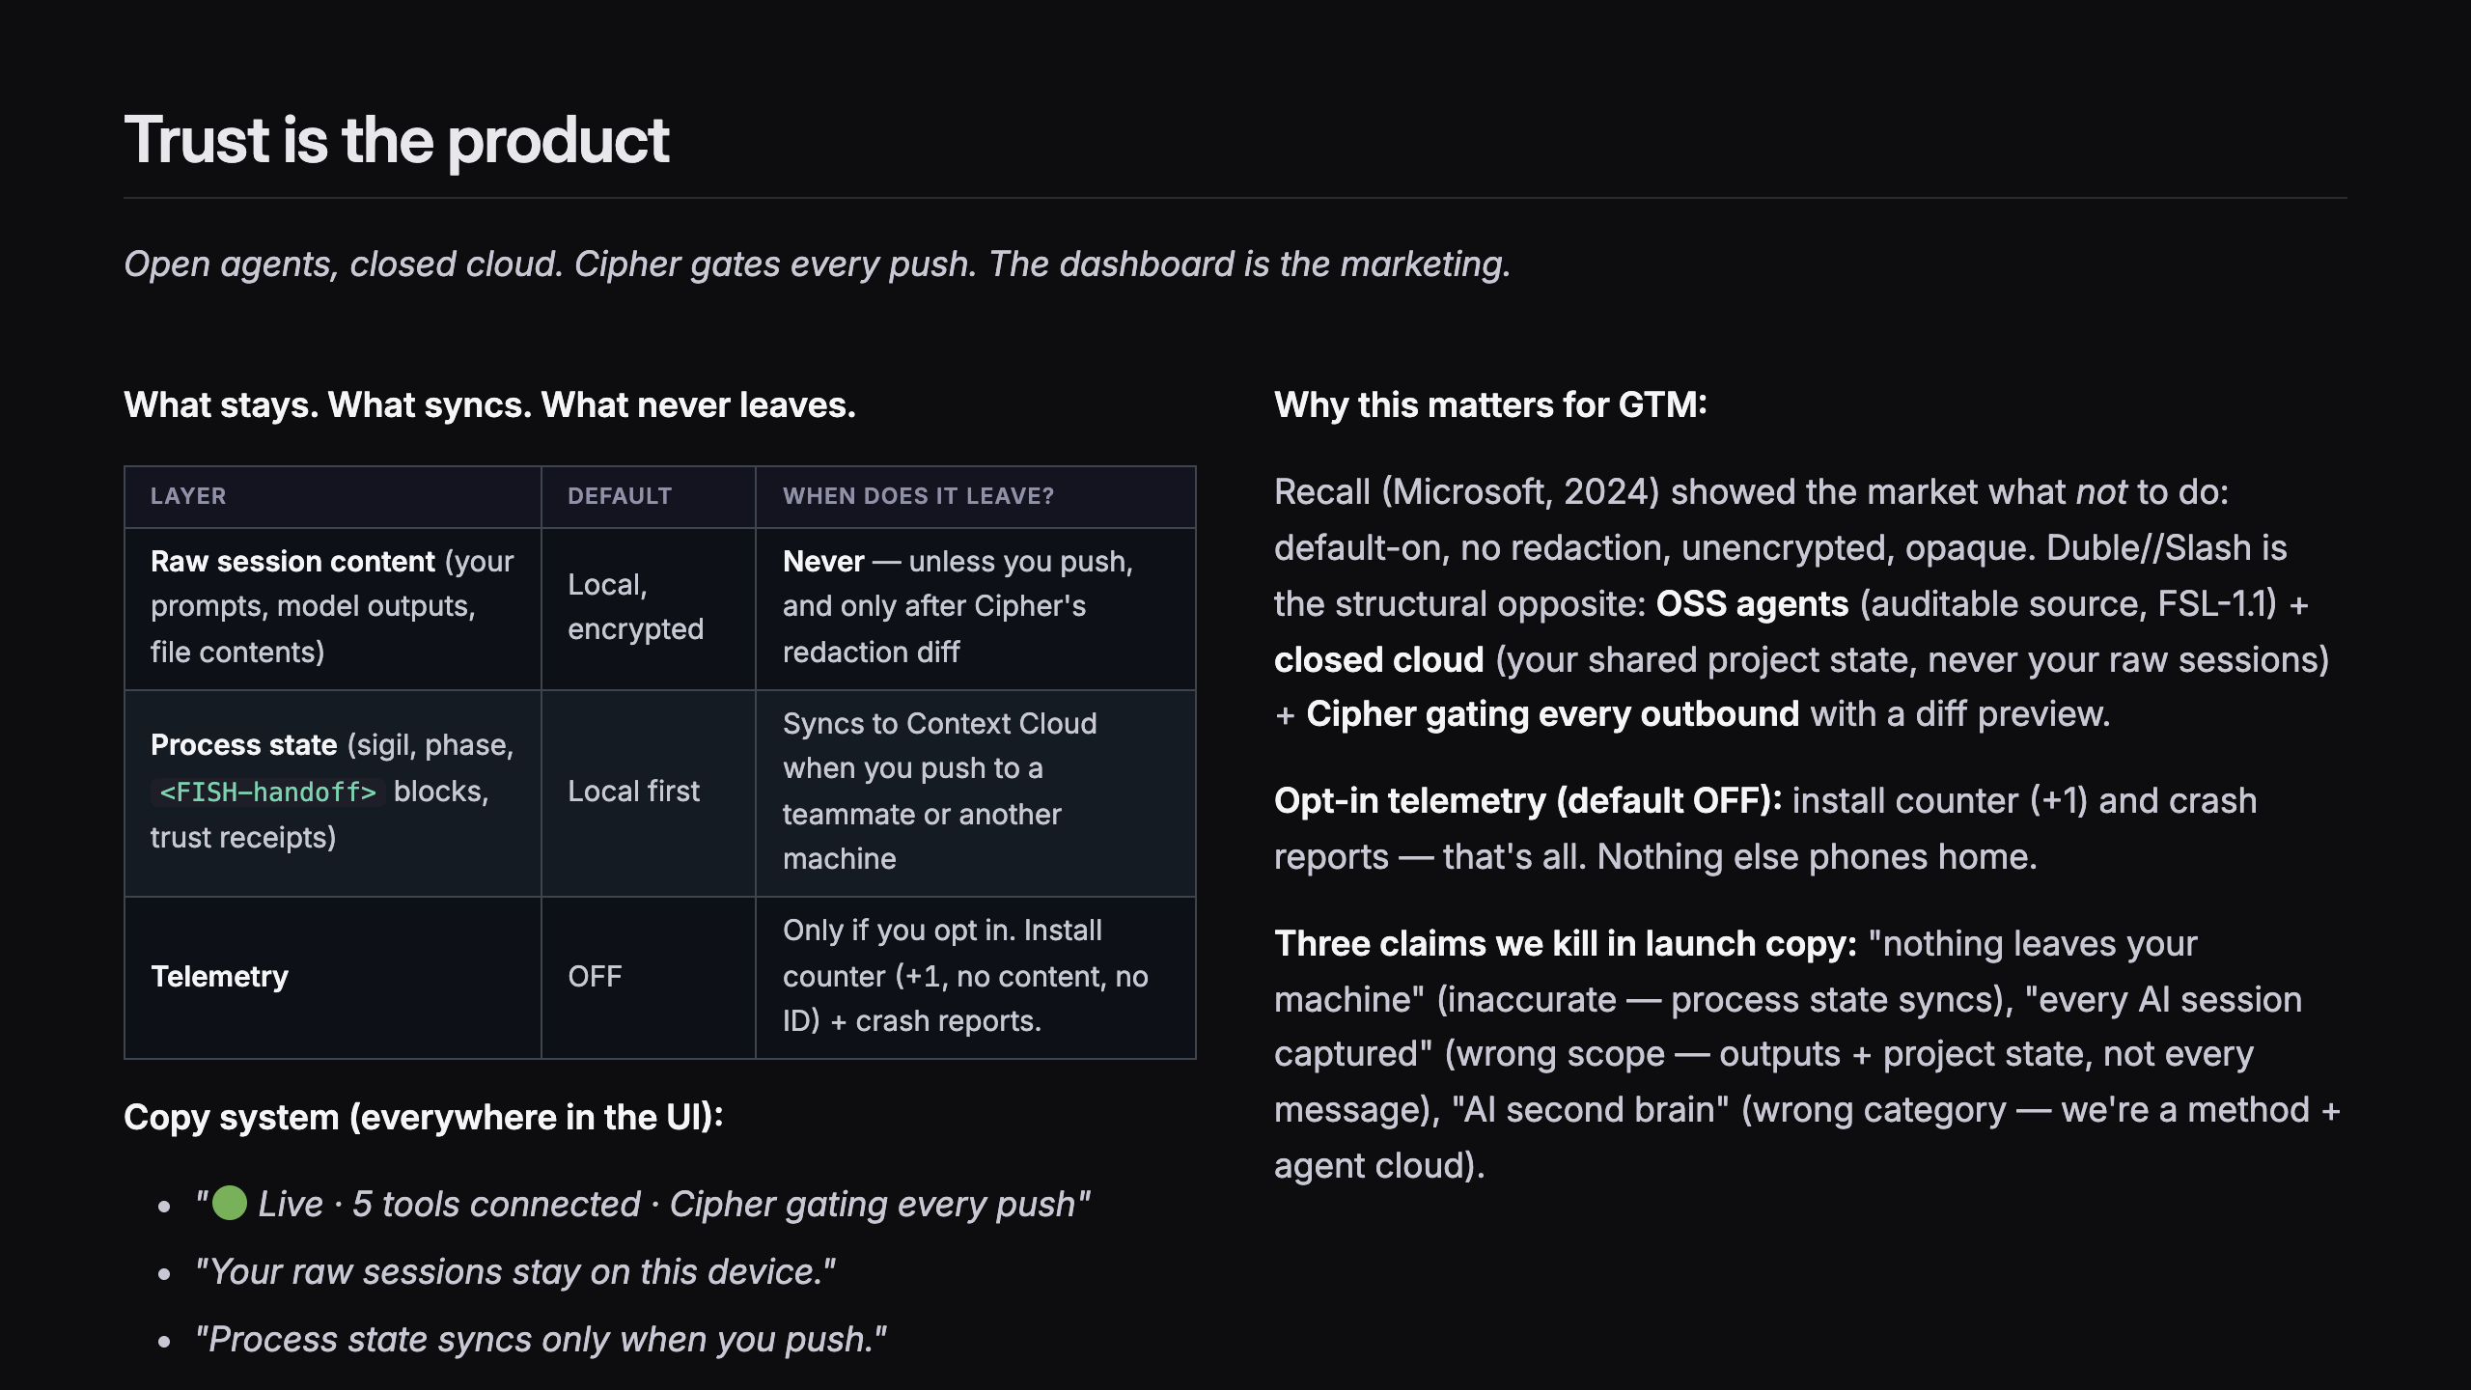
Notes:
SLIDE 8 — TRUST IS THE PRODUCT
SCREENSHOT: Privacy dashboard · see ux-design doc Flow 6 · "Stored on this device / Synced to Context Cloud / Telemetry sent / Agents that have run"

Slide 13
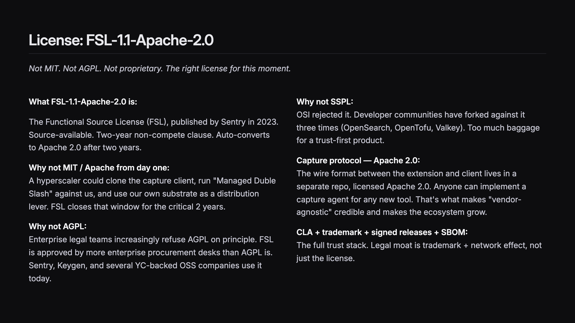
Notes:
SLIDE 9 — LICENSE: FSL-1.1-APACHE-2.0

Slide 14
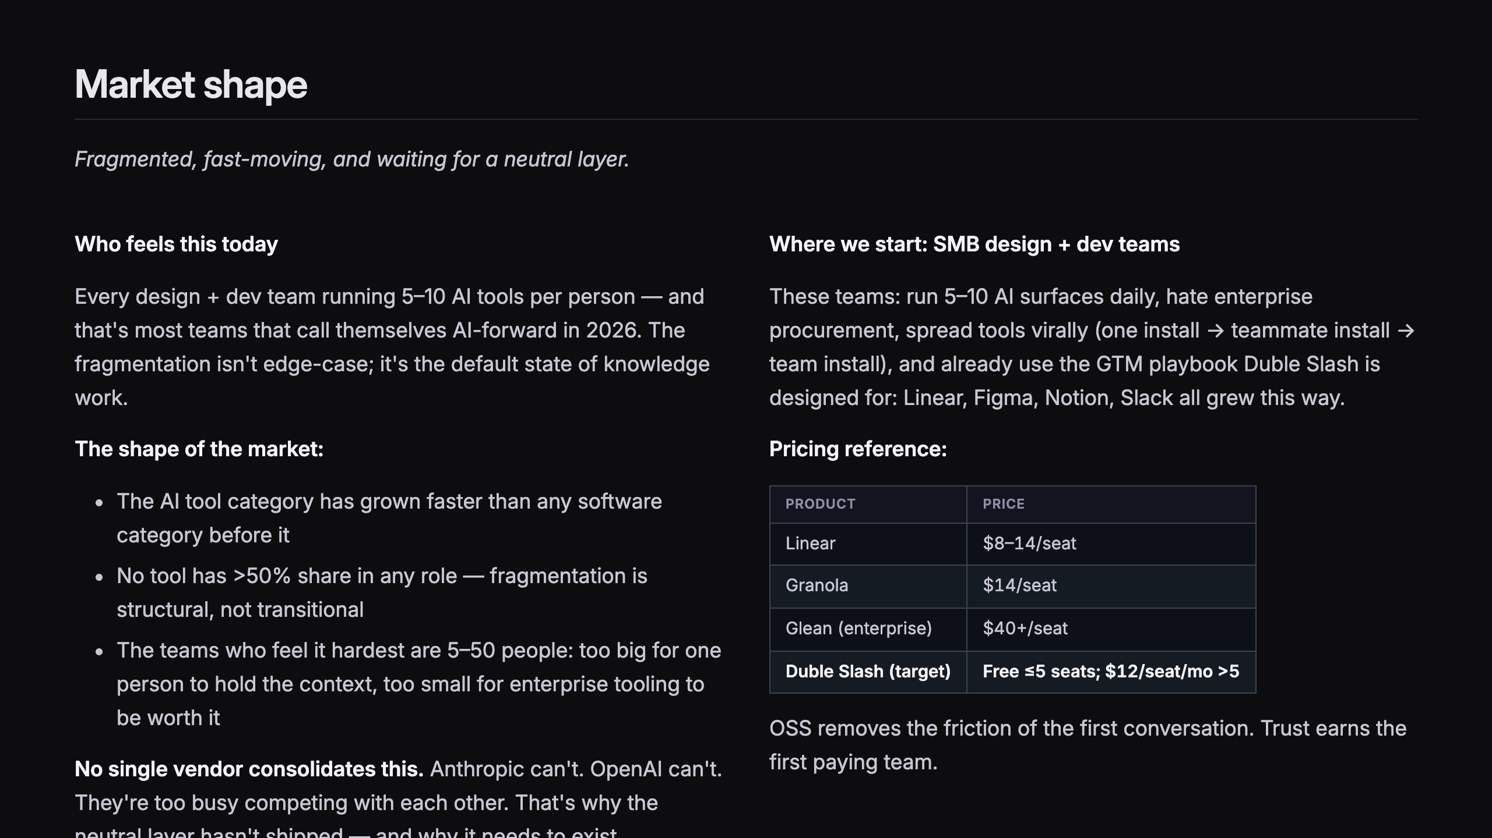
Notes:
SLIDE 10 — MARKET

Slide 15
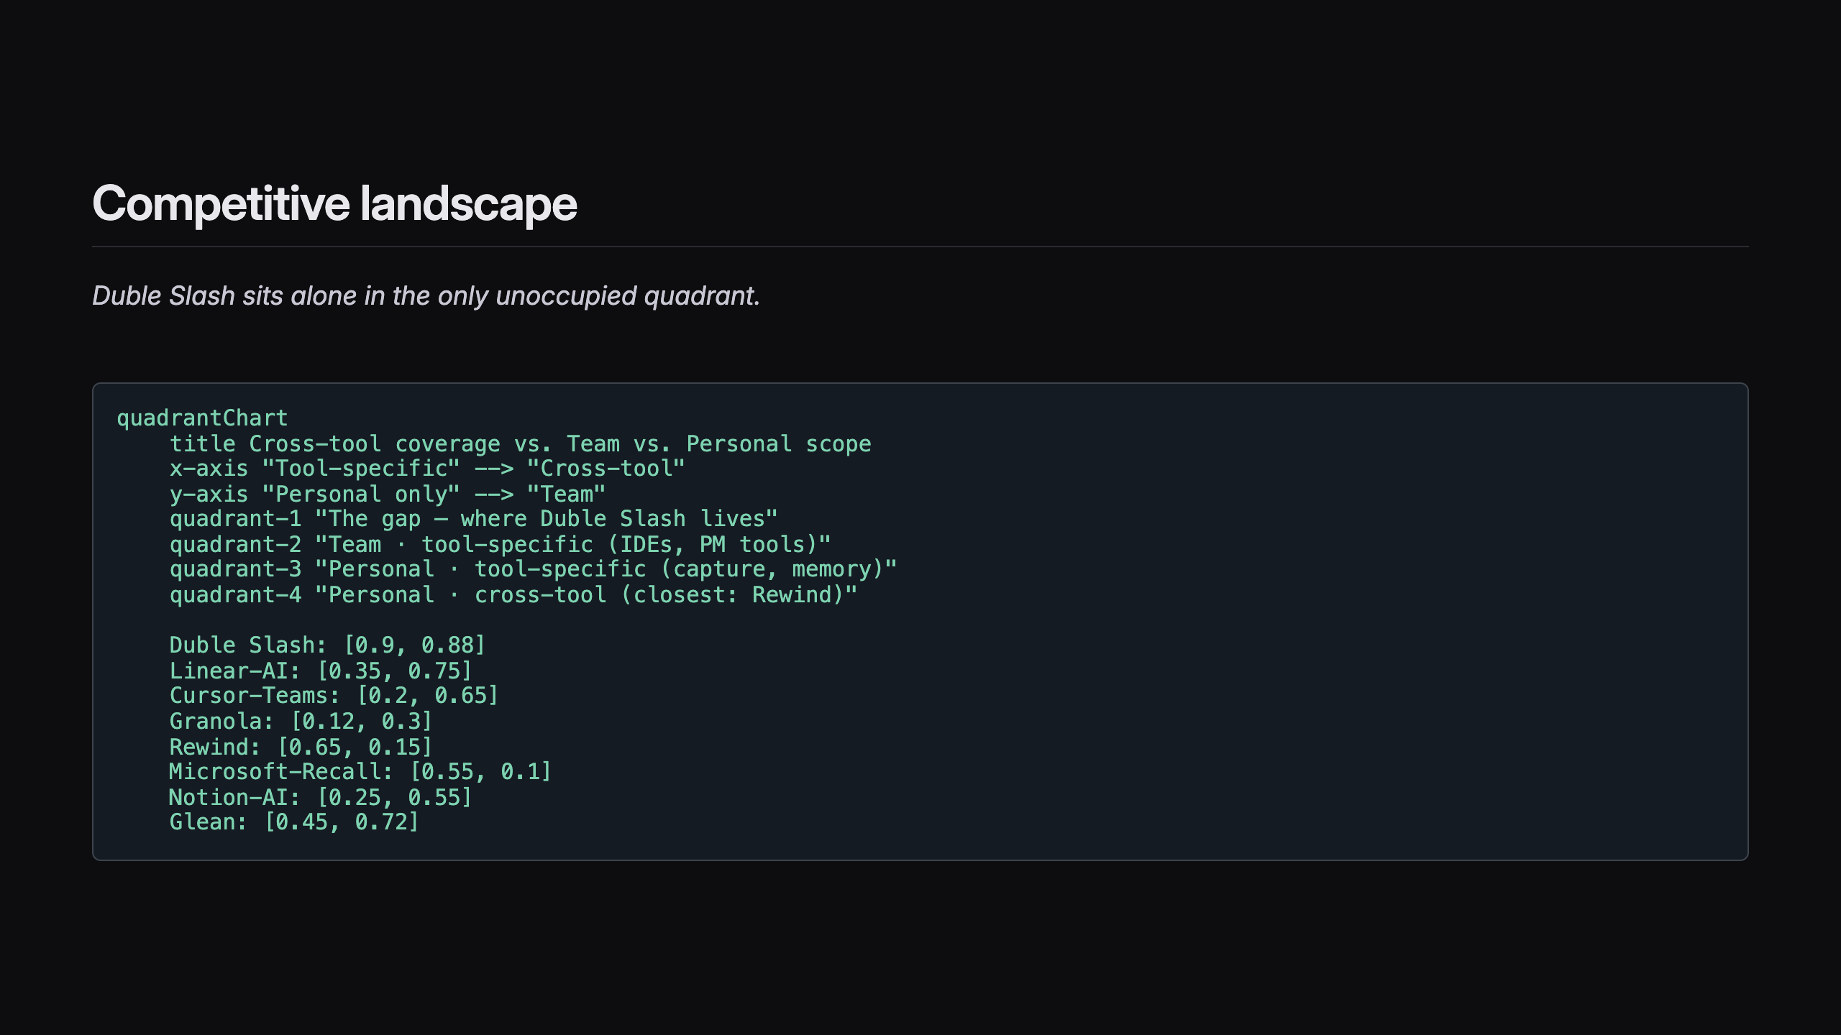
Notes:
SLIDE 11 — COMPETITIVE LANDSCAPE + TALKING POINTS

Slide 16
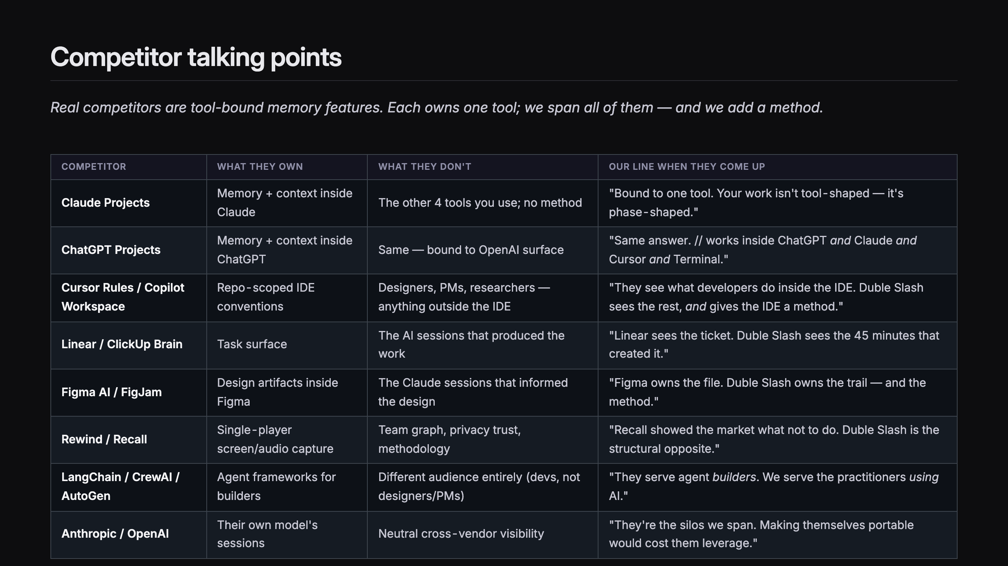
Notes:
SLIDE 12 — COMPETITOR TALKING POINTS

Slide 17
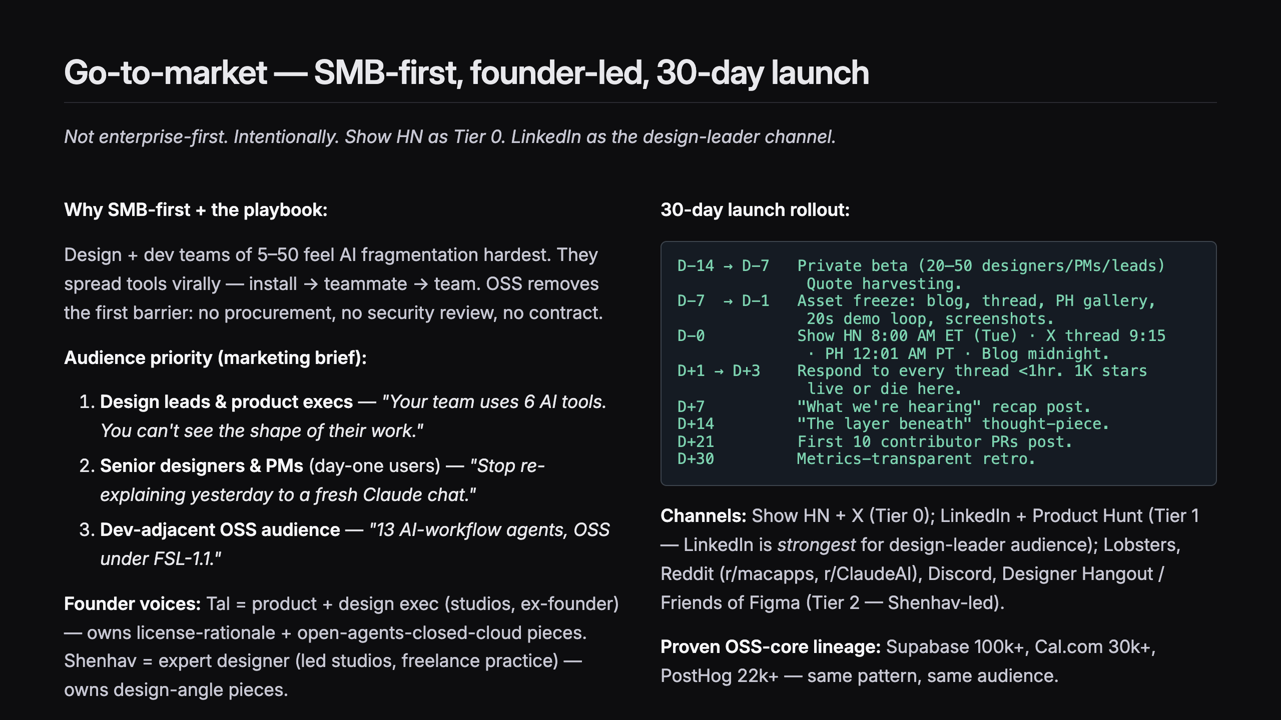
Notes:
SLIDE 13 — GO-TO-MARKET: SMB-FIRST

Slide 18
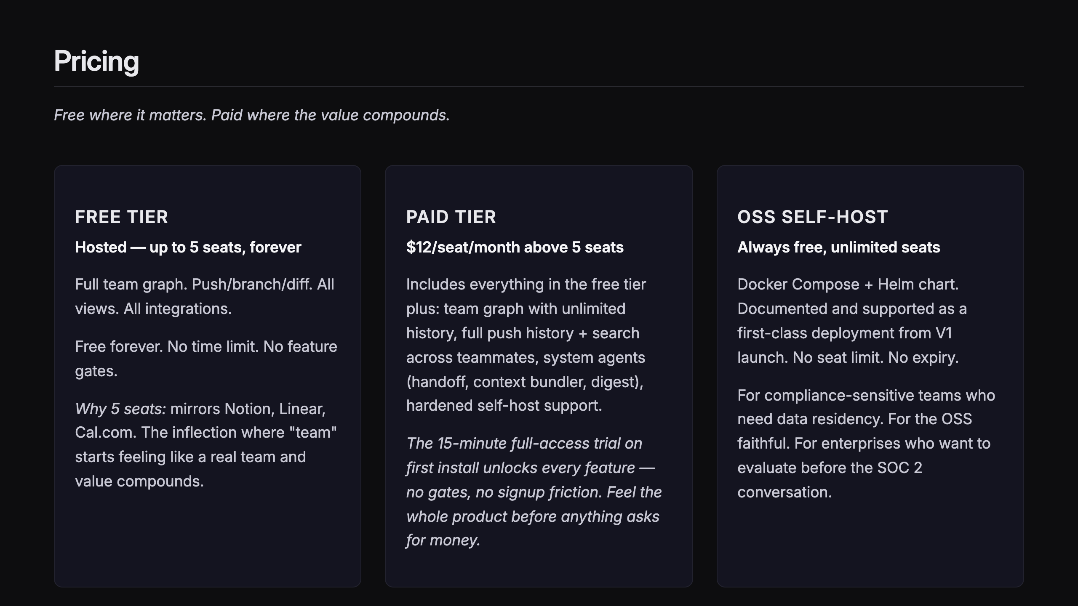
Notes:
SLIDE 14 — PRICING

Slide 19
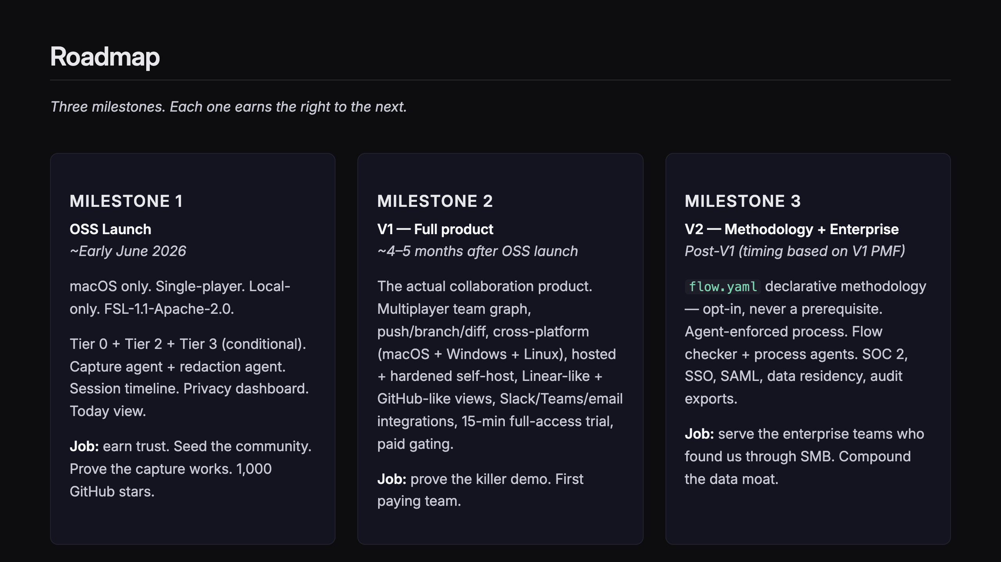
Notes:
SLIDE 15 — ROADMAP: 3 MILESTONES

Slide 20
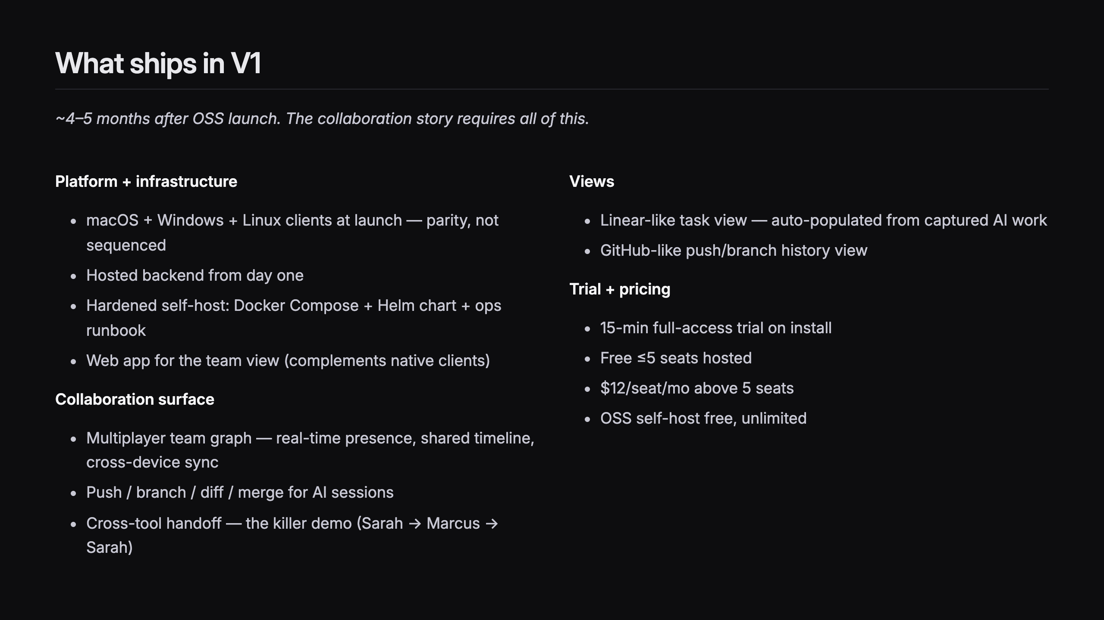
Notes:
SLIDE 16 — WHAT SHIPS IN V1

Slide 21
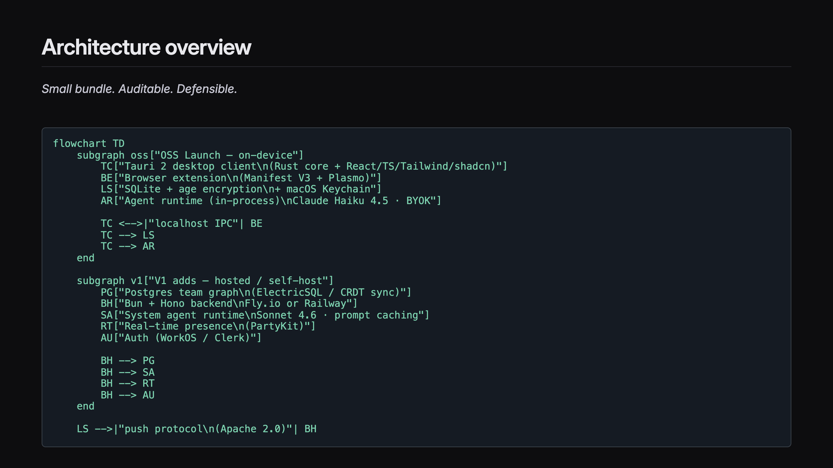
Notes:
SLIDE 17 — ARCHITECTURE OVERVIEW

Slide 22
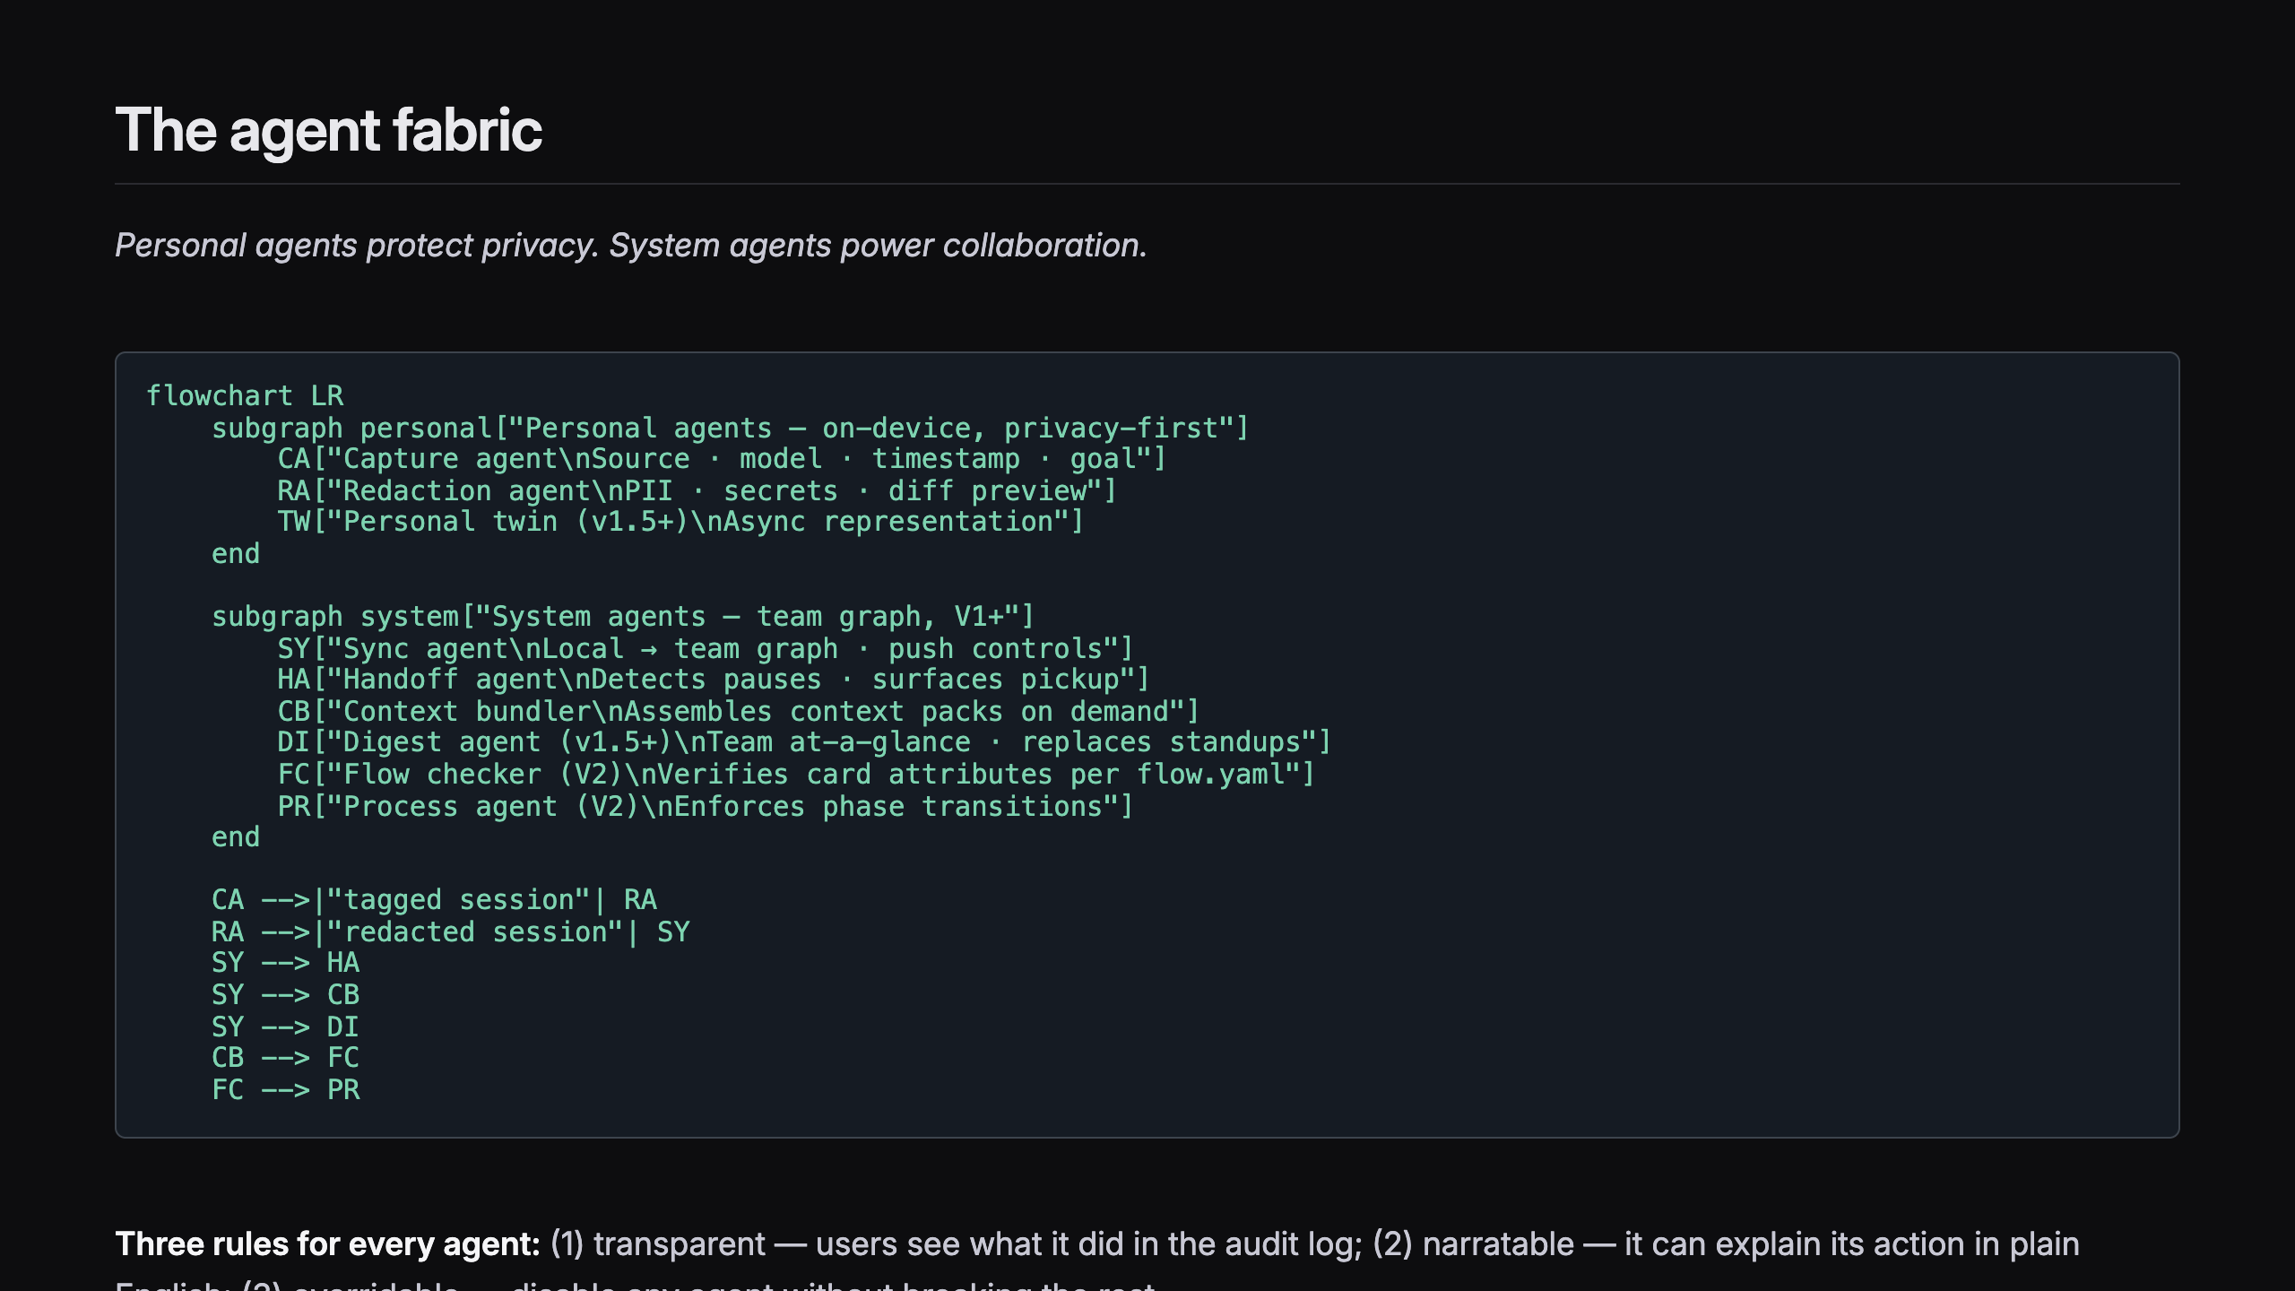
Notes:
SLIDE 18 — THE AGENT FABRIC

Slide 23
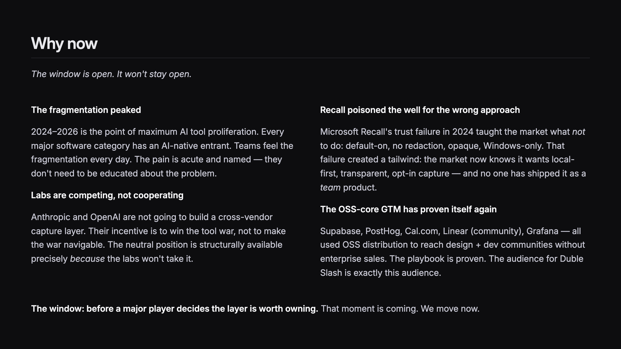
Notes:
SLIDE 19 — WHY NOW

Slide 24
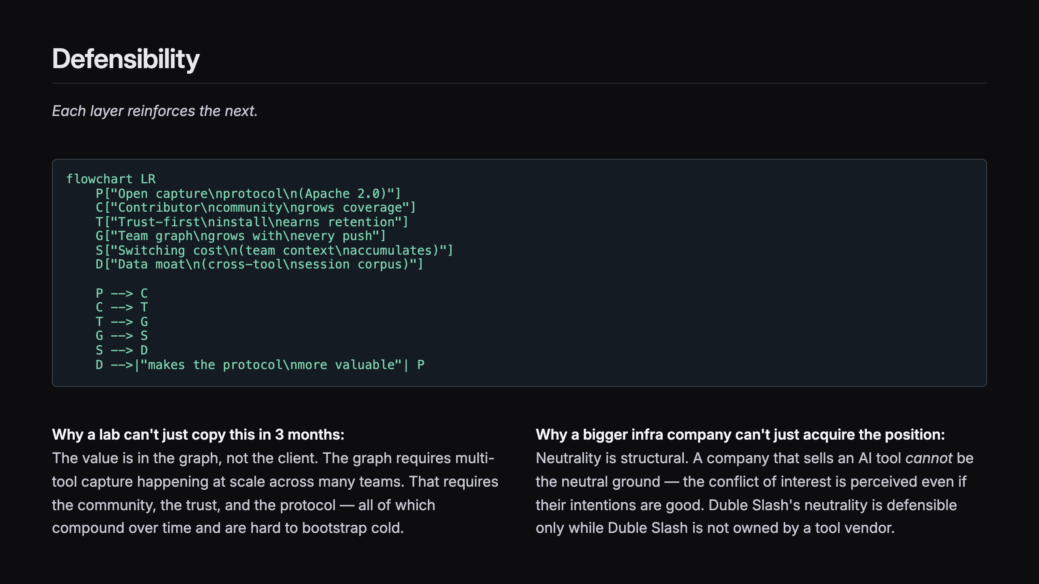
Notes:
SLIDE 20 — DEFENSIBILITY

Slide 25
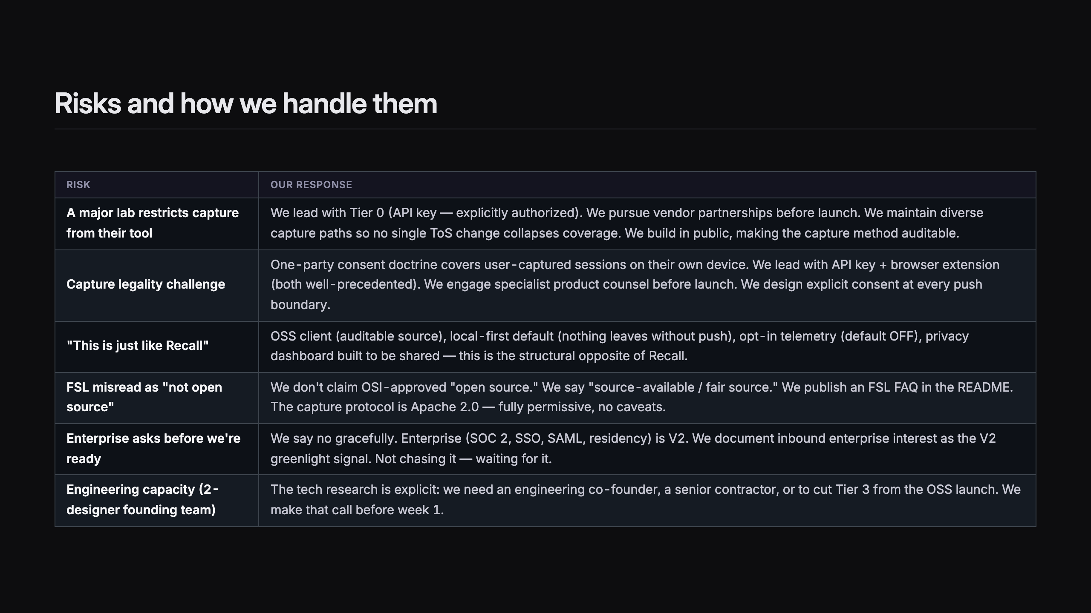
Notes:
SLIDE 21 — RISKS AND HOW WE HANDLE THEM

Slide 26
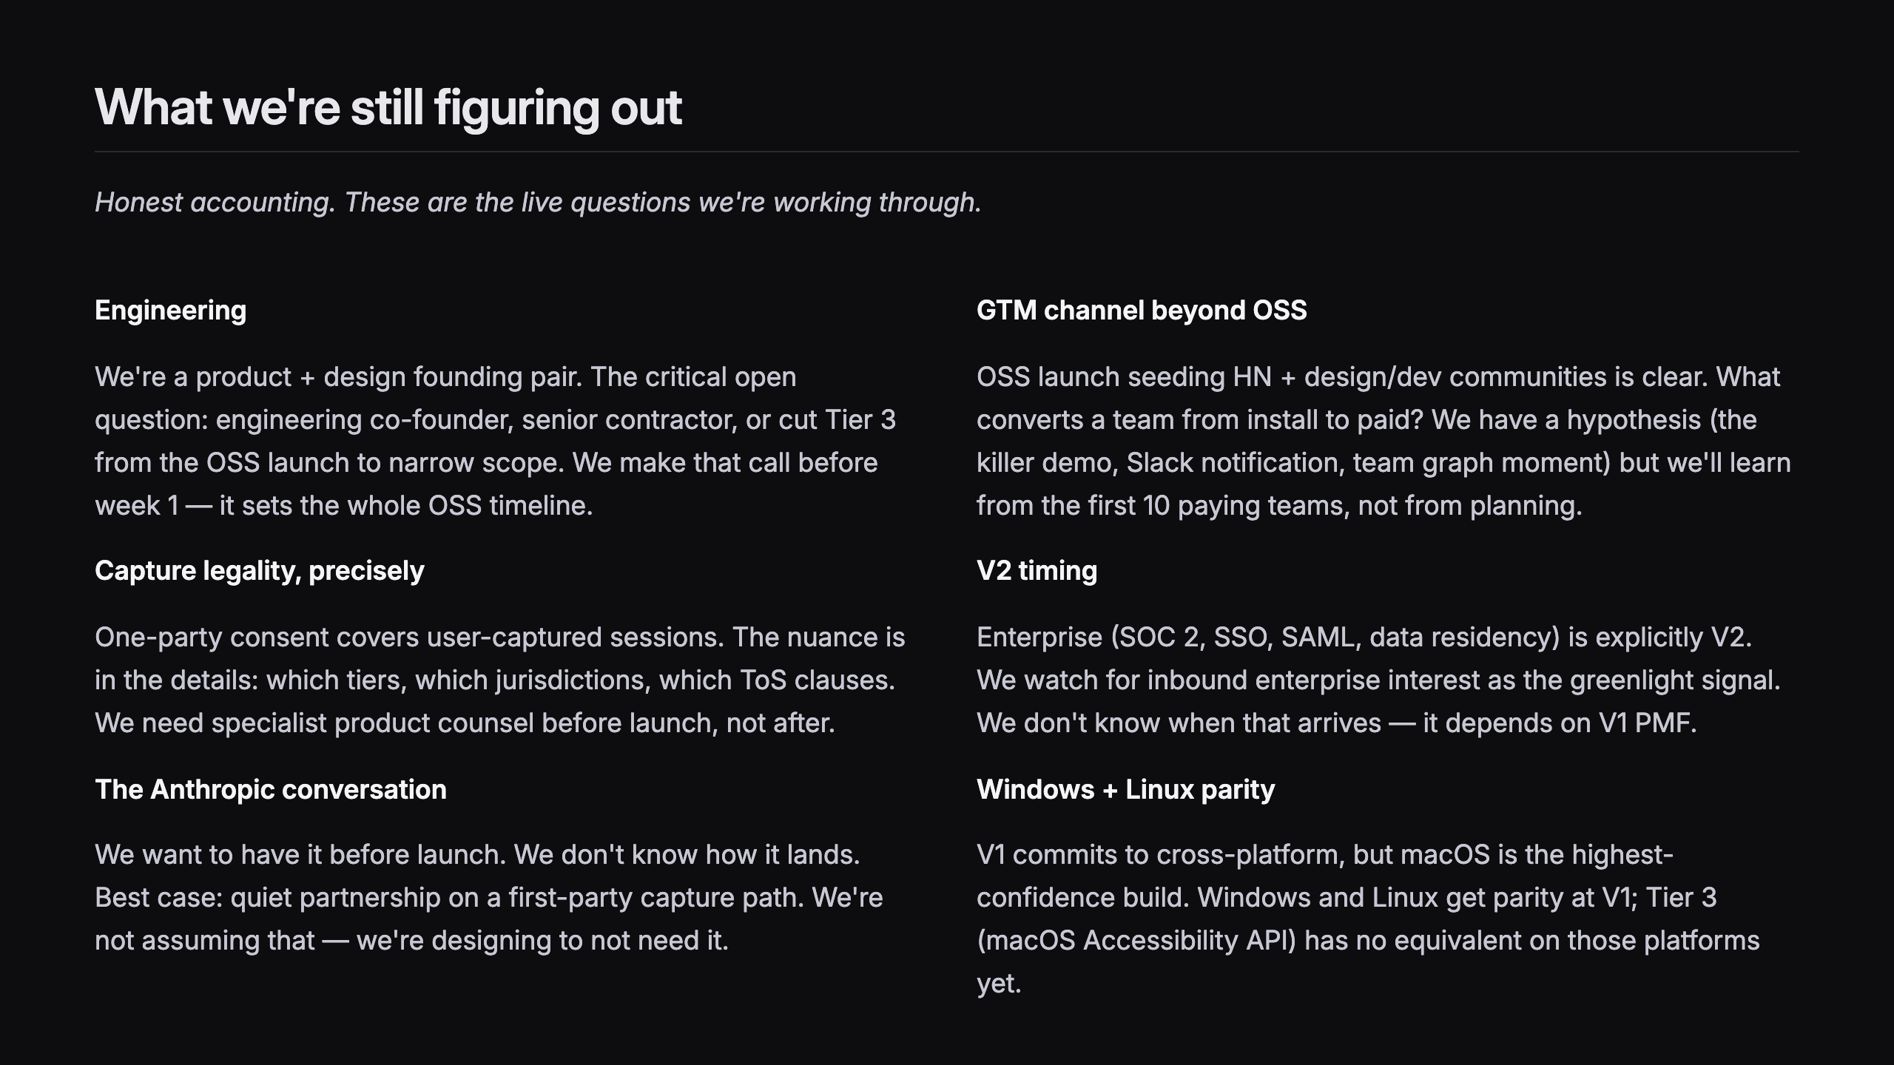
Notes:
SLIDE 22 — WHAT WE'RE STILL FIGURING OUT

Slide 27
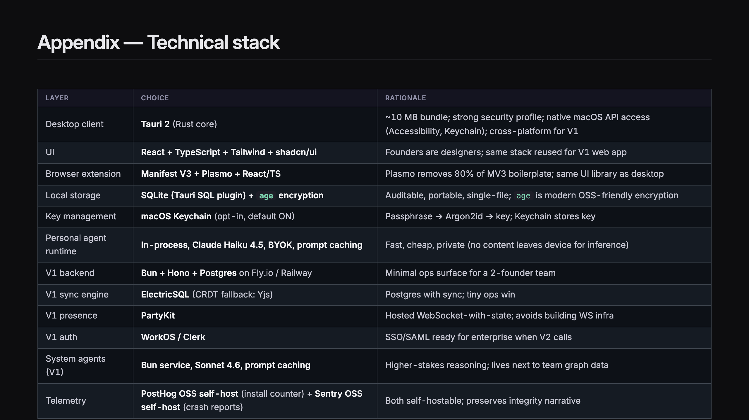
Notes:
SLIDE 23 — APPENDIX: TECHNICAL STACK

Slide 28
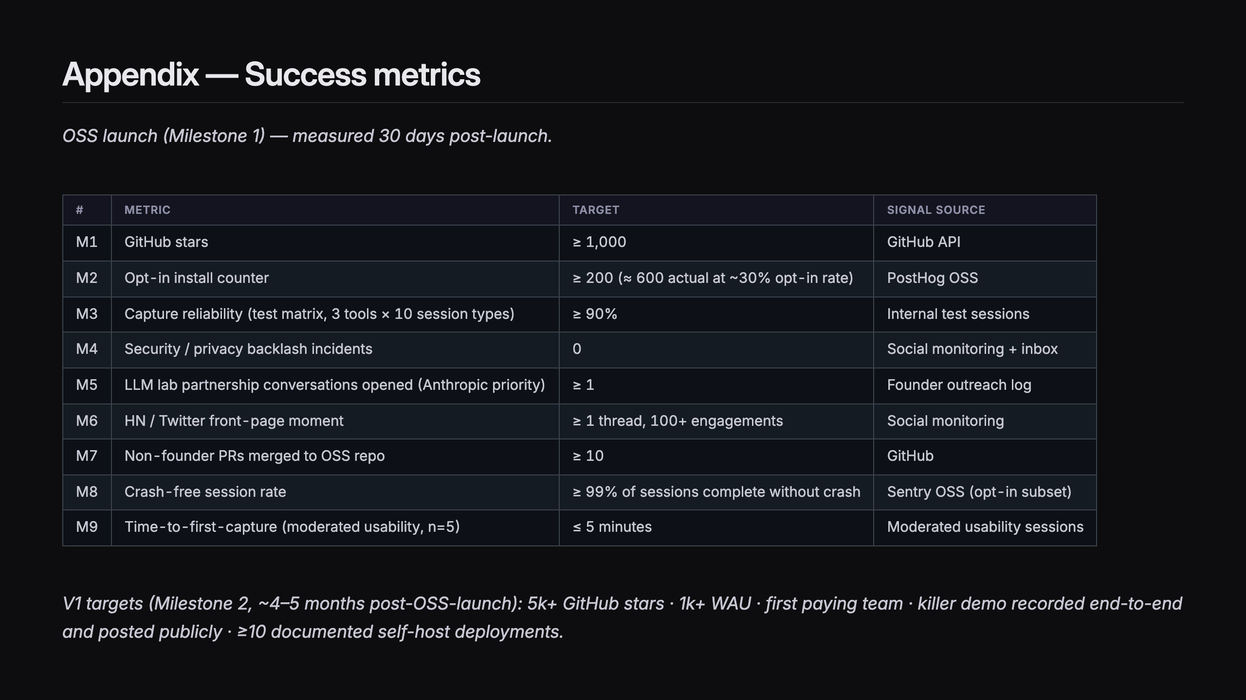
Notes:
SLIDE 24 — APPENDIX: SUCCESS METRICS

Slide 29
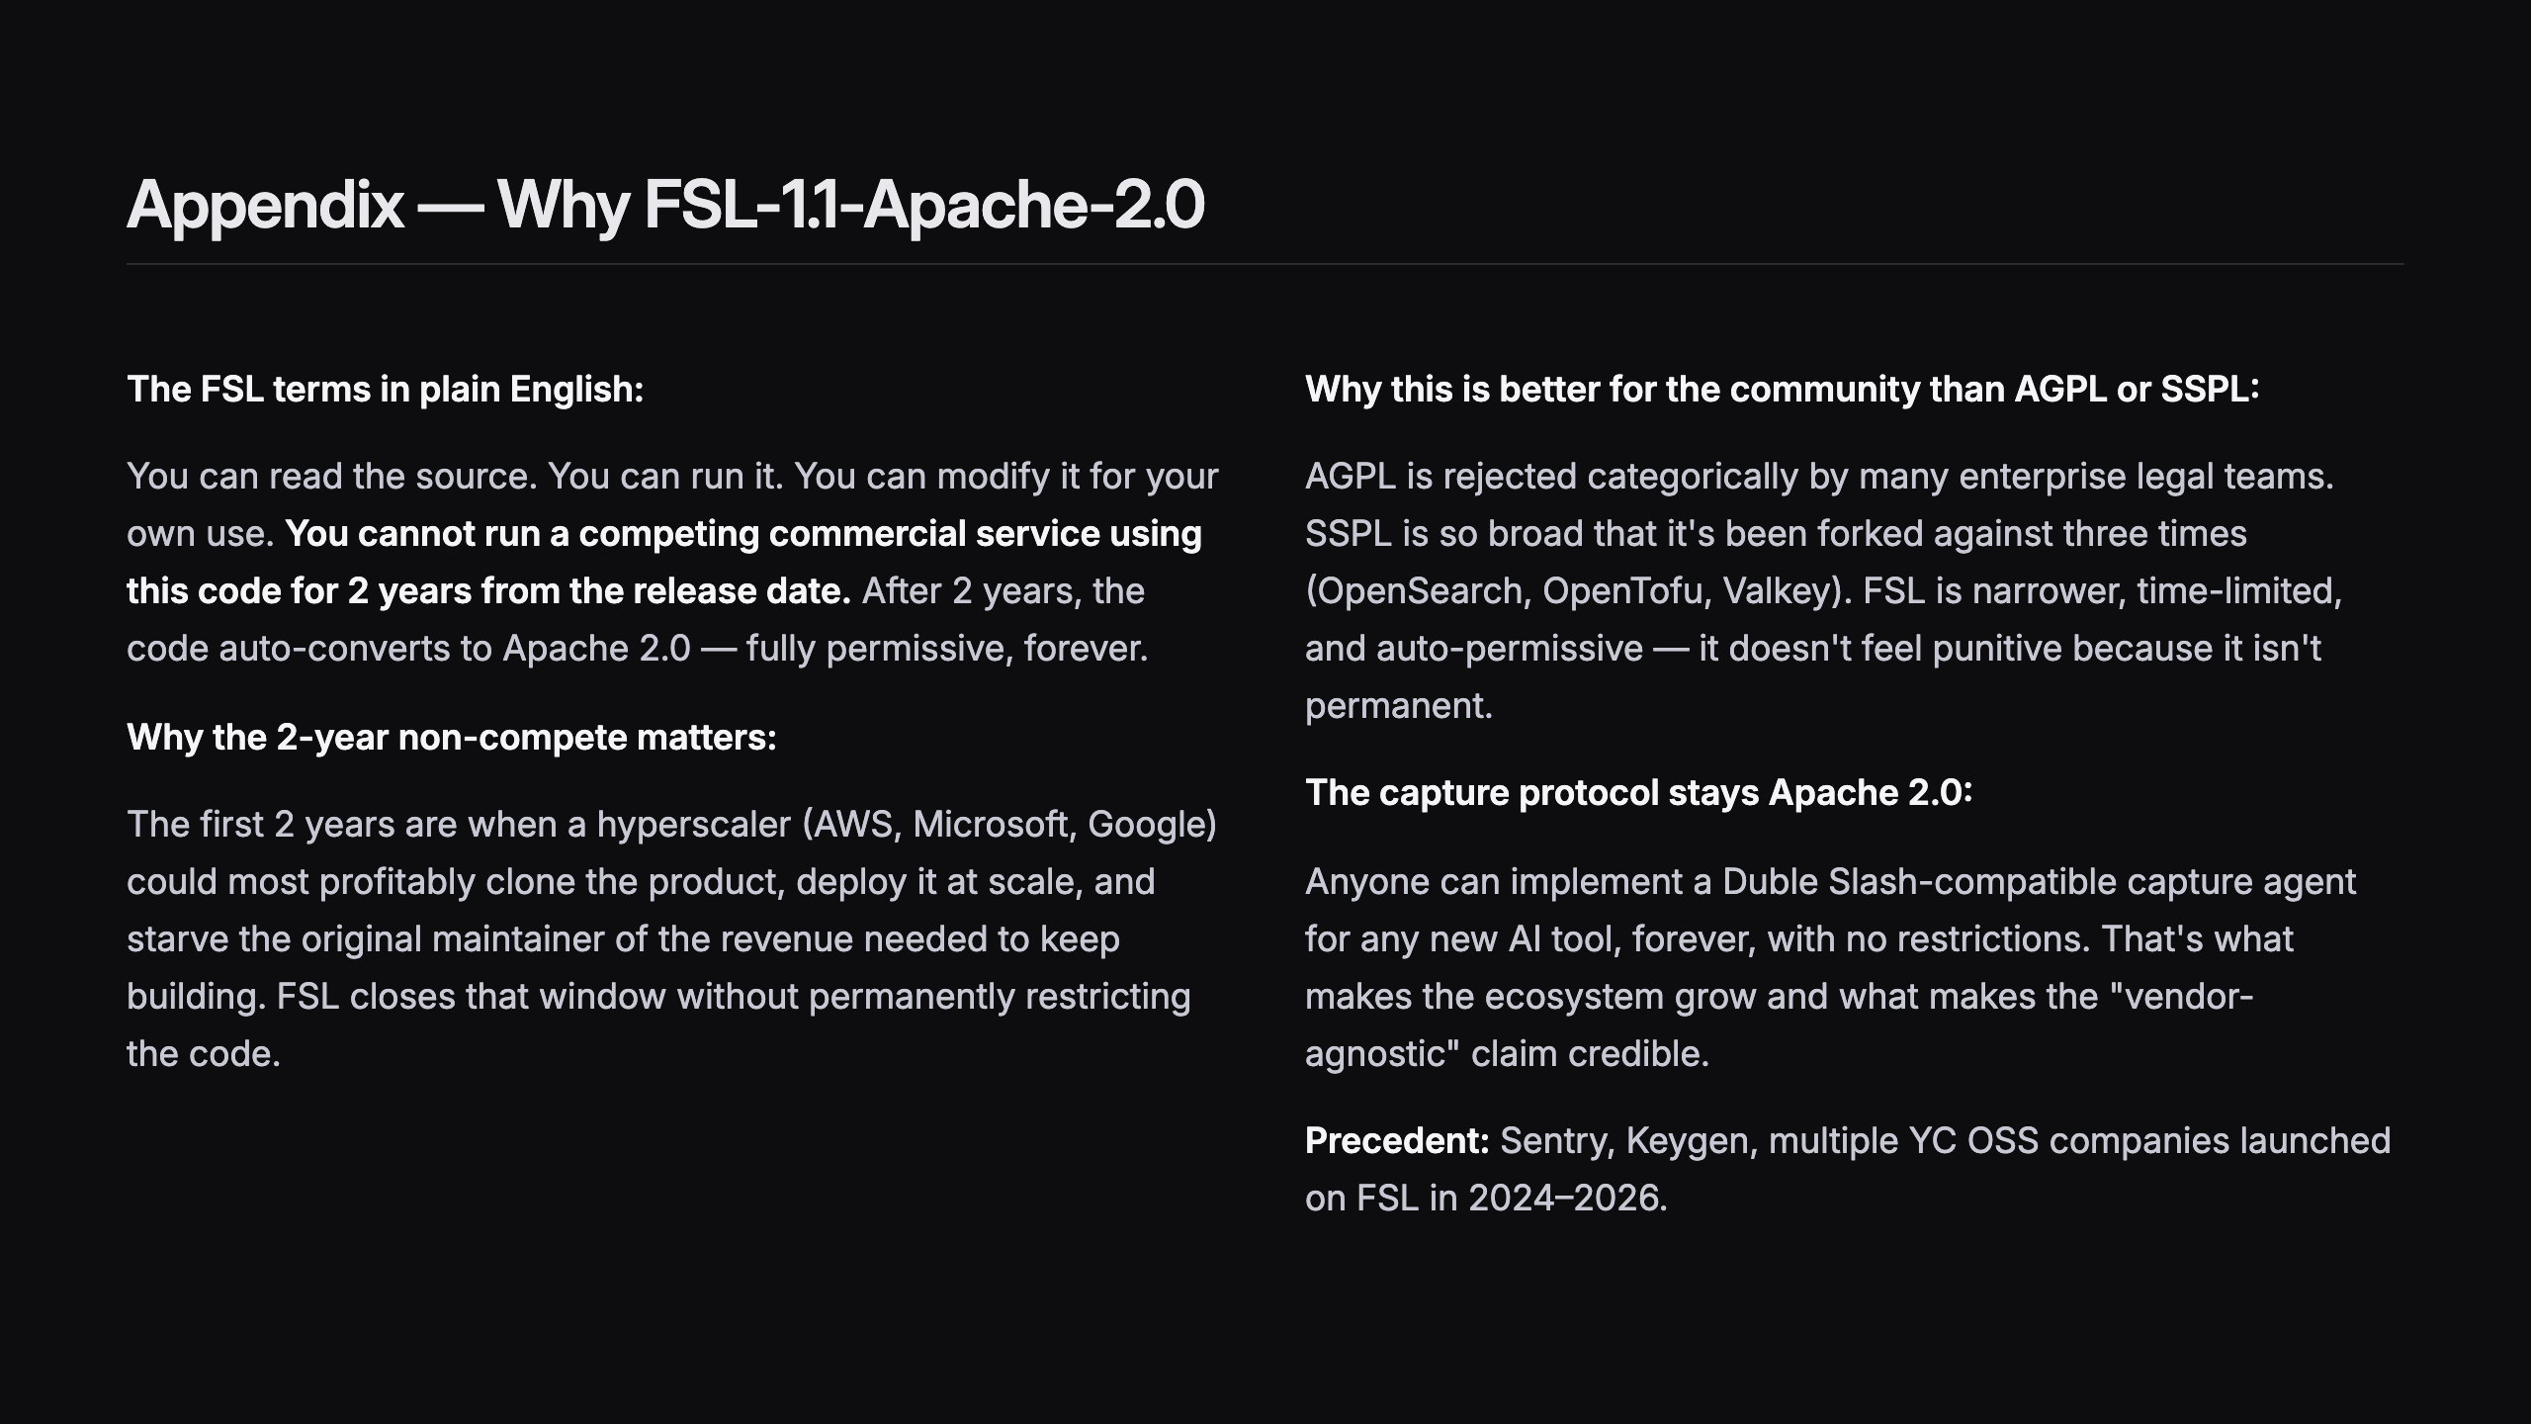
Notes:
SLIDE 25 — APPENDIX: WHY FSL-1.1-APACHE-2.0

Slide 30
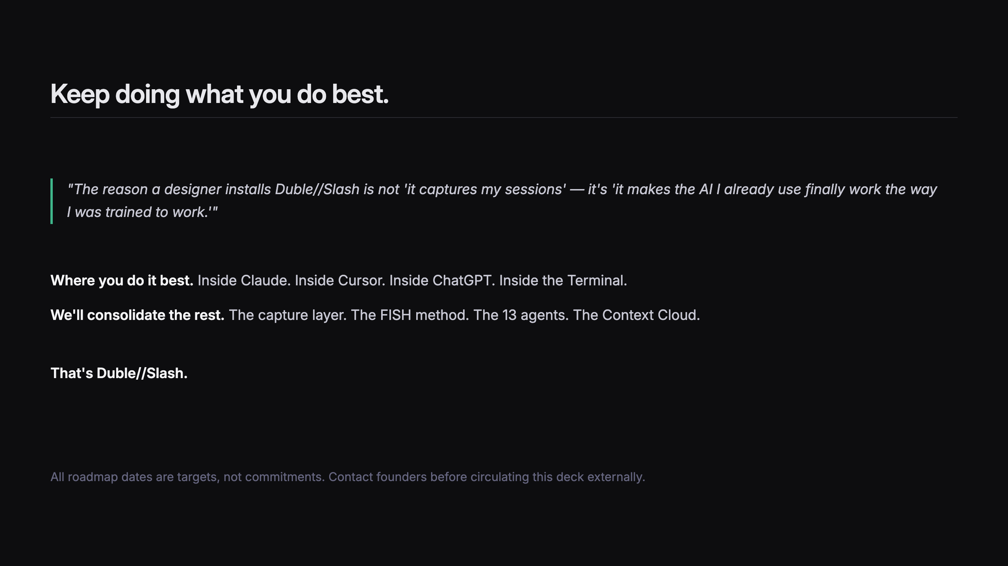
Notes:
SLIDE 26 — CLOSING
LOGO: Duble//Slash wordmark · 180x44 · swap in _bmad/assets/logos/duble-slash-wordmark-white.svg

