Slide 1
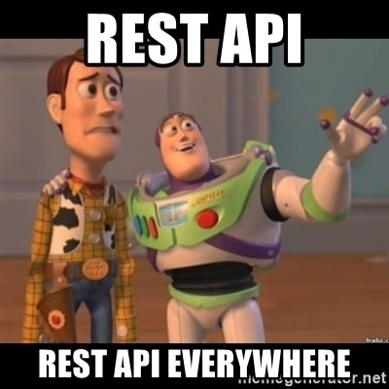

Rest API Fundamentals
Presented by: TalentTEK Training Center

Slide 2
API Concept
API allows interactions between systems by following a set of standards and protocols in order to share features, information, and data
Full form of API
A – Application
P – Programming
I - Interface

Slide 3






API acts as an interface between different applications.
API

Slide 4



Representational State Transfer
REST API
It is an architecture style to develop web applications.
Uses HTTP protocol as a communication interface.
It transfers data through HTTP methods.
GET/POST/PUT PATCH/DELETE
{..}
JSON/XML

Slide 5
Uniform Resource Locator
URL
It is the address to NOT just identify a resource but also to specify how to access it.
In an API, the URL can be named as Base URL, which is the base address used in every request.
Example: http://qa.taltektc.com

Slide 6
Uniform Resource Identifier
URI
It is used in the URL to specify which resource the client would like to access in a request.
Example: http://qa.taltektc.com/api/student/TTCO14NC (green color stuff is URI within the URL)

Slide 7
Request Body or Payload
The body of the request contains all the data that the server needs to successfully process the request.
Only used in requests that must send information such as create or update
Example:
{ "firstName": "Jhon", "lastName": "Doe", "email": "jhon.doe20@gmail.com", "password": "123456", "confirmPassword": "123456", "dob": { "year": 2013,
"month": 12,
"day": 31
}, "gender": "male", "agree": true }

Slide 8
Request Body or Payload
The body of the request contains all the data that the server needs to successfully process the request.
Only used in requests that must send information such as create or update
Example:
{ "firstName": "Hassan", "lastName": "Bhuiyan", "email": "hb_1986@gmail.com", "password": "123456", "confirmPassword": "123456", "dob": { "year": 1986,
"month": 12,
"day": 31
}, "gender": "male", "agree": true }

Slide 9
Parameters in URL
Information that can be sent in a request by the client in order to influence the response by the server.
Path Parameter A variable in the URI path that helps in pointing toward specific resources http://qa.taltektc.com/api/student/TTCO14NC (TTCO14NC id in URI will return particular student info based on the student Id)
Query Parameter A variable in the URI path that helps in querying/filtering http://qa.taltektc.com/api/student?id=TTCO14NC (this is another way we can filter out the student info)

Slide 10
Headers
It allows sending extra information in a request, such as JWT and content-type
JWT
It’s a popular token-based authentication standard
JWT is a Based64Url encoded to form the 3 parts (Header, Payload, and Signature) Authorization: Bearer token {token goes here}
Content-type
The Content-Type header is used to indicate the media type of the resource
Content-type: Application/JSON

Slide 11





REST API Methods
The five most popular HTTP Methods that we need to understand are:
GET
Receive information about an API resource (from db)
POST
Create an API resource (store information in db)
PUT
Update an API resource (store updated information in db)
PATCH
Modify partial information ( store partial updated information in db)
DELETE
Delete an API resource ( remove information in db)

Slide 12
Responses
With every request made to the server, we get response code/status code and sometimes response body
Response Code
2XX – Success
3XX – Redirection
4XX – Problem with the client
5XX – Problem with the server
Response Body
{
"success": true,
"message": "Registration Success",
"id": "TTCO14NC"
}

