Slide 1
TalvMenni ver. 0.1
A object-oriented chess-engine capable of utilizing JavaSpaces for parallel search

Slide 2
Agenda / Outline

Slide 3
Problem Statements
Develop a Object-Oriented Chess Engine.
Examine the possibility of parallellizing search utilzing JavaSpaces.

Slide 4
Vandamálsorðing í pensum

Slide 5
Pensum

Slide 6
Agenda
Search Enhancements
Data Structures

Slide 7
Search Enhancements
Iterative Deepening
Horizon Effect / Quiescence Search
Forward Pruning
Aspirated Search & MTD(f)

Slide 8
Iterative Deepening

Slide 9
Horizon Effect / Quiescence Search

Slide 10
Forward Pruning

Slide 11
Aspirated Search & MTD(f)
Full window -∞ to ∞

Slide 12
Data Structures
Board Representations
Pre-processing Move Generation
deBruijn Indexes
Transposition Tables
History Tables

Slide 13
Board Representations
Arrays
Offset method
Bitboards

Slide 14
Bitboards
Why are Bitboards suitable for chess programming?
Bitwise Operations
Rotated Bitboards
Bitboard Masks for Sliding Pieces

Slide 15
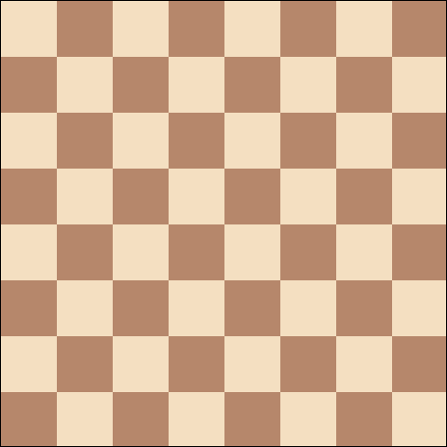
Pre-Processing Move Generation
Attack and Move Patterns

Slide 16
Using de Brujin Sequences to Index a Computer Word
The deBrujn algorithm
  Idea #1: Isolate a 1.
  Idea #2: Hashing.
  Idea #3: de Brujn sequences

Slide 17
Transposition Tables
Advantages: Speed, Free depth, Versatility (opening book)
Disadvantage: memory
Zobrist

Slide 18
History Tables
Killer Moves
History Heuristics

Slide 19
Conclusion
F***ing loosers – we told u we were hardcore!!!

