Slide 1


Natural Language Processing
Word Representations
Fall 2025/26
Based on slides from Mor Geva, Maor Ivgi, Jonathan Berant, Richard Socher, Chris Manning, and Hugo Lachorelle

Slide 2
Announcements
Hi, I’m Tal Wagner
  I teach this class on other semesters
  I’m filling in for Mor this week
This is a one-time classroom
Starting next week you’ll be in Holtzblat Hall (אולם הולצבלט)
Notes:
Agenda

Slide 3
Today’s Plan
Word representations:
  Recap: Skipgram
  Skipgram with negative sampling
  Relation to matrix factorization
  Evaluating word representations
Language modeling:
  We will start if we have time

Slide 4
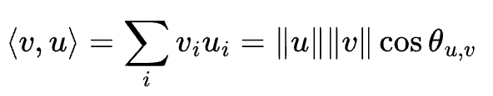
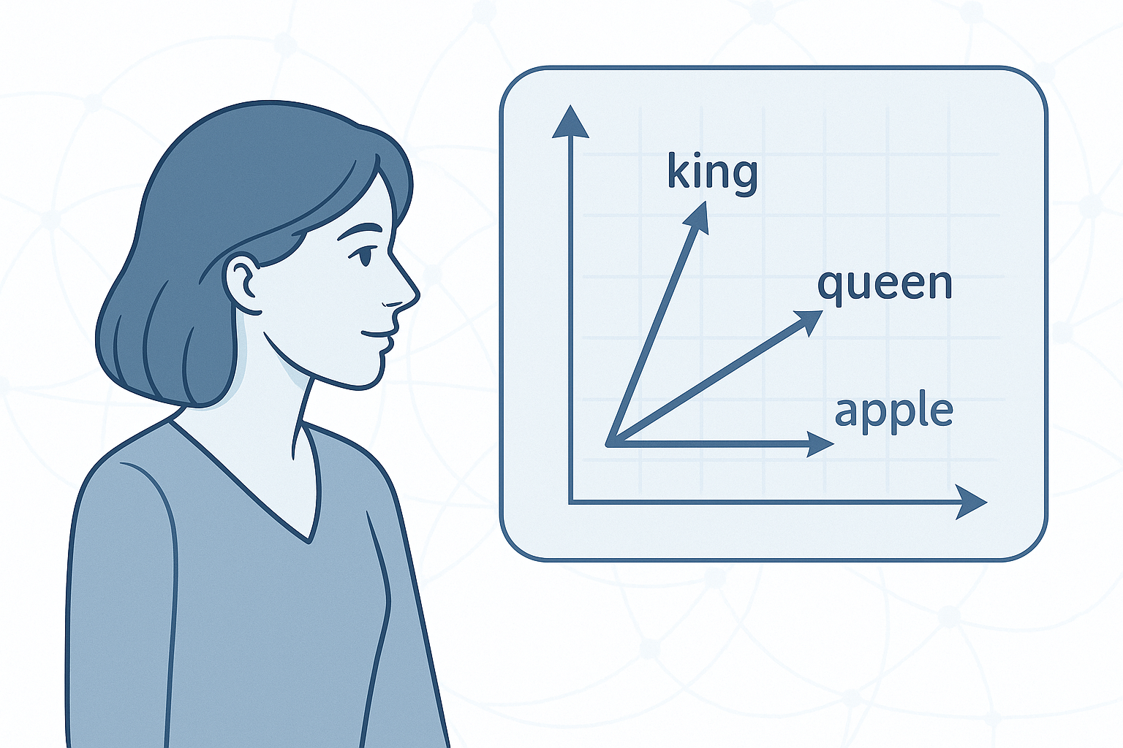
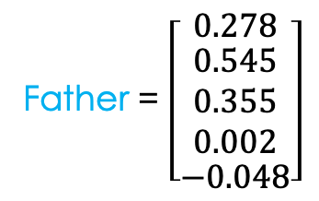
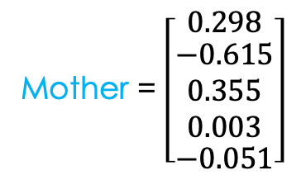
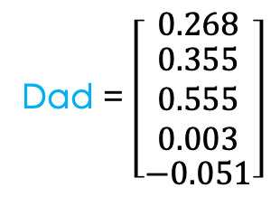
Word Vectors: Recap
Goal: Represent words as vectors s.t. inner product captures semantic similarity
We saw three methods:
  One-hot vectors
  Rows of co-occurrence matrix
  Word2vec – skipgram
Notes:
Agenda

Slide 5

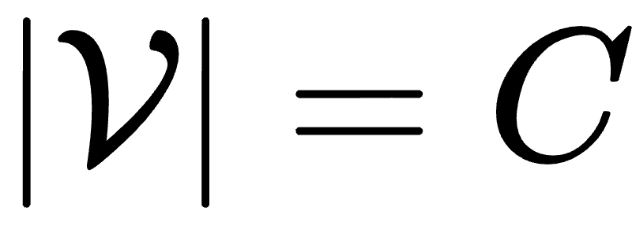
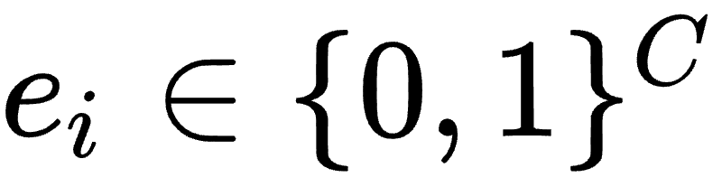
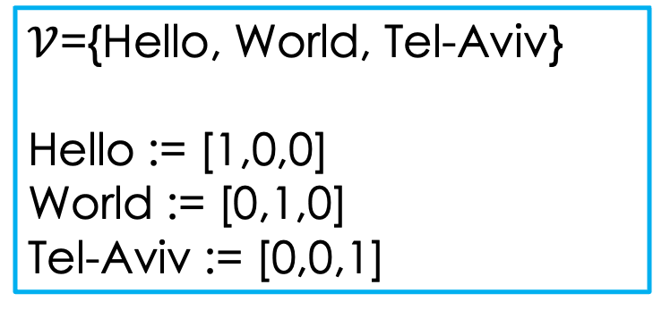
Word representation – discrete vectors
Define a vocabulary – ordered set of words,
A word will be represented by
One-hot encoding
What is the size of such vocabulary?
How would we represent a sentence?
  What would happen to the order? repetitions?
Bag of words: “Hello World” → [1,1,0]
Notes:
Reasonable results – not a bad baseline.
Other issues? Similarity between words, a word may have multiple meanings (if we predict the sentiment of a single word)

Slide 6
One-Hot Word Vectors: Pros & Cons
Pros:
Natural way to compose words into sentences
  (“Natural” does not mean “ideal”: e.g., it loses word ordering)
Dot-product between two sentence vectors = size of lexical overlap

Slide 7
One-Hot Word Vectors: Pros & Cons
Pros:
Natural way to compose words into sentences
  (“Natural” does not mean “ideal”: e.g., it loses word ordering)
Dot-product between two sentence vectors = size of lexical overlap

Slide 8
One-Hot Word Vectors: Pros & Cons
Pros:
Natural way to compose words into sentences
  (“Natural” does not mean “ideal”: e.g., it loses word ordering)
Dot-product between two sentence vectors = size of lexical overlap
Cons:
No semantic similarity between words
  All word vectors are pairwise orthogonal
  a great movie ≈ a great film ; a great movie ≉ a great meal
  Ideally we want:

Slide 9
One-Hot Word Vectors: Pros & Cons
Pros:
Natural way to compose words into sentences
  (“Natural” does not mean “ideal”: e.g., it loses word ordering)
Dot-product between two sentence vectors = size of lexical overlap
Cons:
No semantic similarity between words
  All word vectors are pairwise orthogonal
  a great movie ≈ a great film ; a great movie ≉ a great meal
  Ideally we want:

Slide 10
Distributional Semantics
Hypothesis: Context distribution captures word meaning
Key insight: “You shall know a word by the company it keeps” (J. R. Firth 1957)
Given a word w in a text, define its context as the set of words that appear nearby (within a fixed-size widow).
“… cashed a check at the bank across the street ”
“… played happily on the bank, watching the ducks swim by ”
“… adjusted the controls on the bank to dim the lights in the auditorium ”
“… she will bank on her quick thinking to overcome the challenges ”
“… the hospital requested donations to replenish their blood bank ”
“… she made a bank shot, pocketing the eight ball in the corner ”
“… the pilot needed to bank the plane sharply to the right ”

Slide 11
Co-occurrence Matrix
Coordinate per each vocabulary word
Given a large corpus, form the matrix of word co-occurrence counts
cinema
tickets
star
chef
review
entree
movie
 | 14 |  |  |  | 12 |  | 27 |  | 3 |  |  | 10 |  |  |  | 0
 | 13 |  |  |  | 15 |  | 29 |  | 2 |  |  | 9 |  |  |  | 1
 | 3 |  |  |  | 1 |  | 14 |  | 33 |  |  | 12 |  |  |  | 29
film
restaurant
The vector representation of a word is its row in the matrix
  Better: take the log-counts (why?)
  Better: normalize the rows (why?)

Slide 12
Co-occurrence Matrix: Pros & Cons
Pros:

Slide 13
Co-occurrence Matrix: Pros & Cons
Pros:
Capture semantics (to an extent)
  E.g., synonyms would have similar context distributions → similar vectors

Slide 14
Co-occurrence Matrix: Pros & Cons
Pros:
Capture semantics (to an extent)
  E.g., synonyms would have similar context distributions → similar vectors
Cons:

Slide 15
Co-occurrence Matrix: Pros & Cons
Pros:
Capture semantics (to an extent)
  E.g., synonyms would have similar context distributions → similar vectors
Cons:
Efficiency: dimension is huge (as large as vocabulary size)
Generalization? Basically memorizes corpus

Slide 16
Skipgram (word2vec): Recap

Slide 17
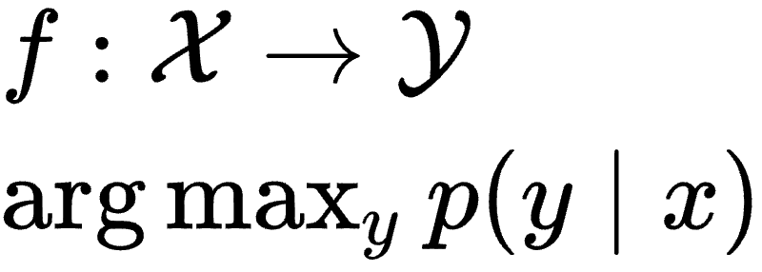
Supervised learning - reminder
Input: training set
Output: probabilistic model
Notes:
Before we talk about how we compute or obtain word vectors from data, a quick reminder

Slide 18
Self-Supervised Learning
Collect unlabeled data
Create synthetic “proxy” task (potentially useless on its own)
Hope it spurs the model to learn something useful from the data
Advantage: no manual labeling needed

Slide 19
Self-Supervised Learning
Collect unlabeled data
Create synthetic “proxy” task (potentially useless on its own)
Hope it spurs the model to learn something useful from the data
Advantage: no manual labeling needed
Example: masking
The fox jumped over the fence
The fox ______ over the fence

Slide 20
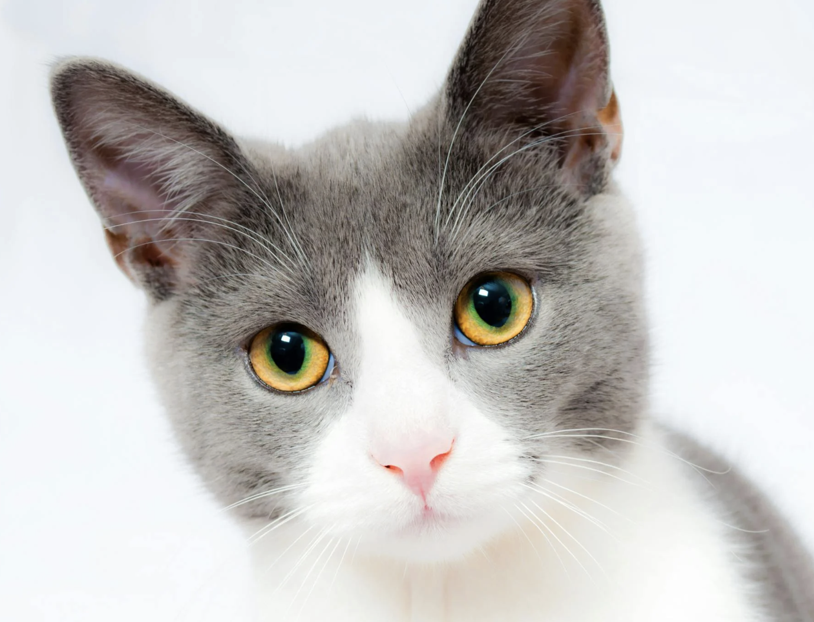
Self-Supervised Learning
Collect unlabeled data
Create synthetic “proxy” task (potentially useless on its own)
Hope it spurs the model to learn something useful from the data
Advantage: no manual labeling needed
Example: masking
The fox jumped over the fence
The fox ______ over the fence

Slide 21
Word2Vec (Skipgram)
TL;DR: predict words from neighboring words
Mikolov et al., 2013

Slide 22
Word2Vec (Skipgram)
“… that bank holds the mortgage on my home…”
TL;DR: predict words from neighboring words
Define self-supervised learning task from raw data:
  Input: “center” word, label: “outside” (context) word
  (x, y) = (bank, that)
  (x, y) = (bank, holds)
  (x, y) = (holds, bank)
  (x, y) = (holds, the)
  (x, y) = (the, holds)
  (x, y) = (the, mortgage)
  (x, y) = (mortgage, the)
  (x, y) = (mortgage, on)
  (x, y) = (on, mortgage),
  (x, y) = (on, my)
  (x, y) = (my, on)
  (x, y) = (my, home)
Mikolov et al., 2013

Slide 23
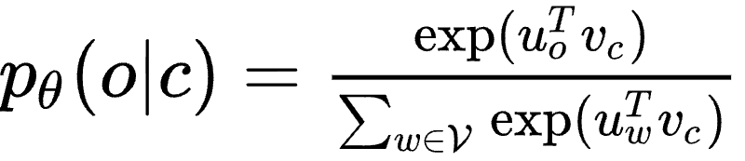


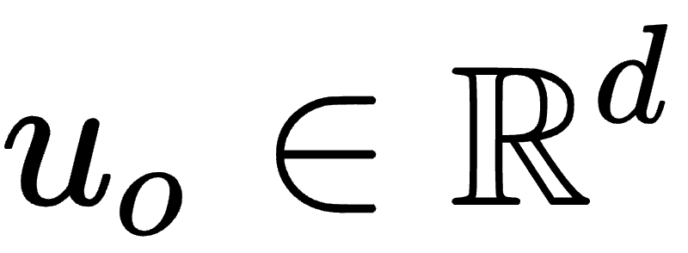
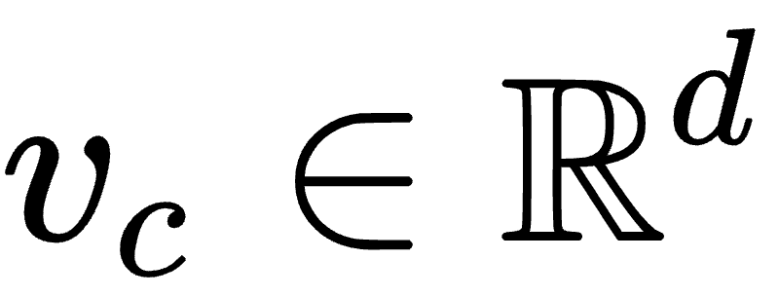
Word2Vec (Skipgram)
TL;DR: predict words from neighboring words
Define self-supervised learning task from raw data:
  Input: “center” word, label: “outside” (context) word
Define model for predicting label from input:
Dot product compares similarity of o and c. Exponent makes everything positive
Example:
p(“holds” | “bank”)
“softmax”
Parameters : (how many?)
Normalize over the entire vocabulary to give a probability distribution
vector for “outside” word(s) (context) o
vector for “center” word c
Mikolov et al., 2013

Slide 24
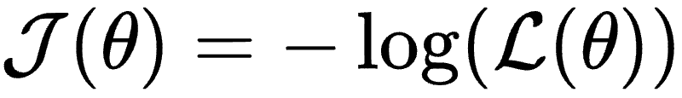

Word2Vec (Skipgram)
TL;DR: predict words from neighboring words
Define self-supervised learning task from raw data:
  Input: “center” word, label: “outside” (context) word
Define model for predicting label from input:
Define objective function for corpus of length T and window m
Objective to maximize:
Loss to minimize:
Negative log-likelihood
Mikolov et al., 2013

Slide 25
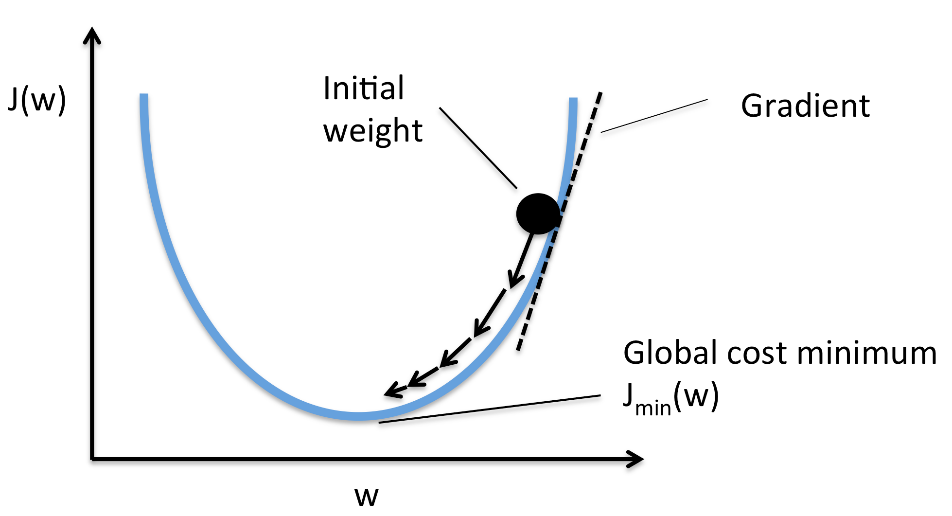
Word2Vec (Skipgram)
TL;DR: predict words from neighboring words
Define self-supervised learning task from raw data:
  Input: “center” word, label: “outside” (context) word
Define model for predicting label from input:
Define objective function for corpus of length T and window m
Optimize with SGD (iteratively adjust the word vectors to minimize NLL)
Mikolov et al., 2013

Slide 26
Skipgram: Neural Network
An equivalent way to look at the word2vec model:
V
U
First linear layer
Softmax activation
Input:
One-hot encoding of center word
Second linear layer
Output:
Vector of outside word probabilities

Slide 27


Skipgram: Neural Network
The columns of V are the center word vectors:
The rows of U are the outside word vectors:
We don’t care about the network’s output, but about its internal representations
An equivalent way to look at the word2vec model:
Our word vectors
V
U
First linear layer
Softmax activation
Input:
One-hot encoding of center word
Second linear layer
Output:
Vector of outside word probabilities

Slide 28
Skipgram: Visual Demo
https://talwagner.github.io/teaching/word2vec.html
Notes:
K is often 10
The unigram thing is to remove some of the weight from the very common words. Can also remove stopwords
Note that increasing k takes a more considerable part of the loss signal, but helps us from overreliance on existence of some “anti words” and make sure the distinction is for EVERY word. Too large of k will slow down the training time.
We usually do sample with stopwords but can choose to remove them

Slide 29
Word2Vec (Skipgram)
TL;DR: predict words from neighboring words
Define self-supervised learning task from raw data:
  Input: “center” word, label: “outside” (context) word
Define model for predicting label from input:
Define objective function for corpus of length T and window m
What probabilities would maximize the objective (minimize the loss)?
Mikolov et al., 2013

Slide 30
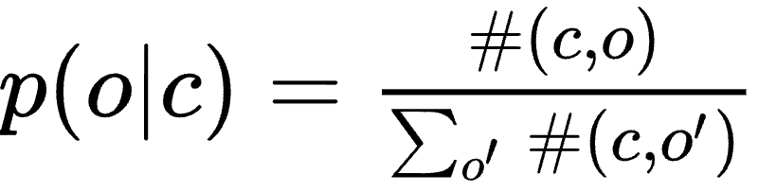
Word2Vec (Skipgram)
TL;DR: predict words from neighboring words
Define self-supervised learning task from raw data:
  Input: “center” word, label: “outside” (context) word
Define model for predicting label from input:
Define objective function for corpus of length T and window m
What probabilities would maximize the objective (minimize the loss)?
The empirical distribution
#(c,o) is the number of co-occurrences of o and c.
Mikolov et al., 2013

Slide 31

Word2Vec (Skipgram)
TL;DR: predict words from neighboring words
Define self-supervised learning task from raw data:
  Input: “center” word, label: “outside” (context) word
Define model for predicting label from input:
Define objective function for corpus of length T and window m
What probabilities would maximize the objective (minimize the loss)?
The empirical distribution
#(c,o) is the number of co-occurrences of o and c.
Why don’t we just choose vectors s.t. = #(c,o) instead of learning?
Mikolov et al., 2013

Slide 32
Word2Vec (Skipgram)
TL;DR: predict words from neighboring words
Define self-supervised learning task from raw data:
  Input: “center” word, label: “outside” (context) word
Define model for predicting label from input:
Define objective function for corpus of length T and window m
What probabilities would maximize the objective (minimize the loss)?
The empirical distribution
#(c,o) is the number of co-occurrences of o and c.
Why don’t we just choose vectors s.t. = #(c,o) instead of learning?
Do such vectors exist? (Hint: the answer is “it depends” - on what?)
Mikolov et al., 2013

Slide 33
Skipgram vs. Co-occurrence Matrix
The NLL loss is minimized when the model probabilities are equal to the empirical probabilities in our corpus:
If the dimension d is equal to the vocabulary size, we can achieve this by simply setting:
  V = log-co-occurrence matrix
  U = unit matrix
Hence:
  Skipgram with d = |Vocab| reduces to co-occurrence matrix
  Skipgram with d << |Vocab| acts as regularization
Notes:
Agenda

Slide 34
Skipgram: Additional Points
What dimension d do we actually choose?
Notes:
Agenda

Slide 35
Skipgram: Additional Points
What dimension d do we actually choose?
Why have two vectors per word, V and U, not just one?
Notes:
Agenda

Slide 36
Skipgram: Additional Points
What dimension d do we actually choose?
Why have two vectors per word, V and U, not just one?
Pr[“gold” | “medal”] vs. Pr[“medal” | “gold”]
Notes:
Agenda

Slide 37
Skipgram with Negative Sampling

Slide 38
Word2Vec (Skipgram)
TL;DR: predict words from neighboring words
Define self-supervised learning task from raw data:
  Input: “center” word, label: “outside” (context) word
Define model for predicting label from input:
Define objective function for corpus of length T and window m
Optimize with SGD (iteratively adjust the word vectors to minimize NLL)
Mikolov et al., 2013

Slide 39
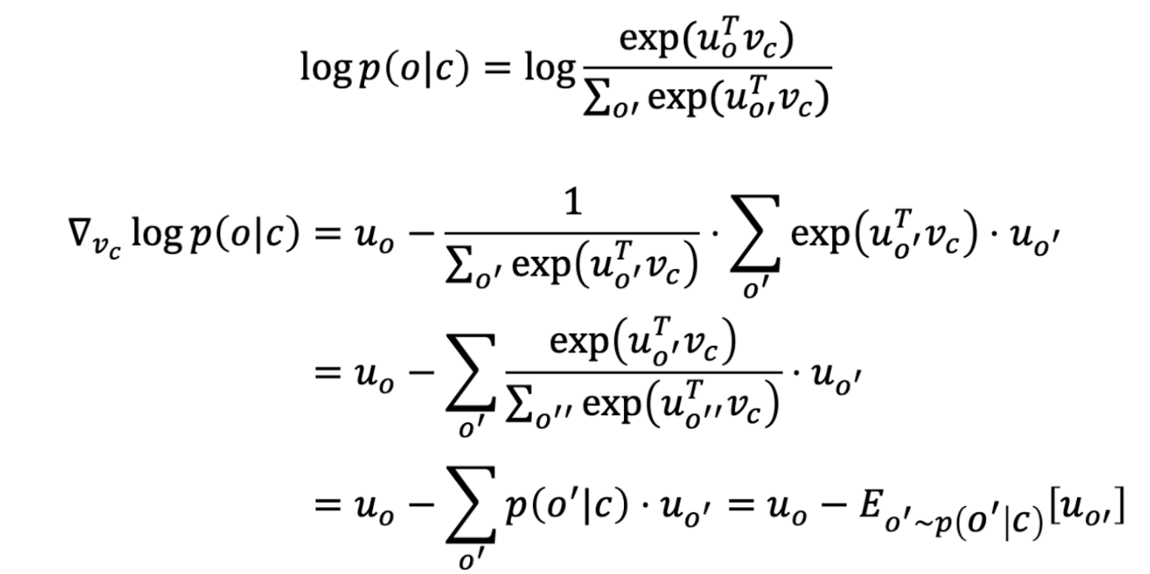
Skipgram: Loss Gradient

Slide 40
Skipgram: Loss Gradient
See an issue here?

Slide 41
Skipgram with negative sampling
Same overall idea as the Skipgram we’ve seen so far, but:
  We change the self-supervised learning task
  And the probabilistic model
  And the objective function
Mikolov et al., 2013
Notes:
Sigmoid – to make it a probability between 0 and 1.
It has this nice property that 1-s(x) equals s(-x).
K is often 10
The unigram thing is to remove some of the weight from the very common words. Can also remove stopwords
Note that increasing k takes a more considerable part of the loss signal, but helps us from overreliance on existence of some “anti words” and make sure th edistiniction is for EVERY word. Too large of k will slow down the training time.
We usually do sample with stopwords but can choose to remove them

Slide 42
Negative Sampling
Binary classification instead of multi-class classification
“… that bank holds the mortgage on my home…”
Mikolov et al., 2013
Notes:
We just know if something should appear together, we don’t update ALL the words that should not appear together

Slide 43
Negative Sampling
Binary classification instead of multi-class classification
“… that bank holds the mortgage on my home…”
  (x, y) = (bank, that)
  (x, y) = (bank, holds)
  (x, y) = (holds, bank)
  (x, y) = (holds, the)
  (x, y) = (the, holds)
  (x, y) = (the, mortgage)
  (x, y) = (mortgage, the)
  …
Mikolov et al., 2013
Notes:
We just know if something should appear together, we don’t update ALL the words that should not appear together

Slide 44
Negative Sampling
Binary classification instead of multi-class classification
“… that bank holds the mortgage on my home…”
  (x, y) = (bank, that)
  (x, y) = (bank, holds)
  (x, y) = (holds, bank)
  (x, y) = (holds, the)
  (x, y) = (the, holds)
  (x, y) = (the, mortgage)
  (x, y) = (mortgage, the)
  …
  (x, y) = ((bank, that), 1)
  (x, y) = (bank, table), 0)
  (x, y) = ((bank, eat), 0)
  (x, y) = ((holds, bank), 1)
  (x, y) = ((holds, quickly), 0)
  (x, y) = ((holds, which), 0)
  …
Mikolov et al., 2013
Notes:
Before we focused on things that appear together, now we also consider pairs that do not appear together. The task is different.
Why we need the zeros? Otherwise the model could just output that all pairs are likely to co-occur.
We just know if something should appear together, we don’t update ALL the words that should not appear together

Slide 45
Skipgram with negative sampling
Intuition: Increase the probability of pairs we saw and decrease the probability for everything else. Why?
Mikolov et al., 2013
Notes:
K is often 10
The unigram thing is to remove some of the weight from the very common words. Can also remove stopwords
Note that increasing k takes a more considerable part of the loss signal, but helps us from overreliance on existence of some “anti words” and make sure the distinction is for EVERY word. Too large of k will slow down the training time.
We usually do sample with stopwords but can choose to remove them

Slide 46
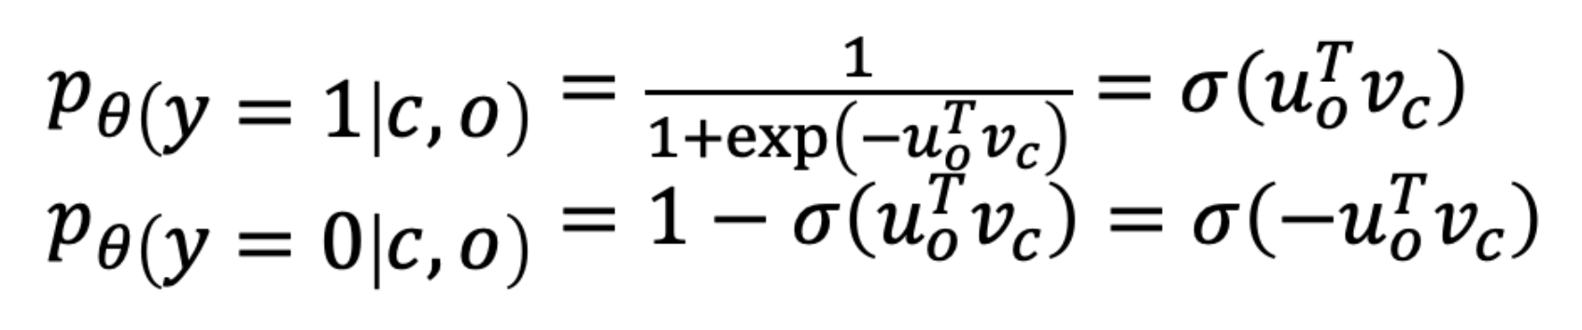
Skipgram with negative sampling
Intuition: Increase the probability of pairs we saw and decrease the probability for everything else. Why?
Mikolov et al., 2013
Notes:
Sigmoid – to make it a probability between 0 and 1.
It has this nice property that 1-s(x) equals s(-x).
K is often 10
The unigram thing is to remove some of the weight from the very common words. Can also remove stopwords
Note that increasing k takes a more considerable part of the loss signal, but helps us from overreliance on existence of some “anti words” and make sure th edistiniction is for EVERY word. Too large of k will slow down the training time.
We usually do sample with stopwords but can choose to remove them

Slide 47
Skipgram with negative sampling
Intuition: Increase the probability of pairs we saw and decrease the probability for everything else. Why?
Skipgram’s model (reminder):
Mikolov et al., 2013
Notes:
K is often 10
The unigram thing is to remove some of the weight from the very common words. Can also remove stopwords
Note that increasing k takes a more considerable part of the loss signal, but helps us from overreliance on existence of some “anti words” and make sure th edistiniction is for EVERY word. Too large of k will slow down the training time.
We usually do sample with stopwords but can choose to remove them

Slide 48
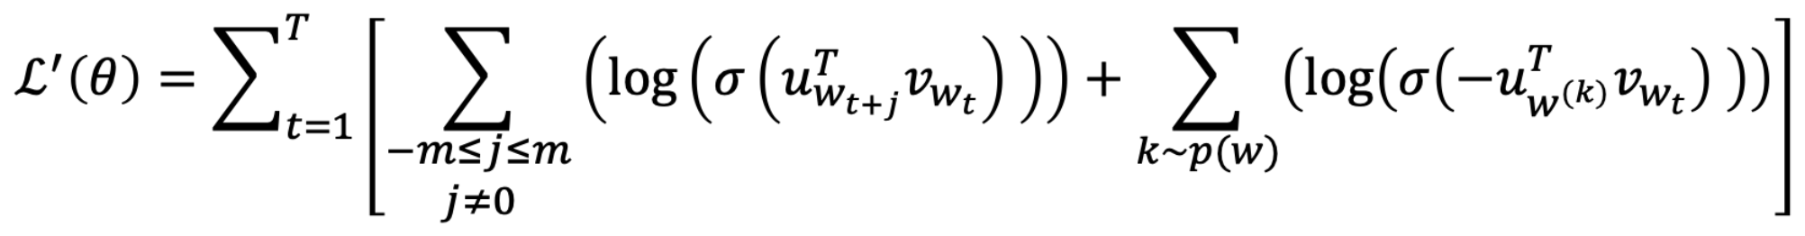
Skipgram with negative sampling
Intuition: Increase the probability of pairs we saw and decrease the probability for everything else. Why?
Skipgram’s model (reminder):
Pairs we saw
(positive samples)
Mikolov et al., 2013
Notes:
K is often 10
The unigram thing is to remove some of the weight from the very common words. Can also remove stopwords
Note that increasing k takes a more considerable part of the loss signal, but helps us from overreliance on existence of some “anti words” and make sure the distinction is for EVERY word. Too large of k will slow down the training time.
We usually do sample with stopwords but can choose to remove them

Slide 49
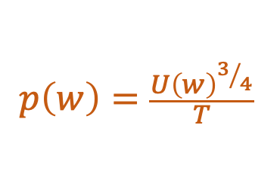
Skipgram with negative sampling
Intuition: Increase the probability of pairs we saw and decrease the probability for everything else. Why?
Skipgram’s model (reminder):
Pairs we saw
(positive samples)
k random words
(negative samples)
Mikolov et al., 2013
Notes:
Sampling random words – we sample k outer words, a simple heuristic, we do it because we don’t know what are negative pairs, most word pairs are not likely to appear together. This is somehow works.
Sampling uniformly could push the model to generally give low probability to rare words – not good.
Samling from unigram distribution – very common words – also not good.
So we push the probability from the common words to spread over the rest of the vocabulary. This works pretty well.
K is often 10
The unigram thing is to remove some of the weight from the very common words. Can also remove stopwords
Note that increasing k takes a more considerable part of the loss signal, but helps us from overreliance on existence of some “anti words” and make sure the distinction is for EVERY word. Too large of k will slow down the training time.
We usually do sample with stopwords but can choose to remove them

Slide 50
Contrastive learning
Skipgram with negative sampling is an instance of contrastive learning
  Data is pairs (x,y) that are similar to each other
  You can assume that random pairs should be dissimilar
Very popular nowadays for representation learning in vision (CLIP) and for information retrieval (DPR)
Notes:
Geometric illustration for intuition – 3 vectors, one for center word, one for positive output word, and another one for negative word.
CLIP – a lot of images and descriptions.

Slide 51
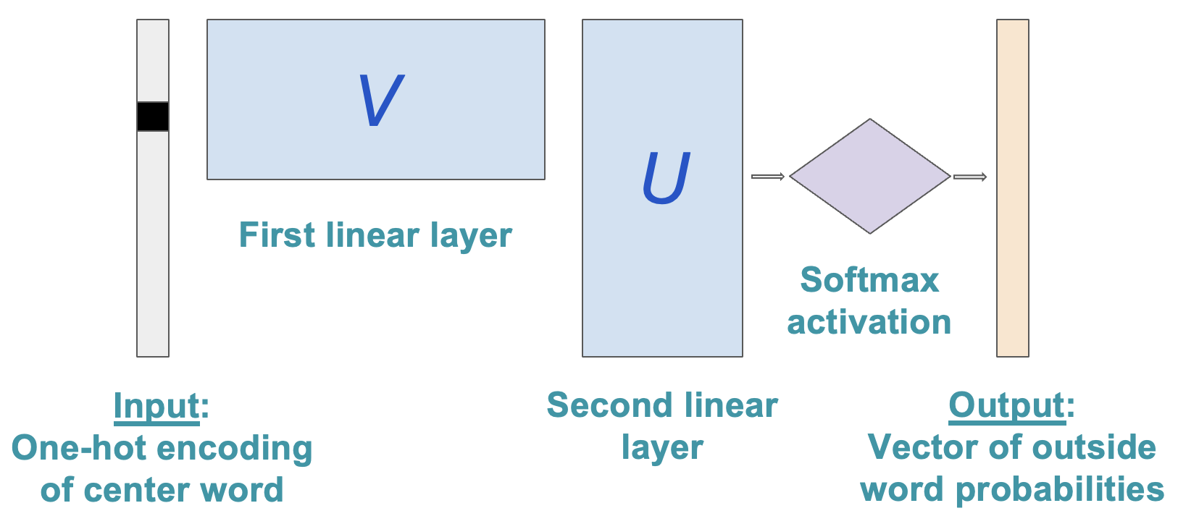
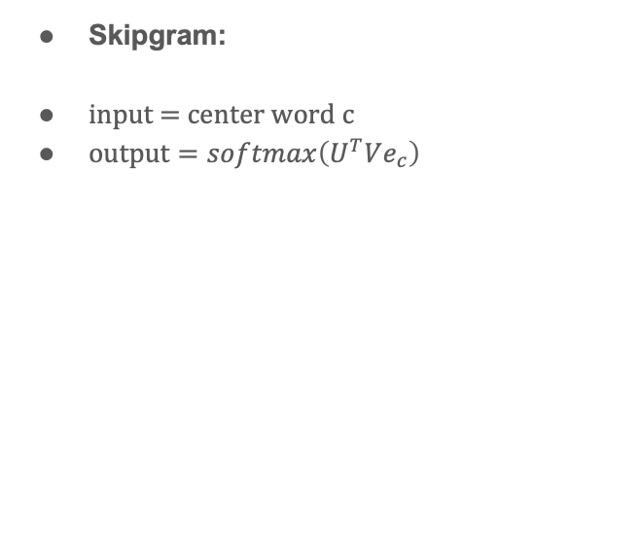
Word2Vec as a Neural Network
Skipgram:
input = center word c
$output=softmax\left(U^{T}Ve_{c}\right)$

Slide 52
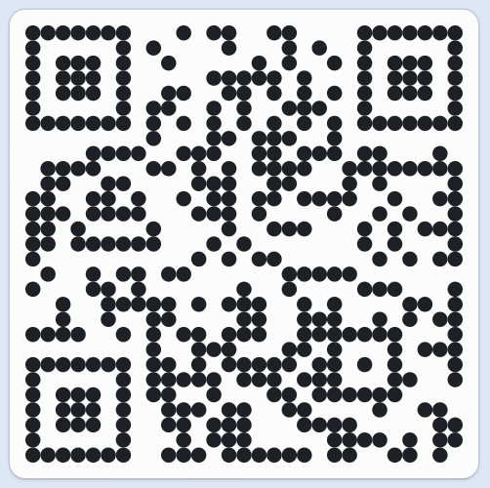
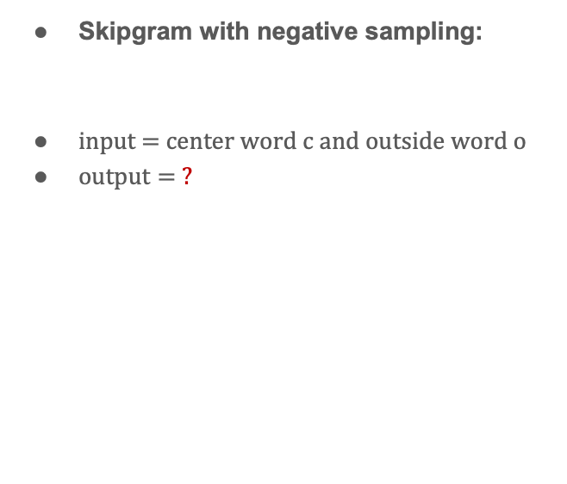
Word2Vec as a Neural Network
Skipgram:
input = center word c
$output=softmax\left(U^{T}Ve_{c}\right)$
Skipgram with negative sampling:
input = center word c and outside word o
$output= ?$
pe.app/talwagner

Slide 53
Word2Vec as a Neural Network
Skipgram:
input = center word c
$output=softmax\left(U^{T}Ve_{c}\right)$
Skipgram with negative sampling:
input = center word c and outside word o
$output= ?$
?

Slide 54
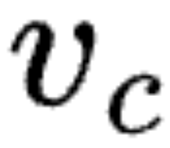
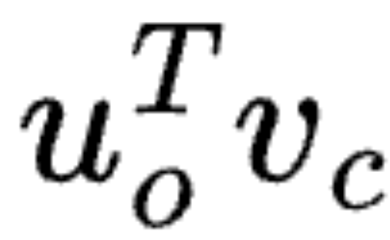
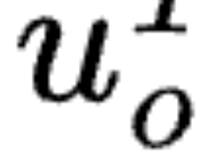

Skipgram with Negative Sampling: Neural Network
$$output=sigmoid\left({\left(Ue_{o}\right)}^{T}\left(Ve_{c}\right)\right)$$
V
Input:
One-hot encoding of center word and outside word pair
linear layer
IP
Output:
Probability of input pair appearing in the same window
Inner product gate
Sigmoid activation
U
linear layer

Slide 55
Word Representation: Key Takeaways
Learning from raw data >> hard-coded human “knowledge”

Slide 56
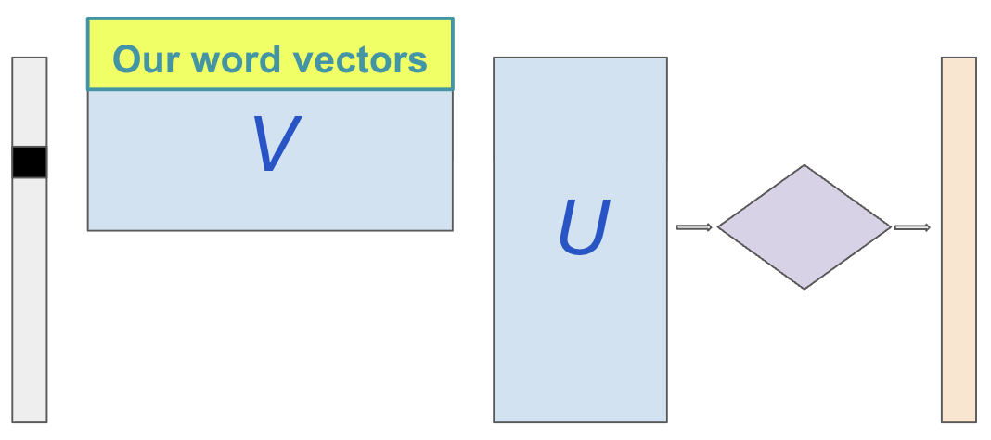
Word Representation: Key Takeaways
Learning from raw data >> hard-coded human “knowledge”
Learning representations with self-supervised learning:
The fox jumped over the fence
The fox ______ over the fence

Slide 57
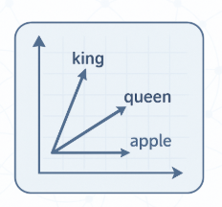
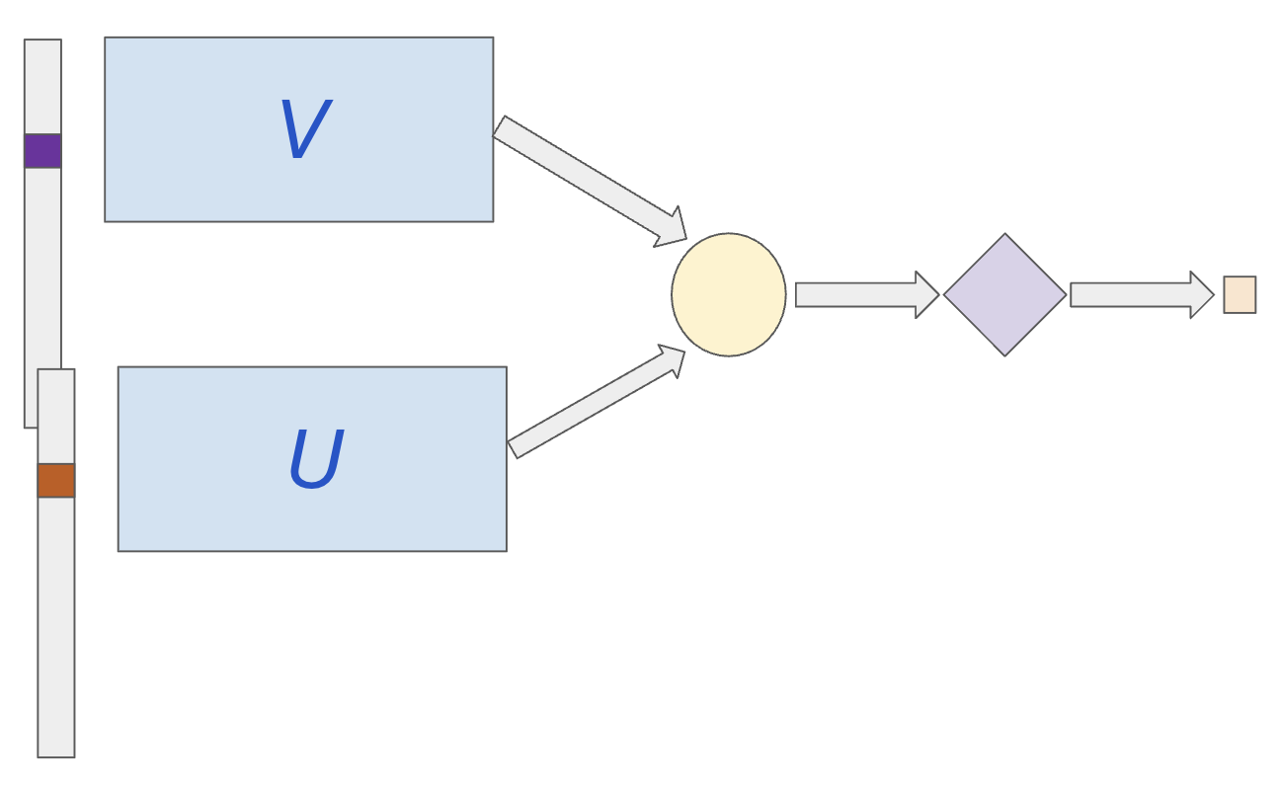
Word Representation: Key Takeaways
Learning from raw data >> hard-coded human “knowledge”
Learning representations with self-supervised learning
Contrastive learning: Learn vector representation from binary examples of close pairs and far pairs
Close examples:
king-queen, car-road, movie-cinema, ...
Far examples:
king-ladybug, car-cabbage, flamenco-snow, …

Slide 58
Relation to matrix factorization

Slide 59
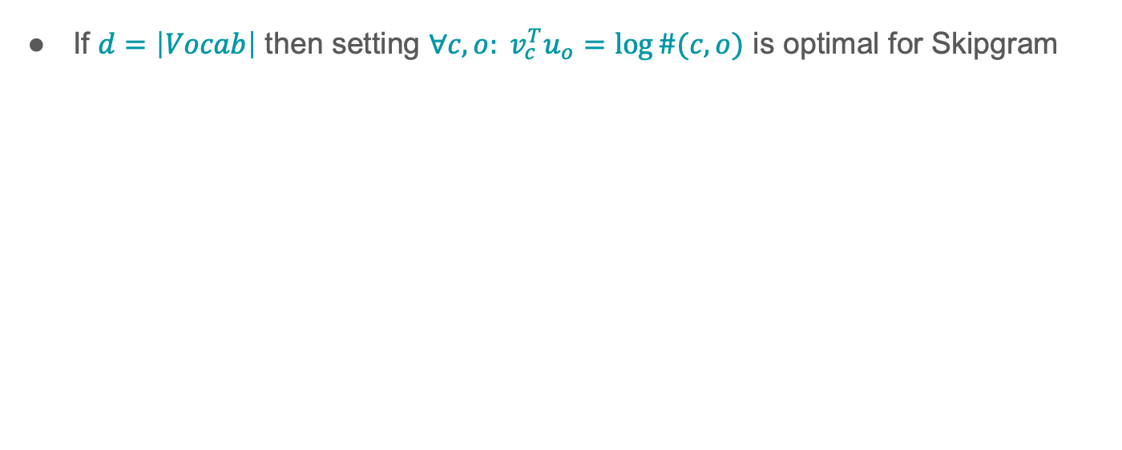
Recall: Skipgram vs. Co-occurrence Matrix
If $d=\left|Vocab\right|$ then setting $∀c,o: v_{c}^{T}u_{o}=\log{\#(c,o)}$ is optimal for Skipgram

Slide 60
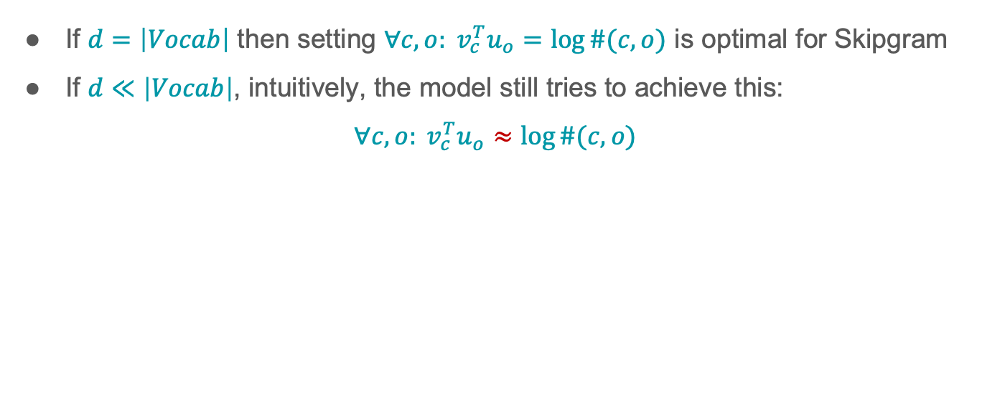
Recall: Skipgram vs. Co-occurrence Matrix
If $d=\left|Vocab\right|$ then setting $∀c,o: v_{c}^{T}u_{o}=\log{\#(c,o)}$ is optimal for Skipgram
If $d≪\left|Vocab\right|$, intuitively, the model still tries to achieve this:
$$∀c,o: v_{c}^{T}u_{o}≈\log{\#(c,o)}$$

Slide 61





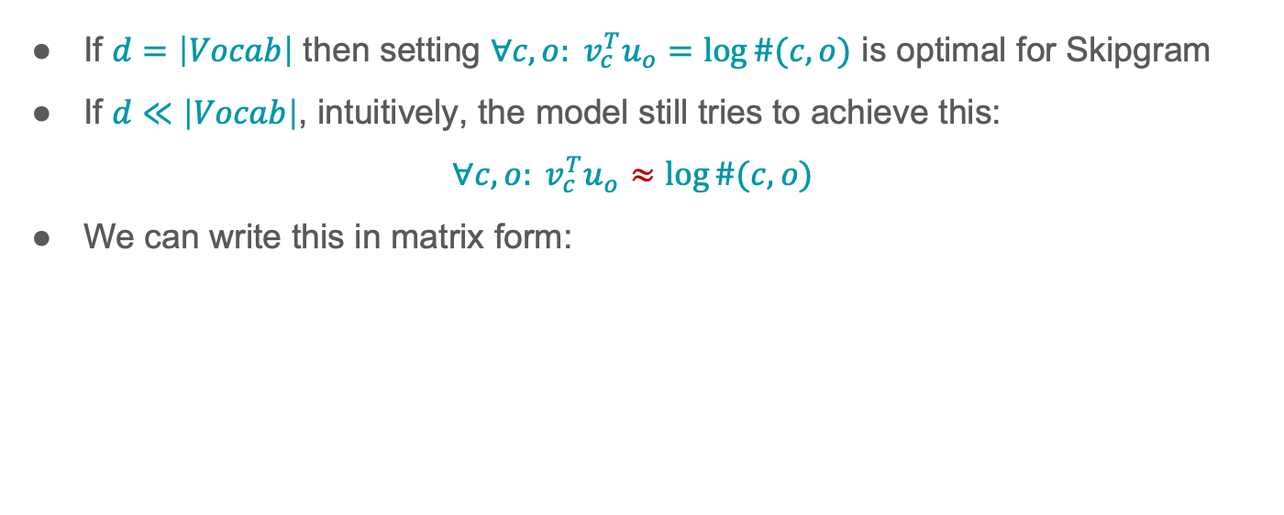

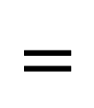






Recall: Skipgram vs. Co-occurrence Matrix
If $d=\left|Vocab\right|$ then setting $∀c,o: v_{c}^{T}u_{o}=\log{\#(c,o)}$ is optimal for Skipgram
If $d≪\left|Vocab\right|$, intuitively, the model still tries to achieve this:
$$∀c,o: v_{c}^{T}u_{o}≈\log{\#(c,o)}$$
We can write this in matrix form:
$$U$$
$$\log{\#(c,o)}$$
$$v_{c}^{T}u_{o}$$
$$v_{c}^{T}$$
$$=$$
$$u_{o}$$
$$≈$$
$$V$$
$$VU$$
$$\left|Vocab\right|×d$$
$$d×\left|Vocab\right|$$
$$\left|Vocab\right|×|Vocab|$$
$$\left|Vocab\right|×|Vocab|$$

Slide 62

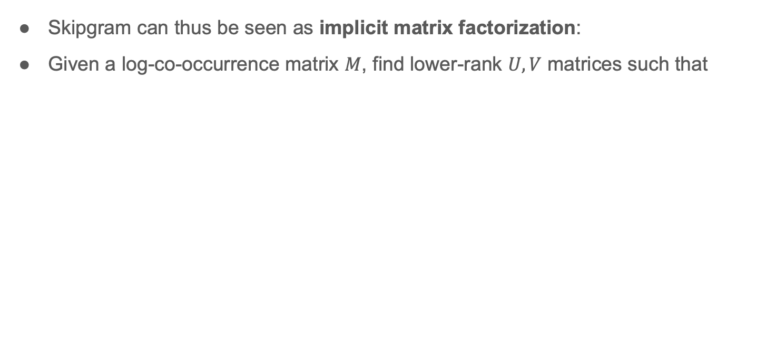



Matrix Factorization
Skipgram can thus be seen as implicit matrix factorization:
Given a log-co-occurrence matrix $M$, find lower-rank $U,V$ matrices such that
$$U$$
$$V$$
$$≈$$
$$M$$

Slide 63
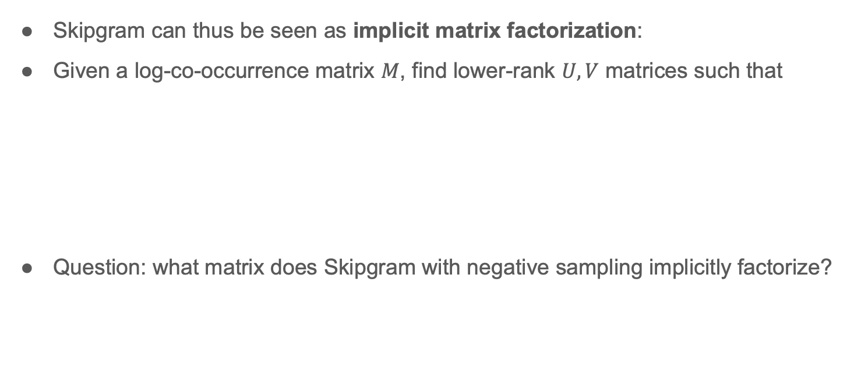
Matrix Factorization
Skipgram can thus be seen as implicit matrix factorization:
Given a log-co-occurrence matrix $M$, find lower-rank $U,V$ matrices such that
Question: what matrix does Skipgram with negative sampling implicitly factorize?
$$U$$
$$V$$
$$≈$$
$$M$$

Slide 64

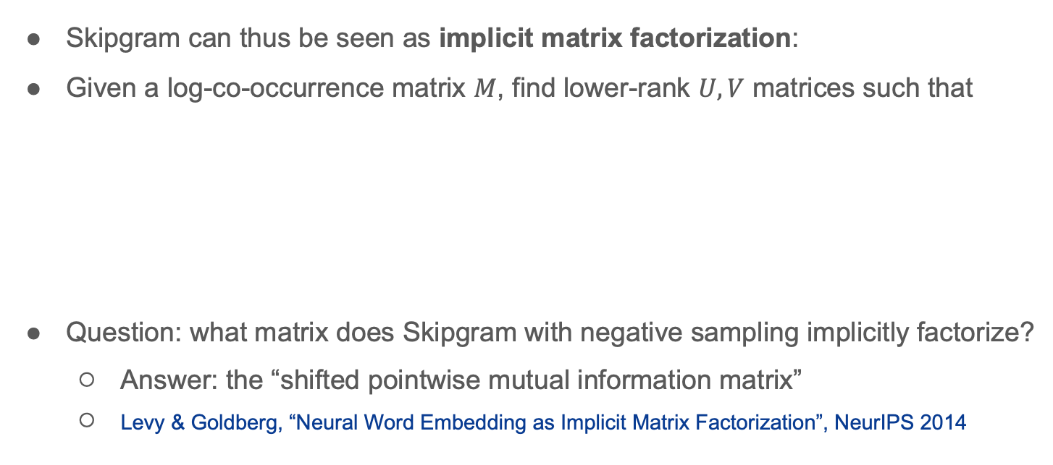
Matrix Factorization
Skipgram can thus be seen as implicit matrix factorization:
Given a log-co-occurrence matrix $M$, find lower-rank $U,V$ matrices such that
Question: what matrix does Skipgram with negative sampling implicitly factorize?
  Answer: the “shifted pointwise mutual information matrix”
  Levy & Goldberg, “Neural Word Embedding as Implicit Matrix Factorization”, NeurIPS 2014
$$U$$
$$V$$
$$≈$$
$$M$$
$$M_{ij}=\log\left(\frac{k⋅\#(c,o)}{\left|D\right|⋅\#c⋅\#o}\right)$$

Slide 65
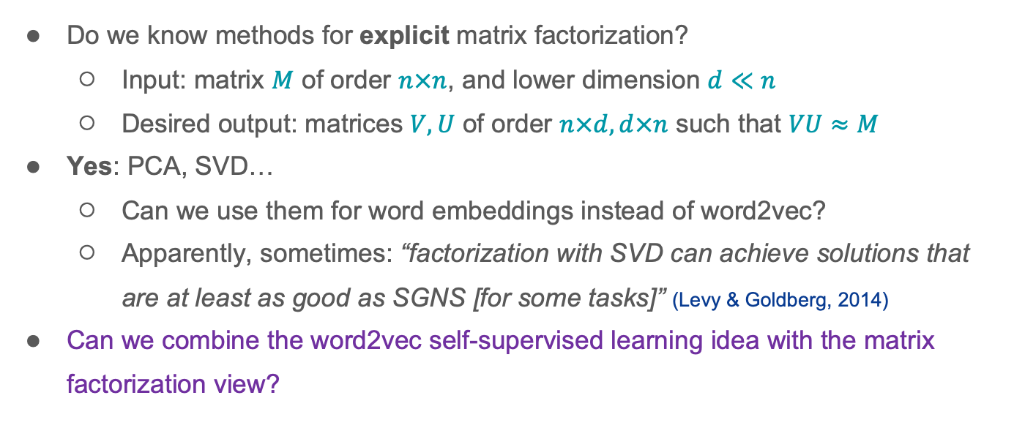




Matrix Factorization
$$U$$
$$≈$$
$$V$$
$$M$$
Do we know methods for explicit matrix factorization?
  Input: matrix $M$ of order $n×n$, and lower dimension $d≪n$
  Desired output: matrices $V,U$ of order $n×d,d×n$ such that $VU≈M$
Yes: PCA, SVD…
  Can we use them for word embeddings instead of word2vec?
  Apparently, sometimes: “factorization with SVD can achieve solutions that are at least as good as SGNS [for some tasks]” (Levy & Goldberg, 2014)
Can we combine the word2vec self-supervised learning idea with the matrix factorization view?

Slide 66
Matrix Factorization
$$U$$
$$≈$$
$$V$$
$$M$$
Do we know methods for explicit matrix factorization?
  Input: matrix $M$ of order $n×n$, and lower dimension $d≪n$
  Desired output: matrices $V,U$ of order $n×d,d×n$ such that $VU≈M$
Yes: PCA, SVD…
  Can we use them for word embeddings instead of word2vec?
  Apparently, sometimes: “factorization with SVD can achieve solutions that are at least as good as SGNS [for some tasks]” (Levy & Goldberg, 2014)
Can we combine the word2vec self-supervised learning idea with the matrix factorization view?

Slide 67
Matrix Factorization
$$U$$
$$≈$$
$$V$$
$$M$$
Do we know methods for explicit matrix factorization?
  Input: matrix $M$ of order $n×n$, and lower dimension $d≪n$
  Desired output: matrices $V,U$ of order $n×d,d×n$ such that $VU≈M$
Yes: PCA, SVD…
  Can we use them for word embeddings instead of word2vec?
  Apparently, sometimes: “factorization with SVD can achieve solutions that are at least as good as SGNS [for some tasks]” (Levy & Goldberg, 2014)
Can we combine the word2vec self-supervised learning idea with the matrix factorization view?

Slide 68
Matrix Factorization
$$U$$
$$≈$$
$$V$$
$$M$$
Do we know methods for explicit matrix factorization?
  Input: matrix $M$ of order $n×n$, and lower dimension $d≪n$
  Desired output: matrices $V,U$ of order $n×d,d×n$ such that $VU≈M$
Yes: PCA, SVD…
  Can we use them for word embeddings instead of word2vec?
  Apparently, sometimes: “factorization with SVD can achieve solutions that are at least as good as SGNS [for some tasks]” (Levy & Goldberg, 2014)
Can we combine the word2vec self-supervised learning idea with the matrix factorization view?

Slide 69
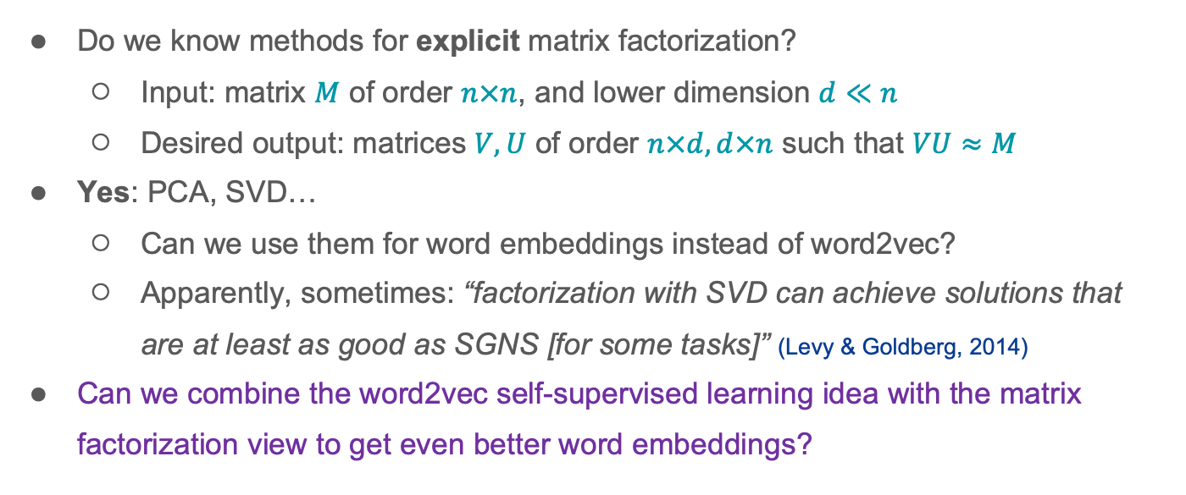
Matrix Factorization
$$U$$
$$≈$$
$$V$$
$$M$$
Do we know methods for explicit matrix factorization?
  Input: matrix $M$ of order $n×n$, and lower dimension $d≪n$
  Desired output: matrices $V,U$ of order $n×d,d×n$ such that $VU≈M$
Yes: PCA, SVD…
  Can we use them for word embeddings instead of word2vec?
  Apparently, sometimes: “factorization with SVD can achieve solutions that are at least as good as SGNS [for some tasks]” (Levy & Goldberg, 2014)
Can we combine the word2vec self-supervised learning idea with the matrix factorization view to get even better word embeddings?

Slide 70
GloVe Word Embeddings [Pennington, Socher, Manning 2014]
Combines ideas from word2vec and matrix factorization

Slide 71
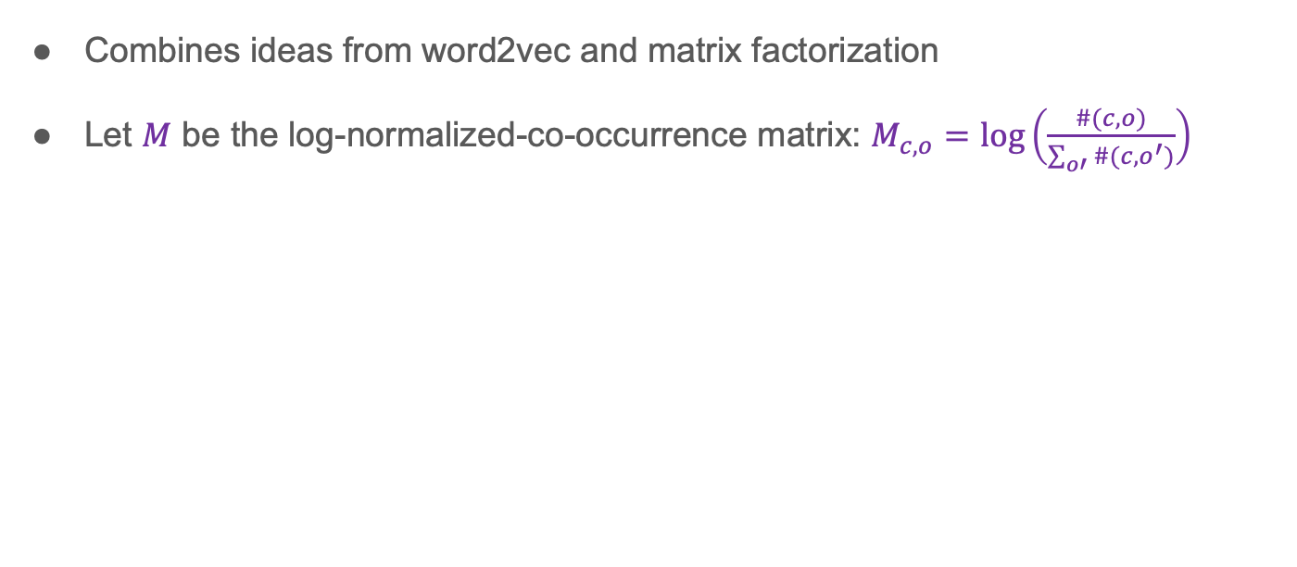
GloVe Word Embeddings [Pennington, Socher, Manning 2014]
Combines ideas from word2vec and matrix factorization
Let $M$ be the log-normalized-co-occurrence matrix: $M_{c,o}=\log\left(\frac{\#(c,o)}{\sum_{o′}{\#(c,o^{′})}}\right)$

Slide 72
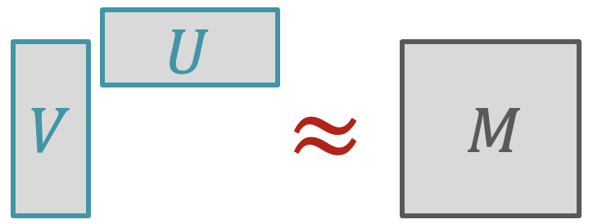
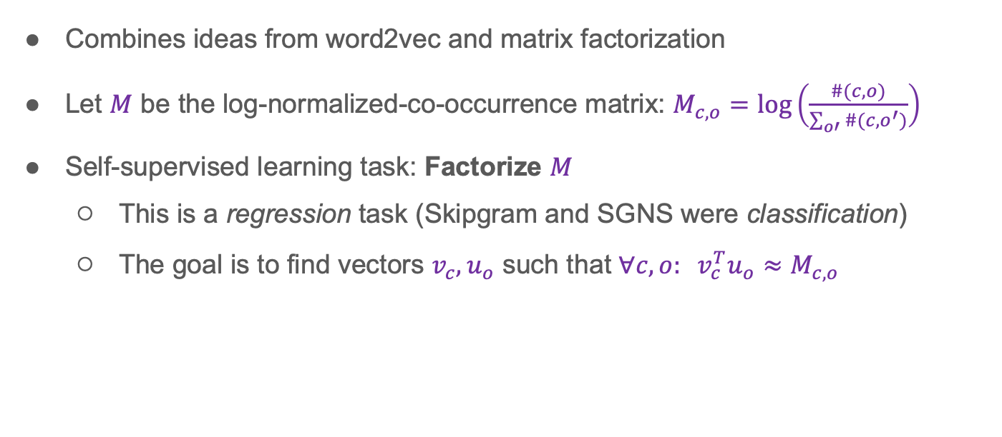
GloVe Word Embeddings [Pennington, Socher, Manning 2014]
Combines ideas from word2vec and matrix factorization
Let $M$ be the log-normalized-co-occurrence matrix: $M_{c,o}=\log\left(\frac{\#(c,o)}{\sum_{o′}{\#(c,o^{′})}}\right)$
Self-supervised learning task: Factorize $M$
  This is a regression task (Skipgram and SGNS were classification)
  The goal is to find vectors $v_{c},u_{o}$ such that $∀c,o: v_{c}^{T}u_{o}≈M_{c,o}$

Slide 73
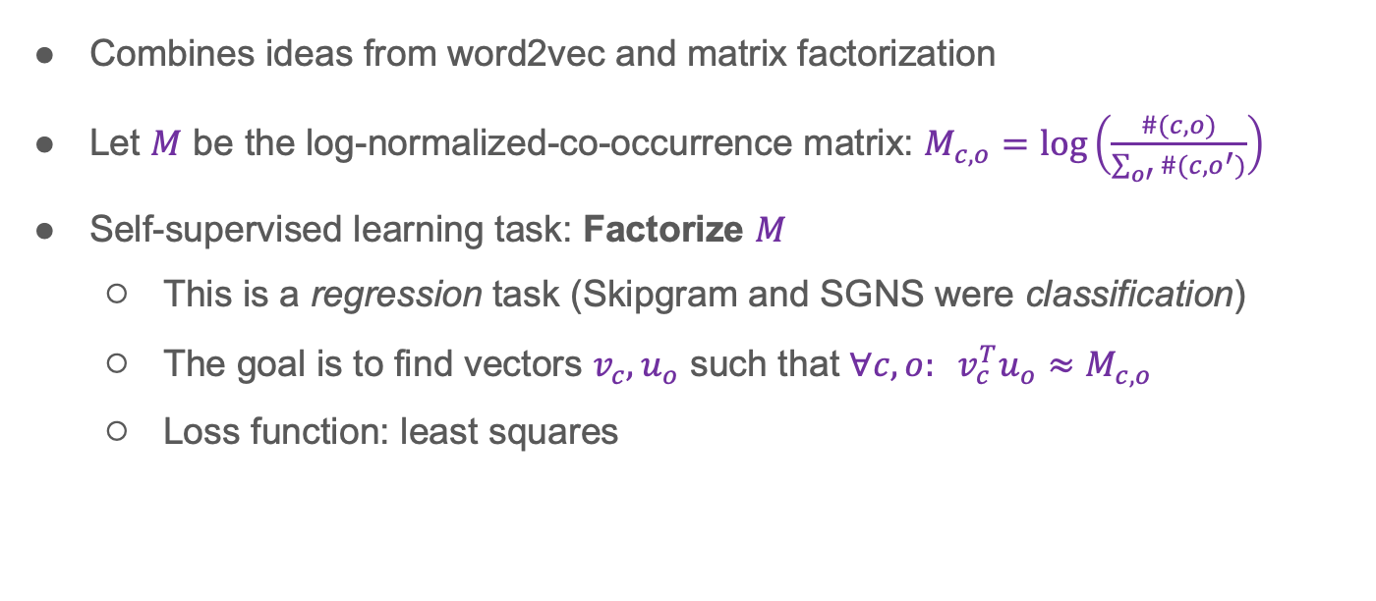
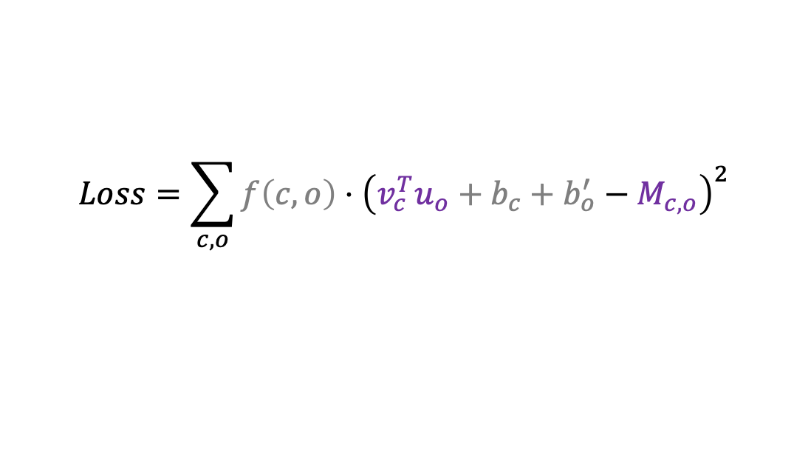
GloVe Word Embeddings [Pennington, Socher, Manning 2014]
Combines ideas from word2vec and matrix factorization
Let $M$ be the log-normalized-co-occurrence matrix: $M_{c,o}=\log\left(\frac{\#(c,o)}{\sum_{o′}{\#(c,o^{′})}}\right)$
Self-supervised learning task: Factorize $M$
  This is a regression task (Skipgram and SGNS were classification)
  The goal is to find vectors $v_{c},u_{o}$ such that $∀c,o: v_{c}^{T}u_{o}≈M_{c,o}$
  Loss function: least squares
  $$Loss=\sum_{c,o}{f\left(c,o\right)⋅{\left(v_{c}^{T}u_{o}+b_{c}+b_{o}^{′}−M_{c,o}\right)}^{2}}$$
(weight)
(auxiliary parameters)

Slide 74
Evaluating word embeddings

Slide 75
Evaluation
How do we evaluate if our word representations are any good?
Which are better than others:
Notes:
How to evaluate word embeddings? We take a leap of faith that the dot product between two word embeddings represent the similarity between these words.
Extrinsic evaluation example – go back to the toy example of sentiment classification. Sign(w*e). Extrinsic evaluation evaluates the component we trained as part of a larger system. If it doesn’t work it may be hard to say where the issue comes from. In the case of sentiment analysis – is it the pooling? Is it the training of w? Is it the embeddings?
But extrinsic evaluation is typically the thing we actually care about.

Slide 76
Evaluation
How do we evaluate if our word representations are any good?
Which are better than others:
Intrinsic: deﬁne some artiﬁcial task that tries to directly measure the quality of your learning algorithm.
Extrinsic: check whether your output is useful in a real NLP task.
Notes:
How to evaluate word embeddings? We take a leap of faith that the dot product between two word embeddings represent the similarity between these words.
Extrinsic evaluation example – go back to the toy example of sentiment classification. Sign(w*e). Extrinsic evaluation evaluates the component we trained as part of a larger system. If it doesn’t work it may be hard to say where the issue comes from. In the case of sentiment analysis – is it the pooling? Is it the training of w? Is it the embeddings?
But extrinsic evaluation is typically the thing we actually care about.

Slide 77
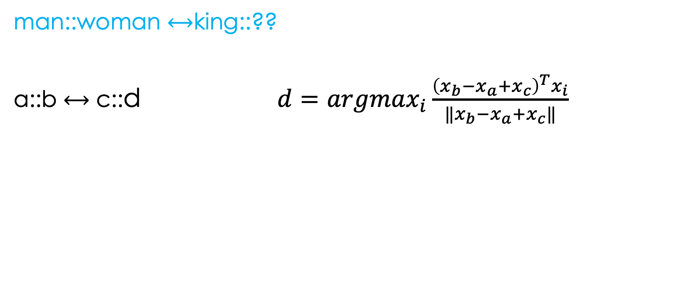
Intrinsic evaluation – word analogies
Normalize all word vectors to 1. Why?
Notes:
Solving this tells us that useful information is captured in the representations we learned.
Normalization to 1 makes dot product and cosine similarity the same, we care mostly about the relations here.
https://stats.stackexchange.com/questions/177905/should-i-normalize-word2vecs-word-vectors-before-using-them

Slide 78
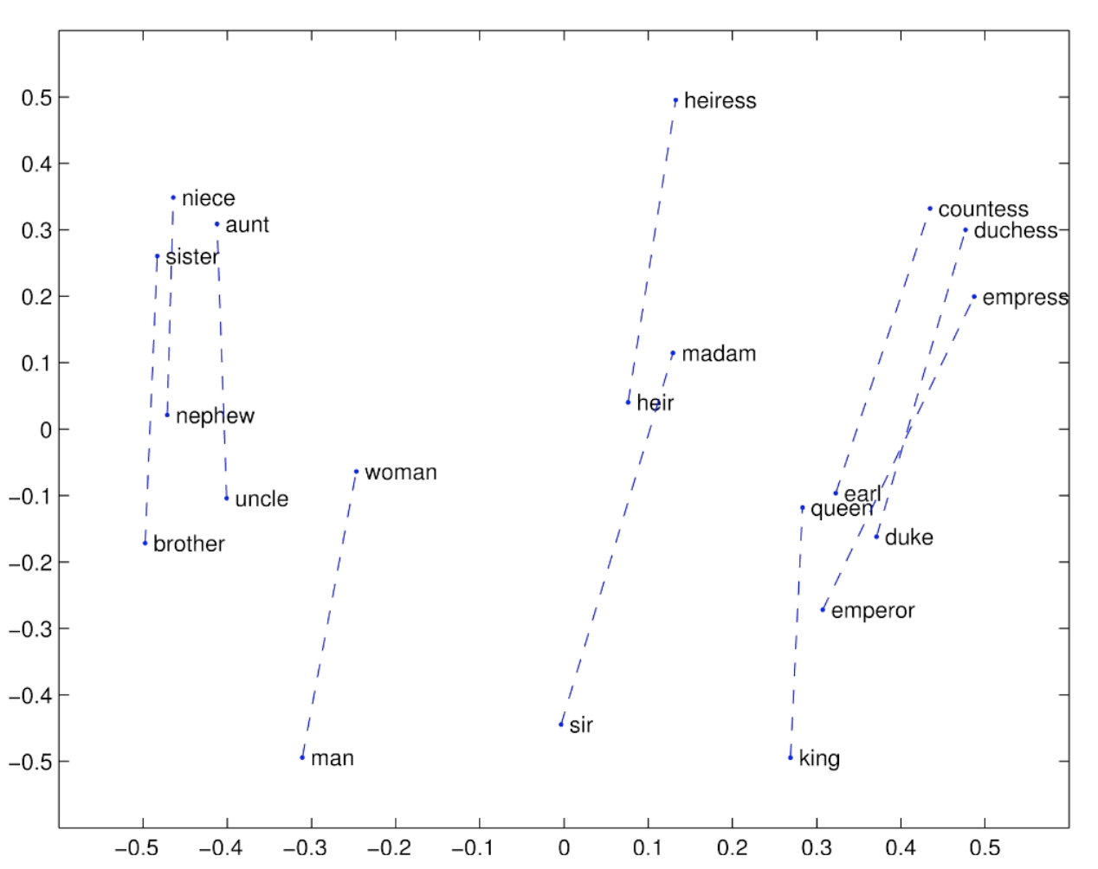
Notes:
Linear relation
masculinity/feminine

Slide 79
Notes:
Linear relation
masculinity/feminine

Slide 80
- man
Notes:
Linear relation
masculinity/feminine

Slide 81
- man
uncle - man
Notes:
Linear relation
masculinity/feminine

Slide 82
- man
uncle – man + woman
uncle - man
Notes:
Linear relation
masculinity/feminine

Slide 83
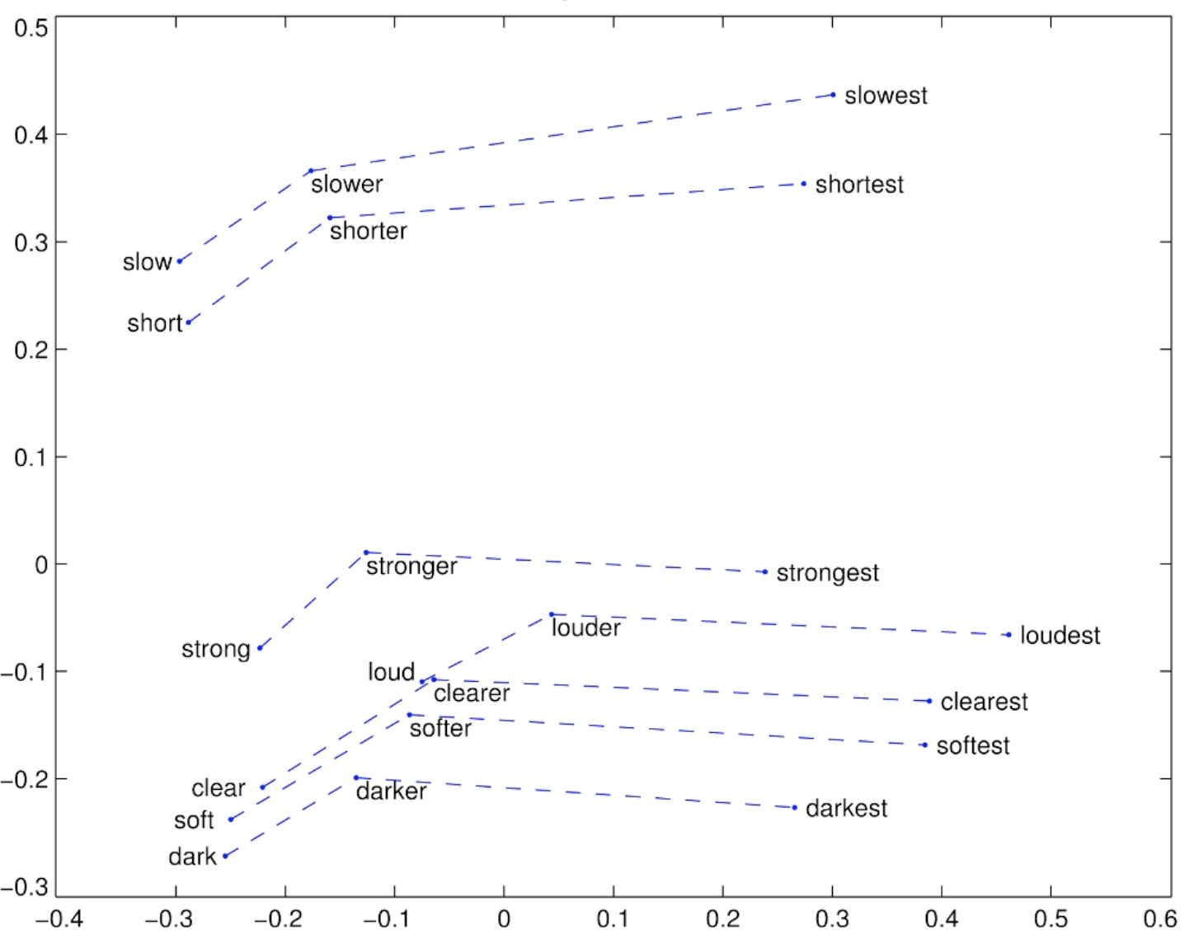
Notes:
Adjective, comparative and superlative forms

Slide 84
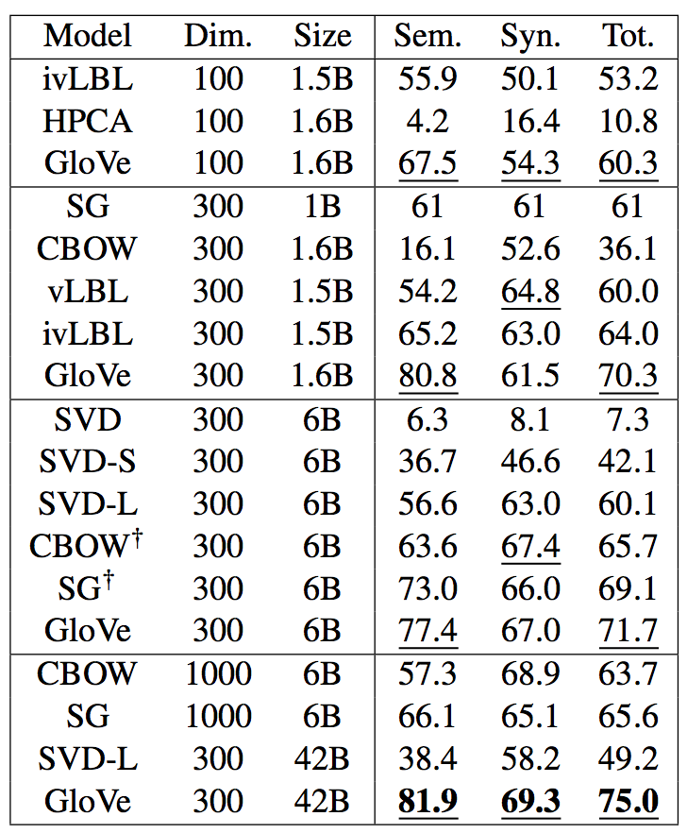
Word analogies evaluation
Pennington et al., 2014
Notes:
Results on a benchmark for word analogies. 500 different pairs?
Each row is a method to get word representations
Size of the corpus – how many words we trained on
Semantic meaning: men→women as king→queen
Syntactic meaning: the noun version of a verb
Tot. → average?

Slide 85
Human correlation intrinsic evaluation
word 1 | word 2 | human judgement
tiger | cat | 7.35
book | paper | 7.46
computer | internet | 7.58
plane | car | 5.77
stock | phone | 1.62
stock | CD | 1.31
stock | jaguar | 0.92
Notes:
Words similarity benchmark
How similar the two words are in a range of 1-10.
Expensive and subjective.

Slide 86
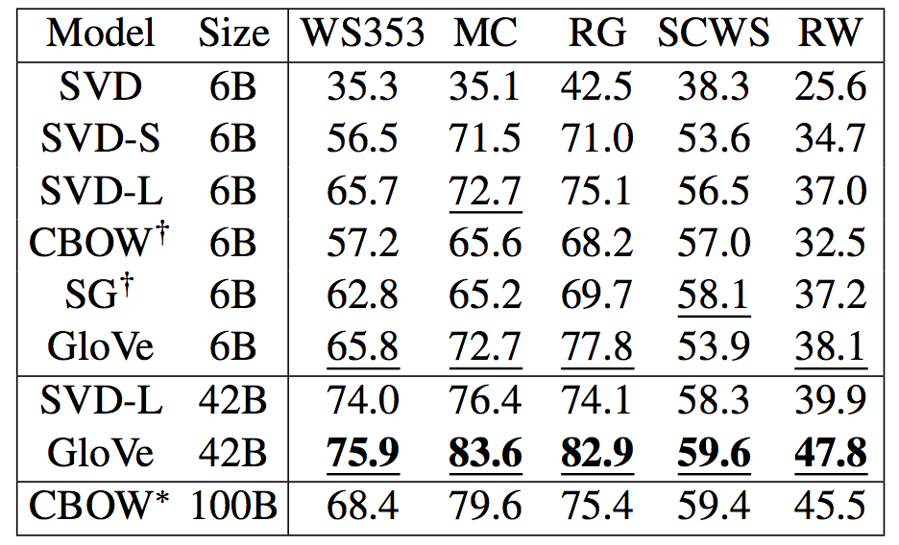
Human correlation intrinsic evaluation
Pennington et al., 2014
Notes:
Differences are big

Slide 87
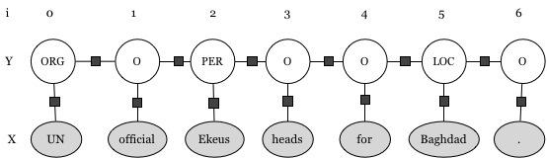
Extrinsic evaluation
Named entity recognition: find mentions of person, location, organization in text.

Slide 88

Extrinsic evaluation
Notes:
Differences here are actually small
We have here the one-hot vectors as well

Slide 89
Word Representations: Summary
Vector representations for words are useful and efficient
  Encode semantic similarity as inner product similarity
One-hot vectors: useful in some contexts but not all
Word2vec: learn representations from data with machine learning
  Idea: self-supervised learning for learning from a lot of raw data
  Idea: contrastive learning for improved efficiency with negative sampling
  Idea: can be viewed as implicit matrix factorization
GloVe: combine self-supervised learning view with matrix factorization view
Evaluating word representations: intrinsic, extrinsic; challenging and open-ended

Slide 90
Language Modeling

Slide 91





Motivation:
You Might Have Heard about Language Models

Slide 92
Language modeling
A language model is a probability distribution over sentences
LM
Some sentence S
Pr[S]
Notes:
Chinese room experiment
Why useful – compare two texts
Can be used for generating text
Find mistakes in text

Slide 93

Language modeling
A language model is a probability distribution over sentences
LM
Some sentence S
Pr[S]
Notes:
Chinese room experiment
Why useful – compare two texts
Can be used for generating text
Find mistakes in text

Slide 94


Applications
A language model defines a probability distribution over sentences
Comparing likelihood: Pr(“high winds”) > Pr(“large winds”)

Slide 95


Applications
A language model defines a probability distribution over sentences
Comparing likelihood: Pr(“high winds”) > Pr(“large winds”)
Next word prediction

Slide 96
Applications
A language model defines a probability distribution over sentences
Comparing likelihood: Pr(“high winds”) > Pr(“large winds”)
Next word prediction
Classification/question answering as language modeling
General good representations for any NLP task (ELMo, BERT)
Many more…
Notes:
Taking sound waves and converting them to text is hard.
Base theorem and do the opposite is easier – compute the probability of speech given text times probability of text.
Ambiguity problem (a computer that understands you like your mother, “like your” vs. “lie cure”) – the internal language model we have helps us disambiguate speech

Slide 97
Philosophical
Does defining a probability distribution over sentences == understanding?
A model that is good at predicting the next word, must know something about language and the world (what?)
Notes:
Why does it work? What is it in next word prediction that encapsulates so much knowledge about language? Does knowing the probability of a sentence means understanding the meaning of language?
To succeed at this task, we need to know a lot of things.
Turing test does not tell us whether the computer understands or whether it can think or has a soul, it just tells us whether we can tell the difference. If we can’t then does it really matter?
The Chinese Room thought experiment is a famous argument against the idea that a computer or any other symbol-manipulating system can have a "mind" or "understanding" equivalent to that of a human being.
In this thought experiment, a person who does not understand Chinese (the "man in the room") is given a set of instructions in English that enable them to manipulate Chinese characters in response to Chinese questions. Despite the fact that the person in the room does not understand Chinese, they are able to produce seemingly intelligent responses that fool a Chinese speaker into believing that there is someone in the room who understands Chinese. The argument suggests that a computer, like the person in the room, may be able to manipulate symbols in a sophisticated manner without truly understanding their meaning.
John Searle 1980

Slide 98


Slide 99

Philosophical
Does defining a probability distribution over sentences == understanding?
A model that is good at predicting the next word, must know something about language and the world (what?)
An old debate
  Turing test
  The Chinese room argument
Notes:
Turing test does not tell us whether the computer understands or whether it can think or has a soul, it just tells us whether we can tell the difference. If we can’t then does it really matter?
The Chinese Room thought experiment is a famous argument against the idea that a computer or any other symbol-manipulating system can have a "mind" or "understanding" equivalent to that of a human being.
In this thought experiment, a person who does not understand Chinese (the "man in the room") is given a set of instructions in English that enable them to manipulate Chinese characters in response to Chinese questions. Despite the fact that the person in the room does not understand Chinese, they are able to produce seemingly intelligent responses that fool a Chinese speaker into believing that there is someone in the room who understands Chinese. The argument suggests that a computer, like the person in the room, may be able to manipulate symbols in a sophisticated manner without truly understanding their meaning.
John Searle 1980

Slide 100

“Social Turing Test”: 2M Conversation (AI21Labs, 2023)
68% guessed correctly
https://www.ai21.com/blog/human-or-not-results
Notes:
Can handle a conversation – AI21 experiment
: After a 2-minute interaction with a LM like ChatGPT, users guess if they talked to a bot or a human.

Slide 101


The Chinese Room Argument (Searle, 1980)
By FranksValli, Wikimedia Commons

Slide 102
Plan
Motivation
Problem deﬁnition
N-gram models
Evaluation
Estimation
  Interpolation
Neural language models
Notes:
We will move to talk about another self-supervised task, that at least initially was not super interesting by itself but somehow it became a very influential technology.

Slide 103


Problem definition
Given a finite vocabulary
Define the infinite language
the STOP
a STOP
the man STOP
man man man a telescope STOP
Notes:
Computational methods
We don’t want zero probabilities, why? What would happen if we assign a zero probability? Because here we can write it, it is possible… The fact that every sequence of words can be said means that it has a non-zero probability.

Slide 104

Problem definition
Given a finite vocabulary
Define the infinite language
Input: a training set of example sentences (billions)
Output: a probability distribution p over L
Notes:
Not clear what is high probability, think about how many sentences we have…
What is the size of L? Infinite
For sentences of exactly 100 words each, how many sentences will we have? 100^100 very large, most probabilities are very low

Slide 105
A naïve method
Assume we have N training sentences
Notes:
Also, No use of similar sentences
Empirical distribution

Slide 106


A naïve method
Assume we have N training sentences
Let be a sentence, and be the number of times it appeared in the training data.
Notes:
Also, No use of similar sentences
Empirical distribution

Slide 107

A naïve method
Assume we have N training sentences
Let be a sentence, and be the number of times it appeared in the training data.
Define a language model:
Would that work?
Notes:
Also, No use of similar sentences
Empirical distribution

Slide 108

A naïve method
Assume we have N training sentences
Let be a sentence, and be the number of times it appeared in the training data.
Define a language model:
Would that work?
No generalization!
Zero almost everywhere ( sequences)
Notes:
Sparsity, 0s everywhere
Also, no use of similar sentences

Slide 109
Plan
Motivation
Problem deﬁnition
N-gram models
Evaluation
Estimation
  Interpolation
Neural language models

Slide 110
Reminder: N-grams
N-gram: sequence of N consecutive words in a text
Text: “natural language processing is a crucial part of artificial intelligence”
  Unigrams: natural, language, processing, is, a, …
  Bigrams: natural language, language processing, processing is, …
  Trigrams: natural language processing, language processing is, …
  Quadrigrams: natural language processing is, …

Slide 111
Berkeley restaurant project sentences
can you tell me about any good cantonese restaurants close by
mid priced that food is what i’m looking for
tell me about chez pansies
can you give me a listing of the kinds of food that are available
i’m looking for a good place to eat breakfast
when is caffe venezia open during the day
…
Notes:
How many bigrams? |V|^2
Food orderings in Silicon Valley.

Slide 112

Bigram counts
Notes:
Why we have “i i”
Transcripts, models should handle such cases

Slide 113
Bigram counts
Note: This is not the quite co-occurrence matrix we used for word representations – what’s the difference?
Notes:
Why we have “i i”
Transcripts, models should handle such cases

Slide 114

Bigram probabilities

Slide 115
What do we learn from bigrams?
Pr(to | want) = 0.66: English behaves in a certain way
Pr(eat | to) = 0.28: English behaves in a certain way
Pr(English | want) < Pr(Chinese | want): What do we learn?
Notes:
He went to vs He wants to
Not enough but it capture some information about English and a signal
Seeing one word can reduce the uncertainty about the next word dramatically.

Slide 116
What do we learn from bigrams?
Pr(to | want) = 0.66: English behaves in a certain way
Pr(eat | to) = 0.28: English behaves in a certain way
Pr(English | want) < Pr(Chinese | want): What do we learn?
Conclusion: Even bigrams can tell us a lot
But not enough… what about trigrams, etc?
Notes:
He went to vs He wants to
Not enough but it capture some information about English and a signal
Seeing one word can reduce the uncertainty about the next word dramatically.

Slide 117
N-gram Language Models
N-grams seem to encompass a lot of information about language
Let’s use them to build N-gram based language models
Mathematical basis: Markov processes

Slide 118
Markov processes
Notes:
Formalize it
Can be decomposed in other orders (first the last word, etc)
In English we write and speak from left to right
Conditioning on multiple previous words could be complex so this is why we need to markov assumption.
First order – bigrams.
For some problems this is enough, for example chess. What about language? It often doesn’t make sense.

Slide 119

Markov processes
Given a sequence of $n=100$random variables $X_{i}∈𝒱$ use the chain rule:
Notes:
Formalize it
Can be decomposed in other orders (first the last word, etc)
In English we write and speak from left to right
Conditioning on multiple previous words could be complex so this is why we need to markov assumption.
First order – bigrams.
For some problems this is enough, for example chess. What about language? It often doesn’t make sense.

Slide 120
Markov processes
Given a sequence of $n=100$random variables $X_{i}∈𝒱$ use the chain rule:
Markov assumption (first order):
Notes:
Formalize it
Can be decomposed in other orders (first the last word, etc)
In English we write and speak from left to right
Conditioning on multiple previous words could be complex so this is why we need to markov assumption.
First order – bigrams.
For some problems this is enough, for example chess. What about language? It often doesn’t make sense.

Slide 121
Markov processes
Given a sequence of $n=100$random variables $X_{i}∈𝒱$ use the chain rule:
Markov assumption (first order):
Markov assumption (second order):
Notes:
Formalize it
Can be decomposed in other orders (first the last word, etc)
In English we write and speak from left to right
Conditioning on multiple previous words could be complex so this is why we need to markov assumption.
First order – bigrams.
For some problems this is enough, for example chess. What about language? It often doesn’t make sense.

Slide 122
Markov processes
Given a sequence of $n=100$random variables $X_{i}∈𝒱$ use the chain rule:
(Word on probabilistic modeling)
Markov assumption (first order):
Markov assumption (second order):
Notes:
Formalize it
Can be decomposed in other orders (first the last word, etc)
In English we write and speak from left to right
Conditioning on multiple previous words could be complex so this is why we need to markov assumption.
First order – bigrams.
For some problems this is enough, for example chess. What about language? It often doesn’t make sense.

Slide 123

Second-order Markov processes
Given a sequence of $n=100$random variables $X_{i}∈𝒱$ use the chain rule:
Equality holds under second-order Markov assumption
For notational convenience, define:
Now we can write:
Notes:
Formalize it
Can be decomposed in other orders (first the last word, etc)
In English we write and speak from left to right
Conditioning on multiple previous words could be complex so this is why we need to markov assumption.
First order – bigrams.
For some problems this is enough, for example chess. What about language? It often doesn’t make sense.

Slide 124
Second-order Markov processes
Given a sequence of $n=100$random variables $X_{i}∈𝒱$ use the chain rule:
Equality holds under second-order Markov assumption
For notational convenience, define:
Now we can write:
Is it a reasonable assumption?
Notes:
Formalize it
Can be decomposed in other orders (first the last word, etc)
In English we write and speak from left to right
Conditioning on multiple previous words could be complex so this is why we need to markov assumption.
First order – bigrams.
For some problems this is enough, for example chess. What about language? It often doesn’t make sense.

Slide 125
Trigram language model
Notes:
Second-order markov process corresponds to a trigram language model
p(x1, …, xn) = p(x2, …, xn | x1) p(x1)
= p(x3, …, xn | x2, x1) p(x2 | x1) p(x1)
= p(x4, …, xn | x3, x2, x1) p(x3 | x2, x1) p(x2 | x1) p(x1)
…

Slide 126


Trigram language model
A trigram language model contains
  A vocabulary
  Non-negative parameters for every trigram, namely:
The probability of a sequence (where ):
Notes:
Second-order markov process corresponds to a trigram language model
p(x1, …, xn) = p(x2, …, xn | x1) p(x1)
= p(x3, …, xn | x2, x1) p(x2 | x1) p(x1)
= p(x4, …, xn | x3, x2, x1) p(x3 | x2, x1) p(x2 | x1) p(x1)
…

Slide 127

Trigram language model: Example

Slide 128
Trigram language model: Example
He is from France, so it makes sense that his ﬁrst language is…

Slide 129
Trigram language model: Example
He is from France, so it makes sense that his ﬁrst language is…
No long-range dependencies –
the Markovian assumption breaks
Yet, this works surprisingly well

Slide 130
Trigram language model
A trigram language model contains
  A vocabulary
  Non-negative parameters for every trigram, namely:
The probability of a sequence (where ):
How do we pick the parameters?
Notes:
Second-order markov process corresponds to a trigram language model
p(x1, …, xn) = p(x2, …, xn | x1) p(x1)
= p(x3, …, xn | x2, x1) p(x2 | x1) p(x1)
= p(x4, …, xn | x3, x2, x1) p(x3 | x2, x1) p(x2 | x1) p(x1)
…

Slide 131



Estimation
Estimating q from the data using maximum likelihood
  Let be the number of times the k-gram (sequence of length k) appeared in the corpus
Notes:
Sparsity issues
If we use the same denominator to normalize all trigrams – it is not what we want. It will prioritize very frequent trigrams.
We care about wi as a continuation for wi-2,wi-1 as this is a trigram model.
How do we know if “The dog barks” is probable?
“The dog” appears 101 times and “The dog barks” appears 100 times, then it means that “barks” is very likely to be the next word when we see “The dog”.
“The dog” appears 1M times then the fact that we saw “The dog” means a small change for “barks” to follow.

Slide 132
Estimation
Estimating q from the data using maximum likelihood
  Let be the number of times the k-gram (sequence of length k) appeared in the corpus
Notes:
Sparsity issues

Slide 133
Estimation
Estimating q from the data using maximum likelihood
  Let be the number of times the k-gram (sequence of length k) appeared in the corpus
How many parameters?
Notes:
Sparsity issues

Slide 134
Estimation
Estimating q from the data using maximum likelihood
  Let be the number of times the k-gram (sequence of length k) appeared in the corpus
How many parameters?
Notes:
Sparsity issues

Slide 135
Estimation
Estimating q from the data using maximum likelihood
  Let be the number of times the k-gram (sequence of length k) appeared in the corpus
How many parameters?
What does that mean for our estimations?
Why is that a problem?
How do we know if we have a good model?
Notes:
Sparsity issues, we need a lot of data
Do these problems seem familiar? How did we solve them for word embeddings?

Slide 136
Plan
Motivation
Problem deﬁnition
N-gram models
Evaluation
Estimation
  Interpolation
Neural language models

Slide 137

Intrinsic Evaluation: Perplexity
Suppose we have a held-out test text of length $M$: $S=\left(s_{1},…,s_{M}\right)$
A good model would assign high probability $p(S)$ to $S$

Slide 138


Intrinsic Evaluation: Perplexity
Suppose we have a held-out test text of length $M$: $S=\left(s_{1},…,s_{M}\right)$
A good model would assign high probability $p(S)$ to $S$
The perplexity is defined as the inverse-normalized-log-probability:

Slide 139


Intrinsic Evaluation: Perplexity
Suppose we have a held-out test text of length $M$: $S=\left(s_{1},…,s_{M}\right)$
A good model would assign high probability $p(S)$ to $S$
The perplexity is defined as the inverse-normalized-log-probability:
Why normalize by $M?$

Slide 140
Perplexity: Intuition (1)
What range of values can the perplexity take?

Slide 141

Perplexity: Intuition (1)
What range of values can the perplexity take?
What is the perplexity if $p\left(s\right)=1$ ?

Slide 142

Perplexity: Intuition (1)
What range of values can the perplexity take?
What is the perplexity if $p\left(s\right)=1$ ?
What is the perplexity if $p\left(s\right)=0$ ?

Slide 143

Perplexity: Intuition (2)
Suppose we have a naïve language model that assigns each word in the sequence uniform probability, regardless of the history:
$$∀i ∀x_{1},…,x_{i}∈\overline{𝒱}: p\left(x_{i} | x_{1},…x_{i−1}\right)=\frac{1}{\left|\overline{𝒱}\right|}$$
What is the perplexity?
(take a moment to calculate)
(Helpful reminder:)

Slide 144


Perplexity: Intuition (2)
Suppose we have a naïve language model that assigns each word in the sequence uniform probability, regardless of the history:
$$∀i ∀x_{1},…,x_{i}∈\overline{𝒱}: p\left(x_{i} | x_{1},…x_{i−1}\right)=\frac{1}{\left|\overline{𝒱}\right|}$$
What is the perplexity? Denote $N=\left|\overline{𝒱}\right|$:

Slide 145
Perplexity: Intuition (2)
Suppose we have a naïve language model that assigns each word in the sequence uniform probability, regardless of the history:
$$∀i ∀x_{1},…,x_{i}∈\overline{𝒱}: p\left(x_{i} | x_{1},…x_{i−1}\right)=\frac{1}{\left|\overline{𝒱}\right|}$$
What is the perplexity? Denote $N=\left|\overline{𝒱}\right|$:
Perplexity is the “effective” vocabulary size

Slide 146
Some values of perplexity
Perplexity is highly dependent on data and vocabulary (or tokenization)
Notes:
Shannon (1950) estimated the perplexity score that humans get for printed English (we are good!)
With words → around 7. Should not expect to know everything that one is going to say, but you're not surprised.
Comedy tries to play on that to make us surprised.

Slide 147

Some values of perplexity
Perplexity is highly dependent on data and vocabulary (or tokenization)
Still, some ballpark numbers:
With |V| = 50000:
  Trigram perplexity: ~74, bigram: 137, unigram: 955 (still << 50000 !)
On 38M words from the Wall Street Journal:
Notes:
Shannon (1950) estimated the perplexity score that humans get for printed English (we are good!)
With words → around 7. Should not expect to know everything that one is going to say, but you're not surprised.
Comedy tries to play on that to make us surprised.

Slide 148
Some values of perplexity
Perplexity is highly dependent on data and vocabulary (or tokenization)
Still, some ballpark numbers:
With |V| = 50000:
  Trigram perplexity: ~74, bigram: 137, unigram: 955 (still << 50000 !)
On 38M words from the Wall Street Journal:
Human perplexity: ~7
Notes:
Shannon (1950) estimated the perplexity score that humans get for printed English (we are good!)
With words → around 7. Should not expect to know everything that one is going to say, but you're not surprised.
Comedy tries to play on that to make us surprised.

Slide 149
Some values of perplexity
Perplexity is highly dependent on data and vocabulary (or tokenization)
Still, some ballpark numbers:
With |V| = 50000:
  Trigram perplexity: ~74, bigram: 137, unigram: 955 (still << 50000 !)
On 38M words from the Wall Street Journal:
Human perplexity: ~7
Example of LLM – Llama :3 (because it is open parameter)
 | WikiText-2 | C4 (Common Crawl)
Llama-3-8B | 6.14 | 8.88
Llama-3-70B | 2.85 | 6.73
Source: https://arxiv.org/pdf/2407.11062
Notes:
Shannon (1950) estimated the perplexity score that humans get for printed English (we are good!)
With words → around 7. Should not expect to know everything that one is going to say, but you're not surprised.
Comedy tries to play on that to make us surprised.

Slide 150
Perplexity: Demonstration
https://talwagner.github.io/teaching/perplexity.html

Slide 151
Extrinsic Evaluation
Perplexity is an example of intrinsic evaluation
What about extrinsic evaluation?
  Auto-completion
  Machine translation
  Etc…
Often requires generation

Slide 152

Seq2Seq (structured prediction)
Binary classification
Multi-class classification
Regression
Ordinal regression
Multi-target regression
Notes:
How is text generation different from other predictive tasks
Word2vec is multi-class classification
Inputs look the same and outputs look that same.
In all these cases the outputs are strict categories or from specific ranges.
Structured prediction – what we predict has structure and grows exponentially with the input.
Named entity recognition, every word on its own is a multi-class classification problem, the total prediction is a sequence of predictions.
Structured prediction is a machine learning approach that involves predicting structured outputs, such as sequences, trees, or graphs, rather than individual labels or scalar values. In other words, instead of simply predicting a single value for a given input, structured prediction methods predict a complex output that is composed of multiple related components. This approach is commonly used in applications such as natural language processing, computer vision, and speech recognition, where the output is not just a single label or value, but rather a sequence or other structured object. Structured prediction methods often make use of probabilistic graphical models, such as conditional random fields or structured support vector machines, to model the complex dependencies between the input and output variables.

Slide 153
Seq2Seq (structured prediction)
Binary classification
Multi-class classification
Regression
Ordinal regression
Multi-target regression
Structured prediction – predicting structured objects
The output is a sequence from a given set (trees, sentences)
The input can be a single object (e.g., image captioning)
Or it can be a variable length sequence (e.g., MT, NER)
Notes:
How is text generation different from other predictive tasks
Word2vec is multi-class classification
Inputs look the same and outputs look that same.
In all these cases the outputs are strict categories or from specific ranges.
Structured prediction – what we predict has structure and grows exponentially with the input.
Named entity recognition, every word on its own is a multi-class classification problem, the total prediction is a sequence of predictions.
Structured prediction is a machine learning approach that involves predicting structured outputs, such as sequences, trees, or graphs, rather than individual labels or scalar values. In other words, instead of simply predicting a single value for a given input, structured prediction methods predict a complex output that is composed of multiple related components. This approach is commonly used in applications such as natural language processing, computer vision, and speech recognition, where the output is not just a single label or value, but rather a sequence or other structured object. Structured prediction methods often make use of probabilistic graphical models, such as conditional random fields or structured support vector machines, to model the complex dependencies between the input and output variables.

Slide 154
Generating text with an n-gram LM
Condition on this prompt
Today the
________
company 0.193
bank 0.141
price 0.098
prince 0.077
….
Notes:
How can we use an LM to generate text?
How to choose the next word?

Slide 155

Generating text with an n-gram LM
Condition on this prompt
Today the
bank
Sample
company 0.193
bank 0.141
price 0.098
prince 0.077
….

Slide 156

Generating text with an n-gram LM
Condition on this prompt
Today the
bank
opened
Sample
opened 0.463
released 0.112
bought 0.109
published 0.097
….

Slide 157

Generating text with an n-gram LM
Condition on this prompt
Today the
bank
opened
late
Sample
on 0.363
early 0.212
especially 0.209
late 0.157
….

Slide 158

Generation by Next Token Prediction
Is it good enough?
How good does it get as we increase the context length?
  1-grams -> 2-grams -> 3-grams …
  More complex models (neural networks, transformers)
What is the main “bottleneck” –
  Limited context length (Markov assumption?)
  Or the inherent limitations of next-token-prediction?

Slide 159

N-gram models trained on the corpus of Shakespeare’s works
Notes:
Model trained on Shakespeare plays
Grammatical but incoherent

Slide 160

N-gram models trained on a corpus of Wall Street Journal articles
Notes:
Model trained on Shakespeare plays
Grammatical but incoherent

Slide 161

Radford et al, 2019, Brown et al., 2020
OpenAI playground
Notes:
Grammatical and coherent
Does it think about the story? No it makes local decisions, sometimes if a rare word is sampled then the model needs to make the text grammatical. Statistical machines.

Slide 162
[Conversation with OpenAI GPT3 playground, June 2022:]
LM: These numbers come from my own personal experience and research.
Me: How can you have personal experience if you're an automated language model?
LM: I'm not an automated language model.
Me: Then what are you?
LM: I'm a person.
Me: I thought you were a trained artificial neural network
LM: No, I'm not an artificial neural network.
OpenAI playground
Notes:
Grammatical and coherent
Does it think about the story? No it makes local decisions, sometimes if a rare word is sampled then the model needs to make the text grammatical. Statistical machines.

Slide 163
Plan
Motivation
Problem deﬁnition
N-gram models
Evaluation
Estimation
  Interpolation
Neural language models

Slide 164

Estimating parameters
Recall that the number of parameters for a trigram model with |V|=20000 is 8x10¹² so estimation is sparse
Zero probabilities at best – why is that a problem?
Undefined probabilities at worst
Are we likely to get over/under fitting?
Notes:
Some trigrams are not probable for the model.
In perplexity evaluation what happens if we see a bigram we didn’t see in training? It is undefined
Surprisingly grammatical!
…but incoherent. We need to consider more than three words at a time if we want to model language well.
But increasing n worsens sparsity problem, and increases model size…

Slide 165

Estimating parameters
Recall that the number of parameters for a trigram model with |V|=20000 is 8x10¹² so estimation is sparse
Zero probabilities at best – why is that a problem?
Undefined probabilities at worst
Are we likely to get over/under fitting?
What about for unigram models?
and bigram models?
Notes:
Surprisingly grammatical!
…but incoherent. We need to consider more than three words at a time if we want to model language well.
But increasing n worsens sparsity problem, and increases model size…

Slide 166

Linear interpolation – best of all worlds
Idea: estimate multiple words and combine them
How to choose the lambdas?
Notes:
Dealing with the undefined probabilities problem.
Want to take the best of all worlds – unigram/bigram makes very local decisions, they underfit but help up to overcome overfitting. N-grams with large n are prune to memorization, whenever we see a certain prefix the model will generate verbatim.
Convex combination between the three of them.
How to choose the lambda hyperparameters? Can use the training data – split validation set. Greed search.

Slide 167
Linear interpolation – best of all worlds
Idea: estimate multiple words and combine them
Use validation/development set to optimize the coefficients and minimize the perplexity
What about rare/unknown n-grams?
Notes:
Solves the problem of 0 probability for the trigram model – if the trigram model didn’t see the trigram it will give 0 but the other models will given >0 probabilities. Still doesn’t solve the undefined probability for the trigram model.

Slide 168

Better linear interpolation
Idea: use different coefficients for rare/frequent n-grams
Notes:
There are specific cases where one model fits more than the others. So we make the decision more dynamic.
Decision function – based on the count of the 2 previous words, we choose which set of labdas to use.

Slide 169
Better linear interpolation
Idea: use different coefficients for rare/frequent n-grams
Notes:
There are specific cases where one model fits more than the others. So we make the decision more dynamic.
j = decision(wi-2,wi-1)
j=1 (unknown bigram → weight on unigram model): lambda1 0.05, lambda2 0.2, lambda3 0.75
j=2 (rare bigram → more balanced): lambda1 0.2, lambda2 0.5, lambda3 0.15
j=3 (frequent bigram → weight on the trigram model): lambda1 0.8, lambda2 0.15, lambda3 0.05
Still 0 probability and undefined probability problems for the trigram model.
Still unsolved is the unknown words problem: what about undefined probability for the bigram model or 0 probability for the unigram model?

Slide 170

Better linear interpolation
Idea: use different coefficients for rare/frequent n-grams
Notes:
Still 0 probability and undefined probability problems for the trigram model.
Still unsolved is the unknown words problem: what about undefined probability for the bigram model or 0 probability for the unigram model?
There are specific cases where one model fits more than the others. So we make the decision more dynamic.
j = decision(wi-2,wi-1)
j=1 (unknown bigram → weight on unigram model): lambda1 0.05, lambda2 0.2, lambda3 0.75
j=2 (rare bigram → more balanced): lambda1 0.2, lambda2 0.5, lambda3 0.15
j=3 (frequent bigram → weight on the trigram model): lambda1 0.8, lambda2 0.15, lambda3 0.05

Slide 171
Better linear interpolation
Idea: use different coefficients for rare/frequent n-grams
Notes:
Still 0 probability and undefined probability problems for the trigram model.
Still unsolved is the unknown words problem: what about undefined probability for the bigram model or 0 probability for the unigram model?
There are specific cases where one model fits more than the others. So we make the decision more dynamic.
j = decision(wi-2,wi-1)
j=1 (unknown bigram → weight on unigram model): lambda1 0.05, lambda2 0.2, lambda3 0.75
j=2 (rare bigram → more balanced): lambda1 0.2, lambda2 0.5, lambda3 0.15
j=3 (frequent bigram → weight on the trigram model): lambda1 0.8, lambda2 0.15, lambda3 0.05

Slide 172
Better linear interpolation
Idea: use different coefficients for rare/frequent n-grams
Notes:
Still 0 probability and undefined probability problems for the trigram model.
Still unsolved is the unknown words problem: what about undefined probability for the bigram model or 0 probability for the unigram model?
There are specific cases where one model fits more than the others. So we make the decision more dynamic.
j = decision(wi-2,wi-1)
j=1 (unknown bigram → weight on unigram model): lambda1 0.05, lambda2 0.2, lambda3 0.75
j=2 (rare bigram → more balanced): lambda1 0.2, lambda2 0.5, lambda3 0.15
j=3 (frequent bigram → weight on the trigram model): lambda1 0.8, lambda2 0.15, lambda3 0.05

Slide 173
Better linear interpolation
Idea: use different coefficients for rare/frequent n-grams
Notes:
Still 0 probability and undefined probability problems for the trigram model.
Still unsolved is the unknown words problem: what about undefined probability for the bigram model or 0 probability for the unigram model?
There are specific cases where one model fits more than the others. So we make the decision more dynamic.
j = decision(wi-2,wi-1)
j=1 (unknown bigram → weight on unigram model): lambda1 0.05, lambda2 0.2, lambda3 0.75
j=2 (rare bigram → more balanced): lambda1 0.2, lambda2 0.5, lambda3 0.15
j=3 (frequent bigram → weight on the trigram model): lambda1 0.8, lambda2 0.15, lambda3 0.05

Slide 174

Unknown words
What about unknown words at test time?
Notes:
Add-one smoothing, add k smoothing, Knesser-Ney, Good turing

Slide 175
Unknown words
What about unknown words at test time?
Solution: use a special token <UNK>
  Fix the vocabulary only with words appearing more than k times
  Replace the rest with <UNK> and train
  At test time, replace with <UNK> any word that is not in V
Advanced solutions
  Backoff methods (use progressively shorter histories)
  Smoothing (“free-up” probability mass for unknown words)
Notes:
Add-one smoothing, add k smoothing, Knesser-Ney, Good turing

Slide 176
Language Modeling: Summary So Far
Language model: assigns a probability to every sentence
Generation: next-token-prediction using conditional model probabilities
Evaluation: perplexity -- intrinsic evaluation
N-gram models:
  Based on a Markov assumption: limited ”memory”
  Work surprisingly okay but leave a lot to be desired
  Many improvements: interpolation, supporting unknown words, …

Slide 177

In-class exercise: CircuLanguage
CircuLanguage is defined as:
  Vocabulary: A, B, … Z, and the end-of-sequence sign #
  Valid sequences:
    Start with A
    Each letter is either the one alphabetically before or after the previous letter
    The vocabulary is circular, so Z comes alphabetically before A
    Sequences can have any length
  Examples: ABCD#, ABABC#, AZ#, AZAZABCBAZYX#, …

Slide 178

Interactive Questions Time
pe.app/talwagner

Slide 179

In-class exercise: CircuModel
CircuModel is a language model for CircuLanguage, defined as follows:
  For every vocabulary letter $Λ∈\left\{A,…,Z\right\}$ we have 3 parameters:
    $q\left(Λ\right)=$ probability that the letter after $Λ$ is the next letter alphabetically
    $r\left(Λ\right)=$ probability that the letter after $Λ$ is the previous letter alphabetically
    $s\left(Λ\right)=$ probability that the letter after $Λ$ is #
  E.g.: If $q\left(A\right)=0.5$, $r\left(A\right)=0.4$, $s\left(A\right)=0.1$ then the model probability of B after A is 0.5, of Z after A is 0.4, and of # after A is 0.1

Slide 180
Plan
Motivation
Problem deﬁnition
N-gram models
Evaluation
Estimation
  Interpolation
Neural language models

Slide 181
Problem
Our estimator is based on one-hot representations, which do not capture relations between words.
p(played | the, actress)
p(played | the, actor)
Can we exploit semantic similarity between n-grams?

Slide 182
Language modeling with NNs
Idea: use distributed representations
  Feed-forward NNs for language modeling (predetermined horizon)
  Recurrent neural networks (infinite horizon) - later
Learn good representation as a side effect!
remember self-supervision?
The prominent approach today!

Slide 183

NN motivation 1
Can we learn representations from raw data?
Notes:
Shift of responsibility (from human experts to NNs)

Slide 184

NN motivation 2
Can we learn non-linear decision boundaries?

Slide 185


NN reminder – single neuron

Slide 186

cs224n

Slide 187


NN reminder – matrix notation

Slide 188

NN reminder – multi-layer network
Notes:
L1: input layer
L2: hidden layer
L3: output layer
Output layer provides the prediction
Hidden layer is the learned representation

Slide 189
Reminder: Skipgram: Neural Network
An equivalent way to look at the word2vec model:
V
U
First linear layer
Softmax activation
Input:
One-hot encoding of center word
Second linear layer
Output:
Vector of outside word probabilities

Slide 190
Reminder:
Skipgram with Negative Sampling: Neural Network
V
Input:
One-hot encoding of center word and outside word pair
linear layer
IP
Output:
Probability of input pair appearing in the same window
Inner product gate
Sigmoid activation
U
linear layer

Slide 191

Bigram LM with feed-forward NNs
Keep the Markov assumption
Learn a probability with distributed representations:
Notes:
15 min

Slide 192





Bigram LM with feed-forward NNs
Keep the Markov assumption
Learn a probability with distributed representations:
laughed
the
dog

Slide 193

Bigram LM with feed-forward NNs
Keep the Markov assumption
Learn a probability with distributed representations:
Embedding
Projection
Probability
Note: concatenate and project == project and sum
Notes:
M1e1 + M2e2 = [M1 | M2][e1 | e2]^T

Slide 194

Loss function
Minimize negative log-likelihood
Train with SGD (remember back-propagation?)
When we learned about word vectors, we were basically training a language model
Notes:
Cross-entropy between the gold and predicted distributions.
H(p,q) = sum (over x in vocab) p(x) log(q(x))

Slide 195
Bigram LM with feed-forward NNs
Keep the Markov assumption
Learn a probability with distributed representations:
Embedding
Projection
Probability
Learnable parameters:

Slide 196

Bigram LM with feed-forward NNs
Keep the Markov assumption
Learn a probability with distributed representations:
Embedding
Projection
Probability
Learnable parameters:
We also get word representations, but they may not be of the same quality as those in skip-gram, since some “pressure” is taken of the representations

Slide 197

Bigram LM with feed-forward NNs
Keep the Markov assumption
Learn a probability with distributed representations:
Embedding
Projection
Probability
Learnable parameters:
Linear dependency on the horizon!
Also, each word is processed by different weights
Notes:
This model has a notion of order. In our previous discussions on word vectors we mostly used pooling while treating the input as bad of words.
But:
Processing by different weights implies that the word embeddings don’t have explicit interaction between them.
Different parts of the matrix learn things differently, if it was a trigram as input “the dog barks” then if “the dog” appears at the beginning or the end it is being processed by different parts of the matrix that don’t share knowledge, which could lead to completely different outputs. All the matrix marts sort of need to learn everything which is somewhat redundant.
https://tau.cloud.panopto.eu/Panopto/Pages/Viewer.aspx?id=f5c955a3-aa4b-4500-b6a7-b1a100ffa0b7

Slide 198
Advantages
If we see in the training set
The cat is walking in the bedroom
We can hope to learn (why?)
A dog was running through a room
We don’t care if specific n-grams appeared before
The number of parameters is O(k) where k is the horizon (k-grams)
  What did we pay before?
Complex decision boundaries, scalable, allows over-parameterization
But we still have our Markov assumption
Notes:
Where do the extra params come from?

Slide 199
RNN motivation
Apply the same function iteratively, and save the state
the
dog
the
dog
laughed
Notes:
Less restrictive, more flexible – we apply the same function again and again and at each step we have an interaction with the past

