Slide 1
Near-Optimal (Euclidean) Metric Compression
Piotr Indyk (MIT) | Tal Wagner (MIT)

Slide 2




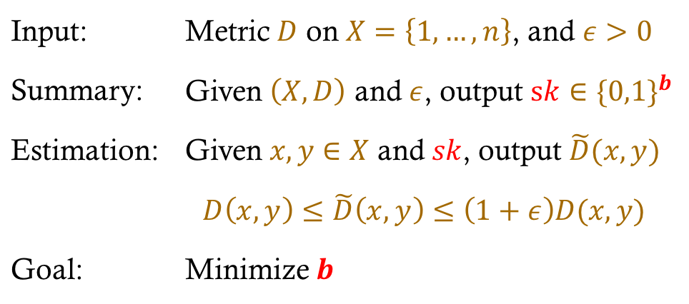
Metric Sketching a.k.a. Distance Oracle
Task: Given a finite metric space, store all distances, approximately, with minimum space.
Formally:
$D$
$ε$
Summ
Input: | Metric $D$ on $X=\left\{1,…,n\right\}$, and $ε>0$
Summary: | Given $\left(X,D\right)$ and $ε$, output $sk∈\{0,1\}^{b}$
Estimation: | Given $x,y∈X$ and $sk$, output $\tilde{D}(x,y)$
 | $$D\left(x,y\right)≤\tilde{D}\left(x,y\right)≤\left(1+ε\right)D(x,y)$$
Goal: | Minimize $b$
sketch
$x,y$
Est
$\tilde{D}(x,y)$

Slide 3

Euclidean Metrics
There is $f:X→ℝ^{d}$ s.t. for all $x,y∈X$,
$$D\left(x,y\right)=‖f\left(x\right)−f\left(y\right)‖$$
$f$ is known during summary, unknown during estimation

Slide 4
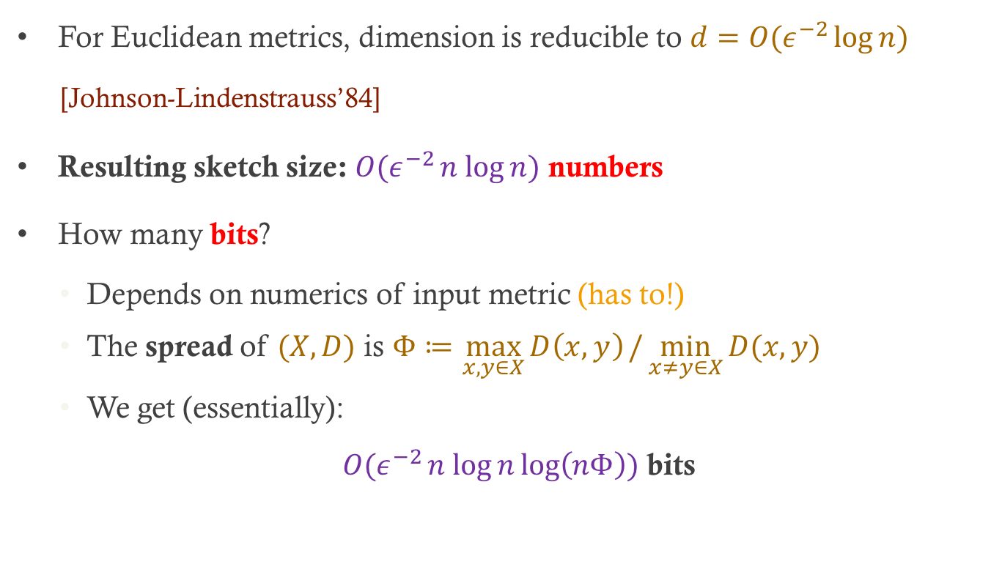
Dimension Reduction
For Euclidean metrics, dimension is reducible to $d=O(ε^{−2}\log{n})$
[Johnson-Lindenstrauss’84]
Resulting sketch size: $O(ε^{−2}n log{n)}$ numbers
How many bits?
Depends on numerics of input metric (has to!)
The spread of $(X,D)$ is $Φ≔\max_{x,y∈X}{D\left(x,y\right)}/\min_{x≠y∈X}{D(x,y)}$
We get (essentially):
$O(ε^{−2}n log{n}\log\left(nΦ\right))$ bits

Slide 5

Is JL Optimal?
For dimension reduction?
Yes [Larsen-Nelson’16]
Previously: Almost - up to a $log⁡(1/ε)$ factor [Alon’03]
For metric sketching?
No [this work]

Slide 6
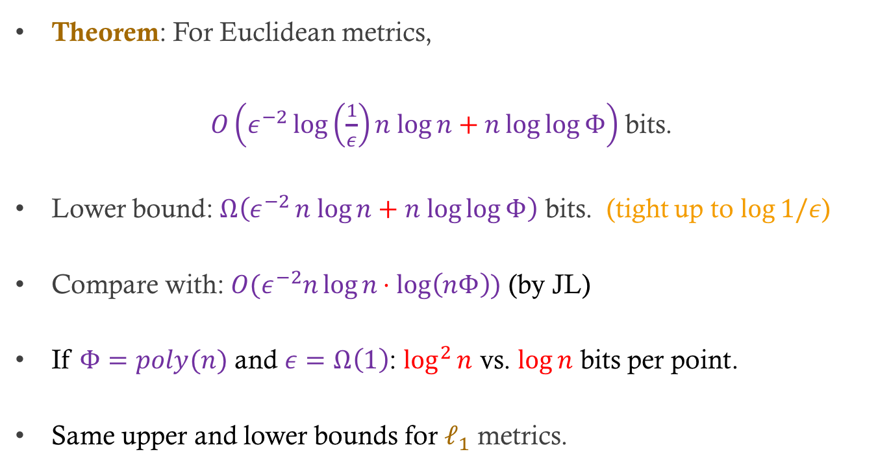
Results: Euclidean Metrics
Theorem: For Euclidean metrics,
$O\left(ε^{−2}\log\left(\frac{1}{ε}\right)n log{n}+n\log{\log{Φ}}\right)$ bits.
Lower bound: $Ω\left(ε^{−2}n log{n}+n log{\log{Φ}}\right)$ bits. (tight up to $\log{1/ε}$)
Compare with: $O(ε^{−2}n\log{n}⋅log\left(nΦ\right))$ (by JL)
If $Φ=poly(n)$ and $ε=Ω\left(1\right)$: $\log^{2}{n}$ vs. $\log{n}$ bits per point.
Same upper and lower bounds for $ℓ_{1}$ metrics.

Slide 7
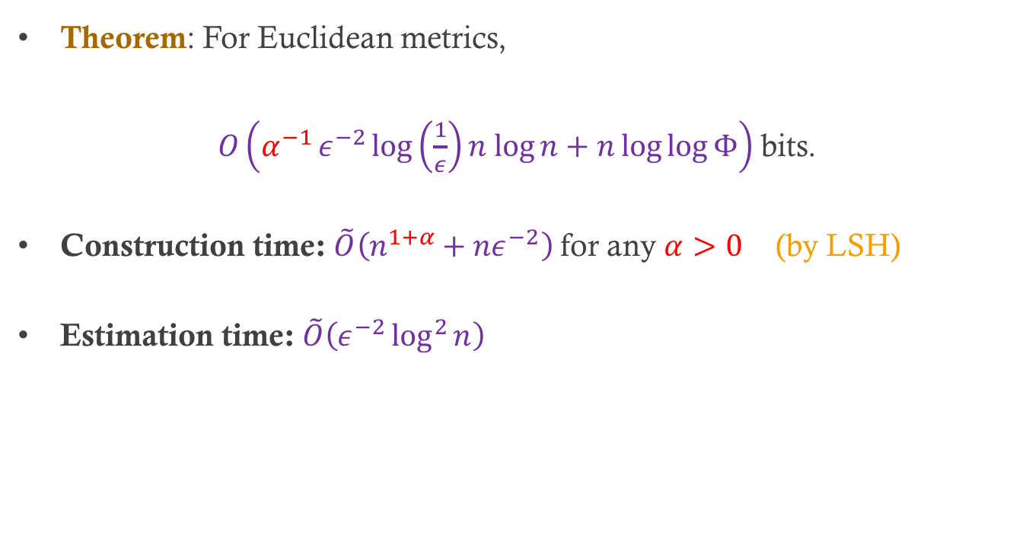
Running Times
Theorem: For Euclidean metrics,
$O\left(α^{−1}ε^{−2}\log\left(\frac{1}{ε}\right)n log{n}+n\log{\log{Φ}}\right)$ bits.
Construction time: $\tilde{O}\left(n^{1+α}+{nε}^{−2}\right)$ for any $α>0$ (by LSH)
Estimation time: $\tilde{O}\left(ε^{−2}\log^{2}{n}\right)$

Slide 8
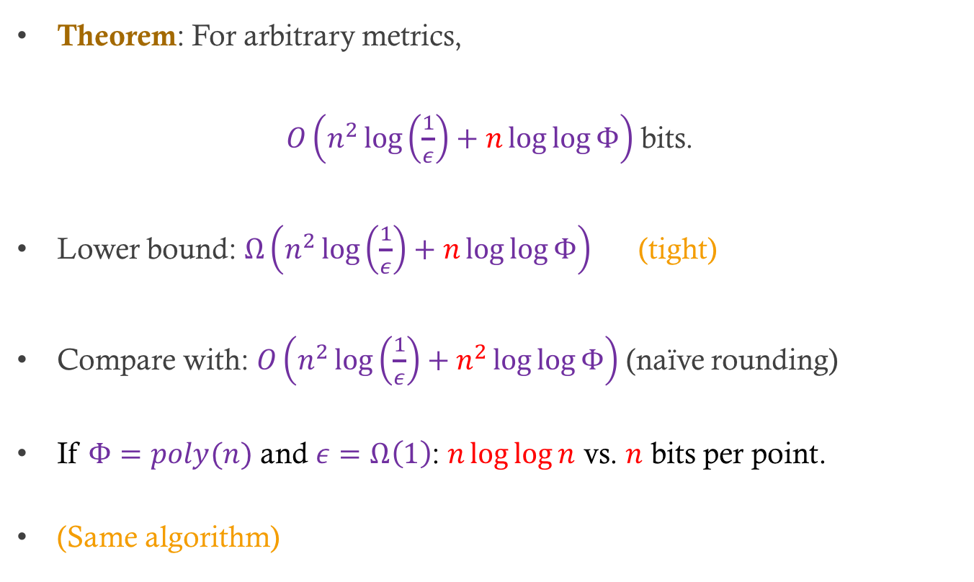
Results: Arbitrary Metrics
Theorem: For arbitrary metrics,
$O\left(n^{2}\log\left(\frac{1}{ε}\right)+n\log{\log{Φ}}\right)$ bits.
Lower bound: $Ω\left(n^{2}\log\left(\frac{1}{ε}\right)+n\log{\log{Φ}}\right)$ (tight)
Compare with: $O\left(n^{2}\log\left(\frac{1}{ε}\right)+n^{2}\log{\log{Φ}}\right)$ (naïve rounding)
If $Φ=poly(n)$ and $ε=Ω\left(1\right)$: $n\log{\log{n}}$ vs. $n$ bits per point.
(Same algorithm)

Slide 9
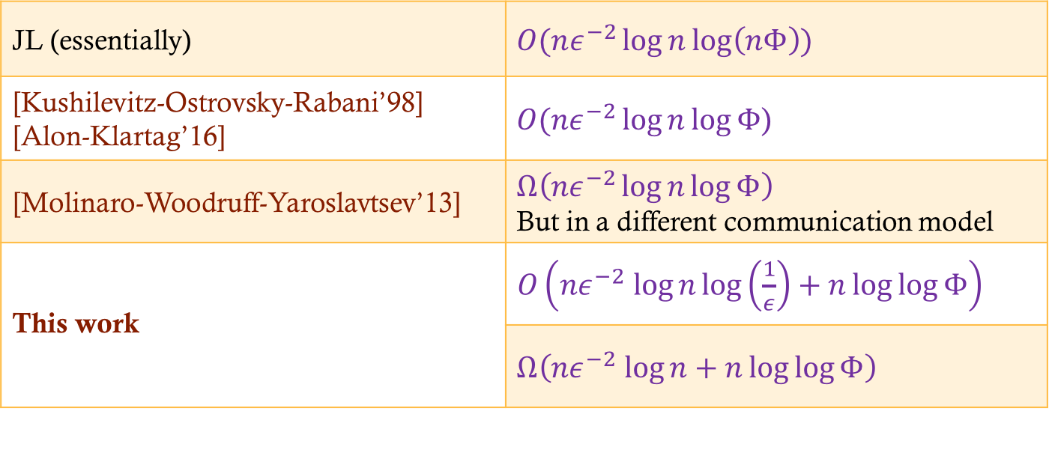
Related Work
Euclidean metrics
JL (essentially) | $O(nε^{−2}\log{n}\log\left(nΦ\right))$
[Kushilevitz-Ostrovsky-Rabani’98] [Alon-Klartag’16] | $O({nε}^{−2}\log{n}\log{Φ}$)
[Molinaro-Woodruff-Yaroslavtsev’13] | $$Ω\left({nε}^{−2}\log{n\log{Φ}}\right)$$ But in a different communication model
This work | $O\left(nε^{−2} log{n}\log\left(\frac{1}{ε}\right)+n\log{\log{Φ}}\right)$
 | $Ω\left(nε^{−2} log{n}+n\log{\log{Φ}}\right)$

Slide 10
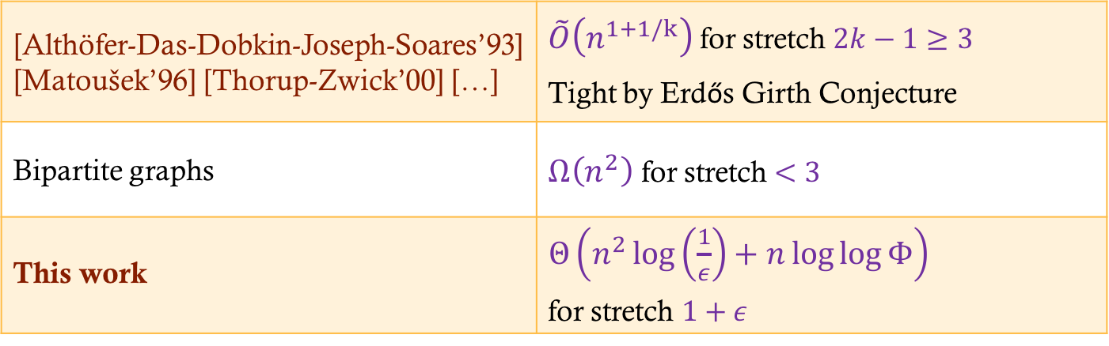
Related Work
Arbitrary metrics
[Althöfer-Das-Dobkin-Joseph-Soares’93] [Matoušek’96] [Thorup-Zwick’00] […] | $\tilde{O}\left(n^{1+1/k}\right)$ for stretch $2k−1≥3$ Tight by Erdős Girth Conjecture
Bipartite graphs | $Ω\left(n^{2}\right)$ for stretch $<3$
This work | $Θ\left(n^{2}\log\left(\frac{1}{ε}\right)+n\log{\log{Φ}}\right)$ for stretch $1+ε$

Slide 11




Algorithm Overview
$D$
$ε$
Summ
sketch
$x,y$
Est
$\tilde{D}(x,y)$

Slide 12





Surrogates
$$ℝ^{d}$$
$$x_{2}$$
$$x_{1}$$
$$r$$
Fix $r$
Store each point as displacement from a nearby point

Slide 13
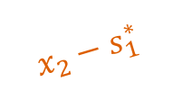
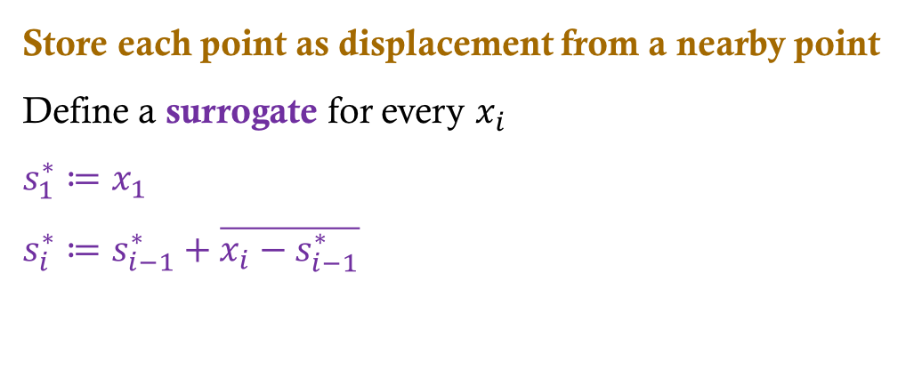


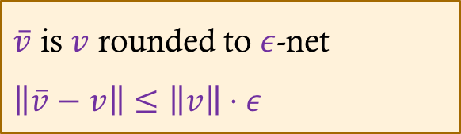
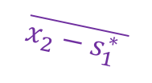
Surrogates
$$ℝ^{d}$$
$$x_{2}$$
$$x_{1}$$
$$x_{2}−s_{1}^{∗}$$
$$s_{1}^{∗}$$
$$\overline{x_{2}−s_{1}^{∗} }$$
$$s_{2}^{∗}$$
Fix $r$
Store each point as displacement from a nearby point
Define a surrogate for every $x_{i}$
$$s_{1}^{∗}≔x_{1}$$
$$s_{i}^{∗}≔s_{i−1}^{∗}+\overline{x_{i}−s_{i−1}^{∗}}$$
$\overline{v}$ is $v$ rounded to $ε$-net
$\left\|\overline{v}−v\right\|≤\left\|v\right\|⋅ε$

Slide 14

Surrogates
$$ℝ^{d}$$
$$x_{2}$$
$$r$$
$$x_{3}$$
$$x_{1}$$
$$s_{1}^{∗}$$
$$s_{2}^{∗}$$
Fix $r$
Store each point as displacement from a nearby point
Define a surrogate for every $x_{i}$
$$s_{1}^{∗}≔x_{1}$$
$$s_{i}^{∗}≔s_{i−1}^{∗}+\overline{x_{i}−s_{i−1}^{∗}}$$
$\overline{v}$ is $v$ rounded to $ε$-net
$\left\|\overline{v}−v\right\|≤\left\|v\right\|⋅ε$

Slide 15

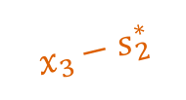

Surrogates
$$ℝ^{d}$$
$$x_{2}$$
$$x_{3}$$
$$x_{1}$$
$$x_{3}−s_{2}^{∗}$$
$$s_{1}^{∗}$$
$$s_{2}^{∗}$$
$$\overline{x_{3}−s_{2}^{∗} }$$
Fix $r$
$$s_{3}^{∗}$$
Store each point as displacement from a nearby point
Define a surrogate for every $x_{i}$
$$s_{1}^{∗}≔x_{1}$$
$$s_{i}^{∗}≔s_{i−1}^{∗}+\overline{x_{i}−s_{i−1}^{∗}}$$
$\overline{v}$ is $v$ rounded to $ε$-net
$\left\|\overline{v}−v\right\|≤\left\|v\right\|⋅ε$

Slide 16


Surrogates
$$x_{2}$$
$$x_{4}$$
$$ℝ^{d}$$
$$x_{3}$$
$$r$$
$$x_{1}$$
$$s_{1}^{∗}$$
$$s_{2}^{∗}$$
Fix $r$
$$s_{3}^{∗}$$
Store each point as displacement from a nearby point
Define a surrogate for every $x_{i}$
$$s_{1}^{∗}≔x_{1}$$
$$s_{i}^{∗}≔s_{i−1}^{∗}+\overline{x_{i}−s_{i−1}^{∗}}$$
$\overline{v}$ is $v$ rounded to $ε$-net
$\left\|\overline{v}−v\right\|≤\left\|v\right\|⋅ε$

Slide 17


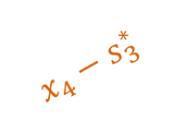
Surrogates
$$x_{2}$$
$$x_{4}$$
$$ℝ^{d}$$
$$x_{3}$$
$$x_{1}$$
$$x_{4}−s_{3}^{∗}$$
$$s_{1}^{∗}$$
$$s_{2}^{∗}$$
$$\overline{x_{4}−s_{3}^{∗} }$$
$$s_{4}^{∗}$$
Fix $r$
$$s_{3}^{∗}$$
Store each point as displacement from a nearby point
Define a surrogate for every $x_{i}$
$$s_{1}^{∗}≔x_{1}$$
$$s_{i}^{∗}≔s_{i−1}^{∗}+\overline{x_{i}−s_{i−1}^{∗}}$$
$\overline{v}$ is $v$ rounded to $ε$-net
$\left\|\overline{v}−v\right\|≤\left\|v\right\|⋅ε$

Slide 18
Surrogates
$$x_{2}$$
$$x_{4}$$
$$ℝ^{d}$$
$$x_{3}$$
$$x_{1}$$
$$s_{1}^{∗}$$
$$s_{2}^{∗}$$
$$s_{4}^{∗}$$
$$s_{3}^{∗}$$
Estimation:
Claim: | $\left\|x_{i}−s_{i}^{∗}\right\|≤2ε⋅r$ (Proof: by induction)
Corollary: | $\left\|s_{i}^{∗}−s_{j}^{∗}\right\|=\left(1±4ε\right)‖x_{i}−x_{j}‖$

Slide 19
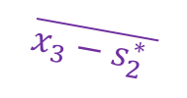

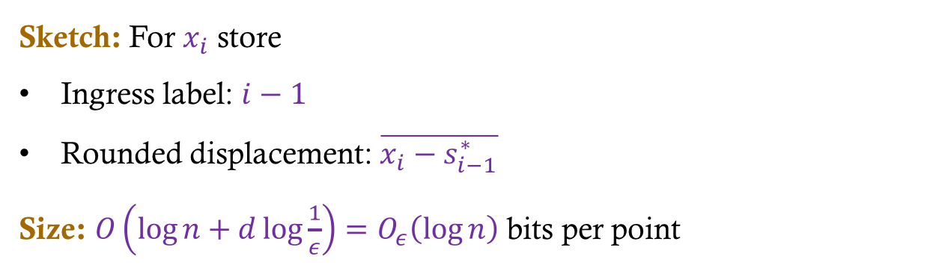

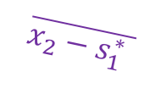
Surrogates
$$x_{2}$$
$$x_{4}$$
$$ℝ^{d}$$
$$x_{3}$$
$$x_{1}$$
$$\overline{x_{2}−s_{1}^{∗} }$$
$$\overline{x_{4}−s_{3}^{∗} }$$
$$s_{4}^{∗}$$
$$s_{2}^{∗}$$
$$\overline{x_{3}−s_{2}^{∗} }$$
$$s_{3}^{∗}$$
Sketch: For $x_{i}$ store
Ingress label: $i−1$
Rounded displacement: $\overline{x_{i}−s_{i−1}^{∗}}$
Size: $O\left(\log{n}+d\log{\frac{1}{ε}}\right)=O_{ε}\left(\log{n}\right)$ bits per point

Slide 20

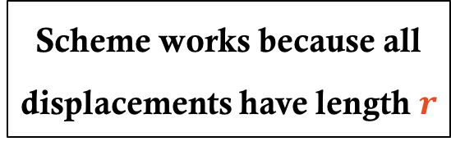
Surrogates
$$x_{2}$$
$$x_{4}$$
$$ℝ^{d}$$
$$r$$
$$r$$
$$x_{3}$$
$$r$$
$$x_{1}$$
Scheme works because all displacements have length $r$
Sketch: For $x_{i}$ store
Ingress label: $i−1$
Rounded displacement: $\overline{x_{i}−s_{i−1}^{∗}}$
Size: $O\left(\log{n}+d\log{\frac{1}{ε}}\right)=O_{ε}\left(\log{n}\right)$ bits per point

Slide 21







Multiple Distance Scales
$$ℝ^{d}$$
$$x_{2}$$
$$y_{2}$$
$$x_{1}$$
$$y_{1}$$
$$r$$
$$R≫r$$
$$R$$
$$r$$

Slide 22

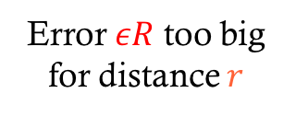
Multiple Distance Scales
$$ℝ^{d}$$
$$x_{2}$$
$$y_{2}$$
$$x_{1}$$
$$y_{1}$$
$$r$$
$$R≫r$$
$$R$$
$$r$$
$$εR$$
Previous scheme breaks down
Error $εR$ too big for distance $r$

Slide 23
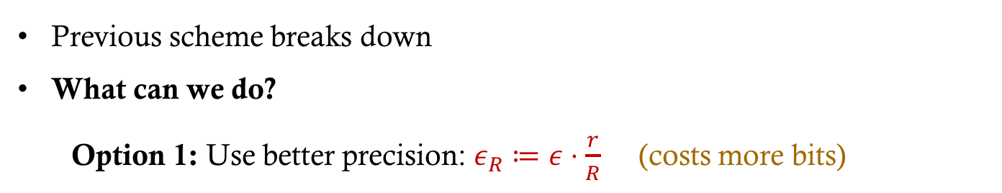
Multiple Distance Scales
$$ℝ^{d}$$
$$x_{2}$$
$$y_{2}$$
$$x_{1}$$
$$y_{1}$$
$$r$$
$$R≫r$$
$$R$$
$$r$$
Previous scheme breaks down
What can we do?
Option 1: Use better precision: $ε_{R}≔ε⋅\frac{r}{R}$ (costs more bits)

Slide 24
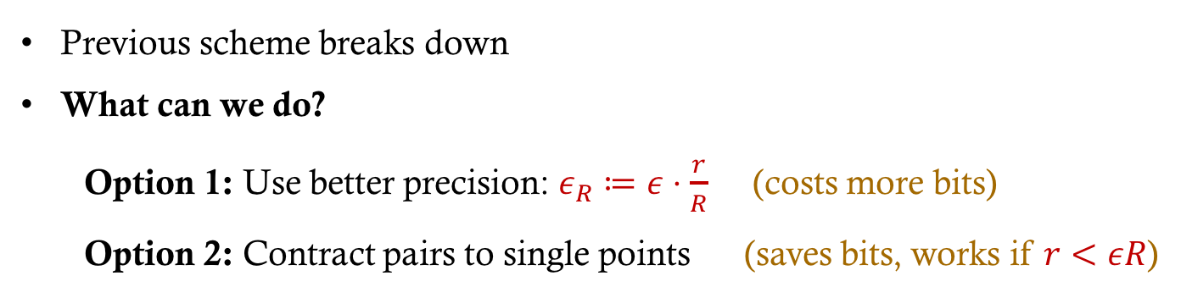
Multiple Distance Scales
$$ℝ^{d}$$
$$x_{2}$$
$$y_{2}$$
$$x_{1}$$
$$y_{1}$$
$$r$$
$$R≫r$$
$$R$$
$$r$$
Previous scheme breaks down
What can we do?
Option 1: Use better precision: $ε_{R}≔ε⋅\frac{r}{R}$ (costs more bits)
Option 2: Contract pairs to single points (saves bits, works if $r<εR$)

Slide 25
General Case: Overview
Store each point as displacement from a nearby point
Tune precision individually per cluster
Contract isolated clusters into single point (from external pov)

Slide 26


Hierarchical Clustering
Step 1: Construct cluster tree.
In level $i$, draw edges of length $<2^{i}$, and take connected components.
$$ℝ^{d}$$
4
5
3
6
1
2
7
8

Slide 27
Hierarchical Clustering
Step 1: Construct cluster tree.
In level $i$, draw edges of length $<2^{i}$, and take connected components.
$$ℝ^{d}$$
4
5
3
6
1
2
7
1
2
3
4
5
6
7
8
8

Slide 28
Hierarchical Clustering
Step 1: Construct cluster tree.
In level $i$, draw edges of length $<2^{i}$, and take connected components.
$$ℝ^{d}$$
4
5
3
6
1
2
1
4
7
7
1
2
3
4
5
6
7
8
8

Slide 29
Hierarchical Clustering
Step 1: Construct cluster tree.
In level $i$, draw edges of length $<2^{i}$, and take connected components.
$$ℝ^{d}$$
4
5
3
6
1
7
1
2
1
4
7
7
1
2
3
4
5
6
7
8
8

Slide 30
Hierarchical Clustering
Step 1: Construct cluster tree.
In level $i$, draw edges of length $<2^{i}$, and take connected components.
$$ℝ^{d}$$
4
1
7
5
3
6
1
7
1
2
1
4
7
7
1
2
3
4
5
6
7
8
8

Slide 31
Hierarchical Clustering
Step 1: Construct cluster tree.
In level $i$, draw edges of length $<2^{i}$, and take connected components.
$$ℝ^{d}$$
1
4
1
7
5
3
6
1
7
1
2
1
4
7
7
1
2
3
4
5
6
7
8
8

Slide 32







Surrogates
Step 2: Store each point as displacement from a nearby point.
Tune precision individually per cluster (based on its level and diameter).
Claim: Amortized $O(ε^{−2}\log{n})$ bits per cluster.
$$ℝ^{d}$$
1
4
1
7
$$ε$$
5
$$ε$$
6
1
7
1
3
$$ε$$
$$ε$$
2
1
4
7
$$ε$$
7
1
$$ε$$
2
3
4
5
6
7
8
8

Slide 33
Tree Compression
Step 3: Contract isolated clusters (from external pov).
Compresses long degree-1 paths in cluster tree.
$$ℝ^{d}$$
1
4
1
7
5
3
6
1
7
1
2
1
4
7
7
1
2
3
4
5
6
7
8
8

Slide 34

Tree Compression
Step 3: Contract isolated clusters (from external pov).
Compresses long degree-1 paths in cluster tree.
Claim: Tree size becomes $O\left(n\log\left(\frac{1}{ε}\right)\right)$.
$$ℝ^{d}$$
1
4
1
7
5
“long
edge”
3
6
1
1
2
1
4
7
7
1
2
3
4
5
6
7
8
8

Slide 35
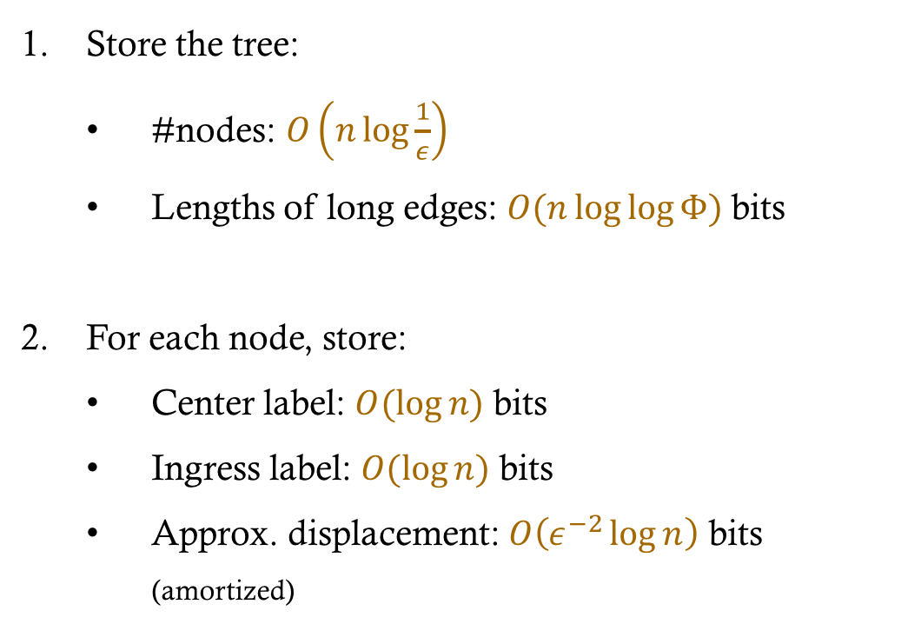

The Sketch
Store the tree:
#nodes: $O\left(n\log{\frac{1}{ε}}\right)$
Lengths of long edges: $O(n\log{\log{Φ) }}$bits
For each node, store:
Center label: $O(\log{n)}$ bits
Ingress label: $O(\log{n)}$ bits
Approx. displacement: $O\left(ε^{−2}\log{n}\right)$ bits (amortized)
$$ℝ^{d}$$
4
5
1
3
6
2
8
7
1
1
7
1
1
4
7
1
2
3
4
5
6
7
8

Slide 36
Estimation
Given a pair of point labels,
Compute best surrogates available in sketch.
Return distance between them.
$$ℝ^{d}$$
1
4
1
7
5
3
6
1
1
2
1
4
7
7
1
2
3
4
5
6
7
8
8

Slide 37
Estimation
Given a pair of point labels,
Compute best surrogates available in sketch.
Return distance between them.
Dist(2,8) = ?
$$ℝ^{d}$$
1
4
1
7
5
3
6
1
1
2
1
4
7
7
2
7
1
2
3
4
5
6
7
8
8

Slide 38
Estimation
Given a pair of point labels,
Compute best surrogates available in sketch.
Return distance between them.
Dist(7,8) = ?
$$ℝ^{d}$$
1
4
1
7
5
3
6
1
1
2
1
4
7
8
7
1
2
4
5
6
8
7
3
7
8

Slide 39
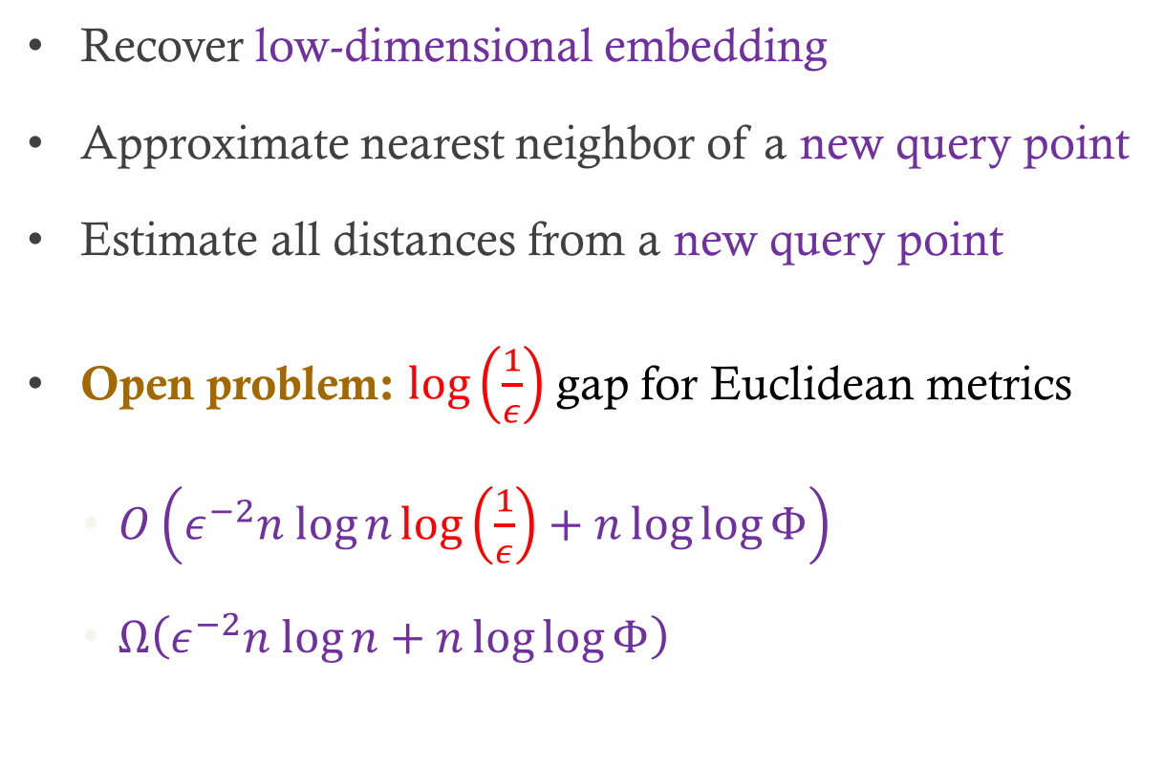
Subsequent Extensions
Recover low-dimensional embedding
Approximate nearest neighbor of a new query point
Estimate all distances from a new query point
Open problem: $\log\left(\frac{1}{ε}\right)$ gap for Euclidean metrics
$O\left(ε^{−2}n log{n}\log\left(\frac{1}{ε}\right)+n\log{\log{Φ}}\right)$
$Ω\left(ε^{−2}n log{n}+n\log{\log{Φ}}\right)$
Thank you

