Slide 1
HTML – introduction
Instructor: tal yaron

Slide 2


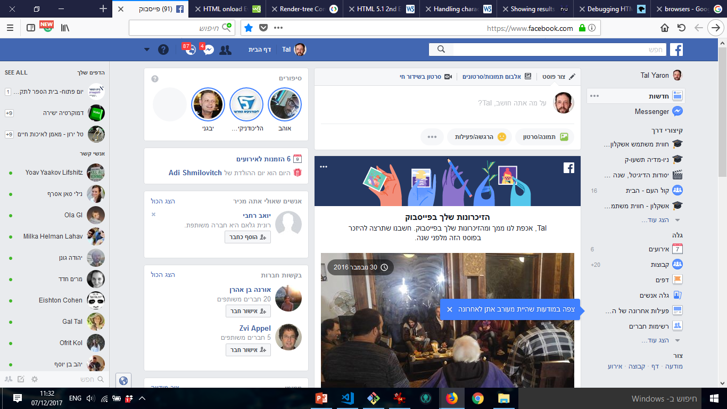



HTML is awesome!

Slide 3
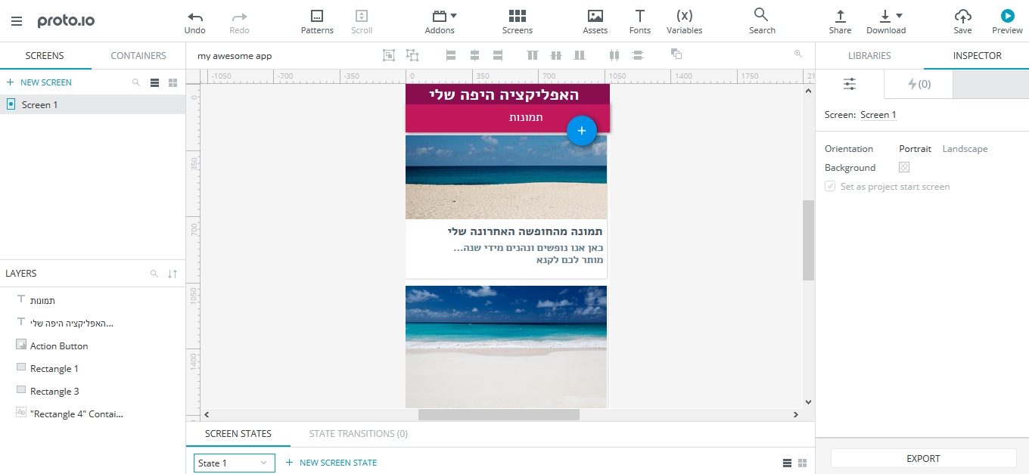
HTML is awesome!

Slide 4
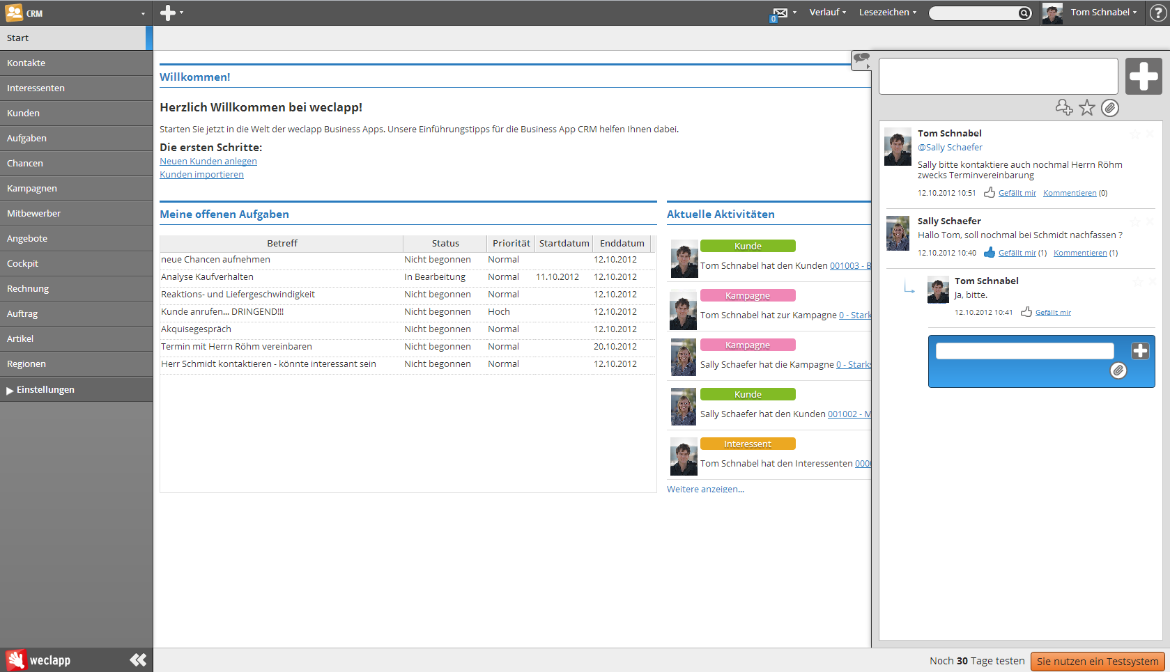
HTML is awesome!

Slide 5

HTML is awesome!

Slide 6
History
Goffer (1991): files and folders
HTML 1 (1991) – designed by Tim Berners-Lee – static web with pictures
HTML 2 (1995) – IETF
form-based file upload
Tables
client-side image maps
Internationalization
JavaScript (1995) - Netscape
HTML 3.2 (1997) – W3C
HTML 4 (1998) – browser events - W3C
HTML 5 (2014) – W3C – semantic, canvas/svg, math

Slide 7

HTML lives in browsers

Slide 8
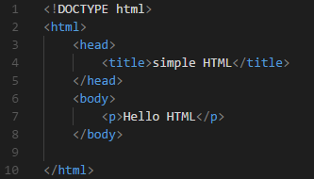
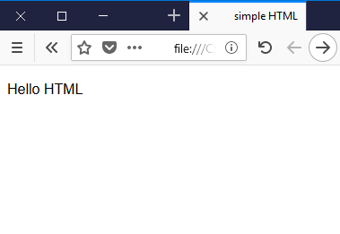
HTML

Slide 9
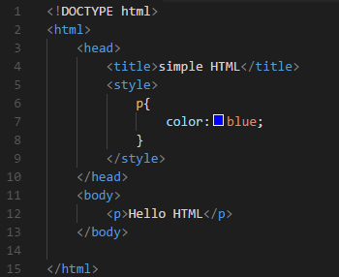
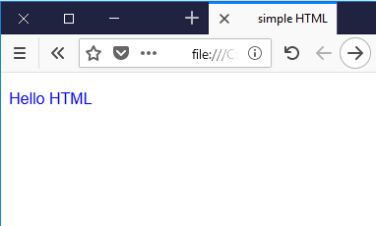
HTML + CSS

Slide 10
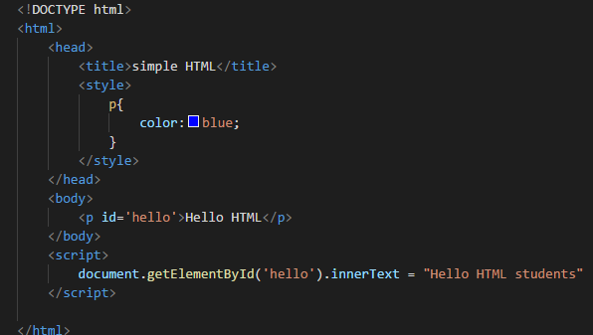
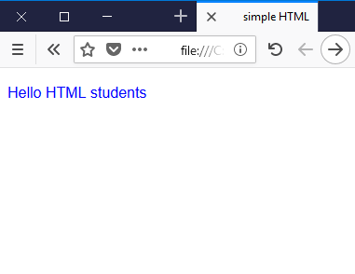
HTML + CSS + JavaScript

Slide 11
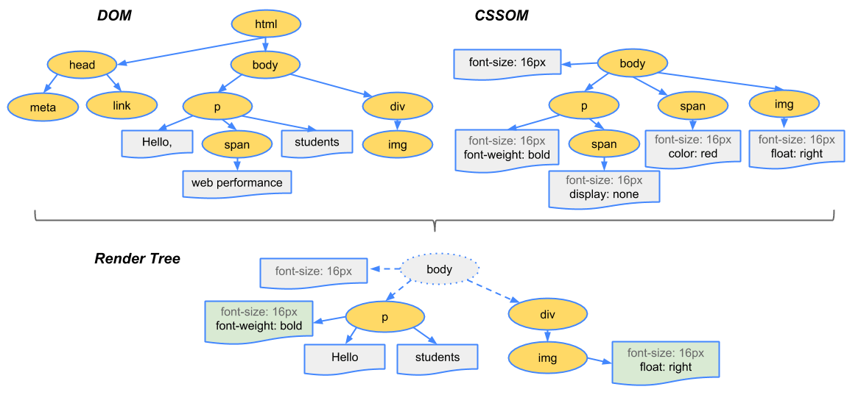
How browsers work
https://developers.google.com/web/fundamentals/performance/critical-rendering-path/render-tree-construction

Slide 12
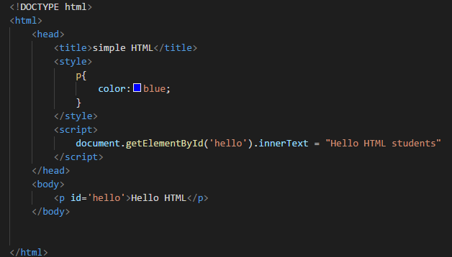
HTML render sequence

Slide 13
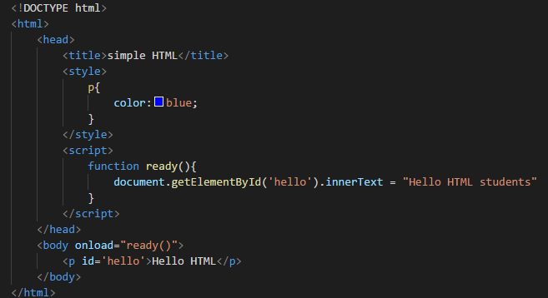
HTML render sequence

Slide 14
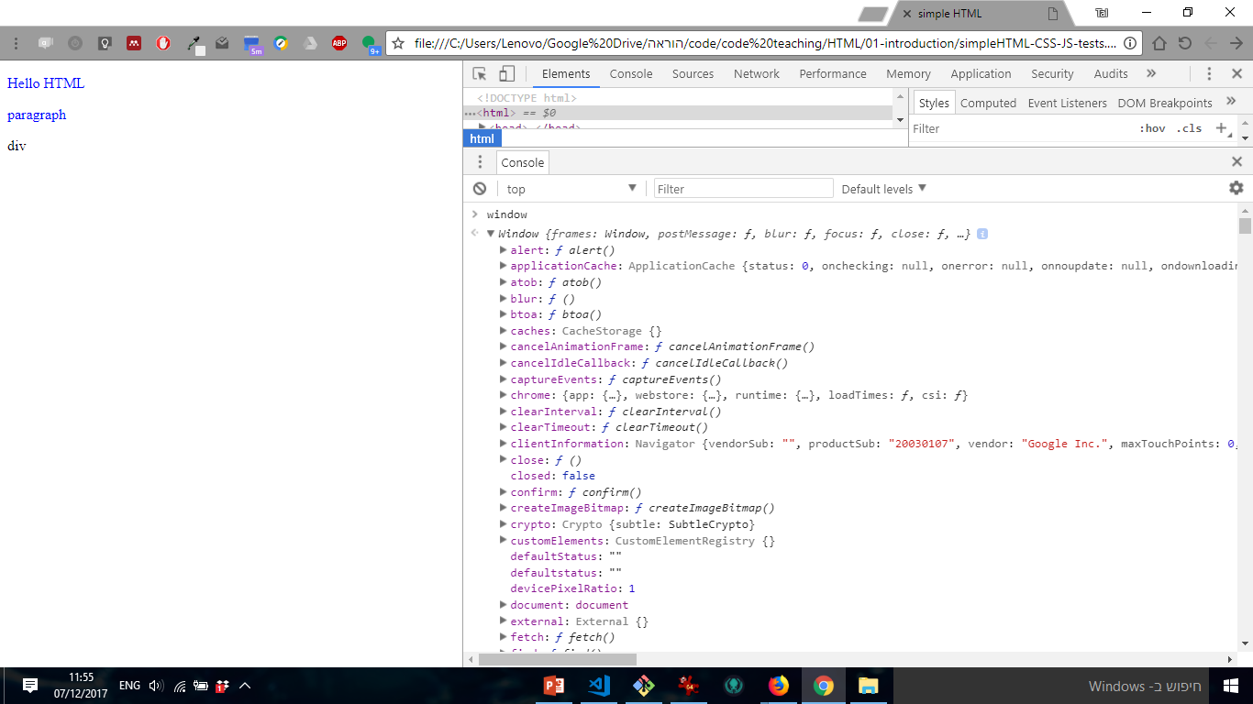
HTML main object is ‘window’

