Slide 1
Redux

Slide 2
Redux
Management of a single model/data/state for an app in a testable environment

Slide 3
Simple react app
component
component
component
component
component
component
component

Slide 4
Simple react app with state
state
component
component
component
component
component
component

Slide 5
Simple react app with state
state
component
component
Bug
component
component
component
component

Slide 6
Simple react app with redux
“reducers”
Store ({state})
dispatch
component
component
“actions”
“subscribe”
component
component
component
component

Slide 7
Simple react app with redux
“reducers”
Store ({state})
dispatch
component
component
Bug
dispatch
“actions”
“actions”
“subscribe”
component
component
component
component

Slide 8

Simple react app with redux
“reducers”
Store ({state})
dispatch
component
component
Bug
dispatch
“actions”
“actions”
“subscribe”
component
component
component
component

Slide 9
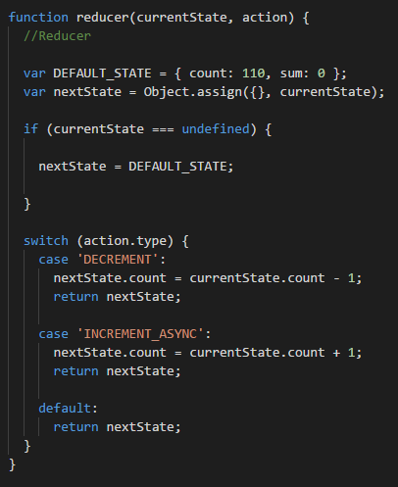



redux

Slide 10
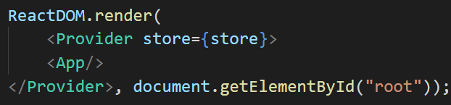
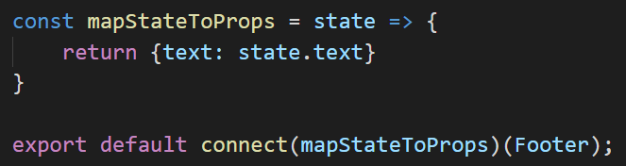
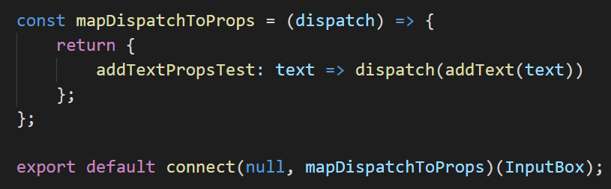
React-Redux
Component

