Slide 1
By value and by reference

Slide 2
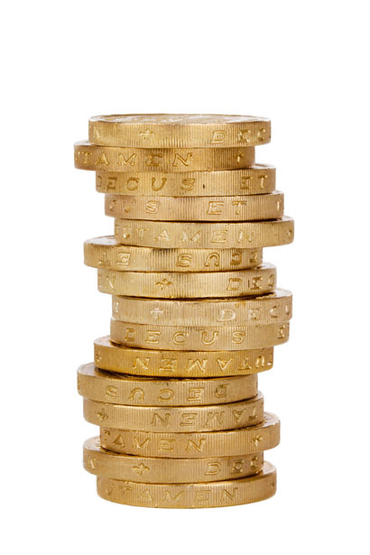
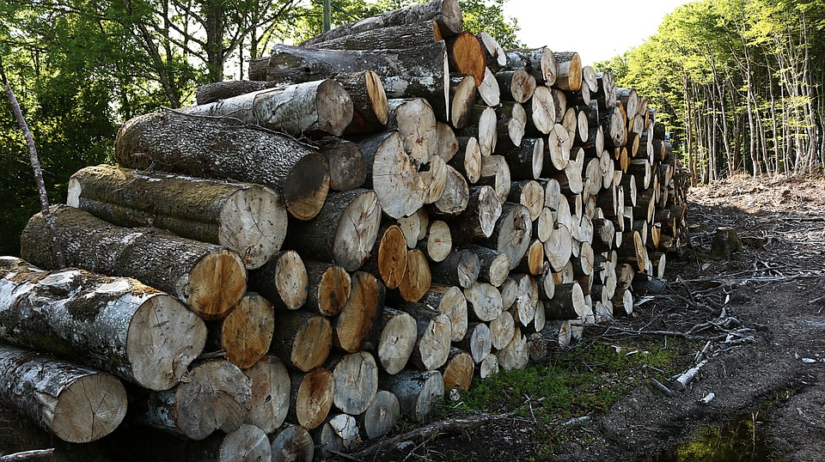
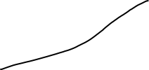

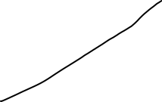

Stack call
Heap memory
Pointing to the location in the heap memory
Data stored
data
data
data
point
point
data
point
point

Slide 3
stack
heap
data
data
data
data
data

Slide 4
stack
heap
data
data
data
data

Slide 5
stack
heap
data
data
data
data
data
data

Slide 6
stack
heap
data
data
pointers
data
data
data
data

Slide 7
By Value
By Reference
Primitives
stack
Objects
heap
String
Number
Boolean
Null
Undefined
Symbol
Object
Functions
Date
Array
Maps
Sets
data
data
pointers
data
data
data
data

Slide 8
