Slide 1
HTML – introduction
Instructor: tal yaron

Slide 2


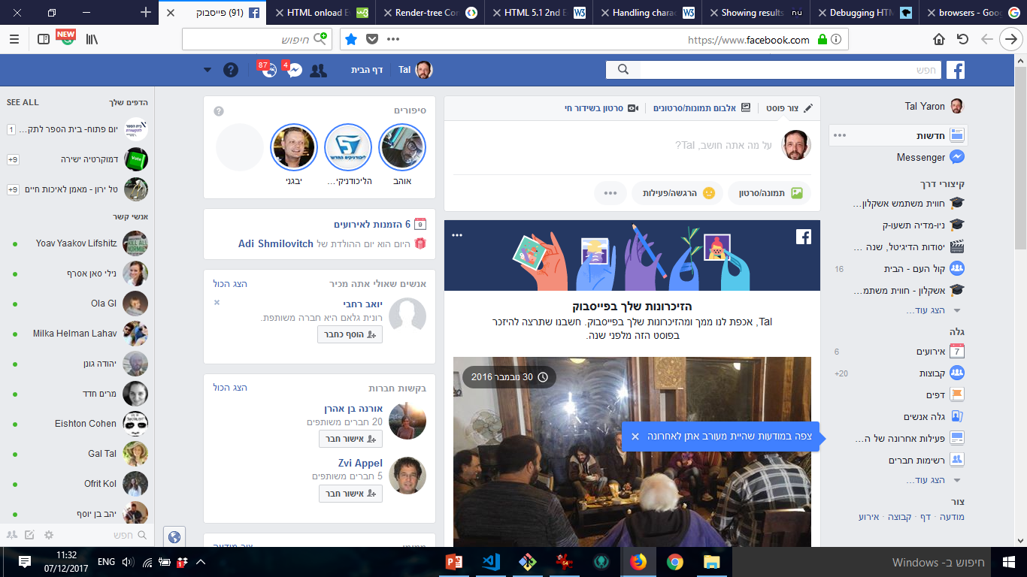



HTML is awesome!

Slide 3
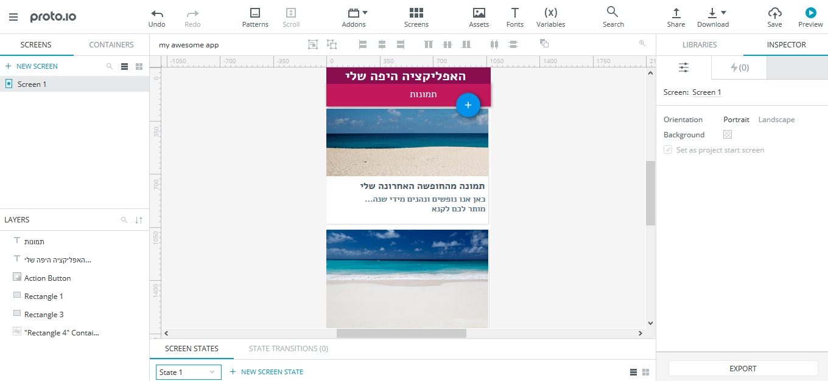
HTML is awesome!

Slide 4
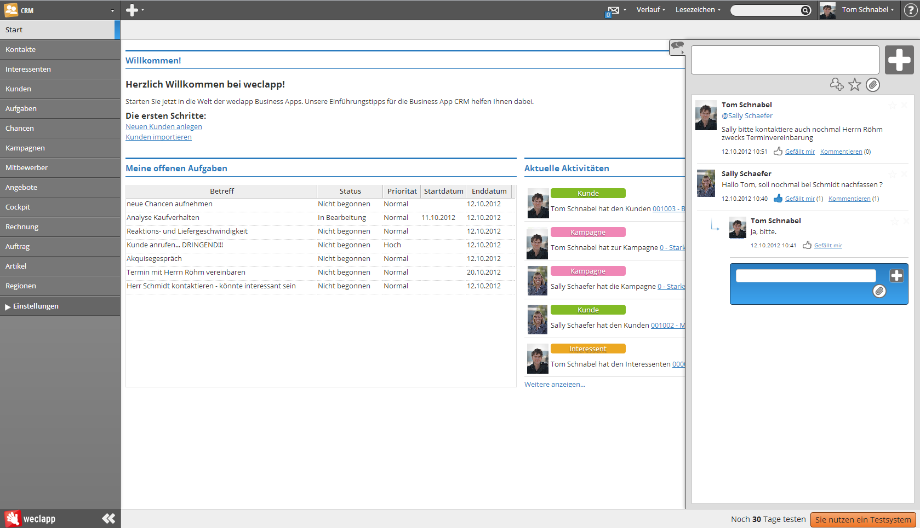
HTML is awesome!

Slide 5

HTML is awesome!

Slide 6
History
Goffer (1991): files and folders
HTML 1 (1991) – designed by Tim Berners-Lee – static web with pictures
HTML 2 (1995) – IETF
form-based file upload
Tables
client-side image maps
Internationalization
JavaScript (1995) - Netscape
HTML 3.2 (1997) – W3C
HTML 4 (1998) – browser events - W3C
HTML 5 (2014) – W3C – semantic, canvas/svg, math

Slide 7
History
2009 – Node.js
2010 – Angular (first main components-driven architecture)
2013 – React
2014 – Vue
2015? – Mithril – the fastest framework
2015 – Progressive Web Apps (PWA)
2018 – Chrome 70 – Windows PWA
2019 – iOS 13 will support PWA?

Slide 8
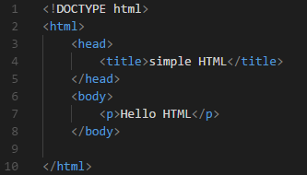
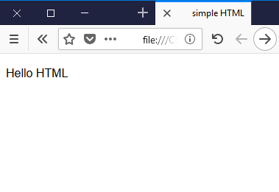
HTML

Slide 9
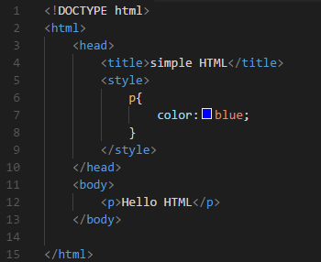
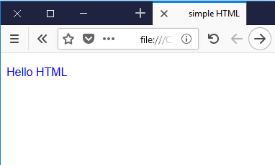
HTML + CSS

Slide 10
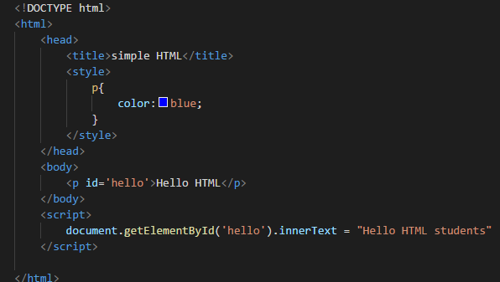
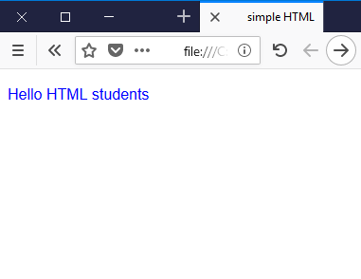
HTML + CSS + JavaScript

Slide 11
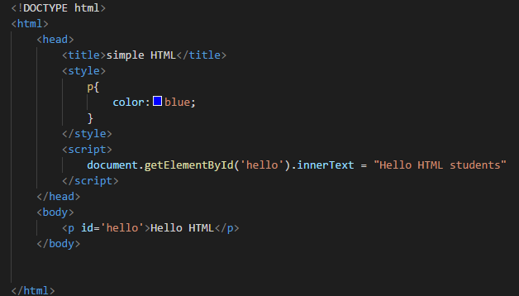
HTML render sequence

Slide 12
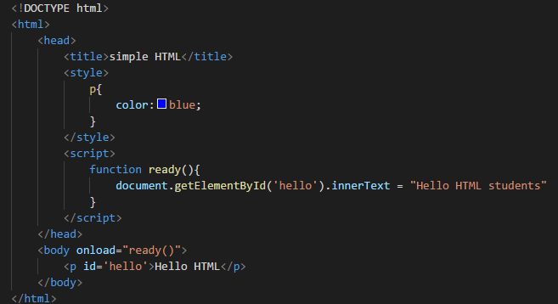
HTML render sequence

Slide 13

HTML lives in browsers

Slide 14



How browsers work
HTML,CSS, JS
JSON
JSON

Slide 15
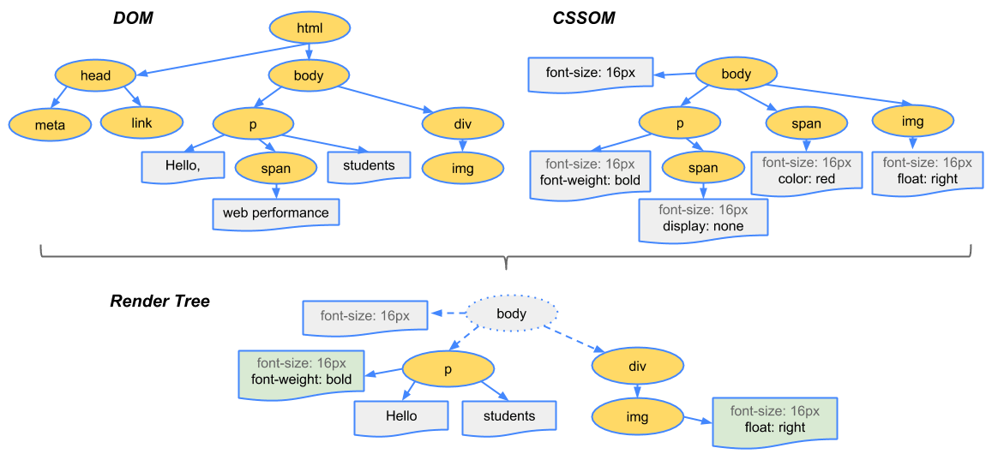
How browsers work
https://developers.google.com/web/fundamentals/performance/critical-rendering-path/render-tree-construction

Slide 16
How browsers work
ECMA script (js standards)
V8 engine (Chrome)
SpiderMonkey (Mozilla)
Code js (txt)
Machine code
CPU

Slide 17
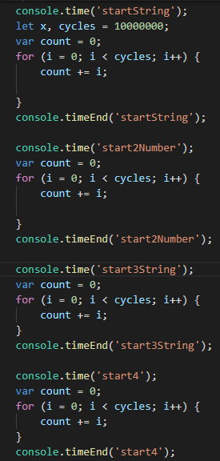


Mozilla vs Chrome

Slide 18
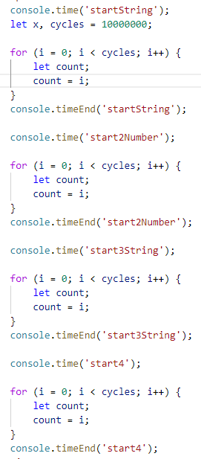

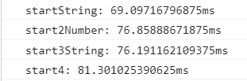
Mozilla vs Chrome

Slide 19
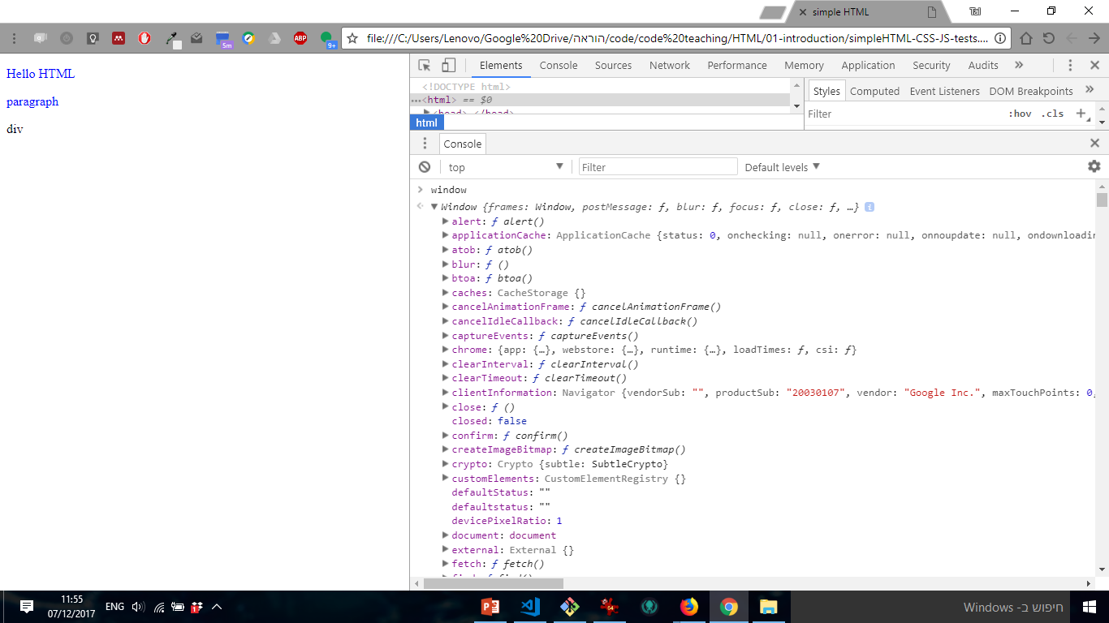
HTML main object is ‘window’

