Slide 1
HTML – Responsive
Instructor: tal yaron
Email: tal.yaron@gmail.com
Phone: 052-607-9419

Slide 2

Responsive
https://developers.google.com/web/fundamentals/design-and-ux/responsive/

Slide 3
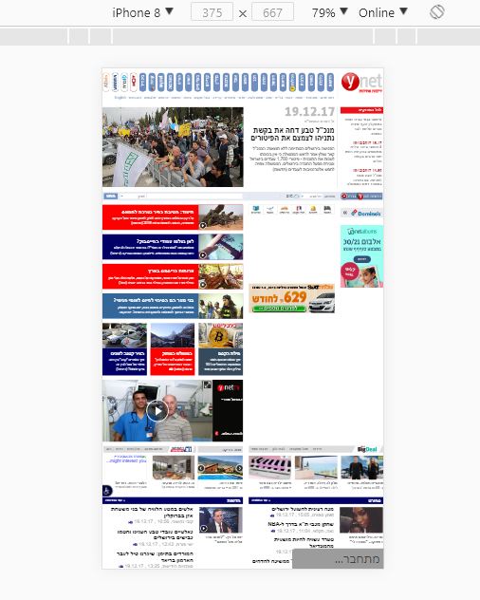
Responsive elements
View port

Slide 4
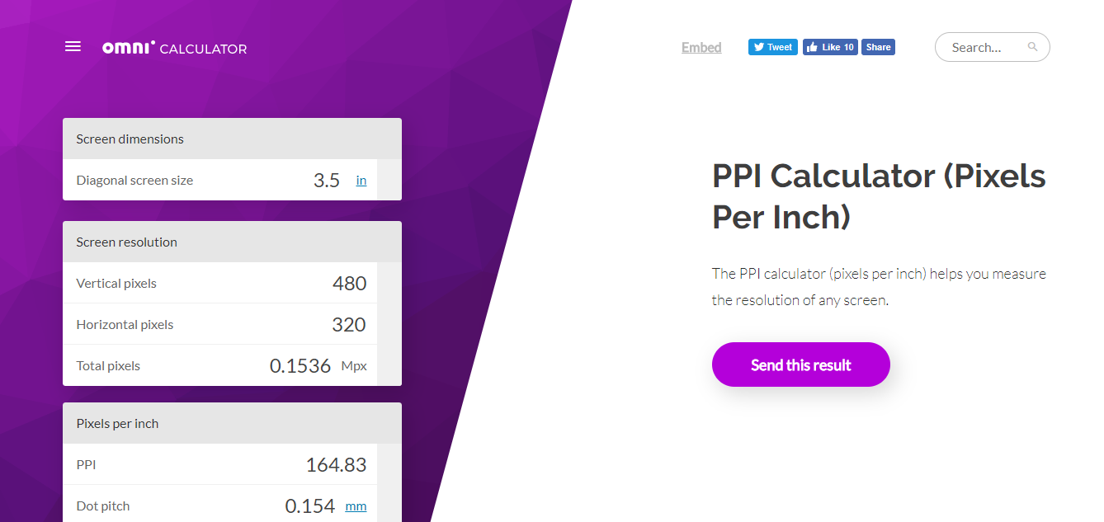
160 dp (pixels)

Slide 5
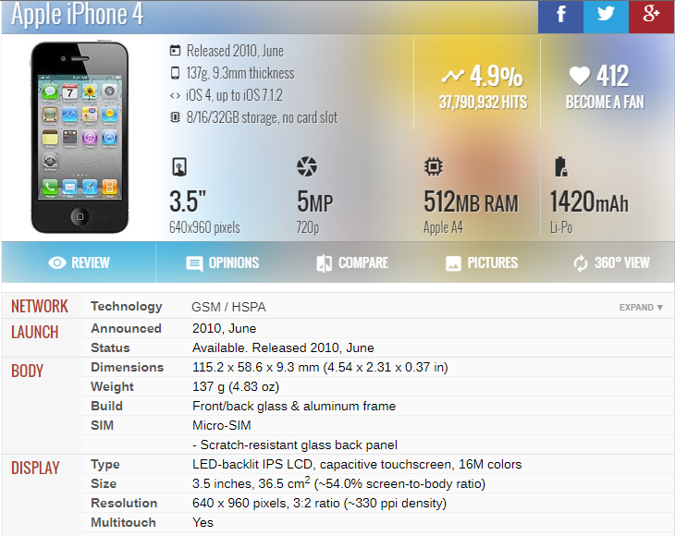
160 dp (pixels)

Slide 6
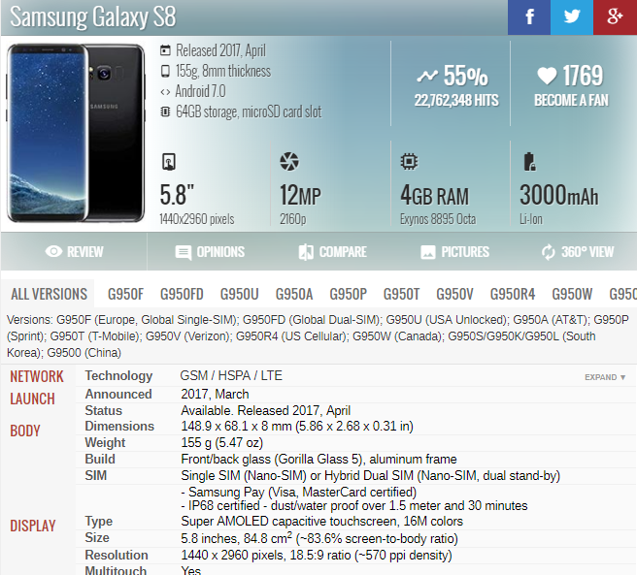
160 dp (pixels)

Slide 7
160 dp (pixels)
<meta name="viewport" content="width=device-width, initial-scale=1.0">
View-port.html
<meta name="viewport" content="width=device-width, initial-scale=0.86, maximum-scale=3.0, minimum-scale=0.86">

Slide 8
Use percentage and not fixed size
precentage.html

Slide 9
Media query
Adjust to several screen sizes
@media (max-width: 400px)
420px~ mobile
768px~ tablet
1280px~ pc
>1920px HD screens
preGrid*.html

Slide 10
Elements in responsive design
In some places, you can hide elements in mobile vs. non-mobile
https://purecss.io/layouts/email/
Index.html

Slide 11
Font-size
Absolute
Relative
cm: centimeter
mm: millimeter
in: inch
px: pixels
em: relative to font-size of element
rem: relative to font-size of root element (html)
vw: 1% of screen width;
vh: 1% of screen height;
%: percent of parent element

Slide 12
Grids and libraries
materialize
Bootstrap (https://getbootstrap.com/docs/3.3/css/#grid)
PureCSS

