Slide 1

React-Redux
With Thunk

Slide 2
What is redux?
Redux is a pattern and library for managing and updating application state, using events called "actions"
App state
action
Reducer:
Predictable way

Slide 3
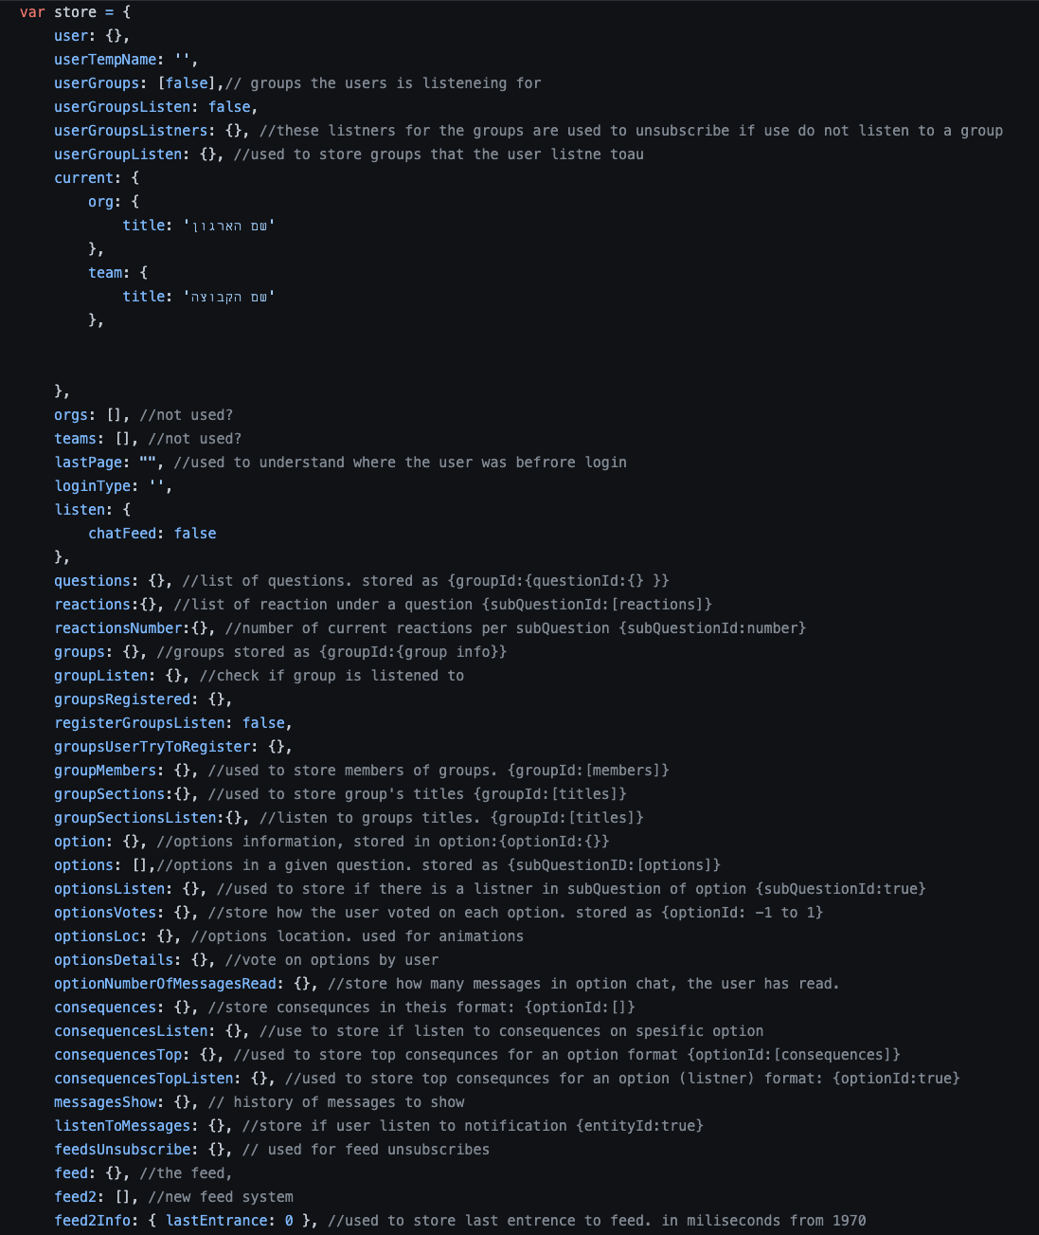
Why Should I Use Redux?
The patterns and tools provided by Redux make it easier to understand when, where, why, and how the state in your application is being updated, and how your application logic will behave when those changes occur.

Slide 4
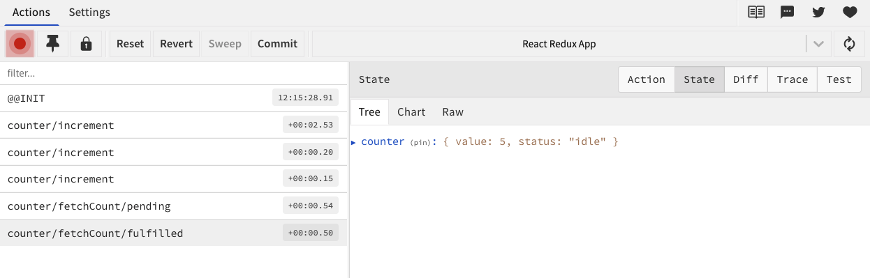
Why Should I Use Redux?
The patterns and tools provided by Redux make it easier to understand when, where, why, and how the state in your application is being updated, and how your application logic will behave when those changes occur.

Slide 5
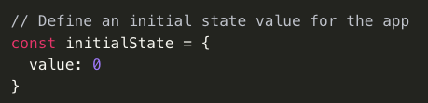
Initial state

Slide 6
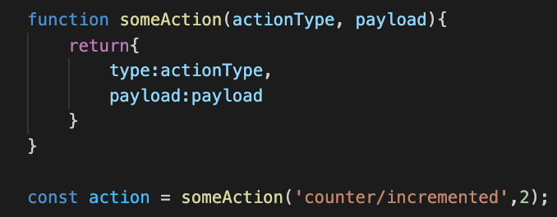
action: what kind of a change…

Slide 7
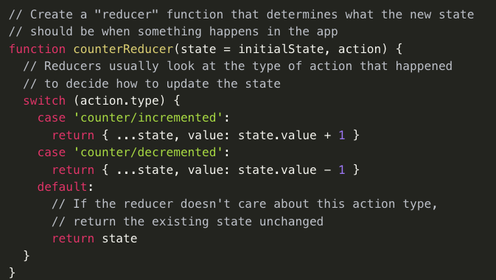
Reducer: changes the state…

Slide 8

Store (state)

Slide 9
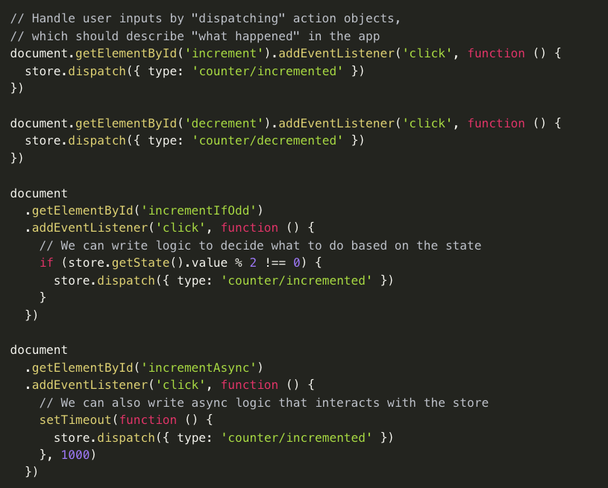
Dispatch actions

Slide 10
The cycle
Reducer:
Predictable way
store
Subscribe to selector
action
component
component
dispatch
Local state

Slide 11
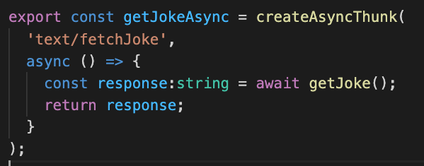
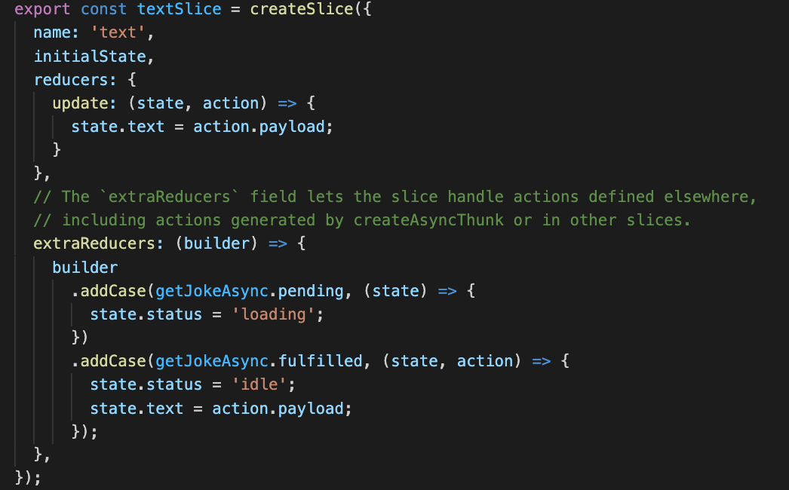
Async (Thunk)
Promise
Reducer:
Predictable way
store
action
component
Subscribe to selector
component
dispatch
Local state

